Slide 1
2020 NFHS SOFTBALL Rules Power Point
Rules Changes
Major Editorial Changes
Points of Emphasis
Notes:
Welcome to the 2020 Softball Power Point Rule Interpreters Meeting.

Slide 2

NFHS Rules Book as e-Books
E-books features:
  Searchable
  Highlight areas of interest
  Make notes
  Easy navigation
  Adjustable viewing size
  Immediate availability
Notes:
The NFHS Rules and Case Book e-books are available for $6.99 each.

Slide 3
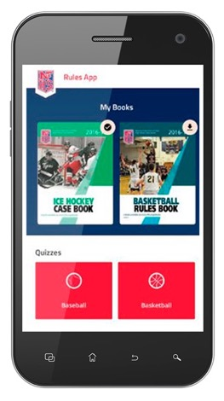
NEW NFHS Rules App
Rules App features:
  Searchable
  Highlight notes
  Bookmarks
  Quizzes for all sports
  Easy navigation
  Immediate availability
  Free to paid members of the NFHS Coaches
  and Officials Associations
  www.nfhs.org/erules for more information
Notes:
Rules app for all NFHS rules books and case books are available on iTunes and Google Play. Rules books and case books are cross-linked and enabled for searchable content.
App is free to download
Each book subscription is $6.99
NFHS Coaches and Officials Association paid members get all books for free
100% states members get books for free in sports designated by their state

Slide 4

Pre-Game EAP Review
Purpose
  Effective communication of Emergency Action Plan
    EAP is required by Law (Gfeller-Waller)
  Guide for administrators, coaches, officials and LAT/FR
Conducted by the Game Day Administrator or Designee
  The NCHSAA recommends that a hard copy or electronic copy of the venue specific EAP be provided to both the lead official and visiting team personnel.

Slide 5
Pre-Game EAP Review Card
All Events
Who is the gameday administrator and what is their contact information?
Is there a Licensed Athletic Trainer (LAT) and/or First Responder (FR) on site and what is their contact information? If a LAT or FR is not on site who is the most qualified person to provide CPR and first aid care?
Has the Emergency Action Plan (EAP) been reviewed and where is the posted venue specific EAP located?
What first aid and emergency equipment is available at the venue and where is it located? (e.g., first aid kit, AED/CPR equipment, spinal injury stabilization equipment, exertional heat illness management equipment, etc.)

Slide 6
Pre-Game EAP Review Card
Outdoor Events
Who will be monitoring environmental and field/facility conditions during the event? (e.g., thunder and lightning, Wet Bulb Globe Temperature)
Who will notify officials of unsafe environmental or field/facility conditions?
Has the lightning or thunder disturbances safe shelter and evacuation route been identified?
What is the Wet Bulb Globe Temperature, if available, at the beginning of the contest?

Slide 7
2020 NFHS SOFTBALL
RULES CHANGES
Notes:
2019 NFHS SOFTBALL RULES CHANGES

Slide 8
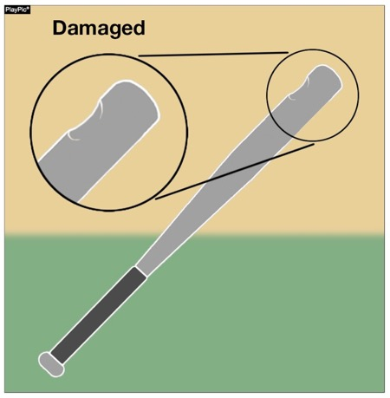
bats
Rules 1-5-1c,d,e, 2-4-3, 7-4-2 penalty NOTE
A damaged bat has been defined as a bat that was once legal but is now broken, cracked or dented. A damaged bat shall be removed without penalty. A bat that continually discolors the ball may be removed from the game with no penalty at the discretion of the umpire. Players who attempt to use damaged bats after they have been removed are then subject to the penalties for unsporting behavior.
Notes:
BATS - RULES 1-5-1c-e, 2-4-3, 7-4-2 PENALTY NOTE
A damaged bat has been defined as a bat that was once legal but is now broken, cracked or dented. A damaged bat shall be removed without penalty. A bat that continually discolors the ball may be removed from the game with no penalty at the discretion of the umpire. Players who attempt to use damaged bats after they have been removed are then subject to the penalties for unsporting behavior.
Rationale: Language was added to provide a clear definition of a damaged bat, delineating it from illegal and altered bats. Damaged bats are not to be considered illegal bats and therefore, they do not carry the same penalty as illegal bats. Damaged bats should be removed from the game without penalty. Language was also added to clarify the new certification marking (USA Softball All Games mark).

Slide 9
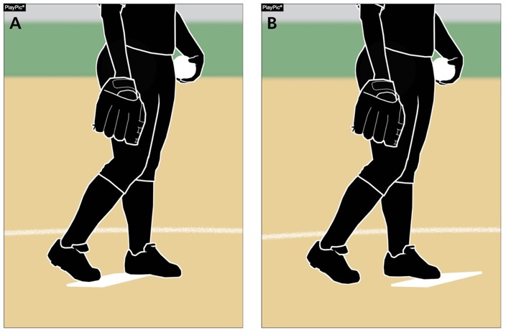
Pitching regulations
Rules 6-1-1, 6-1-2a
Whether both feet are in contact with the pitching plate (PlayPic A) or only the pivot foot is in contact with the pitching plate (PlayPic B), the pitcher shall take (or simulate taking) a signal from the catcher.
Notes:
PITCHING REGULATIONS - RULES 6-1-1, 6-1-2a
Whether both feet are in contact with the pitching plate (PlayPic A) or only the pivot foot is in contact with the pitching plate (PlayPic B), the pitcher shall take (or simulate taking) a signal from the catcher.
Rationale: Prior to starting the delivery of the pitch, the pitcher shall take a position with the pivot foot in contact with the pitcher's plate. The rule language no longer limits the pivot foot to contacting just the top surface of the pitcher’s plate.

Slide 10
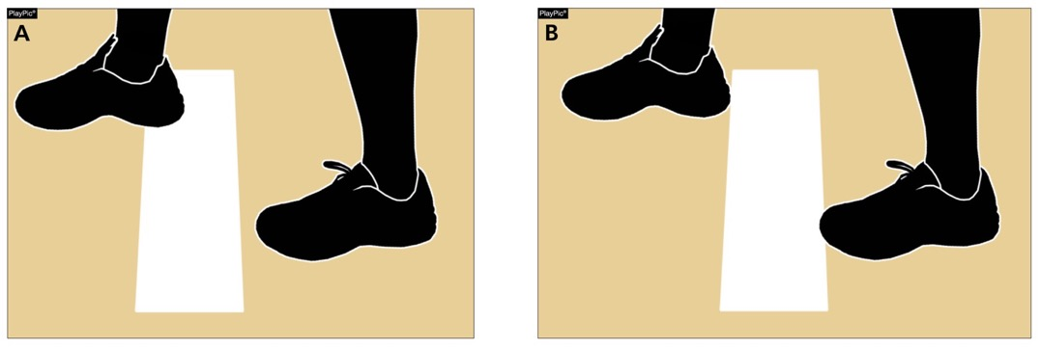
Pitching regulations
Rules 6-1-1, 6-1-2a
Because the pivot foot in PlayPic (A) and (B) is in contact with the pitcher’s plate, this is legal. Previously, it was required that the pivot foot be on top of the pitcher’s plate. The rule change allows it to be on top or in contact with the plate.
Notes:
PITCHING REGULATIONS - RULES 6-1-1, 6-1-2a
Because the pivot foot in PlayPic (A) and (B) is in contact with the pitcher’s plate, this is legal. Previously, it was required that the pivot foot be on top of the pitcher’s plate. The rule change allows it to be on top or in contact with the plate.
Rationale: New language clarifies that the pivot foot must be in contact with the pitcher’s plate, rather than on the top surface of the pitcher’s plate.

Slide 11
How a team scores
Rule 9-1-1 EXCEPTION C
A run is not scored if the runner advances to home plate during action in which the third out is made by a preceding runner who is declared out on an appeal play.
Previous wording only described a runner failing to touch a base. This new wording makes it clear that if the preceding runner is called out for any appeal play, the following runs would not score.
Notes:
HOW A TEAM SCORES - RULE 9-1-1 EXCEPTION C
A run is not scored if the runner advances to home plate during action in which the third out is made by a preceding runner who is declared out on an appeal play. Previous wording only described a runner failing to touch a base. This new wording makes it clear that if the preceding runner is called out for any appeal play, the following runs would not score.
Rationale: New language clarifies that on any appeal play, a run is not scored if the third out is made by a preceding runner.

Slide 12
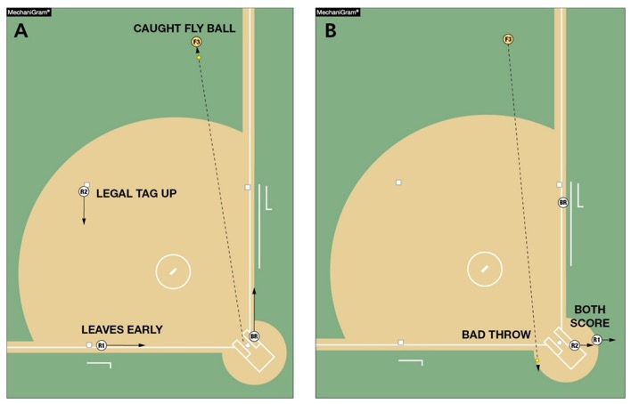
How a team scores
Rule 9-1-1 exception C
In MechaniGram A, the fly ball is caught for the second out. Both runners tag. R1 on third base leaves early and scores, R2 on second base leaves legally to advance to third base. In MechaniGram B, the throw is over the defensive player’s head and R2 scores. The defense then appeals that R1 left early. No runs score since R1 is declared out and no runner can score if the preceding runner is called out on appeal for the third out of the inning.
Notes:
HOW A TEAM SCORES - RULE 9-1-1 EXCEPTION C
In MechaniGram A, the fly ball is caught for the second out. Both runners tag. R1 on third base leaves early and scores, R2 on second base leaves legally to advance to third base. In MechaniGram B, the throw is over the defensive player’s head and R2 scores. The defense then appeals that R1 left early. No runs score since R1 is declared out and no runner can score if the preceding runner is called out on appeal for the third out of the inning.
Rationale: A run is not scored if the runner advances to home plate during action in which the third out is made by the preceding runner who is declared out on an appeal play. Added language clarifies that if a preceding runner is called out on appeal, subsequent runner(s) that cross the plate do not count as run(s) scored.

Slide 13
2020 NFHS SOFTBALL
Major editorial changes
Notes:
2020 NFHS SOFTBALL MAJOR EDITORIAL CHANGES

Slide 14
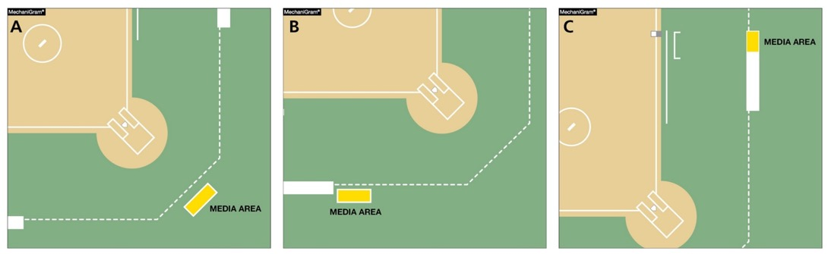
The Field
Rule 1-1-7
Game management or a state administrator may establish a media area as needed.
Notes:
THE FIELD - RULE 1-1-7
Game management or a state administrator may establish a media area as needed.
Rationale: This edit clarifies that game management or a state administrator may establish a dead-ball media area within the confines of the field, but that area will remain a dead-ball area throughout the game.

Slide 15

Field and equipment
Rule 1-5-1d
Updates to add the new USA Softball
All Games certification mark.
This new mark is very similar to the
2004 ASA Softball Logo just with USA
Softball wording.
This new mark will begin to be seen in
2020 and beyond.
Notes:
FIELD AND EQUIPMENT - RULE 1-5-1d
Updates to add the new USA Softball All Games certification mark.
This new mark is very similar to the 2004 ASA Softball Logo just with USA Softball wording.
This new mark will begin to be seen in 2020 and beyond.
Rationale: Language was also added to clarify the new certification marking (USA Softball All Games mark).

Slide 16
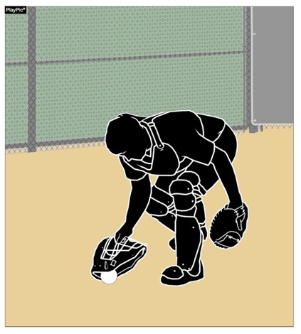
Runners Entitled to advance
Rule 8-4-3d Penalty
Language was clarified to indicate that when F2 stops a wild pitch or passed ball with detached equipment, the batter is not awarded bases. But if that pitch completed the batter’s turn at bat, the batter-runner is awarded first base.
Notes:
RUNNERS ENTITLED TO ADVANCE - RULE 8-4-3d PENALTY
Language was clarified to indicate that when F2 stops a wild pitch or passed ball with detached equipment, the batter is not awarded bases. But if that pitch completed the batter’s tun at bat, the batter-runner is awarded first base.
Rationale: Clarifies that the batter-runner, not the batter is awarded bases when a fielder intentionally contacts the ball with detached equipment.

Slide 17
2020 NFHS SOFTBALL points of emphasis
Notes:
2020 NFHS SOFTBALL POINTS OF EMPHASIS

Slide 18

Damaged bat vs. illegal bat
Bats must bear either the 2000, 2004, or the USA Softball All Games certification mark. Additionally, the bat must not appear on USA Softball’s Non-Approved Bats With Certification Marks list (www.usasoftball.com). Bat barrels made entirely of wood are permitted and need not bear a certification mark but shall not exceed 2-1/4 inches in diameter.
Notes:
BAT CERTIFICATION MARKS
Bats must bear either the 2000, 2004, or the USS Softball All Games certification mark. Additionally, the bat must not appear on the USA Softball’s Non-Approved Bats with Certification Marks list (www.usasoftball.com). Bat barrels made entirely of wood are permitted and need not bear a certification mark but shall not exceed 2 ¼ inches in diameter.
NFHS softball recognizes and utilizes USA Softball’s certification process. In order for a bat to be legal for use in NFHS softball it must be marked with the ASA 2000, 2004 or the USA Softball All-Games Certification Mark. Additionally, any bat with one of these certification marks must not appear on the list of the USA Softball Non-Approved Bats with Certification Marks. This list was created as a way to alert players and coaches that a bat that was once approved for use has now been deemed no longer approved for use. All bats that are approved by USA Softball, formally ASA, for use in fast pitch play shall bear one of the markings shown above.

Slide 19
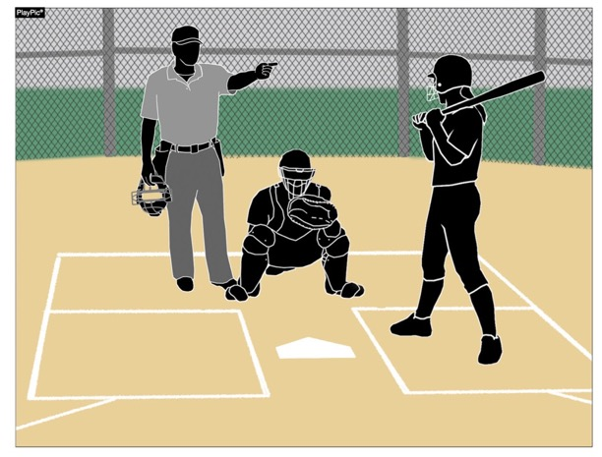
Damaged bat vs. illegal bat
Clarification was needed to delineate the difference between a player using a bat that is damaged versus a bat that is illegal for high school play. By definition, a bat that is damaged (Rule 2-4-3c) is removed from the game without penalty (7-4-2 NOTE). An illegal bat that is non-approved or altered will continue to result in the head coach and the batter being ejected.
Notes:
DAMAGED BAT VS. ILLEGAL BAT
Clarification was needed to delineate the difference between a player using a bat that is damaged versus a bat that is illegal for high school play. By definition, a bat that is damaged (Rule 2-4-3c) is removed from the game without penalty (7-4-2 NOTE). An illegal bat that is non-approved or altered will continue to result in the head coach and the batter being ejected.

Slide 20
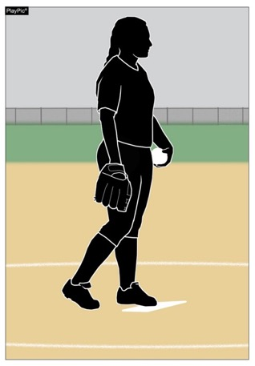
Contact with the pitcher’s plate
Due to the varying levels of play and accompanying variation in pitching skills while pitchers develop, prior to the start of the pitch, NFHS rules allows the pitcher to choose her foot placement. The pitcher may choose to take a position with the pivot foot in contact with the plate and the non-pivot foot behind the pitcher’s plate or both feet in contact with the pitcher’s plate. Prior to the start of the delivery, both feet must be on the ground within or partially within the 24-inch length of the pitcher’s plate. This allows for personal preference and developing pitchers to work through levels of progression.
Notes:
CONTACT WITH THE PITCHER’S PLATE
Due to the varying levels of play and levels of skill in pitching development, prior to the start of the pitch, NFHS rules allows the pitcher to choose foot placement. The pitcher may choose to take a position with the pivot foot in contact with the plate and the non-pivot foot behind the pitcher’s plate or both feet in contact with the pitcher’s plate. Prior to the start of delivery, both feet must be on the ground within or partially within the 24-inch length of the pitcher’s plate. This allows for personal preference and developing pitchers to work through levels of progression.

Slide 21
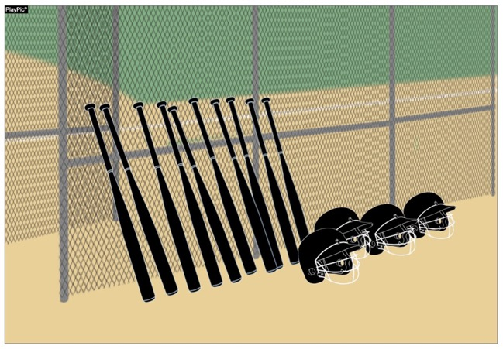
Inspection of equipment
It is the head coach’s responsibility to make certain all players are legally and properly equipped, which includes checking bats, helmets and catcher’s gear prior to every contest. Umpires may inspect equipment but are not required to do so. It is critical that coaches remain vigilant in inspecting equipment before every contest to ensure no damage has occurred or new noncompliant equipment has been purchased since their last inspection.
Notes:
INSPECTION OF EQUIPMENT
It is the head coach’s responsibility to make certain all players are legally and properly equipped, which includes checking bats, helmets, and catcher’s gear prior to every contest. Umpires may inspect equipment but are not required to do so. It is critical that coaches remain vigilant in inspecting equipment before every contest to ensure no damage has occurred or new noncompliant equipment has been purchased since their last inspection.
What is important to remember is equipment wears during use. Bats can become damaged, or a player may purchase a new bat that does not meet the NFHS requirements. Both catchers’ helmets as well as batter’s helmets have screws that hold face guards in place. These screws loosen and will eventually fall out rendering the equipment illegal for use and potentially causing risk to the player if not detected.

Slide 22
2020 NFHS SOFTBALL
ADDITIONAL points of emphasis
Notes:
2020 NFHS SOFTBALL POINTS OF EMPHASIS

Slide 23
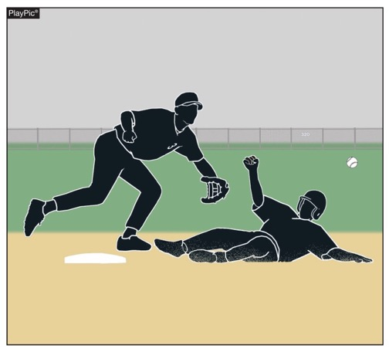
Baserunner’s responsibilities
Legal
Runners are never required to slide, but if a runner elects to slide, it must be legal. A legal slide can either be feet first or head first. If a runner slides feet first, at least one leg and buttock shall be on the ground.

Slide 24
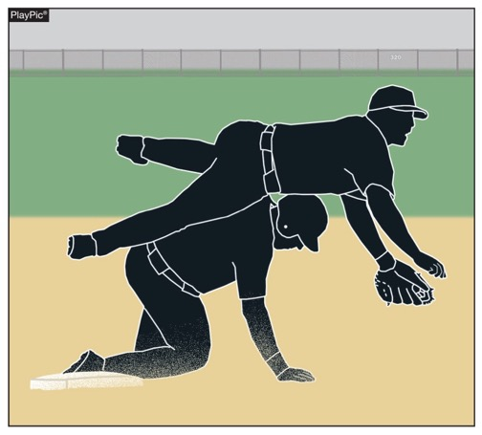
Baserunner’s responsibilities
Illegal
Runners may not pop-up into the fielder.

Slide 25
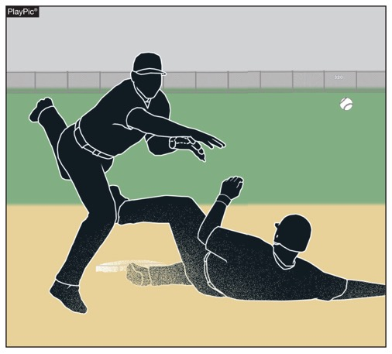
Baserunner’s responsibilities
Illegal
Runners may not have a leg raised higher than the fielder’s knee.

Slide 26
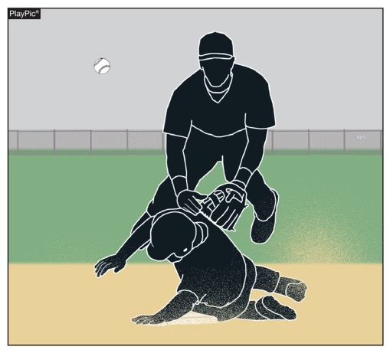
Baserunner’s responsibilities
Illegal
Except at home plate, runners may not slide through or beyond the base.

Slide 27
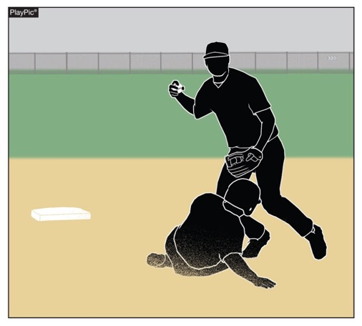
Baserunner’s responsibilities
Illegal
Runners may not slide away from a base in the direction of the fielder. But a runner may slide in a direction away from the fielder to avoid making contact or altering the play of the fielder.

Slide 28
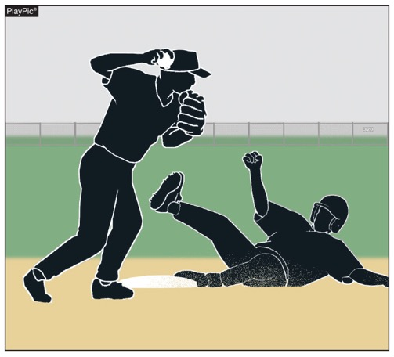
Baserunner’s responsibilities
Illegal
The runner is out when he illegally slides and affects the play. On a force play, the runner is also guilty of interference. The batter-runner is also declared out and all runners must return to the base occupied at the time of the pitch.

Slide 29
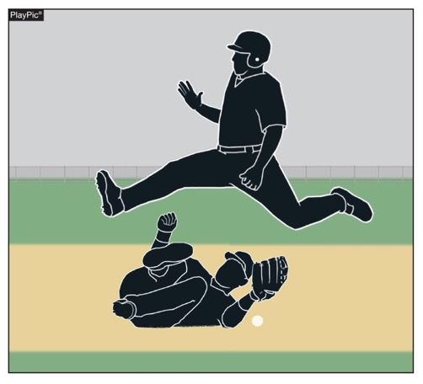
Baserunner’s responsibilities
Legal
Jumping, hurdling and leaping are all legal attempts to avoid a fielder as long as the fielder is lying on the ground.

Slide 30
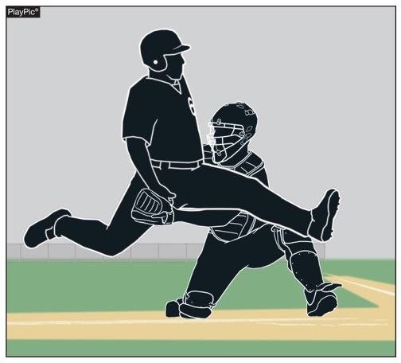
Baserunner’s responsibilities
Illegal
When illegally executed, as shown in the PlayPic, hurdling, jumping or leaping over a fielder supersedes obstruction.

Slide 31
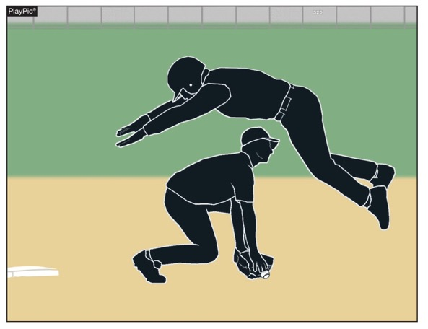
Baserunner’s responsibilities
Illegal
Diving over a fielder is always illegal. Diving supersedes obstruction.

Slide 32
NFHS OFFICIALS Education
Notes:
NFHS OFFICIALS EDUCATION

Slide 33

SPORTS-SPECIFIC Officiating COURSES www.nfhslearn.com
Introduction to mechanics and techniques used in each sport
Ideal for new officials or those in first few years of officiating
30-45 minutes to complete
Topics vary based on the needs of the officials in the sport
NFHS Officials Association members cost is $10
Non-members - course is $20
API available to state associations to collect results
Notes:
SPORTS-SPECIFIC OFFICIATING COURSES WWW.NFHSLEARN.COM
Sports-specific officiating courses are available in the sports of football, soccer, volleyball, swimming and diving, basketball, wrestling and softball. These courses were developed with the newly licensed official or inexperienced official in mind. They are good for experienced officials to assist with updating skill levels and knowledge base. The course varying length from 20 minutes to 45 minutes. Topics are based on the needs of the officials.
Additional courses are being developed for soccer, volleyball, field hockey, basketball, wrestling, softball, baseball and track and field. These will come online sometime in 2019-20 prior to the season opening. The cost of the course is $10.00 to NFOA members (100%) and $20.00 for non-members.

Slide 34

Notes:
VIDEO FOR TEACHING AND LEARNING
The new video library is located at www.nfhslearn.com
A variety of video in many sports is provided.
Officials value watching video clips to improve their craft. Video offers the opportunity to look at a situation, rewind and look at it as many times as needed to understand the call or to question the call.

Slide 35
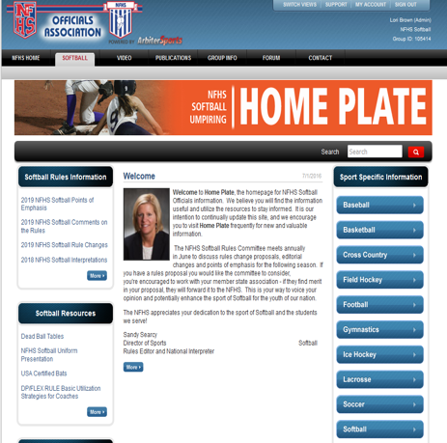
NFHS Officials Association Central Hub
Contains:
  Sport information
  Rules information
  Rules library
  Searchable rules book
  Video content on officiating sport, competition situations and interpretations
Notes:
NFHS OFFICIALS ASSOCIATION CENTRAL HUB
State associations with 100% membership in the NFHS Officials Association and any individual member has access to the Central Hub for officials.

Slide 36
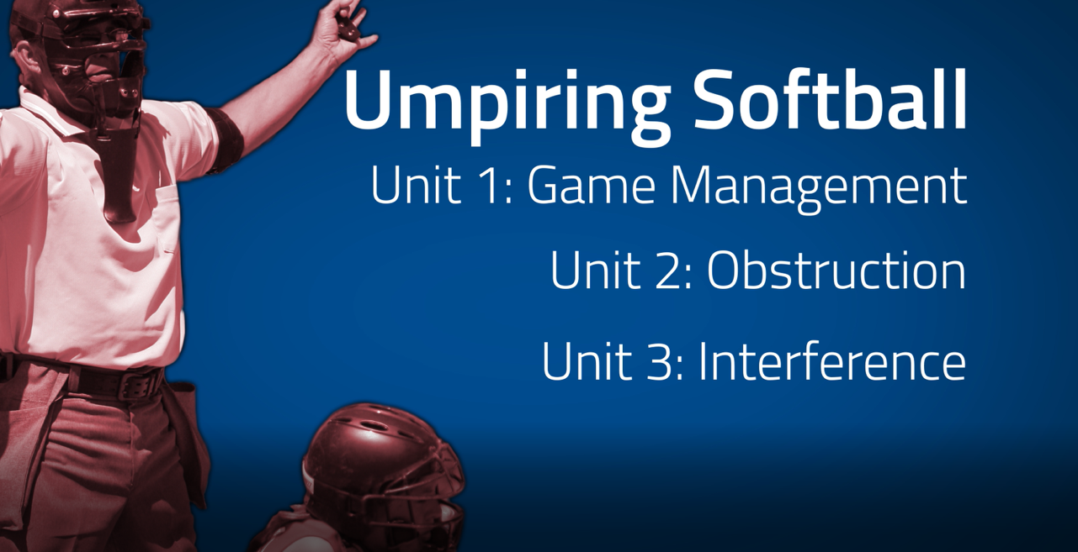
Notes:
UMPIRING SOFTBALL
In partnership with USA Softball, the NFHS has developed the first in a line of educational softball courses. This first course addresses game management, as well as obstruction and interference for both rules codes. The course will be ready for release in March. Umpires who are members of 100% states may obtain the course on NFHSLearn for a cost of $10. Umpires belonging to state associations who are not 100% states are charged $20.

Slide 37
NFHS Learning Center
Notes:
NFHS LEARNING CENTER

Slide 38

Nfhs learning center www.nfhslearn.com
Professional Development For ALL
  Coaches
  Officials
  Administrators
  Parents
  Students
  Performing Arts
Notes:
NFHS LEARNING CENTER
Digital platform for online professional development courses are available on www.nfhslearn.com.

Slide 39
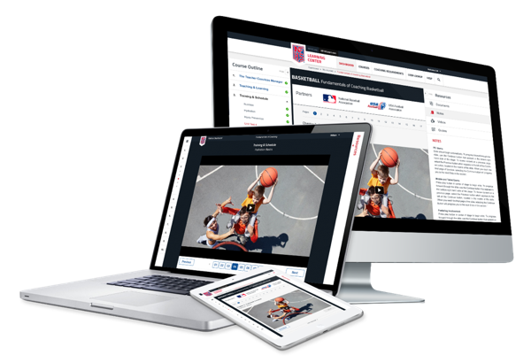
www.nfhslearn.com
FREE courses include:
  Bullying, Hazing and Inappropriate Behaviors
  Student Mental Health and Suicide Prevention
  Understanding Copyright and Compliance
  Protecting Students from Abuse
  Hazing Prevention for Students
  Coaching Unified Sports
  ACL Injury Prevention
  Sportsmanship
  And many more
Notes:
NFHS LEARNING CENTER
FREE courses include:
Bullying, Hazing and Inappropriate Behaviors
Student Mental Health and Suicide Prevention
Understanding Copyright and Compliance
Protecting Students from Abuse
Hazing Prevention for Students
Coaching Unified Sports
ACL Injury Prevention
Sportsmanship
And many more

Slide 40
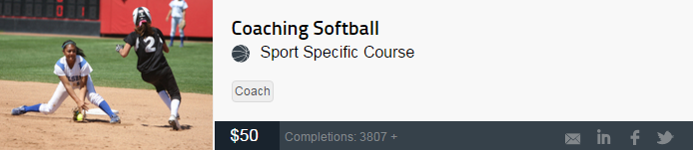
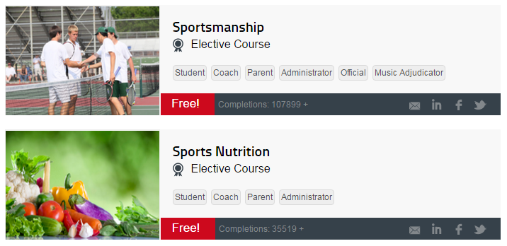
Softball
Coaches Education
Notes:
SOFTBALL COACHES EDUCATION
The NFHS partnered with USA Softball to present the online Softball Coaches Course. Go to www.nfhslearn.com to view the trailer, description and outline for this course.

Slide 41
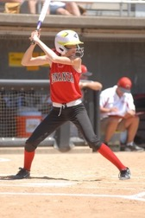
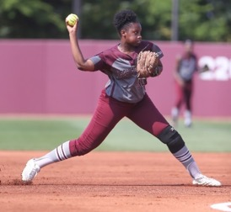
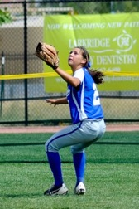
Thank You
National Federation of State High School Associations
PO Box 690 | Indianapolis, IN 46206
Phone: 317-972-6900 | Fax: 317.822.5700
www.nfhs.org | www.nfhslearn.com
Notes:
THANK YOU

Slide 42
General Board Changes
2019-2020

Slide 43
Gender of Player
The NCHSAA allows participation in interscholastic athletics for all students, regardless of gender or gender identification.
Notes:
It is the intent that all students are able to compete on a level playing field in a safe, competitive and friendly environment, free of discrimination.
The following rules and regulations are intended to provide every student athlete with equal opportunities to participate in athletics.

Slide 44
Gender of Player
A student may participate based on the gender noted on the student’s certificate of birth.
  Women shall not participate on a men’s interscholastic athletic team where the school has a women’s team in the same sport or where a school sends an entry to the women’s state playoffs in the same sport.
    In cases where women are permitted on a men’s team, the school forfeits all participation in the women’s playoffs in the same sport.
    Men’s rules will be used where women play on men’s teams.
    Men’s shall not participate on women’s team’s in any sport.

Slide 45
Gender of Player
When a student’s gender identity differs from the gender listed on the student’s certificate of birth, the Gender Identity Request Form must be submitted by the member school to the NCHSAA prior to any participation by the student under circumstances that would constitute ineligibility.
Notes:
The Request should be based on the gender identification of that student in current school records and daily life activities in the school and community.

Slide 46
Gender of Player
  The following information should be submitted with the Request:
    Documentation from individuals such as, but not limited to, parents/legal guardians appointed by a court of competent jurisdiction, friends, and/or teachers, which affirm that the actions, attitudes, and manner demonstrate the student’s consistent gender identification.
    A complete list of all the student’s prescribed, non-prescribed, or over the counter treatments or medications relative to gender identity.
    A complete list of interventions that have happened related to the gender identity of the student.
    Written verification from an appropriate healthcare professional (e.g. physician, psychiatrist, psychologist, school nurse, etc.) of the student’s consistent gender identification. Include any other social/emotional information from health-care professionals that would help the Committee make a decision about the student. This information must be submitted on office letterhead of the healthcare professional who provides verification with contact information and professional title of the individual.
    Any other pertinent documentation or information which the student or parent(s)/legal guardian(s) appointed by a court of competent jurisdiction believe relevant and appropriate.
Notes:
Requested Documentation:
-Affirmations that the actions, attitudes, and manner demonstrate the student’s consistent gender identification
-Complete list of treatments or medications relative to gender identity
-Complete list of interventions related to the gender identity of the student.
-Written verification from an appropriate healthcare professional of the student’s consistent gender identification.
-Any other pertinent documentation or information which the student or parent(s)/legal guardian(s) appointed by a court of competent jurisdiction believe relevant and appropriate.

Slide 47
Gender of Player
The NCHSAA will refer the Gender Identity Request to the NCHSAA Gender Identity Committee for consideration.
  The NCHSAA Gender Identity Committee will consist of the following:
    Current member of the Board of Directors;
    LEA or school administrator;
    Physician with experience in gender identity health care and/or World Professional Association of Transgender Health (WPATH) Standards of Care;
    Psychiatrist, psychologist, or licensed mental health professional familiar with the WPATH.
The Committee will approve the Request if it finds that the student genuinely identifies as the gender indicated in the Request.

Slide 48
Gender of Player
The Committee will require that the member school has verified that the student is eligible in all other aspects.
The Committee will respect and promote the student’s privacy and confidentiality rights under HIPPA and FERPA in the process of considering a Gender Identity Request. Information provided to the Committee will be shared only to the extent necessary to decide the Gender Identity Request; provided that, if a Gender Identity Request is approved, the student’s school may share the student’s gender identity with other schools as necessary to ensure appropriate accommodations when competing at another school.

Slide 49
Gender of Player
In cases where a Gender Identity Request has been approved:
  The student will be declared eligible to participate based on the student’s gender identity.
    1.2.4.a is not in effect.
  It shall be the responsibility of the school to comply with all state and federal mandates/laws.
Notes:
1.2.4.a is the “birth certificate rule”

Slide 50
Home School Participation
Initial Eligibility
Home school students
  Documentation from the Division of Non-Public Education must be presented upon initial dual enrollment- attendance, immunization, transcript, school number, etc.
  Home school students must communicate athletic intent at a member school in which they are domiciled and follow the enrollment and assignment procedures/policies established by the local board of education.
    Notice to principal must take place within ten days prior to the first practice date of each sports season.

Slide 51
Home School Participation
Attendance
Home school students:
  Must have been enrolled in the registered home school for 365 days prior to being eligible in a member school.
  Once deemed eligible at a member school, the student must maintain continuous dual enrollment.
    Unenrollment would render the student ineligible for 365 days.
  Must participate in a class schedule that is at least one half of the school’s instructional day
    At least one class must be on campus each semester or meet LEA requirements.

Slide 52
Home School Participation
Scholastic Requirements:
A student must have passed a minimum load of work during the preceding semester to be eligible at any time during the present semester. The semester is normally considered half of the academic year. All students must also meet local promotion standards, set by the LEA and/or the local school. Home school students must be on grade level according to a nationally standardized achievement test(s) indicating grade level.
A minimum load is defined as five courses in the traditional school schedule and three courses for schools on the “block” format. If the school is on an A/B form of block scheduling, a student must pass six of eight courses during what would traditionally be defined as a semester. Any student, including seniors must pass that minimum load, even if they need fewer for graduation. Home school student must pass all public school courses in which he/she is enrolled.

Slide 53
Transfer Policy
Students transferring to the same member school where the student’s coach has relocated within a calendar year will be deemed ineligible in any sport in which the coach is involved.
  Now applies to within LEA as well as from LEA to LEA.
If deemed ineligible due to athletic purposes, the student will only be ineligible in that sport(s) in which “athletic purposes” was reason for not authorizing

Slide 54
Foreign Exchange Students
  After the first year of participation as a Foreign Exchange Student
    Student can be eligible subsequently, based on the two-semester rule
      Applies to the same school of initial enrollment
Notes:
Previously Foreign Exchange Students were only eligible the first semester of residency in the United States through an approved program.

Slide 55
Ejection Policy
Clarified this policy:
  Leaving the bench and coming on to the playing area during a fight (whether they participate in the fight or not)
Notes:
Language has been cleaned up to match the penalty to alleviate any confusion.

Slide 56
Unpaid Fines
Unpaid fines will be posted for NCHSAA membership view only

Slide 57
Eligibility Summary Forms
Deadline Changes
  Fall – September 1
  Winter – December 1
  Spring – March 15

Slide 58
Post-Season Participation
Clarification:
  Independent NCHSAA member schools are eligible for post-season ONLY in individual sports, based on the sport
Notes:
Clarifying language that independent NCHSAA member schools are not eligible for bracketed sports playoffs

Slide 59
Wilson Game Balls
2019-20
No change, required at State Championships
2020-21
Required use of the official and adopted Wilson game balls in ALL playoff events
Strongly recommend the use of the official and adopted Wilson game balls during the regular season
Notes:
Penalty to be assessed when official ball is not used in games
–Use of illegal equipment

Slide 60
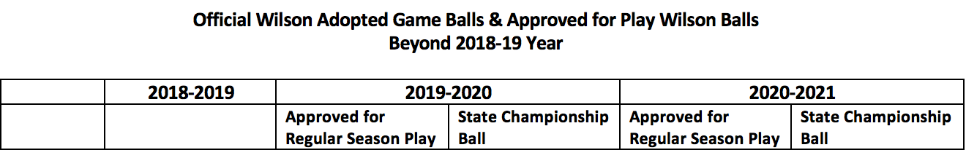
Wilson Game Balls
Softball | WTA9011BNCHS (.47 COR) | WTA9011BSST MSRP: $74.95 | WTA9011BSST MSRP: $74.95 | WTA9011BSST MSRP: $74.95 | WTA9011BSST MSRP: $74.95
Notes:
Again, Wilson is not required during regular season play in 2019-2020. If you use Wilson, these are the approved balls.
Penalty to be assessed when official ball is not used in games
–Use of illegal equipment

Slide 61
NCHSAA Points of Emphasis
-Board approved Item
-Helmets/Protective Gear
-Seeding/Playoffs
-Realignment
2019-2020

Slide 62
Length of Games in a Doubleheader
By mutual agreement in baseball and softball, two member schools may agree to play two, five (5)-inning games in a doubleheader.
Note: This does not violate NFHS playing rules and is permissible by state association adoption. This would not remove the current option of playing a doubleheader as two seven (7)-inning games, or until a regulation game is completed.
Notes:
Single games must still be played under NFHS rules requiring seven inning games or until a regulation game is completed.
Maintain current NCHSAA Handbook regulation regarding suspended games.

Slide 63
Required Coaches Education
NFHS Fundamentals of Coaching
  All coaches (paid and volunteer)
  Prior to first play date
  One-time requirement
NFHS Concussion in Sports
  All coaches (paid and volunteer)
  Prior to first practice
  Annual requirement
CPR/AED Certified
  All head and paid coaches
  Must maintain certification
NFHS Sudden Cardiac Arrest
  All non-paid coaches
  Prior to first practice
  Annual requirement
NCHSAA Rules Clinic
  Head Varsity Coach
  Prior to first play date
  Annual Requirement
Notes:
Once a team makes it to the playoffs, we do compliance checks for fulfillment of these requirements. Please make sure that all coaches on your bench are compliant, including yourself.

Slide 64
Calendar
  Start: Wednesday, February 12
1st Contest: Monday, March 2
MaxPreps Entry Deadline: Saturday, May 9
11:59 p.m.
Seeding: Monday, May 11
Playoff Dates:
1st Round Tuesday, May 12
2nd Round Friday, May 15
3rd Round Tuesday, May 19
4th Round Friday, May 22
Regionals: Tuesday – Saturday, May 26 – 30
State Championships: Friday – Saturday, June 5 – 6
Notes:
Key Dates:
1st Practice – February 12
1st Contest – March 2
Last Play Date – May 9

Slide 65
Participation Limitations
Regular season:
  Season Limit: 23 games
  Weekly Limit: No more than four, provided fourth single game is on a non-school day
    Four games in three days is permissible without using a non-school day (e.g. doubleheaders on a school day)
  Daily Limit: Teams and individuals are limited to two games on a school day. Limit extends to four games, if on a non-school day.
  Permissible for athletes to participate in a junior varsity and varsity game in the same day; still subject to weekly and season limit
Notes:
Wanted to emphasize this information because we had several questions last year

Slide 66
HELMETS/PROTECTIVE GEAR
Reminder: Wearing of helmets for coaches who are coaching in the coach’s box is required.
While not required, by rule defensive players are permitted to wear face/head protection in the field.
  See NFHS Rule 1-8 Art. 4
Notes:
Received some emails making it required for defensive players.
NFHS Rule permits it but has not moved to making it a requirement. NOSCAE does not have a certification for an attachment. They only have a certification for the helmet/face guard that catcher’s wear. One of the reasons is that the national injury report does not show a heightened number of injuries.
We, however, have sent photos and shared information about injuries in our state to the NFHS to use in their reports and presentations.
Softball coaches association, conference, etc. can submit a proposal to Board of Directors to make it a requirement.

Slide 67
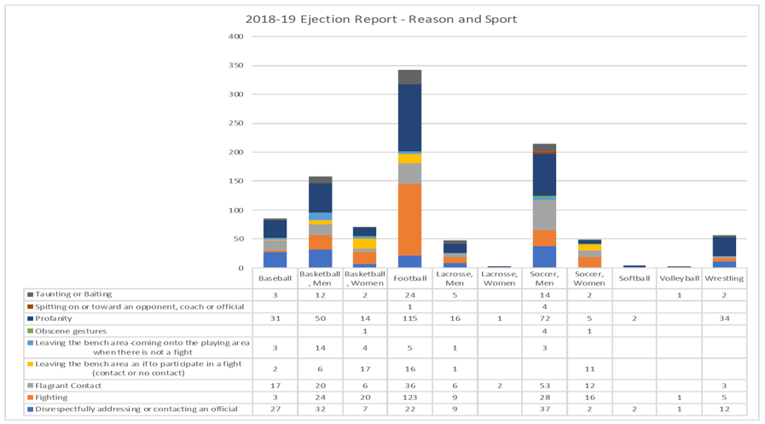
Sportsmanship/Ejections
Notes:
Notice: Softball is pretty low compared to some other sports.

Slide 68
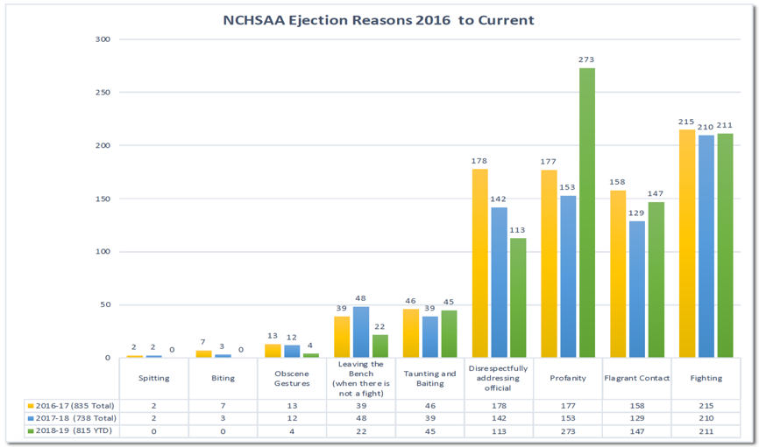
Sportsmanship/Ejections

Slide 69
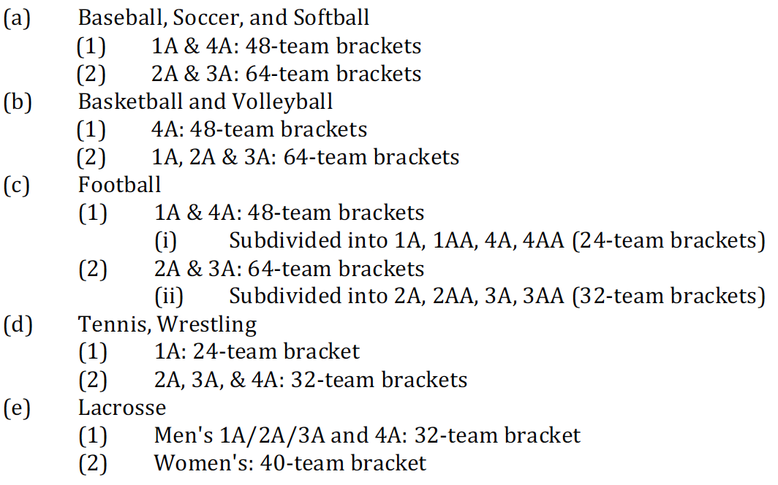
Playoffs/Seeding – Bracket Sizes
Notes:
Softball:
-1A & 4A = 48-team brackets
-2A & 3A = 64-team brackets

Slide 70
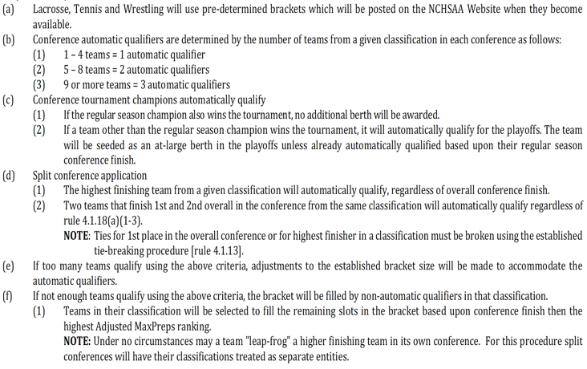
Playoffs/Seeding – Berths and Qualifications

Slide 71
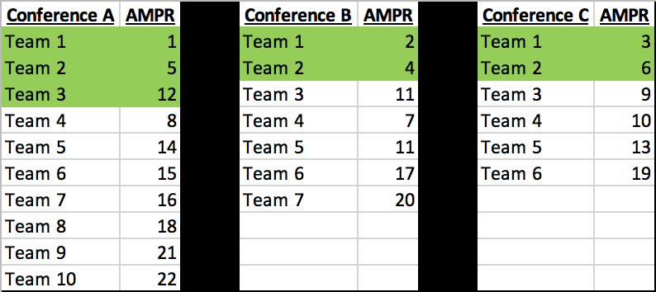
Green highlights = Automatic Qualifiers
The top non-automatic qualifiers from each conference are compared:
Team 4 Team 3 Team 3
Notes:
Leapfrog Example:
-Green highlighted teams are automatic qualifiers
-The top non-automatic qualifiers from each conference are compared (not the best Adjusted MaxPreps Ranking)
-Notice Conference B Team 4 (ADMR of 7) is not available because Team 3 finished ahead of them in the conference standings.
-Team 4 from Conference A is the first at-large qualifier because they have the best ADMR of the teams available to be compared

Slide 72
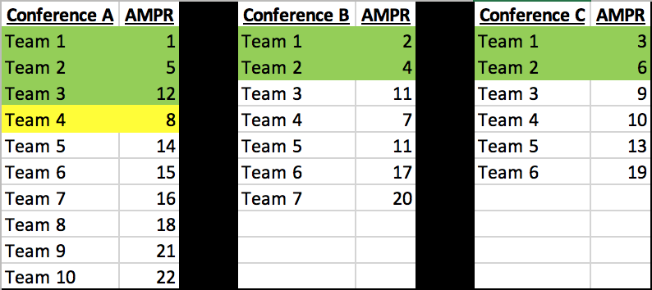
Green highlights = Automatic Qualifiers
The top non-automatic qualifiers from each conference are compared:
Team 5 Team 3 Team 3
Notes:
Now from left to right compare Team 5, Team 3 and Team 3
-Team 3 from Conference C is the next at-large qualifier because they have the best ADMR of the teams available to be compared

Slide 73
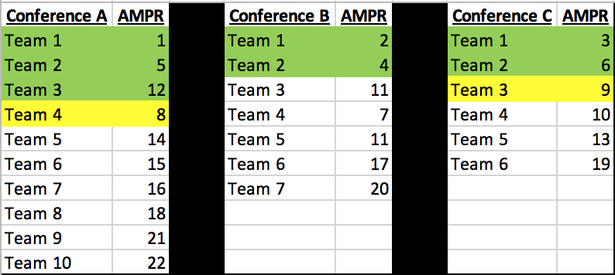
Green highlights = Automatic Qualifiers
The top non-automatic qualifiers from each conference are compared:
Team 5 Team 3 Team 4
Notes:
Now from left to right compare Team 5, Team 3 and Team 4
-Team 4 from Conference C is the next at-large qualifier because they have the best ADMR of the teams available to be compared

Slide 74
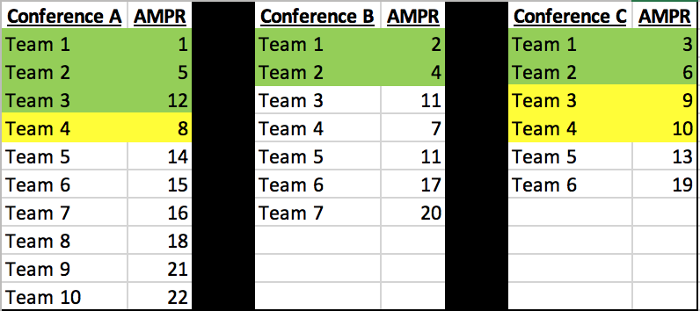
Green highlights = Automatic Qualifiers
The top non-automatic qualifiers from each conference are compared:
Team 5 Team 3 Team 5
Notes:
Now from left to right compare Team 5, Team 3 and Team 5
-Team 3 from Conference B is the next at-large qualifier because they have the best ADMR of the teams available to be compared

Slide 75
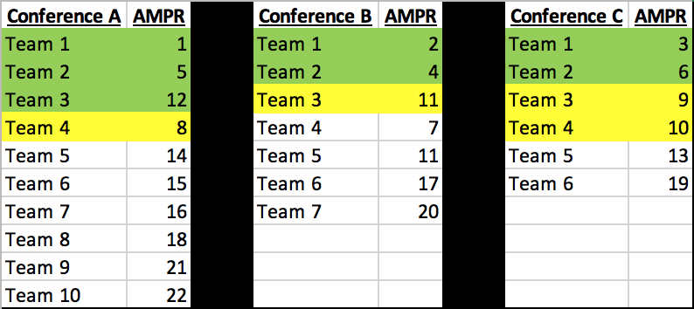
Green highlights = Automatic Qualifiers
The top non-automatic qualifiers from each conference are compared:
Team 5 Team 4 Team 5
Notes:
Now from left to right compare Team 5, Team 4 and Team 5
-Team 4 from Conference B is the next at-large qualifier because they have the best ADMR of the teams available to be compared

Slide 76
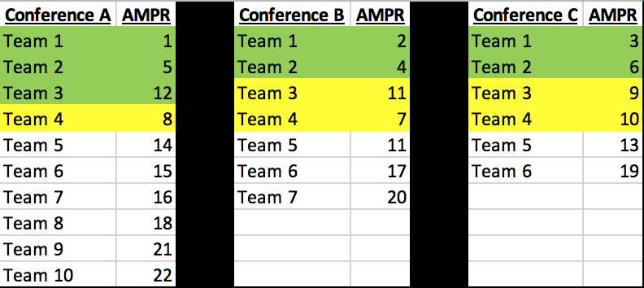
Notes:
Now from left to right compare Team 5, Team 5 and Team 5
-Team 5 from Conference B is the next at-large qualifier because they have the best ADMR of the teams available to be compared

Slide 77
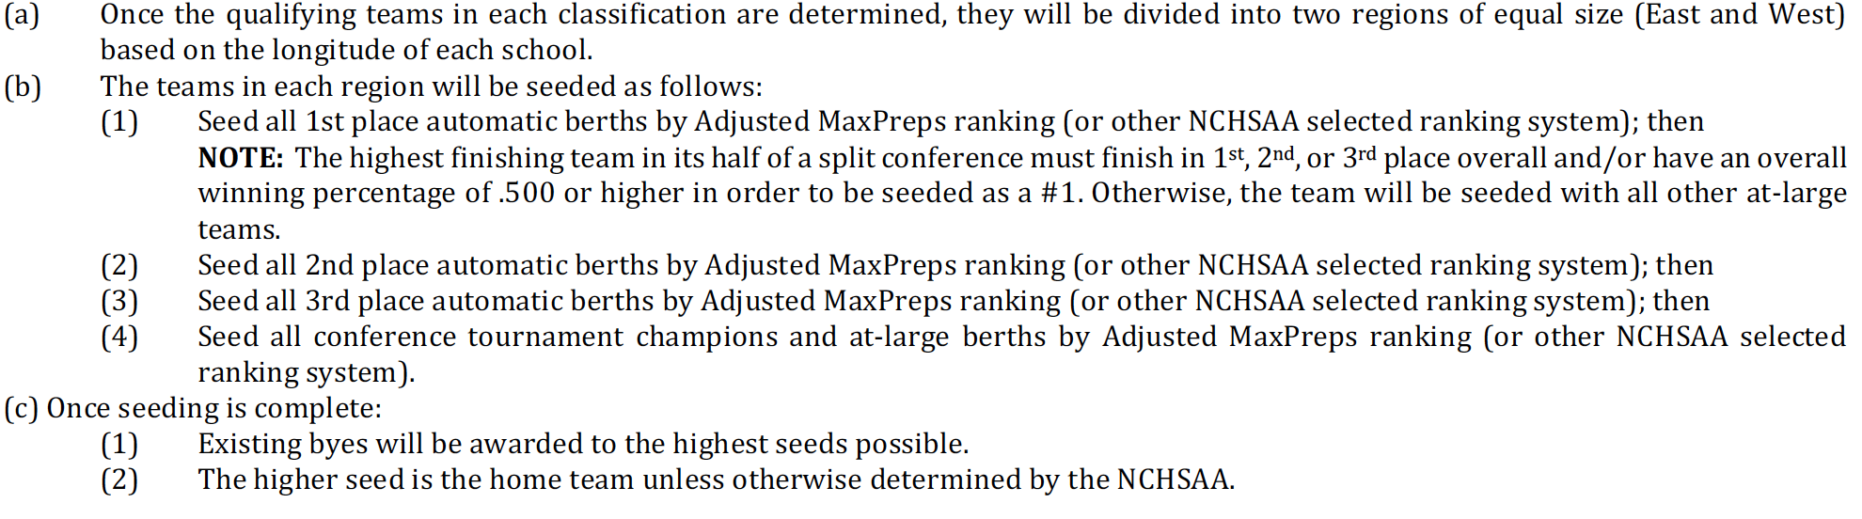
Playoffs/Seeding – Assigning Seeds

Slide 78
2021-2025 Realignment
The Board of Directors instructed NCHSAA Staff to delay the Realignment process by one year
  Eliminating the “lame duck year” of the alignment period
  Decision was to give various committees the opportunity to review the realignment process and the Association’s current classification structure while providing the necessary time for the Board and membership to make any necessary changes to implement their recommendations
Notes:
Important Notes:
-Realignment Committee and Board will seek input relative to classes, percentages, etc.
-Any deviation from 4 classes would require a NCHSAA Amendment change.
-Previous Realignment Committees researched 3, 4 and 5 classes with the help of SAS.

Slide 79
Thank You!
To receive clinic attendance credit:
  State Clinic
    Sign-in prior to leaving
  Coaches Clinic
    Pick-up your card as you leave today
      Enter your code immediately to get credit for attendance
        Mobile device or computer
        All fields required except comments box
        Use same email address that was used for NFHS Courses
      Deadline for entry is August 16, 2019
      Avoid $400 fine for your school
  Online Clinic
    Print certificate and keep on file

