Slide 1
2020 NFHS Baseball Rules Powerpoint
B. Elliot Hopkins, MLD, CAA
NFHS Director of Sports, Sanctioning and Student Services
Notes:
Thank you for participating in this annual interpretation meeting. While the rules of baseball are in great shape, we continue to work toward improving the sport by recruiting and retaining more young people. We have to continue to strive to provide safe conditions and place them in situations that they are able to find success in some aspect of the sport. Ultimately, our goal is for them to be safe, have fun and gain some valuable life lessons from participation. New additions to our rules are indicated by underlining of the change. Deletions are noted by a strike-through of the deleted text.

Slide 2

NFHS Rules Book as e-Books
E-books features:
  Searchable
  Highlight areas of interest
  Make notes
  Easy navigation
  Adjustable viewing size
  Immediate availability
Notes:
The NFHS Rules and Case Book e-books are available for $6.99 each.

Slide 3
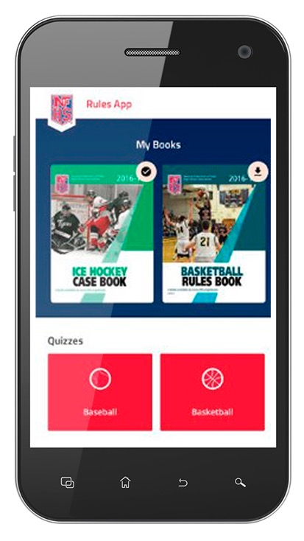
NEW NFHS Rules App
Rules App features:
  Searchable
  Highlight notes
  Bookmarks
  Quizzes for all sports
  Easy navigation
  Immediate availability
  Free to paid members of the NFHS Coaches
  and Officials Associations
  www.nfhs.org/erules for more information
Notes:
Rules Book Apps for all NFHS rules books and case books are available on iTunes and Google Play. Rules books and case books are cross-linked and enabled for searchable content.

Slide 4

Pre-Game EAP Review
Purpose
  Effective communication of Emergency Action Plan
    EAP is required by Law (Gfeller-Waller)
  Guide for administrators, coaches, officials and LAT/FR
Conducted by the Game Day Administrator or Designee
  The NCHSAA recommends that a hard copy or electronic copy of the venue specific EAP be provided to both the lead official and visiting team personnel.

Slide 5
Pre-Game EAP Review Card
All Events
Who is the gameday administrator and what is their contact information?
Is there a Licensed Athletic Trainer (LAT) and/or First Responder (FR) on site and what is their contact information? If a LAT or FR is not on site who is the most qualified person to provide CPR and first aid care?
Has the Emergency Action Plan (EAP) been reviewed and where is the posted venue specific EAP located?
What first aid and emergency equipment is available at the venue and where is it located? (e.g., first aid kit, AED/CPR equipment, spinal injury stabilization equipment, exertional heat illness management equipment, etc.)

Slide 6
Pre-Game EAP Review Card
Outdoor Events
Who will be monitoring environmental and field/facility conditions during the event? (e.g., thunder and lightning, Wet Bulb Globe Temperature)
Who will notify officials of unsafe environmental or field/facility conditions?
Has the lightning or thunder disturbances safe shelter and evacuation route been identified?
What is the Wet Bulb Globe Temperature, if available, at the beginning of the contest?

Slide 7
Pitch Count Protocol
Game Day Tracking Forms must be signed by opposing coaches, or designee, and kept on file.
Counts must be updated on the team's MaxPreps page before 11:00 a.m. on the day following the contest.
  Head Coaches, or their designee, must communicate pitch counts between each inning. Failure to communicate between innings could result in a fine for unsporting behavior if discrepancies arise.
  In cases where there is a discrepancy between the home and visiting teams, the home team book will be used for official tracking. Intentional discrepancies in pitch records will be deemed unsporting, evaluated on a per instance basis, and could result in penalties.

Slide 8
2020 NFhs baseball rule changes

Slide 9
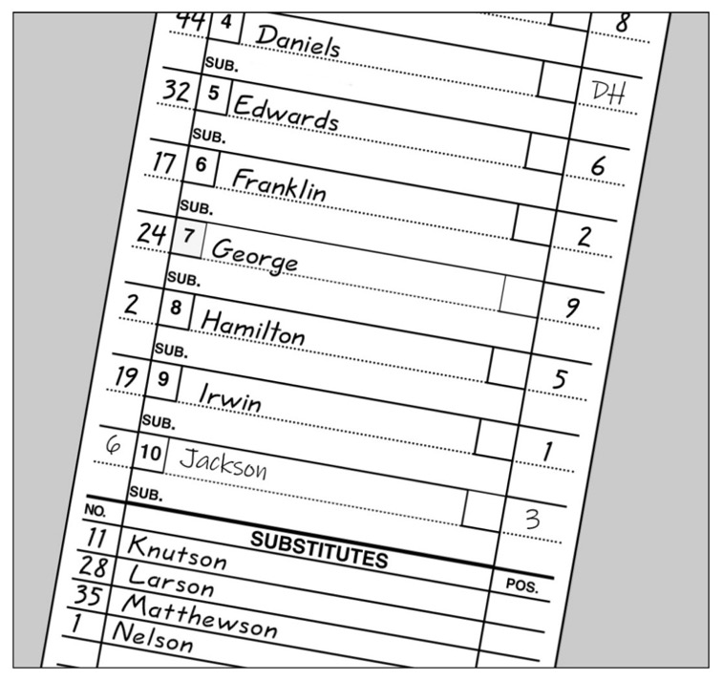
Designated hitter
Rule 3-1-4
The DH may still be a 10th starter hitting for any one of the nine starting defensive players.
Notes:
The designated hitter has been a mainstay rule for decades. It has not changed. We have only added another option with the same concept.

Slide 10
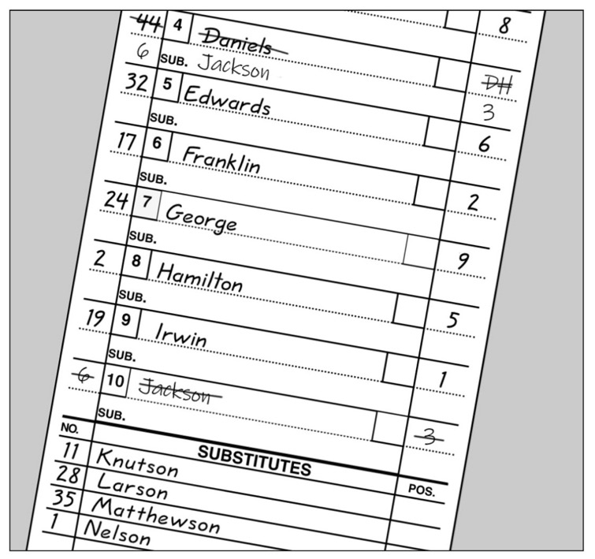
Designated hitter
Rule 3-1-4a1
While there is no change from the previous DH rule.
When using a standard designated hitter, the role of the DH is still terminated for the remainder of the game when the defensive player for whom the DH batted, subsequently bats, pinch-hits or pinch-runs.

Slide 11
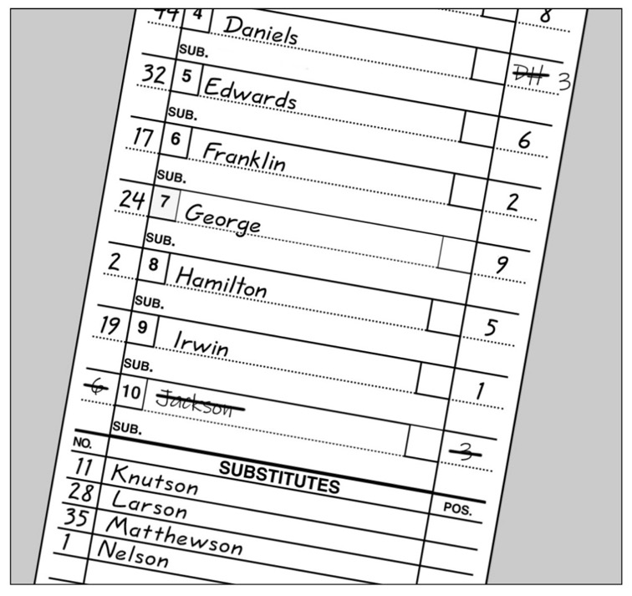
Designated hitter
Rule 3-1-4a2
While there is no change from the previous DH rule.
The role of a standard DH is still terminated for the remainder of the game when the designated hitter or any previous designated hitter assumes a defensive position.

Slide 12
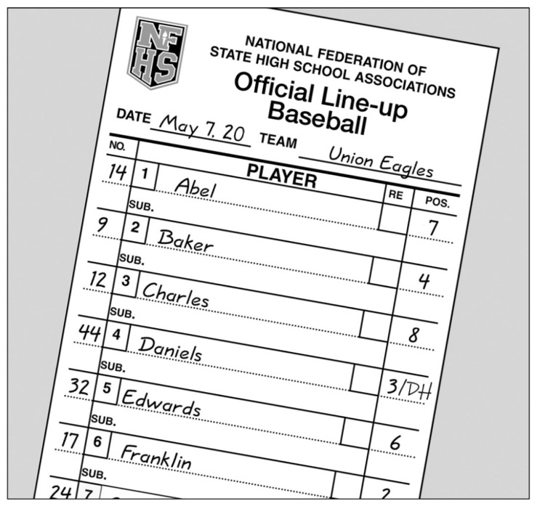
Designated hitter
Rule 3-1-4b
The starting designated hitter (DH) may now be any one of the starting defensive players, including the pitcher.
A Player/DH then holds two positions: defensive player and designated hitter.

Slide 13
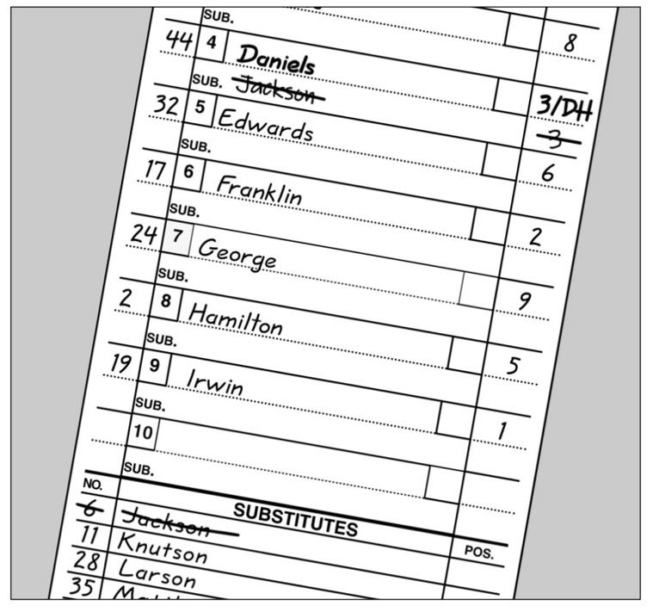
Designated hitter
Rule 3-1-4b
In the case where one player is listed as a starting DH and a starting defensive player in the lineup, the role of the defensive player may be substituted for by any legal substitute.
The original player/DH may re-enter defensively one time.

Slide 14
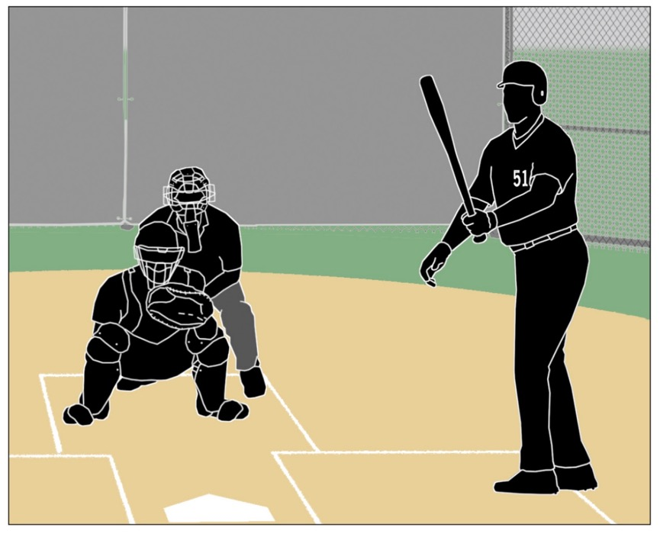
Designated hitter
Rule 3-1-4b-1
When using the P/DH, the role of the DH is terminated for the remainder of the game when any player substitutes offensively for the DH.

Slide 15
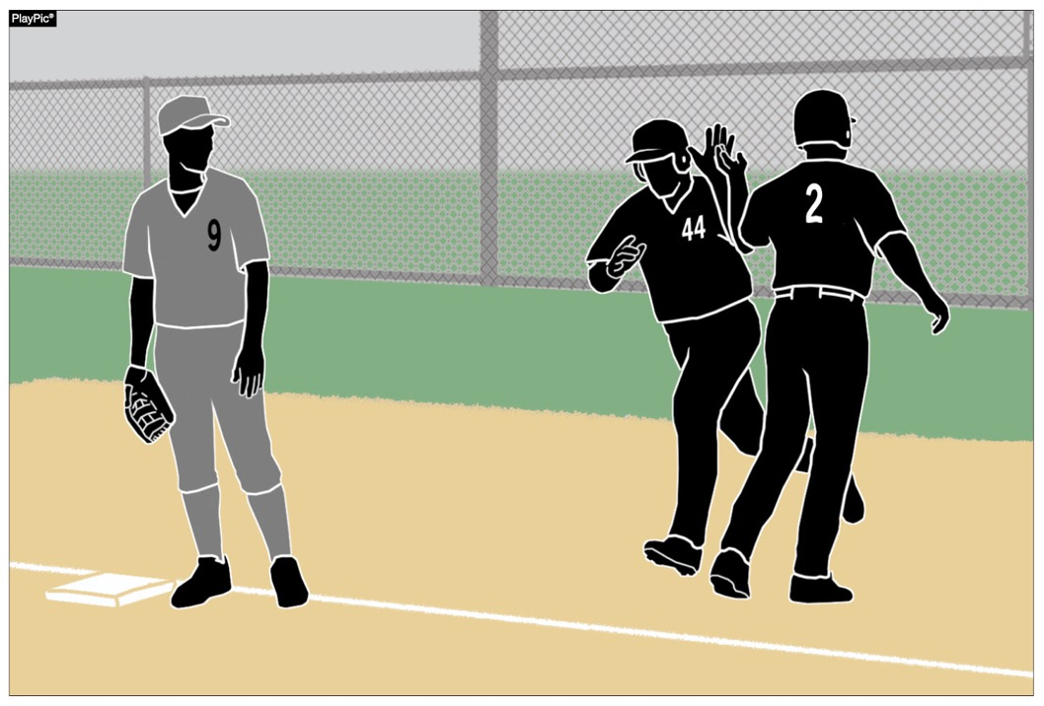
Designated hitter
Rule 3-1-4b-2
As a reminder from the previous rule, the role of the DH is terminated for the remainder of the game when the starting defensive Player/DH is substituted for either as a hitter or a runner.

Slide 16
Designated Hitter (DH)
Rule 3-1-4
ART. 4 . . . A hitter may be (not mandatory) designated for any one starting player (not just pitchers) and all subsequent substitutes for that player in the game. A starting defensive player cannot be listed as the designated hitter in the startup. A designated hitter for said player shall be selected prior to the start of the game, and his name shall be included on the lineup cards presented to the umpire-in-chief and to the official scorer.

Slide 17
Designated Hitter (DH)
Rule 3-1-4
A team forfeits the use of a designated hitter if it fails to declare a designated hitter prior to the game. If a pinch hitter or pinch runner for the designated hitter is used, that player becomes the new designated hitter. The player who was the designated hitter may re-enter as the designated hitter under the re-entry rule. A designated hitter and the player for whom he is batting are locked into the batting order. No multiple substitutions may be made that will alter the batting rotation.
Notes:
If a pinch hitter or pinch runner for the DH is used, that player becomes the new DH under the first option (the standard DH).

Slide 18
Designated Hitter (DH)
Rule 3-1-4
The role of the designated hitter is terminated for the remainder of the game when: A designated hitter may be used in one of the two scenarios:
a.The defensive player, or any previous defensive player for whom the designated hitter batted, subsequently bats, pinch-hits, or pinch-runs for the designated hitter; or
a. The designated hitter may be a tenth starter hitting for any one of the nine starting defensive players. If the designated hitter (DH) is used in this manner, the role of the DH is terminated for the remainder of the game when:

Slide 19
Designated Hitter (DH)
Rule 3-1-4
1. The defensive player, or any previous defensive player for whom the designated hitter batted, subsequently bats, pinch-hits, or pinch-runs for the designated hitter; or
2. The designated hitter or any previous designated hitter assumes a defensive position.

Slide 20
Designated Hitter (DH)
Rule 3-1-4
Rationale:
This rule change will provide coaches some options to strategize how to keep their better players in the game, to contribute to the offensive output of the team and give another player a chance to participate on defense. In addition, considering the pitch count rules, this change would help pitchers to keep their bat (because they are typically the best hitter) in the game, but can come out of the game to protect their arms from overuse.

Slide 21
Points of emphasis

Slide 22
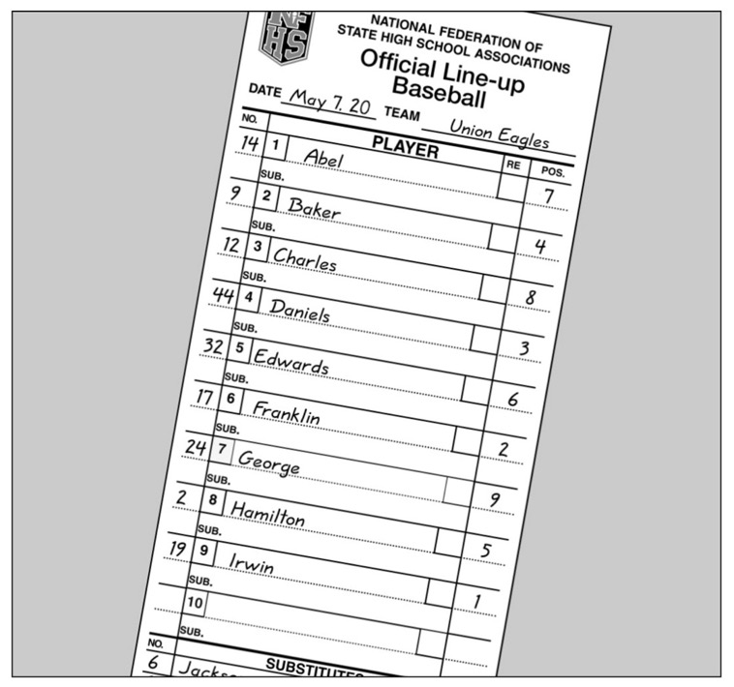
Designated hitter
There are now two options when using a designated hitter: the standard DH and the player/DH. Teams may also still choose to start the game without using a designated hitter (straight 9). All options must be declared prior to the start of the game.

Slide 23

Designated hitter
The courtesy runner (CR) can never have any function with a designated hitter (DH). When a DH comes to bat, he is a DH (regardless of either lineup option); when at bat, he can never assume a defensive position. As a result, a CR is never a legal substitute for a DH.

Slide 24
Designated hitter
If the DH is batting for another player, when he bats, he is a DH. As a result, if a runner comes in for him when he gets on base, it is a substitution, and that player is now the DH. If the DH is a Player/DH, he is batting as the DH. A substitution by an offensive player would eliminate the role of the DH.

Slide 25
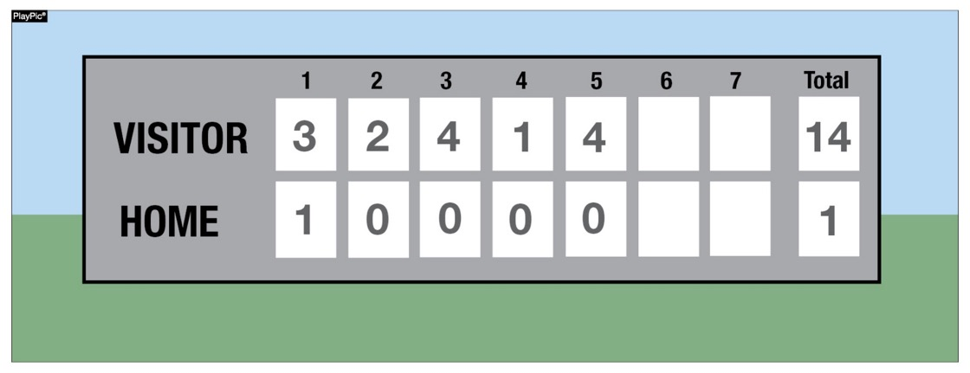
Game-ending procedures
A state association may adopt game-ending procedures that determine how games are ended, including suspended games. However, if a state does not adopt game-ending procedures, by mutual agreement of the opposing coaches and the umpire-in-chief, any remaining play may be shortened or the game terminated. If a state association has adopted game-ending procedures, only those game-ending procedures may be used, unless the opposing coaches wish to terminate the game (4-2-4).

Slide 26
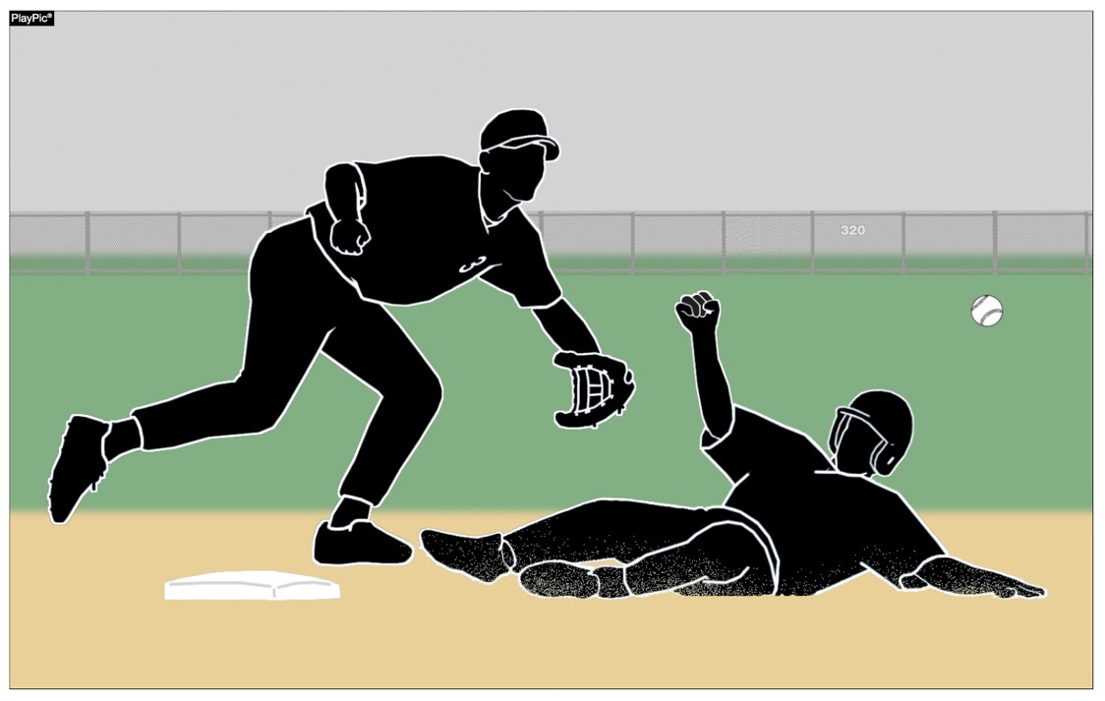
Force-play slide rule
Runners are never required to slide, but if a runner elects to slide at any base, it must be legal. A legal slide can either be feet first or head first. If a runner slides feet first, at least one leg and buttock shall be on the ground.

Slide 27
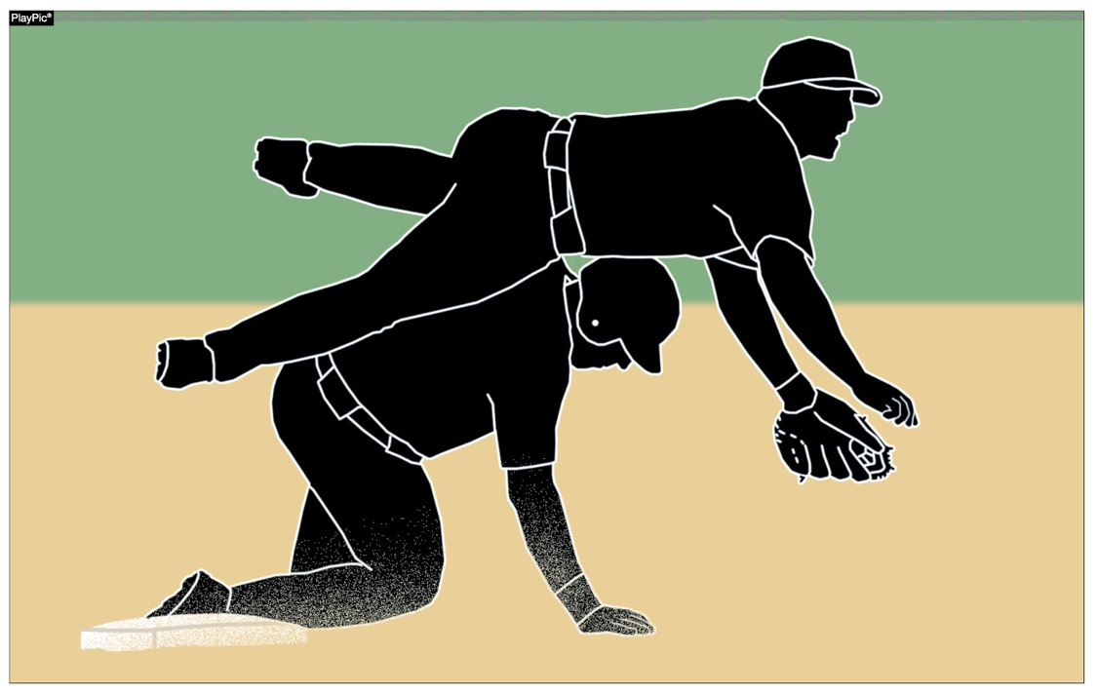
Force-play slide rule
Runners may not pop-up into the fielder.

Slide 28
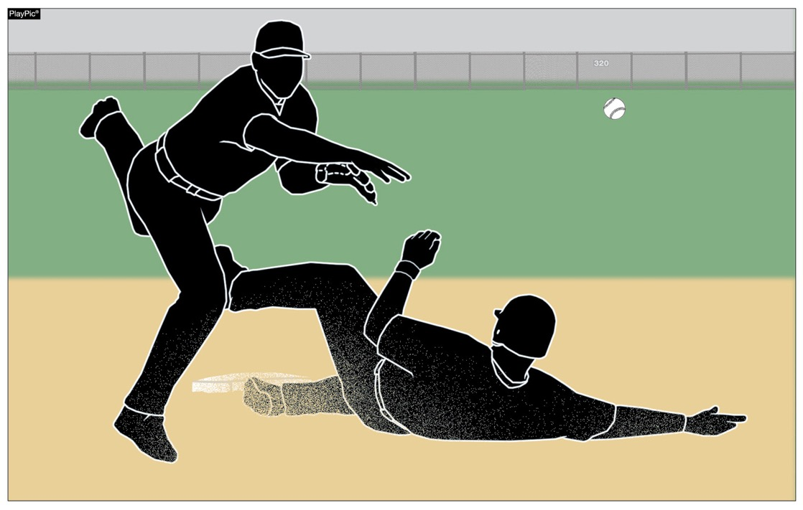
Force-play slide rule
Runners may not have a leg raised higher than the fielder’s knee.

Slide 29
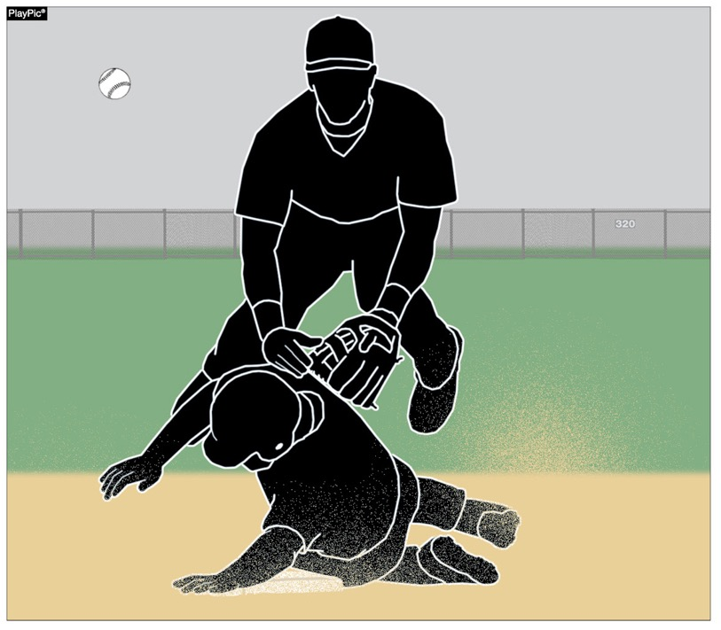
Force-play slide rule
Except at home plate, runners may not slide through or beyond the base.

Slide 30
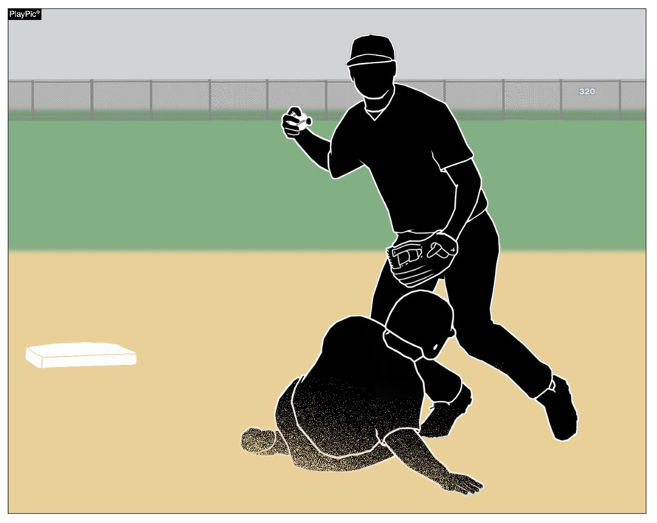
Force-play slide rule
Runners may not slide away from a base in the direction of the fielder. But a runner may slide in a direction away from a fielder to avoid making contact or altering the play of the fielder.

Slide 31
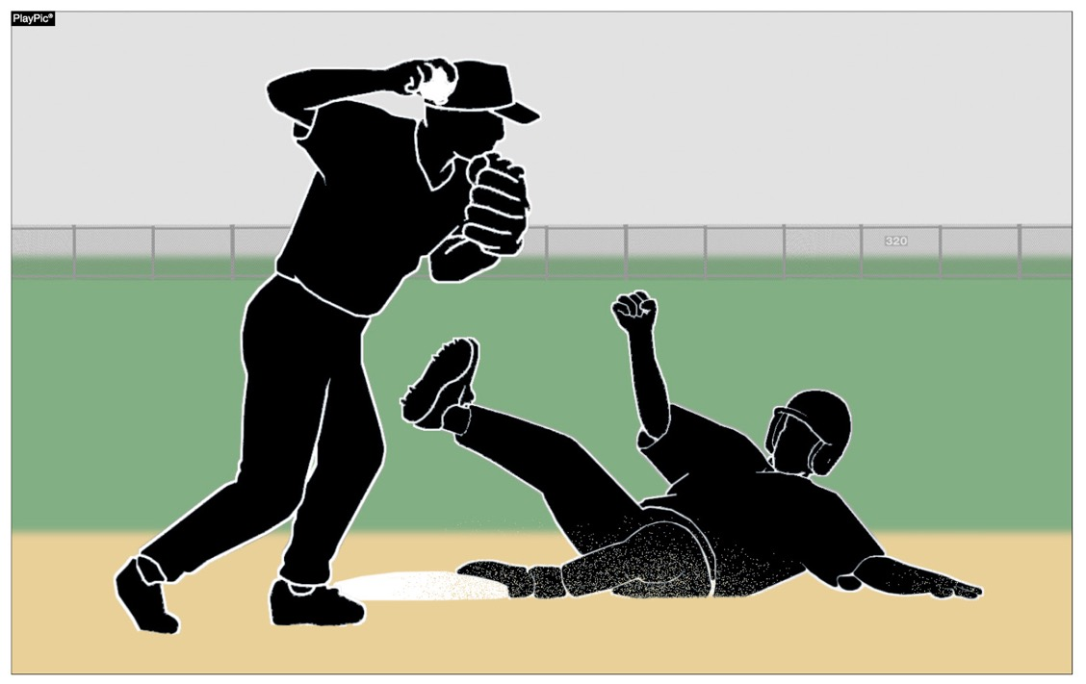
Force-play slide rule
The runner is out when he illegally slides. On a force play, the runner is also guilty of interference. The batter-runner is also declared out and all other runners must return to the base occupied at the time of the pitch.

Slide 32
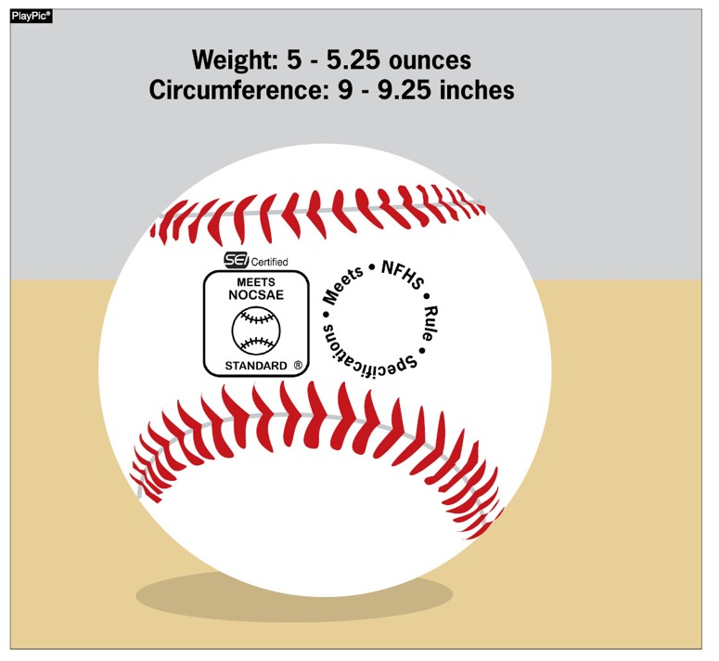
COMPLIANT BASEBALL
The ball shall meet the current NOCSAE standard for baseball effective January 1, 2020. The NFHS authentication mark and the NOCSAE mark shall both be visible on the ball.

Slide 33
Baseballs
Rule 1-3-1
Effective January 1, 2020 the SEI/NOCSAE mark is required on all baseballs that meet the NOCSAE standard that will be used in high school competition.
Baseballs shall have the SEI/NOCSAE mark along with the NFHS Authenticating Mark.
Rationale:
To maintain a consistent and uniform standard for high school competition. To ensure that every baseball manufactured meets the same level of quality and playability.

Slide 34
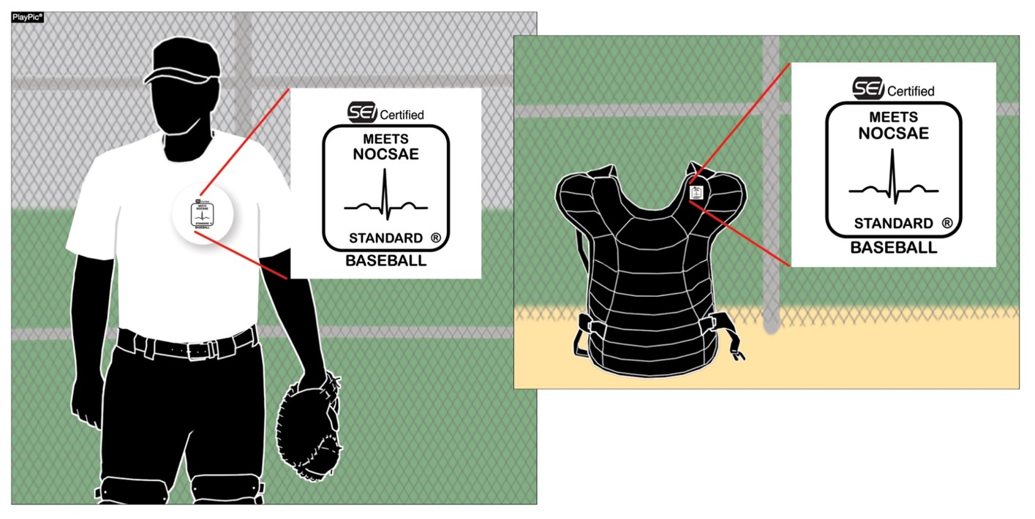
COMPLIANT BODY AND CHEST PROTECTOR
The catcher’s body/chest protector shall meet the NOCSAE standard effective Jan. 1, 2020.
Notes:
The compliant NOCSAE Body protector will have to be worn underneath the traditional chest protector.

Slide 35
Chest and body protector
Rule 1-5-3
The catcher shall wear, in addition to a head protector, a mask with a throat protector, body/chest protector that meets the NOCSAE standard at the time of manufacture (Effective January 1, 2020), protective cup (male only), and baseball protective shin guards. The SEI/NOCSAE mark is required on all body/chest protectors that meets the NOCSAE standard at the time of manufacture that will be used in high school competition.

Slide 36
Chest and body protector
Rule 1-5-3
Rationale:
A SEI/NOCSAE standard has been developed to protect the heart and the cardiac silhouette from commotio cordis. The NOCSAE standard could be included in a product that is either a separate device/apparel or a device constructed into a traditional chest protector. This proposal is recommended and endorsed by the NFHS Sports Medicine Advisory Committee (SMAC) to minimize risk. The catcher has to wear either a chest protector that meets the NOCSAE standard or a body protector that meets the NOCSAE standard underneath a traditional chest protector. It is the responsibility of the coach to verify that his/her players are properly equipped and in uniform.

Slide 37
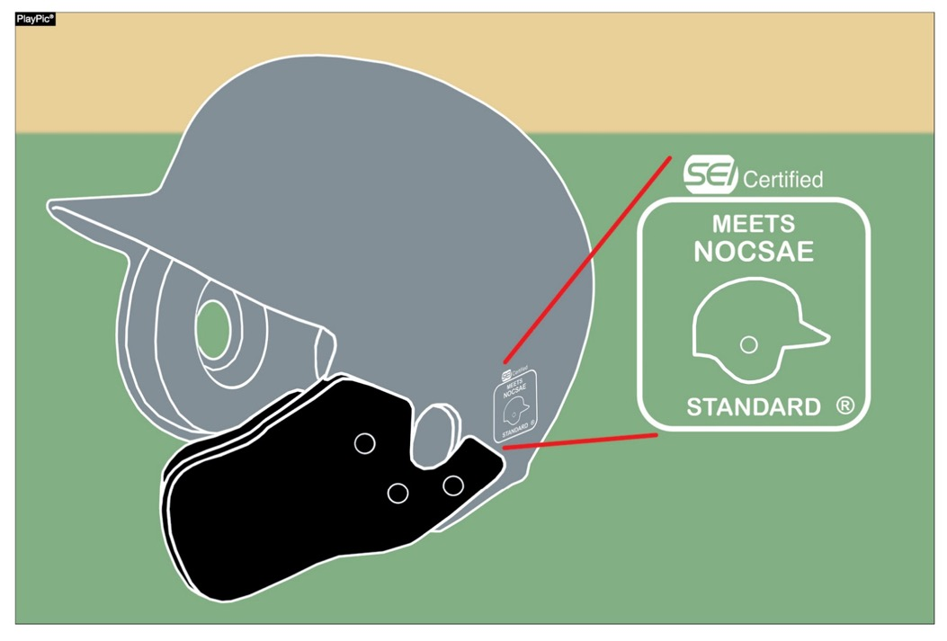
COMPLIANCE OF PLAYER EQUIPMENT
A face mask/guard specifically designed for a particular helmet model may be attached after manufacture, provided that procedure is approved by the manufacturer and meets the SEI/NOCSAE standard at the time of manufacture.
Notes:
Cheek and jaw protectors are allowed to be used on batting helmets.

Slide 38
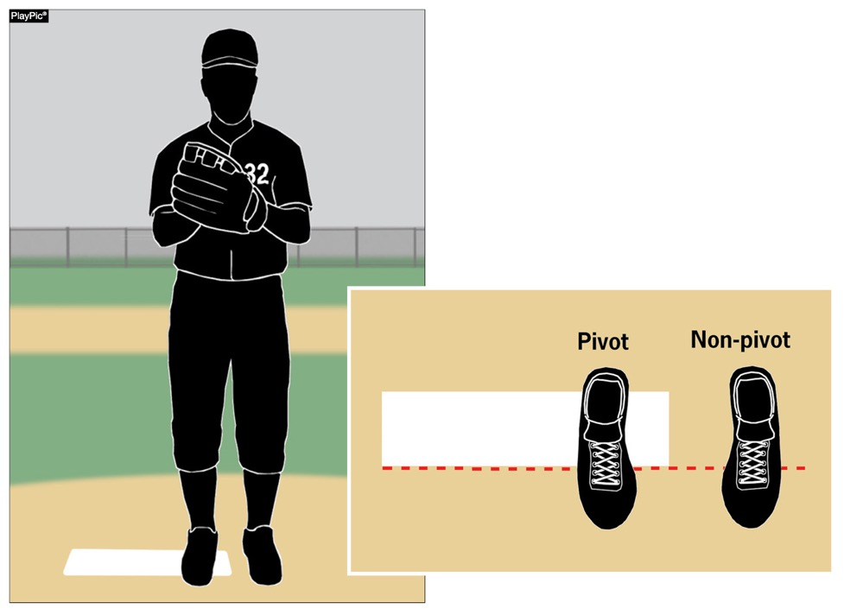
PROPER PITCHING POSITIONS
The windup is one of two legal pitching positions. For the windup, the pitcher’s non-pivot foot shall be in any position on or behind a line extending through the front edge of the pitcher’s plate.

Slide 39
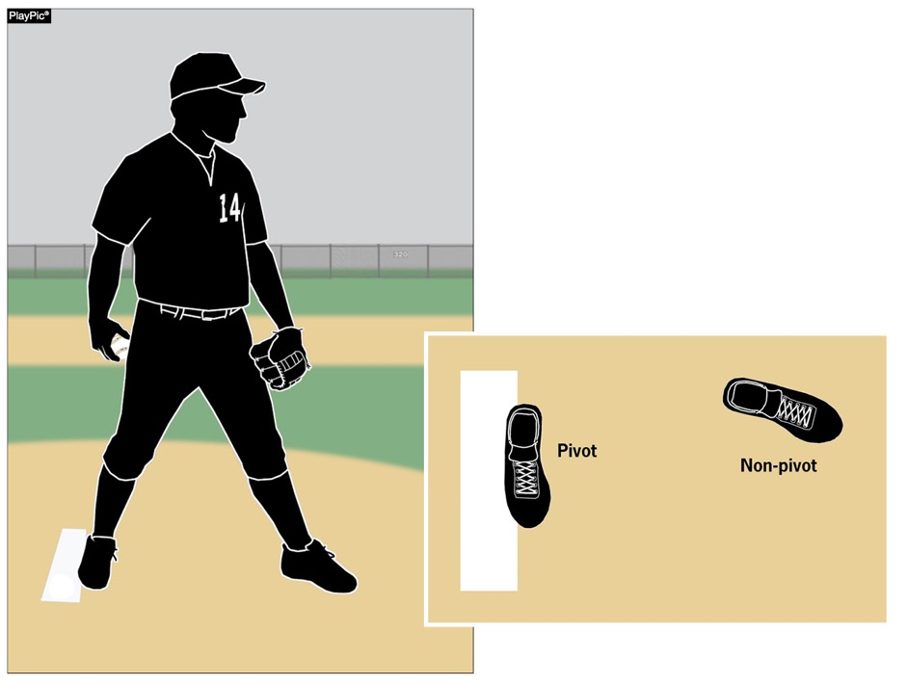
PROPER PITCHING POSITIONS
The set is one of two legal pitching positions. For the set position, a pitcher shall stand with his entire non-pivot foot in front of a line extending through the front edge of the pitcher’s plate and with his pivot foot in contact with or directly in front of and parallel to the pitcher’s plate.

Slide 40
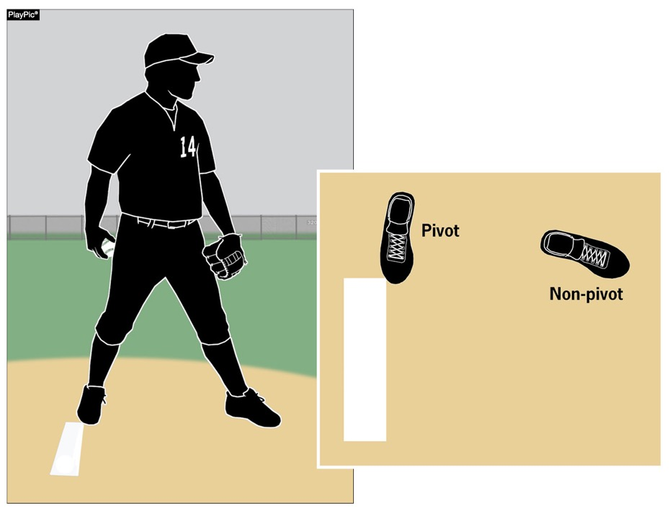
PROPER PITCHING POSITIONS
Pitchers are no longer required to have their entire pivot foot in contact with the pitcher’s plate. This recognizes that many mounds are such that it is problematic for the pitcher to have his entire pivot foot in contact with the pitcher’s plate.

Slide 41
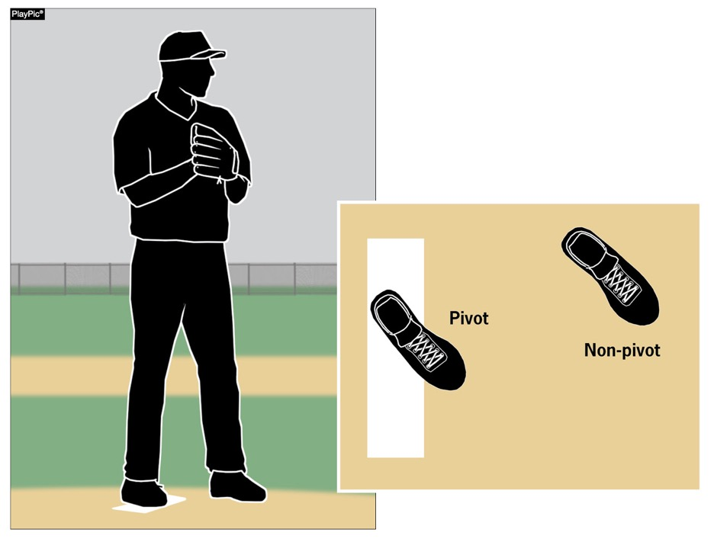
PROPER PITCHING POSITIONS
The so-called hybrid stance is illegal as it does not meet the requirements of either the windup or set positions.

Slide 42
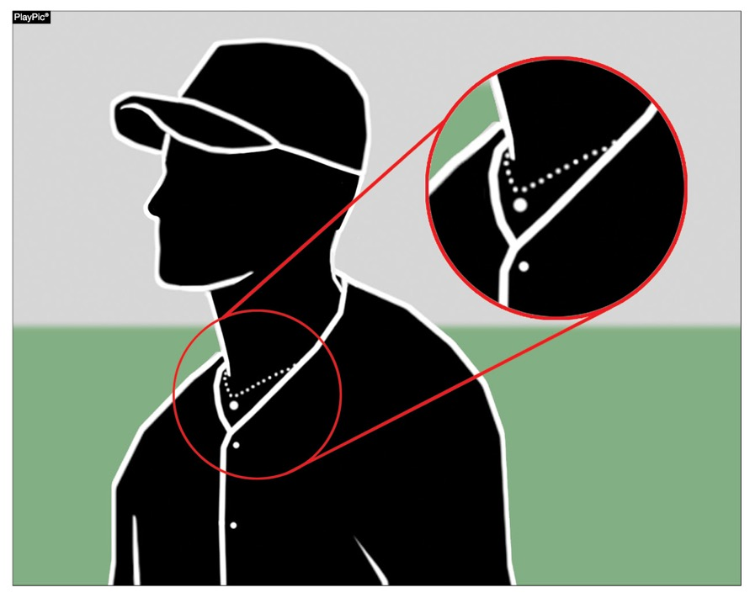
ENFORCEMENT OF nfhs JEWELRY RULE
Jewelry, including necklaces, bracelets and earrings, shall not be worn except for religious or medical medals. A religious medal must be taped and worn under the uniform. A medical alert must be taped and may be visible.

Slide 43
NFHS OFFICIALS and coaches Education

Slide 44

Nfhs learning center www.nfhslearn.com
Professional Development For ALL
  Coaches
  Officials
  Administrators
  Parents
  Students
  Performing Arts
Notes:
Digital platform for online professional development courses are available on www.nfhslearn.com.

Slide 45
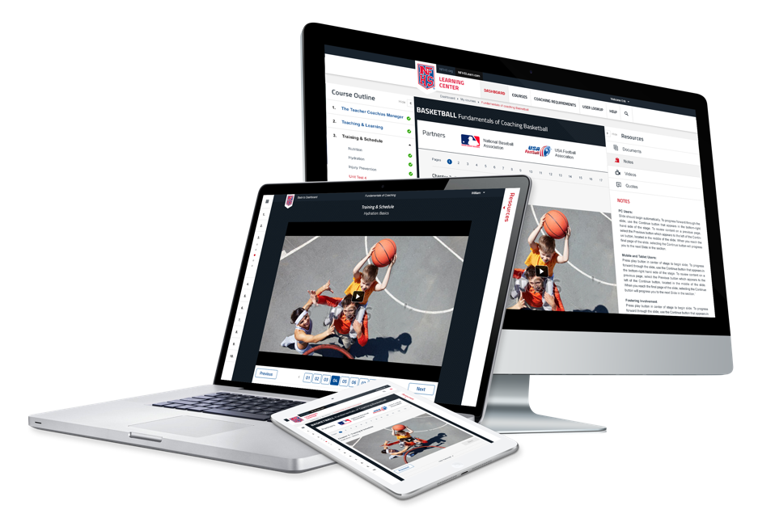
www.nfhslearn.com
FREE courses include:
  Bullying, Hazing and Inappropriate Behaviors
  Student Mental Health and Suicide Prevention
  Understanding Copyright and Compliance
  Protecting Students from Abuse
  Hazing Prevention for Students
  Coaching Unified Sports
  ACL Injury Prevention
  Sportsmanship
  And many more
Notes:
FREE courses include:
Bullying, Hazing and Inappropriate Behaviors
Student Mental Health and Suicide Prevention
Understanding Copyright and Compliance
Protecting Students from Abuse
Hazing Prevention for Students
Coaching Unified Sports
ACL Injury Prevention
Sportsmanship
And many more

Slide 46

NFHS Officials Association Central Hub
https://nfhs-baseball.arbitersports.com/front/105406/Site
Contains:
  Sport information
  Rules information
  Rules library
  Searchable rules book
  Video content on officiating sport, competition situations and interpretations
Notes:
State associations with 100% membership in the NFHS Officials Association and any individual member has access to the Central Hub for officials.

Slide 47
Thank you and have a great Baseball season!
National Federation of State High School Associations
PO Box 690 | Indianapolis, IN 46206
Phone: 317-972-6900 | Fax: 317.822.5700
www.nfhs.org | www

Slide 48
General Board Changes
2019-20

Slide 49
Gender of Player
A student may participate based on the gender noted on the student’s certificate of birth.
  Women shall not participate on a men’s interscholastic athletic team where the school has a women’s team in the same sport or where a school sends an entry to the women’s state playoffs in the same sport.
    In cases where women are permitted on a men’s team, the school forfeits all participation in the women’s playoffs in the same sport.
    Men’s rules will be used where women play on men’s teams.
    Men’s shall not participate on women’s team’s in any sport.

Slide 50
Gender of Player
When a student’s gender identity differs from the gender listed on the student’s certificate of birth, the Gender Identity Request Form must be submitted by the member school to the NCHSAA prior to any participation by the student under circumstances that would constitute ineligibility.
Notes:
The Request should be based on the gender identification of that student in current school records and daily life activities in the school and community.

Slide 51
Gender of Player
  The following information should be submitted with the Request:
    Documentation from individuals such as, but not limited to, parents/legal guardians appointed by a court of competent jurisdiction, friends, and/or teachers, which affirm that the actions, attitudes, and manner demonstrate the student’s consistent gender identification.
    A complete list of all the student’s prescribed, non-prescribed, or over the counter treatments or medications relative to gender identity.
    A complete list of interventions that have happened related to the gender identity of the student.
    Written verification from an appropriate healthcare professional (e.g. physician, psychiatrist, psychologist, school nurse, etc.) of the student’s consistent gender identification. Include any other social/emotional information from health-care professionals that would help the Committee make a decision about the student. This information must be submitted on office letterhead of the healthcare professional who provides verification with contact information and professional title of the individual.
    Any other pertinent documentation or information which the student or parent(s)/legal guardian(s) appointed by a court of competent jurisdiction believe relevant and appropriate.
Notes:
Requested Documentation:
-Affirmations that the actions, attitudes, and manner demonstrate the student’s consistent gender identification
-Complete list of treatments or medications relative to gender identity
-Complete list of interventions related to the gender identity of the student.
-Written verification from an appropriate healthcare professional of the student’s consistent gender identification.
-Any other pertinent documentation or information which the student or parent(s)/legal guardian(s) appointed by a court of competent jurisdiction believe relevant and appropriate.

Slide 52
Gender of Player
The NCHSAA will refer the Gender Identity Request to the NCHSAA Gender Identity Committee for consideration.
  The NCHSAA Gender Identity Committee will consist of the following:
    Current member of the Board of Directors;
    LEA or school administrator;
    Physician with experience in gender identity health care and/or World Professional Association of Transgender Health (WPATH) Standards of Care;
    Psychiatrist, psychologist, or licensed mental health professional familiar with the WPATH.
The Committee will approve the Request if it finds that the student genuinely identifies as the gender indicated in the Request.

Slide 53
Gender of Player
The Committee will require that the member school has verified that the student is eligible in all other aspects.
The Committee will respect and promote the student’s privacy and confidentiality rights under HIPPA and FERPA in the process of considering a Gender Identity Request. Information provided to the Committee will be shared only to the extent necessary to decide the Gender Identity Request; provided that, if a Gender Identity Request is approved, the student’s school may share the student’s gender identity with other schools as necessary to ensure appropriate accommodations when competing at another school.

Slide 54
Gender of Player
In cases where a Gender Identity Request has been approved:
  The student will be declared eligible to participate based on the student’s gender identity.
    1.2.4.a is not in effect.
  It shall be the responsibility of the school to comply with all state and federal mandates/laws.
Notes:
1.2.4.a is the “birth certificate rule”

Slide 55
Home School Participation
Initial Eligibility
Home school students
  Documentation from the Division of Non-Public Education must be presented upon initial dual enrollment- attendance, immunization, transcript, school number, etc.
  Home school students must communicate athletic intent at a member school in which they are domiciled and follow the enrollment and assignment procedures/policies established by the local board of education.
    Notice to principal must take place at least ten days prior to the first practice date of each sports season.

Slide 56
Home School Participation
Attendance
Home school students:
  Must have been enrolled in the registered home school for 365 days prior to being eligible in a member school.
  Once deemed eligible at a member school, the student must maintain continuous dual enrollment.
    Unenrollment would render the student ineligible for 365 days.
  Must participate in a class schedule that is at least one half of the school’s instructional day
    At least one class must be on campus each semester or meet LEA requirements.

Slide 57
Home School Participation
Scholastic Requirements:
A student must have passed a minimum load of work during the preceding semester to be eligible at any time during the present semester. The semester is normally considered half of the academic year. All students must also meet local promotion standards, set by the LEA and/or the local school. Home school students must be on grade level according to a nationally standardized achievement test(s) indicating grade level.
A minimum load is defined as five courses in the traditional school schedule and three courses for schools on the “block” format. If the school is on an A/B form of block scheduling, a student must pass six of eight courses during what would traditionally be defined as a semester. Any student, including seniors must pass that minimum load, even if they need fewer for graduation. Home school student must pass all public school courses in which he/she is enrolled.

Slide 58
Transfer Policy
Students transferring to the same member school where the student’s coach has relocated within a calendar year will be deemed ineligible in any sport in which the coach is involved.
  Now applies to within LEA as well as from LEA to LEA.
If deemed ineligible due to athletic purposes, the student will only be ineligible in that sport(s) in which “athletic purposes” was reason for not authorizing.

Slide 59
Foreign Exchange Students
  After the first year of participation as a Foreign Exchange Student
    Student can be eligible subsequently, based on the two-semester rule
      Applies to the same school of initial enrollment
Notes:
Previously Foreign Exchange Students were only eligible the first semester of residency in the United States through an approved program.

Slide 60
Ejection Policy
Clarified this policy:
  Leaving the bench and coming on to the playing area during a fight (whether they participate in the fight or not)
Notes:
Language has been cleaned up to match the penalty to alleviate any confusion.

Slide 61
Unpaid Fines
Unpaid fines will be posted for NCHSAA membership view only

Slide 62
Eligibility Summary Forms
Deadline Changes
  Fall – September 1
  Winter – December 1
  Spring – March 15

Slide 63
Post-Season Participation
Clarification:
  Independent NCHSAA member schools are eligible for post-season ONLY in individual sports, based on the sport.
Notes:
Clarifying language that independent NCHSAA member schools are not eligible for bracketed sports playoffs

Slide 64
Wilson Game Balls
2019-20
No change, required at State Championships
2020-21
Required use of the official and adopted Wilson game balls in ALL playoff events
Strongly recommend the use of the official and adopted Wilson game balls during the regular season
Notes:
Penalty to be assessed when official ball is not used in games
–Use of illegal equipment

Slide 65
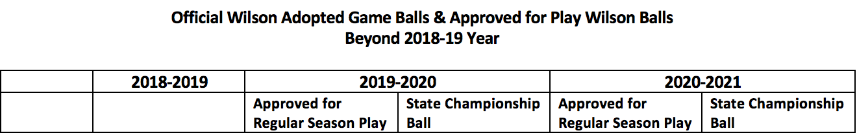
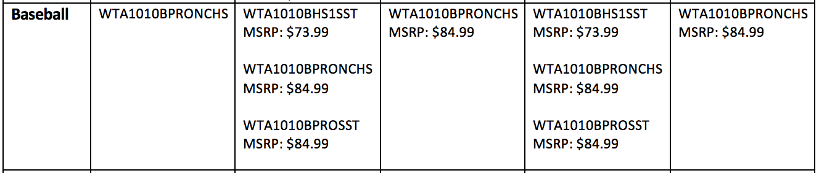
Wilson Game Balls
Notes:
Penalty to be assessed when official ball is not used in games
–Use of illegal equipment

Slide 66
Sport Specific Board Changes,
NCHSAA Points of Emphasis
&
Requested Topics by NCBCA
-Playoff Format Proposals
-Realignment/Rankings
2019-20

Slide 67
Game Length of Doubleheaders
State adoption to amend length of games
  By mutual agreement two member schools may agree to play two 5-inning games in a doubleheader

Slide 68
Required Coaches Education
NFHS Fundamentals of Coaching
  All coaches (paid and volunteer)
  Prior to first play date
  One-time requirement
NFHS Concussion in Sports
  All coaches (paid and volunteer)
  Prior to first practice
  Annual requirement
CPR/AED Certified
  All head and paid coaches
  Must maintain certification
NFHS Sudden Cardiac Arrest
  All non-paid coaches
  Prior to first practice
  Annual requirement
NCHSAA Rules Clinic
  Head Varsity Coach
  Prior to first play date
  Annual Requirement

Slide 69
Calendar
  Start: Wednesday, February 12
1st Contest: Monday, March 2
MaxPreps Entry Deadline: Saturday, May 9
11:59 p.m.
Seeding: Monday, May 11
Playoff Dates:
1st Round Tuesday, May 12
2nd Round Friday, May 15
3rd Round Tuesday, May 19
4th Round Friday, May 22
Regionals: Tuesday - Saturday, May 26 - 30
State Championships: Friday - Saturday, June 5 - 6
Notes:
Key Dates:
1st Practice - February 12
1st Contest - March 2
Last Play Date - May 9

Slide 70
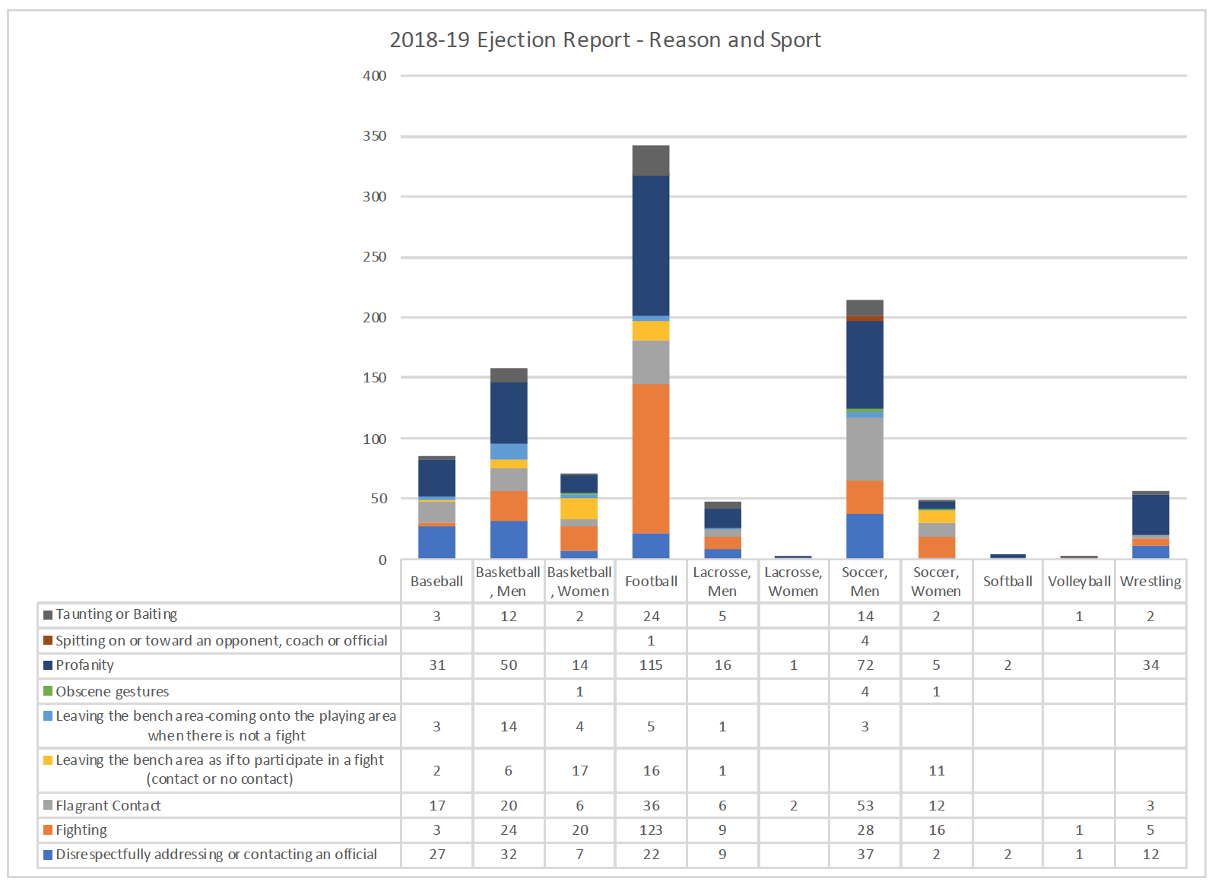
Sportsmanship/Ejections

Slide 71
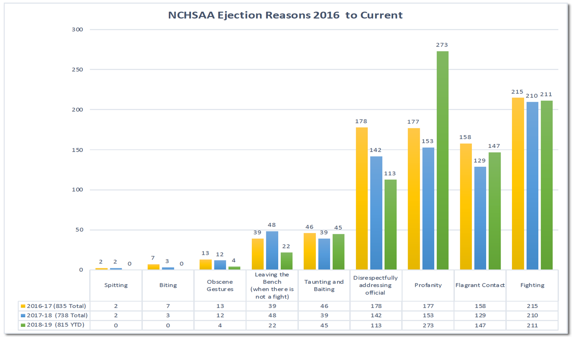
Sportsmanship/Ejections

Slide 72
17-18 Baseball Financial Report
Expenses
Game Expenses $ 17,481.96
  Facility
  Host School
  Awards
  Security/Medical
  Hospitality
  Officials, etc.
Team Expenses $ 23,628.30
  40% of Gate
  Travel
  Meals, etc.
Total Expenses $ 41,110.26
Revenue
Gate Receipts $ 42,512.00
Endowment $ (4,325.00)
Radio Fees $ 400.00
Total Receipts $ 38,587.00
Loss $2,523.26
Notes:
In an effort of continued transparency with the membership the men’s championships operated at loss of $ 2,523.26

Slide 73
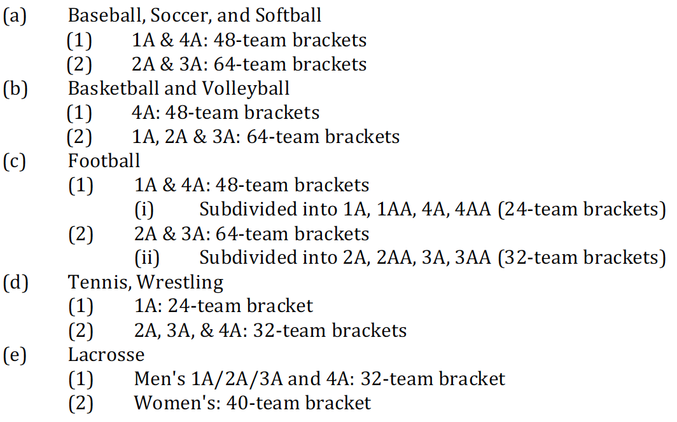
Playoffs/Seeding – Bracket Sizes
Notes:
Soccer:
-1A and 4A = 48-team brackets
-2A and 3A = 64-team brackets

Slide 74
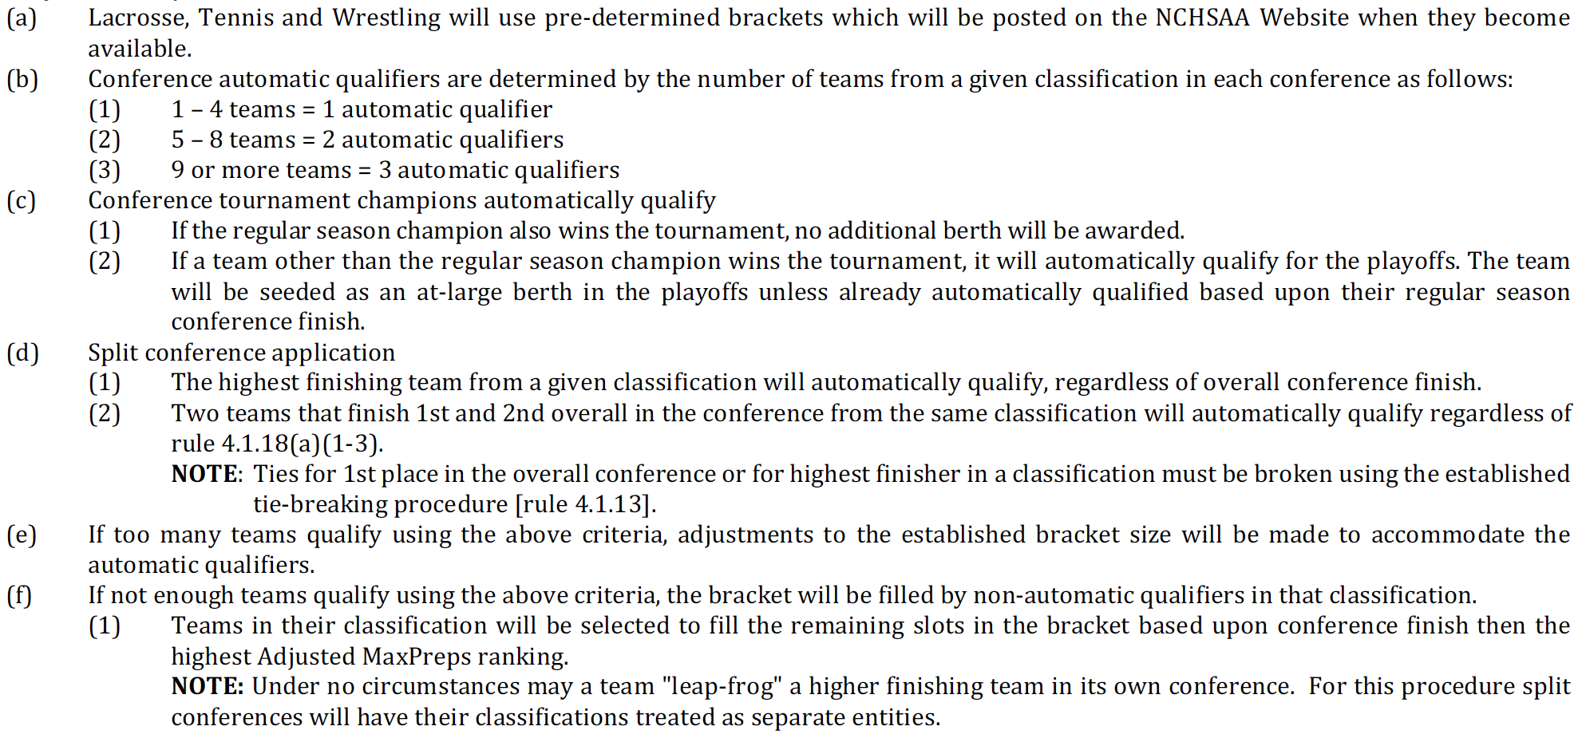
Playoffs/Seeding – Berths and Qualifications

Slide 75
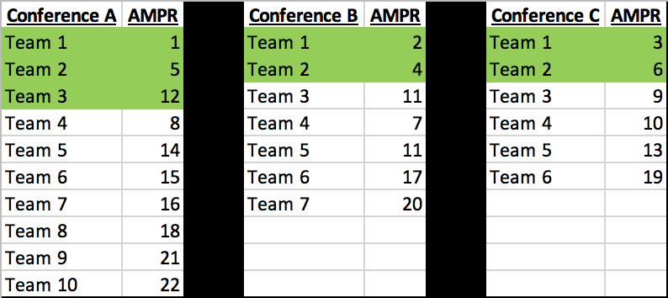
Green highlights = Automatic Qualifiers
The top non-automatic qualifiers from each conference are compared:
Team 4 Team 3 Team 3
Notes:
Leapfrog Example:
-Green highlighted teams are automatic qualifiers
-The top non-automatic qualifiers from each conference are compared (not the best Adjusted MaxPreps Ranking)
-Notice Conference B Team 4 (ADMR of 7) is not available because Team 3 finished ahead of them in the conference standings.
-Team 4 from Conference A is the first at-large qualifier because they have the best ADMR of the teams available to be compared

Slide 76
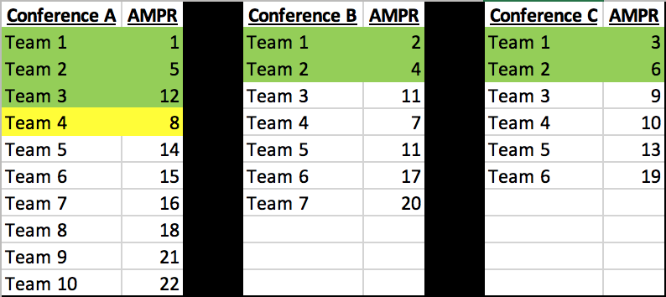
Green highlights = Automatic Qualifiers
The top non-automatic qualifiers from each conference are compared:
Team 5 Team 3 Team 3
Notes:
Now from left to right compare Team 5, Team 3 and Team 3
-Team 3 from Conference C is the next at-large qualifier because they have the best ADMR of the teams available to be compared

Slide 77
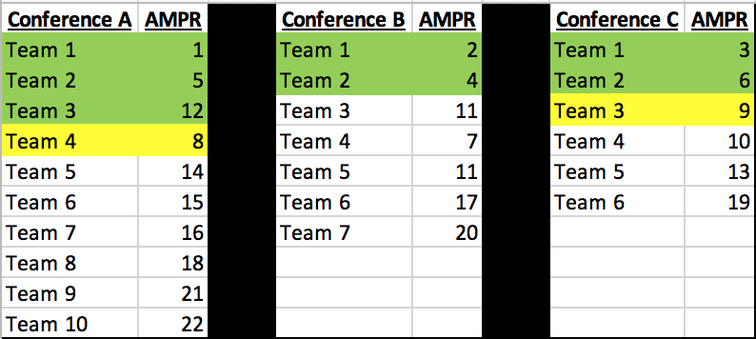
Green highlights = Automatic Qualifiers
The top non-automatic qualifiers from each conference are compared:
Team 5 Team 3 Team 4
Notes:
Now from left to right compare Team 5, Team 3 and Team 4
-Team 4 from Conference C is the next at-large qualifier because they have the best ADMR of the teams available to be compared

Slide 78
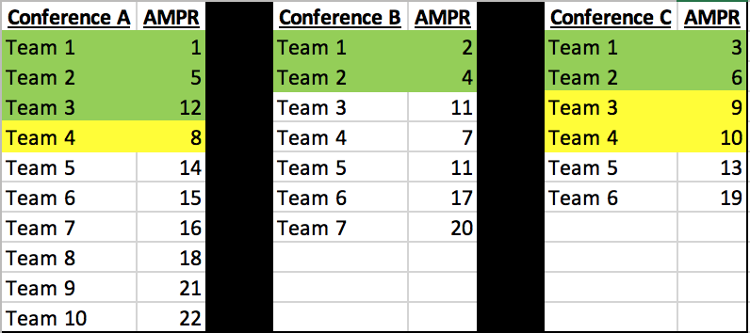
Green highlights = Automatic Qualifiers
The top non-automatic qualifiers from each conference are compared:
Team 5 Team 3 Team 5
Notes:
Now from left to right compare Team 5, Team 3 and Team 5
-Team 3 from Conference B is the next at-large qualifier because they have the best ADMR of the teams available to be compared

Slide 79
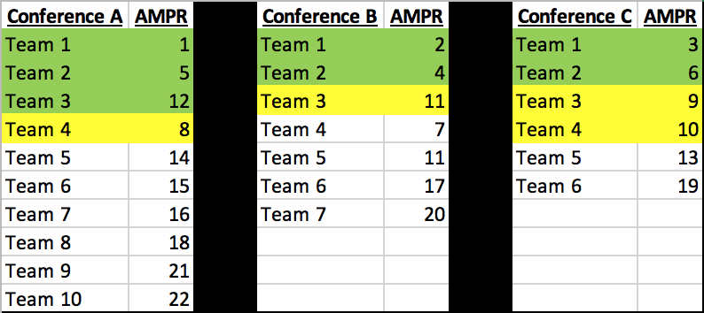
Green highlights = Automatic Qualifiers
The top non-automatic qualifiers from each conference are compared:
Team 5 Team 4 Team 5
Notes:
Now from left to right compare Team 5, Team 4 and Team 5
-Team 4 from Conference B is the next at-large qualifier because they have the best ADMR of the teams available to be compared

Slide 80
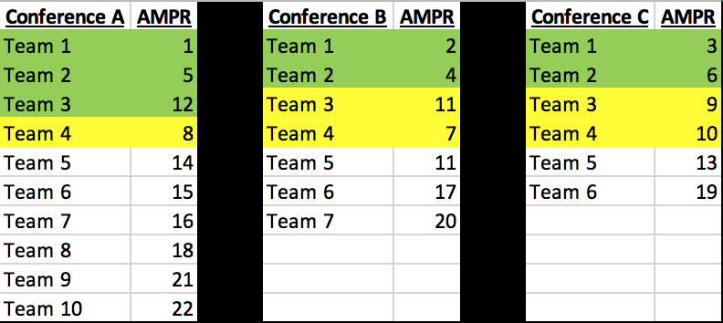
Notes:
Now from left to right compare Team 5, Team 5 and Team 5
-Team 5 from Conference B is the next at-large qualifier because they have the best ADMR of the teams available to be compared

Slide 81
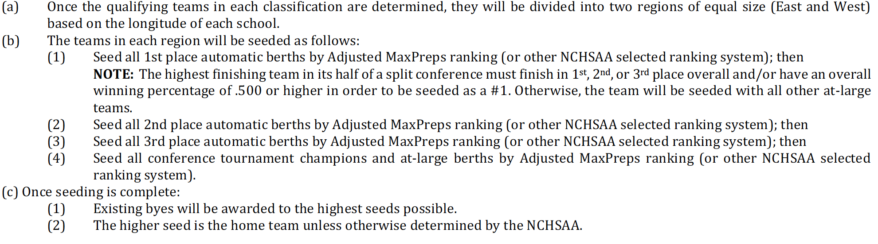
Playoffs/Seeding – Assigning Seeds

Slide 82
NCBCA Proposals
Spring 2019
  State Championship
    Thursday, Friday and Saturday
  Playoff Format 1
    Seed Wednesday
    Frist Round Friday
    4th Round Best of 3 Series
  Playoff Format 2
    First 3 Rounds week 1
      Tuesday, Thursday, Saturday
    4th Round Best of 3 Series

Slide 83
2021-2025 Realignment
The Board of Directors instructed NCHSAA Staff to delay the Realignment process by one year
  Eliminating the “lame duck year” of the alignment period
  Decision was to give various committees the opportunity to review the realignment process and the Association’s current classification structure while providing the necessary time for the Board and membership to make any necessary changes to implement their recommendations
Notes:
Important Notes:
-Realignment Committee and Board will seek input relative to classes, percentages, etc.
-Any deviation from 4 classes would require a NCHSAA Amendment change.
-Previous Realignment Committees researched 3, 4 and 5 classes with the help of SAS.

Slide 84
Rankings
MaxPreps
  Proprietary Formula
  Rankings FAQ
2019 Playoff History
  State Finalist finished 1 or 2 in conference standings
  State Finalist were all in top 25 of Adjusted MaxPreps Rankings

Slide 85
Thank You!
To receive clinic attendance credit:
  State Clinic
    Sign-in prior to leaving
  Coaches Clinic
    Pick-up your card as you leave today
      Enter your code immediately to get credit for attendance
        Mobile device or computer
        All fields required except comments box
        Use same email address that was used for NFHS Courses
      Deadline for entry is August 16, 2019.
      Avoid $400 fine for your school
  Online Clinic
    Print certificate and keep on file

