Slide 1


2019-20 NCHSAA Swimming and Diving Rules Clinic
Brad Alford
Director of Sports and Championships

Slide 2
2019-20 NFHS Swimming and diving Rules PowerPoint
Rules Changes
Major Editorial Changes
Points of Emphasis

Slide 3
2019-20 nfhs swimming and diving
Rule Changes

Slide 4
Uniforms
3-3-1, 3-3-2, 3-3-2 PENALTIES, 3-3-3, 3-3-3 and 3-3-4 PENALTIES
Rule 3-3 has been reorganized to identify penalties for specific uniform violations. No other changes were made to these rules.
Rule 3-3-1 recommends that all swimmers and divers wear suits of identical coloring and pattern.
Notes:
Rule 3-3 was reorganized to identify penalty protocol for specific uniform violations. No other changes were made to these rules.
Rule 3-3-1 recommends that all swimmers and divers wear suits of identical coloring and pattern.
Rationale: Specific rules related to suit coverage, what can be placed on the uniform, and suit construction have not changed. Penalties associated with violations of Rule 3-3 were simply reorganized to provide clear indication of when the coach and/or the competitor should be notified. All language concerning suit coverage was moved from 3-3-1 to 3-3-2. As a result, the new Rule 3-3-1 recommends, not mandates, that swimmers and divers wear suits of similar coloring and pattern.

Slide 5
Uniforms
3-3-1, 3-3-2, 3-3-2 PENALTIES, 3-3-3, 3-3-3 and 3-3-4 PENALTIES
Rule 3-3-2 contains all language addressing suit coverage:
Suits shall be of one piece;
A competitor shall not be permitted to participate wearing a suit that is not of decent appearance;
Boys shall wear suits which cover the buttocks and shall not extend above the waist or below the top of the kneecap;
Girls shall wear suits which cover the buttocks and breasts and shall not extend beyond the shoulders or below the top of the kneecap, nor cover the neck.
Notes:
Rule 3-3-2 contains all language addressing suit coverage:
Suits shall be of one piece;
A competitor shall not be permitted to participate wearing a suit that is not of decent appearance;
Boys shall wear suits which cover the buttocks and shall not extend above the waist or below the top of the kneecap;
Girls shall wear suits which cover the buttocks and breasts and shall not extend beyond the shoulders or below the top of the kneecap, nor cover the neck.
Rationale: All current language addressing suit coverage previously contained in Article 1 and 3 now resides in Rule 3-3-2, which applies to all swimmers and divers. Again, no language regarding uniform compliance was changed in Rule 3-3.

Slide 6
Uniforms
3-3-1, 3-3-2, 3-3-2 PENALTIES, 3-3-3, 3-3-3 and 3-3-4 PENALTIES
3-3-2 PENALTIES
When an official discovers a competitor wearing illegal attire as
described in Article 2, the official shall:
When observed prior to the start of the heat/dive, notify the coach of the competitor to make the swimsuit legal;
When observed after the heat/dive officially begins, disqualify the competitor at the completion of the heat/dive;
Notes:
3-3-2 PENALTIES
When an official discovers a competitor wearing illegal attire as described in Article 2, the official shall:
when observed prior to the start of the heat/dive, notify the coach of the competitor to make the swimsuit legal;
when observed after the heat/dive officially begins, disqualify the competitor at the completion of the heat;
Rationale: Penalties associated Rule 3-3-2 rule were reorganized to provide clear indication of when the coach should be notified. When a violation is observed before the start of the heat or dive, the official must notify the competitor’s coach, not the competitor. If the competitor cannot comply without delaying the start of the heat/ dive, the competitor is disqualified from that event/dive and shall not be eligible for further competition until in a legal suit. When a violation is observed after the heat or dive officially begins, the competitor is disqualified at the completion of the heat or dive, the competitor's performance time/score is nullified and he/she shall not be eligible for further competition until in a legal suit.

Slide 7
Uniforms
3-3-1, 3-3-2, 3-3-2 PENALTIES, 3-3-3, 3-3-3 and 3-3-4 PENALTIES
Rule 3-3-3 addresses information that can be placed on the suit or cap:
Competitor’s name, school name, school nickname or logo;
Advertising or name other than that permitted in 3-3-2c is prohibited;
Size of a single visible manufacturer’s logo/trademark/reference;
Size of one American flag or memorial patch;
The FINA mark and/or individual barcode.
Notes:
Rule 3-3-3 addresses information that can be placed on the suit or cap:
Competitor’s name, school name, school nickname or logo;
Advertising or name other than that permitted in 3-3-2c is prohibited;
Size of a single visible manufacturer’s logo/trademark/reference;
Size of one American flag or memorial patch;
The FINA mark and/or individual barcode.
Rationale: Specific rules related to what can be placed on the uniform are contained in Rule 3-3-3 and have not changed. School information, manufacturer’s logo size, and size of the American flag and/or the memorial patch are specified. Rule 3-3-3 applies to all competitors, meaning both swimmers and divers.

Slide 8
Uniforms
3-3-1, 3-3-2, 3-3-2 PENALTIES, 3-3-3, 3-3-3 and 3-3-4 PENALTIES
Rule 3-3-4 addresses suit construction for swimmers (excluding divers):
Constructed of a woven/knit textile material;
Must be permeable except for one post-construction, school name and/or logo not to exceed 9 square inches;
May not aid buoyancy;
May not have fastening systems other than a waist tie for a brief or jammer and elastic material in the terminal ends.
Notes:
Rule 3-3-4 addresses suit construction for swimmers (excluding divers):
Constructed of a woven/knit textile material;
Must be permeable except for one post-construction, school name and/or logo not to exceed 9 square inches;
May not aid buoyancy;
May not have fastening systems other than a waist tie for a brief or jammer and elastic material in the terminal ends.
Rationale: Specific rules related to suit construction for swimmers are contained in Rule 3-3-4 and have not changed. Suit construction rules regarding material, permeability, buoyancy or fastening systems are not applicable to suits for divers.

Slide 9
Uniforms
3-3-1, 3-3-2, 3-3-2 PENALTIES, 3-3-3, 3-3-3 and 3-3-4 PENALTIES
Rule 3-3-3 and 3-3-4 PENALTIES: When an official discovers a competitor wearing illegal attire as described in Articles 3 and 4, the official shall:
When observed prior to the start of the heat/dive, notify the coach or the competitor to make the swimsuit legal;
When observed after the heat/dive officially begins, disqualify the competitor at the completion of the heat;
Notes:
Rule 3-3-3 and 3-3-4 PENALTIES: When an official discovers a competitor wearing illegal attire as described in Articles 3 and 4, the official shall:
When observed prior to the start of the heat, notify the coach or the competitor to make the swimsuit legal;
When observed after the heat officially begins, disqualify the competitor at the completion of the heat;
Rationale: In situations which a violation of Rule 3-3-3 or 3-3-4 occurs, the official may notify the coach or the competitor. When a violation is observed prior to the start of the heat/dive, the official should notify the coach or the competitor to make the attire legal before becoming eligible to compete. If the competitor cannot comply without delaying the start of the heat/ dive, the competitor is disqualified from the event/dive and shall not be eligible for further competition until in legal attire. When a violation is observed after the heat/dive officially begins, the official shall disqualify the competitor at the completion of the heat/dive, nullify the competitor's performance time and he/she shall not be eligible for further competition until in legal attire.

Slide 10
Uniforms
3-3-1, 3-3-2, 3-3-2 PENALTIES, 3-3-3, 3-3-3 and 3-3-4 PENALTIES
The remaining articles have been renumbered:
Rule 3-3-5 addresses speed, buoyancy, body compression and adhesives.
Rule 3-3-6 requires coaches to verify that all competitors are legally attired.
Notes:
The remaining articles have been renumbered:
Rule 3-3-5 addresses speed, buoyancy, body compression, adhesives.
Rule 3-3-6 requires coaches to verify that all competitors are legally attired.
Rationale: Rule 3-3-5 and 3-3-6 were renumbered and no changes were made to this language.

Slide 11
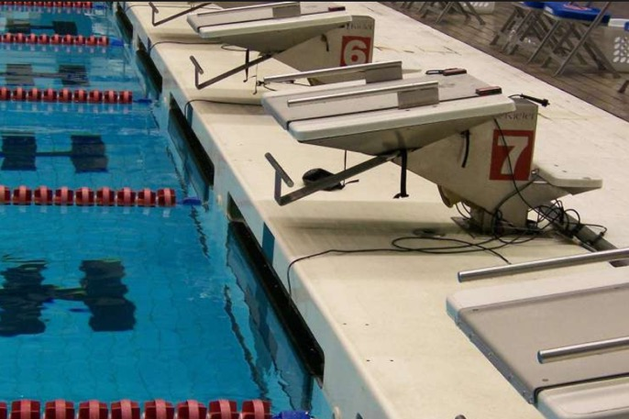

finishes
8-1-7, 8-2-1g, 8-2-2h, 8-2-3g, 8-2-4e
Rule 8-1-7: To finish the race, the swimmer shall contact the finish end in the manner prescribed by the stroke.
Notes:
Rule 8-1-7: To finish the race, the swimmer shall contact the finish end in the manner prescribed by the stroke.
Rationale: Previous language requiring the competitor to contact the touchpad or end wall between the lane lines where the touch pad should be located when in the proper position was removed. A legal finish now requires the competitor to contact either the touchpad or the finish end according to the finish rules pertaining to the stroke being swum. The rule no longer requires the touchpad to be contacted when electronic timing is used, provided the competitor contacts the finish wall as prescribed by the rules applicable to that stroke.

Slide 12
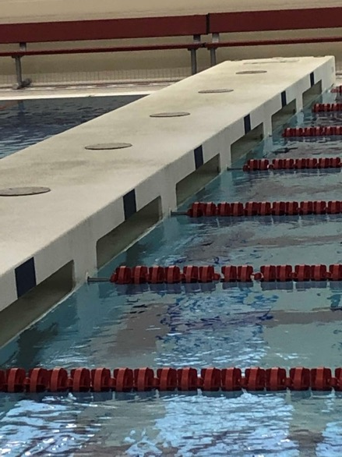
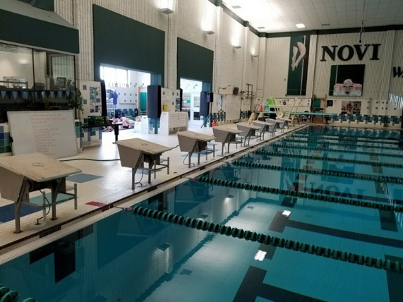
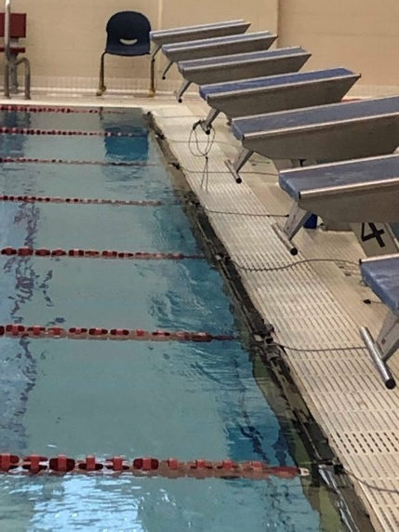
finishes
8-1-7, 8-2-1g, 8-2-2h, 8-2-3g, 8-2-4e
Rule 1-1-1: The end walls are the walls perpendicular to the race course.
Notes:
Rule 1-1-1: The end walls are the walls perpendicular to the race course.
Rationale: When competitor makes contact with the touchpad or end wall in accordance with the requirements of the stroke being swum, the race is completed. Contact with the end wall is interpreted as contact with any structure at the end of the course (deck wall above the gutter, starting block, back of the gutter). There are a variety of pool configurations, and end walls. If some part of the end wall is contacted, and the touchpad is not activated, timers should use backup watch times. Timers shall not stop their watches until the competitor touches the touchpad, end wall or any solid structure at the end of the course.
Use backup times:
A swimmer touches a non-sensitive area of the touchpad
A swimmer touches the touchpad but not hard enough to activate the touchpad
A swimmer misses the touchpad but touches the end wall in accordance with the stroke
A swimmer touches the end wall above the gutter and touchpad
A swimmer touches the starting block wall above the gutter and touchpad
A backstroke swimmer finishes in the recessed portion of the gutter

Slide 13
finishes
8-1-7, 8-2-1g, 8-2-2h, 8-2-3g, 8-2-4e
Rule 8-2-1g
The backstroke finish requires completion of the required distance
and contact with the touchpad or finish end by any part of the
swimmer with some part of the body at or above the surface.
Rule 8-2-2h
The breaststroke finish requires completion of the required distance and contact with the touchpad or finish end with both hands simultaneously, not necessarily on the same plane.
Notes:
Rule 8-2-1g
The backstroke finish requires completion of the required distance and contact with the touchpad or finish end by any part of the swimmer with some part of
the body at or above the surface.
Rule 8-2-2h
The breaststroke finish requires completion of the required distance and contact with the touchpad or finish end with both hands simultaneously, not necessarily on the same plane.
Rationale: Competitors are required to make contact with the touchpad or finish end in the manner prescribed by the stroke being swum. For example, In the backstroke, the competitor shall remain on the back during the finish.

Slide 14
finishes
8-1-7, 8-2-1g, 8-2-2h, 8-2-3g, 8-2-4e
Rule 8-2-3g
The butterfly finish requires completion of the required distance and contact with the touchpad or finish end with both hands simultaneously, not necessarily on the same plane.
Rule 8-2-4e
The freestyle finish requires completion of the required distance and contact with the touchpad or the finish end by any part of the swimmer.
Notes:
Rule 8-2-3g
The butterfly finish requires completion of the required distance and contact with the touchpad or finish end with both hands simultaneously, not necessarily on the same plane.
Rule 8-2-4e
The freestyle finish requires completion of the required distance and contact with the touchpad or the finish end by any part of the swimmer.
Rationale: Again, in the butterfly and the freestyle, competitors are required to make contact with the touchpad or finish end. All specific rules applicable to the stroke being swum must be adhered to.

Slide 15
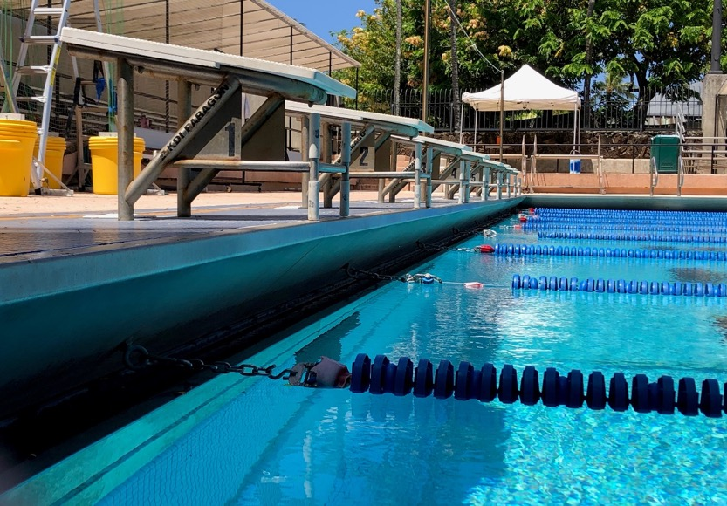
finishes
8-1-7, 8-2-1g, 8-2-2h, 8-2-3g, 8-2-4e, 8-3-5
Rule 8-3-5: Each swimmer of a
relay team must contact the
finish end at the conclusion of
his or her leg of the relay in
accordance with the finish rule
applicable to the stroke being
swum.
Notes:
Rule 8-3-5: Each swimmer of a relay team must contact the finish end at the conclusion of his or her leg of the relay in accordance with the finish rule applicable to the stroke being swum.
Rationale: Language requiring only the final swimmer to contact the touchpad was removed. The wording was amended to be consistent with the changes to Rule 8-1-7 and requires each swimmer to contact the finish end at the conclusion of his or her leg in accordance with the finish rule applicable to the stroke being swum. Relay takeoff judges will need to be aware that the incoming swimmer has finished his/her leg when ANY structural part of the end of the pool (including starting blocks) is contacted, and the release of the next swimmer must be assessed in that framework. If relay judging equipment is being utilized, there will be no viable data available unless the incoming swimmer activates the touchpad on each exchange.

Slide 16
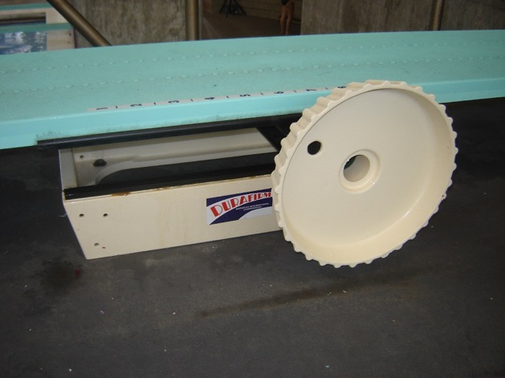
The pool, board and equipment
9-1-3
A fulcrum, which can be moved
and set at varying positions between
5 feet 1 inch and 7 feet 6 inches
(1.549 m and 2.286 m) from the rear
of the diving board, is required.
Notes:
A fulcrum, which can be moved and set at varying positions between 5 feet 1 inch and 7 feet 6 inches (1.549 m and 2.286 m) from the rear of the diving board, is required.
Rational: The change expands the range of where the fulcrum can be set, from 5 feet 1 inch to 7 feet 6 inches. These measurements aligns with current diving board manufacturers’ installation directions. The rule was updated to comply with current industry standards.

Slide 17
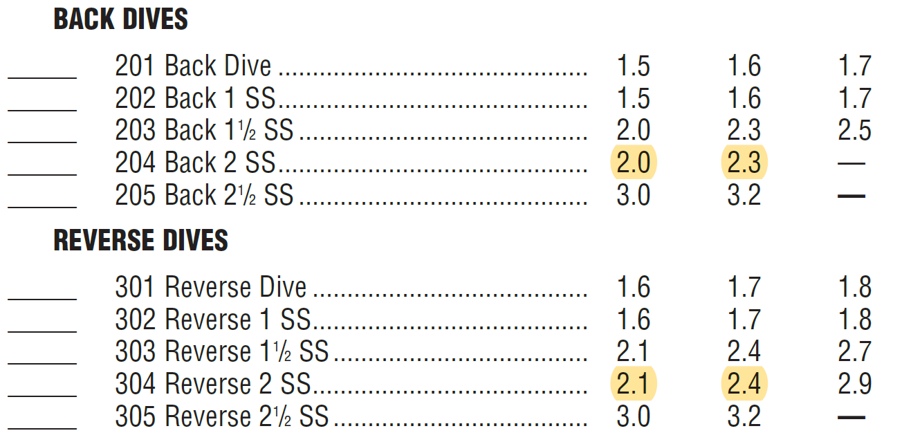
Choice of dives
9-4 Table
The degree of difficulty of four dives has been changed:
Notes:
The degree of difficulty of four dives has been changed:
Rationale: This change provides consistency of degree of difficulties assessed to back and reverse dives (head first entries) versus back and reverse somersaults (feet first entries). The degree of difficulty for back and reverse double somersaults was lowered to match back and reverse 1½ somersaults.
Because this is a change from current FINA degree of difficulty assessments, meet management is advised to edit diving software programs relative to these changes so that the correct degree of difficulty is applied when computer software is utilized to conduct a meet.

Slide 18
Form of the dives
9-5-6
The flight shall be either in the:
straight position where the body shall not be bent either at the knees or hips. The feet shall be together and the toes pointed. The position of the arms is at the option of the diver;
pike position in which the body shall be bent at the hips, the legs must be kept straight at the knees, the feet shall be together, and the toes pointed. The position of the arms is at the option of the diver;
tuck position in which the body shall be compact, is bent at the knees and hips with the knees and feet close together within the bodyline of the shoulders. The hands shall be on the lower legs and the toes pointed;
free position in which a combination of positions may be used to perform twisting dives.
Notes:
The flight shall be either in the:
a. straight position where the body shall not be bent either at the knees or hips. The feet shall be together and the toes pointed. The position of the arms is at
the option of the diver;
b. pike position in which the body shall be bent at the hips, the legs must be kept straight at the knees, the feet shall be together, and the toes pointed. The
position of the arms is at the option of the diver;
c. tuck position in which the body shall be compact, is bent at the knees and hips with the knees and feet close together within the bodyline of the shoulders.
The hands shall be on the lower legs and the toes pointed;
d. free position in which a combination of positions may be used to perform twisting dives.
Rationale: Diving descriptions were adjusted to maintain consistency with national trends. The language has been updated to clarify requirements of the straight, pike, tuck, and free positions.

Slide 19
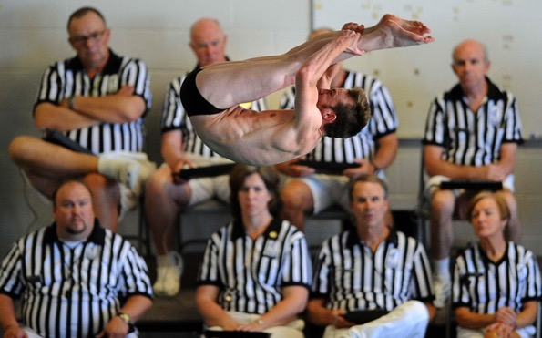
Awarding points
9-7-4 note
A dive is unsatisfactory if, in the diving referee's opinion:
NOTE: In a championship meet, the diving referee may consult
with a designated member of the judging panel concerning a
possible unsatisfactory dive.
Notes:
A dive is unsatisfactory if, in the diving referee's opinion:
NOTE: In a championship meet, the diving referee may consult with a designated member of the judging panel concerning a possible unsatisfactory dive.
Rationale: The addition of the NOTE is consistent with the diving referee’s capability of consulting with a designated member of the judging panel concerning a possible failed dive. Now the diving referee may confer with said member regarding an unsatisfactory dive. Use of another perspective is appropriate because the penalty for an unsatisfactory dive is severe. Often, judges are not able to be positioned so that all have an ideal view of the diver’s performance.

Slide 20
2019-20 nfhs swimming and diving
Major Editorial Changes

Slide 21
Authorized officials
4-1-2
In championship meets multi-team meets, a meet committee and a meet director shall assume responsibility for all aspects of meet management. The meet committee shall make decisions on matters not specifically covered by the rules or on the misapplication of a rule during a meet. Judgment calls of officials are not subject to review by this committee. The decisions of the meet committee are final.
Notes:
In championship meets multi-team meets, a meet committee and a meet director shall assume responsibility for all aspects of meet management. The meet committee shall make decisions on matters not specifically covered by the rules or on the misapplication of a rule during a meet. Judgment calls of officials are not subject to review by this committee. The decisions of the meet committee are final.
Rationale: The editorial change clarifies that a meet committee and meet director are only required for championship meets. Other meets are administered by the referee or other officials appropriate to the type of meet.

Slide 22
The referee
4-2-2e
During the meet, the responsibilities of the referee are to:
Notify the competitor's coach of an observed violation of 3-3-2 3-3-5
during competition. This may be accomplished with a verbal
announcement if the competitor's coach cannot be reached without
delay of the meet.
Notes:
During the meet, the responsibilities of the referee are to:
Notify the competitor's coach of an observed violation of 3-3-2 during competition. This may be accomplished with a verbal announcement if the competitor’s coach cannot be reached without delay of the meet.
Rationale: The change in rule reference was a result of the change to Rule 3-3.

Slide 23
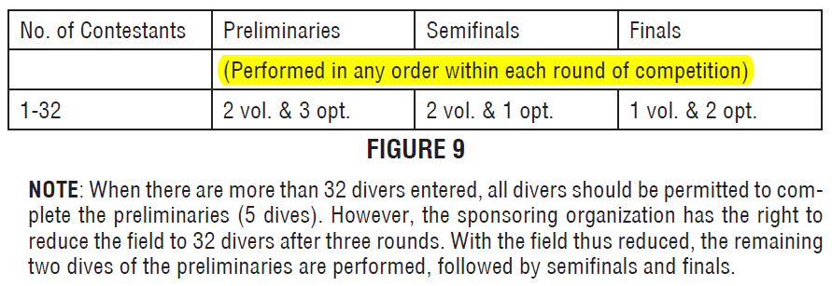
Choice of dives
9-4-1d Table
A row in the Figure 9 Table was omitted from the previous rule book and has been reinserted to Rule 9-4-1d.
Notes:
A row in the Figure 9 Table was omitted from the previous rule book and has been reinserted to Rule 9-4-1d.
Rationale: The middle row was omitted from the hard copy of the 2018-19 NFHS Swimming and Diving Rules Book. It depicts when voluntary and optional dives must be performed during the preliminary, semi-final, and final round of an eleven-dive meet. It has been reinserted.

Slide 24
2019-20 nfhs swimming and diving
Points of Emphasis

Slide 25
preventing shallow water blackout
How to Avoid Shallow Water Blackout
Never hyperventilate
Never ignore the urge to breathe
Never swim alone
Never play breath holding games
No repetitive underwater laps
Notes:
How to Avoid Shallow Water Blackout
Never hyperventilate
Never ignore the urge to breathe
Never swim alone
Never play breath holding games
No repetitive underwater laps
Rationale: The rules for NFHS swimming and diving exist to ensure fair competition in a positive, safe and healthy environment. Consequently, the NFHS Swimming and Diving Rules Committee recognizes concerns that have been raised over instances of shallow water blackout, otherwise known as hypoxic blackout, which can affect swimmers of all experience levels. Shallow water blackout is a potentially fatal condition that causes a swimmer to lose consciousness while under water. Shallow water blackout can be prevented through education, awareness, and understanding of the dangers of breath-holding. For further information, visit shallowwaterblackoutprevention.org.

Slide 26
suit coverage
Suit Coverage:
Continues to be a focus;
Language addressing coverage and the protocol for addressing violations has been reorganized in the rules book;
Pre-meet coaches and athlete meetings requires the coach to verify that his/her athletes are properly and legally equipped;
Recommend that school administrators and coaches address suit coverage with parents and athletes during their pre-season meetings.
Notes:
Suit Coverage:
Continues to be a focus of administrators, coaches, and officials, and competitors;
Language addressing coverage and the protocol for addressing violations has been reorganized in the rules book;
Pre-meet coaches and athlete meetings requires the coach to verify that his/her athletes are properly and legally equipped;
It is recommended that school administrators and coaches address suit coverage with parents and athletes during their pre-season meetings.
Rationale: Suit coverage continues to be a focus of administrators, coaches, and officials, and competitors. While the rule itself has not changed, language addressing coverage and the protocol for addressing violations has been reorganized in the rules book. In addition, pre-meet coaches and athlete meetings have been mandated, which is an opportunity for the coach to verify that his/her athletes are properly and legally equipped AND an opportunity for captains/peers to consult with their teammates to assure suits and caps meet rule guidelines. It is recommended that coaches address suit coverage with parents and athletes during their pre-season meetings, to specify that suits should be worn as the manufacturer has intended and that athletes purchasing personal suits for competition only obtain suits that comply with NFHS rules regarding appropriate coverage as well as design and decoration.

Slide 27
Accommodations for students with a disability
Accommodations for Students With a Disability Updates:
Updated language for hearing and visual impairments;
Updated images of official’s signals for forward and backstroke starts;
Updated images of modified starting positions;
Available in the 2019 NFHS Swimming Officials Guidelines Manual.
Notes:
Accommodations for Students With a Disability Updates
Updated language for hearing and visual impairments;
Updated images of official’s signals for forward and backstroke starts;
Updated images of modified starting positions;
Available in the 2019 NFHS Swimming Officials Guidelines Manual.
Rationale: Language and officials signals regarding the inclusion of students with a disability have been updated and will be available in the 2019 NFHS Swimming Officials Guidelines Manual. Included are updated images of officials signals for the forward and backstroke start as well as images for modified starting positions. Specific accommodations for visually impaired and hearing-impaired competitors are also provided in this publication.

Slide 28
sub-varsity competition
State associations may modify events and distances for non-varsity competition.
NFHS playing rules are written specifically for varsity competition.
Modifications for levels other than varsity are at the discretion of the state association.
Notes:
State associations may modify events and distances for non-varsity competition.
NFHS playing rules are written specifically for varsity competition.
Modifications for levels other than varsity are at the discretion of the state association.
Rationale: The policy permitting state associations to modify events and distances for non-varsity competition remains in effect (5-1-1 NOTE 1). States have the authority to shorten/lengthen distances and add other events in non-varsity competition. NFHS playing rules are written specifically for varsity competition. Modifications for levels other than varsity are at the discretion of the state association.

Slide 29
pre-meet conference
In situations where conducting a pre-meet conference is impractical:
State associations may determine an alternative method of compliance;
Topics that should be covered are listed in the NFHS Swimming Officials Guidelines Manual;
Must provide appropriate information for athletes, coaches, and meet officials to assure that the stated purposes for the pre-meet conference are met.
Notes:
In situations where conducting a pre-meet conference is impractical:
State associations may determine an alternative method of compliance;
Topics that should be covered are listed in the NFHS Swimming Officials Guidelines Manual;
Must provide appropriate information for athletes, coaches, and meet officials to assure that the stated purposes for the pre-meet conference
are met.
Rationale: The mandatory pre-meet conference as applied to large championship or multi-meets can become problematic in some contexts, particularly in large meets. The pre-meet conference is a time to review meet procedures, special instructions and any unusual pool conditions. A comprehensive list of items to be covered is included in Appendix G of the NFHS Swimming Officials Guidelines Manual. State associations may determine an alternative method or methods of communication in situations where the size of the meet makes a pre-meet conference impractical. State associations are encouraged to provide appropriate policy direction for officials and meet administrators in assuring that the stated purposes for this conference are fulfilled and that both coaches and athletes are fully informed and prepared for the ensuing competition.

Slide 30
2019-20 nfhs swimming and diving
Swimming and Diving Reminders

Slide 31
Exhibition competitors
1-2-3, 3-2-1c, 9-3-1
Rule 1-2-3: Exhibition competitors are permitted unless state association policy determines otherwise. An exhibition competitor is a non-scoring contestant in a regularly scheduled and scored event.
Rule 3-1-2c: Each team shall be permitted an equal number of additional entries in a pool with eight lanes or more.
Rule 9-3-1: The number of team entries permitted in swimming and diving events shall be the same.
Notes:
Rule 1-2-3: Exhibition competitors are permitted unless state association policy determines otherwise. An exhibition competitor is a non-scoring contestant in a regularly scheduled and scored event.
Rule 3-1-2c: Each team shall be permitted an equal number of additional entries in a pool with eight lanes or more.
Rule 9-3-1: The number of team entries permitted in swimming and diving events shall be the same.
Exhibition Reminders:
Rule 1-2-3 tells us that exhibition competitors may participate in a scored event, and Rule 3-1-2c states that with prior mutual consent, each team shall be permitted as many additional entries as may be equally provided for both teams, in a pool with eight lanes or more. For example, in an eight-lane pool, if each team is permitted three scoring individual entries, one exhibition competitor from each team could be permitted to participate to fill eight lanes.
State associations may also permit additional heats of exhibition competitors. When additional heats of exhibition competitors are permitted by state association policy, additional participants may be permitted in diving.
Additionally, Rule 9-3-1 also addresses team entries by stating that the number of team entries in diving competition shall be the same as in the swimming events for that meet. In the scenario just described, three scoring divers and one exhibition diver could participate.

Slide 32
NFHS Learning Center

Slide 33
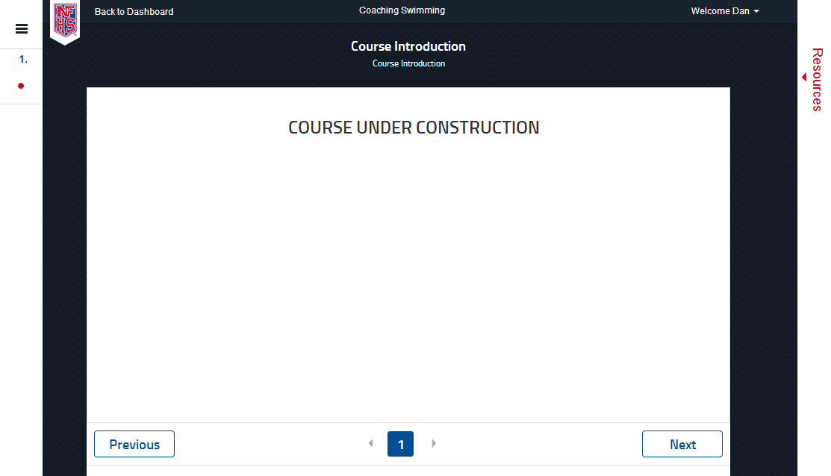


Coaching Swimming
Developed with NISCA
Notes:
The NFHS is pleased to partner with the National Interscholastic Swim Coaches Association to present the online Coaching Swimming course. Go to www.nfhslearn.com to view the trailer, description and outline for this course. Encourage your coaches to sign-up today!

Slide 34




www.nfhslearn.com
Coaching Diving
Course Objectives
Units
Coaching Fundamentals: components of a dive, direction designations and position designations
Dryland: body positioning, drills, basic jumping skills and hurdle progressions
Forward and Backward Dives: feet-first entry, front fall-in, headfirst entry
Inward, Reverse and Twisting Skills: demonstrations and testing
Teaching Methodology
Fundamentals
Dryland Skills
Forward Skills
Backward Skills
Inward Skills
Reverse Skills
Twisting Skills
Notes:
Coaching Diving is a course developed by the NFHS in conjunction with the National Interscholastic Swim Coaches Association (NISCA) and USA Diving. This course teaches the fundamentals of becoming an effective diving coach. The course explores the different types of dives and the training required to execute the to the best of the diver’s ability.
More:
- Unlimited access to course & resources for one year from date of purchase
- Use as an elective to fulfill AIC or CIC certification requirements

Slide 35
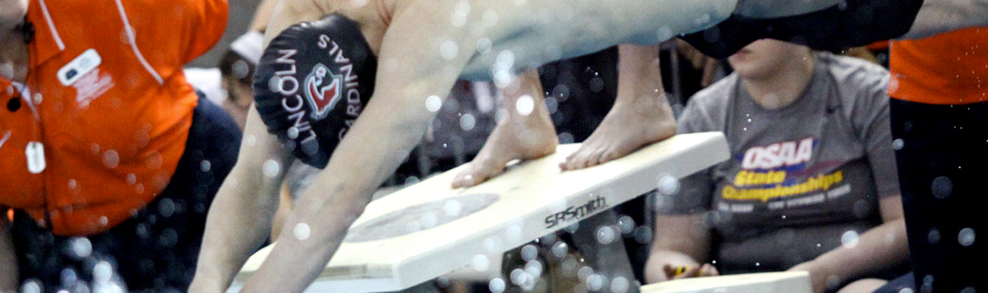
Officiating Swimming & Diving
Course Objectives
Units
Understand the roles of professionalism, rules knowledge, and communication and how they help ensure a fair meet.
Know how to consistently identify swimming violations in each type of event.
Learn the elements of a proper dive and how to score dives appropriately.
Elements of Professional Development
Officiating Swimming
Officiating Diving
Judging Practicum
Unlimited access to course for 1 year from the date of purchase
Approved by NFHS for 3 course clock hours
Notes:
Officiating Swimming and Diving is a course developed by the NFHS in conjunction with the National Interscholastic Swim Coaches Association (NISCA) and USA Diving. This course defines the elements of professional development and the fundamentals of officiating strokes and turns. The course also explores officiating and judging diving and provides a judging practicum that includes feedback of submitted scores. Officials may select either the swimming track, the diving track, or both, depending on rules required by their state association.
More:
- Unlimited access to course & resources for one year from date of purchase
- Use as an elective to fulfill AIC or CIC certification requirements

Slide 36
2019-20 nfhs swimming and diving
Resources

Slide 37


Nfhs Swimming and Diving Officials’
Guidelines Manuals
The revised manuals will be available August 1 on the following website locations:
http://www.nfhs.org/activities-sports/swimming-diving/ https://arbitersports.com

Slide 38

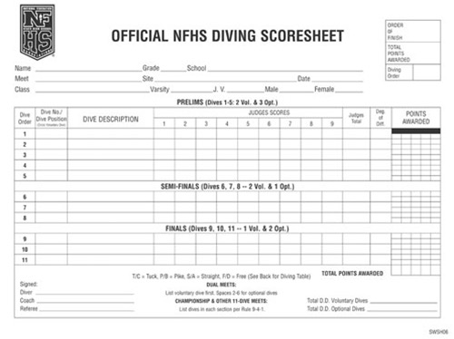
Nfhs Swimming and Diving publications
The Rules Book, Scorebook and other
swimming and diving materials can be
ordered online at www.nfhs.com, or by
calling 1-800-776-3462.
Notes:
The NFHS swimming and diving publications are available to order online or by using the toll free number.

Slide 39
General Board Changes
2019-20

Slide 40
Gender of Player
The NCHSAA allows participation in interscholastic athletics for all students, regardless of gender or gender identification.
Notes:
It is the intent that all students are able to compete on a level playing field in a safe, competitive and friendly environment, free of discrimination.
The following rules and regulations are intended to provide every student athlete with equal opportunities to participate in athletics.

Slide 41
Gender of Player
A student may participate based on the gender noted on the student’s certificate of birth.
  Women shall not participate on a men’s interscholastic athletic team where the school has a women’s team in the same sport or where a school sends an entry to the women’s state playoffs in the same sport.
    In cases where women are permitted on a men’s team, the school forfeits all participation in the women’s playoffs in the same sport.
    Men’s rules will be used where women play on men’s teams.
    Men’s shall not participate on women’s team’s in any sport.

Slide 42
Gender of Player
When a student’s gender identity differs from the gender listed on the student’s certificate of birth, the Gender Identity Request Form must be submitted by the member school to the NCHSAA prior to any participation by the student under circumstances that would constitute ineligibility.
Notes:
The Request should be based on the gender identification of that student in current school records and daily life activities in the school and community.

Slide 43
Gender of Player
  The following information should be submitted with the Request:
    Documentation from individuals such as, but not limited to, parents/legal guardians appointed by a court of competent jurisdiction, friends, and/or teachers, which affirm that the actions, attitudes, and manner demonstrate the student’s consistent gender identification.
    A complete list of all the student’s prescribed, non-prescribed, or over the counter treatments or medications relative to gender identity.
    A complete list of interventions that have happened related to the gender identity of the student.
    Written verification from an appropriate healthcare professional (e.g. physician, psychiatrist, psychologist, school nurse, etc.) of the student’s consistent gender identification. Include any other social/emotional information from health-care professionals that would help the Committee make a decision about the student. This information must be submitted on office letterhead of the healthcare professional who provides verification with contact information and professional title of the individual.
    Any other pertinent documentation or information which the student or parent(s)/legal guardian(s) appointed by a court of competent jurisdiction believe relevant and appropriate.
Notes:
Requested Documentation:
-Affirmations that the actions, attitudes, and manner demonstrate the student’s consistent gender identification
-Complete list of treatments or medications relative to gender identity
-Complete list of interventions related to the gender identity of the student.
-Written verification from an appropriate healthcare professional of the student’s consistent gender identification.
-Any other pertinent documentation or information which the student or parent(s)/legal guardian(s) appointed by a court of competent jurisdiction believe relevant and appropriate.

Slide 44
Gender of Player
The NCHSAA will refer the Gender Identity Request to the NCHSAA Gender Identity Committee for consideration.
  The NCHSAA Gender Identity Committee will consist of the following:
    Current member of the Board of Directors;
    LEA or school administrator;
    Physician with experience in gender identity health care and/or World Professional Association of Transgender Health (WPATH) Standards of Care;
    Psychiatrist, psychologist, or licensed mental health professional familiar with the WPATH.
The Committee will approve the Request if it finds that the student genuinely identifies as the gender indicated in the Request.

Slide 45
Gender of Player
The Committee will require that the member school has verified that the student is eligible in all other aspects.
The Committee will respect and promote the student’s privacy and confidentiality rights under HIPPA and FERPA in the process of considering a Gender Identity Request. Information provided to the Committee will be shared only to the extent necessary to decide the Gender Identity Request; provided that, if a Gender Identity Request is approved, the student’s school may share the student’s gender identity with other schools as necessary to ensure appropriate accommodations when competing at another school.

Slide 46
Gender of Player
In cases where a Gender Identity Request has been approved:
  The student will be declared eligible to participate based on the student’s gender identity.
    1.2.4.a is not in effect.
  It shall be the responsibility of the school to comply with all state and federal mandates/laws.
Notes:
1.2.4.a is the “birth certificate rule”

Slide 47
Home School Participation
Initial Eligibility
Home school students
  Documentation from the Division of Non-Public Education must be presented upon initial dual enrollment- attendance, immunization, transcript, school number, etc.
  Home school students must communicate athletic intent at a member school in which they are domiciled and follow the enrollment and assignment procedures/policies established by the local board of education.
    Notice to principal must take place within at least days prior to the first practice date of each sports season.

Slide 48
Home School Participation
Attendance
Home school students:
  Must have been enrolled in the registered home school for 365 days prior to being eligible in a member school.
  Once deemed eligible at a member school, the student must maintain continuous dual enrollment.
    Unenrollment would render the student ineligible for 365 days.
  Must participate in a class schedule that is at least one half of the school’s instructional day
    At least one class must be on campus each semester or meet LEA requirements.

Slide 49
Home School Participation
Scholastic Requirements:
A student must have passed a minimum load of work during the preceding semester to be eligible at any time during the present semester. The semester is normally considered half of the academic year. All students must also meet local promotion standards, set by the LEA and/or the local school. Home school students must be on grade level according to a nationally standardized achievement test(s) indicating grade level.
A minimum load is defined as five courses in the traditional school schedule and three courses for schools on the “block” format. If the school is on an A/B form of block scheduling, a student must pass six of eight courses during what would traditionally be defined as a semester. Any student, including seniors must pass that minimum load, even if they need fewer for graduation. Home school student must pass all public school courses in which he/she is enrolled.

Slide 50
Transfer Policy
Students transferring to the same member school where the student’s coach has relocated within a calendar year will be deemed ineligible in any sport in which the coach is involved.
  Now applies to within LEA as well as from LEA to LEA.
If deemed ineligible due to athletic purposes, the student will only be ineligible in that sport(s) in which “athletic purposes” was reason for not authorizing.

Slide 51
Foreign Exchange Students
  After the first year of participation as a Foreign Exchange Student
    Student can be eligible subsequently, based on the two-semester rule
      Applies to the same school of initial enrollment.
Notes:
Previously Foreign Exchange Students were only eligible the first semester of residency in the United States through an approved program.

Slide 52
Ejection Policy
Clarified this policy:
  Leaving the bench and coming on to the playing area during a fight (whether they participate in the fight or not)
Notes:
Language has been cleaned up to match the penalty to alleviate any confusion.

Slide 53
Unpaid Fines
Unpaid fines will be posted for NCHSAA membership view only

Slide 54
Eligibility Summary Forms
Deadline Changes
  Fall – September 1
  Winter – December 1
  Spring – March 15

Slide 55
Post-Season Participation
Clarification:
  Independent NCHSAA member schools are eligible for post-season ONLY in individual sports, based on the sport
Notes:
Clarifying language that independent NCHSAA member schools are not eligible for bracketed sports playoffs.
Independent Members: Cabarrus Charter, Eastern NC School for the Deaf, Millenium Charter, NC Leadership Academy, NC School for the Deaf, Sugar Creek Charter

Slide 56
Pre-Game EAP Review
Purpose
  Effective communication of Emergency Action Plan
    EAP is required by Law (Gfeller-Waller)
  Guide for administrators, coaches, officials and LAT/FR
Conducted by the Game Day Administrator or Designee
  The NCHSAA recommends that a hard copy or electronic copy of the venue specific EAP be provided to both the lead official and visiting team personnel.

Slide 57
Pre-Game EAP Review Card
All Events
Who is the gameday administrator and what is their contact information?
Is there a Licensed Athletic Trainer (LAT) and/or First Responder (FR) on site and what is their contact information? If a LAT or FR is not on site who is the most qualified person to provide CPR and first aid care?
Has the Emergency Action Plan (EAP) been reviewed and where is the posted venue specific EAP located?
What first aid and emergency equipment is available at the venue and where is it located? (e.g., first aid kit, AED/CPR equipment, spinal injury stabilization equipment, exertional heat illness management equipment, etc.)

Slide 58
Pre-Game EAP Review Card
Outdoor Events
Who will be monitoring environmental and field/facility conditions during the event? (e.g., thunder and lightning, Wet Bulb Globe Temperature)
Who will notify officials of unsafe environmental or field/facility conditions?
Has the lightning or thunder disturbances safe shelter and evacuation route been identified?
What is the Wet Bulb Globe Temperature, if available, at the beginning of the contest?

Slide 59
Sport Specific Changes
&
NCHSAA Points of Emphasis
2019-20

Slide 60
Regional Assignments
Regional assignments will be based on conference affiliation
  Golf
  Cross-Country
  Swimming and Diving
  Track & Field

Slide 61
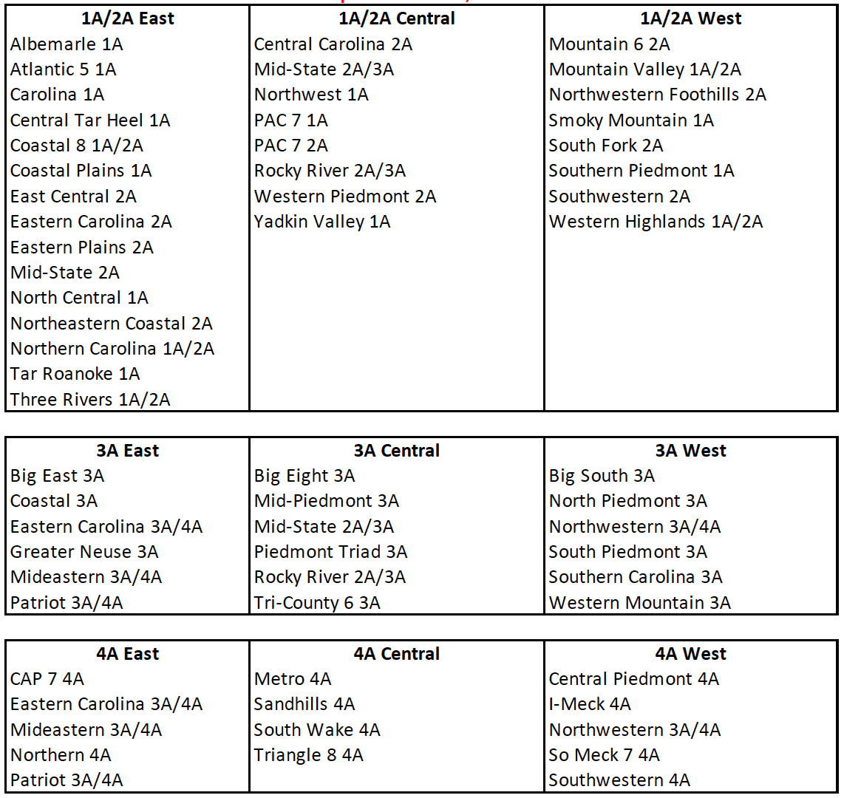
Regional Assignments

Slide 62
400 Freestyle Relay
Prelim/Final Event at the State Championship
  No longer a timed final

Slide 63
Payment of Officials
MUST BE PAID!
  Referee - $51 flat fee
  Stroke and Turn Judge, Starter, Diving Judge - $26 flat flee
6 Lane Requirements
  Referee and two (2) stroke and turn judged
8 Lane Requirements
  Referee and three (3) stroke and turn judged

Slide 64
Required Coaches Education
NFHS Fundamentals of Coaching
  All coaches (paid and volunteer)
  Prior to first play date
  One-time requirement
NFHS Concussion in Sports
  All coaches (paid and volunteer)
  Prior to first practice
  Annual requirement
CPR/AED Certified
  All head and paid coaches
  Must maintain certification
NFHS Sudden Cardiac Arrest
  All non-paid coaches
  Prior to first practice
  Annual requirement
NCHSAA Rules Clinic
  Head Varsity Coach
  Prior to first play date
  Annual Requirement

Slide 65
Calendar
  Start: Wednesday, October 30
1st Contest: Wednesday, November 18
Regional Entry Deadline: Saturday, January 25
8:00 p.m.
Late Entry Deadline: Monday, January 27 3:00 p.m.
Regionals: Friday, January 31 and/or Saturday, February 1
States: 1A/2A Thursday, February 6, 2020
4A Friday, February 7, 2020
3A Saturday, February 8, 2020
Notes:
Key Dates:
1st Practice - August 1 (men) and February 12 (women)
1st Contest – August 19 (men) and March 2 (women)
Last Play Date – November 2 (men) and May 9 (women)

Slide 66
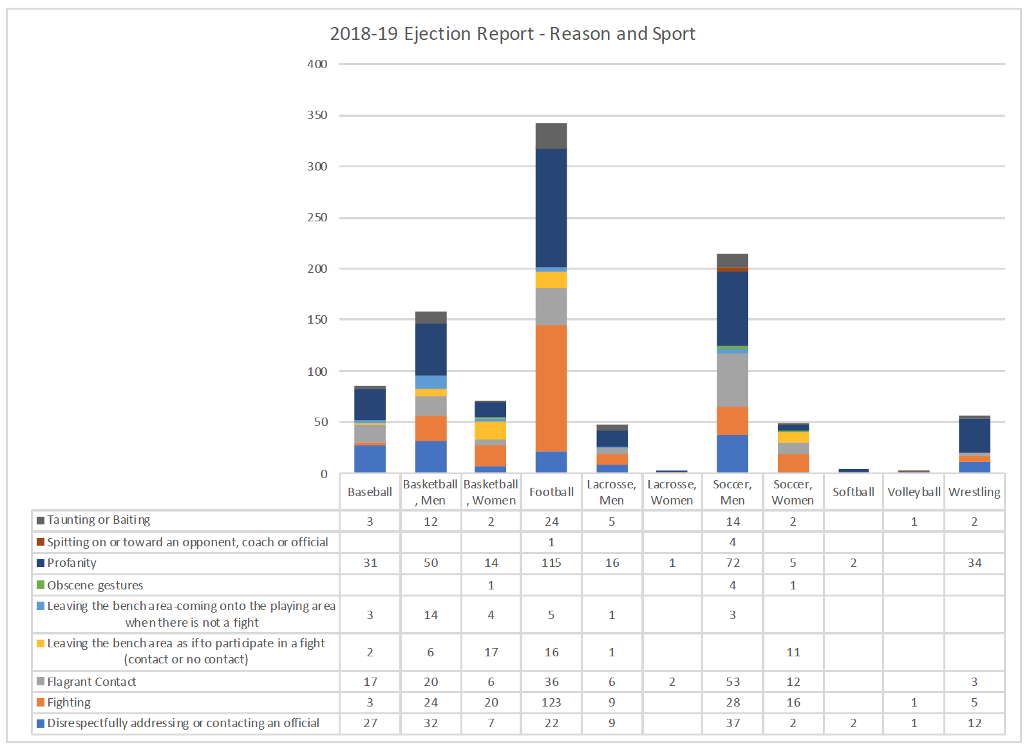
Sportsmanship/Ejections

Slide 67
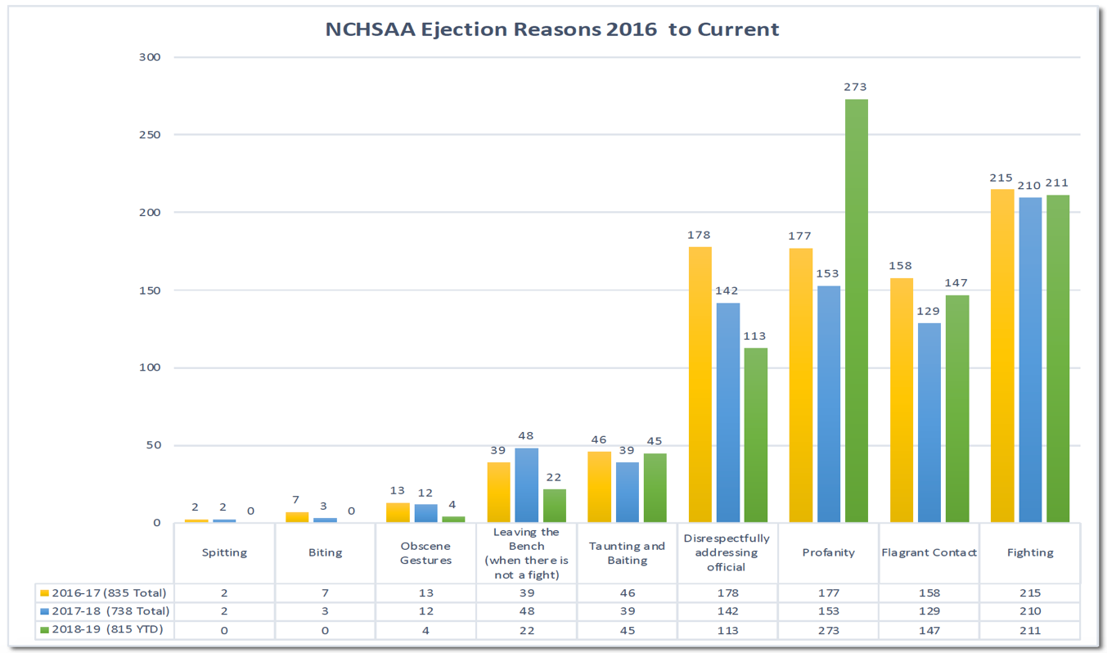
Sportsmanship/Ejections

Slide 68
18-19 Swim and Dive Financial Report
Expenses
Expenses $ 45,679.01
  Facility
  Host School
  Awards
  Security/Medical
  Hospitality
  Officials, etc.
Team Expenses $ 16,241.25
  Travel
Total Expenses $ 61,920.26
Revenue
Gate Receipts $ 21,015.00
Endowment $ (2,436.00)
T-Shirt Share $ 1,475.10
Total Receipts $ 20,054.54
Loss $41,865.72
Notes:
In an effort of continued transparency with the membership the men’s championships operated at a loss of $41,865.72

Slide 69
2021-2025 Realignment
The Board of Directors instructed NCHSAA Staff to delay the Realignment process by one year
  Eliminating the “lame duck year” of the alignment period
  Decision was to give various committees the opportunity to review the realignment process and the Association’s current classification structure while providing the necessary time for the Board and membership to make any necessary changes to implement their recommendations
Notes:
Important Notes:
-Realignment Committee and Board will seek input relative to classes, percentages, etc.
-Any deviation from 4 classes would require a NCHSAA Amendment change.
-Previous Realignment Committees researched 3, 4 and 5 classes with the help of SAS.

Slide 70
NCPrepSwimming
New for 2019-2020: When you upload meet results, you will be asked to identify your Meet Referee, and meet files with excessive errors will be rejected.
Team Abbreviations - Make sure these are correct for all teams in your meets - new schools, please reach out to me for an abbreviation.
Send results in a timely fashion. Hopefully having done this for a full complement for a full season, this will become second nature.
Meters v Yards. Please make sure that your meet file is correctly coded for meters vs yards with particular emphasis on the 500 freestyle. If you contest the 400 free instead of the 500 free, please make sure the event is coded as a 400 and not as a 500, and vice versa.

Slide 71
NCPrepSwimming
Event numbers should always be numeric and should be 1-24. Diving is events 9 and 10. We have seen events 5A and 5B instead of 5 and 6. We have seen event 88 for diving. Review your events file before the start of the season.
Diving events should contain the correct number of dives as the "distance" - either 6 or 11. We've seen 5, we've seen 0.
Please add birth dates and middle initials to your NCPS roster for all athletes.
Review your roster regularly for duplicates and mistakes.

Slide 72
Thank You!
To receive clinic attendance credit:
  State Clinic
    Sign-in prior to leaving
  Coaches Clinic
    Pick-up your card as you leave today
      Enter your code immediately to get credit for attendance
        Mobile device or computer
        All fields required except comments box
        Use same email address that was used for NFHS Courses
      Deadline for entry is August 16, 2019.
      Avoid $400 fine for your school
  Online Clinic
    Print certificate and keep on file

