Slide 1
2019 nfhs football rules powerpoint
NCHSAA
State Rules Clinic
Mark Dreibelbis/Associate Commissioner
Notes:
This PowerPoint presentation from the National Federation of State High School Associations (NFHS) covers the following:
2019 NFHS Football Rules Changes-
2019 NFHS Football Editorial Changes-
2019 NFHS Football Points of Emphasis-
2019 NFHS Football Rules Reminders-
2019-20 NFHS Football Information-

Slide 2
Rule 7-5-2e – Penalty exception
This is a North Carolina experimental rule for 2019.
It is legal for a player positioned directly behind the snapper to conserve time intentionally by throwing the ball forward to the ground immediately after receiving a direct hand to hand the snap that has not touched the ground.

Slide 3
Rule 7-5-2e – Penalty exception
RATIONALE: Many teams utilize the spread offense and run all offensive plays from the shotgun formation. Making teams go under center for a direct, hand-to-hand snap is not keeping up with current trends of the game.
REFEREE – Report # of times utilized in a game to Mark Dreibelbis, Supervisor of Officials @ mark@nchsaa.org.

Slide 4

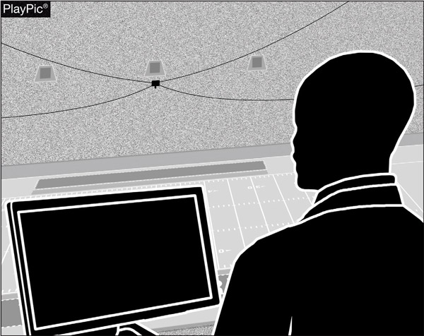
Postseason instant REPLAY
RULES 1-3-7 NOTE (NEW),
TABLE 1-7 — 1-3-7 NOTE (NEW)
By adoption, state associations may create instant replay procedures that permit game or replay officials to use a replay monitor during state postseason contests to determine if a decision by the on-field game officials is incorrect.
Notes:
Rule Change:
RULE 1 – SECTION 3 – GAME EQUIPMENT
ART. 7 . . . Other than replay or television monitoring equipment, game officials may use supplementary equipment to aid in game administration as authorized by the state association.
NOTE: A state association may create instant-replay procedures that permit game or replay officials to use a replay monitor during state postseason contests to determine if a decision by the on-field game officials is incorrect.
RULE 1 – SECTION 7 – STATE ASSOCIATION ADOPTIONS
Authorize the use of instant replay during state postseason contests. (1-3-7 NOTE)
Rationale for Change:
By state association adoption, instant replay may only be used during state postseason contests to review decisions by the on-field game officials. This adoption would allow state associations to develop protocols for use of video replay.
Case Book: See SITUATIONS 1.1.9, 1.3.7

Slide 5
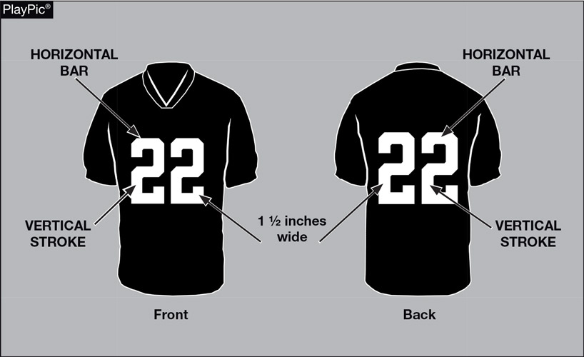
FOOTBALL JERSEY NUMBERS
RULE 1-5-1c
The entire body of the number (the continuous horizontal bars and vertical strokes) exclusive of any border(s) shall be approximately 1½ – inches wide.
Notes:
Rule Change:
RULE 1 – SECTION 5 – PLAYER EQUIPMENT
ART. 1 . . . Mandatory equipment. Each player shall participate while wearing the following pieces of properly fitted equipment, which shall be professionally manufactured and not altered to decrease protection: …
c. Numbers
1. The numbers shall be clearly visible and legible using Arabic numbers 1-99 inclusive and shall be on the front and back of the jersey.
2. The numbers, inclusive of any border(s), shall be centered horizontally at least 8 inches and 10 inches high on front and back, respectively.
3. The entire body of the number (the continuous horizontal bars and vertical strokes) exclusive of any border(s) shall be approximately 1½-inches wide.
4. The color and style of the number shall be the same on the front and back.
5. Through the 2023 season, the body of the number (the continuous horizontal bars and vertical strokes) shall be either:
(a) a continuous color(s) contrasting with the jersey color; or
(b) the same solid color(s) as the jersey with a minimum of one border that is at least ¼-inch in width of a single solid contrasting color.
6. Effective with the 2024 season, the entire body of the number (the continuous horizontal bars and vertical strokes) shall be a single solid color that clearly contrasts with the body color of the jersey.
Rationale for Change:
The purpose of numbers on jerseys is to provide clear identification of players. In order to enhance the ability to easily identify players, the committee has clarified the size requirements for jersey numbers through the 2023 season. The committee also added a new requirement that, effective in the 2024 season, jersey numbers must be a single solid color that clearly contrasts with the body color of the jersey.

Slide 6
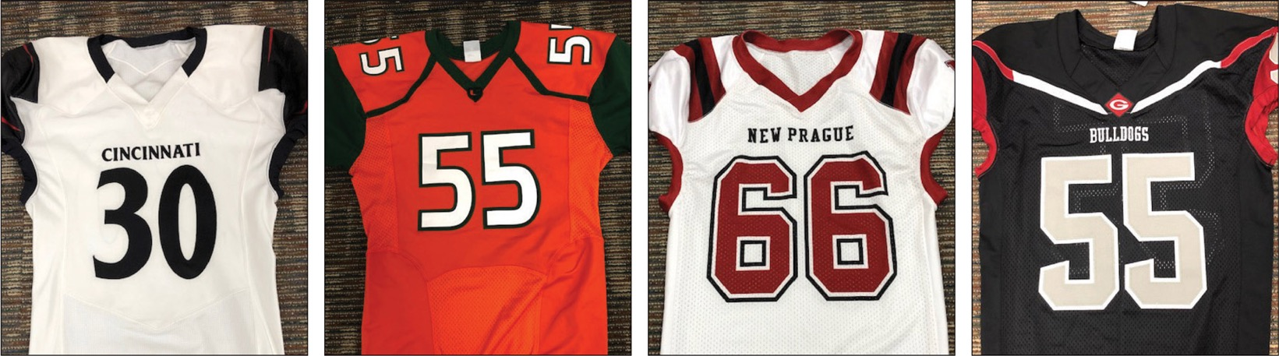
Football JERSEY numbers
RULES 1-5-1c, 1-5-1c(6) (NEW)
A
B
C
D
The style of the numbers on all four of these jerseys are legal now and will be in 2024 as well.
Notes:
Rule Change:
RULE 1 – SECTION 5 – PLAYER EQUIPMENT
ART. 1 . . . Mandatory equipment. Each player shall participate while wearing the following pieces of properly fitted equipment, which shall be professionally manufactured and not altered to decrease protection: …
c. Numbers
1. The numbers shall be clearly visible and legible using Arabic numbers 1-99 inclusive and shall be on the front and back of the jersey.
2. The numbers, inclusive of any border(s), shall be centered horizontally at least 8 inches and 10 inches high on front and back, respectively.
3. The entire body of the number (the continuous horizontal bars and vertical strokes) exclusive of any border(s) shall be approximately 1½-inches wide.
4. The color and style of the number shall be the same on the front and back.
5. Through the 2023 season, the body of the number (the continuous horizontal bars and vertical strokes) shall be either:
(a) a continuous color(s) contrasting with the jersey color; or
(b) the same solid color(s) as the jersey with a minimum of one border that is at least ¼-inch in width of a single solid contrasting color.
6. Effective with the 2024 season, the entire body of the number (the continuous horizontal bars and vertical strokes) shall be a single solid color that clearly contrasts with the body color of the jersey.
Rationale for Change:
The purpose of numbers on jerseys is to provide clear identification of players. In order to enhance the ability to easily identify players, the committee has clarified the size requirements for jersey numbers through the 2023 season. The committee also added a new requirement that, effective in the 2024 season, jersey numbers must be a single solid color that clearly contrasts with the body color of the jersey.

Slide 7
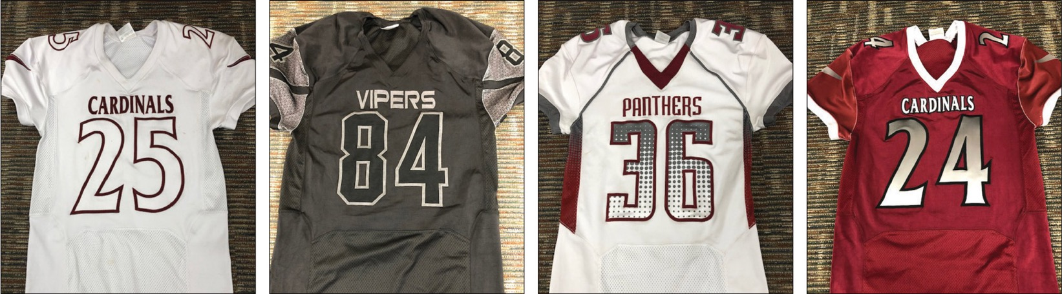
Football JERSEY numbers
RULES 1-5-1c, 1-5-1c(6) (NEW)
A
B
C
D
The style of the numbers on these jerseys are legal through the 2023 season. The following four types of number designs will be illegal in 2024.
Notes:
Rule Change:
RULE 1 – SECTION 5 – PLAYER EQUIPMENT
ART. 1 . . . Mandatory equipment. Each player shall participate while wearing the following pieces of properly fitted equipment, which shall be professionally manufactured and not altered to decrease protection: …
c. Numbers
1. The numbers shall be clearly visible and legible using Arabic numbers 1-99 inclusive and shall be on the front and back of the jersey.
2. The numbers, inclusive of any border(s), shall be centered horizontally at least 8 inches and 10 inches high on front and back, respectively.
3. The entire body of the number (the continuous horizontal bars and vertical strokes) exclusive of any border(s) shall be approximately 1½-inches wide.
4. The color and style of the number shall be the same on the front and back.
5. Through the 2023 season, the body of the number (the continuous horizontal bars and vertical strokes) shall be either:
(a) a continuous color(s) contrasting with the jersey color; or
(b) the same solid color(s) as the jersey with a minimum of one border that is at least ¼-inch in width of a single solid contrasting color.
6. Effective with the 2024 season, the entire body of the number (the continuous horizontal bars and vertical strokes) shall be a single solid color that clearly contrasts with the body color of the jersey.
Rationale for Change:
The purpose of numbers on jerseys is to provide clear identification of players. In order to enhance the ability to easily identify players, the committee has clarified the size requirements for jersey numbers through the 2023 season. The committee also added a new requirement that, effective in the 2024 season, jersey numbers must be a single solid color that clearly contrasts with the body color of the jersey.

Slide 8
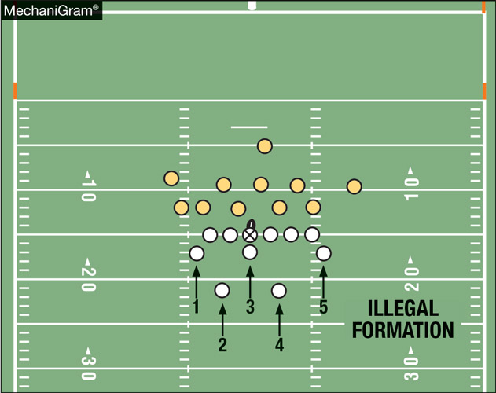
FORMATION ruleS 2-14-1, 7-2-5a
A scrimmage formation requires a minimum of five A players legally on their line and no more than four players behind their line at the snap. This formation would be a foul at the snap.
Notes:
Rule Change:
RULE 2 – SECTION 14 – FORMATIONS
ART. 1 . . . A scrimmage formation requires a minimum of five A players legally on their line at the snap.
RULE 7 – SECTION 2 – FORMATION/POSITION, NUMBERING AND ACTION AT THE SNAP
ART. 5 . . . Player formation and numbering requirements include:
a. At the snap, at least five A players shall be on their line of scrimmage and no more than four A players may be backs.
Rationale for Change:
A legal scrimmage formation now requires at least five offensive players on their line of scrimmage with no more than four backs. This change will make it easier to identify legal and illegal offensive formations.
Case Book: See SITUATIONS 1.1.3, 7.2.1B, 7.2.5C

Slide 9
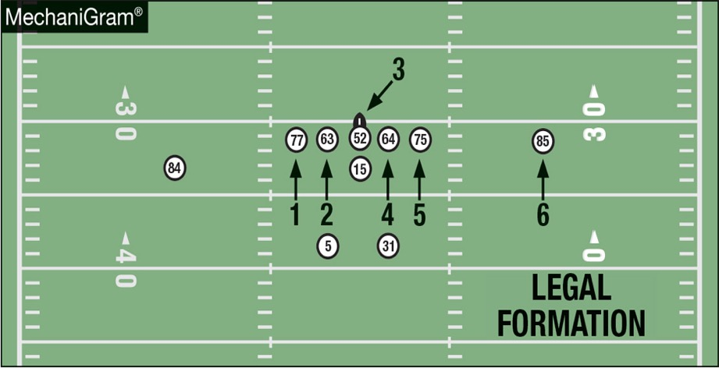
FORMATION ruleS 2-14-1, 7-2-5a
Even though there are only 10 Team A players on the field, because there are at least five linemen properly numbered and no more than four backs, this formation is legal.
Notes:
Comment on Slide:
See comments on slide.

Slide 10
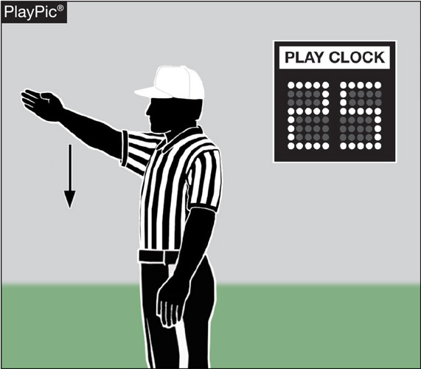
PLAY CLOCK
RULES 2-35, 3-6-1, 3-6-2a, 7-2-1
Referee gives ready-for-play signal and 25-second play clock begins before a try following a score; to start a period or overtime series; following administration of an inadvertent whistle; following a charged timeout and following an officials timeout.
Notes:
Rule Change:
RULE 2 – SECTION 35 – READY-FOR-PLAY
Ready-for-play signifies that the ball may be put in play by a snap or a free kick with 25 seconds or 40 seconds on the play clock.
RULE 3 – SECTION 6 – PLAY CLOCK, BALL READY FOR PLAY AND DELAY
ART. 1 . . . Play clock and ready-for-play:
a. Play clock:
1. 25 seconds will be on the play clock and start on the ready-for-play signal:
(a) Prior to a try following a score;
(b) To start a period or overtime series;
(c) Following administration of an inadvertent whistle;
(d) Following a charged time-out;
(e) Following an official's time-out as in 3-5-7 or 3-5-10, except for 3-5-7b; and
(f) Following the stoppage of the play clock by the referee for any other reason.
2. 40 seconds will be on the play clock after a down other than specified in 3-6-1a(1), and start when the ball is declared dead by a game
official.
b. The ball is ready for play:
1. When the ball has been placed for a down and the referee marks the ball ready for play after giving the ready-for-play signal as in 3-6-1a(1);
2. Starting immediately after the ball has been ruled dead by a game official after a down, the ball has been placed on the ground by the game
official and the game official has stepped away to position as in 3-6-1a(2).
ART. 2 . . . Action or inaction which prevents promptness in putting the ball in play is delay of game. This includes:
a. Failure to snap or free kick prior to the expiration of the 25- or 40-second play clock. …
RULE 7 – SECTION 2 – FORMATION/POSITION, NUMBERING AND ACTION AT THE SNAP
ART. 1 . . . After the ready-for-play, each player of A who participated in the previous down and each substitute for A must have been, momentarily, between the 9-yard marks, before the snap.
Rationale for Change:
To have a more consistent time period between downs, the rules committee approved situations where 40 seconds will be placed on the play clock. The new rule defines when 40 seconds will be placed on the play clock and when 25 seconds will be placed on the play clock.
Case Book: See SITUATIONS 3.6.1 COMMENT, 3.6.1A, 3.6.1B, 3.6.1C, 3.6.1D, 3.6.1E, 3.6.1F, 5.3.2B, 5.3.3, 7.2.1C

Slide 11
PLAY CLOCK
RULES 2-35, 3-6-1, 3-6-2a, 7-2-1
Administrative Stoppage (25-Second Play Clock)
  Following a touchback
  Following a charged time out
  Following penalty enforcement
  Following an injury timeout
  Start of a quarter
  Following a change of possession
  Following an official’s timeout for measurement
  Try for point
  Free kick following a try, field goal, or safety

Slide 12
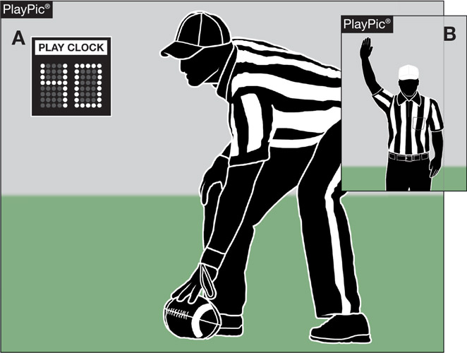
PLAY CLOCK
RULES 2-35, 3-6-1, 3-6-2a, 7-2-1
The play clock is set to 40 and is started immediately when a running play ends, team A gains a first down or after an incomplete pass.
Notes:
Comment on Slide:
See comments on slide.

Slide 13
PLAY CLOCK
RULES 2-35, 3-6-1, 3-6-2a, 7-2-1
40 Second Play Clock
  End of a running play – inbounds or out of bounds
  End of a pass play – complete or incomplete

Slide 14
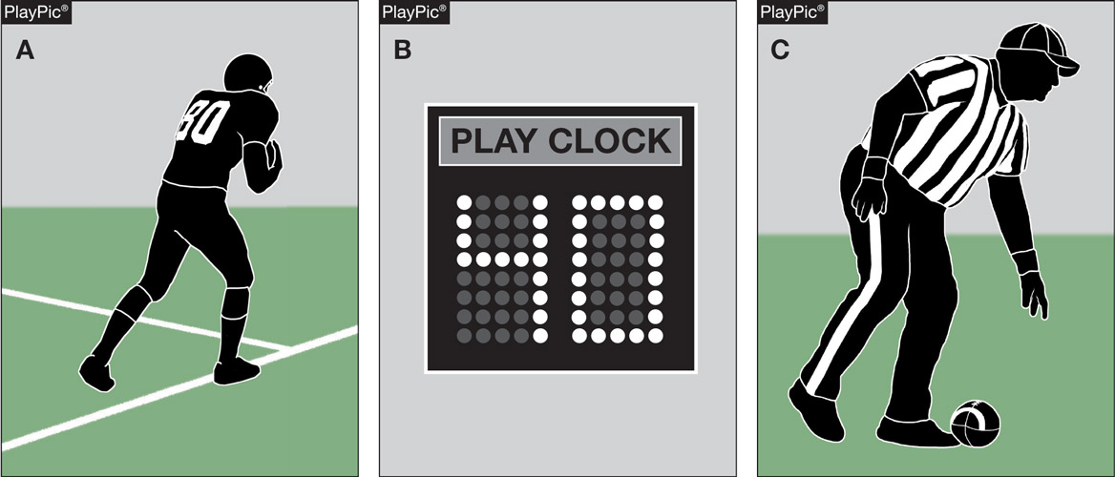
PLAY CLOCK
RULES 2-35, 3-6-1, 3-6-2a, 7-2-1
Runner goes out of bounds (PlayPic A). Play clock is set to 40 and is started immediately (PlayPic B). The ball is marked ready for play when the umpire sets the ball and walks away to his position (PlayPic C).
Notes:
Comment on Slide:
See comments on slide.

Slide 15
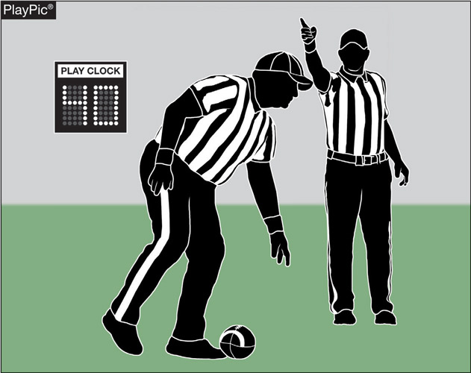
PLAY CLOCK
RULES 2-35, 3-6-1, 3-6-2a, 7-2-1
When the 40-second play clock is in force, the ball is considered ready for play when the ball is placed and the umpire has moved to his position.
Notes:
Comment on Slide:
See comments on slide.

Slide 16
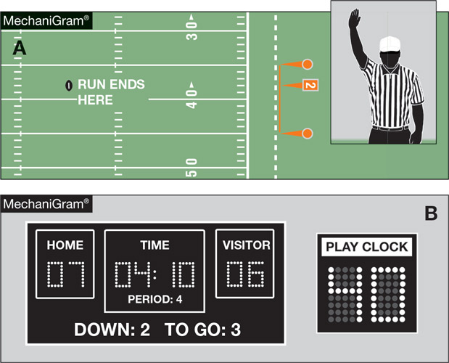
PLAY CLOCK
RULES 2-35, 3-6-1, 3-6-2a, 7-2-1
When the covering official declares the ball dead with an upraised arm, the play clock begins its countdown from 40 seconds.
Notes:
Comment on Slide:
See comments on slide.

Slide 17
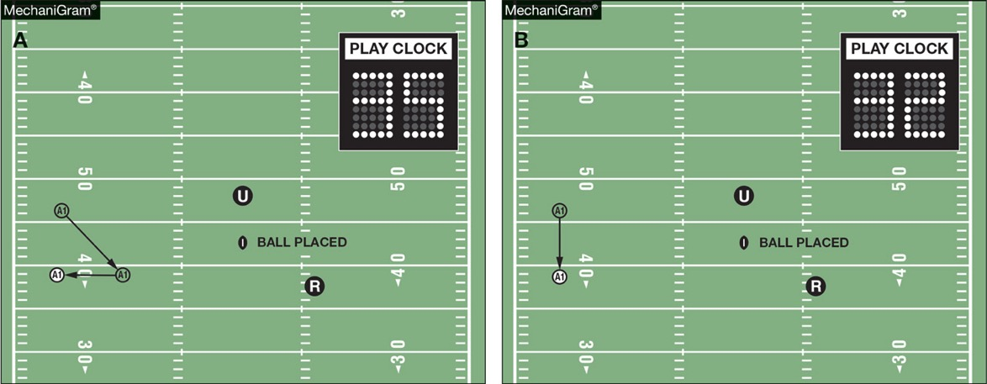
PLAY CLOCK
RULE 7-2-1
LEGAL
ILLEGAL
In MechaniGram A, A1, who was downfield on the previous play, comes back inside the 9-yard marks prior to the umpire setting the ball with 35 seconds on the play clock and then immediately goes outside the marks after the ready-for-play. In MechaniGram B, A1 remains outside the 9-yard marks with 32 seconds on the play clock when the ball is placed by the umpire. The requirement remains in place that all players get inside the 9-yard marks after the ready-for-play and before the snap.
Notes:
Rule Change:
RULE 7 – SECTION 2 – FORMATION/POSITION, NUMBERING AND ACTION AT THE SNAP
ART. 1 . . . After the ready-for-play, each player of A who participated in the previous down and each substitute for A must have been, momentarily, between the 9-yard marks, before the snap.
Rationale for Change:
To have a more consistent time period between downs, the rules committee approved situations where 40 seconds will be placed on the play clock. The new rule defines when 40 seconds will be placed on the play clock and when 25 seconds will be placed on the play clock.
Case Book: See SITUATION 7.2.1C

Slide 18
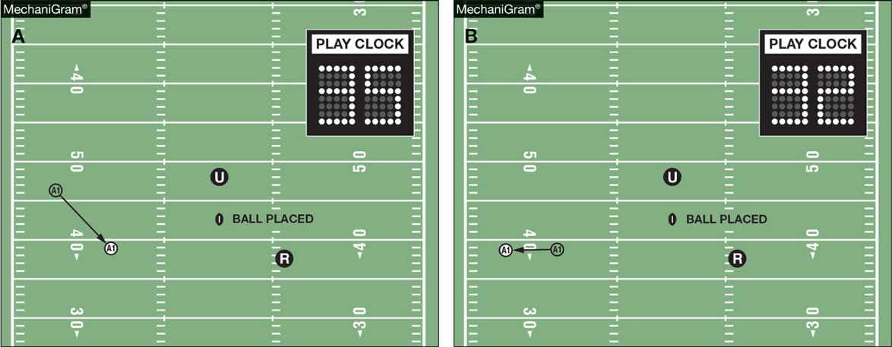
PLAY CLOCK
RULE 7-2-1
LEGAL
In MechaniGram A, the ball is placed by the umpire with 35 seconds on the play clock and A1, who was downfield on the previous play, then comes back inside the 9-yard marks. In MechaniGram B, A1 then goes outside the 9-yard marks with 32 seconds on the play clock. That is legal. A1 has met the requirement to be inside the 9-yard marks after the ready-for-play and before the snap.
Notes:
Comment on Slide:
See comments on slide.

Slide 19
WWW.NCHSAA.ORG
OFFICIALS
EDUCATION
FOOTBALL
NCHSAA Clock Operator Instructions ** New **
NCHSAA 40-Second Clock Rule ** New **
If Clock Operator cannot comply, time will be kept on the field by the Back Judge.

Slide 20
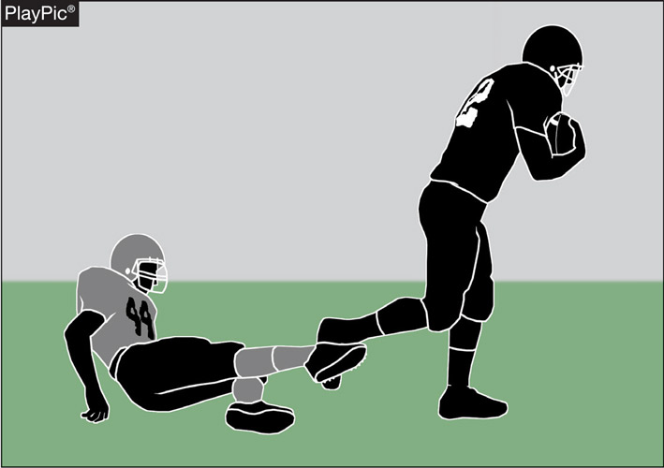
Tripping rules 2-45, 9-4-3o (NEW),
9-4-3o PENALTY (NEW)
The foul for tripping has been expanded to include the runner. It is now illegal to trip any opponent. Tripping is the intentional use of the lower leg or foot to obstruct an opponent below the knee. The penalty is 15 yards.
Notes:
Rule Change:
RULE 2 – SECTION 45 – TRIPPING
Tripping is the intentional use of the lower leg or foot to obstruct an opponent below the knee.
RULE 9 – SECTION 4 – ILLEGAL PERSONAL CONTACT
ART. 3 . . . No player or nonplayer shall: …
o. Trip an opponent.
PENALTY: … Art. 3o – illegal tripping – (S38-46) – 15 yards; …
Rationale for Change:
In an effort to decrease risk, tripping the runner is now prohibited. It is now a foul to intentionally use the lower leg or foot to obstruct a runner below the knees.
Case Book: See SITUATION 2.42.1

Slide 21
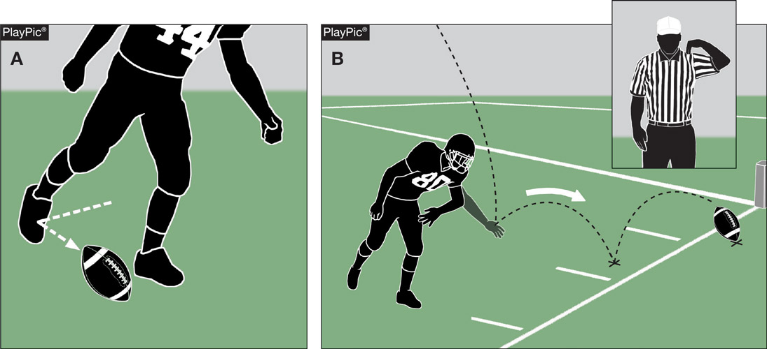
Illegal kicking and batting rules 6-2-1 PENALTY, 9-7 PENALTY
The penalties for illegally kicking the ball (PlayPic A) and illegally batting the ball (PlayPic B) have been reduced from 15 yards to 10 yards.
Notes:
Rule Change:
RULE 6 – SECTION 2 – SCRIMMAGE KICKS
PENALTY: Art. 1 – Illegal kick – (S31) – 10 yards.
RULE 9 – SECTION 7 – ILLEGAL KICKING AND BATTING
PENALTY: Arts. 1, 2, 3, 4 – Illegal kicking or batting – (S31) – 10 yards.
Rationale for Change:
The penalty for illegally kicking or batting the ball was reduced from 15 yards to 10 yards.
Case Book: See SITUATIONS 9.7.1C, 9.7.3

Slide 22
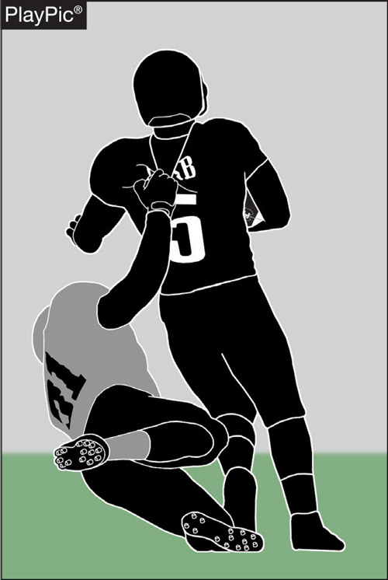
ILLEGAL HORSE-COLLAR TACKLE
RULES 9-4-3k
The name plate area (directly below the back collar) has been added to the criteria for an illegal horse-collar tackle. It is a foul to grab the inside back, name plate area or side collar of either the shoulder pads or the jersey of the runner and subsequently pull (backwards or sideward) that opponent to the ground, even if possession is lost. The horse-collar is enforced as a live-ball foul.
Notes:
Rule Change:
RULE 9 – SECTION 4 – ILLEGAL PERSONAL CONTACT
ART. 3 . . . No player or nonplayer shall: …
k. Grab the inside back or side collar, or the name plate area (directly below the back collar), of either the shoulder pads or the jersey of the runner and subsequently pull (backward or sideward) that opponent to the ground (Horse-collar), even if possession is lost. The horse-collar foul is enforced as a live-ball foul. …
Rationale for Change:
Grabbing the name plate area of the jersey of the runner, directly below the back collar, and pulling the runner to the ground is now an illegal personal contact foul.
Case Book: See SITUATION 9.4.3P

Slide 23
2019 nfhs football editorial changes

Slide 24
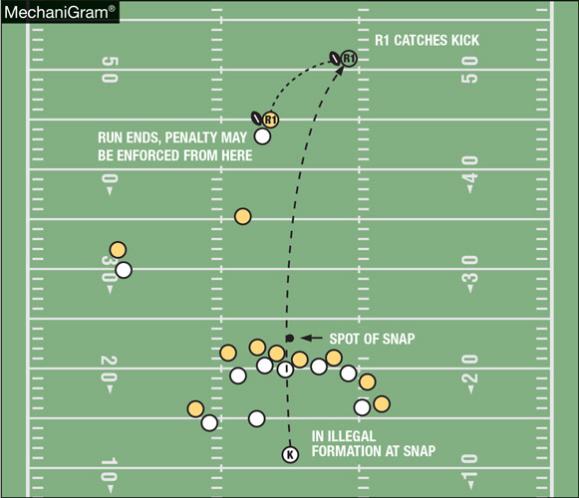
Penalty enforcement rules 5-2-2, 5-2-4,
10-4-2c EXCEPTION, 10-5-1j
Team R may choose penalty enforcement from the succeeding spot for a foul other than kick-catching interference that occurs from the start of a kick down until the kick ends.
Notes:
Editorial Change:
RULE 5 – SECTION 2 – DOWN AND POSSESSION AFTER PENALTY
ART. 2 . . . Foul during a scrimmage down and before any change of possession:
When a foul occurs during a scrimmage down and before any change of team possession, and before a receiver is first to touch a scrimmage kick while it is beyond the neutral zone, the ball belongs to A or K after enforcement
unless:
1. It is a 2-16-2h (post-scrimmage kick) foul;
2. The foul is kick-catching interference; or
3. K fouls and R selects succeeding spot enforcement, per 10-4-2 EXCEPTION.
b. The number of the next down is the same as that of the down during which the foul occurred unless penalty acceptance includes a first down or loss of down, or the enforcement or the advance results in a first down.
c. The loss-of-down aspect of a penalty has no significance following a change of possession or if the line to gain is reached after enforcement.
ART. 4 . . . When a foul occurs prior to or during a free-kick down and before any change of team possession, the down which follows enforcement is a free-kick down, unless R selects succeeding spot enforcement, per 10-4-2 EXCEPTION, or following a fair catch or an awarded fair catch, a scrimmage down is chosen for the replay.
RULE 10 – SECTION 4 – BASIC SPOTS
ART. 2 . . . The basic spot is the previous spot: …
c. For a foul which occurs during a down in which a legal kick occurs and an inadvertent whistle ends the down prior to possession by either team.
EXCEPTION: The basic spot may, at the option of the offended team, be the succeeding spot for fouls by K during a free or scrimmage kick down (other than kick catch interference) prior to the end of the kick when K will not be next to put the ball in play.
RULE 10 – SECTION 5 – SPECIAL ENFORCEMENT RULES
ART. 1 . . . The following fouls have special enforcement provisions and options for the offended team: …
j. Fouls by K during a free or scrimmage kick down prior to the end of the kick. (10-4-2 EXCEPTION)
Rationale for Change:
Clarification.

Slide 25
2019 nfhs football editorial changes
1-1-9 | Added reference to Rule 1-3-7 NOTE.
1-3-6, 3-1-2, 3-3-1, 3-4, 3-4-1, 3-4-2, 3-4-3, 3-4-4, 3-4-5, 3-5-9, | Added “game” before “clock.”
1-5-5, 9-6-4b | Added “intermission” after “halftime.”
1-6-1 NOTE, 2-24-3, 2-26-5, 3-5-2 NOTE b, 3-5-3, 3-5-6, 4-3-6, 5-3-1, | Deleted “signal” after “ready-for-play.”
Table 1-7 | Further clarified some of the state association adoptions.
2-6-2b | Changed “hash” to “9-yard” marks.
2-8, 2-25-1, 2-28-1, 2-43, 3-5-7j, 3-6-2d, 4-1-6, 5-3-2 NOTE, 7-1-5, 7-1-7, 8-3-2, | Deleted “marked” before “ready-for-play.”
Notes:
Comment on Slide:
This slide lists the rules references and a brief description of the football editorial changes that were made to the 2019 NFHS Football Rules Book.

Slide 26
2019 nfhs football editorial changes
Table 3-1, 3-5-10, | Further clarified periods, intermission and the game clock.
3-4-6 | Added “game or play” before “clock.”
3-4-8 | Clarified timing by adding “by the game or play clock.”
5-2-2, 5-2-4 | Further clarified “succeeding spot enforcement.”
6-5-4 | Added “next” before “down.”
6-5 PENALTY | Added “S7” to “delay of game.”
7-2-6 | Further clarified a huddle and shift.
7-2 PENALTY | Clarified the rules references for the penalties on illegal numbering and illegal formation.
TABLE 7-5-2, TABLE 7-5 | Added “incomplete” to better describe a thrown pass.
8-5-2 EXCEPTION | Further clarified that once the ball leaves the end zone, the original momentum is canceled.
Notes:
Comment on Slide:
This slide lists the rules references and a brief description of the football editorial changes that were made to the 2019 NFHS Football Rules Book.

Slide 27
2019 nfhs football editorial changes
9-2-3a | Changed rules reference from “2-3-4” to “2-3-5.”
9-3 PENALTY | Deleted the penalty for “tripping” from 9-3.
9-4 PENALTY | Added the penalty “illegal tripping” to 9-4.
9-9-5 NOTE | Changed the rules references from “9-10-3 and 9-10-4” to “9-9-3 and 9-9-4.”
10-4-2c EXCEPTION | Added “prior to the end of the kick” to further clarify.
10-5-1c | Changed the rules reference from “9-10” to “9-9.”
10-5-1j | Added “prior to the end of the kick” to further clarify.
Resolving Tied Games | In 3-1, added “three-minute” before ‘Intermission.”
Nine-, Eight-, Six-Player Rules Differences | Clarified that at least “three” A players shall be on the line at the snap in both Nine-Player and Eight-Player Rules.
Penalty Summary | Updated rules references and penalty signal numbers. Also, added “Illegal kicking or batting the ball” to the “Loss of 10 Yards” summary.
Notes:
Comment on Slide:
This slide lists the rules references and a brief description of the football editorial changes that were made to the 2019 NFHS Football Rules Book.

Slide 28
2019 nfhs football points of emphasis

Slide 29
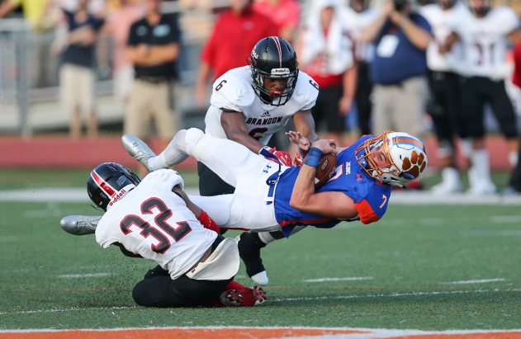
2019 nfhs football points of emphasis
1. Proper Procedures for Weather Delays
2. Free-Blocking Zone and Legal Blocking
Notes:
Comment on Slide:
The following football points of emphasis were selected by the NFHS Football Rules Committee for the 2019 high school football season. These two football points of emphasis need to be stressed to all coaches, game officials, players, parents, school administrators, appropriate health-care professionals and all others who have an interest in high school football.

Slide 30
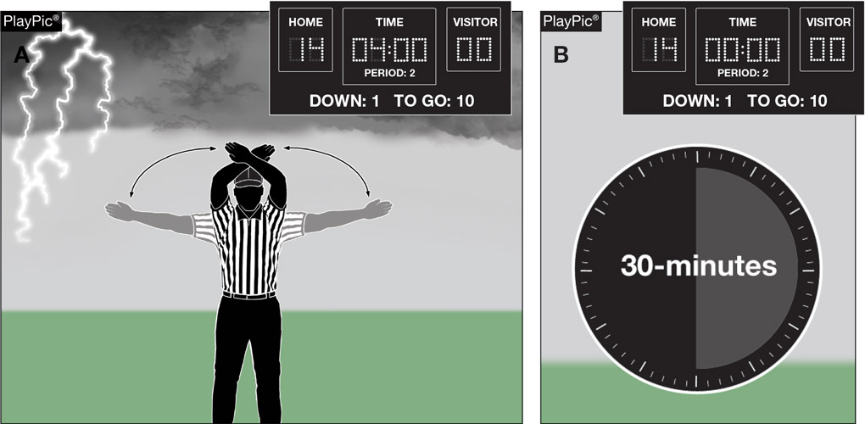
PROPER PROCEDURES FOR WEATHER DELAYS
In PlayPic A, game is suspended with 4:00 left in 2nd period due to lightning. In PlayPic B, after 30-minute delay, game resumes and reaches halftime intermission. Halftime Intermission is still required to be at least 10 minutes in length.
Notes:
Proper Procedures for Weather Delays (Point of Emphasis):
At some point during the high school football season, many parts of the country have to address weather issues. Some of these, according to NFHS guidelines, dictate a suspension/delay during a game. Most of the time, the delay is due to lightning and thunder (either lightning seen or thunder heard); and when a suspension or delay occurs, the teams are sent to a safe, sheltered area until the weather situation has ended. NFHS guidelines on handling lightning and thunder delays require use of the 30-minute rule, meaning when the game has been suspended, play cannot resume until at least 30 minutes have elapsed following the last sighting of lightning or the sound of thunder. Once the game is suspended, each further instance of lightning or thunder requires a reset of the clock and the commencement of a new 30-minute interval.
Seldom is there a problem with game officials or site administrators following the basic 30-minute rule when there is lightning or thunder. However, some game officials and administrators are not abiding by the mandatory halftime intermission and warm-up rule when there is a lightning delay near the end of the first half. If there is such a delay late in the second period, once the second period is completed, NFHS playing rules require a halftime intermission of at least 10 minutes followed by the required 3-minute warm-up period before the third period may begin. Coaches or game officials cannot shorten the halftime intermission or the warm-up period. However, both coaches could agree to shorten (end) the second period during the delay, and then the third period could start after the delay as soon as the mandatory warm-up period is completed.
It is important for game officials, coaches and administrators to be aware of the halftime intermission and warm-up rules on nights when the weather could present delays and to administer those NFHS football rules correctly.

Slide 31
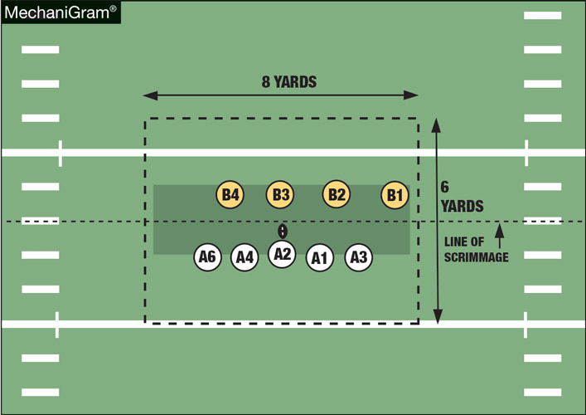
FREE-BLOCKING ZONE AND LEGAL BLOCKING
The free-blocking zone is a rectangular area extending laterally 4 yards either side of the spot of the snap and 3 yards behind each line of scrimmage. A player is in the free-blocking zone when any part of his body is in the zone at the snap.
Notes:
Free-Blocking Zone and Legal Blocking (Point of Emphasis):
The free-blocking zone is a rectangular area established when the ball is snapped. It extends 4 yards laterally on either side of the ball, and 3 yards behind each line of scrimmage. Blocking below the waist and blocking in the back may be permitted in the free-blocking zone provided that certain conditions are met.
Offensive and defensive linemen may block each other below the waist in the free-blocking zone provided that all players involved in the blocking are on their line of scrimmage and in the free-blocking zone at the snap, and the ball is in the zone. Each team’s line of scrimmage is a vertical plane through the point of the ball closest to that team’s goal line.
Offensive linemen may block defensive players in the back in the free-blocking zone as long as the blocker is on his line of scrimmage and in the free-blocking zone at the snap, the opponent is in the free-blocking zone at the snap, and the contact is in the zone.
To determine whether blocking below the waist and blocking in the back are legal, game officials must first determine whether players are in the free-blocking zone at the snap. Since offensive linemen are in the zone if any part of their body is in the zone at the snap, game officials must check the spacing between offensive linemen. As long as the line is using “normal” splits and the formation is “balanced” (i.e., the distance between the outside foot of each lineman and the inside foot of the adjacent linemen is no greater than 2 feet and an equal number of linemen are on each side of the snapper), all players, including the tight end, are deemed to be in the zone at the snap. If the splits are wider than 2 feet, the tight end is considered out of the zone and therefore cannot legally block below the waist or in the back.

Slide 32
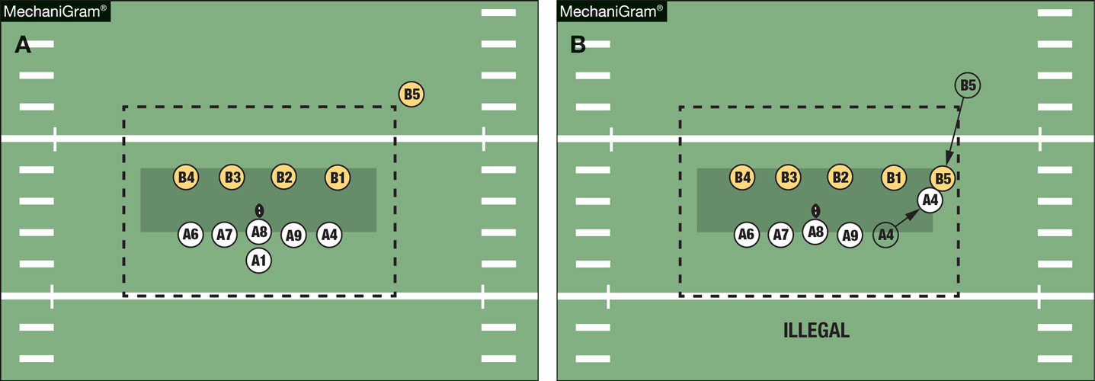
FREE-BLOCKING ZONE AND LEGAL BLOCKING
In MechaniGram A, lineman A4 was inside the free-blocking zone at the snap. In MechaniGram B, Blitzing linebacker B5 was not in the free-blocking zone at the snap and was not a lineman. When A4 blocks B5 below the waist, that is a foul.
Notes:
Free-Blocking Zone and Legal Blocking (Point of Emphasis) - continued:
Once game officials determine which players are in the zone at the snap, the next determination is whether a block below the waist or a block in the back occurs in the free-blocking zone. Because the free-blocking zone disintegrates once the ball leaves the zone, it may be difficult to determine whether the ball is in the zone at the time the block occurs when the offense is using a “shotgun” formation (a formation where there is no direct hand-to-hand snap and the player who receives the snap is more than 3 yards behind his line of scrimmage), due to the very short time interval between the snap and the ball leaving the zone.
In addition to observing blocking by offensive linemen, game officials must also be alert to defenders “cutting” running backs and wide receivers who are not on their line of scrimmage or in the free-blocking zone at the snap. Restrictions on blocking below the waist apply equally to offensive and defensive players. Finally, offensive players in the backfield can never legally block below the waist or in the back.

Slide 33
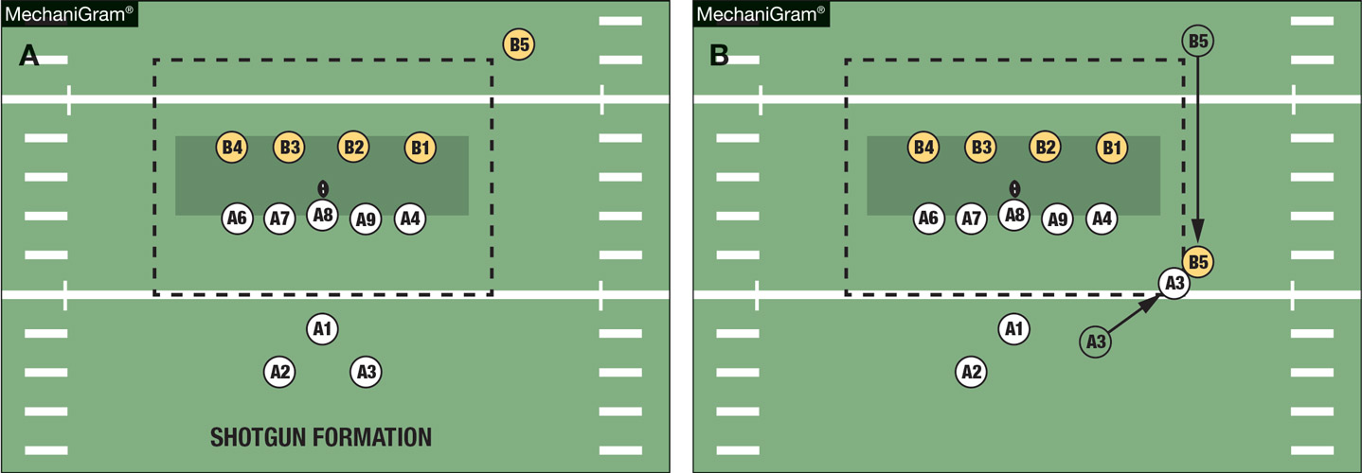
FREE-BLOCKING ZONE AND LEGAL BLOCKING
ILLEGAL
In MechaniGram A, Team A is in shotgun formation. In MechaniGram B, back A3, who was outside the free-blocking zone, is outside the free-blocking zone when he blocks B5, who is also outside the zone, below the waist. That is a foul.
Notes:
Free-Blocking Zone and Legal Blocking (Point of Emphasis) - continued:
See comments on slide.

Slide 34
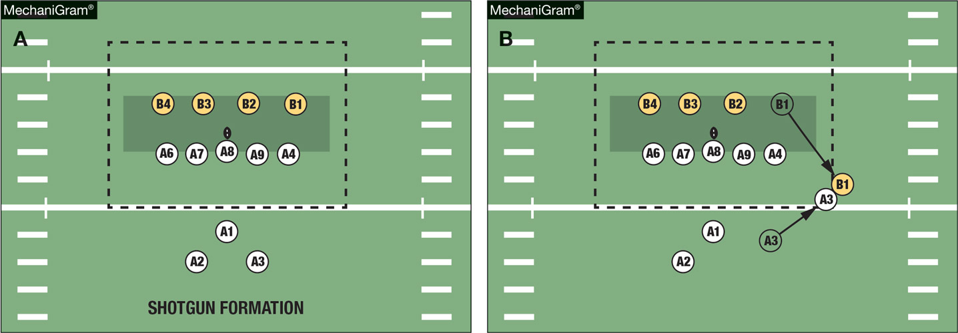
FREE-BLOCKING ZONE AND LEGAL BLOCKING
ILLEGAL
In MechaniGram A, Team A is in shotgun formation. In Mechanigram B, back A3, who was outside the free-blocking zone, is outside the free-blocking zone when he blocks B1 below the waist. That is a foul.
Notes:
Free-Blocking Zone and Legal Blocking (Point of Emphasis) - continued:
See comments on slide.

Slide 35
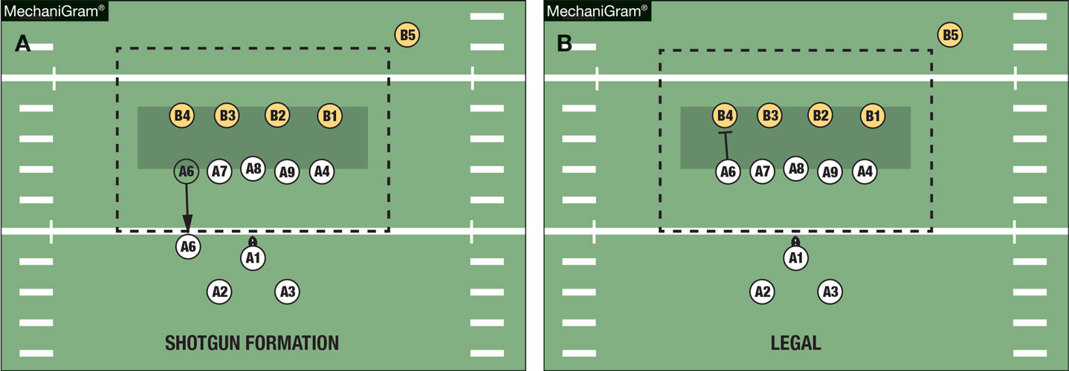
FREE-BLOCKING ZONE AND LEGAL BLOCKING
In Mechanigram A, because A6 did not immediately begin his block on the snap, he may not block below the waist. In Mechanigram B, the initial thrust is simultaneous with the snap. That is a legal block. MUST BE IN A 3 OR 4-POINT STANCE TO BLOCK BELOW THE WAIST.
Notes:
Free-Blocking Zone and Legal Blocking (Point of Emphasis) - continued:
See comments on slide.

Slide 36
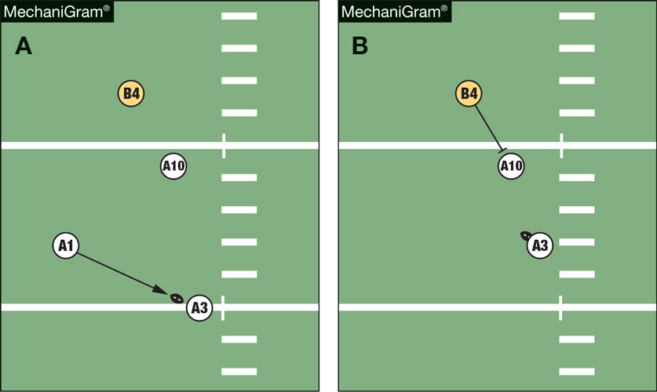
FREE-BLOCKING ZONE AND LEGAL BLOCKING
In MechaniGram A, A3 takes a backward pass on a toss sweep with A10 the lead blocker. In MechaniGram B, defender B4 blocks A10 below the waist to free up other defenders. That is a foul.
ILLEGAL
Notes:
Free-Blocking Zone and Legal Blocking (Point of Emphasis) - continued:
See comments on slide.

Slide 37
2019 nfhs football rules reminders

Slide 38
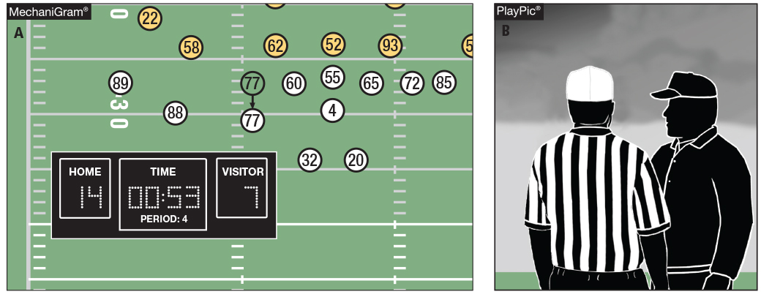
Game clock option
RULE 3-4-7
With less than 2 minutes left in the half and the game clock running, A false starts (MechaniGram A). The offended team may choose to start the game clock on the snap (PlayPic B).
Notes:
Rules Reminder:
RULE 3 - SECTION 4 STARTING AND STOPPING THE CLOCK
ART. 7 . . . When a penalty is accepted with less than two minutes remaining in either half, the offended team will have the option to start the game clock on the snap. …
Comment on Slide:
Rule change in 2017. The committee added an option for the offended team on an accepted penalty inside the last two minutes of either half. The referee continues to have the authority to start or stop the game clock if a team attempts to conserve or consume time illegally.
Case Book: See SITUATIONS 3.3.3D, 3.3.4A, 3.3.4B, 3.4.2A, 3.4.2B, 3.4.2D, 3.4.6 COMMENT, 3.4.7A, 3.4.7B, 3.4.7C

Slide 39
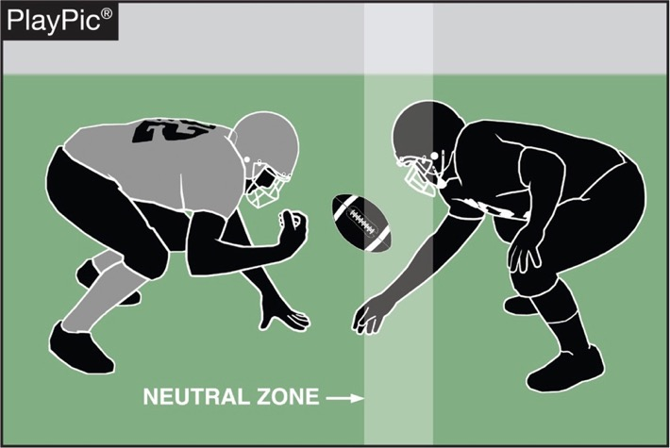
Encroachment rule 7-1-6
After the ready-for-play signal and after the snapper is in contact with the ball, it is encroachment if a defensive player contacts the ball or the snapper’s arms or hands until the snap is completed (Rule 2-40).
Notes:
Rules Reminder:
RULE 7 - SECTION 1 BEFORE THE SNAP
ART. 6 . . . Following the ready for play and after the snapper has placed his hand(s) on the ball, encroachment occurs if:
a. Any other player breaks the plane of the neutral zone;
b. A defensive player makes contact with the ball prior to the end of the snap; or
c. A defensive player makes contact with the hand(s) or arm(s) of the snapper prior to the snapper releasing the ball. …
Comment on Slide:
Rule change in 2017. Defensive players are restricted from contacting the ball or the snapper's hand(s) or arm(s) until the snapper has released the ball.

Slide 40
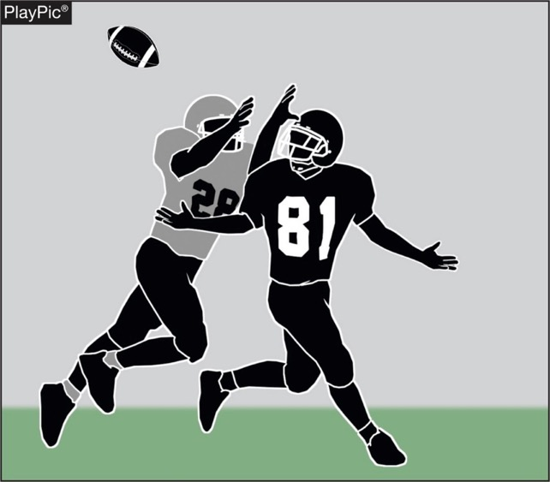
Pass interference rule 7-5-10
Face guarding (without contact) in and of itself is no longer considered an act of forward pass interference.
Notes:
Rules Reminder:
RULE 7 - SECTION 5 FORWARD-PASS CLASSIFICATION
ART. 10 . . . It is forward-pass interference if any player of A or B who is beyond the neutral zone interferes with an eligible opponent's opportunity to move toward, catch or bat the pass. …
Comment on Slide:
Rule change in 2017. This change eliminated the previous foul for non-contact face guarding forward-pass interference.

Slide 41
2018-2019 nfhs football game officials manual

Slide 42
2019 nfhs football game officials manual REMINDERS
2019 is a non-print year for the NFHS Football Game Officials Manual.
Added in 2018, that some white accents are now allowed on the black football shoe that game officials wear as a part of the game official uniform.
2019 Game Officials Manual Points of Emphasis (See pages 86-87 of the 2018-2019 NFHS Football Game Officials Manual):
1. Equipment Issues to be Addressed
2. Consistent Pace of Play Throughout the Game
3. Timing Rules and Procedures
The Game Officials Manual Committee updated for 2019 the following two items:
1. NFHS General Instructions for Football Game and Play Clock Operators
2. NFHS General Instructions for Football Line-To-Gain Crews
Notes:
Comment on Slide:
Reminders for 2019 from the NFHS Football Game Officials Manual Committee on the 2018-2019 NFHS Football Game Officials Manual and other items.
See comments on the slide.

Slide 43
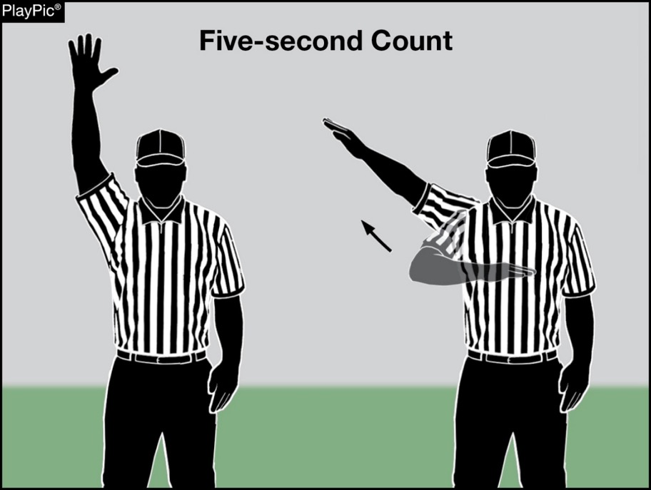
Update on recommended crew communication signals for 2019
Visible count by R (Four-Game Officials Crew) and BJ (Five-Game Officials Crew) of the last five seconds when the on-field 40/25-second play
clocks are not utilized.
Notes:
Comment on Slide:
See comments on the slide. This signal will not be updated in the 2018-2019 NFHS Football Game Officials Manual (Page 24) since it is a non-print year for the Manual.

Slide 44
2019 nfhs football information

Slide 45

NFHS Rules Book as e-Books
E-books features:
  Searchable
  Highlight areas of interest
  Make notes
  Easy navigation
  Adjustable viewing size
  Immediate availability
Notes:
Comment on Slide:
Overview of NFHS Rules Books as E-Books.

Slide 46
Nfhs learning center

Slide 47

Nfhs learning center www.nfhslearn.com
Professional Development For ALL
  Coaches
  Officials
  Administrators
  Parents
  Students
  Performing Arts
Notes:
Comment on Slide:
See comments on slide.

Slide 48
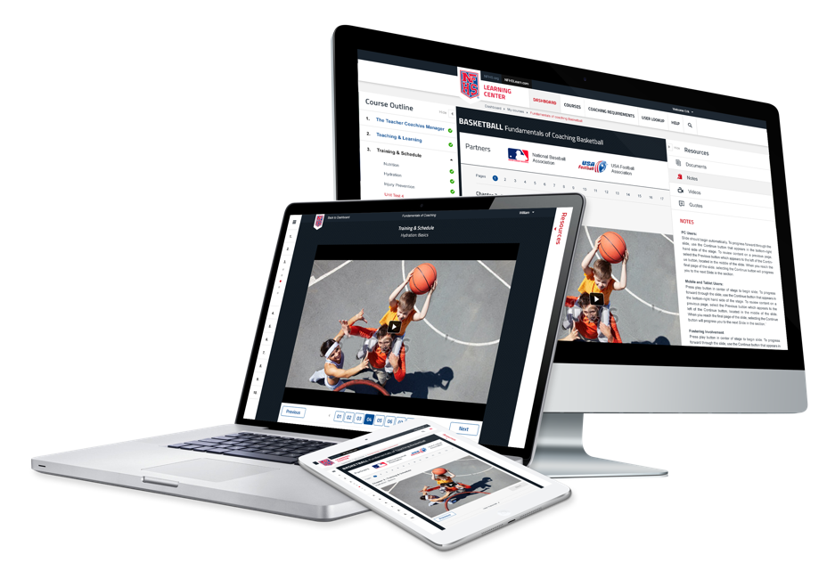
www.nfhslearn.com
FREE courses include:
  Bullying, Hazing and Inappropriate Behaviors
  Student Mental Health and Suicide Prevention
  Understanding Copyright and Compliance
  Protecting Students from Abuse
  Hazing Prevention for Students
  Coaching Unified Sports
  ACL Injury Prevention
  Sportsmanship
  And many more
Notes:
Comment on Slide:
See comments on slide.

Slide 49



Concussion in Sports
Course Objectives
Units
Understand what concussions are and their impact on players
Recognize the complications associated with concussions
Recognize the signs and symptoms of concussion
Know when additional medical attention is needed
Understand what your responsibilities are in concussion management
Understand the proper concussion management protocols
List the steps a player should use to return to active play safely after a concussion
Concussion Overview
The Problem
Your Responsibilities
4.3 Million
Courses Delivered
Available at nfhslearn.com!
Notes:
Comment on Slide:
About: The NFHS has teamed up with the Centers for Disease Control and Prevention (CDC) to educate coaches, officials, parents and students on the importance of proper concussion recognition and management in high school sports. This free course highlights the impact of sports-related concussion on athletes, teaches how to recognize a suspected concussion, and provides protocols to manage a suspected concussion with steps to help players return to play safely after a concussion. Each state's requirements for concussion management are included as part of the course.
www.nfhslearn.com

Slide 50
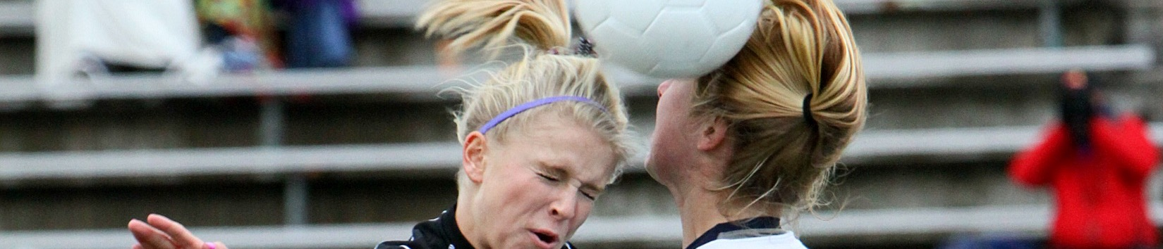

Concussion for Students
Course Objectives
Units
Understand what concussions are and their impact on players
Recognize the signs and symptoms of concussions
Understand how a student should help a teammate who is experiencing a concussion
Understand what students can do to prevent concussions
Identification
Symptoms
Signs
What to Do
Prevention
Available at nfhslearn.com!
Notes:
Comment on Slide:
About: Concussion for Students, developed in Partnership with the Barrow Neurological Institute, has been designed specifically for students to inform them on how to identify, react to, and prevent concussions. This free course is presented as a social media conversation, showing how four different students learn about concussion in different ways. It includes high school students and medical professionals discussing concussion. The key goal is for students to be able to identify signs and symptoms of a concussion so that they can get immediate help before any further injury can occur.
www.nfhslearn.com

Slide 51
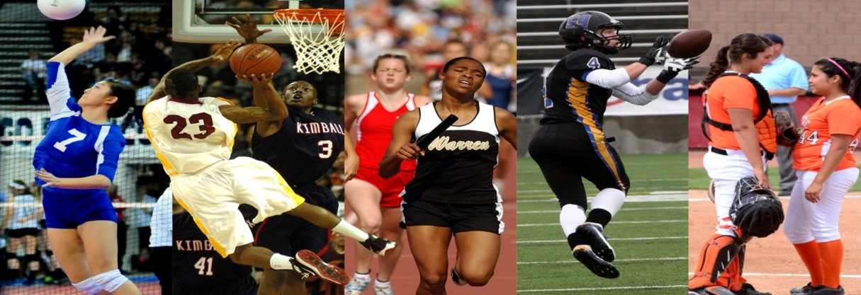
Thank You
National Federation of State High School Associations
PO Box 690 | Indianapolis, IN 46206
Phone: 317-972-6900 | Fax: 317.822.5700
www.nfhs.org | www.nfhslearn.com

