Slide 1

Presented by:
Chiquana Dancy
Director of Sports & Student Programs
2018-19 Track & Field
Rules & Regulations

Slide 2
2019 NFHS Track and field rules powerpoint
Rules Changes
Major Editorial Changes
Points of Emphasis

Slide 3

National Federation of
State High School Associations
NFHS (located in Indianapolis, IN – Est. 1920):
  National leadership organization for high school sports and fine arts activities;
  National authority on interscholastic
  activity programs.
  Conducts national meetings;
  Sanctions interstate events;
  Produces national publication for
  high school administrators;
  National source for interscholastic coach
  training and national information center.
Notes:
The NFHS is the National authority on interscholastic sports and activities and has been in the educational activities business since 1920.

Slide 4

National Federation of
State High School Associations
Membership = 50 member state associations and D.C.
NFHS reaches more than 19,000 high schools and 12 million participants in high school activity programs, including more than 7.8 million in high school sports.
Notes:
Services of the NFHS reaches more than 19,000 high schools and 12 million participants throughout the 8 NFHS sections across the U.S.

Slide 5








NFHS Rules Review Committee
The NFHS Rules Review Committee is chaired by the chief operating officer and composed of all rules editors. After each committee concludes its deliberations and has adopted its recommended changes for the subsequent year, such revisions will be evaluated by the Rules Review Committee.
Davis Whitfield
Chief Operating Officer
Lindsey Atkinson
Volleyball
Bob Colgate
Football and Sports
Medicine
Sandy Searcy
Softball and Swimming & Diving
Elliot Hopkins
Baseball and Wrestling
Julie Cochran
Cross Country, Gymnastics, Field Hockey and
Track & Field
James Weaver
Boys and Girls Lacrosse and Spirit
Theresia Wynns
Basketball and Soccer
Dan Schuster
Ice Hockey
Notes:
All rules committee recommended rules changes are vetted through the NFHS Rules Review Committee before advancing to the NFHS Board of Directors for final action. The committee, as you see, is comprised of all NFHS Director of Sports.

Slide 6


















National Federation of
State High School Associations
The NFHS writes playing rules for 17 sports for boys and girls at the high school level.
  Publishes 4 million pieces of materials annually.
Notes:
Here you can see that the NFHS writes rules for 17 sports, publishes High School Today along with several other key publications totaling over 4 million pieces annually.

Slide 7

NFHS Rules Book as e-Books
E-books features:
  Searchable
  Highlight areas of interest
  Make notes
  Easy navigation
  Adjustable viewing size
  Immediate availability
Notes:
In addition to the printed rules book, the Track & Field and Cross Country Rules Book is also available as an E-book for a nominal cost of $6.99
The NFHS Rules and Case Book E-books are available for $6.99 each.

Slide 8

NEW NFHS Rules App
Rules App features:
  Searchable
  Highlight notes
  Bookmarks
  Quizzes for all sports
  Easy navigation
  Immediate availability
  Free to paid members of the NFHS Coaches and Officials Associations
  www.nfhs.org/erules for more information
Notes:
Comment on Slide:
The app is free to download
Each book subscription is $6.99
NFHS Coaches and Officials Association paid individual members get all books for free as a part of their membership benefits
100% states members get books for free in sports designated by their state
New in 2017 – Rules apps for all NFHS rules books and case books available on iTunes and Google Play. Rules books and case books will be cross-linked. Searchable content.

Slide 9

Guidelines for Schools and state associations for consideration of accommodations
Notes:
To assist state associations in working with schools for the inclusion of students with disabilities the following guide prepared by the NFHS Task Force on the Inclusion of Students with Disabilities is being provided for your review.
Following these guidelines will assist in the individual student assessment by the student and the school.
When requesting a possible accommodation, coaches should work with their school and the state association as early as possible in the sport season.
Contest officials shall defer decisions on rule accommodations to the respective state association.
This information serves as a guide. Each state association may develop its own process.

Slide 10
NFHS Track & field and cross country
Rules Changes

Slide 11

Notes:
The NFHS and Gill Athletics continue our partnership as we share a common goal of striving for excellence by our athletes and with track and field equipment.
Gill Athletics is the official partner for track and field equipment with the NFHS.

Slide 12
4-3-1 Competitor’s uniform in track and field and cross country
  The NFHS Track and Field Rules Committee reorganized Rule 4-3:
    The uniform top and bottom were combined into 4-3-1b to help reduce redundant language within the book.
  Anything worn under the uniform is now considered a foundation garment. Foundation garments are not subject to logo/trademark/reference or color restrictions.
  All uniform rules (track and field and cross country) now fall in rule 4-3.
Notes:
This change eliminates the redundant language in Article 1.
Current logo/trademark/reference restrictions remain in place for all uniform top and/or bottoms.
It expands the current interpretation of foundation garment to include any item worn under the uniform top and/or bottom. The games committee does have the authority to restrict the wearing of any item outside of the required school uniform and therefore could create more restrictive rules regarding items worn under the uniform if deemed appropriate. This change would minimize issues related to logo/trademark/reference, color and length of undergarments.

Slide 13
6-2-20
General rules for field events
“-“ pass; “O” cleared; “X” failed
This is the correct way to list attempts.
Notes:
Adds consistency through all NFHS Track and Field books and other rule codes.

Slide 14
6-6-11, 6-8-12
Discus throw
Rule 6-6 Discus Throw
ART. 11. . . The measurement shall be recorded to the nearest lesser inch or even number centimeter (e.g., 0-2-4-6-8).
Rule 6-8 Javelin Throw
ART. 12. . . The measurement shall be recorded to the nearest lesser inch or even number centimeter (e.g., 0-2-4-6-8).
Notes:
Puts rule in line with other rule codes and enables states using the metric system to give a fairer depiction of the actual performance.

Slide 15
6-9-4, 6-9-5, 6-9-7 long jump/triple jump
The landing pit shall be filled with sand or other soft material to a depth at least 12 inches (30 centimeters) deep.
The landing pit shall have a minimum width of 9 feet (2.75 meters).
  a. In the Long Jump, the distance between the takeoff board and the nearer edge of the landing area shall be at least 3 feet (1 meter) and not more than 10 feet (3 meters). The distance between the foul line and the farther edge of the landing area shall be at least 32 feet (10 meters).
  b. In the Triple Jump, the nearer edge of the landing area shall be at least 36 feet (11 meters) from the foul line for men and 27.89 feet (8.5 meters) for women. Distances of 32 feet (10 meters) and 26 feet (8 meters), respectively, are recommended.
  NOTE: Distance from the foul line or takeoff board may be adjusted to accommodate different levels of competition. Competitors may change which foul line or takeoff board they are using during competition, but only with the prior notification and confirmation of the event judge.
Notes:
One of the 2017-18 NFHS Board Goals is to address specific areas of risk in all NFHS Sports.
We want our student-athletes to benefit from the protection enjoyed by athletes participating under other rules codes.
These changes bring the NFHS rules in line with “the industry standard.”

Slide 16
8-1-1 THRU 3
COURSE
ART. 1 …The cross country course shall be 2500 to 5000 meters (1.5 to 3.1 miles) in length as determined by the meet director or games committee. Measurement shall be along the shortest possible route a runner may take on the prescribed course. The course shall be clearly marked. This may be by a single wide line or boundary lines, both inside and outside marked with a material which is not injurious to the eyes or skin. The use of natural or artificial boundary markers may also be used. Signposts with large directional arrows wherever the course turns, or flags about 1-foot square and mounted on stakes which hold them 6 feet or more above the ground shall be used.
Note: If a single wide line is used it may or may not mark the shortest possible route a runner may take.
FLAG DESIGNATIONS
· A red flag indicates a turn to the left. Runners must stay on the right side of the flag.
· A yellow flag indicates a turn to the right. Runners must stay on the left side of the flag.
·A blue flag indicates a course straight ahead. Runners may run on either side of the flag.
Notes:
Clarification of course markings better describes legal course layout.

Slide 17
8-3-2 thru 5
No matter the finish system being used, the order of finish is based on when the competitor’s torso crosses the finish line.
Terminology was changed to image based timing system.
Notes:
There are currently three methods for determining order of finish in cross country:
the traditional hand timing with tear tags, shoe or bib chips and photo finish systems.
This rule change clarifies that no matter the system used, the order of finish is based on when the torso crosses the finish line.

Slide 18
NFHS Track & field and cross country
Editorial Changes

Slide 19
4-3-1
Competitor’s uniform in track and field and cross country
  The top or one‐piece uniform may have school name, school logo, school nickname and/or competitor's name.
Notes:
Consistent NFHS rule book language.

Slide 20
4-6-5
Disqualification and Conduct
Art. 5. . .
NOTES:
1. The use of an inhaler during competition containing a prescription drug designed to alleviate the asthmatic condition is not considered to be an illegal aid as long as a physician’s statement documenting the need of the athlete to use the prescription is presented to the meet director/referee prior to the beginning of the meet.
Notes:
Clarifies terminology.

Slide 21
5-1-3
Track Construction
If cones are used with the absence of a curb, the cones should be placed on the line, up to the edge of lane one.
Cones should be spaced about 1.5 meters or 5 feet apart
Notes:
Clarifies the placement of cones if being used in lieu of a raised curb.

Slide 22
5-2-3 course measurements
Art. 3 …A lane is the course which is marked on the track and for a race or that part of a race during which the runner must stay in a prescribed path. Lanes vary in width depending
upon the size of the track and the number desired or a given event. Standard Lane width is 42 inches (1.07 meters). Lanes on a facility shall have equal width.
Notes:
All lanes should be the same width to insure fair competition. This change would bring NFHS rules in line with other rule codes.
In the case of a raised curb, the curbs relationship to the measure line is already adjusted to compensate for the effect the curb may have on an athlete. As for construction, a track built with a wider lane 1 will have to be built 10cm wider than a track that is built with equal width lanes.

Slide 23
6-5-1, 6-9-1 pole vault, long jump, triple jump
To calculate the slope – compare the elevation at the start of the runway to the elevation at the zero line or take-off board.
  Intermediate measurements are not considered.
  Elevation and Planarity Tolerances still must be met.
Notes:
Brings language in line with other rule codes.
There can (should) be a gradual rise and fall in runways within d-zones, as long as it is within tolerance.
Tolerance - elevation at the start of the runway and the end (zero point of the pole vault and takeoff boards/landing pits of the horizontal jumps), should not exceed 1’ in 1000’ (.1%) downward.
Planarity/evenness tolerances must still be met as well. Localized dips or high spots exceeding ¼” in 10’ should be corrected.
Checking that the surface’s evenness or planarity is within tolerance is separate from the grade elevation measurements addressed by this verbiage change.

Slide 24
8-3-3 Cross Country
Start/Conclusion
With the deletion of 8-6 Competitors Uniform in Cross Country - the wearing of chip/transponder/number was moved to section 8-3
The penalty for altering the chip/transponder/number was also moved here.
Notes:
Art. 3… In cross country, a competitor shall wear the assigned contestant number and/or computerized
transponders/chips during competition. The number and/or transponders/chips shall be worn, unaltered, for purposes of official timing and place finish.
PENALTY: A competitor not wearing the assigned contestant number and/or computerized transponders/chips or altering such items in a manner which interferes with the recording of place finish is a rule violation resulting in disqualification from the race.

Slide 25
NFHS Track & field and cross country
Points of Emphasis

Slide 26
Points of emphasis
Uniforms
Wearable Technologies
Officials Safety and Recommendations in vertical and horizontal jumps

Slide 27
Points of emphasis uniforms
Increasing difficulty to officiate uniform rule.
  Individuals purchasing all or part of the uniform.
  Slight variations in uniform design from year to year.
Slight differences in design do not negatively impact the identification of a relay or cross country team by an official.
Expectation is that teams can still be clearly identified as representing the same school through predominant color, school logo, and color combinations of all outer garments.
Notes:
The games committee will continue to have the authority to restrict or permit the wearing of any item outside of the required school uniform.

Slide 28
Points of emphasis wearable technologies
Policing wearable technology has become difficult to officiate.
Technology can be found in watches, sports bras, shoes, jewelry, etc. and it is nearly impossible to distinguish from the same item type that does not include the technology.
The market is forecasted to sell almost 500 million wearables by 2021.
Notes:
Restricting the wearing of a watch because it contains GPS capability is futile when the same technology is available in the shoe, the sports bra they have on or the ring they are wearing.
Nearly all these wearable technologies can both transmit and receive collected data from other mechanisms.
This data can be used to evaluate how the body is performing, and the user can adjust as needed based on that data.

Slide 29
Points of emphasis wearable technologies
Electronic devices are still not permitted to transmit information to the competitor during a race or trial.
  If such communication is observed by an official, the competitor should be disqualified.
Discussion about compliance with Federal and State Policies should be addressed by schools concerning the Privacy and legal issues surrounding personal biometric information.

Slide 30
Points of emphasis officials safety and recommendations in vertical and horizontal jumps
The safety of the athletes and officials is most important before, during and after the competition.
Eliminating hazardous conditions from the venue
  Foreign debris in the landing area,
  Inspection of the runway for tripping hazards
  Removing equipment out of harm's way.
  Always be prepared for the unexpected even though the event seems to be progressing as planned.

Slide 31
Safety and recommendations in vertical and horizontal jumps
Horizontal Jumps
  Make sure pits are full of sand and turned,
  Shovels and rakes are placed tines down after use to avoid accidental injuries.
  Inspect each takeoff board and pit edges. Also instruct those raking the pit to keep the sand off the track as much as possible.
Vertical Jumps
  Make sure the pits meet the rule standard,
  Pits are correct size and properly padded,
  Check that each crossbar meets standards and is clearly marked.
  In pole vault, double check standards and extenders, and that the planting box is free of water and in good condition.

Slide 32
Safety and recommendations in vertical and horizontal jumps
Do not allow multiple jumpers on the runway at the same time during competition.
During warm-ups, pay special attention when athletes are trying to set their marks and other competitors are on the runway or apron.
  Athletes running away from the pit or mat to set their marks with or without implements can be hazardous to other competitors and officials in the area if no one is paying attention.
Remember to control the runway during practice and during the competition. If another event (i.e., throwing) is in progress near your venue, warn the athletes to pay attention when participating and leaving the event.
Be attentive when you are at the venue particularly when track events are in progress.
Instruct the athletes as to which direction to exit the pit or mat so as not to interfere with oncoming runners or adjacent events.

Slide 33
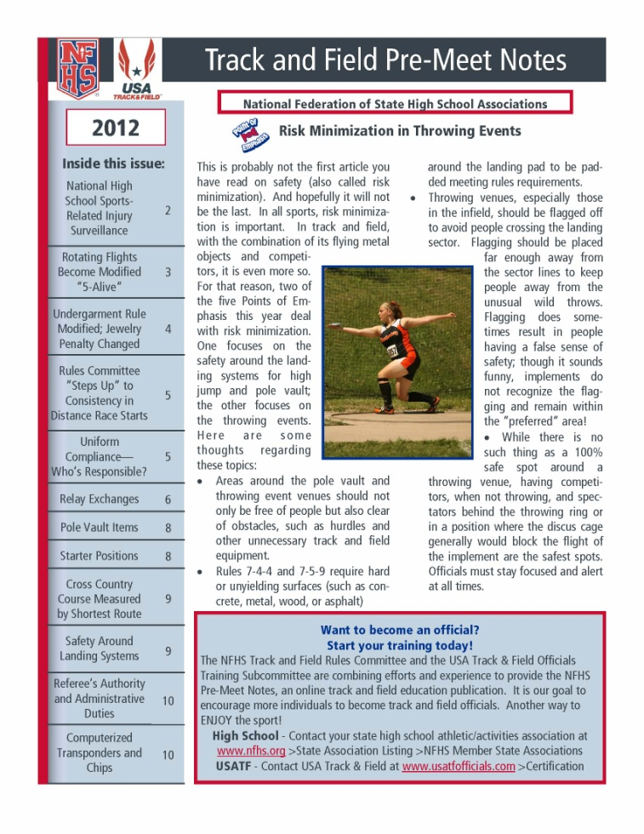



NFHS Track and Field
Pre-Meet Notes
NFHS Track and Field
Pre-Meet Notes
will be available online at http://www.nfhs.org/track.aspx
and
https://www.usatf.org/groups/officials/newsletters/
NFHS Track and Field Pre-Meet Notes are made possible through the cooperative efforts of the NFHS Track and Field Rules Committee and USA Track and Field Officials Training Subcommittee
Notes:
Pre-Meet Notes will be available online via NFHS and USATF.
This pre-season publication is prepared for officials and coaches.
It is of great value to volunteers also working the meets.
The Pre-Meet Notes also provide information on how to become an official with your state association and USATF.

Slide 34
NFHS Officials Association
Central Hub

Slide 35

NFHS Officials Association Central Hub
https://www1.arbitersports.com/front/105416/Site
Contains:
  Sport information
  Rules information
  Rules library
  Searchable rules book
  Video content on officiating sport, competition situations and interpretations
Notes:
State associations with 100% membership in the NFHS Officials Association and any individual member has access to the Central Hub for officials.

Slide 36
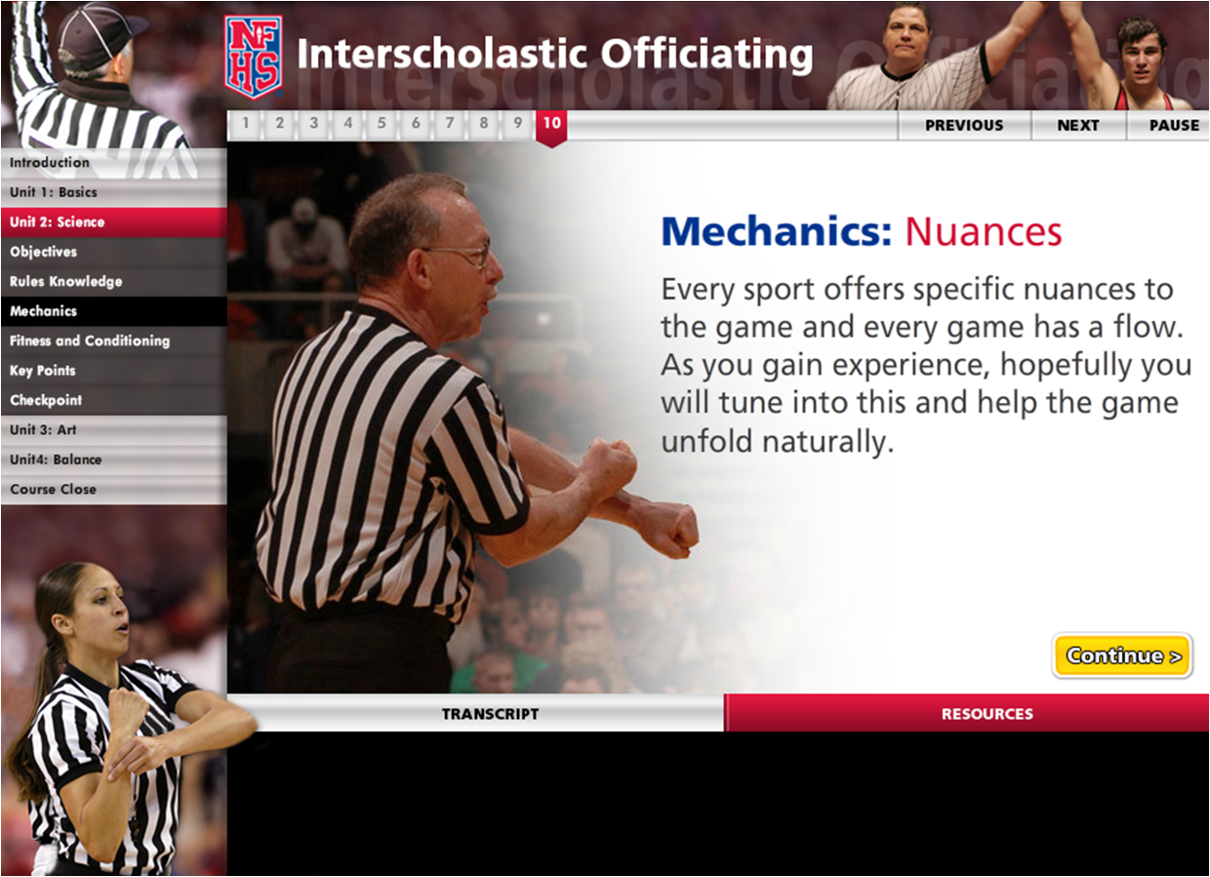
Interscholastic Officiating www.nfhslearn.com
Introduction to skills and concepts used as an official
Ideal for new officials or those in first few years of officiating
30-45 minutes to complete
Topics include: basics of becoming and staying an official, science of officiating, art of officiating, how to combine these skills for successful officiating
Course is FREE to any NFHS Officials Association member
Non-members course is $20
API available to state associations to collect results
Notes:
The Interscholastic Officiating Course contains the following information:
Introduction to skills and concepts used as an official
Ideal for new officials or those in first few years of officiating
30-45 minutes to complete
Topics include: basics of becoming and staying an official, science of officiating, art of officiating, how to combine these skills for successful officiating
Course is FREE to any NFHS Officials Association member
Non-members course is $20
Contact NFHS Officials Department for details (317.972.6900)

Slide 37
NFHS OFFICIALS EDUCATION
SPORT-SPECIFIC COURSES
Courses Available
  Officiating Football
  Soccer – Fouls and Misconduct
  Swimming and Diving
  Officiating Wrestling
  Officiating Basketball
  Umpiring Softball
  Officiating Volleyball – Ball Handling
Future Courses
  Officiating Baseball
  Basketball – Three-Person Mechanics
  Field Hockey
  Track and Field
  Volleyball – Overlapping
  Softball – Mechanics
  Communication Among Officials and Coaches
  Soccer - Offside
Notes:
NFHS OFFICIAL EDUCATION
Courses Available
Officiating Football
Soccer – Fouls and Misconduct
Swimming and Diving
Officiating Wrestling
Officiating Basketball
Umpiring Softball
Officiating Volleyball – Ball Handling
Check the listing for sport courses to come.

Slide 38
NFHS Learning Center

Slide 39

Nfhs learning center www.nfhslearn.com
Professional Development For ALL
Coaches
Officials
Administrators
Parents
Students
Performing Arts
Notes:
Digital platform for online professional development courses are available on www.nfhslearn.com.

Slide 40
NFHS learning center www.nfhslearn.com
Over 1.3 Million courses delivered in 2017
Over 6.7 Million courses since 2007 launch
Over 55 courses available
Over 25 at No Cost!

Slide 41

free courses | Over 20 available! www.nfhslearn.com
Examples of FREE courses include:
Bullying, Hazing and Inappropriate Behaviors
Social Media
Introduction to Interscholastic Music
Concussion in Sports
Heat Illness Prevention
Sudden Cardiac Arrest
Sportsmanship
Sports Nutrition
Coaching Unified Sports
Positive Sport Parenting
NCAA Eligibility

Slide 42
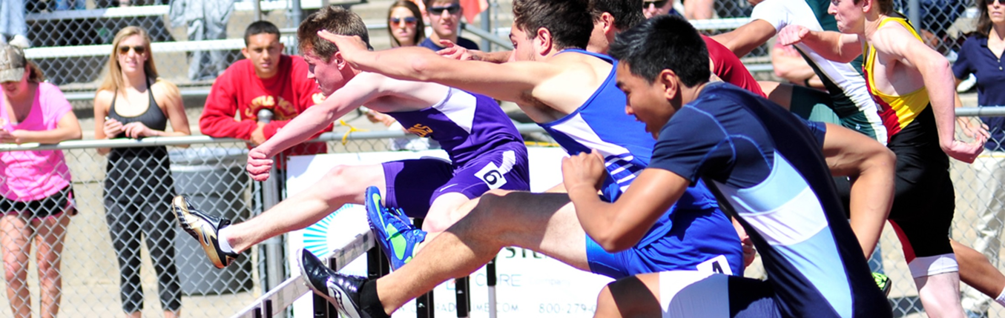


Coaching
Track and Field
Course Objectives
Units
■ Types of races – sprint and endurance
■ Running form – proper posture, arm movement, and leg movement
■ Start and Drive phase – block and standing start
■ Types of jumps – horizontal and vertical
■ Jump elements – approach, take off, flight and landing
■ Throwing – basic skills for each event type
■ How to teach skills for correct form
■ Teaching progressions to combine skills into full movement
■ Running
■ Jumping
■ Throwing
More Information at nfhslearn.com!
Notes:
About: Coaching Track and Field, developed by USA Track and Field and the NFHS is hosted by decorated Olympic athletes Dan O'Brien and Hyleas Fountain. The course presents the fundamentals of running, jumping and throwing, as well as the importance of sound mechanics and how to teach these basic skills. After taking this course, you will be able to identify key points or stages of a skill, and use visual demonstrations with verbal cues to help participants execute a particular technique or skill. Members of USA Track and Field will receive a $15 discount as an added benefit.
More:
■ Unlimited access to course & resources for one year from date of purchase
■ Use to fulfill AIC or CIC certification requirements
■ Approved by NFHS for 5 course clock hours

Slide 43


Coaching
Pole Vault
Course Objectives
■ Starting a beginner – teaching proper standing grip height, width of hands on pole, and position of hands on pole
■ How to instruct beginning level pole-vaulters through skill development drills and build confidence
■ Maintaining a safe practice and competition environment – proper pad placement and securing of vault mat pads
Units
■ Starting a Beginner
■ Basic Laws of Physics
■ Drills and Coaching Techniques
■ Problem Solving
■ Equipment and Facility
■ Interactive Exercise
More Information at nfhslearn.com!
Notes:
About: This course, developed by USA Track and Field and the NCAA, has been designed to help both coaches and athletes. Coaches will learn to develop and teach the introductory skills of pole vaulting to your students. After completing this course, each participant will have a better understanding of the fundamentals of pole vaulting, as well as the best practices and techniques that will help educate and promote safety in the sport.
More:
■ Unlimited access to course & resources for one year from date of purchase
■ FREE Course
■ Use as an elective to fulfill CIC certification requirements
■ Approved by NFHS for 3 course clock hours

Slide 44
NFHS Network

Slide 45

NFHS Network
By 2020, every high school sporting event in America will be streamed live.
The NFHS Network will be THE DESTINATION for fans to view these broadcasts.
www.NFHSnetwork.com

Slide 46


Notes:
Capture the moment, share the excitement and be a part of the memories!
Visit NFHSnetwork.com, THE DESTINATION, to view high school events at their best.

Slide 47
Thank You!
National Federation of State High School Associations
PO Box 690 | Indianapolis, IN 46206
Phone: 317-972-6900 | Fax: 317.822.5700
www.nfhs.org | www.nfhslearn.com
www.nfhs.org

Slide 48
NCHSAA
BOARD CHANGES
IMPORTANT INFORMATION
ELIGIBILITY & COMPLIANCE

Slide 49
Board Changes
Cross Country Regional Championship Adjustments
  The number of state championship advancers will be determined by teams that participate in the regional championship.
    Note: This a change from determining advancers based on the number of schools registered for the regional meet.
  Adjust the state championship qualifiers from regional meet to the following: The top 4 teams or 25%, whichever is greater, will advance from the regional to the state championship.

Slide 50
Board Changes
Indoor Track & Field Hosting Requirement
  Eliminate the requirement for schools to request to host “polar bear” meets (indoor meets on outdoor facilities) with at least 5 schools present.
    Note: Any meet with less than 5 schools still requires NCHSAA approval

Slide 51
Board Changes
Ticket Prices
  Increased ticket prices for all playoff rounds, including regional and state championships, across all sports effective July 1, 2018

Slide 52
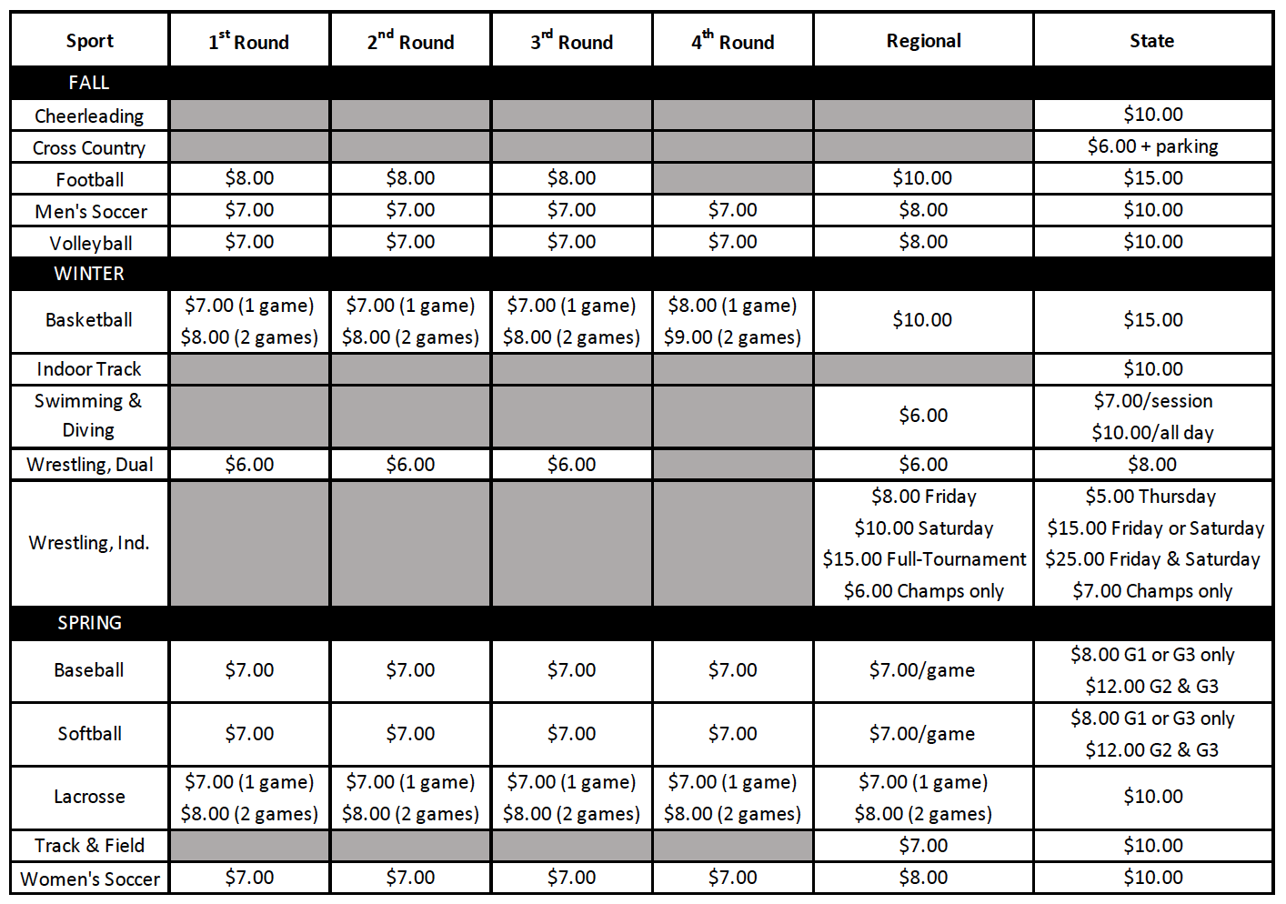
Board Changes
Notes:
This updated chart is in the 2018-19 Handbook.

Slide 53
Board Changes
Transfer Policy
  Added language to the Transfer Policy allowing Staff to review all Transfer Certification requests.
    “Absent mutual agreement, and in consideration of the above, exceptions for immediate athletic eligibility for transfers from one LEA to a different LEA will first be considered by the NCHSAA Staff, then by the NCHSAA Transfer Committee, if necessary.”

Slide 54
Board Changes
Amateur Rule
  Acceptance of money or a forbidden award will cause an athlete to lose athletic eligibility in all sports for 365 days.

Slide 55
Board Changes
Sportsmanship/Ejection Policy
  Added language to 2.4.2 (f)
    “The NCHSAA will have zero tolerance within the confines of an NCHSAA event for the following: profanity of any kind, inappropriate language, racial or ethnic slurs, sexist or homophobic language”.

Slide 56
Board Changes
Sportsmanship/Ejection Policy Penalties
  Added “coaches” to 2.4.3 (c)
    “Players or coaches receiving two ejections for unacceptable behavior as defined above will be suspended from all sports for the remainder of that sport season.”

Slide 57
Board Changes
Scrimmages/Ejections Report
  Ejections in pre-season scrimmages now require:
    Coach/player suspended from the remainder of the scrimmage – inclusive of multiple scrimmage events on same day (jamboree)
    Player must complete the NFHS “Sportsmanship” course before being eligible to compete in next scrimmage/contest
    Head Coach must complete the NFHS “Teaching and Modeling Behavior” course for any

Slide 58
Board Changes
Video Review for Ejections
  When available, NCHSAA staff may utilize video to invoke ejections/sanctions not reported by game officials.
  Video clips to be presented for committee review within two (2) business days of the contest.

Slide 59
Board Changes
Return To Play Form
  If a student participating in an interscholastic athletic activity exhibits signs or symptoms consistent with concussion, the student shall be removed from the activity at that time and shall not be allowed to return to play or practice that day. The student shall not return to play or practice on a subsequent day until the student is evaluated by and receives written clearance for such participation from (i) a physician licensed under Article 1 of Chapter 90 of the General Statutes with training in concussion management, (ii) a neuropsychologist licensed under Article 18A of Chapter 90 of the General Statutes with training in concussion management and working in consultation with a physician licensed under Article 1 of Chapter 90 of the General Statutes, (iii) an athletic trainer licensed under Article 34 of Chapter 90 of the General Statutes, (iv) a physician assistant, consistent with the limitations of G.S. 90-18.1, or (v) a nurse practitioner, consistent with the limitations of G.S. 90-18.2.

Slide 60
Board Changes
Return To Play Form
  NCHSAA recommends a medical physician!

Slide 61
Board Changes
Home Campus Background and Description
August 2000: Current system built and maintained by local technology vendor
April 2015:
Inhouse systems administrator hired
July 2018:
Convert all NCHSAA database needs to Home Campus
Current system is functional but:
Lacks centralization
Ability to grow or add new functions
Intermittent access issues based on user’s platform
Notes:
The Board approved a change in the database management system from FileMaker to Home Campus.

Slide 62
Board Changes
Home Campus Scope
  The following are 2017-2022 NCHSAA Strategic plans items that will be accomplished by this conversion:
    1.1.3 Update the current systems for reporting violations and infractions.
    1.2.3.3 Create an interactive tool on the NCHSAA website to help students and parents determine athletic eligibility
    2.2.3 Evaluate stakeholder information delivery systems.
    2.3.1 Monitor trends in the digital media space, including live video/streaming and social media, and find ways to benefit schools through new technologies.

Slide 63
Board Changes
Home Campus Phase 1 – Existing
  The new system will include the following current database functions:
    Membership data information (coaches, school information, etc.)
    LEA data information
    Regional Supervisors data information and clinic scheduling
    Sport clinic attendance for coaches
    Eligibility summary data entry for each sport season
    Endowment games
    Transfers
    Violations
    Sanctions
    Ejections/Disqualifications
    Seeding for baseball, basketball, golf (regionals), football, lacrosse, tennis (dual team and regionals), volleyball, softball, and wrestling (dual team)

Slide 64
Board Changes
Home Campus Phase 1 – New
  The new system will also add the following:
    Ability for system athletic directors to search the membership directory as well as monitor the schools in their LEA for compliance.
    Ability to have games, rosters and records entered in MaxPreps to be auto-populated in the school’s database.
    Ability to have NFHS Learn coach education auto-populated in the school’s database.
    Ability to digitize all financial forms such as playoff and endowment game forms.
    Ability to export search results to an Excel document for off-line use.
    Home Campus also offers many additional features that will be rolled out following stakeholder needs assessments.

Slide 65
Important Information
Dates: Cross Country
1st Practice: July 30th
1st Contest: August 13th
Entry Deadline: October 19th (3:00pm-NC MileSplit)
Regional: October 27th
State Championship: November 3rd

Slide 66
Important Information
Dates: Indoor Track & Field
1st Practice: October 31st
1st Contest: November 14th
Entry Deadline: February 2nd (9:00pm-NC MileSplit)
State Championships: February 8-9, 2019
Dates: Outdoor Track & Field
1st Practice: February 13th
1st Contest: February 27th
Entry Deadline: May 4th (6:00pm-NC MileSplit)
Regionals: May 10 or May 11
State Championships: May 17 & 18, 2019

Slide 67
Dead Periods
Important Information
Summer 2018 (All) | July 2-July 8 and July 16-22
Fall 2018 (Indoor & Outdoor) | July 30 through August 19
Winter 2018 (Cross Country & Outdoor) | Oct 31 through November 20
Last five (5) days of the first semester (All)
Spring 2019 (Cross Country & Indoor) | February 13 through March 5
Last ten (10) days of the second semester (All)
Summer 2019 (All) | July 1-July 7 and July 15-July 21

Slide 68
Important Information
Regular Season Limitations
Cross Country:
  No more than three (3) meets may be scheduled per week
  An individual is limited to one contest a day (no season limit)
Track & Field:
  An individual is limited to one (1) meet per day, maximum of four (4) events per meet.
  Indoor: No more than two (2) meets may be scheduled per week
  Outdoor: No more than three (3) meets may be scheduled per week
  NOTE: If a team participates in separate events on the same day, each meet will count towards the daily and weekly limitations for the individual and team.

Slide 69
Important Information
Use form provided on NCHSAA website to request to host an indoor meet on an outdoor facility, if less than five (5) teams
Indoor & Outdoor: Regular season meets and results must be entered on NC MileSplit (nc.milesplit.com)
  NOTE: Full meet results must be entered within 48 hours of the completion of the meet (This rule now applies to both indoor and outdoor seasons).
  Any school hosting a meet and does not post results within the specified timeframe are subject to penalties.

Slide 70
Important Information
Regional and State Meet Entry Processes
Cross Country & Outdoor Track/Field:
  Regionals: Teams and individuals must be entered into regionals by coach using NC MileSplit
  State Meet: Qualify from Regionals; information submitted by regional directors
Indoor Track & Field:
  Coaches must enter athletes into the state meet using NC MileSplit

Slide 71
Important Information
Late Entry Process
Procedure for Cross Country, Indoor and Outdoor Track & Field
  May be submitted to the NCHSAA and must be in by 3:00pm the Monday prior to the regional (state championship for indoor track)
  Use late entry form on NCHSAA website to fax or email prior to deadline; once reviewed AND if accepted
  A $50 fee will be assessed for each individual entry; check made payable to NCHSAA
  No entries after this will be accepted

Slide 72
Important Information
NC MileSplit
Create/update your rosters and team information at the beginning of the season
You can enter your athletes into the regional (outdoor) and state (indoor) meets as they hit the qualifying standards. You should not wait until the end of the season.
Web administrator: Jason Creasy (jcreasy@milesplit.com or jason.creasy11@gmail.com)

Slide 73
Important Information
NC MileSplit
Complete results from all meets (indoor and outdoor) MUST be entered using meet management software (i.e. RaceTab or Hy-Tek)
  No handwritten/Word files accepted
  Only entries submitted through the approved database will be accepted for regional and state meet qualifying

Slide 74
Important Information
Points of Emphasis
All NFHS and NCHSAA rules should be practiced throughout the regular season, including the uniform rules.
Regional Assignments: Posted on the respective web pages for Cross Country and Track & Field
Outdoor Track & Field: The top 4 finishers in each event (including relays) will advance from regionals to the state meet. All ties at the regional level must be broken.
Wheelchair Competition:
  Must satisfy regionals/state qualifying standards and
  Regular season participation is required
  Must inform the NCHSAA if you have a wheelchair participant

Slide 75
Important Information
Sportsmanship
The quality of responsible behavior characterized by a spirit of generosity and a genuine concern for opponents, officials and teammates.
  Wholesome athletic environment
  Good Sportsmanship > Victory
  Modest in victory, gracious in defeat
  Respecting judgment and integrity of game officials
  Role modeling good behavior

Slide 76
Important Information
Ejection Policy
  Fighting
  Leaving the bench area
  Flagrant contact
  Biting
  Taunting, baiting or spitting toward an opponent or official
  Profanity
  Obscene gestures
  Disrespectfully addressing an official

Slide 77
Important Information
Ejection Follow-Up
  Teaching & Modeling Behavior Course
    Required for any coach ejected during a contest
    Required for any coach who has player (s) ejected for fighting
  NFHS Sportsmanship Course
    For any ejected/disqualified player
    Free, on-line course (nfhslearn.com)

Slide 78
Important Information
Inclement/Hot Weather Guidelines
The following should be considered when scheduling practice:
  Time of day
  Intensity level of practice
  Equipment worn
  Environmental conditions
  High Temperature and high humidity create a dangerous situation for athletes. High humidity and low temperature can also cause serious heat-related problems.
  Water/fluid replacement breaks recommended each 20 or 30 minutes. (depending on practice conditions)
  Check with your AD on your LEA’s and school’s policy pertaining to practice on days of extreme heat.

Slide 79
Eligibility and Compliance
Eligibility Video
Required viewing for all coaches
Should be done with the athletic director
Includes opportunities to discuss concussions/sudden cardiac arrests/sickle cell, etc.

Slide 80
Eligibility and Compliance
Preseason Meeting
Required attendance by all parents
Time to share rules, regulations, expectations, philosophy etc.
Time to get all required signatures--pledges, Gfeller-Waller information, etc.
Eligibility and Authorization

Slide 81
Eligibility and Compliance
Coaches Education
NFHS Fundamentals of Coaching Course
  All coaches must have satisfied the requirement prior to first contest.
  Complete prior to first contest; subject to a $500 fine; continuing to coach without completion = another $500.

Slide 82
Eligibility and Compliance
Coaches Education
Concussion Management Certification
  The NFHS Concussion in Sports Course (free on-line course) or an equivalent course must be completed annually (after June 1, 2018 and before the first date of practice) by all coaches.
  Prior to the first date of practice for that sport; subsequently, the certificate of completion must be on file at the individual school; subject to $500 fine.
The pole vault head coach is required to take the NFHS “Coaching Pole Vault” course prior to the first date of practice in their sport.

Slide 83
Eligibility and Compliance
Coaches’ Education
CPR/AED Certification
  All head and paid coaches must be CPR/AED certified
NFHS Sudden Cardiac Arrest Course
  All non-paid coaches are required to complete the NFHS Sudden Cardiac Arrest Course annually (after June 1, 2018 and before the first date of practice).

Slide 84
Eligibility and Compliance
Gfeller-Waller Concussion Law
Requirements
  Concussion signs and symptoms
    Given prior to participation
    Parents/athletes sign indicating “receipt of” Return to Play (RTP) form signed by a physician licensed to practice medicine
    An up-to-date Emergency Action Plan (EAP)
      Must be on-file, posted and updated annually
  “When in doubt, sit them out”

Slide 85
Eligibility and Compliance
Coaches Education
Accredited Interscholastic Coach (AIC) (6th Nationally)
  Requires completion of 4 courses:
    Fundamentals of Coaching
    1st Aid, Health & Safety for Coaches
    Sport Specific Course or Teaching Sports Skills
    Concussion in Sports (Free)

Slide 86
Eligibility and Compliance
Coaches Education
Certified Interscholastic Coach (CIC) (3rd Nationally)
  Completion of AIC requirements PLUS:
    Teaching & Modeling Behavior
    Engaging Effectively with Parents
    Sportsmanship
    Creating a Safe and Respectful Environment
    Strength & Conditioning
    2 additional courses (User Choice)

Slide 87
Thank You!
Get involved with student services programs
Visit the NCHSAA website often

