Slide 1


THE “RIM”

Slide 2


WORKING OUTSIDE THE DIAMOND
BASE UMPIRE MECHANIC
Why:
  Inside / Outside Theory may put you in harms way!
  Keep the ball in Front of you!
  Umpire keeps sight of the ball.
  Umpires can judges the best position to umpire the play!
  Keep Umpires Safe!
  Put the Umpire Ahead of the Runner!

Slide 3
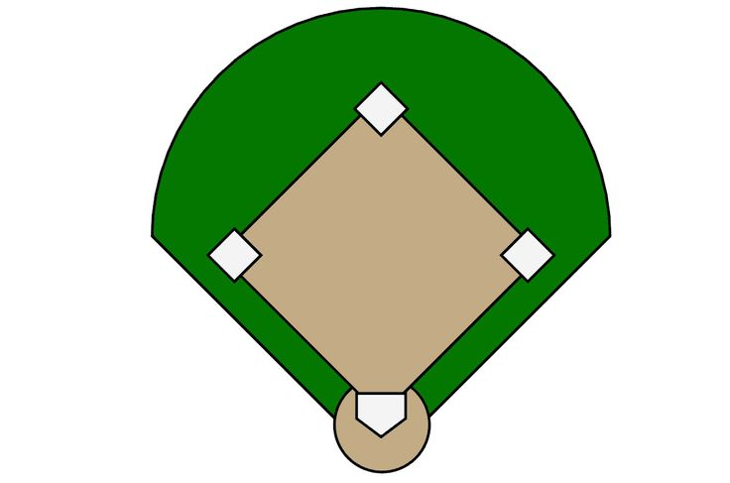


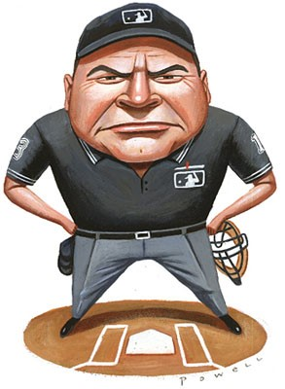
mechanics
Pre – Pitch
  Know Responsibilities
  Initial Position(s)
Read & React
  Read Ball
  React by going to best place to umpire play!
  TIP FOR WORKING “RIM”:
If coming inside the diamond puts the ball at your back, it is probably not the best choice.

Slide 4
BENEFITS / ADVANTAGES
By not automatically coming inside on every ball batted to the outfield an umpire reaps other benefits that are not at first apparent.
Save step throughout the course of the game!
Umpire has more time to assess the play!
  Catch / No Catch
  Base Hit / Gapper
  HR / Off Fence
Assessment allows umpire to determine:
  What is required?
  Where Do I need to be?
  What is my next call?

Slide 5
BENEFITS / ADVANTAGES
Allows Umpire to get in postion!
  Be Set & Alert!
  Accurate Judgement!
  Better view of:
    Tag-ups
    Touching Bases
    Obstruction
    Partner

Slide 6
plays
Every play is unique and requires an evaluation and choice by the umpire. Some generalities that can usually be applied are:
• With no one on and the ball hit center or left field – stay outside
• With no one on and the ball hit right-center or right field and there may be a play on the batter runner – stay outside
• With no one on and the ball hit to right-center or right field – pivot inside
• From B position and the ball hit to center or left field – stay outside
• From B position and the ball hit right field – pivot inside
• From C position, since the umpire will always be responsible for the batter-runner at first, the umpire must come inside on nearly all runner configurations and the ball hit to the outfield. Exception: Ball hit to center field to right field fence!

Slide 7
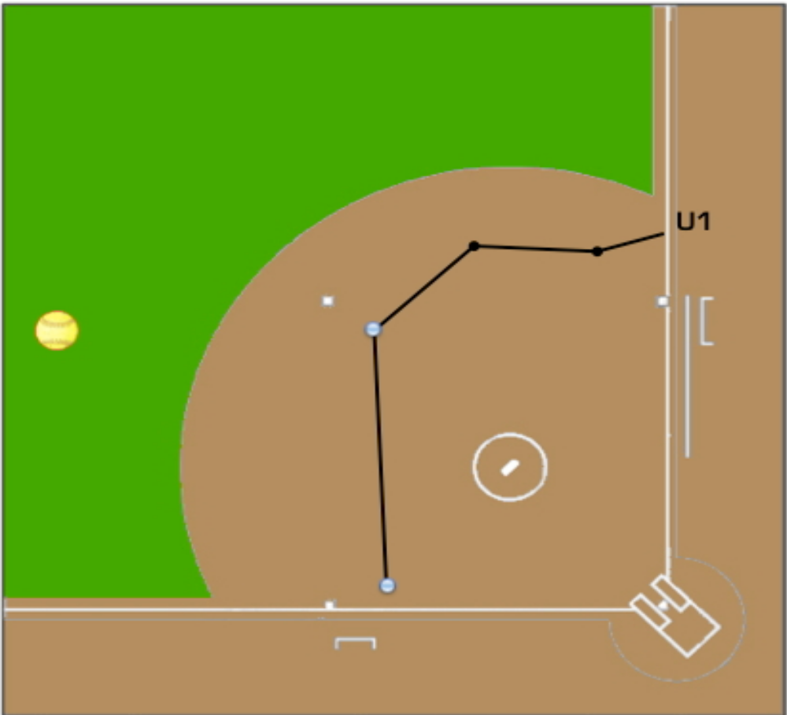
situation
With no one on, the ball hit left field, the umpire chooses to stay outside, and it turns into a triple:
Cut behind runner to get position for potential call on rounding second base.
Continues to inside edge of 3rd base for potiental tag play.

Slide 8
summary
Rather than trying to memorize anything, or always doing this, or always doing that, umpires should work towards making good choices of positioning no matter where they are on the diamond, no matter how many runners there are, and no matter where the ball is hit.
The “RIM”
Umpire choose to pivot or stay outside!
Judges the ball, runners, & type of hit!
Keeps the ball in front of you!
Umpire achieves best position for Play!
Umpire looks for best Angle to make the call!

