Slide 1
2018 nfhs
Football rules changes

Slide 2

2018-19 Football
Mark Dreibelbis
Associate Commissioner, Supervisor of Officials
Tra Waters
Assistant Commissioner – Sports & Championships

Slide 3
Ejection/DQ Protocol
NCHSAA Handbook Policy

Slide 4
Ejection Criteria Fighting
2 game suspension in Football
4 game suspension in all other sports
Includes kicking, attempting to strike with fist/hand/leg/feet/or equipment
Instigating a fight with an unsportsmanlike act causing an opponent to retaliate
Leaving the bench when there is a fight
  Carries same penalty(s) as being in a fight
Substitutes should NEVER leave the bench area to participate

Slide 5
Ejection Criteria Leaving The Bench When There Is Not A Fight
1 game suspension in Football
2 game suspension in all other sports
  Remember – Substitutes should NEVER leave the bench area to participate

Slide 6
Ejection Criteria
Flagrant Contact
Maliciously running over the catcher/fielder without an attempt to avoid contact
Excessive out-of-bounds or “away-from-the-playing-action” that is unwarranted or extreme in nature
Tackling/contact to the head dangerously in a malicious manner
Illegally hitting or cross-checking an opponent with the stick in Lacrosse
Any flagrant act that is not associated with a legal play associated with that sport
  1 game suspension in Football
  2 game suspension in all other sports

Slide 7
Ejection Criteria
Other
Biting Observed or Determined By An Official
Taunting, Baiting, Or Spitting Toward An Opponent Or Official
  Flag/Technical Foul/Technical Violation vs. Ejection
Profanity
  The NCHSAA will have Zero Tolerance within the confines of an NCHSAA event for the following: “Profanity of any kind, inappropriate language, racial or ethnic slurs, sexist or homophobic language.”
  For the above
1 game suspension in Football
2 game suspension in all other sports

Slide 8
Ejection Criteria
Continued Other
Obscene Gestures, Including Gesturing In Such A Manner As To Intimidate Or Instigate
Disrespectfully Address An Official
Physically contacting an official is subject to automatic expulsion and can result in ineligibility for remainder of a career
  This includes school administrators. Expect/require role modeling excellence from this level of personnel.
For the above:
1 game suspension in Football
2 game suspension in all other sports
“Give the respect you expect…and expect it in return.”

Slide 9
Coach Ejection
Handbook Regulation 2.4.3 (j):
Anytime a coach is ejected from a contest, he/she does not participate the remainder of that day. The coach is also suspended from the next two scheduled, re-scheduled or contracted dates at that level of competition (one in Football) and all games in the interim at other levels of competition.
  EXAMPLE: JV coach ejected from game. Misses the next 2 JV games and all Varsity games until the 2-game JV suspension is served.
Handbook Regulation 2.4.3 (k):
The coach is not permitted to be at the game during his/her suspension. A student who is ejected is allowed at the game site but may not be dressed in uniform.

Slide 10
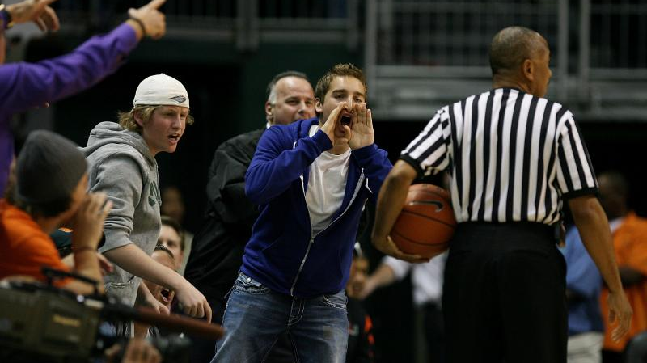
Fan Behavior
Deal with it!
This is one of the reasons we identify the Game Administrator on site.
Utilize them as a resource…they should be a “teammate”
Remember – we have identified the Game Administrator to have Zero Tolerance in regards to proper behavior – a role model
An official cannot eject a fan. Go through the Game Administrator and/or security personnel to remove a fan.
Record this and report to your Regional Supervisor and the NCHSAA office (mark@nchsaa.org)

Slide 11
Filing An Ejection Report
Required within 24 hours after completion of the event
$50 fine to the official(s) for failing to complete the Ejection Report(s)
Go to www.nchsaa.org
Click on OFFICIALS
Scroll down ORANGE box on left side of the Officials page
Click on EJECTION/DQ REPORTING
NOTE: Officials must file all Ejection and DQ reports online
PASSWORD: report1

Slide 12
Filing An Ejection Report
A separate Ejection/DQ Report must be filed for each individual who is to be penalized.
Example: If have a fight, must identify the player/number of EACH school and file individual reports
Example: If have multiple players on a team ejected, must file separate reports for each individual
Do not list multiple players/#’s on the same Ejection Report
For an ejection, click on the actual ejection criteria listed on the Ejection Report Form
Comment box available to detail/describe the situation
Please use proper grammar and professionalism when filing in this information

Slide 13
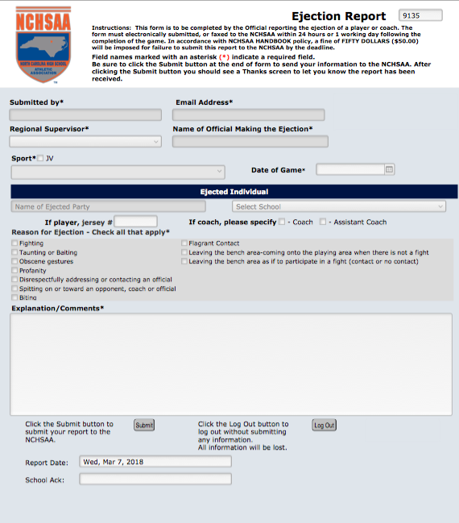
Filing An Ejection Report

Slide 14
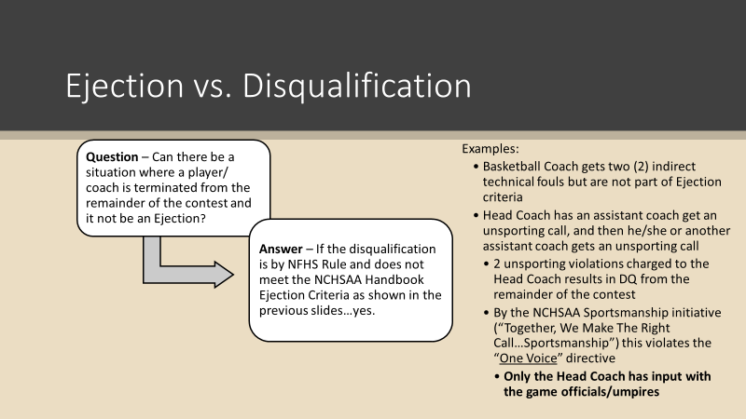

Slide 15
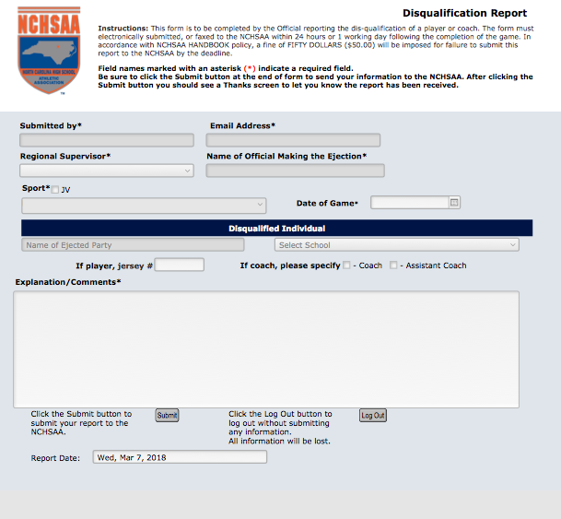
Filing A DQ Report

Slide 16
Ejection Criteria
Post-Game Ejections
No “free shots” after the game/contest…in fact, there should be enhanced attention given to post-game ejections
  These are to be enforced same as in-game ejections.
  Do not allow inappropriate language/contact/input after the contest is complete
  Coaches and players are expected to role model excellence at all times
  “What you permit, you
  promote!”

Slide 17

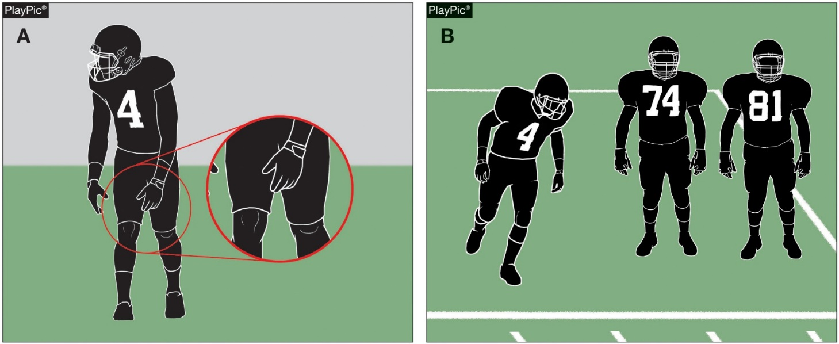
EQUIPMENT
RULES 1-5-4, 1-5-5, 3-5-10e (NEW),
3-6-2, 9-8-1h, 9-9
Players who fail to wear required equipment during a down (PlayPic A) must be replaced for one down (PlayPic B).
No thigh pads.
No knee pads.
Notes:
Rule Change:
RULE 1 - SECTION 5 PLAYER EQUIPMENT
ART. 4 . . . Prior to the start of the game, the head coach shall be responsible for verifying to the referee and another game official that all of his players are legally equipped in compliance with these rules and will use no illegal equipment. Any questions regarding legality of a player’s equipment or the presence of required equipment shall be resolved by the umpire.
ART. 5 . . . When any required player equipment is missing or worn improperly, an official's time-out shall be declared. If the missing or improperly worn equipment is detected during the down or subsequent dead-ball action related to the down without being directly attributable to a foul by an opponent or if a player is wearing otherwise legal equipment in an illegal manner, the player shall be replaced for at least one down, unless halftime or an overtime intermission occurs. If proper and legal equipment has become improperly worn through use but prompt repair is possible and does not delay the ready-for-play signal for more than 25 seconds, such repair may be made without replacing the player for at least one down. (3-5-2b, 3-5-5b, 3-5-7e, 3-5-10d, 3-5-10e)
RULE 3 - SECTION 5 CHARGED AND OFFICIAL’S TIME-OUTS - INTERMISSIONS
ART. 10 . . . An official's time-out (which is not charged to either team) occurs, and the player shall be replaced for at least one down, unless halftime or an overtime intermission occurs when: …
e. Any required player equipment is missing or improperly worn.
RULE 3 - SECTION 6 BALL READY FOR PLAY AND DELAY
ART. 2 . . . Action or inaction which prevents promptness in putting the ball in play is delay of game. …
RULE 9 - SECTION 8 NONCONTACT UNSPORTSMANLIKE CONDUCT BY NONPLAYERS
ART. 1 . . . No coach, substitute, athletic trainer or other team attendant shall act in an unsportsmanlike manner once the game officials assume authority for the contest. Examples are, but not limited to: …
h. Following pregame verification as in 1-5-4, a coach allowing his/her players to use illegal equipment. (1-5-3) …
Rationale for Change:
Prior to the game, the head coach is responsible for verifying that the players are legally equipped and will not use illegal equipment. The penalty for a player who is not properly equipped has changed from a distance penalty against the team to removal of that player for at least one down. The penalty provisions for any use of illegal equipment remain unchanged and result in an unsportsmanlike conduct foul charged to the head coach.
Case Book: See SITUATIONS 1.5.1C, 1.5.1E, 3.5.10H, 3.5.10I, 3.5.10J, 3.5.10K, 3.5.10L

Slide 18
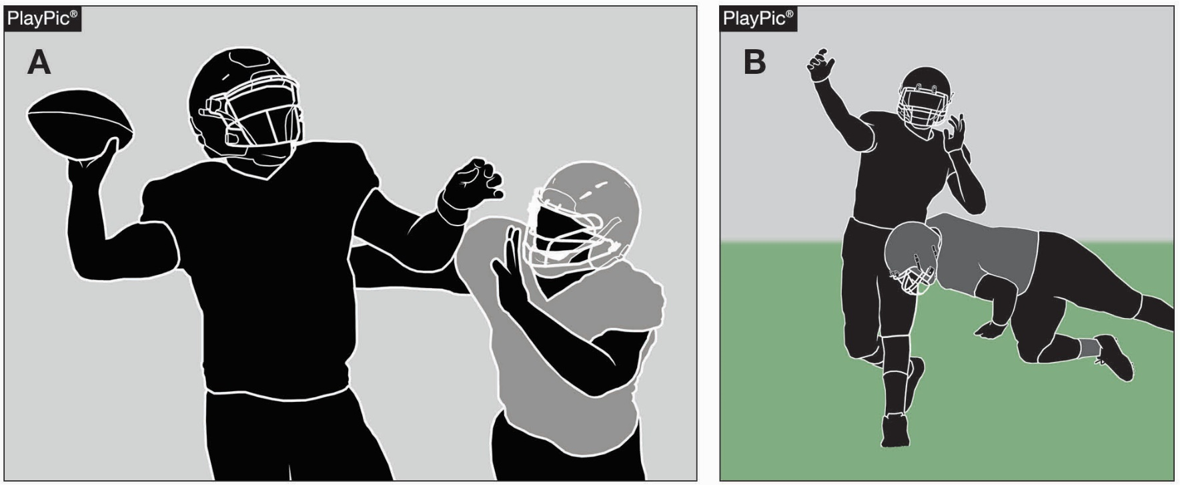
DEFENSELESS PLAYER
RULE 2-32-16a
Player in PlayPic A is defined as a runner and is not defenseless. Once the ball is thrown, he is a passer and is defined as a defenseless player (PlayPic B).
Notes:
Rule Change:
RULE 2 - SECTION 32 PLAYER DESIGNATIONS
ART. 16 . . . A defenseless player is a player who, because of his physical position and focus of concentration, is especially vulnerable to injury. A player who initiates contact against a defenseless player is responsible for making legal contact. When in question, a player is defenseless.
Examples of defenseless players include, but are not limited to:
a. A passer; …
Rationale for Change:
The committee clarified that defenseless player provisions do not apply to a passer until a legal forward pass is thrown. The passer continues to be a defenseless player until the pass ends or the passer moves to participate in the play.

Slide 19
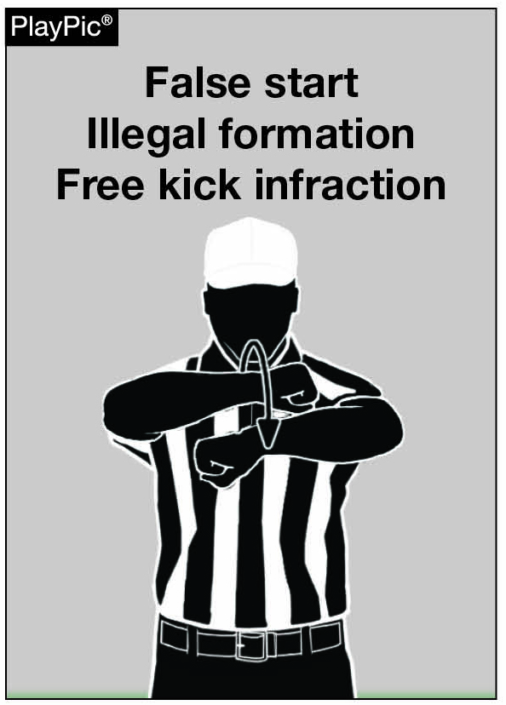
SIGNAL
RULES 6-1-3b PENALTY,
6-1-4 PENALTY
Signal 19 used for:
K player(s) more than 5 yards behind its free-kick line
K player more than 5 yards behind its free-kick line and any other player kicks the ball
At time of kick, K does not have at least 4 players on each side of kicker
19
Notes:
Rule Change:
RULE 6 - SECTION 1 THE KICKOFF AND OTHER FREE KICKS
PENALTY: Arts. 2, 11 – Free-kick infraction – (S7-19) – 5 yards; Art. 3a – encroachment – (S7-18) – 5 yards; Arts. 3b, 4 – free kick infraction – (S7-19) – 5 yards; …
See Signal 19 on the NFHS Official Football Signals
Rationale for Change:
The signal for free kick infractions, other than encroachment of the neutral zone, has been changed from signal 18 to signal 19.
Case Book: See SITUATIONS 6.1.3A, 6.1.3B, 6.1.4

Slide 20
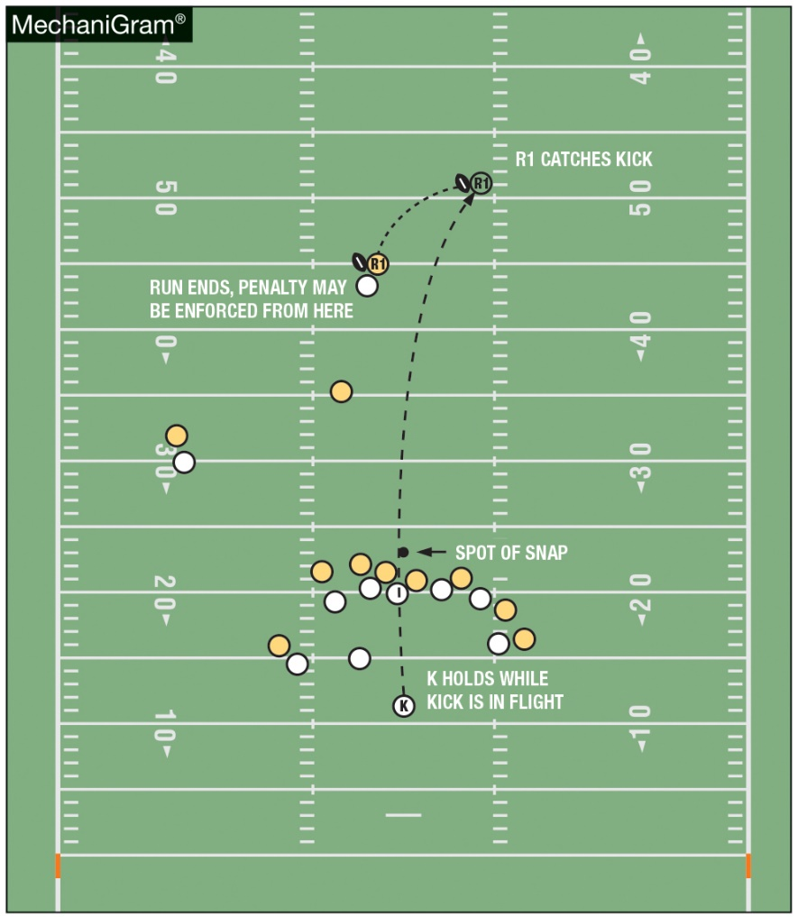
PENALTY ENFORCEMENT
RULES 6-1-9b (NEW), 6-1-9b PENALTY (NEW), 10-4-2 EXCEPTION (NEW) 10-5-1j (NEW)
R has additional option when K fouls during a free or scrimmage kick down. Penalty may be enforced from succeeding spot if K is not next to put the ball in play.
Notes:
Rule Change:
RULE 6 - SECTION 1 THE KICKOFF AND OTHER FREE KICKS
ART. 9 . . . A free kick shall not be kicked out of bounds between the goal lines untouched inbounds by R. If it is kicked out of bounds and R does not accept a penalty for kick-catch interference on the same kick as in 6-5-4, R has the following choices:
a. Accept a 5-yard penalty from the previous spot and have K rekick;
b. Accept a 5-yard penalty from the succeeding spot;
c. Put the ball in play at the inbounds spot 25 yards beyond the previous spot; or
d. Decline the penalty and put the ball in play at the inbounds spot.
PENALTY: … Art. 9 – free kick out of bounds – (S19) – 5 yards and re-kick, 5 yards from the succeeding spot, or put it in play at the inbounds spot 25 yards beyond the previous spot if previous spot on midfield side of R25.
RULE 10 - SECTION 4 BASIC SPOTS
ART. 2 . . . The basic spot is the previous spot: …
EXCEPTION: The basic spot may, at the option of the offended team, be the succeeding spot for fouls by K during a free or scrimmage kick down (other than kick catch interference) when K will not be next to put the ball in play.
RULE 10 - SECTION 5 SPECIAL ENFORCEMENT RULES
ART. 1 . . . The following fouls have special enforcement provisions and options for the offended team: …
j. Fouls by K during a free or scrimmage kick down. (10-4-2 EXCEPTION)
Rationale for Change:
In an effort to reduce re-kicks, further minimize risk and ensure that appropriate penalties are in place for all fouls, the committee has added an option for fouls committed by the kicking team during free and scrimmage kicks. The change would allow the receiving team all of the previous options as well as accepting the distance penalty at the end of the down.
Case Book: See SITUATIONS 6.1.9B, 6.1.9D, 6.1.9G, 6.1.9H, 6.1.9I

Slide 21
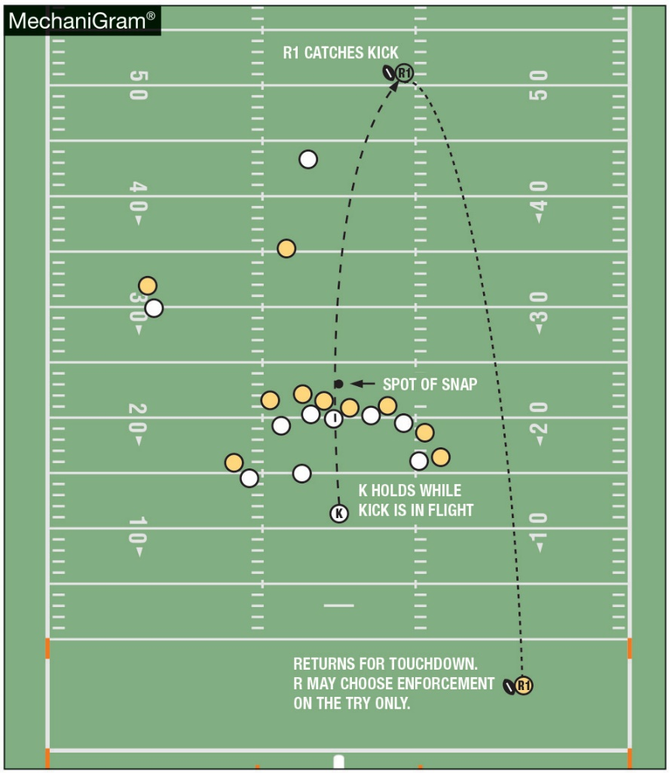
PENALTY ENFORCEMENT
RULES 6-1-9b (NEW), 6-1-9b PENALTY (NEW), 10-4-2 EXCEPTION (NEW) 10-5-1j (NEW)
K fouls during the kick. R returns the kick for a touchdown. Because the foul occurred during the kick and the succeeding spot is the goal line, R may only have the penalty enforced on the try.
Notes:
Comment on Slide:
See comments on slide.

Slide 22
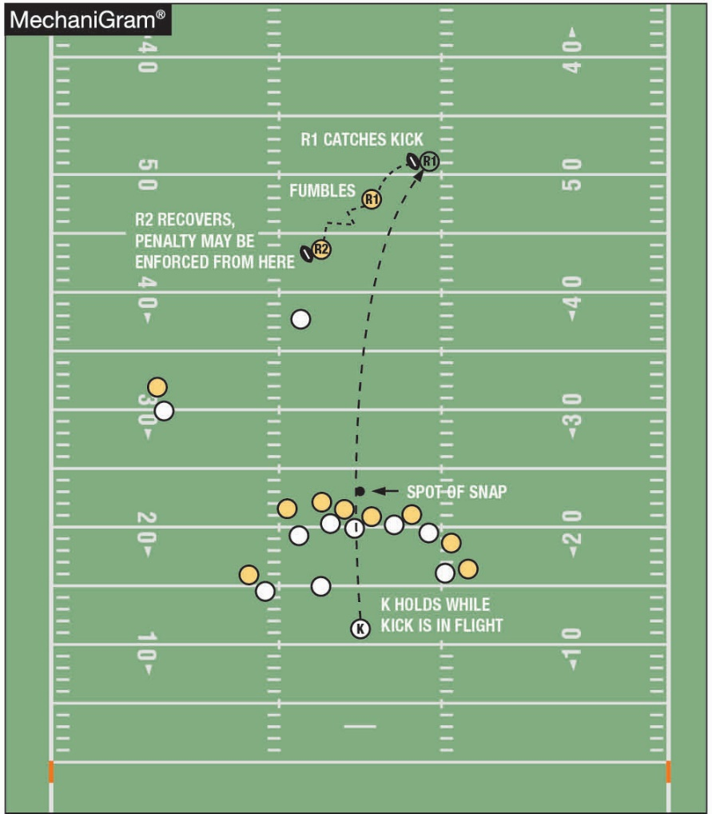
PENALTY ENFORCEMENT
RULES 6-1-9b (NEW), 6-1-9b PENALTY (NEW), 10-4-2 EXCEPTION (NEW) 10-5-1j (NEW)
R has additional option when K fouls during a free or scrimmage kick down. Even though R fumbled, since R will be next to put the ball in play, the penalty may be enforced from the succeeding spot.
Notes:
Comment on Slide:
See comments on slide.

Slide 23
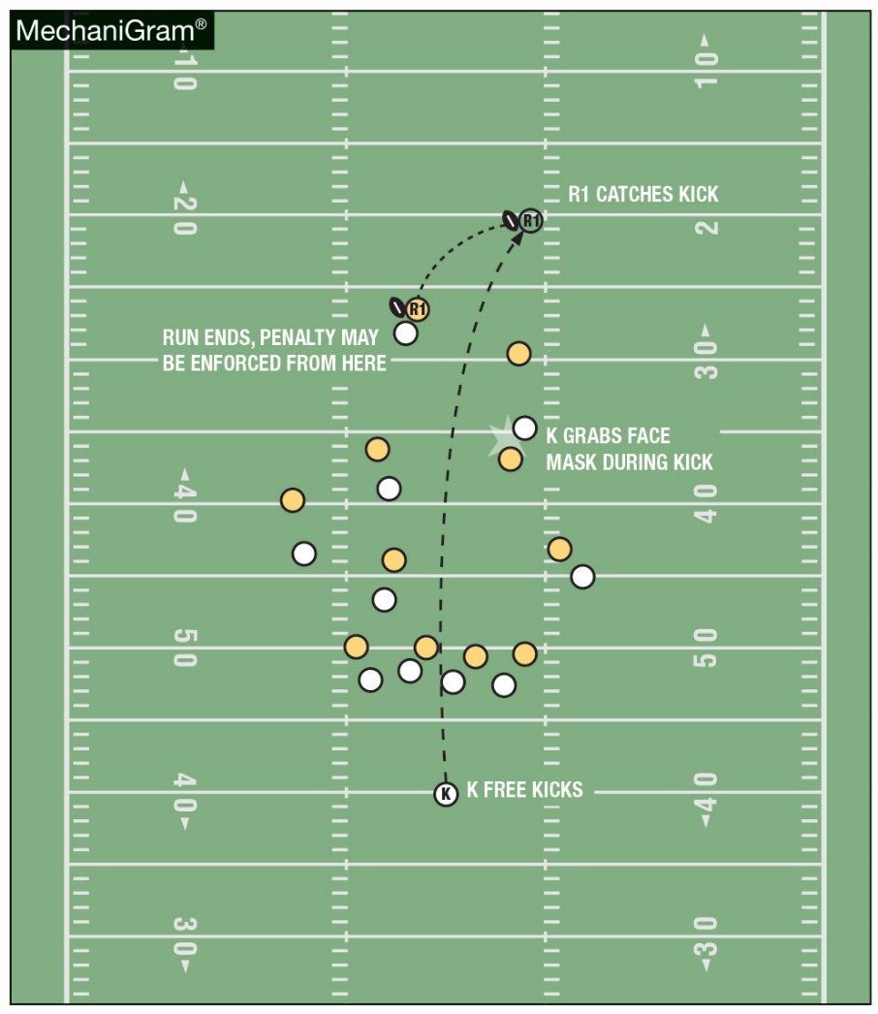
PENALTY ENFORCEMENT
RULES 6-1-9b (NEW), 6-1-9b PENALTY (NEW), 10-4-2 EXCEPTION (NEW) 10-5-1j (NEW)
R has additional option when K fouls during a free or scrimmage kick down. Penalty may be enforced from succeeding spot if K is not next to put the ball in play.
Notes:
Comment on Slide:
See comments on slide.

Slide 24
2018 nfhs Football editorial changes

Slide 25
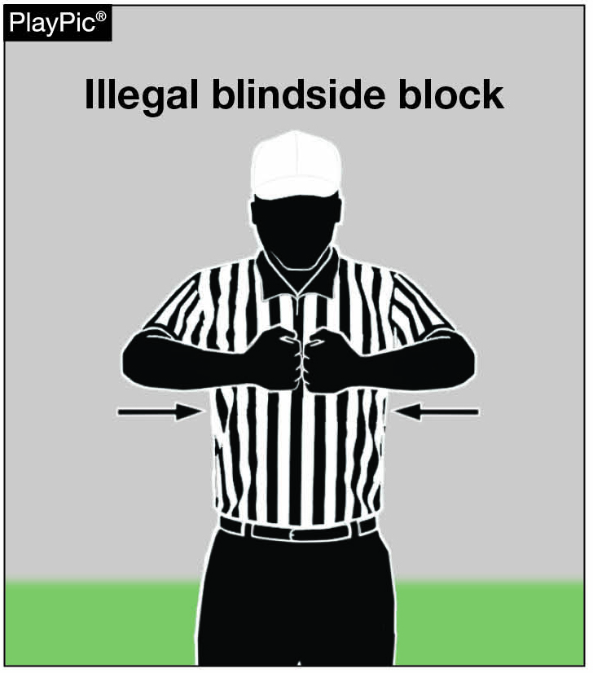
NEW OFFICIAL FOOTBALL SIGNAL - #26 (ILLEGAL BLINDSIDE BLOCK)
Signal 26 is a new signal and has been added to the NFHS Official Football Signals chart.
To indicate an illegal blindside block, the fists are bumped together at chest level.
26
Notes:
Comment on Slide:
See comments on slide.

Slide 26
2018 nfhs Football points of emphasis

Slide 27
2018 NFHS FOOTBALL
POINTS OF EMPHASIS
Proper Wearing and Use of Required Equipment
2. Pace of Play and Timing Issues
Enforcement of Penalties for Personal
Fouls and Unsportsmanlike Conduct Fouls
4. Defenseless Player and Blindside Blocks
Notes:
Comment on Slide:
The following football points of emphasis were selected by the NFHS Football Rules Committee for the 2018 high school football season. These four football points of emphasis need to be stressed to all coaches, game officials, players, parents, school administrators, appropriate health-care professionals and all others who have an interest in high school football.

Slide 28
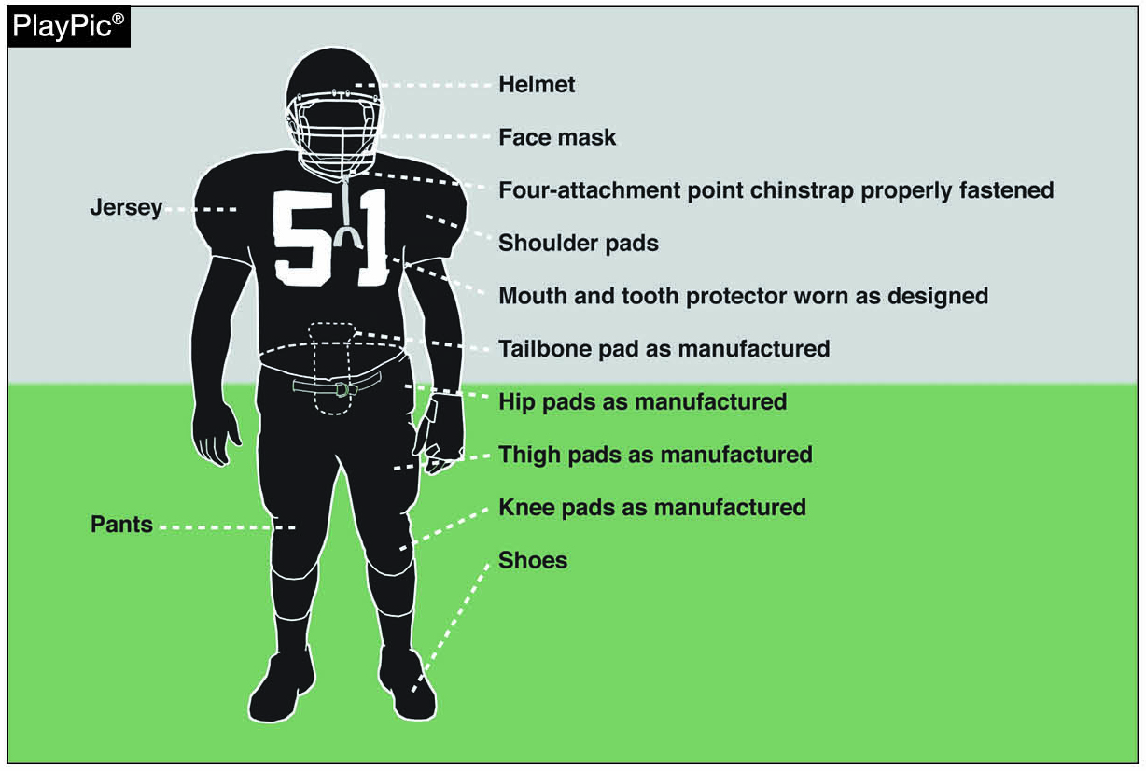
Proper wearing and use of required equipment
Notes:
Proper Wearing and Use of Required Equipment (Point of Emphasis):
Prior to the start of each game, the head coach must verify that all of his players have the proper equipment and that no illegal equipment will be used. The purpose of equipment rules is to ensure the safety and protection of both the player wearing the equipment and his opponent. Due to the potential for injury, game officials must strictly enforce equipment rules. Game officials have been reluctant to penalize a team for the failure of a player to properly wear all of the required equipment. This reluctance may be due to game officials assuming that equipment violations are a minor offense and do not warrant penalties. In view of this reluctance, a rule change has been implemented to lessen the severity of the consequence of violating equipment rules. With the lessened severity, it is imperative that game officials follow appropriate procedures when equipment violations occur. Equipment rules are an extremely important part of the game, and it is therefore essential that game officials are diligent in promptly addressing any and all equipment rule violations.
Equipment violations can be grouped into three categories: (1) failure to properly wear required equipment, (2) failure to wear or use legal and/or required equipment, and (3) wearing illegal equipment. The first category encompasses instances where the required equipment is present, but is not worn properly. Examples include, but are not limited to, unsnapped chin straps, tooth and mouth protectors that are dangling, or jerseys that do not fully cover the shoulder pads or back pads. If game officials observe any improperly worn equipment during a dead-ball period, they should declare an official’s time-out and ask the player to make a correction. However, if the equipment issue is not recognized until the snap is imminent, the game official should immediately sound his whistle to prevent the snap from occurring, declare an official’s time-out and require that the player leave the game for at least one down to address the equipment issue. The second category is when a player is missing any required equipment. In this situation, an official’s time-out must be declared, the player must leave the game for at least one down and will not be allowed to return to the game until the missing equipment is obtained and properly worn by the player. The third category occurs when a player wears illegal equipment. Examples include, but are not limited to, the wearing of cleats that exceed ½-inch, or the presence of a sticky substance on a player’s uniform. If a player is detected wearing illegal equipment, his head coach is charged with an unsportsmanlike conduct foul under Rule
9-8-1h.
If any equipment becomes illegal or defective during the game, correction must be made before the player continues to participate. Examples include chin-strap snaps which break off of the helmet or a jersey that slides up over the top of the shoulder pad. If the correction can be made without the assistance of a team attendant, and without delaying the ready-for-play signal by more than 25 seconds, an official’s time-out may be called to perform such correction. Alternatively, a team may request a charged time-out to perform the correction. However, if correction cannot be completed within 25 seconds, or during a charged timeout, the player may not continue to participate until correction is made.

Slide 29
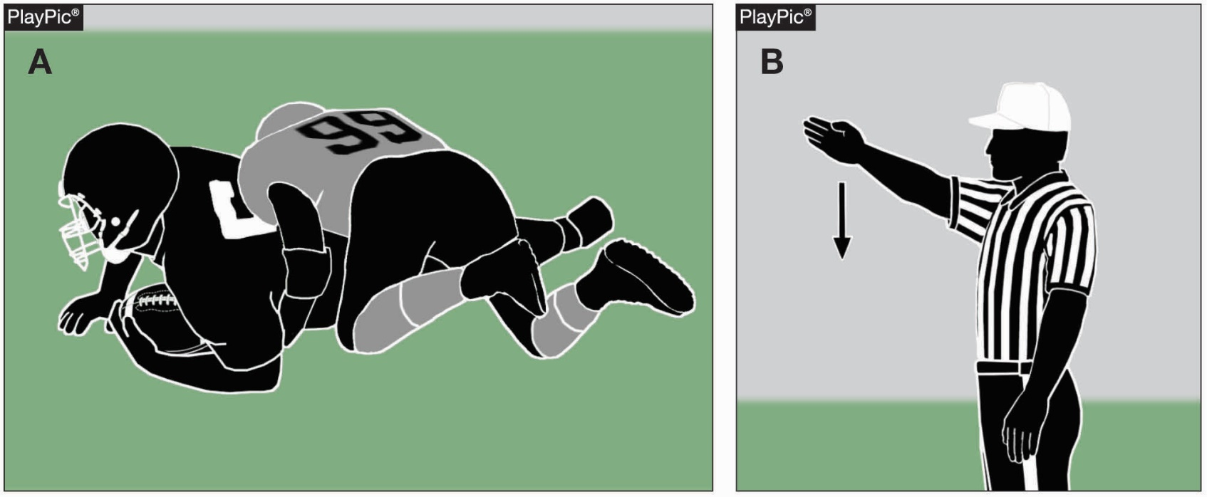
Pace of play and timing issues
After the ball is dead on the previous play (PlayPic A), the ready-for-play signal should be given between 12 and 15 seconds later.
Notes:
Pace of Play and Timing Issues (Point of Emphasis):
In order to maintain a fair balance between offense and defense, a consistent pace of play should be established and maintained by the game officials during the entire contest. Each team should be allowed an equal opportunity to make substitutions and call plays during the time between the dead ball and the next ready-for-play signal. The pace of play should not change during the contest, and should be the same from game to game, and from officiating crew to officiating crew. Therefore, the committee recommends the ready-for-play signal be given between 12 and 15 seconds after the previous dead ball. This pace of play should be consistent no matter if either team wants to hurry up or slow down. Long incomplete passes, plays into the side zones and first downs may require the game officials to hustle to get the ball and line-to-gain equipment properly set, while short runs up the middle may require a slight delay before marking the ball ready for play. Consistency is the goal without regard to particular game situations.
To accomplish a consistent pace, the referee should develop a “feel” for 12 to 15 seconds. This feel can be accomplished in many ways. A few examples could be for a referee to establish a routine of duties to perform after each dead-ball whistle, then mark the ball ready-for-play after completing those duties. A referee could also use the game clock to time 12 to 15 seconds if it is running and easily observable. Lastly, a referee could ask an observer to record the amount of time between a dead-ball whistle and the next ready-for-play so pace -of-play adjustments can be made during their next contest. With some attention by the referee and effort by the entire officiating crew, consistent pace of play can be achieved.
In a similar fashion, game officials should also be vigilant about unfair use of the game clock. Rule 3-4-6 has been around for many years and allows the referee to start or stop the game clock when a team attempts to illegally conserve or consume time. This rule applies at any time during the contest including the last two minutes of either half. Game officials are encouraged to become “clock aware” at 4:00 in each half for potential illegal clock manipulation. Game officials should also be “clock aware” near the end of the first and third periods if weather conditions or field conditions could give a team an advantage through the delay or acceleration of the reversal-of-field position at the end of each period.
In 2017, the NFHS Football Rules Committee adopted Rule 3-4-7 which gives an offended team the option to start the clock on the snap when a penalty is accepted with less than two minutes left in either half. This option applies to any accepted penalty by either team if the clock would otherwise start on the subsequent ready-for-play signal. In a situation where there is a live-ball foul by one team and a dead-ball foul by the other, or a dead-ball foul by both teams, each team would be given the option to start the clock on the snap if it would have otherwise started on the ready-for-play. If either team exercises this option, the clock will start on the snap. It is of no significance whether or not the clock was running at the time a foul occurred.

Slide 30
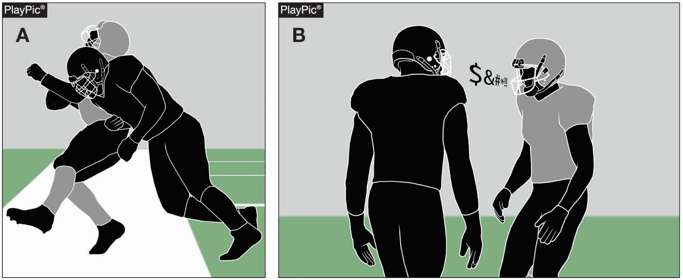
ENFORCEMENT OF PENALTIES FOR PERSONAL FOULS AND UNSPORTSMANLIKE CONDUCT FOULS
Illegal personal contact fouls involve potential for injury to an opponent (PlayPic A). Unsportsmanlike conduct (non-contact fouls) includes profanity and vulgar language (PlayPic B).
Notes:
Enforcement of Penalties for Personal Fouls and Unsportsmanlike Conduct Fouls (Point of Emphasis):
Rule 9-4 provides a list of illegal personal contact fouls. These acts are illegal due to the potential for injury to an opponent. With a few notable exceptions, these fouls do not carry an automatic disqualification, although disqualification may result if the covering official judges the foul to be flagrant. Additionally, the penalties for repeated violations in the same game are not cumulative. For example, if a player pulls a ball carrier down by the face mask and later in the game commits a taunting foul, the player remains in the game. Unnecessary roughness fouls are personal fouls — not unsportsmanlike conduct fouls — and are not being included in the specific fouls that would lead to disqualification unless the act is flagrant. Unsportsmanlike conduct fouls never involve contact with an opponent.
Game officials need to be aware of all circumstances before enforcing the distance penalty for a personal foul as there are several factors to be evaluated, such as the type of play (loose ball vs. running play), whether there was a change of possession, whether a score occurred during the play or whether a double foul or multiple fouls occurred.
Rules 9-5 and 9-8-1 define noncontact unsportsmanlike conduct and provide general examples of such fouls including using profanity, vulgar language or gestures, attempting to influence a game official’s decision, a coach allowing his players to use illegal equipment, being on the field except as a substitute or replaced player and several other situations.
Specific examples of unsportsmanlike conduct include but are not limited to the following: any delayed, excessive or prolonged act by which a player attempts to focus attention upon himself; using abusive, threatening or insulting language or gestures to opponents, teammates or game officials; or using baiting or taunting acts or words that engender ill will between teams.
Unsportsmanlike conduct fouls accumulate and any player or non-player who receives two such fouls is automatically disqualified from the contest. However, any single foul judged by the game official to be flagrant is disqualification. Unsportsmanlike conduct penalties are always enforced from the succeeding spot.
Situations have arisen in recent years regarding unsportsmanlike conduct that have not been correctly called. For example, the “Where’s the tee?” play described in the case book is an example of unsportsmanlike conduct. The ball should be declared dead and the penalty should be enforced as a dead-ball foul. Football has been and will continue to be a game of deception and trickery involving multiple shifts, unusual formations and creative plays; however, actions and language designed to confuse the defense into believing there is a problem and a snap isn’t imminent are beyond the scope of fair play.

Slide 31
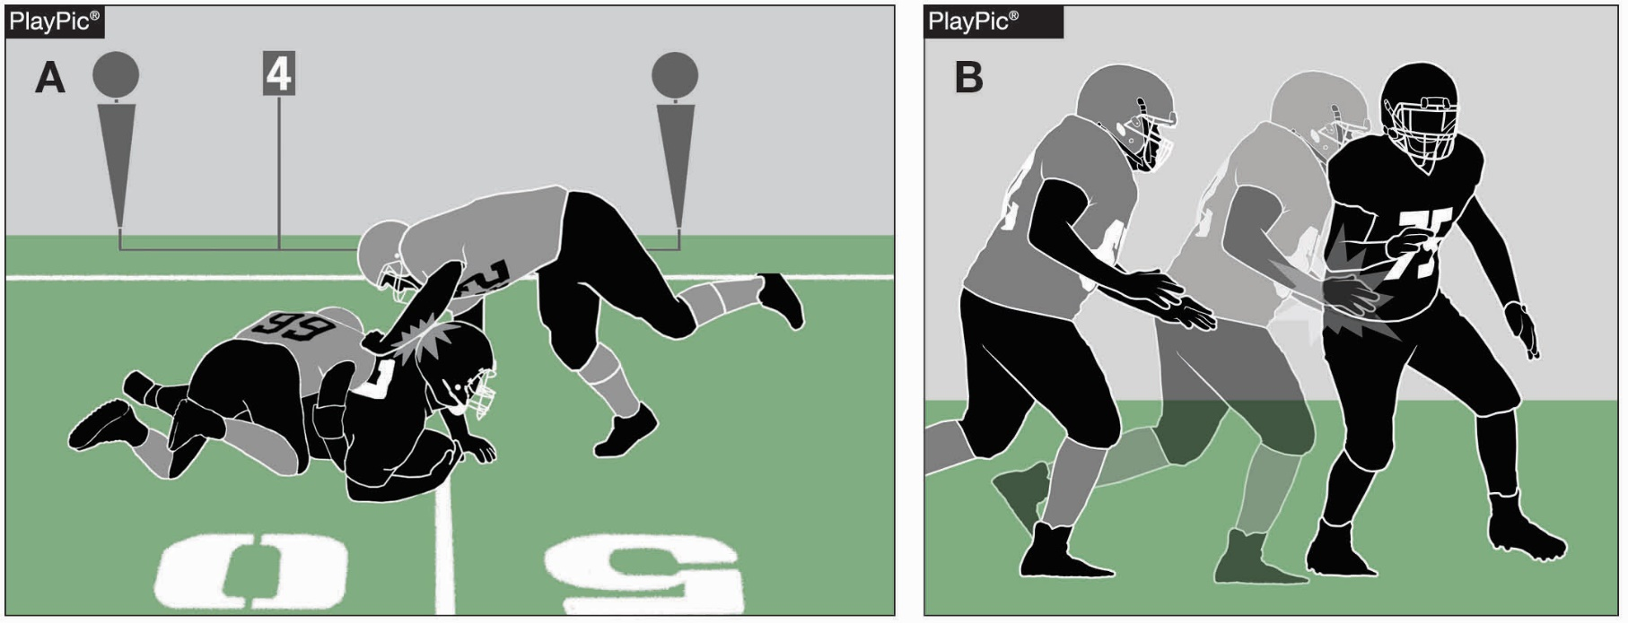
Defenseless player and blindside blocks
A downed runner is defenseless and cannot protect himself against unnecessary contact (PlayPic A). An Illegal blindside block is a forceful block outside the free-blocking zone when the blocker does not initiate the block with open hands (PlayPic B).
Notes:
Defenseless Player and Blindside Blocks (Point of Emphasis):
In 2017, the NFHS adopted rules defining and giving examples of defenseless players, and rules prohibiting forceful blindside blocks outside the free-blocking zone unless initiated with open hands. Coaches and game officials should understand, teach and apply these rules in a manner promoting player safety and minimizing the risk of player injury.
Defenseless Player — A defenseless player is one who, because of his physical position and focus of concentration, is especially vulnerable to injury. The most common types of defenseless players include passers, receivers, sliding runners, runners whose forward progress is stopped, players out of the play and players who are blindside blocked.
A defenseless player is not in an equal physical position with the player attacking him and could be severely injured when contacted. For example, a player passing or attempting to catch a ball is completely exposed to opponents. A player obviously out of the play has no reason to think an opponent will charge into him. A runner in an opponent’s grasp and whose forward progress has been stopped cannot defend himself from an opponent taking a free shot at him. A downed runner or a runner giving himself up and sliding feet first cannot protect himself against unnecessary contact. A player receiving a blindside block is unaware of the opponent charging him. What is common among all these situations is that the player cannot defend himself or avoid potential contact, leaving himself vulnerable to injury. Special attention must be given to contact against these players to determine if it is legal. Although defenseless players who are involved in the play may be contacted by an opponent, the player initiating contact must do so in a legal manner.
The term “defenseless player” is relatively new to the rules, but the protection afforded these players is not. For several years, the rules have penalized roughing the passer, kick catching interference, illegal helmet contact, unnecessary roughness and late hits. Classifying players as defenseless reinforces the prohibition against illegal contact and emphasizes the need to protect the most vulnerable players. Excessive and unnecessary contact, including forceful contact to the head or neck area of a defenseless player, has long been illegal, and it has no part in the game. Coaches must exercise leadership in eliminating illegal contact, and game officials must act decisively to penalize illegal contact to minimize the risk of player injury.
Blindside Blocks — A blindside block is an effective blocking technique. There is nothing improper in executing blindside blocks generally, and the rules do not preclude their use altogether. Instead, to enhance player safety and minimize the risk of injury, the rules prohibit a specific type of blindside block: one that is forceful, is not initiated with open hands and occurs outside the free-blocking zone.
A blindside block is a foul if: (1) the block occurs outside of the free-blocking zone; (2) the blocker does not initiate the block with open hands; and (3) the block is forceful. If all three of these factors are present, the blindside block is illegal.
Coaches should teach proper blindside blocking techniques, and game officials should evaluate whether a blindside block is legal, based on these three factors and the considerations below, as well as the underlying spirit and intent of the rules—to promote safety, eliminate illegal contact and minimize the risk of injury to players.
• Whether the player being blocked can see the block coming. A blindside block is “a block against an opponent other than the runner, who does not see the blocker approaching.” In other words, it is a block that the opponent does not see coming.
Game officials must first determine whether a block is a blindside block. Usually, this will be obvious. The player being blocked will be looking away from the blocker while being blocked from the side by an opponent. In some situations, however, the player being blocked may turn his head to see the blocker just before contact occurs. Such contact is still considered a blindside block. Though the player may have seen the blocker approach, he did not do so in sufficient time to have a reasonable opportunity to react, adjust and defend himself.
Some element of time, though it may be very short, is necessary to accomplish the rule’s safety purposes. In most situations, the blocker is running at full speed, increasing his momentum and focusing on one player. The player being blocked, however, is focused elsewhere and completely unaware of the charging blocker. Such a player who turns his head at the last second and sees his opponent just before contact cannot realistically protect himself. He is just as defenseless and vulnerable to injury as if he had not turned his head at all. Game officials should not be overly technical with this requirement and should always err on the side of player safety. The intent of this rule is to protect the player being blocked. It is not intended to create a legal way of throwing a shoulder or body block. When in question, the block is a blindside block.

Slide 32
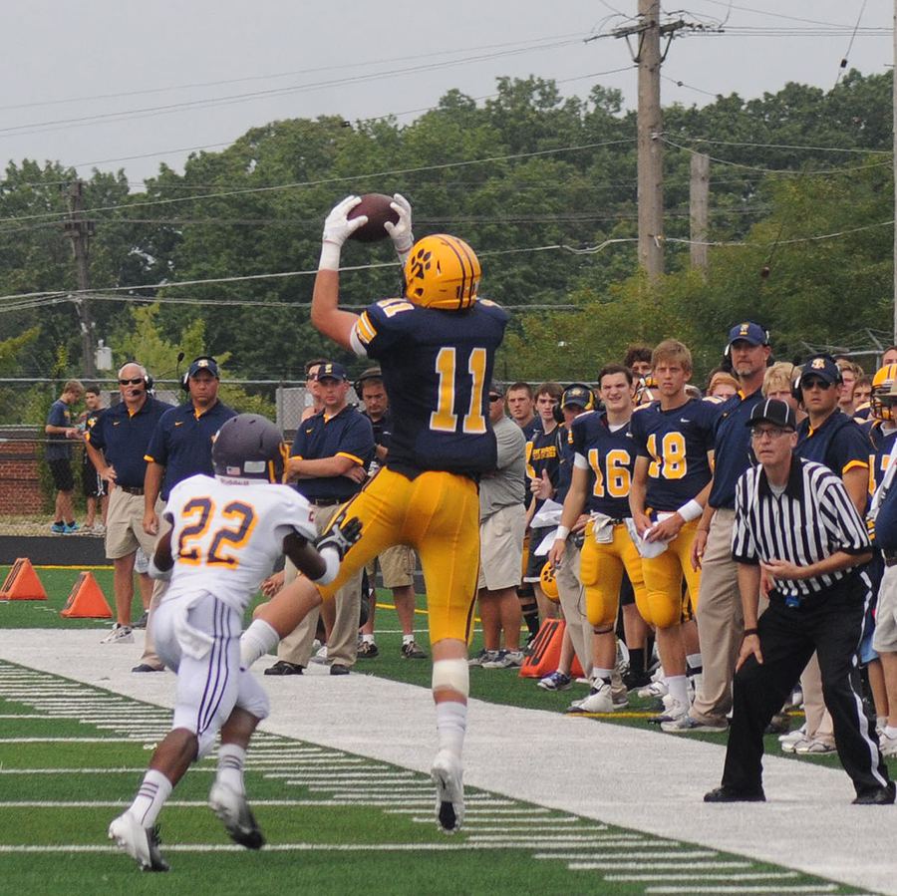
Defenseless player and blindside blocks
Notes:
Defenseless Player and Blindside Blocks (Point of Emphasis) continued:
• Whether the block occurred outside of the free-blocking zone. If a blindside block occurs in the free-blocking zone, it is legal even if the contact is forceful and even if it is not initiated with open hands. Of course, the contact must otherwise be legal—a player cannot clip or target an opponent, for example. However, the free-blocking zone exists only during scrimmage plays, and it disintegrates as soon as the ball leaves the zone. When the zone is gone, any blindside block by rule occurs outside of the free-blocking zone and, if forceful, must be initiated with open hands to be legal. • Whether the block was initiated with the open hands. Any forceful blindside block outside the free-blocking zone must be initiated with open hands. Blocks initiated with the shoulder or body are dangerous because of the amount of force they generate. Blocks initiated with open hands are significantly less dangerous because they do not typically generate that same amount of force. The open-hands requirement is intended to reduce the force associated with blindside blocks.
As a result, game officials should consider two things in determining whether a blocker has complied with the open-hand requirement. First, the blocker’s initial contact with his opponent must be with open hands if the block is forceful. Second, the force of the block should come from the blocker’s hands and arms rather than from his shoulder or body.
A player who makes first contact with open hands and imparts a force to the opponent by extending his hands and arms has complied with this rule. However, a player who makes first contact with open hands but nonetheless forcefully drives his shoulder or body into his opponent has not complied with the rule. Instead, he has thrown a shoulder or body block with all the force that his shoulder and body carry. The open-hand requirement is meant to reduce that type of force. It is not intended to allow an otherwise illegal shoulder or body block simply by placing open hands on the opponent at the last second.
• Whether the block was forceful. If a player has thrown a non-open-handed blindside block outside the free-blocking zone, game officials must finally determine whether the block is forceful. If the block is forceful, it is a foul; if not forceful, it is not.
“Forceful contact” is something more than minor contact but something less than excessive contact. The contact should be significant enough to notice, but it does not have to be violent or otherwise unnecessary to be forceful. As an aid to judging whether a block is forceful, the covering official should consider whether the blocker was only attempting to take his opponent out of the play, or whether the block was intended to take the opponent out of the game. The former is legal, while the latter is illegal.
Game officials should take the entire block into consideration. The focus should be on the block itself and the blocker, because he is the player generating the force behind the block. The reaction of the player being blocked may help, but it is not the determining factor. Game officials should never base their decision on forceful contact solely on whether the player goes to the ground.
Where a blocker’s shoulder or body contact results in minor movement of the opponent and the force of the block is not obvious, the block is not forceful. However, where the blocker makes contact with some obvious degree of force behind the block, contact is forceful regardless of the effect on the opponent.
Finally, game officials should be diligent in observing these blocks and penalizing infractions. Although the rule applies throughout the game, blindside blocks are most likely to be made by the offense on returns following interceptions, free kicks and punts. They may also occur when the offense reverses direction on the field. Game officials must use proper mechanics on these plays and be in position to observe players throwing blindside blocks. The most likely offenders will be those doing something different from others. For example, if most players are moving north, these players will be moving south or east and west. These are the players who crack or peel back, “swim upstream” or “go against the grain,” and they are suspect for potentially committing illegal contact fouls.
Through good position and technique, a player initiating an open-handed blindside block can effectively obstruct his opponent with sufficient forceful contact while minimizing the risk of player injury. By teaching these techniques and consistently penalizing infractions, coaches and game officials will have continued taking positive steps toward reinforcing player safety, minimizing injury, and removing unnecessary and excessive contact from the game.

Slide 33
2018 nfhs football rules reminders

Slide 34
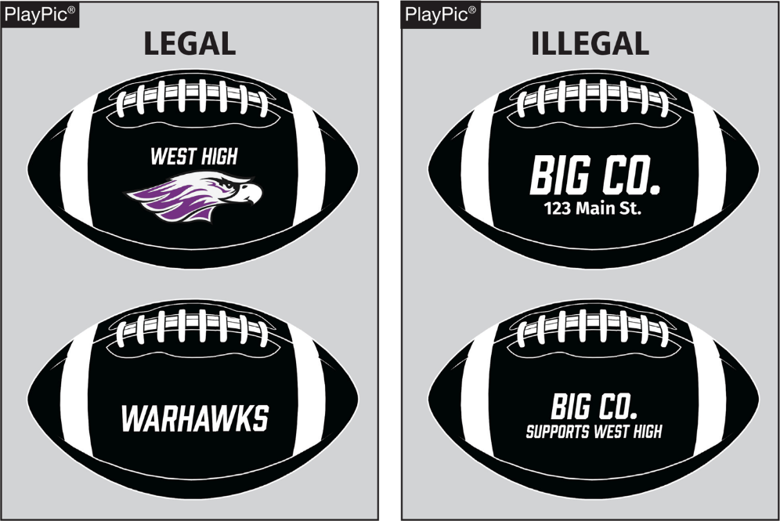
Permissible items on balls
RULE 1-3-1h
The ball may contain
only the following
permissible items:
Ball manufacturer’s
name and/or logo;
School name, logo
and/or mascot;
Conference name and/or
logo; State association name
and/or logos; and NFHS name
and/or logos.
Notes:
Rules Reminder:
RULE 1 - SECTION 3 GAME EQUIPMENT
ART. 1 . . . The ball shall meet the following specifications: …
h. Contain only the following permissible items:
1. Ball manufacturer's name and/or logo;
2. School name, logo and/or mascot;
3. Conference name and/or logo;
4. State association name and/or logos; and
5. NFHS name and/or logos.
Comment on Slide:
Rule change in 2017. The ball cannot have commercial advertising added to the surface. The only permissible items on the ball are the ball manufacturer's name and/or logo; school name, logo and/or mascot; conference name and/or logo; state association name and/or logos; and NFHS name and/or logos.

Slide 35
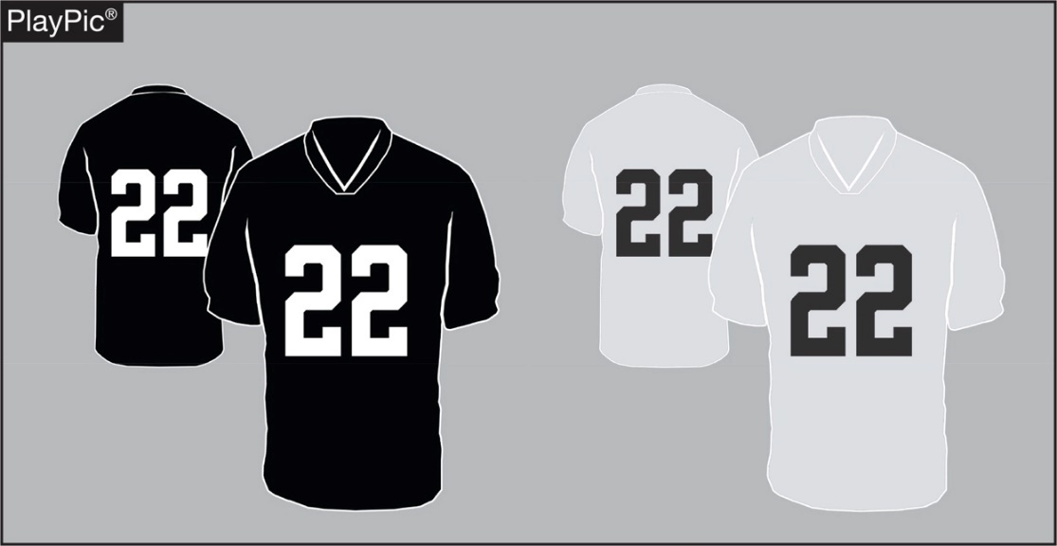
Home team jerseys
Rule 1-5-1(b)3
The home jersey is to be a dark color that clearly contrasts with white. The home jersey on the left (A) is currently legal. The home jersey on the right (B) will be illegal when the rule takes effect in 2021.
A
B
Notes:
Rules Reminder:
RULE 1 - SECTION 5 PLAYER EQUIPMENT
ART. 1 . . . Mandatory equipment. Each player shall participate while wearing the following pieces of properly fitted equipment, which shall be professionally manufactured and not altered to decrease protection: …
b. Jersey: …
3. Players of the home team shall wear jerseys, unaltered from the manufacturer's original design/production, that meet the following criteria: The body of the jersey (inside the shoulders, inclusive of the yoke of the jersey or the shoulders, below the collar, and to the bottom of the jersey) may not include white, except as stated below. Effective 2021, the jerseys of the home team shall be a dark color that clearly contrasts to white. If white appears in the body of the jersey of the home team, it may only appear: …
Comment on Slide:
Rule change in 2017. Home game jersey specifications were further revised to provide schools and manufacturers additional clarification regarding the current trend of utilizing lighter gray shades. The implementation date of 2021 affords schools and manufacturers the opportunity to ensure that newer dark-colored jerseys will clearly contrast with white jerseys. The requirement for contrasting colors to white is not a new rule, and this new clarification will allow changes to be made during normal replacement cycles.

Slide 36
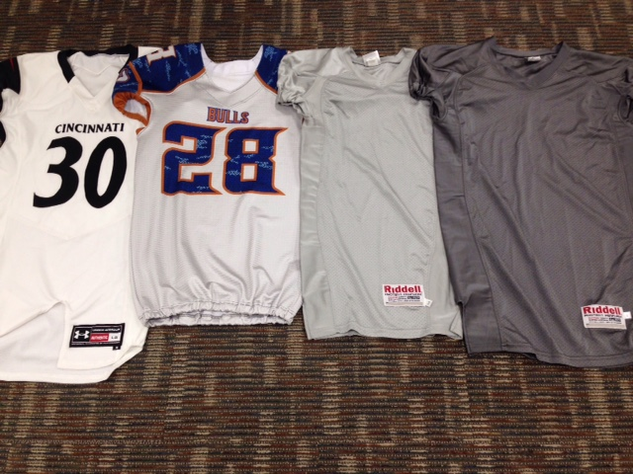
Home team jerseys
Rule 1-5-1(b)3
A
B
C
D
Notes:
Comment on Slide:
The picture on this slide shows you some sample football jerseys. Jersey A is a legal white visitor jersey. Jerseys B and C are home jerseys that are light gray and that do not clearly contrast with a white visitor jersey. Beginning 2021, Jerseys B and C will be illegal as they both are not dark enough for a home jersey. Jersey D is a legal dark gray home jersey.

Slide 37
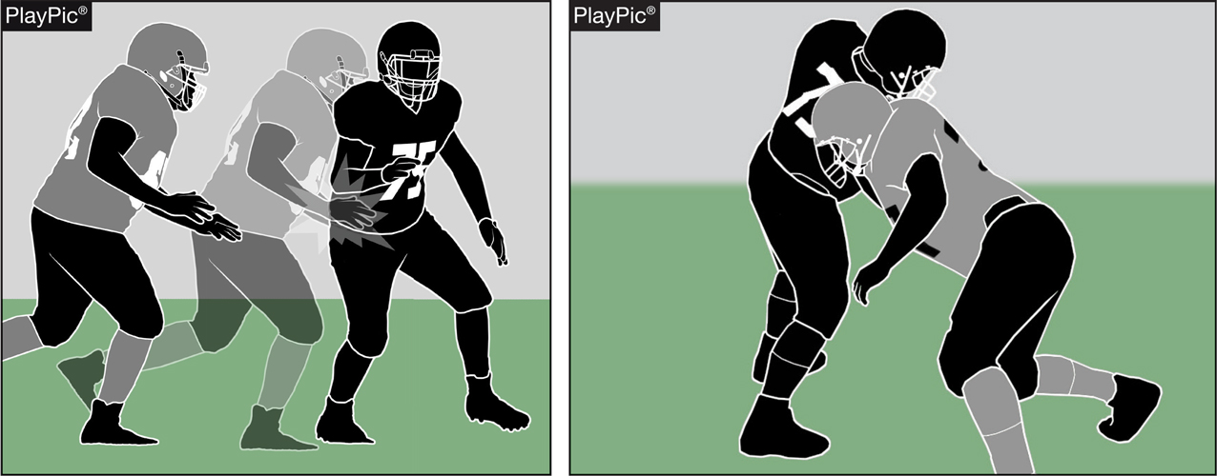
Blindside block
RULES 2-3-10; 9-4-3n; 9-4 PENALTY
A blindside block is a block against an opponent other than the runner, who does not see the blocker approaching.
A
B
Notes:
Rules Reminder:
RULE 2 - SECTION 3 BLOCKING
ART. 10 . . . A blindside block is a block against an opponent other than the runner, who does not see the blocker approaching.
RULE 9 - SECTION 4 ILLEGAL PERSONAL CONTACT
ART. 3 . . . No player or nonplayer shall: …
Execute a blindside block outside of the free-blocking zone with forceful contact unless initiated with open hands. …
PENALTY:
Arts. 3a through g, l, n – Other personal fouls – (S38) – 15 yards;
Comment on Slide:
Rule Change in 2017. Continuing with the focus on risk minimization, the committee created a definition for a blindside block. This block involves contact by a blocker against an opponent who, because of physical positioning and focus of concentration, is vulnerable to injury. Unless initiated with open hands, it is a foul for excessive and unnecessary contact when the block is forceful and outside of the free-blocking zone.
Case Book: See SITUATIONS 9.4.3A, 9.4.3 COMMENT, 9.4.3W, 9.4.3X

Slide 38
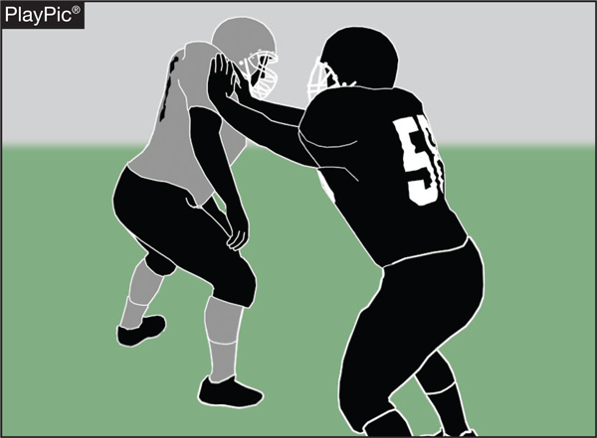
Blindside block
RULES 2-3-10; 9-4-3n; 9-4 PENALTY
A blindside block is a
block outside of the
free-blocking zone against
an opponent other than
the runner who does not
have a reasonable
opportunity to see the
blocker approaching. As seen in the PlayPic, a blindside block with forceful contact initiated with open hands is legal, inside or outside of the free-blocking zone.
Notes:
Comment on Slide:
See comments on slide.

Slide 39
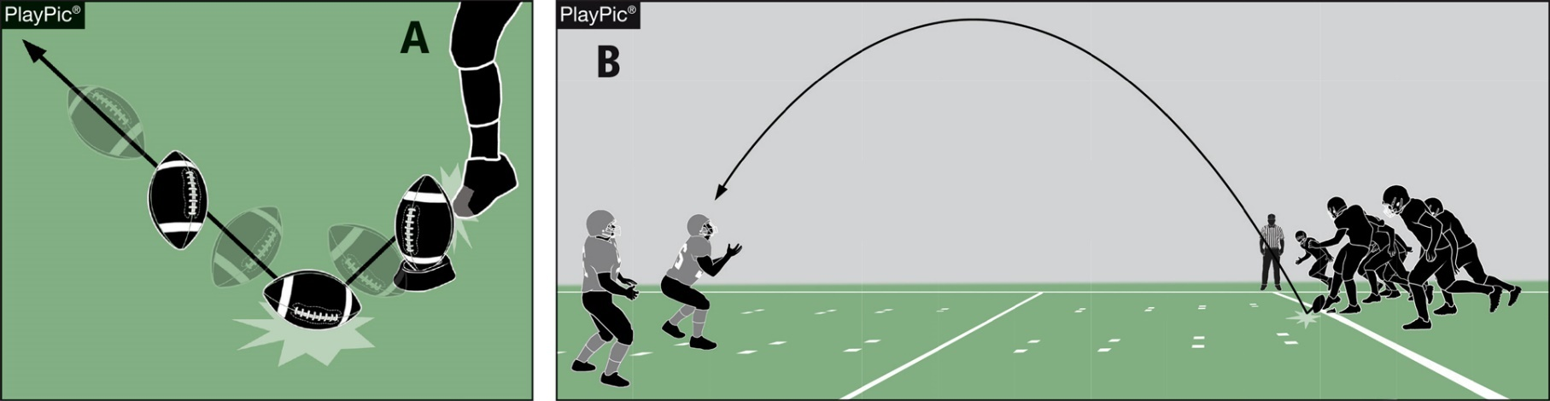
Pop-up kick
RULES 2-24-10; 6-1-11; 6-1 PENALTY
A pop-up kick is a free kick in which the kicker drives the ball immediately to the ground, the ball strikes the ground once and goes into the air in the manner of a ball kicked directly off the tee. Such kicks will be penalized as a dead-ball foul.
Notes:
Rules Reminder:
RULE 2 - SECTION 24 KICKS
ART. 10 . . . A pop-up kick is a free kick in which the kicker drives the ball immediately into the ground, the ball strikes the ground once and goes into the air in the manner of a ball kicked directly off the tee.
RULE 6 - SECTION 1 THE KICKOFF AND OTHER FREE KICKS
ART. 11 . . . A pop-up kick is illegal.
PENALTY: Arts. 2, 11 – Free-kick infraction – (S7-19) – 5 yards;
Comment on Slide:
Rule change in 2017. Continuing with the committee's efforts to minimize risk, a pop-up kickoff has been defined. A pop-up kick is a free kick in which the kicker drives the ball immediately to the ground, the ball strikes the ground once and goes into the air in the manner of a ball kicked directly off the tee. Such kicks will be penalized as a dead-ball free-kick infraction.
Case Book: See SITUATION 6.1.11

Slide 40
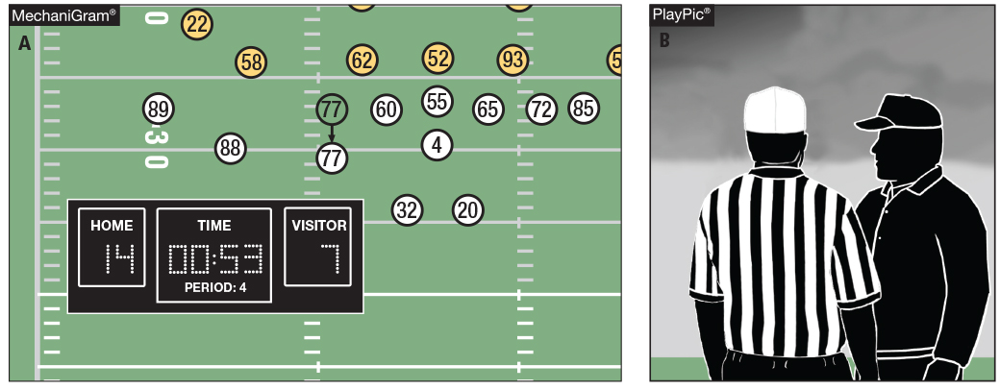
Game clock option
RULE 3-4-7
With less than 2 minutes left in the half and the game clock running, A false starts (MechaniGram A). The offended team may choose to start the game clock on the snap (PlayPic B).
Notes:
Rules Reminder:
RULE 3 - SECTION 4 STARTING AND STOPPING THE CLOCK
ART. 7 . . . When a penalty is accepted with less than two minutes remaining in either half, the offended team will have the option to start the game clock on the snap. …
Comment on Slide:
Rule change in 2017. The committee added an option for the offended team on an accepted penalty inside the last two minutes of either half. The referee continues to have the authority to start or stop the clock if a team attempts to conserve or consume time illegally.
Case Book: See SITUATIONS 3.3.3D, 3.3.4A, 3.3.4B, 3.4.2A, 3.4.2B, 3.4.2D, 3.4.6 COMMENT, 3.4.7A, 3.4.7B, 3.4.7C

Slide 41
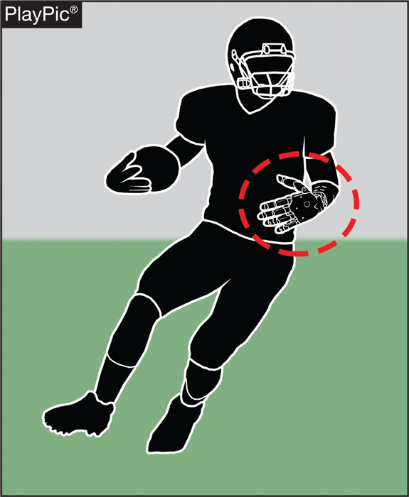
Dead ball, down ends rule 4-2-2l
The player has a prosthetic
arm. If the prosthetic limb
comes completely off the
runner, the ball becomes
dead and the down ends.
Notes:
Rules Reminder:
RULE 4 - SECTION 2 DEAD BALL AND END OF THE DOWN
ART. 2 . . . The ball becomes dead and the down is ended: …
l. When a prosthetic limb comes completely off the runner.
Comment on Slide:
Rule change in 2017. With this change, the ball becomes dead when a prosthetic limb comes completely off the runner.

Slide 42
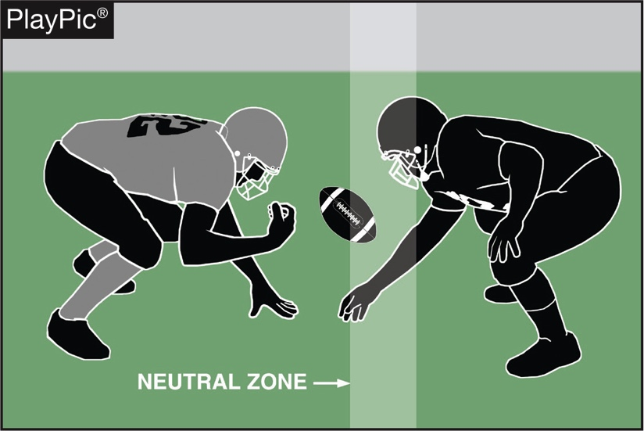
Encroachment rule 7-1-6
After the ready-for-play signal and after the snapper is in contact with the ball, it is encroachment if a defensive player contacts the ball or the snapper’s arms or hands until the snap is completed (Rule 2-40).
Notes:
Rules Reminder:
RULE 7 - SECTION 1 BEFORE THE SNAP
ART. 6 . . . Following the ready-for-play and after the snapper has placed his hand(s) on the ball, encroachment occurs if:
a. Any other player breaks the plane of the neutral zone;
b. A defensive player makes contact with the ball prior to the end of the snap; or
c. A defensive player makes contact with the hand(s) or arm(s) of the snapper prior to the snapper releasing the ball. …
Comment on Slide:
Rule change in 2017. Defensive players are restricted from contacting the ball or the snapper's hand(s) or arm(s) until the snapper has released the ball.

Slide 43
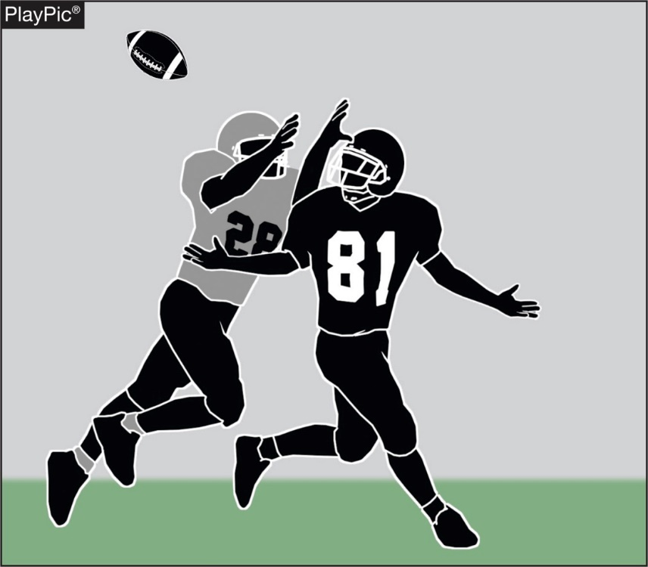
Pass interference rule 7-5-10
Face guarding (without contact) in and of itself is no longer considered an act of forward pass interference.
Notes:
Rules Reminder:
RULE 7 - SECTION 5 FORWARD-PASS CLASSIFICATION
ART. 10 . . . It is forward-pass interference if any player of A or B who is beyond the neutral zone interferes with an eligible opponent's opportunity to move toward, catch or bat the pass. …
Comment on Slide:
Rule change in 2017. This change eliminates the previous foul for non-contact face guarding forward-pass interference.

Slide 44
2018-2019 nfhs football game officials manual

Slide 45
Major revisions to the 2018-2019 nfhs football game officials manual
A new NFHS Official Football Signal for Illegal Blindside Block (Signal 26) was added to the NFHS Official Football Signals.
“Targeting” was added to Signal 24 of the NFHS Official Football Signals.
“Free kick infraction” was added to Signal 19 of the NFHS Official Football Signals.
Added that some white accents are now allowed on the black football shoe that game officials wear as a part of the game official uniform.
Notes:
Comment on Slide:
Major revisions approved by the NFHS Football Game Officials Manual Committee in January 2018 for the 2018-2019 NFHS Football Game Officials Manual. See comments on the slide.

Slide 46
Major revisions to the 2018-2019 nfhs football game officials manual
Added that “No game official shall use alcohol on the day of the contest or any form of tobacco product (e-cigarette or similar item) beginning with the arrival at the competition site until departure following the completion of the contest.”
Under END-OF-GAME AND OVERTIME PROCEDURE, added that “The game officials retain clerical authority over the game through the completion of any reports, including those imposing disqualifications, that are responsive to actions occurring while the game officials had jurisdiction.”
Under RUNNING PLAY – REFEREE (Five-Game Officials), after the ball is spotted, move to a position that is visible to clock operator, approximately 10-15 yards from the line-of scrimmage and 5 yards wide of the huddle.
Notes:
Comment on Slide:
Major revisions approved by the NFHS Football Game Officials Manual Committee in January 2018 for the 2018-2019 NFHS Football Game Officials Manual. See comments on the slide.

Slide 47
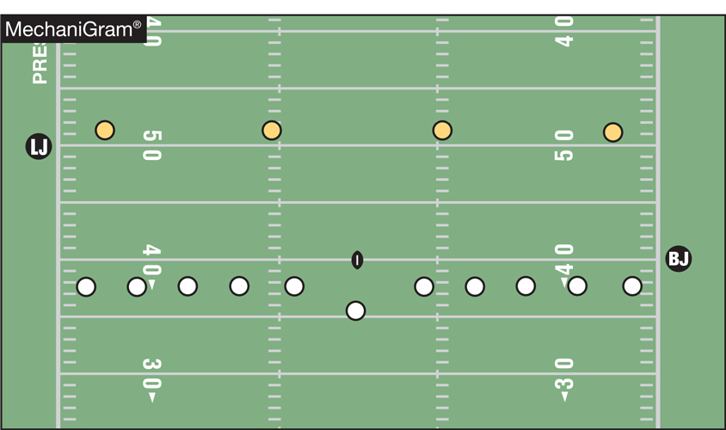
Mechanics for pop-up kicks
Official’s Mechanics
The game official on K’s free-kick line (back judge in crew of 5, head linesman in crew of 4) is primary for judging a pop-up kick. The game official on R’s free-kick line (line judge in crews of 5 or 4) is secondary.
Notes:
Comment on Slide:
The NFHS Football Game Officials Manual Committee approved a new football officiating mechanic for the 2017 rule change dealing with the pop-up kicks. See comments on slide for the specifics on this new football officiating mechanic.

Slide 48
2018 nfhs football information

Slide 49
revised 2018 NFHS guidelines on lightning and thunder
(In Appendix in rules book)
GUIDELINES ON HANDLING PRACTICES AND CONTESTS
DURING LIGHTNING OR THUNDER DISTURBANCES
These guidelines provide a default policy to those responsible or sharing duties for making decisions concerning the suspension and restarting of practices and contests based on the presence of lightning or thunder. The preferred sources from which to request such a policy for your facility would include your state high school activities association and the nearest office of the National Weather Service.
PROACTIVE PLANNING
1. Assign staff to monitor local weather conditions before and during practices and contests.
2. Develop an evacuation plan, including identification of appropriate nearby safer areas and determine the amount of time needed to get everyone to a designated safer area:
a. A designated safer place is a substantial building with plumbing and wiring where people live or work, such as a school, gymnasium or
library. An alternate safer place from the threat of lightning is a fully enclosed (not convertible or soft top) metal car or school bus.
3. Develop criteria for suspension and resumption of play:
a. When thunder is heard or lightning is seen*, the leading edge of the thunderstorm is close enough to strike your location with lightning.
Suspend play for at least 30 minutes and vacate the outdoor activity to the previously designated safer location immediately.
b. 30-minute rule. Once play has been suspended, wait at least 30 minutes after the last thunder is heard or lightning is witnessed* prior to
resuming play.
c. Any subsequent thunder or lightning* after the beginning of the 30-minute count will reset the clock and another 30-minute count
should begin.
d. When lightning-detection devices or mobile phone apps are available, this technology could be used to assist in making a decision to
suspend play if a lightning strike is noted to be within 10 miles of the event location. However, you should never depend on the reliability
of these devices and, thus, hearing thunder or seeing lightning* should always take precedence over information from a mobile app or
lightning-detection device.
* – At night, under certain atmospheric conditions, lightning flashes may be seen from distant storms. In these cases, it may be safe to continue an event. If no thunder can be heard and the flashes are low on the horizon, the storm may not pose a threat. Independently verified lightning detection information would help eliminate any uncertainty.
4. Review the lightning safety policy annually with all administrators, coaches and game personnel and train all personnel.
5. Inform student-athletes and their parents of the lightning policy at start of the season.
Revised and Approved March 2018
Notes:
Comment on Slide:
In March 2018, the NFHS Sports Medicine Advisory Committee (SMAC) approved the revised “NFHS Guidelines on Handling Practices and Contests During Lightning or Thunder Disturbances.” The NFHS SMAC worked with some of the top lightning and thunder experts in the country on the revision of these guidelines. These revised guidelines can be found in the Appendix in the NFHS Rules Books for those respective sports that have to deal with lightning and thunder.
Please keep in mind, these guidelines provide a default policy to those responsible or sharing duties for making decisions concerning the suspension and restarting of practices and contests based on the presence of lightning or thunder. The preferred sources from which to request such a policy for your facility would include your state high school activities association and the nearest office of the National Weather Service.

Slide 50

NFHS Rules Book as e-Books
E-books features:
  Searchable
  Highlight areas of interest
  Make notes
  Easy navigation
  Adjustable viewing size
  Immediate availability
Notes:
Comment on Slide:
Overview of NFHS Rules Books as E-Books.

Slide 51
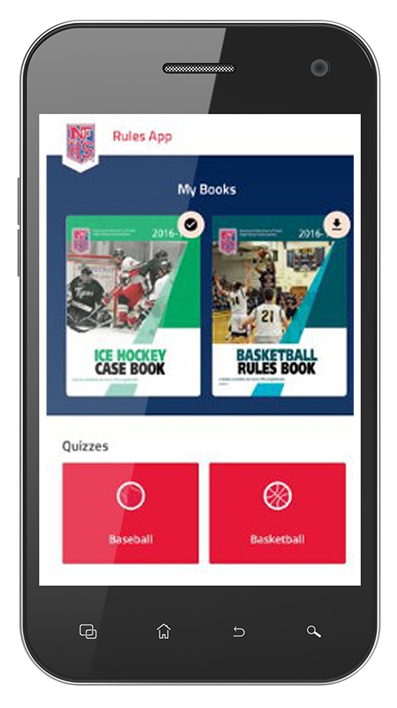
NEW NFHS Rules App
Rules App features:
  Searchable
  Highlight notes
  Bookmarks
  Quizzes for all sports
  Easy navigation
  Immediate availability
  Free to paid members of the NFHS Coaches and Officials Associations
  www.nfhs.org/erules for more information
Notes:
Comment on Slide:
App is free to download
Each book subscription is $6.99
NFHS Coaches and Officials Association paid members get all books for free
100% states members get books for free in sports designated by their state
New in 2018 – Rules apps for all NFHS rules books and case books available on iTunes and Google Play. Rules books and case books will be cross-linked. Searchable content.

Slide 52
2018 Nfhs officials education

Slide 53
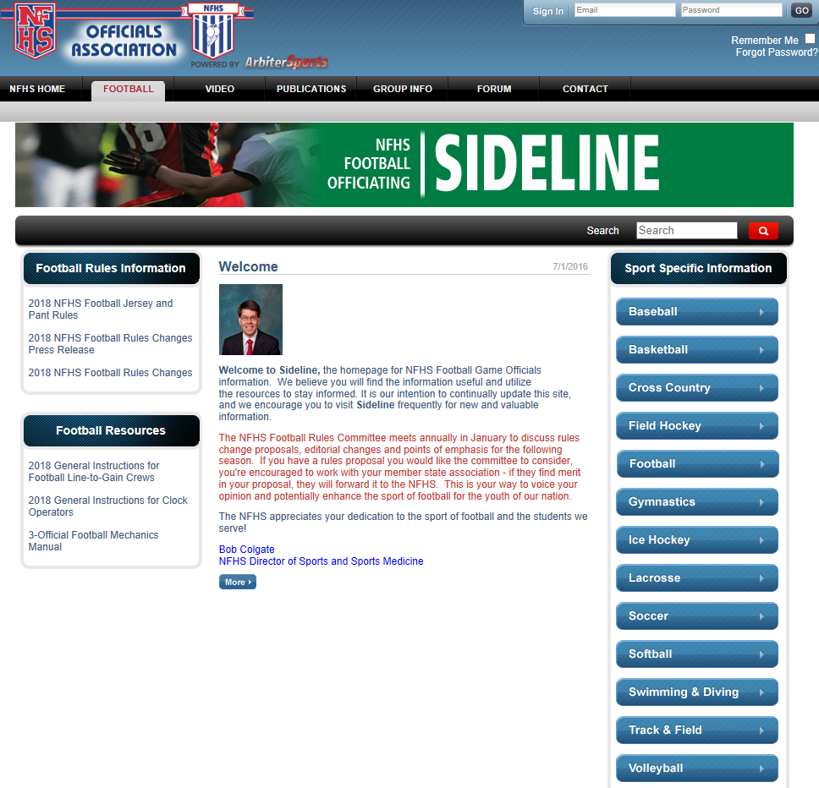
NFHS Officials Association Central Hub
Contains:
  Sport information
  Rules information
  Rules library
  Searchable rules book
  Video content on officiating sport, competition situations and interpretations
https://nfhs-football.arbitersports.com
Notes:
Comment on Slide:
See comments on slide.

Slide 54
Nfhs learning center

Slide 55
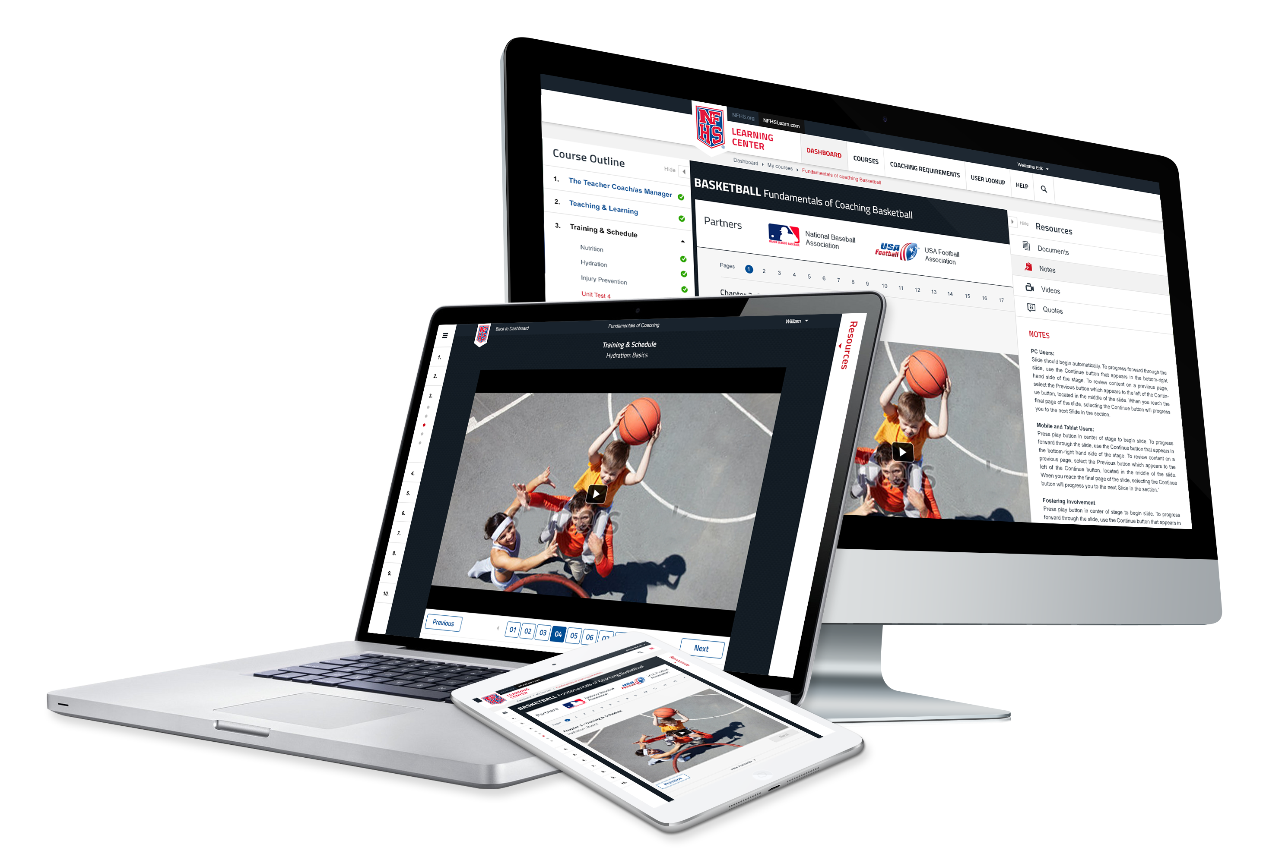
www.nfhslearn.com
FREE courses include:
Bullying, Hazing and Inappropriate Behaviors
Understanding Copyright and Compliance
Hazing Prevention for Students
Concussion in Sports
Concussion for Students
Heat Illness Prevention
Sudden Cardiac Arrest
Sportsmanship
Coaching Unified Sports
Positive Sport Parenting
NCAA Eligibility
Notes:
Comment on Slide:
See comments on slide.

Slide 56
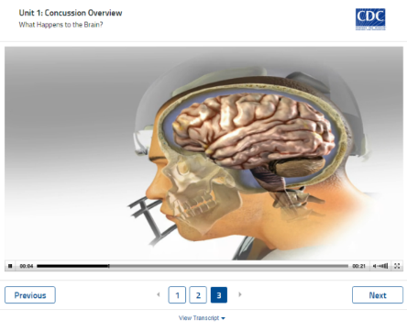

Concussion in sports
Course Objectives
■ Understand what concussions are and their impact on players
■ Recognize the complications associated with concussions
■ Recognize signs and symptoms of concussion
■ Know when additional medical attention is needed
■ Understand what your responsibilities are in concussion
management
■ Understand the proper concussion management protocols
■ List the steps a player should use to return to active play
safely after a concussion
Units
■ Concussion Overview
■ The Problem
■ Your Responsibility
Notes:
Comment on Slide:
About: The NFHS has teamed up with the Centers for Disease Control and Prevention (CDC) to educate coaches, officials, parents and students on the importance of proper concussion recognition and management in high school sports. This free course highlights the impact of sports-related concussion on athletes, teaches how to recognize a suspected concussion, and provides protocols to manage a suspected concussion with steps to help players return to play safely after a concussion. Each state's requirements for concussion management are included as part of the course.
www.nfhslearn.com

Slide 57
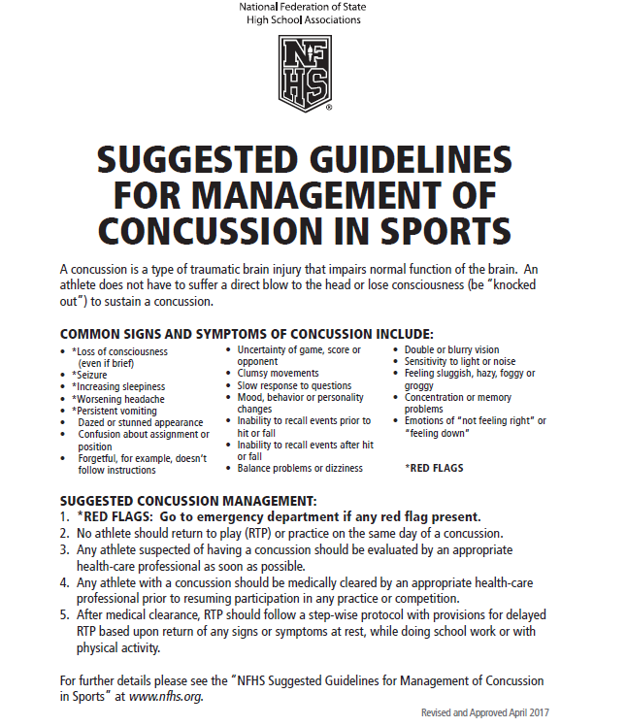
Nfhs suggested guidelines for management of concussion in sports
In the Appendix
in all of the
2018-19 NFHS
Rules Book
Notes:
Comment on Slide:
The “NFHS Suggested Guidelines for Management of Concussion” is in the Appendix in all of the 2018-19 NFHS Rules Books and was developed by the NFHS Sports Medicine Advisory Committee (SMAC).

Slide 58
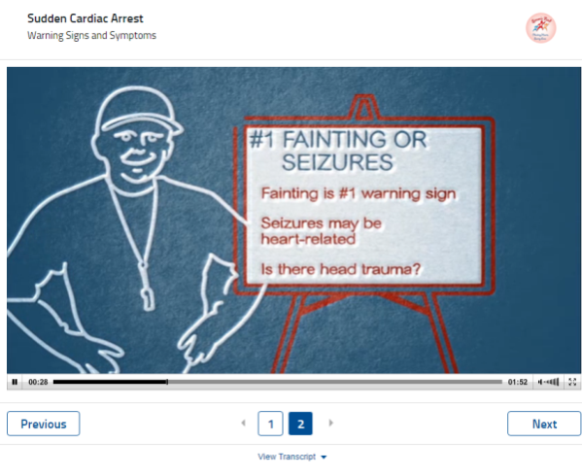


Sudden cardiac arrest
Course Objectives
Units
■ Understand what sudden cardiac arrest is
■ Recognize the warning signs and symptoms of sudden
cardiac arrest
■ Learn what to do if a player collapses during physical
activity
■ Introduction
■ Sudden Cardiac Arrest
■ Post Test
Notes:
Comment on Slide:
About: Sudden Cardiac Arrest is the number one cause of death in student-athletes during exercise across the United States. Caused by a structural or electrical problem associated with the heart, Sudden Cardiac Arrest happens when the heart unexpectedly stops beating and pumping blood. With content developed by Simon’s Fund, this free course will help you learn and recognize the warning signs and symptoms of Sudden Cardiac Arrest. Also included are tips for what to do in the critical moments after an individual suddenly collapses in order to save their life.
www.nfhslearn.com

Slide 59
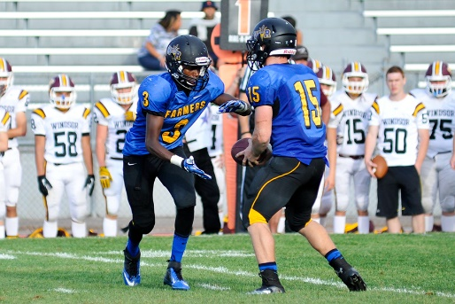
Heat illness prevention
Course Objectives
Units
■ Recognize that Exertional Heatstroke (EHS) is the leading preventable cause of death among athletes
■ Know the importance of a formal pre-season heat acclimatization plan
■ Know the importance of having and implementing a specific hydration plan, keeping your athletes well-hydrated, and providing ample opportunities for, and encouraging, regular fluid replacement
■ Know the importance of appropriately modifying activities in relation to the environmental heat stress and contributing risk factors (e.g., illness, overweight) to keep your athletes safe and performing well
■ Know the importance for all staff to closely monitor all athletes during practice and training in the heat, and recognize the signs and symptoms of developing heat illness
■ Know the importance of, and resources for, establishing an Emergency Action Plan and promptly implementing it in case of suspected EHS or other medical emergency
■ Fundamentals
1. Start Slow, Then Progress
2. Allow for Individual
Conditioning
3. Adjust Intensity and Rest
4. Start Sessions Adequately
Hydrated
5. Recognize Signs Early
6. Recognize More Serious
Signs
7. Have an Emergency Action
Plan
Notes:
Comment on Slide:
About: Exertional heat stroke is the leading cause of preventable death in high school athletics. Exertional heat stroke also results in thousands of emergency room visits and hospitalizations throughout the nation each year. This free course from the NFHS is designed to give you the critical information you need to minimize the risk of exertional heat stroke among your athletes. The course presents seven fundamentals, which when followed, will minimize heat related illnesses of the students who participate.
www.nfhslearn.com

Slide 60
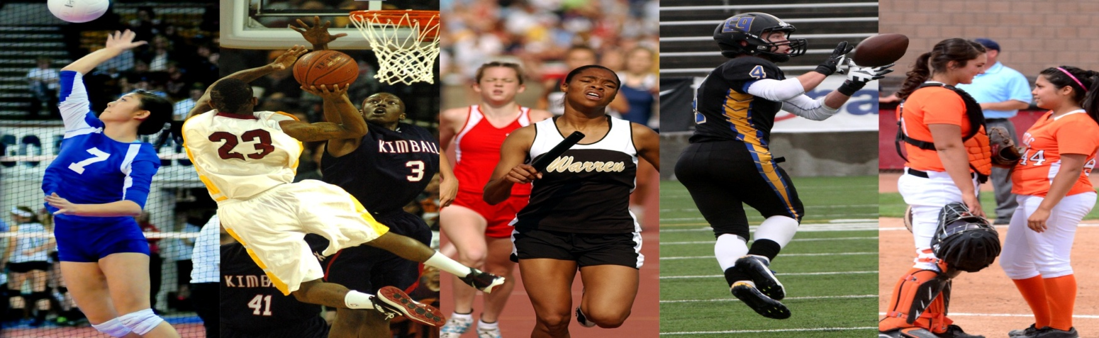
Thank You
National Federation of State High School Associations
PO Box 690 | Indianapolis, IN 46206
Phone: 317-972-6900 | Fax: 317.822.5700
www.nfhs.org | www.nfhslearn.com

Slide 61
Football Specific Changes
General Changes
Important Information
Eligibility and Compliance

Slide 62
Football: Important Dates
First Practice: July 30th
First Scrimmage: August 8th
First Contest: August 17th
Seeding: November 3rd
State Championships: December 8th
UNC, NC State University, Wake Forest University, Duke University

Slide 63
Practice Options
Practice Options: There are set practice options that can be utilized during the football preseason period:
Option A - One, three hour practice (which includes “flex time”).
Option B - One, three hour practice, followed by a mandatory three hour cool down period, followed by a one hour walk-through.
Option C (Double Practice) - One three-hour, or two-hour practice, followed by a mandatory three-hour cool down period, followed by a two-hour, or three-hour practice (Maximum of five hours of practice time per 24-hour period).
  Option C days must be followed by Option A, Option B, or off-day
  Under no circumstances may you have back-to-back Option C days
  Under no circumstances can the two-hour session of Option C contain any body-to-body contact (Live Action, Thud, and Control).
The mandatory cool-down period must be held in an air-conditioned environment.

Slide 64
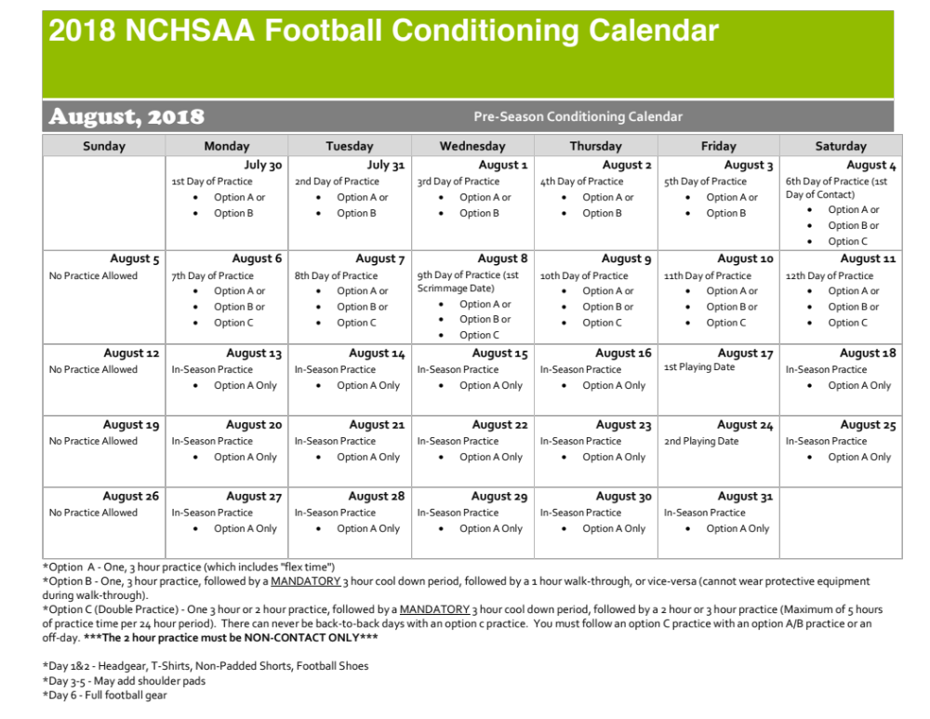

Slide 65
Heat & Humidity
The following should be considered when scheduling practice:
Time of day
Intensity level of practice
Equipment worn
Environmental conditions
High Temperature and high humidity create a dangerous situation for athletes. High humidity and low temperature can also cause serious heat-related problems.
Water/fluid replacement breaks recommended each 20 or 30 minutes. (depending on practice conditions)
Check with your AD on your LEA’s and school’s policy pertaining to practice on days of extreme heat.

Slide 66
Heat & Humidity - Wet Bulb Globe Temperature
WBGT readings must be taken by the AT/FR or designee not more than 30 minutes before the beginning of practice. Subsequent readings must be taken whenever water/rest breaks are taken or every 30 minutes, whichever comes first.
WBGT Index and Athletic Activity Chart in the 90 or Above category for Athletic Activity Guidelines: SUSPEND PRACTICE/MUST INCLUDE MANDATORY BREAKS AS DIRECTED BY GAMEDAY ADMINISTRATOR DURING CONTEST.

Slide 67
8-Quarter Rule
1A/2A – 10 Athletes Total
3A/4A – 5 Athletes Total
Athletes CANNOT participate in 3 games in a calendar week
  Monday – Saturday
    Postponements to Monday, 8-quarter Thursday/Friday
Athletes MUST be examined after conclusion of JV game and Pre-Participation paperwork MUST be signed/date by all parties each week and shared with Conference Administrators

Slide 68
Skill Development
Football is now the same as all other sports in regard to skill development
On a given day, an athlete is limited to 1.5 hours of skill development or weight training/conditioning during the academic school year calendar; inclusive of all weekends, holidays, work days, etc. Skill development sessions are not to exceed 1.5 hours in duration including flex time (stretching), meetings, video review and breaks.

Slide 69
Dead Periods
Summer 2018 | July 2 - 8 and July 16 - 22
Winter 2018 | October 31 through November 20 & Last 5 student days of 1st semester
Spring 2019 | February 13 through March 5 & Last 10 student days of 2nd semester
Summer 2019 | July 1 - 7 and July 15 - 21

Slide 70
General Changes
Seeding
  At-large berths
    4.1.18(e)(1): Teams in their classification will be selected to fill the remaining slots in the bracket based upon conference finish, then MaxPreps ranking.
  At-large berth interpretation
    Clarified/adjusted interpretation of the rule below to: The highest finishing non-automatic qualifying team in each conference will be compared based on their adjusted MaxPreps ranking. Under no circumstance may a team “leap-frog” a higher finishing team in its own conference.

Slide 71
General Changes
Seeding
  Split Conference Application Adjustments:
    4.1.19(b)(1): Removed wording: “...and highest finishing team in each classification of a split conference”
    Added note: The highest finishing team in its half of a split conference must finish in 1st, 2nd, 3rd place overall and/or have an overall winning percentage of .500 or higher in order to be seeded as a #1. Otherwise, the team will be seeded with all other at-large teams.

Slide 72
General Changes
Home Campus Background and Description
August 2000: Current system built and maintained by local technology vendor
April 2015:
Inhouse systems administrator hired
July 2018:
Convert all NCHSAA database needs to Home Campus
Current system is functional but:
Lacks centralization
Ability to grow or add new functions
Intermittent access issues based on user’s platform

Slide 73
General Changes
Home Campus Scope
  The following are 2017-2022 NCHSAA Strategic plans items that will be accomplished by this conversion:
    1.1.3 Update the current systems for reporting violations and infractions.
    1.2.3.3 Create an interactive tool on the NCHSAA website to help students and parents determine athletic eligibility
    2.2.3 Evaluate stakeholder information delivery systems.
    2.3.1 Monitor trends in the digital media space, including live video/streaming and social media, and find ways to benefit schools through new technologies.

Slide 74
General Changes
Home Campus Phase 1 – Existing
  The new system will include the following current database functions:
    Membership data information (coaches, school information, etc.)
    LEA data information
    Regional Supervisors data information and clinic scheduling
    Sport clinic attendance for coaches
    Eligibility summary data entry for each sport season
    Endowment games
    Transfers
    Violations
    Sanctions
    Ejections/Disqualifications
    Seeding for baseball, basketball, golf (regionals), football, lacrosse, tennis (dual team and regionals), volleyball, softball, and wrestling (dual team)

Slide 75
General Changes
Home Campus Phase 1 – New
  The new system will also add the following:
    Ability for system athletic directors to search the membership directory as well as monitor the schools in their LEA for compliance.
    Ability to have games, rosters and records entered in MaxPreps to be auto-populated in the school’s database.
    Ability to have NFHS Learn coach education auto-populated in the school’s database.
    Ability to digitize all financial forms such as playoff and endowment game forms.
    Ability to export search results to an Excel document for off-line use.
    Home Campus also offers many additional features that will be rolled out following stakeholder needs assessments.

Slide 76
General Changes
Ticket Prices
  Increased ticket prices for state championship finals only, for 2018 winter and spring sports
  Increased playoff and fall state championship ticket prices across all sports effective July 1, 2018.

Slide 77
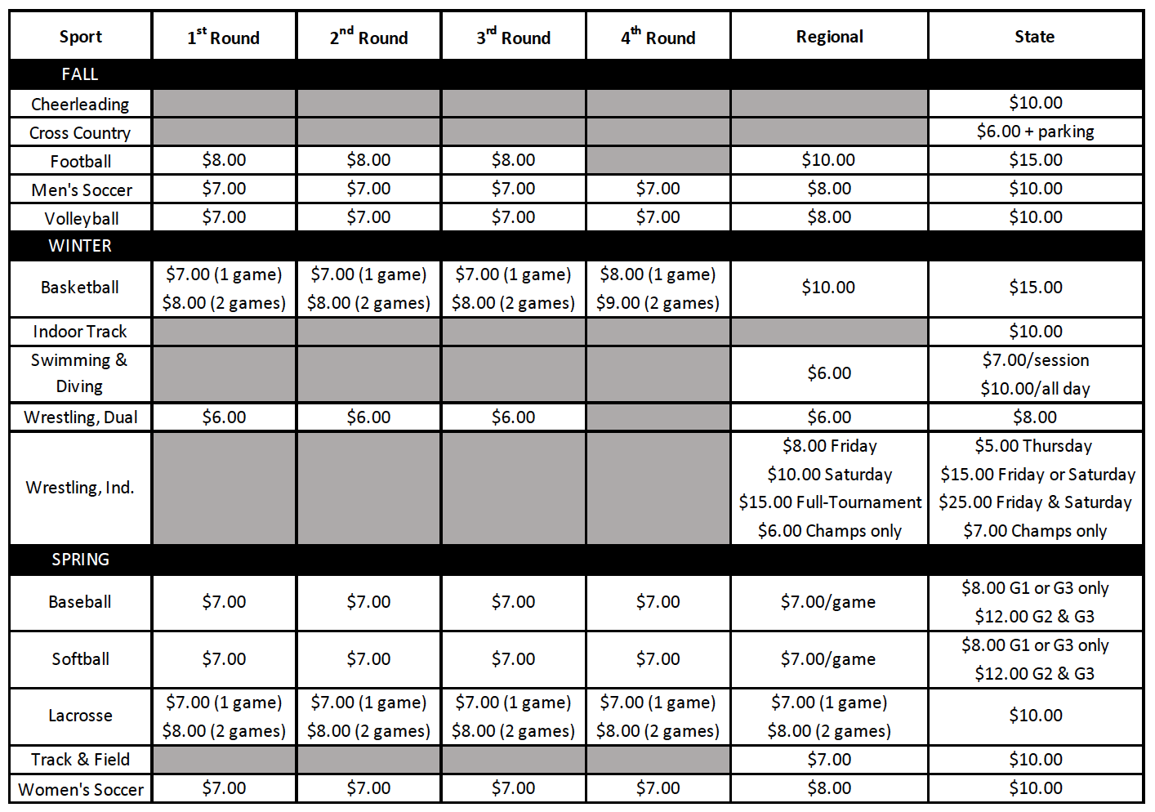
General Changes

Slide 78
General Changes
Transfer Policy
  Added language to the Transfer Policy allowing Staff to review all Transfer Certification requests.
    “Absent mutual agreement, and in consideration of the above, exceptions for immediate athletic eligibility for transfers from one LEA to a different LEA will first be considered by the NCHSAA Staff, then by the NCHSAA Transfer Committee, if necessary.”

Slide 79
General Changes
Amateur Rule
  Acceptance of money or a forbidden award will cause an athlete to lose athletic eligibility in all sports for 365 days.

Slide 80
General Changes
Sportsmanship/Ejection Policy
  Added language to 2.4.2 (f)
    “The NCHSAA will have zero tolerance within the confines of an NCHSAA event for the following: profanity of any kind, inappropriate language, racial or ethnic slurs, sexist or homophobic language”.

Slide 81
General Changes
Sportsmanship/Ejection Policy Penalties
  Added “coaches” to 2.4.3 (c)
    “Players or coaches receiving two ejections for unacceptable behavior as defined above will be suspended from all sports for the remainder of that sport season.”

Slide 82
General Changes
Scrimmages/Ejections Report
  Ejections in pre-season scrimmages now requires:
    Coach/player suspended from the remainder of the scrimmage – inclusive of multiple scrimmage events on same day (jamboree)
    Player must complete the NFHS “Sportsmanship” course before being eligible to compete in next scrimmage/contest
    Head Coach must complete the NFHS “Teaching and Modeling Behavior” course for any

Slide 83
General Changes
Video Review for Ejections
  When available, NCHSAA staff may utilize video to invoke ejections/sanctions not reported by game officials.
  Video clips to be presented for committee review within two (2) business days of the contest.

Slide 84
General Changes
Officiating Regulations
  Added language to 3.3.2(e)(1)
    “Schools are to us only NCHSAA-registered officials working through an approved NCHSAA officials association for varsity, junior varsity and ninth grade football, soccer, baseball, volleyball, basketball, wrestling, swimming and lacrosse at events hosted by or contested at the member school.”

Slide 85
General Changes
Return To Play Form
  If a student participating in an interscholastic athletic activity exhibits signs or symptoms consistent with concussion, the student shall be removed from the activity at that time and shall not be allowed to return to play or practice that day. The student shall not return to play or practice on a subsequent day until the student is evaluated by and receives written clearance for such participation from (i) a physician licensed under Article 1 of Chapter 90 of the General Statutes with training in concussion management, (ii) a neuropsychologist licensed under Article 18A of Chapter 90 of the General Statutes with training in concussion management and working in consultation with a physician licensed under Article 1 of Chapter 90 of the General Statutes, (iii) an athletic trainer licensed under Article 34 of Chapter 90 of the General Statutes, (iv) a physician assistant, consistent with the limitations of G.S. 90-18.1, or (v) a nurse practitioner, consistent with the limitations of G.S. 90-18.2.

Slide 86
General Changes
Return To Play Form
  NCHSAA recommends a medical physician!

Slide 87
Important Information
MaxPreps
  Official Statistics Provider
  Records and standings for post-season qualifications
    Official record
    Incorrect record subject to DQ from playoffs
  All games MUST be entered by:
    Friday, November 2nd by 11:59 pm
    Triple check your record!
    Instructions can be found on the NCHSAA website

Slide 88
Important Information
Sportsmanship
The quality of responsible behavior characterized by a spirit of generosity and a genuine concern for opponents, officials and teammates.
  Wholesome athletic environment
  Good Sportsmanship > Victory
  Modest in victory, gracious in defeat
  Respecting judgment and integrity of game officials
  Role modeling good behavior

Slide 89
Important Information
Ejection Policy
  Fighting
  Leaving the bench area
  Flagrant contact
  Biting
  Taunting, baiting or spitting toward an opponent or official
  Profanity
  Obscene gestures
  Disrespectfully addressing an official

Slide 90
Important Information
Ejection Follow-Up
  Teaching & Modeling Behavior Course
    Required for any coach ejected during a contest
    Required for any coach who has player (s) ejected for fighting
  NFHS Sportsmanship Course
    For any ejected/disqualified player
    Free, on-line course (nfhslearn.com)

Slide 91
Eligibility and Compliance
Eligibility Video
Required viewing for all coaches
Should be done with the athletic director
Includes opportunities to discuss concussions/sudden cardiac arrests/sickle cell, etc.

Slide 92
Eligibility and Compliance
Preseason Meeting
Required attendance by all parents
Time to share rules, regulations, expectations, philosophy etc.
Time to get all required signatures--pledges, Gfeller-Waller information, etc.
Eligibility and Authorization

Slide 93
Eligibility and Compliance
Coaches Education
NFHS Fundamentals of Coaching Course
  All coaches must have satisfied the requirement prior to first contest.
  Complete prior to first contest; subject to a $500 fine; continuing to coach without completion = another $500.

Slide 94
Eligibility and Compliance
Coaches Education
Concussion Management Certification
  The NFHS Concussion in Sports Course (free on-line course) or an equivalent course must be completed annually (after June 1, 2018 and before the first date of practice) by all coaches.
  Prior to the first date of practice for that sport; subsequently, the certificate of completion must be on file at the individual school; subject to $500 fine.

Slide 95
Eligibility and Compliance
Coaches’ Education
CPR/AED Certification
  All head and paid coaches must be CPR/AED certified
NFHS Sudden Cardiac Arrest Course
  All non-paid coaches are required to complete the NFHS Sudden Cardiac Arrest Course annually (after June 1, 2018 and before the first date of practice).

Slide 96
Eligibility and Compliance
Gfeller-Waller Concussion Law
Requirements
  Concussion signs and symptoms
    Given prior to participation
  Parents/athletes sign indicating “receipt of” Return to Play (RTP) form signed by a physician licensed to practice medicine
  An up-to-date Emergency Action Plan (EAP)
    Must be on-file, posted and updated annually
  “When in doubt, sit them out”

Slide 97
Eligibility and Compliance
Coaches Education
Accredited Interscholastic Coach (AIC) (6th Nationally)
  Requires completion of 4 courses:
    Fundamentals of Coaching
    1st Aid, Health & Safety for Coaches
    Sport Specific Course or Teaching Sports Skills
    Concussion in Sports (Free)

Slide 98
Eligibility and Compliance
Coaches Education
Certified Interscholastic Coach (CIC) (3rd Nationally)
  Completion of AIC requirements PLUS:
    Teaching & Modeling Behavior
    Engaging Effectively with Parents
    Sportsmanship
    Creating a Safe and Respectful Environment
    Strength & Conditioning
    2 additional courses (User Choice)

Slide 99
Thank You!
Get involved with student services
Visit the NCHSAA website often
Sign-in/pick-up your card as you leave today
  Enter your code immediately to get credit for attendance
    Mobile device or computer
    All fields required except comments box
    Use same email address that was used for NFHS Courses
  Deadline for entry is August 13, 2018
  Avoid $400 fine for your school

