Slide 1
2017-18 Men’s Lacrosse
Mark Dreibelbis
Associate Commissioner
Tra Waters
Assistant Commissioner – Sports & Championships

Slide 2
Sportsmanship…Together We Make the Right Call
Zero tolerance regarding profanity/inappropriate language.
“One Voice” – Only the Head Coach has communication with the officials.
  Assistant Coaches will be properly penalized and the penalty also is assessed to the Head Coach
Positive and effective/professional communication is expected by all parties associated with the game contest.

Slide 3
2018 NFHS Boys Lacrosse
Rule Review
Notes:
On behalf of the NFHS, welcome to the 2018 Boys Lacrosse Rules Review.
Since 1920, The National Federation of State High School Associations (NFHS) has led the development of education-based interscholastic sports and activities that help students succeed in their lives. We set directions for the future by building awareness and support, improving the participation experience, establishing consistent standards and rules for competition, and helping those who oversee high school sports and activities. This rules review is a service of the NFHS.
Each state high school association adopting these rules is the sole and exclusive source of binding rules interpretations for contests involving its member schools.
Questions about the interpretation of NFHS rules should begin by contacting the rules interpreter designated by his or her state high school association.
The NFHS is the sole and exclusive source of model interpretations of NFHS rules. State rules interpreters may contact the NFHS for model rules interpretations. No other model
rules interpretations should be considered.

Slide 4
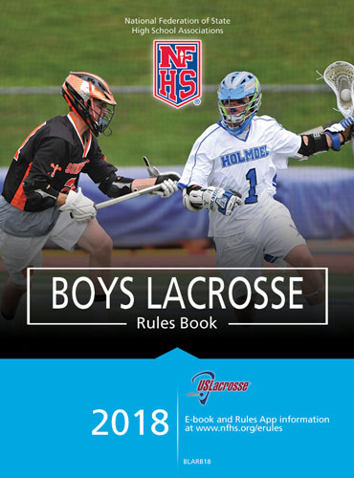
2018 NFHS Rules Book
2018 Boys Lacrosse Rules Book available at:
www.nfhs.com
http://www.nfhs.com/c-198-boys-lacrosse.aspx
$8.20 Plus S/H
Notes:
To maintain the sound traditions of this sport, encourage sportsmanship and minimize the inherent risk of injury, the National Federation of State High School Associations
writes playing rules for varsity competition among student-athletes of high school age. Member associations of the NFHS independently make decisions regarding
compliance with or modification of these playing rules for the student-athletes in their respective states.
The NFHS Rules Books are available for purchase at www.nfhs.com.

Slide 5
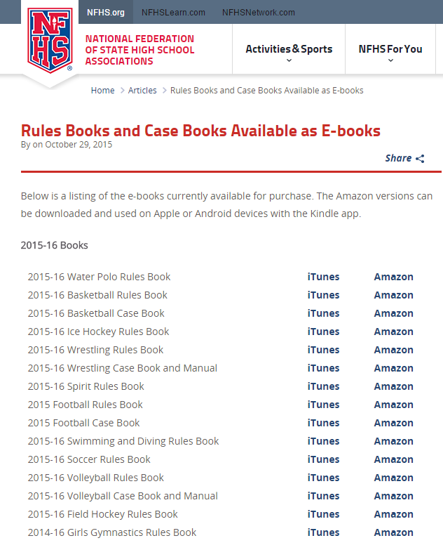
NFHS Rules E-Books
E-Books are available for purchase at: www.nfhs.org/ebooks/
$6.99 Apple or Android
Notes:
E-books are currently available for purchase. The Amazon versions can be downloaded and used on Apple or Android devices with the Kindle app. Apple users can visit iTunes for available books. Apple, Android and Kindle users can buy e-books from Amazon.com and view them through the Kindle app.
Price: $6.99 each.
Visit www.nfhs.org/ebooks for more information.

Slide 6
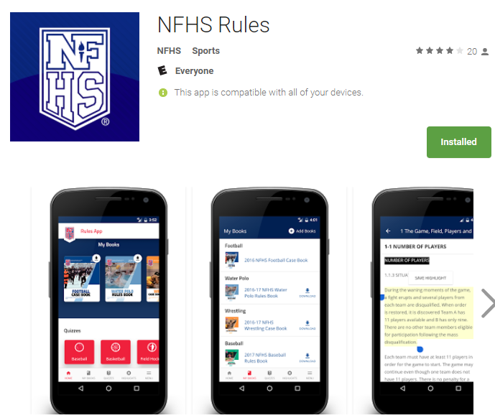
NFHS Rules App
Rules App available
On iTunes and Google Play
$6.99 Apple or Android

Slide 7
2018 NFHS Boys Lacrosse
Rule Revisions
Major Rules Changes
Situations and Rulings
Points of Emphasis
Corrections
Notes:
Now for our rules review…
In this presentation we will cover the following:
The Major Rules Changes
Updated Situations and Rulings and
Points of Emphasis

Slide 8
2018 NFHS Boys Lacrosse
Major Rules Changes
Notes:
As one of the fastest growing sports in the county, with nearly 110,000 boys participating in interscholastic high school lacrosse today, the NFHS rules and revisions for this high school boys’ lacrosse season focuses on risk minimization while maintaining the integrity of the game.
First, let’s review the Major Rule Changes for 2017.

Slide 9
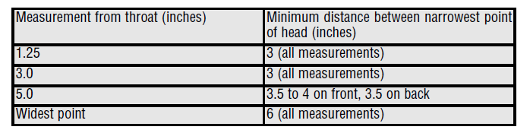
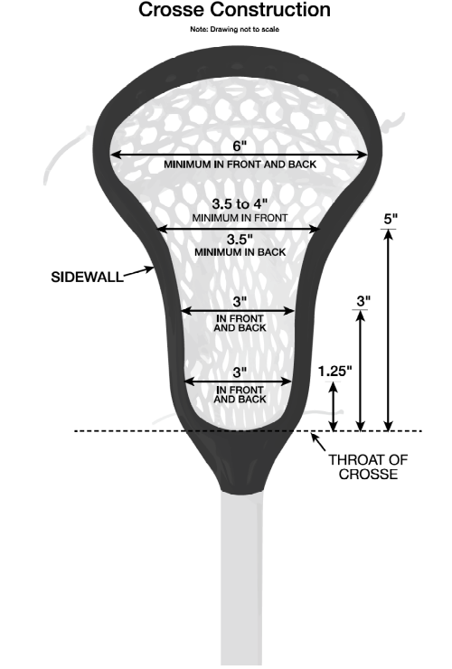
Crosse Dimensions
Rule 1-6-1 Page 13
Beginning in 2018, minimum stick specifications shall be as follows:
Notes:
Rule 1-6-1 defines crosse dimensions and specifications at different locations to address issues with the ball being stuck in the crosse.
The measurements for the crosse shall include the following:
Measurement from throat (inches) Minimum distance between narrowest point of head (inches)
1.25 3 (all measurements)
3.0 3 (all measurements)
5.0 3.5 to 4 on front; 3.5 on back
Widest point 6 (all measurements)
From the 1.25-inch measurement to the top of the crosse, the distance between the sidewalls of the crosse must be at least 3 inches.
The change in crosse specifications will align with other rules codes.
This change in equipment will begin in 2018 to allow for phased implementation for manufacturers.
Can players use the old specifications in 2017-18? No

Slide 10
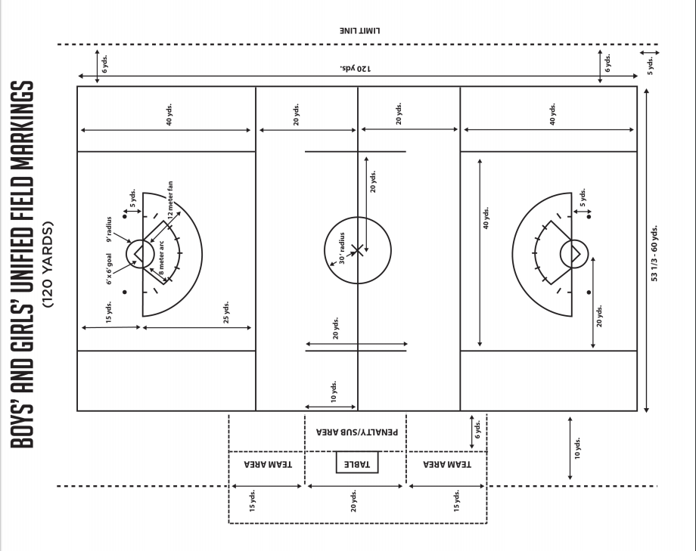
1-2 Page 9
Adopt the 120-yard Unified girls and boys field as an allowed field option..
Notes:
The 120 yard unified field is an option beginning in the 2018 season.

Slide 11
1-7-5 Page 16
Note: Pockets of nontraditional synthetic material manufactured for lacrosse are permitted. The pocket must meet the specifications of 1-7.
Notes:
This will allow for new products entering the market that are nontraditional, but not illegal.

Slide 12
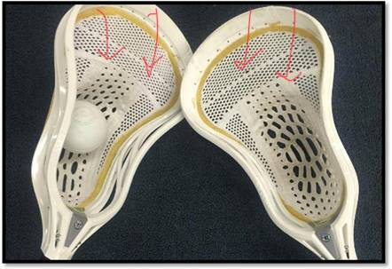
Question from a recent clinic: Does a pocket made from non-traditional materials have a shooting string?
Answer from NFHS: the committee believes that the strings across separating the top from the pocket are within 4 in and would be considered as the 4 in arch and legal esp since the synthetic stick pocket has been approved. If additional strings are added by a player, the legality would have to be judged closely.
Rules Interpretation:
New Synthetic Pocket

Slide 13
1-9-1g Page 18
Note: Beginning in 2022, the home team will be required to wear white jerseys, and the away team will be required to wear non-white jerseys.
Notes:
Better defining home and away jerseys.

Slide 14
4-3-3d Page 33
The official shall make certain that the reverse surfaces of the crosses match evenly in that the top of one head lines up with the throat of the other and are perpendicular to the ground.
Notes:
Clarification of stick alignments during face offs.

Slide 15
4-3-3n Page 34
n. A contrasting color between the head and the top glove must be visible on the shaft at faceoffs. The circumference of the shaft shall not exceed 3.5 inches.
Note: This can be accomplished with:
    Original shaft color
    Paint
    A single wrap of tape or
    Other material
Notes:
Added flexibility in color contrasting between shaft, glove and head for face offs to adhere to the rule

Slide 16
4-9-2 a & o Page 41
A goal shall be disallowed:
A. If a shot is released after the game horn sounds to indicate the end of a period.
A goal shall be allowed:
O. A goal will be allowed if the shot is released prior to the end of the period.
Notes:
Allows for an easier determination if a goal was scored.

Slide 17
4-18-4 Penalty Page 47
PENALTY: Conduct foul on the defensive player. A second violation by the player team will be enforced as releasable unsportsmanlike conduct, served by the offending player.
Notes:
Clarification in first violation as conduct foul and continued violations as unsportsmanlike penalties.

Slide 18
6-5-2x Page 71
ART. 2… The following are examples of illegal procedure:
x. Failure to wear a required mouthpiece properly (unless it comes out during play).

Slide 19
6-10-2 Page 75
The stall warning remains in effect until:
A goal is scored
A shot that hits the goal pipes
A shot that hits the goalie or hits his equipment
The defensive team gains possession
The period ends resulting in a faceoff
Notes:
Allows for the stall warning to be terminated when a shot is taken and a goal is scored, or ball hits goal pipe or goalie.

Slide 20
7-3 page 81
RESUMING PLAY AFTER PENALTY
When a penalty occurs and the ball is in the offended team’s offensive half of the field, the ball shall be put in play by the team awarded the ball, at the spot where the ball was when play was suspended.
If the ball was in the goal area when play was suspended, it shall be restarted nearest to the spot of the ball at the time of the whistle, 20 yards laterally outside the goal area.
Notes:
Clarifies the ball placement after a foul.

Slide 21
7-8-2 d & j Page 86
D. A shot is taken that does not result in a goal, unless the shot is caught in the air by a teammate.
J. A second defensive foul is committed during the final two minutes of regulation play with the team that is ahead possessing the ball, unless a scoring play is imminent.

Slide 22
7-8-3 page 86
A shot remains a shot until
  The ball comes to rest on the field
  The ball hits the ground and goes past the goal
  Possession is gained by any member of the defensive team; or
  After hitting the goalkeeper, goalkeeper equipment, goal posts or crossbar, the ball is touched by any player of the either team other than the defending goalkeeper, or an official

Slide 23
2018 NFHS Boys Lacrosse
Points of Emphasis
Notes:
Finally, let’s review the Points of Emphasis for 2016.

Slide 24
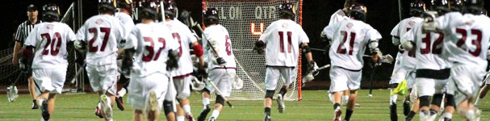
Points Of Emphasis
Points of Emphasis – Page 93
  Mouthpieces
  Face-offs
  Slow Whistle
  Shots at the end of Periods
  Crosse Change in 2018
Notes:
Points of Emphasis - (See page 93)
Mouthpieces
Face-offs
Slow Whistle
Shots at the end of Periods
Crosse Change in 2018

Slide 25

Points of Emphasis
Mouthpieces
In 2017 the foul for a mouth guard violation was changed from a personal foul to technical foul to encourage penalty enforcement for those who violate the rule. Coaches should encourage players to wear mouth guards properly (i.e. No Fish hooking) and legally, officials are expected to call the foul.
Notes:
In 2017 the foul for a mouth guard violation was changed from a personal foul to technical foul to encourage penalty enforcement for those who violate the rule. Coaches should encourage players to wear mouth guards properly (i.e. No Fish hooking) and legally, officials are expected to call the foul.

Slide 26
Points of Emphasis
Face-offs
Face off players are allowed to make contact first however only legal contact is allowed on players taking a faceoff.
Legal body contact includes checking a player who has no other part of the body touching the ground except the feet.
Body checks must be made below the neck, above the waist and to the front or side of an opponent.
Illegal body checks, including spearing with the head, shall be strictly enforced.
Notes:
a. Face off players are allowed to make contact first however only legal contact is allowed on players taking a faceoff. Legal body contact includes checking a player who has no other part of the body touching the ground except the feet. Body checks must be made below the neck, above the waist and to the front or side of an opponent. Illegal body checks, including spearing with the head, shall be strictly enforced.
b. Faceoff players must have a visible contrasting color between the head and top glove on the shaft. Contrasting color can be accomplished with the original shaft color, paint, a single wrap of tape, or other materials that do not make the shaft circumference exceed 3.5 inches.
c. Officials should continue to enforce the face off procedure that players reverse surfaces of the crosse shall match evenly so that the top of one head aligns with the throat of the throat of their opponent. Additionally both heads shall be perpendicular to the ground.

Slide 27
Points of Emphasis
Face-offs
B. Faceoff players must have a visible contrasting color between the head and top glove on the shaft.
Contrasting color can be accomplished with:
The original shaft color
Paint
A single wrap of tape or
Other materials that does not make the shaft circumference exceed 3.5 inches

Slide 28
Points of Emphasis
Face-offs
C. Officials should continue to enforce the face off procedure:
The player’s reverse surfaces of the crosse shall match evenly so that the top of one head aligns with the throat of the throat of their opponent.
Additionally both heads shall be perpendicular to the ground.

Slide 29
Points of Emphasis
Slow Whistle
When there is a flag down during a slow whistle situation. The attacking team is no longer required to keep the ball in the goal area.
* Unless required by rule or officials. *
NOTE: Team A must still meet requirement for advancing the ball into the goal area.
Notes:
When there is a flag down during a slow whistle situation. The attacking team is no longer required to keep the ball in the goal area other wise known as “ the attack box”. A normal stalling situation can still be applied by officials if need.

Slide 30
Points of Emphasis
Shots at the ends of periods
A goal will be allowed if the shot is released prior to the end of a period.
NOTE:
No goal if offensive Team A deflects or touches the ball.
Goal is good if defensive Team B deflects or touches the ball and it enters goal.
The shot ends when Team B gains possession or ball comes to rest.
Notes:
A goal will be allowed if the shot is released prior to the end of a period.

Slide 31
2018 NFHS Boys Lacrosse
Situations and Rulings
Notes:
Finally, let’s review the Points of Emphasis for 2016.

Slide 32
1.9.1 SITUATION E Page 20
  SECTION 9: PLAYER EQUIPMENT
  A1 scores a goal. Before the next faceoff, it is noticed that (a) A1 is not wearing a legal uniform;
  (b) A1 is not wearing one or more mandatory pieces of protective equipment other than a mouthpiece;
  (c) has no mouthpiece.
  RULING: (a) Goal counts technical violation with no time served.
  (b) Goal counts and A1 serves a 1-minute non-releasable penalty for illegal equipment;
  (c) Goal counts, technical violation, no time served. In all cases the game restarts with the ball awarded to team B on its offensive half of the field at the Center.

Slide 33
2.1.4 Situation Page 24
  SECTION 1: NUMBER AND DESIGNATGION OF PLAYERS
  Team A coach adds (a) an additional player to the team roster after the game has begun. (b) The coach adds several additional players to the roster after the game has begun. RULING: Legal.

Slide 34
4.3.1 Situation H (new) Page 35
B1 slashes A1. Flag down. A1 shoots, and the period ends while the shot is in the air. The ball enters the goal.
RULING: The goal counts and B1 serves 1-minute. The next period shall begin with a man-down faceoff.

Slide 35
4.3.3 Situation c
A1 comes to center to take a faceoff with:
(a) no contrasting color on the shaft, or
(b) has tape on the plastic throat of the shaft.
RULING: In both cases, technical foul on Team A for delay of game. Award the ball to Team B in offensive end.
NOTE: A1 does not serve penalty time and his crosse is legal for play other than faceoffs.

Slide 36
4.14.3 New Page 46
Over-and-back has not occurred if after a face-off, before either team gains possession, the ball is propelled into either attack area then back over the center-line.
NOTE: Over-and-back may only occur after team possession in its own goal area.

Slide 37
4.18.1 Situation E Page 47
Team B has 2 or more players in crease attempting to block a shot. B1, B2 & B3 are all in crease.
Team B players will serve.
B1 :30 Conduct Foul
B2, B3 1:00 Releasable Personal Foul
NOTE: If Team B was penalized for same infraction prior to this, B1, B2 & B3 would all serve 1:00 releasable personal fouls.

Slide 38
4.18.2 situation g
B1 (not the goalkeeper) picks up a loose ball or catches a pass while in the crease.
B1 still in crease as A1 checks his crosse causing the ball to enters goal.
RULING: Legal goal. Interference may be called only when the designated goalkeeper is involved.

Slide 39
4.18.4 New Page 49
A1 shoots while B1 Goalkeeper is away from the crease area. While the shot is in flight, B2 steps in the crease to block the shot.
RULING: Play-on until the shot comes to its normal conclusion.
NOTE: B2’s first violation no time serve. Any subsequent violation on B2 will result in 1:00 releasable foul.

Slide 40
4.26 Situation Page 56
(a) The ball goes out-of-bounds on the end line.
(b) The ball goes out of-bounds on the end line following a flag down slow whistle. Either team calls a timeout.
RULING: In (a), the ball should be re-started at the spot where the ball crossed the end line. In (b), the ball should be re-started outside the goal area.

Slide 41
6.2.1 Situation j NEW Page 67
Goalkeeper A1, who is in his crease with possession, throws an outlet pass while attack player B1 stands in front of the crease in a covering position. A1 releases the ball. His natural follow-through causes contact with B1’s crosse.
RULING: Goalkeeper interference by B1. Play-on, and award the ball to Team A at center if the pass is not completed.

Slide 42
6.5.2 situation o Page 73
During the faceoff, but before possession is gained, A1 pushes B1 who is attempting to secure the ground ball, in B’s defensive side of the field.
Official awards the ball to B at the spot of the infraction.
RULING: Correct. The ball is moved to the offended team’s offensive side of the field only on a pre-whistle violation.

Slide 43
6.5.2 Situation q New page 73
A1 shoots and scores. When the official goes to get the ball out of the goal, the goalkeeper shows him that his crosse or any other piece of required equipment is broken.
RULING: If the goalkeeper notices the broken equipment, he should verbally notify the officials immediately during the play so the officials can stop play to correct the problem. The goal stands since the problem was not noticed by the officials nor acknowledged by the goalkeeper before the shot was in flight.

Slide 44
6.5.2 Situation r new page 73
Goalkeeper B1, seeking to stop play in an unsettled situation:
Intentionally breaks required equipment or drops a glove; or
Yells to the officials that his equipment is broken when he broke it intentionally in order to stop play.
RULING: The officials stop play and assess a two-minute nonreleasable unsportsmanlike conduct penalty on B1.

Slide 45
6.10.2 situation f page 76
Team A has been warned to “keep it in.” After recovering a shot:
that hit the goal, goalkeeper, or his equipment, or
Team B deflects pass or causes ground ball to leave defensive area. Does Team A get new :10 count “get it in”?
RULING: (a) Stall warning has ended
(b) Yes, stall warning continued with full :10

Slide 46
6.10.3 situation c Page 77
Team A is ahead by four goals or less in the 4th quarter.
Team A satisfied the initial :10 count with 2:07 remaining.
Team A carries or passes ball outside the goal area with 2:02 remaining.
At 2:00 mark, the official warns Team A to “get it in” and starts a visual :10 count.
RULING: Correct procedure. Automatic stalling is in effect for Team A. Team A must “get it in” and “keep it in” the goal area.

Slide 47
7.3 Situation d page 82
After a faceoff and before possession has been declared or the ball crosses the defensive-area line, B4, who was behind the defensive-area line at the beginning of the faceoff, comes across the defensive-area line to play the loose ball.
RULING: Technical foul against B. Ball awarded to Team A at the spot where the ball was when play was suspended.

Slide 48
7.11.2 Situation A page 90
While ball is loose in the crease, A1 interferes with goalkeeper B1.
RULING: Play-on situation. If B1 fails to gain possession of the ball, ball is ­awarded to Team B, in the crease.

Slide 49
2018 NFHS Boys Lacrosse
Corrections
Notes:
As one of the fastest growing sports in the county, with nearly 110,000 boys participating in interscholastic high school lacrosse today, the NFHS rules and revisions for this high school boys’ lacrosse season focuses on risk minimization while maintaining the integrity of the game.
First, let’s review the Major Rule Changes for 2017.

Slide 50
1-6-1 page 14
Crosse shall measure between 6 and 10 inches.
  Not 6-1/2 inches as mentioned
  Other sections effected:
  Situation 5.5B Page 60
  POE Crosse Change Page 93

Slide 51
4-18-4 SITUATION Page 49
Replace the reference to “B2” in the beginning of the 2nd and 3rd paragraphs with “the team’”,
  Reflects the rule change.

Slide 52
2018 NFHS Boys Lacrosse
NFHS Services and Initiatives
Notes:
As we conclude the NFHS Boys lacrosse Rules Review, we would like to review some of the NFHS services and initiatives…

Slide 53

Accredited Interscholastic Coach
– National Coach Certification Program –
More Information at nfhslearn.com!
Level One National Certification Course Requirements:
• Fundamentals of Coaching
• First Aid, Health and Safety for Coaches
• Sport-specific Course or Teaching Sports Skills
• Concussion in Sports (FREE)
Notes:
The NFHS Coach Certification Program is a national professional credential offered to individuals who are currently coaching or aspire to coach at the interscholastic level. The attainment of this national certification demonstrates the completion of a series of courses offered by the NFHS that will enhance the ability of the coach to better serve the student, the school, the community and the profession of coaching.

Slide 54
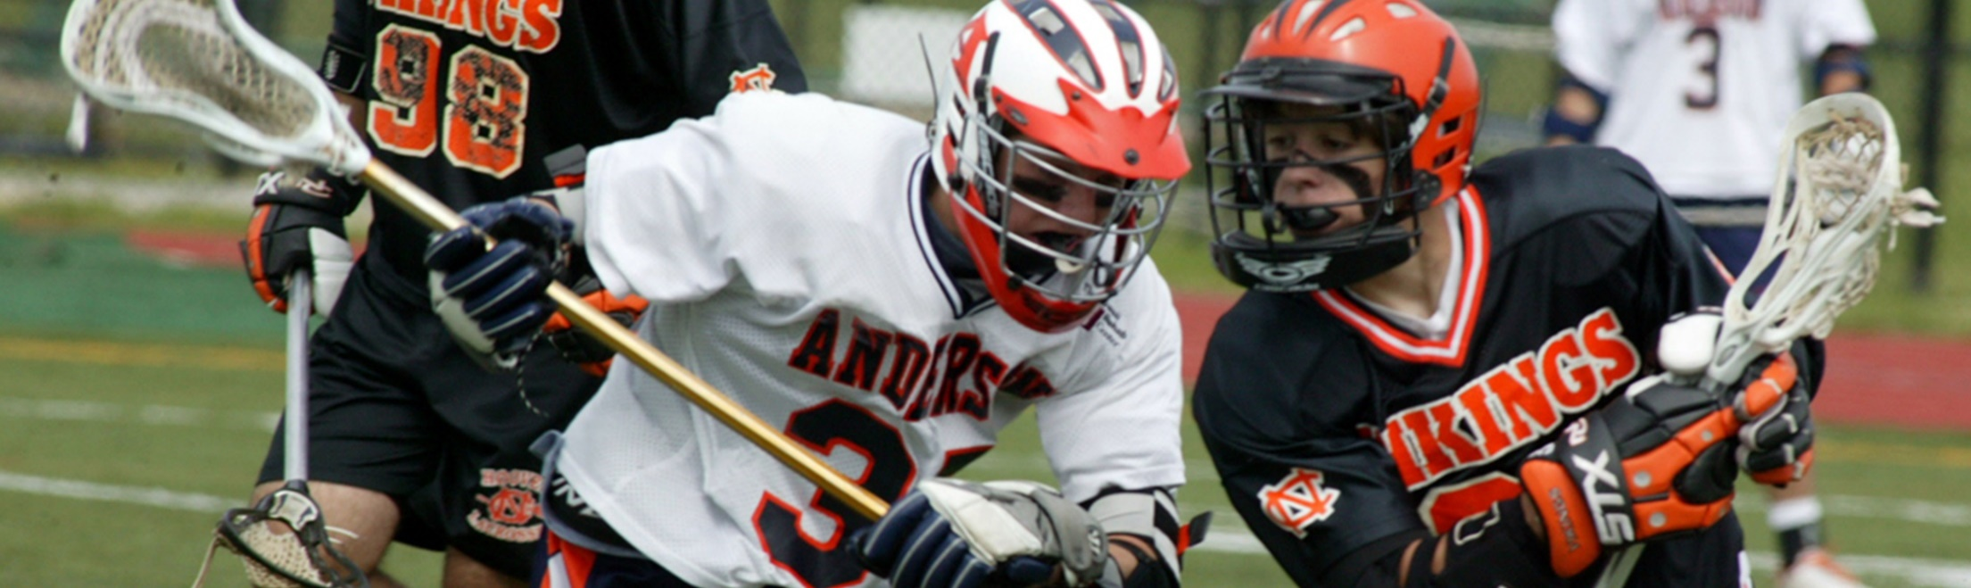


Coaching
Boys Lacrosse
Course Objectives
■ Differences between girls and boys lacrosse ■ How to create drills and structure effective practice sessions
■ Methods and techniques for teaching lacrosse ■ How lacrosse is played
■ Learn basic rules of boys lacrosse ■ Player positions and game structure
■ Understand essential beginning lacrosse skills and be able to teach those skills to players
Units
■ Origin and Background ■ Playing the Game
■ Teaching Lacrosse ■ Skills and Techniques
■ Team Tactics
More Information at nfhslearn.com!
Notes:
Check out the course available on NFHS Learn such as Coaching Boys Lacrosse….
Coaching Boys Lacrosse, developed by US Lacrosse (USL) in partnership with the NFHS, presents the history of lacrosse and demonstrates how to teach and coach the skills and tactics of the sport. Members of USL pay just $15 for this course as an added member benefit.
The course also includes:
■ Unlimited access to course & resources for one year from date of purchase
■ Use to fulfill NFHS AIC or CIC certification requirements
■ Approved by NFHS for 5 course clock hours
For more information go to nfhslearn.com

Slide 55
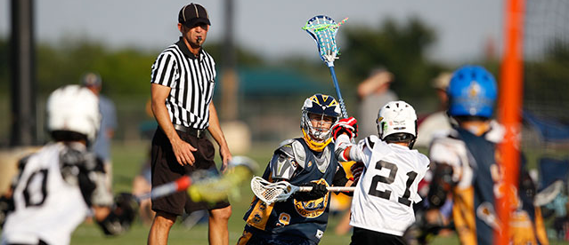
Interscholastic
Officiating
■ Officiating Basics
■ The Science of Officiating a Contest
■ The Art of Officiating a Contest
■ Putting it All Together
■ Rules Knowledge
■ The High School Environment
■ The Foundation of Officiating
■ Managing Difficult Situations
■ Game Speed Decisions
■ Professional Development
Notes:
About: Coaching Boys Lacrosse, developed by US Lacrosse (USL) in partnership with the NFHS, presents the history of lacrosse and demonstrates how to teach and coach the skills and tactics of the sport. Members of USL pay just $15 for this course as an added member benefit.
More:
■ Unlimited access to course & resources for one year from date of purchase
■ Use to fulfill AIC or CIC certification requirements
■ Approved by NFHS for 5 course clock hours

Slide 56



Concussion in Sports
■ Understand what concussions are & their impact on players
■ Recognize signs and symptoms of concussion
■ Recognize the complications associated with concussions
■ Know when additional medical attention is needed
■ Understand your responsibilities
■ Understand the proper concussion management protocols
■ List the steps a player should use to return to active play safely after a concussion
Units
■ Concussion Overview ■ The Problem
■ Your Responsibility
More Information at nfhslearn.com!
Notes:
About: The NFHS has teamed up with the Centers for Disease Control and Prevention (CDC) to educate coaches, officials, parents and students on the importance of proper concussion recognition and management in high school sports. This course highlights the impact of sports-related concussion on athletes, teaches how to recognize a suspected concussion, and provides protocols to manage a suspected concussion with steps to help players return to play safely after a concussion. Each state's requirements for concussion management are included as part of the course.
More:
■ Unlimited access to course & resources for 90 days from date of purchase
■ FREE Course
■ Required course for AIC and CIC certification
■ Approved by NFHS for 1 course clock hour

Slide 57
NCHSAA Information & Board Changes
2017-18

Slide 58
Important Dates
  Start: Wednesday, February 14
1st Contest: Wednesday, February 28
MaxPreps Entry Deadline: Saturday, April 28 (11:59 p.m.)
Brackets Posted Monday, April 30
Playoff Dates:
1st Round Wednesday, May 2
2nd Round Friday, May 4
3rd Round Tuesday, May 8
4th Round Saturday, May 11
Regionals: Tuesday, May 15
State Championships: Friday and Saturday, May 18-19

Slide 59
Number of Contests
No more than three per week.
Teams and individuals are limited to one contest a day.

Slide 60
Playoffs
Bracket Sizes:
  1A/2A/3A – 24 Teams
  4A – 40 Teams
Pre-determined Brackets (no seeding for 2018)
  Will be posted in the spring

Slide 61
Amateur Rule
Increased allowable merchandise to be received from $20.00 to $250.00 per sports season
Acceptance of money or a forbidden award will cause an athlete to lose athletic eligibility for the semester in which the violation occurred, and the following semester.

Slide 62
Senior Exceptions
Students may be allowed to wear school uniforms, including protective equipment, in outside organization competition, so long as the student has exhausted athletic eligibility in that sport and received permission from the member school.
  Approval from the LEA is strongly recommended.
Exception to the numbers restrictions for students who have exhausted their eligibility in that sport.
  Dead period rules will remain.

Slide 63
Transfer Rule
Students transferring to a member school where the student’s coach has relocated to within a year will be deemed ineligible for a period of 365 days LEA to LEA
A student’s first transfer after initial entry into the 9th grade is not subject to the NCHSAA transfer rule (LEA to LEA). For any transfer thereafter, the student must sit out for 2 consecutive semesters (at least 50% of the current semester + following semester) or 365-days, whichever is less.

Slide 64
Transfer Rule
NCHSAA Transfer Committee will be composed of the NCHSAA Executive Committee and at least one (1) non-district affiliated member.
Modify initial entry interpretation for non-district affiliated schools (Charter and Non-Boarding Parochial) –Rule 1.2.1(a)(2): boundary criteria shall only apply after initial entry into ninth grade.
Students who want to participate in cheerleading are not subject to the transfer policy, however all current eligibility requirements would remain applicable.

Slide 65
Residence Rule
No Custody
  Residency shall be deemed to be with the parent with whom the student begins the school year (i.e. 1st semester).
Bona Fide Change: The change must not be solely made for athletics purposes.

Slide 66
Endowment Games
The home team will remit twenty-five (25) percent of the gross revenue to the NCHSAA’s endowment fund. If a member school plays an endowment game against a non-member school, the member school is responsible for remitting payment to the NCHSAA regardless of where the game is played.

Slide 67
Wet Bulb Globe Temperature
Added language to the WBGT Index and Athletic Activity Chart in the 90 or Above category for Athletic Activity Guidelines: SUSPEND PRACTICE/MUST INCLUDE MANDATORY BREAKS AS DIRECTED BY GAMEDAY ADMINISTRATOR DURING CONTEST.

Slide 68
Facilities
The NCHSAA has the right to require host teams to find an adequate facility based on expected game/contest attendance and/or quality of venue.

Slide 69
Coaches Education
Annual requirements must be completed after June 1, 2017 and before the first date of practice.
NFHS Sudden Cardiac Arrest
  To require all non-paid coaches to complete the NFHS Sudden Cardiac Arrest Course annually and prior to the first contest.

Slide 70
Eligibility Summary Submission Dates
Fall – September 15th
Winter – December 15th
Spring – April 1st

Slide 71
Skill Development/Dead Periods
Changed in-season dead periods from 6 weeks to 3 weeks
Added new dead period:
  Last 10 student days of the school year
    Effective 2017-2018

Slide 72
MaxPreps
Official Statistics Provider
Records and standings for post-season qualifications
  Official record
  Incorrect record subject to DQ from playoffs
All games MUST be entered by:
  Saturday, April 28th by 11:59 pm
  Triple check your record!
  Instructions can be found on the NCHSAA website

Slide 73
Sportsmanship
The quality of responsible behavior characterized by a spirit of generosity and a genuine concern for opponents, officials and teammates.
Wholesome athletic environment
Good Sportsmanship > Victory
Modest in victory, gracious in defeat
Respecting judgment and integrity of game officials
Role modeling good behavior

Slide 74
Ejection Policy
Fighting
Leaving the bench area
Flagrant contact
Biting
Taunting, baiting or spitting toward an opponent or official
Profanity
Obscene gestures
Disrespectfully addressing an official

Slide 75
Ejection Follow-Up
Teaching & Modeling Behavior Course
  Required for any coach ejected during a contest
  Required for any coach who has player (s) ejected for fighting
NFHS Sportsmanship Course
  For any ejected/disqualified player
  Free, on-line course (nfhslearn.com)
All certificates must be sent to NCHSAA

Slide 76
Inclement/Hot Weather Guidelines
The following should be considered when scheduling practice:
Time of day
Intensity level of practice
Equipment worn
Environmental conditions
High Temperature and high humidity create a dangerous situation for athletes. High humidity and low temperature can also cause serious heat-related problems.
Water/fluid replacement breaks recommended each 20 or 30 minutes. (depending on practice conditions)
Check with your AD on your LEA’s and school’s policy pertaining to practice on days of extreme heat.

Slide 77
Dead Periods
Summer 2017 | July 3-July 19 and July 17-23
Fall 2017 | July 31 through August 20
Winter 2017 | Oct 30 through November 19
Spring 2018 | N/A
Summer 2018 | July 2-July 8 and July 16-July 22

Slide 78
Eligibility & Compliance

Slide 79
Eligibility
Video
Required viewing for all coaches
Should be done with the athletic director
Includes opportunities to discuss concussions/sudden cardiac arrests/sickle cell, etc.

Slide 80
Eligibility
Preseason Meeting
Required attendance by all parents
Time to share rules, regulations, expectations, philosophy etc.
Time to get all required signatures--pledges, Gfeller-Waller information, etc.
Eligibility and Authorization

Slide 81
Eligibility
Eligibility Checklist
  Use to ensure school has done its due diligence

Slide 82
Clinic Attendance
Head coaches in baseball, basketball, cheerleading, football, golf, lacrosse, soccer, softball, swimming, tennis, track & field, volleyball and wrestling must attend an NCHSAA approved State Rules Clinic.
Must be completed prior to coaching in the first contest; subject to $400 fine, in addition to a $500 fine if he/she actually coaches in the contest

Slide 83
Clinic Attendance
If the head coach cannot attend the NCCA clinic or is not hired until afterwards, the requirement can also be met at one of the statewide officials’ clinics, which are posted on the NCHSAA Website under clinics. Please note that several volleyball and soccer clinics for officials occur prior to the NCCA Clinic.
Athletic directors cannot satisfy this requirement by attending a rules’ session in place of the head coach

Slide 84
Coaches’ Education
NFHS Fundamentals of Coaching Course
All coaches must satisfy the requirement prior to first contest.
Complete prior to first contest; subject to a $500 fine; continuing to coach without completion = another $500.

Slide 85
Coaches’ Education
Concussion Management Certification
The NFHS Concussion in Sports Course (free on-line course) or an equivalent course must be completed annually (after June 1, 2017 and before the first date of practice) by all coaches.
Prior to the first date of practice for that sport; subsequently, the certificate of completion must be on file at the individual school; subject to $500 fine.

Slide 86
Coaches’ Education
CPR/AED Certification
All head and paid coaches must be CPR/AED certified
  Effective August 1, 2017
NFHS Sudden Cardiac Arrest Course
All non-paid coaches are required to complete the NFHS Sudden Cardiac Arrest Course annually (after June 1, 2017 and before the first date of practice).
  Effective August 1, 2017

Slide 87
Gfeller-Waller Concussion Law
Requirements of the Law:
Concussion signs and symptoms
  Given prior to participation
  Parents/athletes sign indicating “receipt of” Return to Play (RTP) form signed by a physician licensed to practice medicine
  An up-to-date Emergency Action Plan (EAP)
  Must be on-file
  Must be posted
  Must be updated annually
“When in doubt, sit them out”

Slide 88
Cardiac Safety Program
All NCHSAA member schools must have a Cardiac Safety Program to include three (3) components:
Appropriate number of AEDs on Campus
AED maintenance program (battery checks, maintain, replacement at appropriate intervals)
Required viewing of short AED/CPR video for all supervising adults (teachers, coaches, administrators)

Slide 89
Coaches’ Education
Accredited Interscholastic Coach (AIC)
Requires completion of 4 courses:
  Fundamentals of Coaching
  1st Aid, Health & Safety for Coaches
  Sport Specific Course or Teaching Sports Skills
  Concussion in Sports (Free)

Slide 90
Coaches’ Education
Certified Interscholastic Coach (CIC)
Completion of AIC requirements
Plus:
  Teaching & Modeling Behavior
  Engaging Effectively with Parents
  Sportsmanship
  Creating a Safe and Respectful Environment
  Strength & Conditioning
  2 additional courses (User Choice)

Slide 91
Transfer Policy
If a bona fide change of residence—no transfer waiver necessary
Transfer packet with forms are on-line; password protected
Work with athletic director to ensure students meet residence rule requirements

Slide 92
2018 NFHS Boys Lacrosse
Rule Presentation
Thank you for your participation!
Notes:
Thank you and have a great season!

