Slide 1
2018 NFHS softball Rules
PowerPoint
Rules Changes
Major Editorial Changes
Points of Emphasis

Slide 2
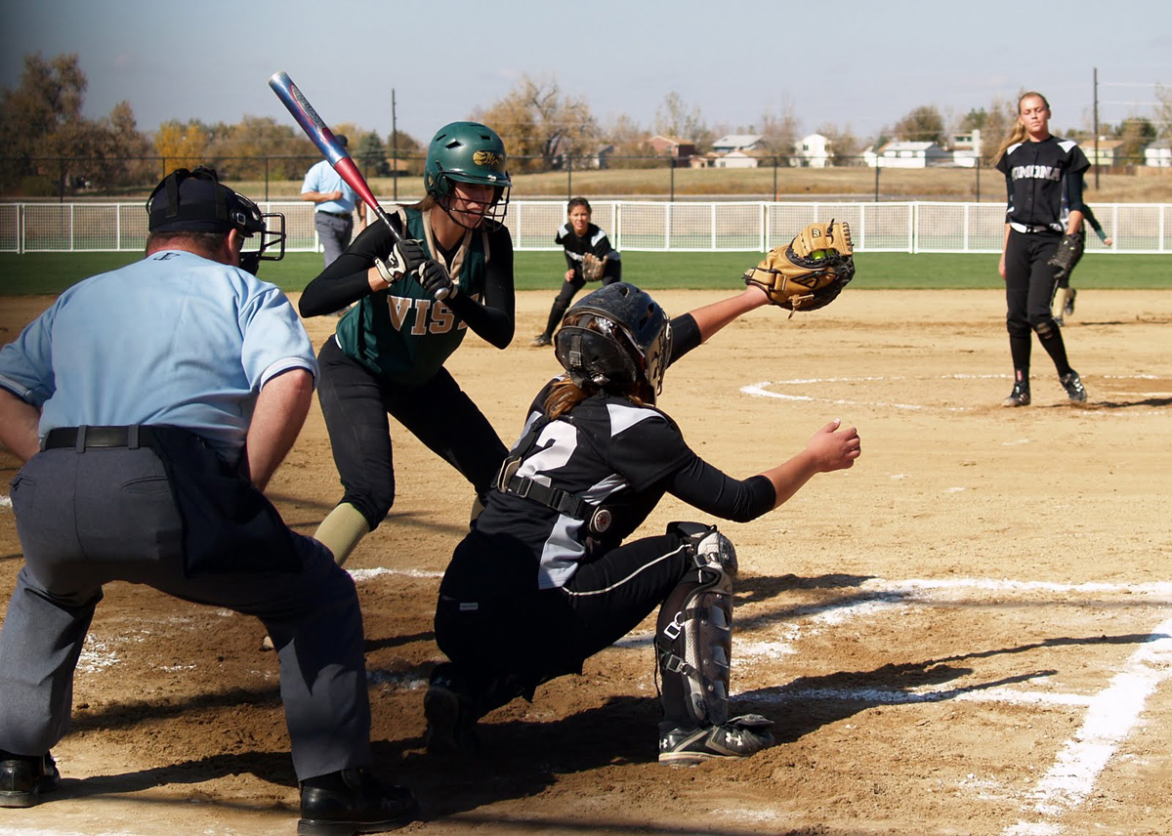
National Federation of
State High School Associations
NFHS (located in Indianapolis, IN – Est. 1920):
  National leadership organization for high school sports and fine arts activities;
  National authority on interscholastic
  activity programs.
  Conducts national meetings;
  Sanctions interstate events;
  Produces national publication for
  high school administrators;
  National source for interscholastic coach
  training and national information center.

Slide 3

National Federation of
State High School Associations
Membership = 50 member state associations and D.C.
NFHS reaches more than 19,000 high schools and 12 million participants in high school activity programs, including more than 7.8 million in high school sports.

Slide 4

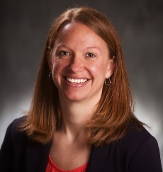
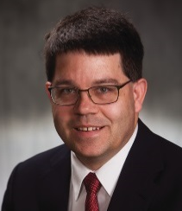



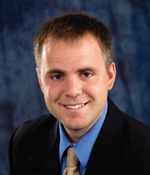

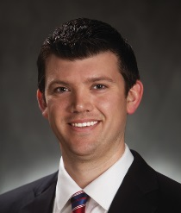
NFHS Rules Review Committee
The NFHS Rules Review Committee is chaired by the chief operating officer and composed of all rules editors. After each committee concludes its deliberations and has adopted its recommended changes for the subsequent year, such revisions will be evaluated by the Rules Review Committee.
Davis Whitfield
Chief Operating Officer
Lindsey Atkinson
Volleyball
Bob Colgate
Football and Sports
Medicine
Sandy Searcy
Softball and Swimming & Diving
Elliot Hopkins
Baseball and Wrestling
Julie Cochran
Cross Country, Field Hockey, Gymnastics and
Track & Field
James Weaver
Boys and Girls Lacrosse and Spirit
Theresia Wynns
Basketball and Soccer
Dan Schuster
Ice Hockey

Slide 5





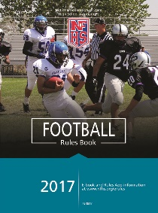
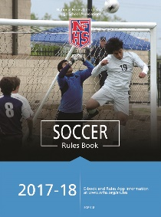

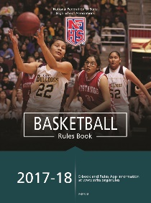



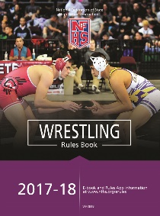
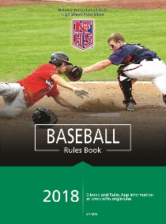
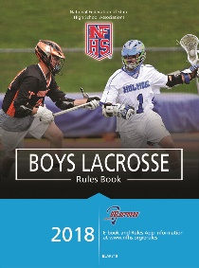

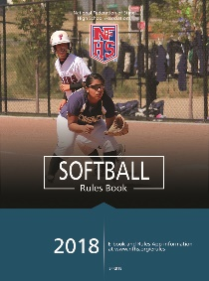

National Federation of
State High School Associations
The NFHS writes playing rules for 17 sports for boys and girls at the high school level.
  Publishes 4 million pieces of materials annually.

Slide 6

NFHS Rules Book as e-Books
E-books features:
  Searchable
  Highlight areas of interest
  Make notes
  Easy navigation
  Adjustable viewing size
  Immediate availability

Slide 7
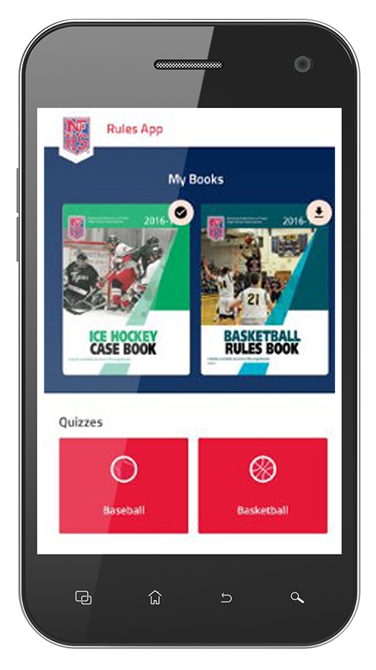
NEW NFHS Rules App
Rules App features:
  Searchable
  Highlight notes
  Bookmarks
  Quizzes for all sports
  Easy navigation
  Immediate availability
  Free to paid members of the NFHS Coaches and Officials Associations
  www.nfhs.org/erules for more information
Notes:
Comment on Slide:
App is free to download
Each book subscription is $6.99
NFHS Coaches and Officials Association paid members get all books for free
100% states members get books for free in sports designated by their state
New in 2017 – Rules apps for all NFHS rules books and case books available on iTunes and Google Play. Rules books and case books will be cross-linked. Searchable content.

Slide 8

Guidelines for Schools and state associations for consideration of accommodations
Notes:
To assist state associations in working with schools for the inclusion of students with disabilities the following guide prepared by the NFHS Task Force on the Inclusion of Students with Disabilities is being provided for your review.
Following these guidelines will assist in the individual student assessment by the student and the school.
When requesting a possible accommodation, coaches should work with their school and the state association as early as possible in the sport season.
Contest officials shall defer decisions on rule accommodations to the respective state association.
This information serves as a guide. Each state association may develop its own process.

Slide 9
2018 NFHS softball
Rules Changes

Slide 10



Team IP Ad
Notes:
Team IP is one of our corporate sponsors.
Just as our athletes strive for excellence, Team IP shares that same goal of excellence for service and products.

Slide 11
CORRECTIONS
Rules Book 2-65-2
ART. 2 . . . Intentional Walk (Base on balls) – A request made to the umpire by the defensive coach, pitcher or catcher, for the purpose of awarding the batter first base. No pitches are thrown. The request may be made prior to or during the at bat.
Case Book
8.1.1 SITUATION G J: R1 is on third. R1 starts home as in a
squeeze play. F3, who is playing close for a bunt, cuts off the pitch
and tags R1. RULING: This is treated the same as catcher
obstruction. The ball becomes dead at the end of playing action.
The coach or captain of the team at bat has the option of the play
or penalty. If the penalty is accepted, R1 is awarded home and B2
is awarded first. (2-36, 8-1-1d)
Notes:
Rule 2-65-2: The coach, pitcher or catcher of the defensive team may request an intentional walk either before or during the pitch count. This phrase “No pitches are thrown” should be deleted from page 29.
Case Book SITUATION: The second 8.1.1 SITUATION G listed on page 51 of the 2017-18 Softball Case Book should be entitled 8.1.1 SITUATION J.

Slide 12
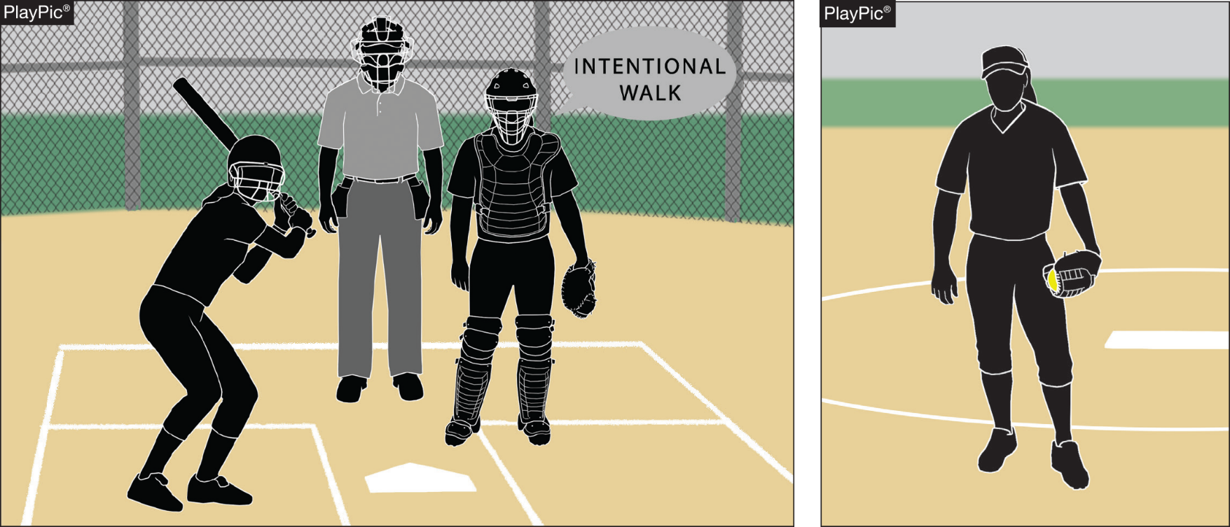
INTENTIONAL WALK
RULES 2-65-2, 8-1-1c, 8-4-3a
INTENTIONAL WALK
ART. 2 . . . Intentional Walk (Base on balls) (S.P.). A request made to the umpire by the defensive coach, pitcher or catcher, for the purpose of awarding the batter first base. No pitches are thrown. The request may be made prior to or during the at bat.
Notes:
This rule change to permit intentional walks was enacted to align fast pitch and slow pitch rules, to keep up with current trends of the sport, and also to maximize the flow of the game.

Slide 13

Equipment
Rule 3-2-7c EXCEPTION (NEW)
Any wristband with a playbook/playcard attached shall be considered equipment and is permitted as long as it is a single, solid color and not optic yellow. It does not have to match the color of the upper undergarment. It shall only be worn on the non-pitching arm.
Notes:
Language was added to address the use and placement of the wristband playbook/play card and defines this item as a piece of equipment. It also addresses restrictions on color.

Slide 14
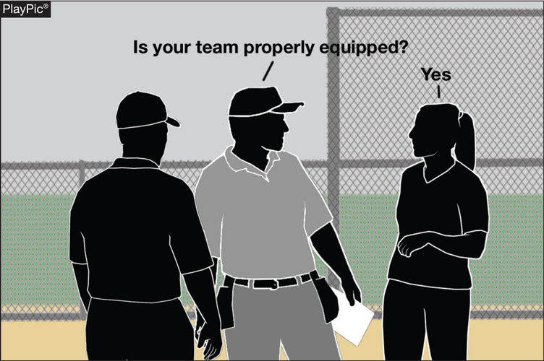
equipment
Rule 3-2-15
ART. 15 . . . All equipment shall be inspected by the umpire, and is to be placed outside the dugout/bench prior to the start of the game.
Notes:
This change removes the responsibility of the umpires to inspect equipment prior to the start of the game. Rule 4-1-2d requires head coaches to verify that their players are legally and properly equipped during the pre-game meeting.

Slide 15
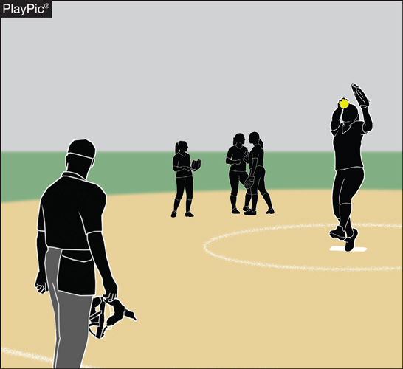
CHARGED CONFERENCES rule 3-7-1 NOTE (New)
NOTE: If the incoming pitcher
has already pitched in the
game, she will receive five
warm- up pitches. When a
pitcher is removed by rule
and the incoming pitcher has
not pitched in the game, the
umpire is authorized to permit additional
warm-up pitches.
Notes:
If a coach has been charged more conferences than permitted by rule, the pitcher shall be removed for the duration of the game. If a pitcher is removed for this reason, the umpire is authorized to allow the incoming pitcher a reasonable number of pitches if she has not already pitched in the game. If she has already pitched in the game, she will receive 5 warm-up pitches, unless she has pitched that half inning in which case, she will not receive any warm up pitches.

Slide 16

Pitching regulations (F.P.)
Rule 6-1-2b
Any step backward shall begin prior to the start of the pitch. The step backward may end before or after the hands come together. Once the pitch has started, the pitcher shall not take more than one step which must be forward, toward the batter and simultaneous with the delivery.
Notes:
The pitcher may now step back with the non-pivot foot at any time prior to the start of the pitch. This slight change allows for a more fluid sequence of motion and will aid the development of pitchers.

Slide 17
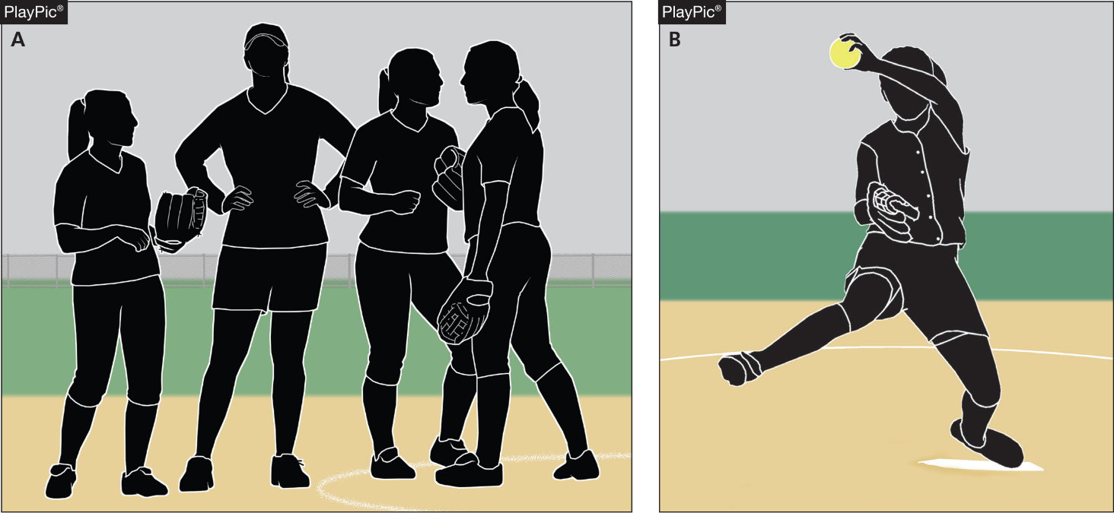
infractions by pitcher (f.p.)
Rule 6-2-5 NOTE 2
ART. 5 . . . At the beginning of each half-inning or when a pitcher relieves
another, no more than one minute may be used to deliver no more than five balls to the catcher or other teammate. The one-minute time limit begins
from the third out of the previous half-inning. Play shall be suspended during
this time.
NOTE 2: Umpire is authorized to allow more pitches when weather is inclement or if pitcher was removed by rule or due to an injury.
Notes:
Added language provides umpires with the authority to allow a reasonable number of warm-up pitches to an incoming pitcher due to circumstances that require a pitcher to be removed by rule.

Slide 18
PITCHER’S RECORD
RULE 9-6-2
ART. 2 . . . The number of bases on balls, batters being hit by a pitch (F.P.), strikeouts, and base hits allowed by each pitcher shall be recorded in the summary. If a batter is hit by what would have been the fourth ball (F.P.), it is recorded as a hit batter. An intentional walk is recorded as a base on balls.
Notes:
The added language specifies how an intentional walk is recorded in the pitcher’s record.

Slide 19
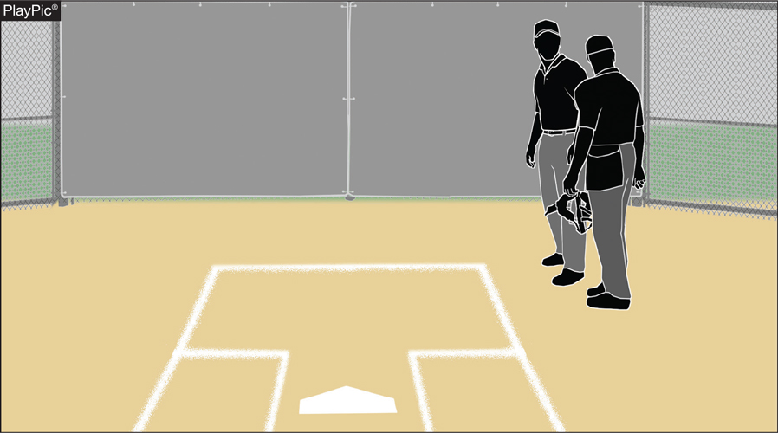
Plate umpire rule 10-2-3a
ART. 3 . . . The duties include those listed in 10-2-1 and also the following:
a. conduct the pregame conference as in 4-1-2. Inspect equipment, including batting and catcher’s helmets, bats, inspect the condition of the field, define the dugout/bench areas, and if necessary, designate the official scorekeeper (9-2-2).
Notes:
The responsibility of checking equipment before a game has been removed from the umpires duties. Umpires shall continue to check the field conditions, define the dugout/bench areas and conduct a pregame conference where they verify with the coaches that all teams equipment is legal.

Slide 20
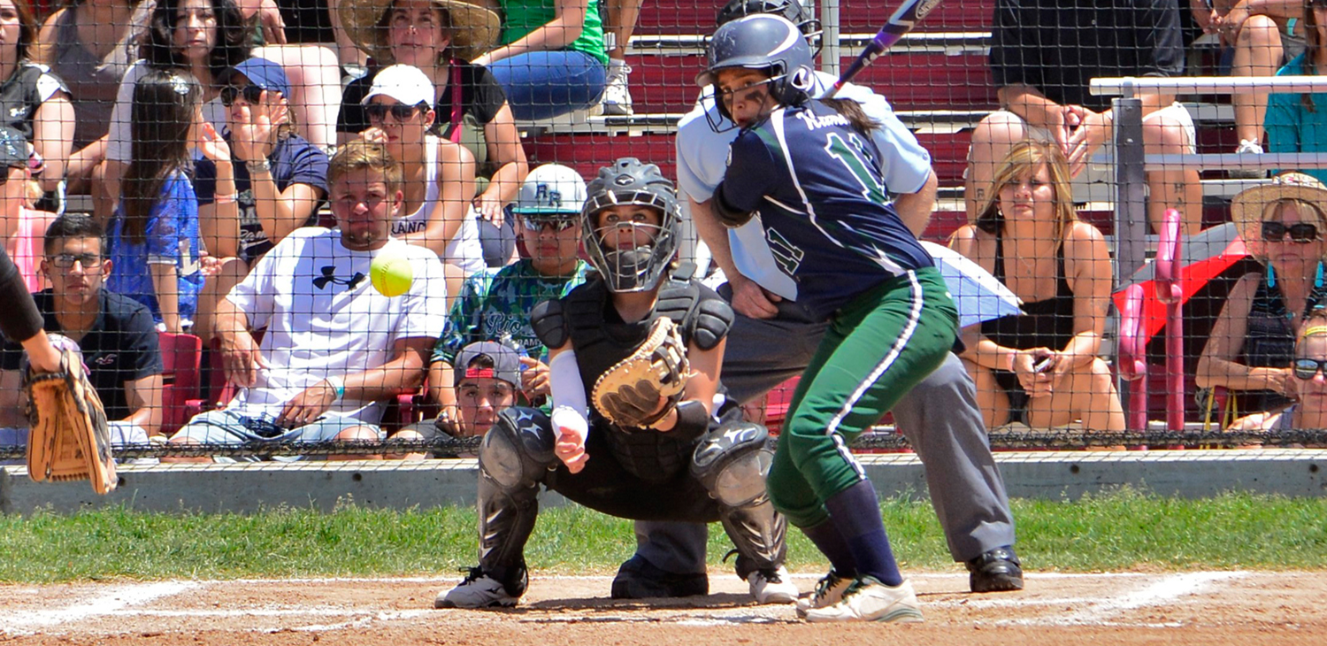
2018 NFHS softball
Major Editorial changes

Slide 21

Bench and field conduct rule 3-6-12
ART. 12 . . . Tobacco products, in any form, are prohibited. No participant, coach or administrator shall use alcohol or any form of tobacco product (e-cigarette or similar items) beginning with arrival at the competition site until departure following the completion of the contest.
Notes:
Tobacco products, including e-cigarettes, are prohibited beginning with the arrival at the competition site and until departure after the game. The language provides clarity and consistency for restriction of alcohol and tobacco use by participants or school personnel.

Slide 22
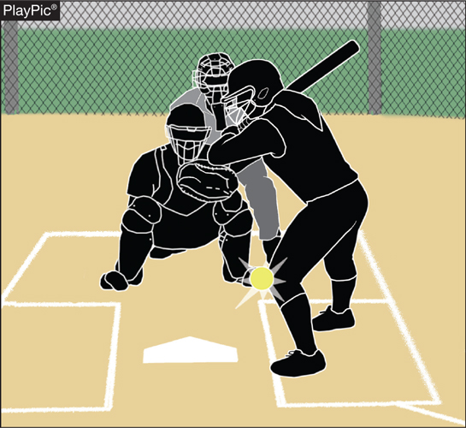
8-1-2 hit by pitch
ART. 2 . . . A batter is awarded first base when:
c. (F.P.) a pitched ball (not entirely in
the batter’s box) not swung at nor
called a strike touches any part of
the batter’s person or clothing. It
does not matter if the ball strikes
the ground before hitting the
batter. The batter’s hands are not
to be considered part of the bat.
If no attempt is made to avoid being hit, the batter will not be
awarded first base unless it is ball
four.
Notes:
The language clarifies that the batter must make an attempt to avoid being hit by a pitched ball in the area between the plate and the batter’s box. A batter is awarded first base if she is hit by a pitch that is entirely within the batter’s box without any requirement to avoid being hit. However, if the ball is not entirely within the batter’s box she is required to make an attempt to avoid being hit.
This portion of the rule had been inadvertently omitted from a previous rules book.

Slide 23
Bench and field conduct rule 10-1-6
ART. 6 . . . Umpires shall not use tobacco products in any form in the vicinity of the playing field. No game official shall use alcohol or any form of tobacco product (e-cigarette or similar items) beginning with arrival at the competition site until departure following the completion of the contest.
Notes:
Tobacco products, including e-cigarettes, are prohibited beginning with the arrival at the competition site and until departure after the game. Language provides clarity and consistency for restriction of alcohol and tobacco use by officials.

Slide 24

2018 NFHS softball
Points of emphasis

Slide 25
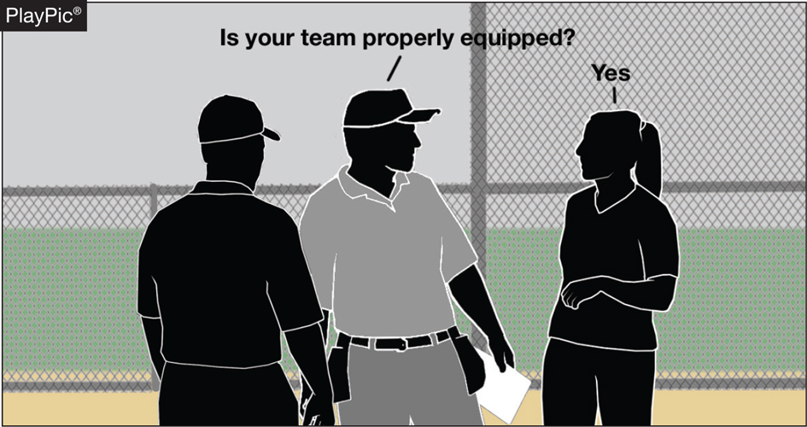
Coaches responsibility
Coaches are responsible
for verifying at the
pregame conference that
all their players are
legally and properly
equipped. Penalties for illegal equipment range from correcting the problem if possible or having the equipment removed. Possible restriction to the dugout or ejection for the player and coach depending on the severity of the infraction could occur.
Notes:
Rule 3-2-15 has been removed. Coaches are reminded of their responsibilities per Rule 4-1-2d, which requires them to verify that all their players are legally and properly equipped, at the pregame conference. Coaches should review the following rules: 1-4 Gloves/Mitts, 1-5 Bats, 1-6 Batting Helmets, 1-7 Catchers Equipment and 3-2 Uniforms and Player Equipment.

Slide 26
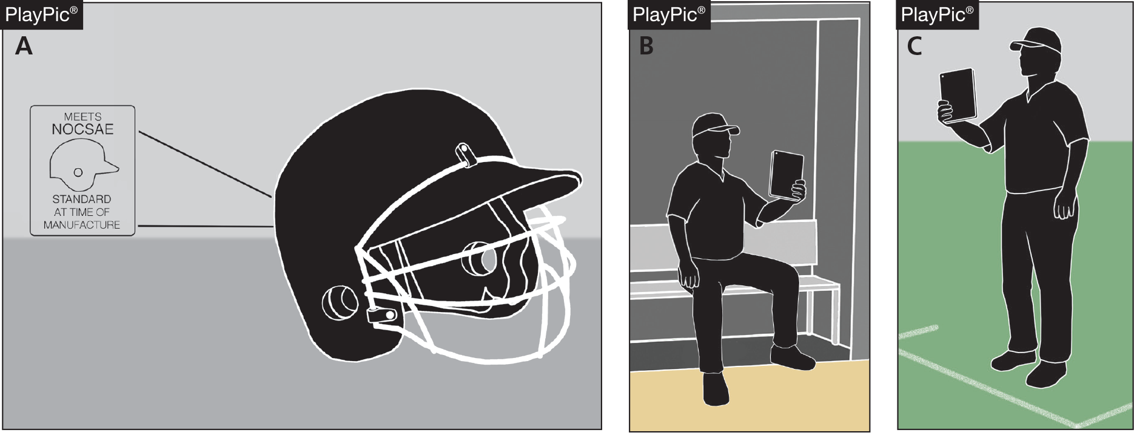
Other equipment
Coaches should also review Rule 1-8 to be familiar with what other equipment is permitted for players and coaches.
Notes:
Coaches should also review Rule 1-8 other equipment. To be familiar with what other equipment is permitted for players and coaches. Penalties for illegal equipment range from correcting the problem, if possible, or having the equipment removed. Possible restriction to the dugout or ejection for the player and coach depending on the severity of the infraction could occur.

Slide 27

Hit by pitch
The ball is not in the
strike zone and is not
completely in the
batter’s box. The
batter still must make
an effort to avoid
being hit.
Notes:
Rule 8-1-2c describes a scenario in which the ball is neither entirely in the strike zone (this is a dead ball strike) or the batter’s box (hit by pitch and awarded first base). In the area between the strike zone and completely in the batter’s box, the batter still has to make an effort to avoid being hit.

Slide 28
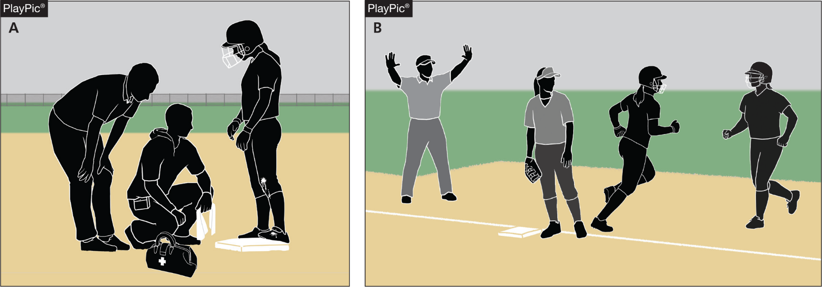
Courtesy runner for pitcher and catcher
The pitcher is injured (PlayPic A) and is unable to face the first batter in the bottom of the first inning. The player who ran for her is retroactively her substitute, no longer a courtesy runner (PlayPic B). All substitution rules apply and the pitcher and/or catcher has left the game.
Notes:
The Rule 8-9-2 EXCEPTION is unique: If the pitcher of record, after having a courtesy runner, is injured and unable to pitch in the bottom of the inning, her courtesy runner becomes a retroactive substitute for her. All substitution rules apply and the pitcher and/or catcher has left the game.

Slide 29
NFHS Officials association central hub

Slide 30
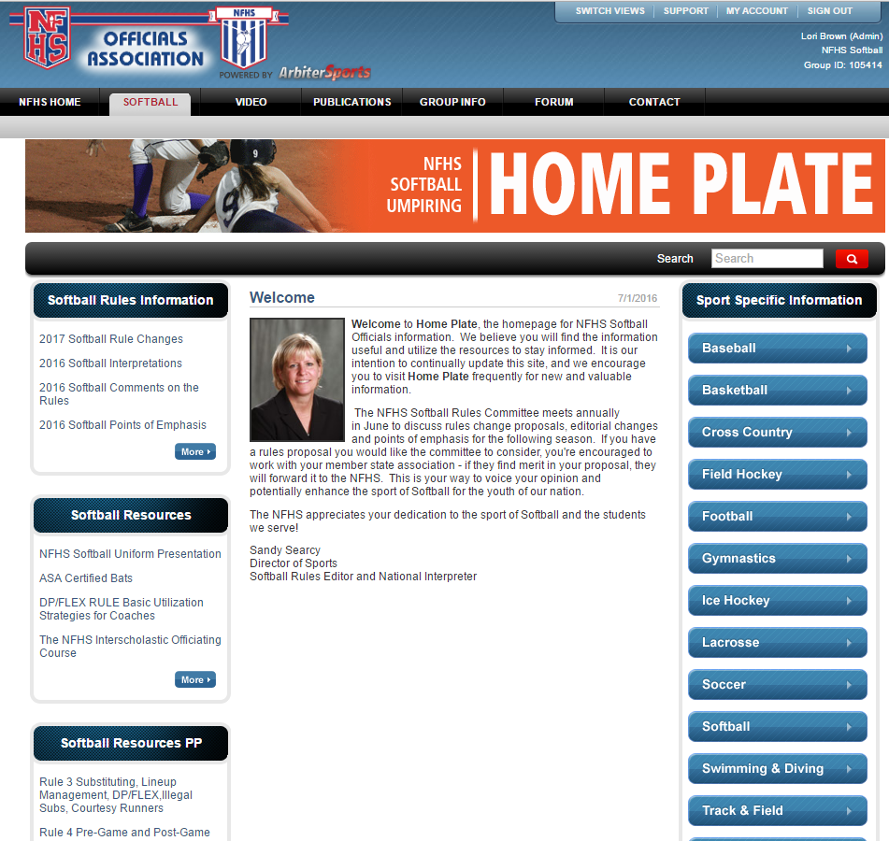
NFHS Officials Association Central Hub
https://nfhs-softball.arbitersports.com/front/105414/Site
Contains:
  Sport information
  Rules information
  Rules library
  Searchable rules book
  Video content on officiating sport, competition situations and interpretations

Slide 31
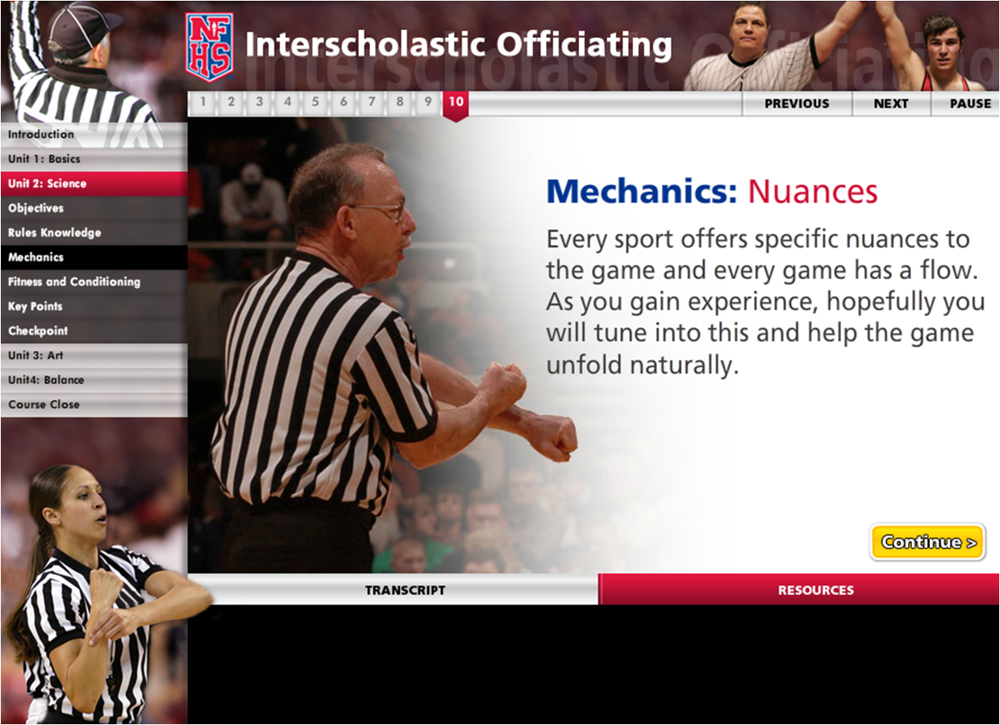
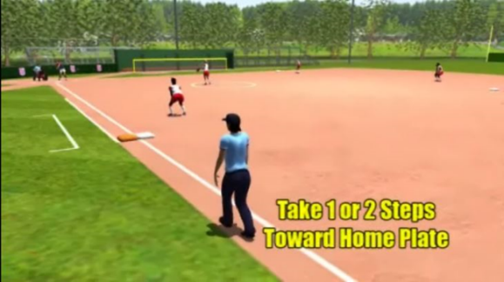
NFHS Officials education
Course and videos
Ideal for new officials or those in first few years of officiating
30-45 minutes to complete
Topics include: Basics of Becoming and Staying an Official, Science of Officiating, Art of Officiating
Course is FREE to NFHS Officials Association members, non-members fee is $20
NFHSLearn.com
Sports such as soccer, basketball and baseball offer direct illustrations of the rules book, including rules references and officials signals
Animated mechanics videos for softball and baseball umpires
Video interpretation of the NFHS Basketball Rules Book created through a partnership with the International Association of Approved Basketball Officials

Slide 32

Notes:
In partnership with USA Softball, the NFHS has developed the first in a line of educational softball courses. This first course addresses game management, as well as obstruction and interference for both rules codes. Umpires who are members of 100% states may obtain the course on NFHS Learn for a cost of $10. Umpires belonging to state associations who are not 100% states are charged $20.

Slide 33
NFHS Learning Center

Slide 34

The NFHS Learning Center
Mission: Provide ongoing professional development for Coaches, Administrators, Students, Parents and Officials on the role they play within interscholastic athletics and activities.

Slide 35

www.NFHSLearn.com
Register on
NFHSLearn.com and
receive the following
great benefits:
  Immediate access to all 18 NFHS free courses
  Opportunity to receive email updates on your sport, upcoming courses and much more
  Access coursework 24/7/365
  Access completion certificates 24/7/365

Slide 36






NFHS FREE Courses
Concussion in Sports
Coaching Pole Vault
NCAA Eligibility
Positive Sport Parenting
Sportsmanship
Sports Nutrition
Heat Illness Prevention
Introduction to Music Adjudication
Introduction to Pitch Smart
Learning Pro – Suite of 4 courses
Coaching Unified Sports
Creating a Safe and Respectful Environment
Engaging Effectively with Parents
Sudden Cardiac Arrest
Captains Course
Interscholastic Officiating
National Coach Certification Program

Slide 37
NFHS Network

Slide 38

NFHS Network
By 2020, every high school sporting event in America will be streamed live.
The NFHS Network will be THE DESTINATION for fans to view these broadcasts.

Slide 39

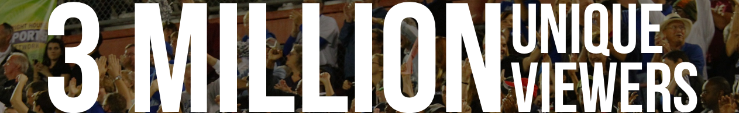

Slide 40
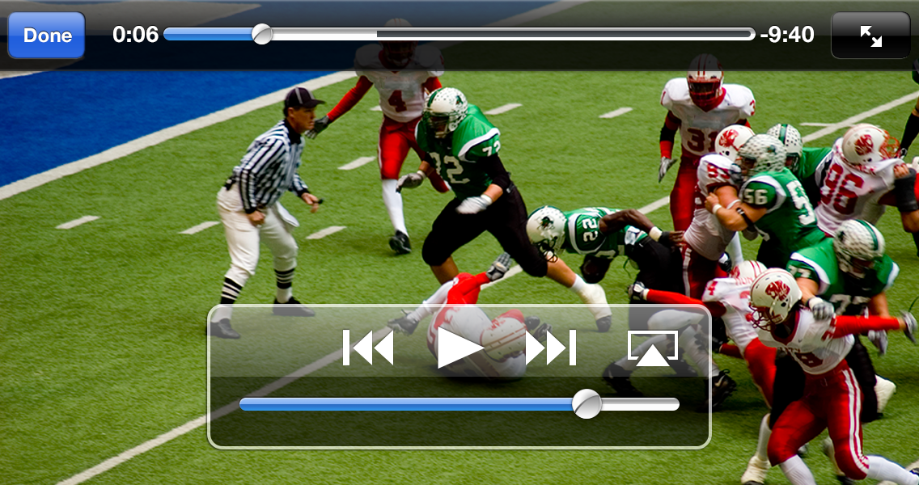
NFHS Network
View from mobile…

Slide 41
Thank You and have a great season!
www.nfhs.org

Slide 42
NCHSAA
RULES & REGULATIONS

Slide 43
Board Changes 2017-18
Amateur Rule
Increase allowable merchandise to be received from $20.00 to $250.00 per sports season
Acceptance of money or a forbidden award will cause an athlete to lose athletic eligibility for the semester in which the violation occurred, and the following semester.

Slide 44
Board Changes 2017-18
Senior Exceptions
Students may be allowed to wear school uniforms, including protective equipment, in outside organization competition, so long as the student has exhausted athletic eligibility in that sport and received permission from the member school. Approval from the LEA is strongly recommended.
Exception to the numbers restrictions for students who have exhausted their eligibility in that sport. Dead period rules will remain.

Slide 45
Board Changes 2017-18
Transfer Rule
Students transferring to a member school where the student’s coach has relocated to within a year will be deemed ineligible for a period of 365 days LEA to LEA
A student’s first transfer after initial entry into the 9th grade is not subject to the NCHSAA transfer rule (LEA to LEA). For any transfer thereafter, the student must sit out for 2 consecutive semesters (at least 50% of the current semester + following semester) or 365-days, whichever is less.

Slide 46
Board Changes 2017-18
Transfer Rule
NCHSAA Transfer Committee will be composed of the NCHSAA Executive Committee and at least one (1) non-district affiliated member.
Modify initial entry interpretation for non-district affiliated schools (Charter and Non-Boarding Parochial) –Rule 1.2.1(a)(2): boundary criteria shall only apply after initial entry into ninth grade.
Students who want to participate in cheerleading are not subject to the transfer policy, however all current eligibility requirements would remain applicable.

Slide 47
Board Changes 2017-18
Residence Rule
No Custody
  Residency shall be deemed to be with the parent with whom the student begins the school year (i.e. 1st semester).
Bona Fide Change: The change must not be solely made for athletics purposes.

Slide 48
Board Changes 2017-18
Endowment Games
The home team will remit twenty-five (25) percent of the gross revenue to the NCHSAA’s endowment fund. If a member school plays an endowment game against a non-member school, the member school is responsible for remitting payment to the NCHSAA regardless of where the game is played.

Slide 49
Board Changes 2017-18
Wet Bulb Globe Temperature
Add language to the WBGT Index and Athletic Activity Chart in the 90 or Above category for Athletic Activity Guidelines: SUSPEND PRACTICE/MUST INCLUDE MANDATORY BREAKS AS DIRECTED BY GAMEDAY ADMINISTRATOR DURING CONTEST.
Facilities
The NCHSAA has the right to require host teams to find an adequate facility based on expected game/contest attendance and/or quality of venue.

Slide 50
Board Changes 2017-18
Coaches Education
Annual requirements must be completed after June 1, 2017 and before the first date of practice.
NFHS Sudden Cardiac Arrest
  To require all non-paid coaches to complete the NFHS Sudden Cardiac Arrest Course annually and prior to the first contest. Effective Date: August 1, 2017

Slide 51
Board Changes 2017-18
Eligibility Summary Submission Dates
Fall – September 15th
Winter – December 15th
Spring – April 1st

Slide 52
Board Changes 2017-18
Skill Development/Dead Periods
Change In-season dead periods from 6 weeks to 3 weeks
Add new dead period:
  Last 10 student days of the school year
    Effective 2017-2018

Slide 53
Board Changes 2017-18
Playoff Bracket Size
Change bracket sizes for baseball, basketball, football, soccer, softball and volleyball to:
  1A – 48 teams
  2A – 64 teams
  3A – 64 teams
  4A – 48 teams

Slide 54
Board Changes 2017-18
Playoff Qualification Process
Conference automatic qualifiers are determined by the number of teams from a given classification in each conference as follows:
  1 – 4 teams = 1 automatic qualifier
  5 – 8 teams = 2 automatic qualifiers
  9 or more teams = 3 automatic qualifiers

Slide 55
Board Changes 2017-18
Playoff Qualification Process
Conference tournament champions automatically qualify
  If the regular season champion also wins the tournament, no additional berth will be awarded.
  If a team other than the regular season champion wins the tournament, it will automatically qualify for the playoffs. The team will be seeded as an at-large berth in the playoffs unless already automatically qualified based upon their regular season conference finish.

Slide 56
Board Changes 2017-18
Playoff Qualification Process
Split conference application
  The highest finishing team from a given classification will automatically qualify, regardless of overall conference finish.
  Two teams that finish 1st and 2nd overall in the conference from the same classification will automatically qualify regardless of rule 4.1.18(a) (1-3).
  **Ties for 1st place in the overall conference or for highest finisher in a classification must be broken using the established tie-breaking procedure [rule 4.1.13].

Slide 57
Board Changes 2017-18
Playoff Qualification Process
If too many teams qualify using the above criteria, adjustments to the established bracket size will be made to accommodate the automatic qualifiers.
If not enough teams qualify using the above criteria, the bracket will be filled by non-automatic qualifiers in that classification
  Teams in their classification will be selected to fill the remaining slots in the bracket based upon conference finish then the highest Adjusted MaxPreps ranking (or other NCHSAA selected ranking system) will be selected to fill the remaining slots in the bracket.

Slide 58
Board Changes 2017-18
Playoff Seeding
Once the qualifying teams in each classification are determined, they will be divided into two regions of equal size (East and West) based on the longitude of each school.
The teams in each region will be seeded as follows:
  Seed all 1st place automatic berths by Adjusted MaxPreps ranking (or other NCHSAA selected ranking system); then
    NOTE: The highest finishing team in its half of a split conference must finish in 1st, 2nd, or 3rd place overall and/or have an overall winning percentage of .500 or higher in order to be seeded as a #1. Otherwise, the team will be seeded with all other at-large teams.
  Seed all 2nd place automatic berths by Adjusted MaxPreps ranking (or other NCHSAA selected ranking system); then
  Seed all 3rd place automatic berths by Adjusted MaxPreps ranking (or other NCHSAA selected ranking system); then
  Seed all conference tournament champions and at-large berths by Adjusted MaxPreps ranking (or other NCHSAA selected ranking system).
Once seeding is complete:
  Existing byes will be awarded to the highest seeds possible.
  The higher seed is the home team unless otherwise determined by the NCHSAA.

Slide 59
Important Dates
Date of 1st Practice: February 14, 2018
Date of 1st Contest: February 28, 2018
Reporting Deadline: May 5, 2018 at 11:59pm (MaxPreps entries)
NOTE: The reporting deadline is incorrect in the printed copy of the Handbook but has been updated on-line and on this PPT.

Slide 60
Playoff Dates
Seeding: May 7th
1st Round: May 9th
2nd Round: May 12th
3rd Round: May 15th
4th Round: May 18th
Regional: May 22nd - 26th
State Championship: June 1-2, 2018
(Note: Discuss facility seating capacity)

Slide 61
Dead Periods
Summer 2017 | July 3-July 9 July 17-23
Fall 2017 | July 31-August 19
Winter 2017 | Oct 30 (Oct 16 for non-football schools) through November 18
Last five (5) days of the first semester
Last ten (10) days of the second semester
Summer 2018 | July 2-July 8 and July 16-July 22

Slide 62
Season Limitation
No more than 23 games, or 24 with one being an approved Endowment Game
Teams and individuals are limited to two games on a school day. The limitation extends to four games, if on a non-school day.
Conference tournaments are not included

Slide 63
MaxPreps
Official Statistics Provider
Records and standings for post-season qualifications
  2017-18: MaxPreps Record = Official Record
  Incorrect record subject to DQ from playoffs
All game results MUST be entered by May 5th at 11:59 p.m.
  Triple check your record!
Instructions can be found on the NCHSAA website
NOTE: The reporting deadline is incorrect in the printed copy of the Handbook but has been updated on-line and on this PPT.

Slide 64
Sportsmanship
The quality of responsible behavior characterized by a spirit of generosity and a genuine concern for opponents, officials and teammates.
Wholesome athletic environment
Good Sportsmanship > Victory
Modest in victory, gracious in defeat
Respecting judgment and integrity of game officials
Role modeling good behavior

Slide 65
Ejection Policy
Fighting
Leaving the bench area
Flagrant contact
Biting
Taunting, baiting or spitting toward an opponent or official
Profanity
Obscene gestures
Disrespectfully addressing an official

Slide 66
Ejection Follow-Up
Teaching & Modeling Behavior Course
  Required for any coach ejected during a contest
  Required for any coach who has player (s) ejected for fighting
NFHS Sportsmanship Course
  For any ejected/disqualified player
  Free, on-line course (nfhslearn.com)
All certificates must be sent to NCHSAA

Slide 67
Inclement/Hot Weather Guidelines
The following should be considered when scheduling practice:
Time of day
Intensity level of practice
Equipment worn
Environmental conditions
High Temperature and high humidity create a dangerous situation for athletes. High humidity and low temperature can also cause serious heat-related problems.
Water/fluid replacement breaks recommended each 20 or 30 minutes. (depending on practice conditions)
Check with your AD on your LEA’s and school’s policy pertaining to practice on days of extreme heat.

Slide 68
ELIGIBILITY & COMPLIANCE

Slide 69
Eligibility
PowerPoint
Required viewing for all coaches
Should be done with the athletic director
Includes opportunities to discuss concussions/sudden cardiac arrests/sickle cell, etc.

Slide 70
Eligibility
Preseason Meeting
Required attendance by all parents
Time to share rules, regulations, expectations, philosophy etc.
Time to get all required signatures--pledges, Gfeller-Waller information, etc.
Eligibility and Authorization

Slide 71
Eligibility
Eligibility Checklist
  Use to ensure school has done its due diligence

Slide 72
Clinic Attendance
Head coaches in baseball, basketball, cheerleading, football, golf, lacrosse, soccer, softball, swimming, tennis, track & field, volleyball and wrestling must attend an NCHSAA approved State Rules Clinic.
Must be completed prior to coaching in the first contest; subject to $400 fine, in addition to a $500 fine if he/she actually coaches in the contest
Can be satisfied at the NC Coaches’ Association Clinic being held here in Greensboro—July 17-20

Slide 73
Clinic Attendance
If the head coach cannot attend the NCCA clinic or is not hired until afterwards, the requirement can also be met at one of the statewide officials’ clinics, which are posted on the NCHSAA Website under clinics. Please note that several volleyball and soccer clinics for officials occur prior to the NCCA Clinic.
Athletic directors cannot satisfy this requirement by attending a rules’ session in place of the head coach

Slide 74
Coaches’ Education
NFHS Fundamentals of Coaching Course
All coaches must satisfy the requirement prior to first contest.
Complete prior to first contest; subject to a $500 fine; continuing to coach without completion = another $500.

Slide 75
Coaches’ Education
Concussion Management Certification
The NFHS Concussion in Sports Course (free on-line course) or an equivalent course must be completed annually (after June 1, 2017 and before the first date of practice) by all coaches.
Prior to the first date of practice for that sport; subsequently, the certificate of completion must be on file at the individual school; subject to $500 fine.

Slide 76
Coaches’ Education
CPR/AED Certification
All head and paid coaches must be CPR/AED certified
  Effective August 1, 2017
NFHS Sudden Cardiac Arrest Course
All non-paid coaches are required to complete the NFHS Sudden Cardiac Arrest Course annually (after June 1, 2017 and before the first date of practice).
  Effective August 1, 2017

Slide 77
Gfeller-Waller Concussion Law
Requirements of the Law:
Concussion signs and symptoms
  Given prior to participation
  Parents/athletes sign indicating “receipt of” Return to Play (RTP) form signed by a physician licensed to practice medicine
  An up-to-date Emergency Action Plan (EAP)
  Must be on-file
  Must be posted
  Must be updated annually
“When in doubt, sit them out”

Slide 78
Cardiac Safety Program
All NCHSAA member schools must have a Cardiac Safety Program to include three (3) components:
Appropriate number of AEDs on Campus
AED maintenance program (battery checks, maintain, replacement at appropriate intervals)
Required viewing of short AED/CPR video for all supervising adults (teachers, coaches, administrators)

Slide 79
Coaches’ Education
“Education is a journey, not a destination”

Slide 80
Coaches’ Education
Accredited Interscholastic Coach (AIC)
Requires completion of 4 courses:
  Fundamentals of Coaching
  1st Aid, Health & Safety for Coaches
  Sport Specific Course or Teaching Sports Skills
  Concussion in Sports (Free)

Slide 81
Coaches’ Education
Certified Interscholastic Coach (CIC)
Completion of AIC requirements
Plus:
  Teaching & Modeling Behavior
  Engaging Effectively with Parents
  Sportsmanship
  Creating a Safe and Respectful Environment
  Strength & Conditioning
  2 additional courses (User Choice)

Slide 82
Transfer Policy
If a bona fide change of residence—no transfer waiver necessary
Transfer packet with forms are on-line; password protected
Work with athletic director to ensure students meet residence rule requirements

Slide 83

UHC Sidelines Hunger Food Drive
Bring non-perishable food to the NCHSAA Booth during the coach’s clinic and be entered into a raffle to win money for your school!
Winners of the raffle will be announced during the East/West Games! Winner does not need to be present to win! First place receives $250, second place- $150, and third place- $100 for their respective athletic programs!

Slide 84
THANK YOU
Get involved with Student Services Programs
Visit the NCHSAA website often
Pick-up your card as you leave today
  Enter your code into the computer immediately to get credit for attendance
    Mobile device or computer
    All fields required except the comments box
    Use same email address that was used for NFHS Courses
  Deadline for entry is August 14, 2017
  Avoid $400 fine for your school

