Slide 1


SAOA VOLLEYBALL
LINE JUDGE
TRAINING
©2014 Dwayne Thompson

Slide 2
Introduction
Welcome to the SAOA’s Volleyball Line Judge Training program.
These slides are intended to aid you in performing your duties as a Line Judge more effectively.
Please review the following slides to become familiar with the procedures of line judging.

Slide 3
The Importance Of Line Judges
Line judges play an essential role in supervising the match along with the other officials.
Line Judges have to be prepared, knowing our responsibilities and fulfilling our role to the best of our ability.
That we are one of the spokes in the overall wheel of officiating in a match.

Slide 4
Line Judge Expectations
Line Judges have to maintain the same image as other match officials inside and outside the competition area. (i.e. PROFESSIONALISM)
Line Judges must show exemplary conduct throughout the competition (including before, during, and after the match!).
Line Judges also need to adhere to established guidelines (i.e. showing up on time, proper uniform, honoring assignments, etc.).

Slide 5
Pre-Match Instructions
Before the match begins, the first referee will give instructions to the crew. These instructions cover all facets of game management.
The first referee will also let the Line Judges know what they are looking for and give line assignments .
Listen carefully to the first referee’s instructions and ask questions if necessary for clarification.

Slide 6
Line Judge Signals
Signals used must be those approved by the NFHS and/or NCHSAA.
Signals are to be shown clearly so that the referee, the players, coaches, and spectators can understand the call being made.
The signal must be quick, sharp, and held for a moment . (and repeated if required)
Communication with the officiating crew is paramount.

Slide 7
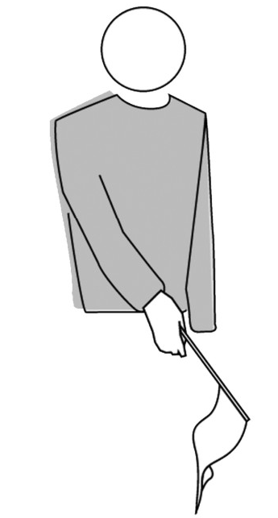
Line Judge Signals (cont’d)
Signal #1 – Ball “In”
Flag in the hand held
outward at a 45 degree
angle.
Used when the ball touches
the playing court, including
the boundary lines.
Signaled by the line judge
who controls the line
nearest to where the ball
touches the floor.

Slide 8
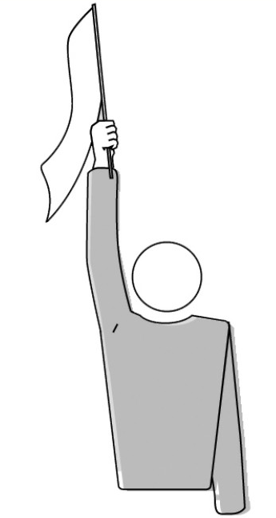
Line Judge Signals (cont’d)
Signal #2 “Out”
Point straight up with
the flag.
Used when the part of
the ball that touches the floor
lands completely outside the
boundary lines.
Used to indicate the ball
touching an object outside the
court, the ceiling or a person out
of play.
Used to indicate the ball touching
the ropes, posts, or net itself
outside the side bands.
Signaled by the line judge who
controls the line nearest to where
the ball touches the floor.

Slide 9

Line Judge Signals (cont’d)
Signal #3
“Ball Touched”
Raise the flag and touch the top
of the flag with the palm of the
free hand.
Used when the ball is
touched by the blocker(s) or
a player of the receiving/
defending team and then
touches the floor outside of
the boundary lines on the
same side OR when a team
has played the ball and it
lands out on their own side.
Signaled by the line judge who
controls the line nearest to
where the ball touches the floor.

Slide 10
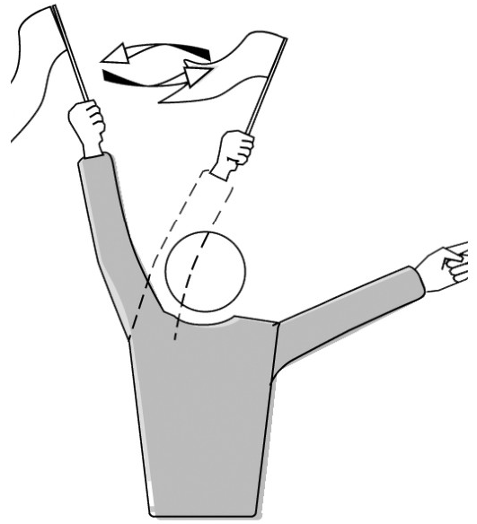
Line Judge Signals (cont’d)
Signal #4 “Foot
Fault” or “Ball
Outside Antenna”
Wave the flag over the
head and point to the
antenna or the end line.
Used when the ball crosses the
vertical plane of the net partially
or completely outside the
antenna into the opponent’s
court OR it touches net features
outside the antenna OR when
the server faults OR when a player
is outside their own court at the
moment of the service hit.
Signaled by the line judge who is
responsible for the line where the
infraction takes place.

Slide 11

Line Judge Signals (cont’d)
Signal #5
“Impossible
to Judge”
Place both arms
across the chest
forming an “X”.
Used when the line judge
is unable to evaluate a
fault within their
jurisdiction
Example: When
a player blocks
your view of
the play.

Slide 12
Line Judge Positioning
Line Judge positions are assigned to each Line Judge by the First Referee prior to the match.
Line Judges stand at the corners of the court closest to the right hand of each referee, diagonally in the corner.
Once a line judge has an established his/her position, they retain it for the entire match.

Slide 13
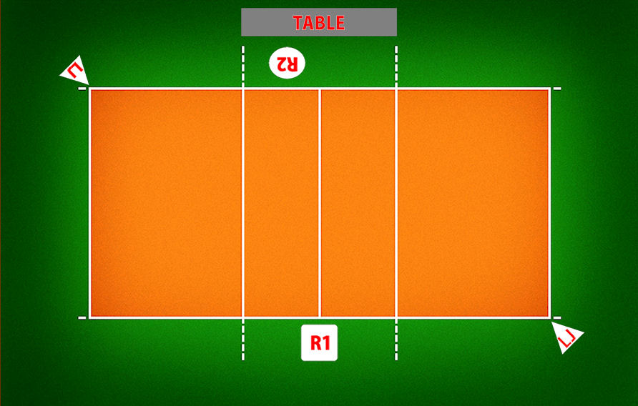
Line Judge Positioning (cont’d)
The graphic below shows how line judges should position themselves on the court.

Slide 14
Line Judge Positioning (cont’d)
There are essentially three positions when line judging:
1) Relaxed – feet close together, standing erect, flag held
down at the waist with both hands.
2) Ready position – higher knee bend, athletic position
with feet shoulder width apart, one foot in front of the
other; as play progresses this transitions to a deeper
knee bend and allows for movement as necessary.
3) Signaling – back to erect standing position, with flag
used to indicate detected fault (if no fault, you revert to
the relaxed position)

Slide 15
Line Judge Positioning (cont’d)
During a rally, line judges may need to move from their assigned locations – this is usually to:
Avoid interfering with players playing the ball.
Better observe a ball crossing the net near an antenna.
To keep the ball in sight during ball contact with player(s) or equipment, including the ‘pancake’ dig.
To keep their body facing the action at all times.
To report to the first referee when summoned to the referee stand.

Slide 16
Line Judge Positioning (cont’d)
There are other situations that arise in a match that dictate the line judge’s location:
Pre-match Protocol (Player Introductions, National Anthem, etc)
Time outs (Regular & Injury )
Intermission Between Sets
Post-match protocol (If Applicable)
Please Note: Each league may have different requirements and protocols. One of our jobs as the officiating crew is to know the protocol!

Slide 17
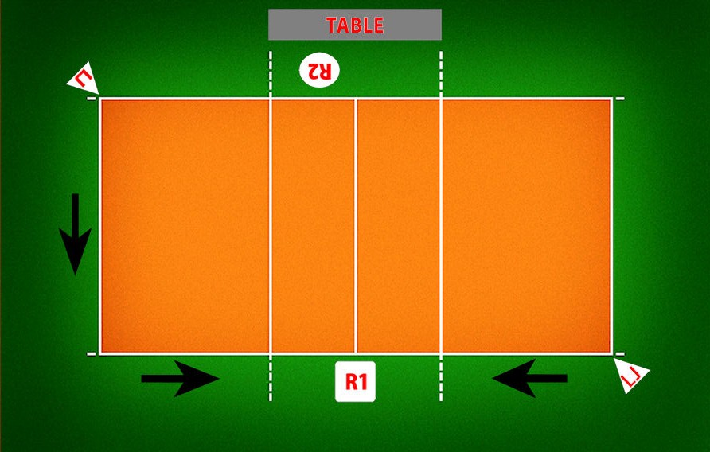
Line Judge Positioning (cont’d)
The graphic below shows path that each line judge takes toward the First Referee’s stand. Take note that line judges do not walk on the court during the transition to and from the new position.

Slide 18
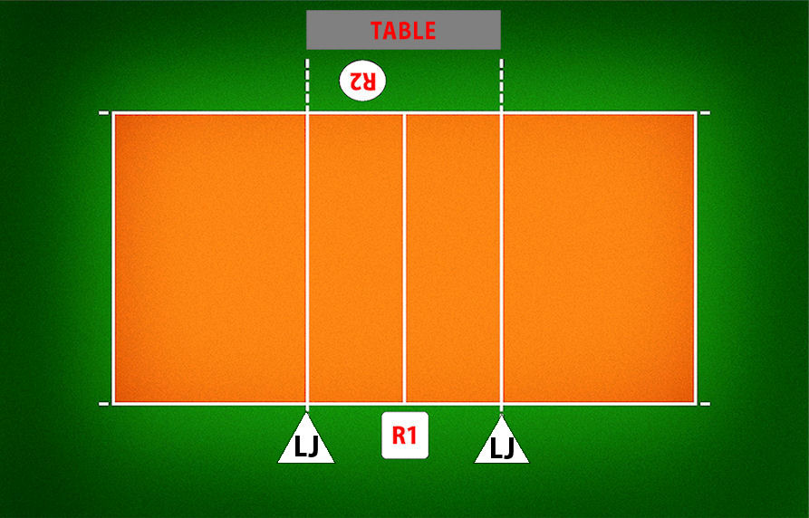
Line Judge Positioning (cont’d)
The graphic below shows the correct line judge position during a time out. The line judge transitions back to their assigned spot at the sound of the 45 second warning horn or when both teams come back on the court.

Slide 19
During The Match
Getting ready to make a call:
Our attention span during play is of major importance.
Continual scanning of the ball in play and the line of responsibility allows for temporary evaluation. i.e. Look from the ball to the line about 2-3 times per play to ready yourself for judgment.
This is done by moving the eyes rather than the head (unless head movement is necessary).

Slide 20
Techniques & Tips
Be prepared – this will help you achieve the best level of concentration and condition to work the match.
Stand in a position which allows evaluation of play within your jurisdiction – you can move, especially to avoid interfering with play.
Signals should be made quickly and should be decisive – the sequence for line judges is: 1) See, 2) Decide, and 3) Signal (making eye contact with the First Referee)

Slide 21
Techniques & Tips (cont’d)
Focus
- Pay attention to those points or areas where the rally is taking place.
- Briefly follow the ball path, then change focus (the ‘snap-shot’ method).
Anticipation
- Looking forward after seeing the initial contact, and anticipate the landing where a decision is required.

Slide 22
Techniques & Tips (cont’d)
At no time should there be any discussion between a team member (coach, player, etc) and a line judge.
If the line judge is being harassed or notices some other irregularity, they should signal and go to the first referee to inform them of the facts – only the first referee can apply sanctions if necessary.
If the ball lands in/at/near the corner (no touch)
On your line the ball is out, signal ‘out’
On your line the ball is in and without any doubt in on the other line, signal ‘in’
On your line the ball is in, but the other line is uncertain make eye contact with the other line judge.
Your partner, following the sequence in this process, will be:
a) signaling “out” as in #1, YOU signal “out”,
b) signaling “in” as in #2, YOU signal “in”,
c) looking at you, meaning it’s not out for either of you,
BOTH line judges signal “in”.
These are not steps, but actually one decision that leads to a signal or eye contact – communication is paramount!

Slide 23
Being Over-ruled by the
First Referee
Keep in mind, when working as a line judge and signaling, you’re indicating judgment.
The first referee may or may not agree with your assessment – if the first referee disagrees, don’t insist on your signal.
Don’t let your eyes get as big as dinner plates. Remember your body language.. It says a lot!
Relax, re-focus, and be ready for the next play.
At the next time out or after the match, politely ask the First Referee what you may have missed.
Remember… Communication is the key to success!

Slide 24
Line Judge Responsibilities
As a Line Judge, I perform my duties by using a flag to signal:
The foot faults of the server
Any contact with the antenna on their side of the court by any player during their action of playing the ball or interfering with the play.
The ball crossing the net outside the crossing space into the opponent’s court or touching the antenna on their side of the court.
I also have to repeat my signal should the first referee request it!

Slide 25
Line Judge Responsibilities (cont’d)
The ball ‘in’ and ‘out’ whenever the ball lands near my line.
The touches of ‘out’ balls by the team RECEIVING the ball.
The ball touching the antenna, the served ball crossing the net outside the antenna, etc
Any player (except the server) stepping outside of their playing court at the moment of the serve.

Slide 26
Available Resources
SAOA Volleyball Website
www.southeasternofficials.com
NFHS Website
www.nfhs.org
NCHSAA Website
www.nchsaa.org

Slide 27
Questions?

