Slide 1


2015 Preseason
First Year Lacrosse Official’s Clinic
Notes:
This presentation is intended as a three-hour introduction to three-man mechanics
It covers both NCAA and NFHS mechanics
Depending on your audience, you may wish to delete some slides (e.g., NFHS-only slides for an NCAA group, or more basic slides for an advanced group) or you may wish to skip some slides but keep them as backup material

Slide 2


Week #3:
Admin Review,
Mechanics Review,
Most Frequent Penalties
Notes:
This presentation is intended as a three-hour introduction to three-man mechanics
It covers both NCAA and NFHS mechanics
Depending on your audience, you may wish to delete some slides (e.g., NFHS-only slides for an NCAA group, or more basic slides for an advanced group) or you may wish to skip some slides but keep them as backup material

Slide 3
Week #3:
Admin Review
Notes:
This presentation is intended as a three-hour introduction to three-man mechanics
It covers both NCAA and NFHS mechanics
Depending on your audience, you may wish to delete some slides (e.g., NFHS-only slides for an NCAA group, or more basic slides for an advanced group) or you may wish to skip some slides but keep them as backup material

Slide 4
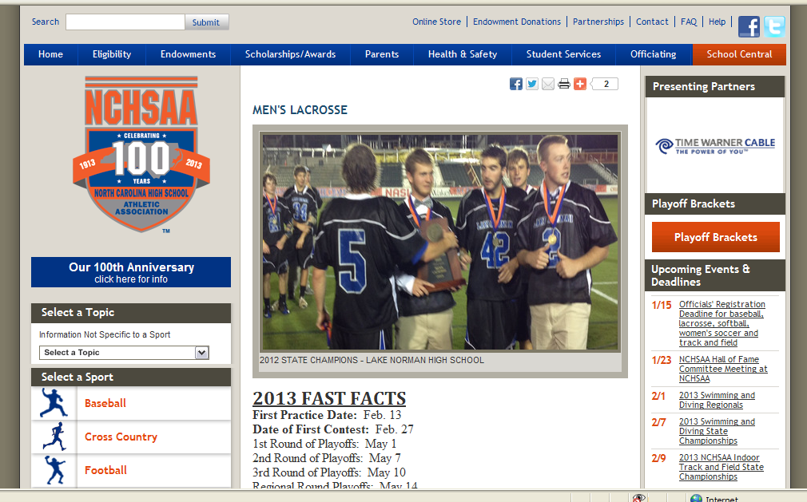
www.nchsaa.org

Slide 5
Announcements From NCHSAA
REGISTRATION DEADLINES
SPRING: December 15
(Baseball, Softball, Lacrosse):
2015 Test Dates
Men's Lacrosse: January 12-16, 2015

Slide 6
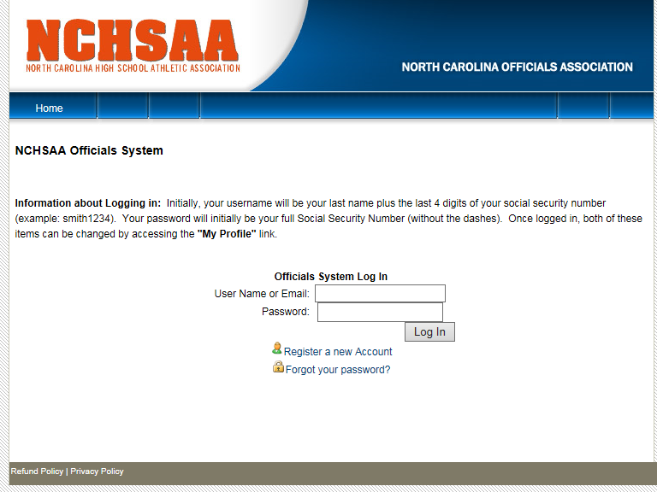
https://officiating.nchsaa.org/login.aspx

Slide 7
Announcements From NCHSAA
2015 SEASON FAST FACTS
First Day of Practice: Feb. 16, 2015
First Contest Date: March 2, 2015
*Reporting Deadline: May 4, 2015
1st Round of Playoffs: May 6, 2015
2nd Round of Playoffs: May 8, 2015
3rd Round of Playoffs: May 12, 2015
4th Round of Playoffs: May 15, 2015
Regional Round of Playoffs: May 19, 2015
State Championships: May 22-23, 2015

Slide 8
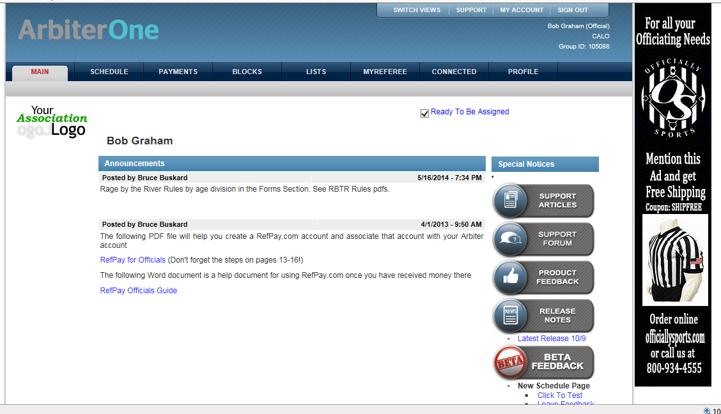
www.arbitersports.com

Slide 9
Week #3:
Mechanics Review
Notes:
This presentation is intended as a three-hour introduction to three-man mechanics
It covers both NCAA and NFHS mechanics
Depending on your audience, you may wish to delete some slides (e.g., NFHS-only slides for an NCAA group, or more basic slides for an advanced group) or you may wish to skip some slides but keep them as backup material

Slide 10

The Mission of our Mechanics
To put us in the best position to make the calls that allow us to keep the game safe and fair.
To use methods that are easily applied in a consistent manner by officials of various levels of ability in games of various levels of skill.

Slide 11

Field Position
Notes:
This presentation is intended as a three-hour introduction to three-man mechanics
It covers both NCAA and NFHS mechanics
Depending on your audience, you may wish to delete some slides (e.g., NFHS-only slides for an NCAA group, or more basic slides for an advanced group) or you may wish to skip some slides but keep them as backup material

Slide 12
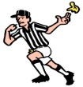
HOME
VISITOR
XXXX
OOOO

Slide 13
HOME
VISITOR
XXXX
OOOO
T
L
L
T
TRAIL:
Side-Line and fast break the other way
Watch late hits on shots, report goal scored by
Counts: wing & top
Technicals in area and Personals anywhere
LEAD:
Responsibility for entire offensive area until
trail is in position. Lead has first count.
Rubber band on Goal-Line Extended
End-Line and Side-Line behind
Focus on goal and crease on shots
Counts: first count, then wing
Technicals in area and Personals anywhere
ZLAX Publications

Slide 14
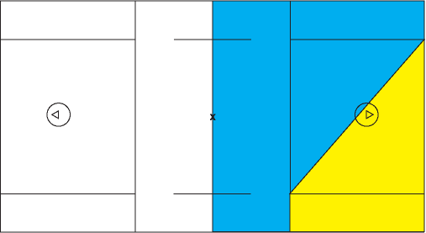
Settled situation: On/Off official
T is the “On” official when ball is in the blue area
T
L
L is the “On” official when ball is in the yellow area

Slide 15
Proper Officiating Mechanics Puts You in Position to See the Play.
Notes:
This presentation is intended as a three-hour introduction to three-man mechanics
It covers both NCAA and NFHS mechanics
Depending on your audience, you may wish to delete some slides (e.g., NFHS-only slides for an NCAA group, or more basic slides for an advanced group) or you may wish to skip some slides but keep them as backup material

Slide 16
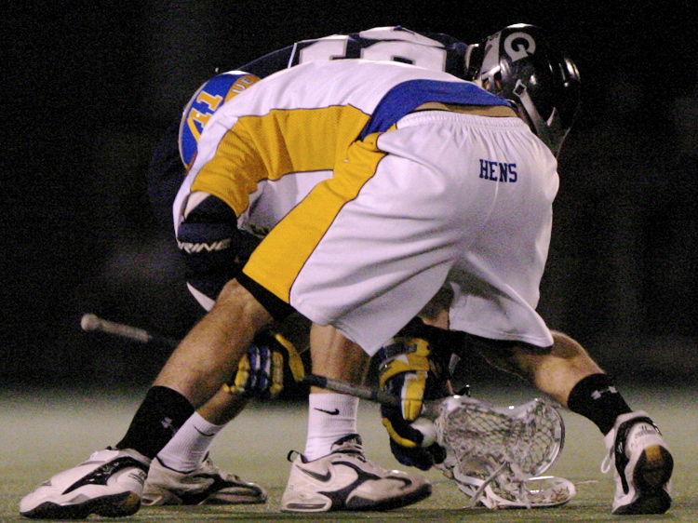
Where’s the Ball?

Slide 17
Proper Officiating Mechanics:
See the Beginning, The Middle and The End of the Play.
Notes:
This presentation is intended as a three-hour introduction to three-man mechanics
It covers both NCAA and NFHS mechanics
Depending on your audience, you may wish to delete some slides (e.g., NFHS-only slides for an NCAA group, or more basic slides for an advanced group) or you may wish to skip some slides but keep them as backup material

Slide 18
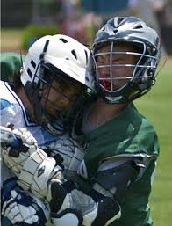

Slide 19
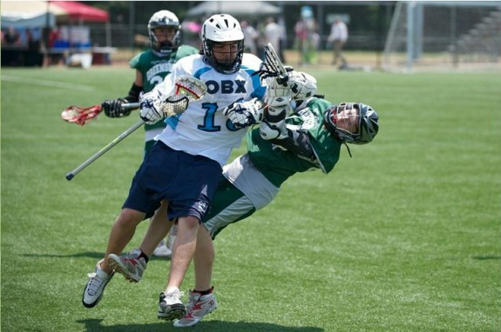

Slide 20
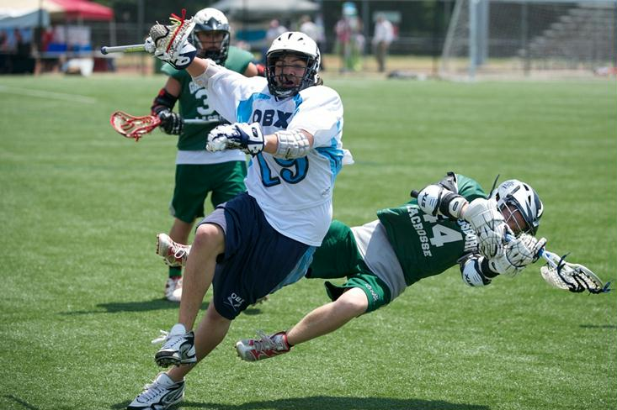

Slide 21
Where’s the Ball?

Slide 22
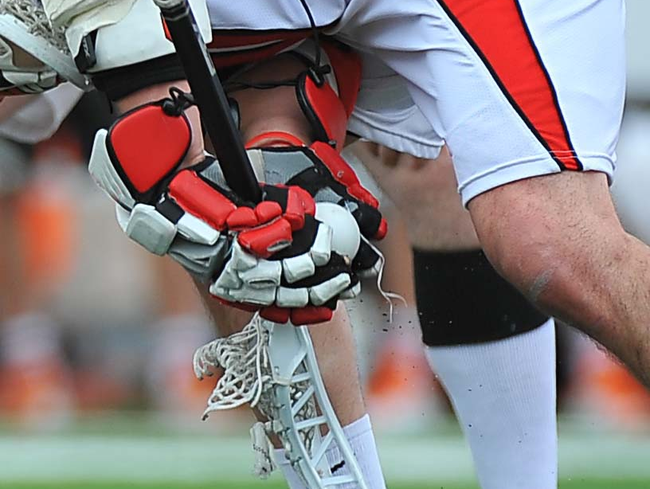
Where’s the Ball?

Slide 23
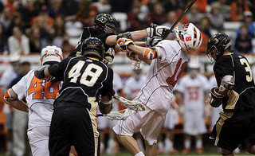

Slide 24
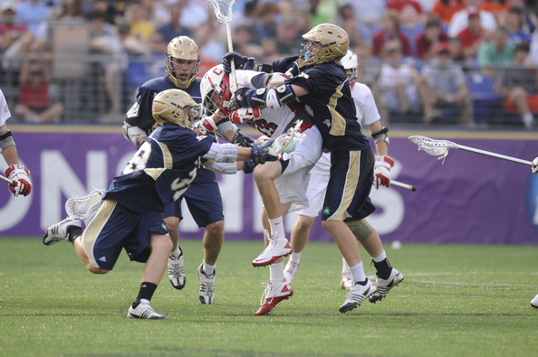

Slide 25
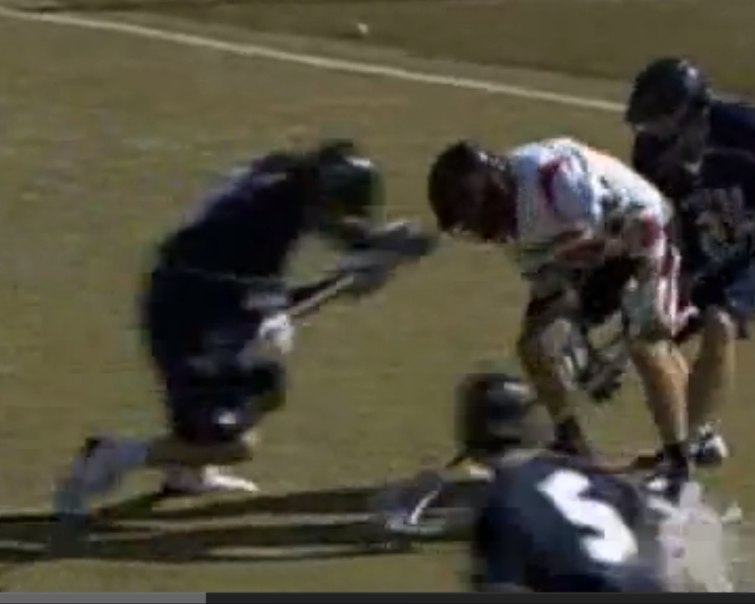
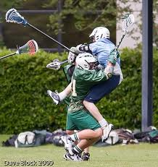
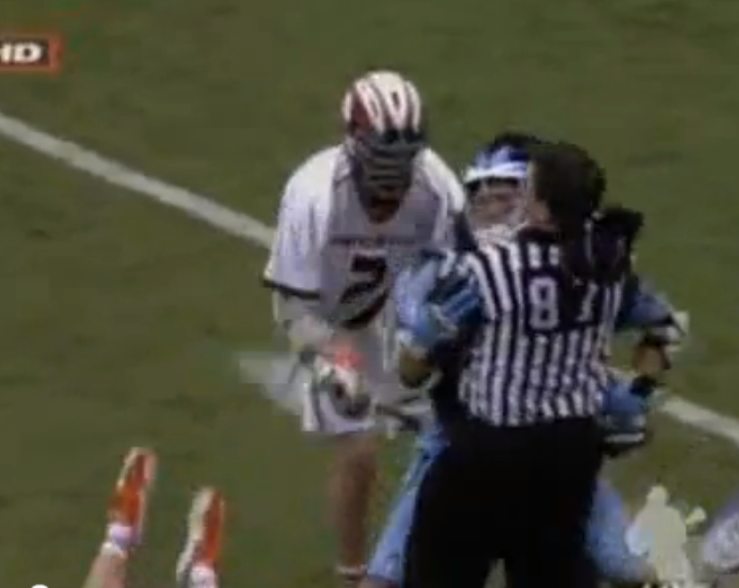
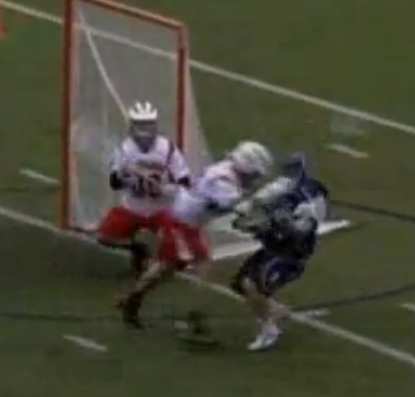

Slide 26
Week #3:
Most Frequent Penalties
Notes:
This presentation is intended as a three-hour introduction to three-man mechanics
It covers both NCAA and NFHS mechanics
Depending on your audience, you may wish to delete some slides (e.g., NFHS-only slides for an NCAA group, or more basic slides for an advanced group) or you may wish to skip some slides but keep them as backup material

Slide 27
Two General Types of Fouls
Technical Fouls include all violations of the rules of the game, of a technical nature, except those specifically listed as personal or ejection fouls.
The penalty for a technical foul shall be either a 30-second suspension of the offending player from the game or simply the awarding of the ball to the team fouled .
Personal Fouls are those of a serious nature: illegal body checking, slashing, cross-checking, tripping, unnecessary roughness, unsportsmanlike conduct and the use of an illegal crosse.
The penalty for a personal foul shall be suspension from the game for one to three minutes, depending on the official's judgment of the severity and perceived intent of the personal foul. Ball is awarded to the team fouled.

Slide 28
Technical Fouls
Technical fouls are those of a less serious nature than personal fouls and include all violations of the rules of the game except those specifically listed as personal or ejection fouls.
PENALTY: The penalty for a technical foul shall be either a 30-second suspension of the offending player from the game (if the team fouled had possession of the ball at the time the foul was committed) or simply the awarding of the ball to the team fouled (if the team fouled did not have possession of the ball at the time the foul was committed).
EXCEPTION: A loose-ball technical foul by Team B followed by a personal foul by Team A during the play-on will result in both players serving penalty time.

Slide 29
Most Frequent Penalties/Calls:
Technical Fouls
Play-On ― Loose balls: Push, Hold (get the ball up, prevent injuries)
Push
Hold
Illegal Procedure
Off-Sides
Out-of-bounds (the line is out)
not really a foul, but you blow your whistle to stop play.

Slide 30
MOST FREQUENT PENALTIES
Keep your eyes up & on the players and not on the ball!
Use the Principle of Advantage/Disadvantage, especially Technical Fouls.
Push
  Shoving a player from the rear, but not a violent blow.
  Focus on contact between the shoulder blades, open hand contact, and free hands not on the crosse.
  Loose balls - be especially vigilant when contact makes the player unable to scoop up a ground ball.
  Did the push result in the offending team gaining an advantage? If not, then let the play develop.
    Was the ball carrier moving away from the goal?
    Did the player fall and / or lose the ball?
  If contact is severe enough, call an Illegal Body Check!
  Watch for pushes around the crease, the sidelines and at the midfield. DON'T just look at the feet, notice the cause! (Ask yourself: “How did he get there?”)

Slide 31
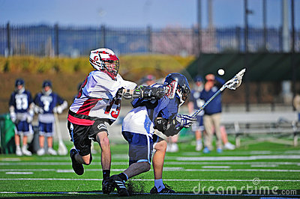

Slide 32
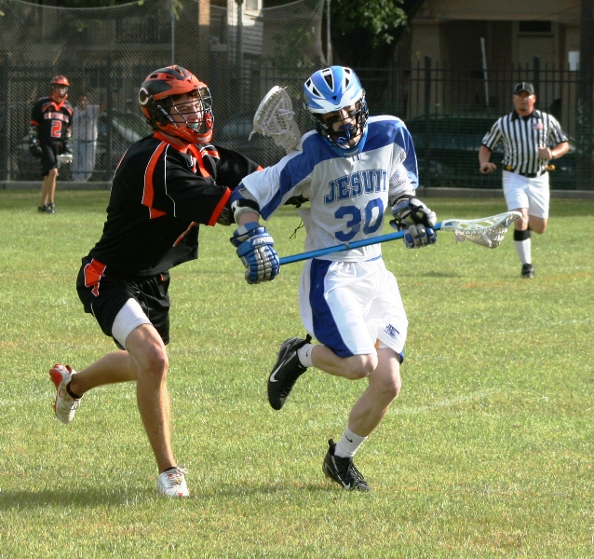

Slide 33
MOST FREQUENT PENALTIES
Keep your eyes up & on the players and not on the ball!
Use the Principle of Advantage/Disadvantage, especially Technical Fouls.
Hold
  Impeding a player's movement with the crosse.
  A free hand on the back during a one-handed check. The check can be legal - call the hold!
  Watch for the "Cross Check" Hold - playing defense, along the side or back of the attacker, with the portion of the crosse between the gloves. Contact with the attacker must be with the gloved hand(s), with the hands on the crosse, or with the forearm.
    Note - If they thrust out with the crosse, call a Cross Check!

Slide 34
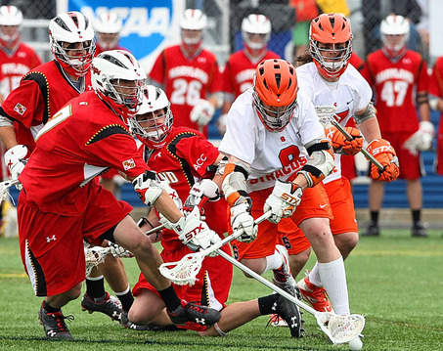
Hold?

Slide 35
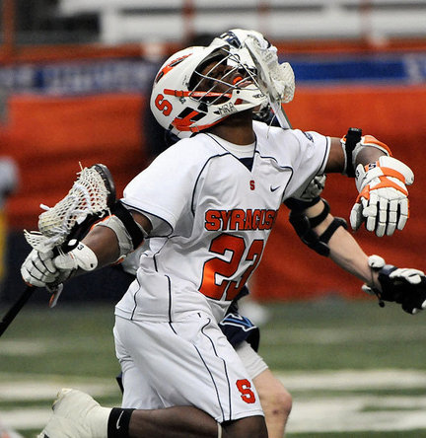

Slide 36
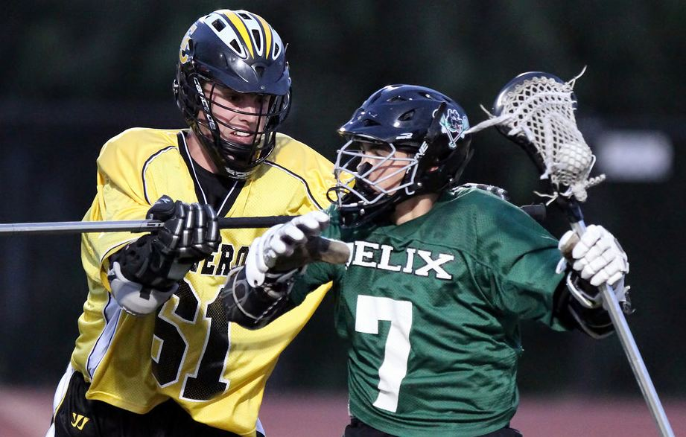

Slide 37
MOST FREQUENT PENALTIES
Keep your eyes up & on the players and not on the ball!
Use the Principle of Advantage/Disadvantage, especially Technical Fouls.
Illegal Procedure - the catch-all call!
  Illegally touching the ball (hand-ball); may also be USC with new rule
  Illegal actions with crosse – throwing it, playing without one, etc.
  "Flicking" the crosse in the face of the opponent.
  Playing (the player) from out of bounds.
  Restraining box violations on faceoff's.
  Time-out violations (calling too many, coming on the field, etc.).
  Too many men on the field (Note - officiate this with leniency; when a player enters the field, and steps back off the field and does not gain an advantage, is not a violation).
  More than four long sticks in the game.
  Deliberately creating a loose ball to try to avoid a 4 second (crease) clearing violation.
  Delay of Game - failure to make ball ready for play / causing a delay.
    Not providing the ball to the nearest official (goalie heaving or throwing the ball after a goal is scored - warn one time).
    Tossing the ball away from the restart spot.
    Failure to be ready to resume play after a time out or end of a period.
  Failure to advance (4, 10 and 20 second counts).

Slide 38
MOST FREQUENT PENALTIES
Keep your eyes up & on the players and not on the ball!
Use the Principle of Advantage/Disadvantage, especially Technical Fouls.
Off-Sides
  Lead has first off-sides call coming down the field.
  Defensive players commit most of the off-sides.
  Count the defensive players ahead. Look for six helmets or jerseys (plus the goalie) of the same color.
  If you count 7, throw your flag and use slow whistle.
  Don’t count behind, you might miss something in front.
  Trail should hustle to the mid-line and count forward; then look across the mid-line. Do both fast!
  If player steps on the mid-line, then he is over.
  Player can run out of bounds to avoid off-side.
  Once flagged, the player may stay off-sides.
  In a “settled clear”, trail should have the mid-line as the ball approaches. Watch their feet.

Slide 39


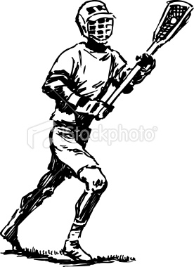
HOME
VISITOR
XXXX
OOOO
G
G

Slide 40
MOST FREQUENT PENALTIES
Out Of Bounds
  Not a penalty, but will often cause a turnover.
  Be in position:
  Side-line during transition (especially bench side)
    End-line if you are lead and ball contested behind goal
  Pay attention to the feet
  If checked out of bounds, was it a legal check? Did player turn? Push? Illegal Body Check?
  Who touched the ball last? Tipped?
  Shot: which player is closest to the ball at the point it went out of bounds? Run the ball out so you can make the call!
  Mechanic: Whistle, one hand up, then point new direction and yell color; if side-line, then two hands up for horn.

Slide 41
Personal Fouls
Personal fouls are those of a serious nature: illegal body checking, slashing, cross-checking, tripping, unnecessary roughness, unsportsmanlike conduct and the use of an illegal crosse.
PENALTY: The penalty for a personal foul shall be suspension from the game of the offending player for one to three minutes, depending on the official's judgment of the severity and perceived intent of the personal foul. The ball shall be given to the team fouled.

Slide 42
Most Frequent Penalties/Calls:
Personal Fouls
Slash
Illegal Body Check
Cross-Check
Trip

Slide 43
MOST FREQUENT PENALTIES
Keep your eyes up & on the players and not on the ball!
Use the Principle of Advantage/Disadvantage, especially Technical Fouls.
  Slash
    Excessive or repeated checks with the crosse on the arms - warn them to "Get Stick!"
    Checks across the back with the crosse. This is a Point of Emphasis and MUST be called.
    If a swing is particularly violent (could likely cause injury), don't wait until the 2nd swing.
    Be alert to a player holding the crosse in a one-handed tomahawk position!
    Watch the attack slashing a Defensive man when clearing the ball, especially if they have no chance of reaching the player's crosse.
    Watch for swinging crosses that make contact on the hips or legs on the follow-through.
    Must be a blow and not a brush.

Slide 44
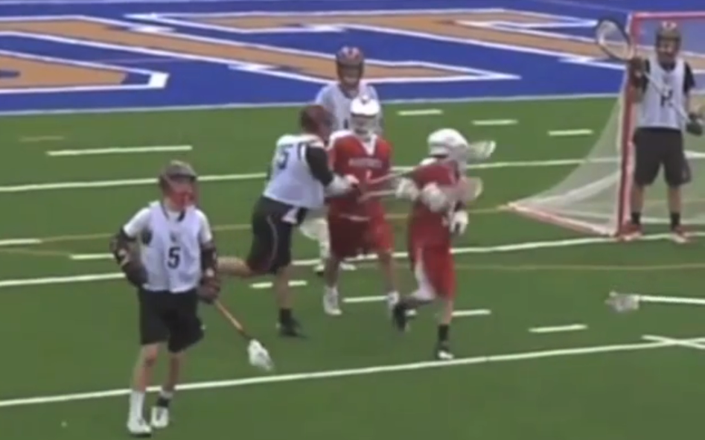

Slide 45
http://www.youtube.com/watch?v=Cy0enElzCRA

Slide 46
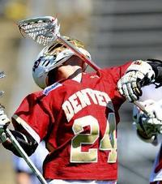

Slide 47
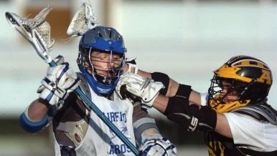
Slash?

Slide 48
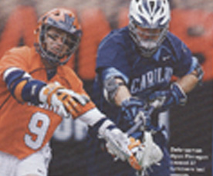
Slash?

Slide 49
MOST FREQUENT PENALTIES
Keep your eyes up & on the players and not on the ball!
Use the Principle of Advantage/Disadvantage, especially Technical Fouls.
Cross-Check
  Checks with the crosse handle extended, or extending of the arms as contact is made.
  If someone is using a cross-check hold on their opponent, and then thrusts out or makes a blow with the crosse to push them away, call the Cross Check. This is NOT a Cross Check Hold.
  The loose ball scrum - be on the look out for a player coming in to clear out the pile, often times leading with their hands and crosse in front, rather than the body.
  Point of emphasis: protect the player’s head, a cross-check that slides up, and into the head is dangerous!
  Watch the play, and call it!

Slide 51
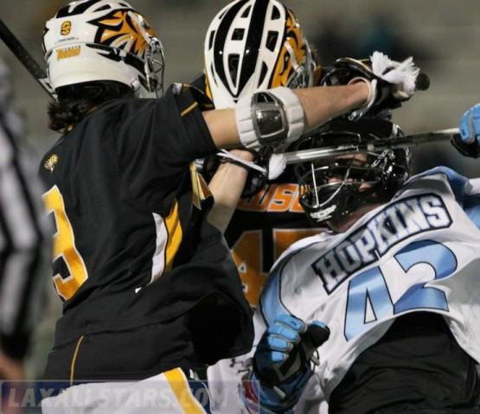

Slide 52
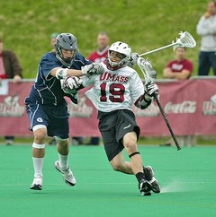

Slide 53
Proper Officiating Mechanics:
See the Beginning, The Middle and The End of the Play.
Notes:
This presentation is intended as a three-hour introduction to three-man mechanics
It covers both NCAA and NFHS mechanics
Depending on your audience, you may wish to delete some slides (e.g., NFHS-only slides for an NCAA group, or more basic slides for an advanced group) or you may wish to skip some slides but keep them as backup material

Slide 54
End
?

Slide 55
2013 NFHS Boys Lacrosse Rules Revisions
Rules 4-3-6 New and 5-10-1d New
ART 6 . . . It is illegal for a player to deliberately use his hand or fingers to play the ball. This shall be enforced immediately as an unsportsmanlike conduct penalty.
It is illegal for a player to grab an opponent’s crosse with the open hand or fingers. This shall be enforced immediately as an unsportsmanlike conduct penalty.
Note: Inadvertent touching of the ball when the hand is grasping the stick should not be called as an unsportsmanlike conduct foul.
5-10-1d . . . d. Deliberately use his hand or fingers to play the ball or grab an opponent’s crosse with the open hand or fingers.
Note: Inadvertent touching of the ball when the hand is grasping the stick should not be called as an unsportsmanlike conduct foul.

Slide 56
Face Off Sportsmanship
The committee addressed sportsmanship issues with changes in Rules 4-3-6 and 5-10-1d. An unsportsmanlike conduct penalty will be assessed if a player deliberately uses his hands or fingers to play the ball, or if a player grabs an opponent’s crosse with the open hand or fingers.
“These revisions were made in response to situations where players attempt to deceive officials by using their hands or fingers to strip the ball from an opponent’s crosse on the faceoff,” Summers said.
Summers noted that inadvertent touching of the ball when the hand is grasping the stick should not be called as an unsportsmanlike conduct foul.

Slide 57
2013 NFHS Boys Lacrosse Rules Revisions
Rule 5-4
ART. 1 . . . A player shall not initiate contact to an opponent’s head or neck with a cross-check or with any part of his body (head, elbow, shoulder, etc.) or stick. Any follow-through that contacts the head or neck shall also be considered a violation of this rule.
ART. 2 . . . A player shall not initiate an excessive, violent or uncontrolled slash to the head/neck.
ART 3 . . . A player, including an offensive player in possession of the ball, shall not block an opponent with the head or initiate contact with the head (known as spearing).
PENALTY: One-, two- or three-minute non-releasable foul, at the official’s discretion, for violation of Article 1, 2 or 3. If the contact to the head/neck is considered deliberate or reckless, the penalty shall be a minimum two- or three-minute non-releasable foul. An excessively violent violation of this rule may result in an ejection.

Slide 58
Reducing Head Injuries
With the recent concentration on reducing head injuries in high school sports, the committee added new language to Rule 5-4 which states that “a player shall not initiate an excessive, violent or uncontrolled slash to the head/neck.” In addition, the rule now prohibits an offensive player in possession of the ball from blocking an opponent with the head or initiating contact with the head.
Kent Summers, NFHS director of performing arts and sports, said if the contact to the head/neck is considered deliberate or reckless, the penalty shall be a minimum two- or three-minute non-releasable foul.
“In light of the potentially devastating, long-term effects of head injuries, it remains a priority to eliminate or minimize the frequency and impact of violent checks and collisions,” Summers said.

