Slide 1


2015 Preseason
First Year Lacrosse Official’s Clinic
Notes:
This presentation is intended as a three-hour introduction to three-man mechanics
It covers both NCAA and NFHS mechanics
Depending on your audience, you may wish to delete some slides (e.g., NFHS-only slides for an NCAA group, or more basic slides for an advanced group) or you may wish to skip some slides but keep them as backup material

Slide 2


Week #2:
History of Lacrosse,
Admin Review,
Basic Mechanics
Notes:
This presentation is intended as a three-hour introduction to three-man mechanics
It covers both NCAA and NFHS mechanics
Depending on your audience, you may wish to delete some slides (e.g., NFHS-only slides for an NCAA group, or more basic slides for an advanced group) or you may wish to skip some slides but keep them as backup material

Slide 3
Week #2:
Short History of Lacrosse
Notes:
This presentation is intended as a three-hour introduction to three-man mechanics
It covers both NCAA and NFHS mechanics
Depending on your audience, you may wish to delete some slides (e.g., NFHS-only slides for an NCAA group, or more basic slides for an advanced group) or you may wish to skip some slides but keep them as backup material

Slide 4
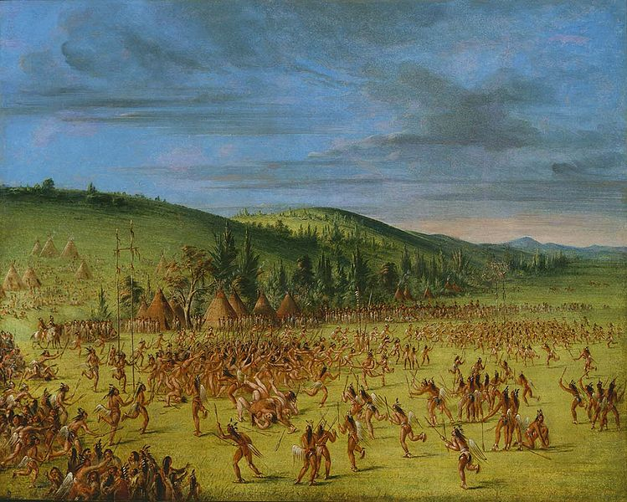

Slide 5
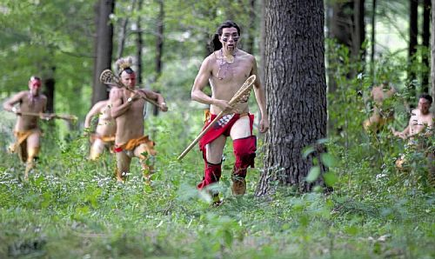

Slide 6


Slide 7
Famous Lacrosse Players
(other than Mikko Red Arrow, Bruce Buskard and myself)
• Silverheels is the nickname of the actor that played Tonto on “The Lone Ranger”. Born Harold J. Smith on the Six Nations Reservation in Canada.
• The senior United States senator and former Democratic presidential candidate was a former lacrosse player. John Kerry played lacrosse and hockey at St. Paul’s School in NH and continued his hockey career at Yale, where he also played JV lacrosse.
• He’s one of the best coaches in the NFL, but New England Patriots head coach also has a strong affinity for and knowledge of lacrosse. Bill Belichick was a captain his senior year at Wesleyan University in 1975.

Slide 8
Famous Lacrosse Players
• The “Great One” wasn’t an exceptional athlete in only one sport. As a kid, Wayne Gretzky played lacrosse just like many other Canadians and ice hockey players. He wrote, “I could hardly wait to get my lacrosse stick out and start throwing the ball around. It didn’t matter how cold or rainy it would be, we’d be out firing the ball against walls and working on our moves as we played the lacrosse equivalent to road hockey.”
• Jimmy Brown is the only player to be inducted into the halls of fame for the NFL, college football and lacrosse. Regarded as one of the best athletes the country has ever produced, Brown says lacrosse was his favorite sport. He played at Manhasset High School on Long Island and went on to play at Syracuse University. He was an All-American midfielder his senior year, where he scored 43 goals and had 21 assists.

Slide 9
Week #2:
Admin Review
Notes:
This presentation is intended as a three-hour introduction to three-man mechanics
It covers both NCAA and NFHS mechanics
Depending on your audience, you may wish to delete some slides (e.g., NFHS-only slides for an NCAA group, or more basic slides for an advanced group) or you may wish to skip some slides but keep them as backup material

Slide 10
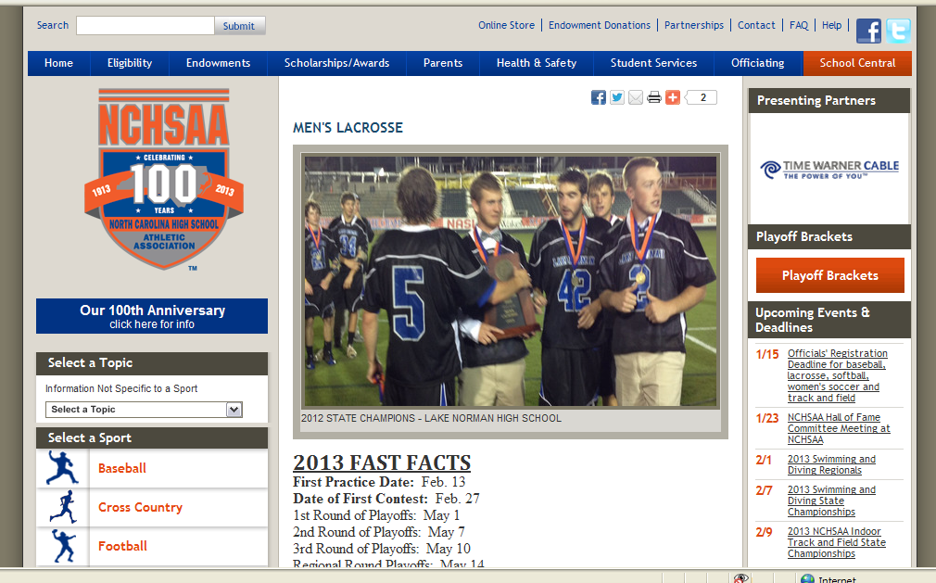
www.nchsaa.org

Slide 11
Announcements From NCHSAA
REGISTRATION DEADLINES
SPRING: December 15
(Baseball, Softball, Lacrosse):
2015 Test Dates
Men's Lacrosse: January 12-16, 2015

Slide 12
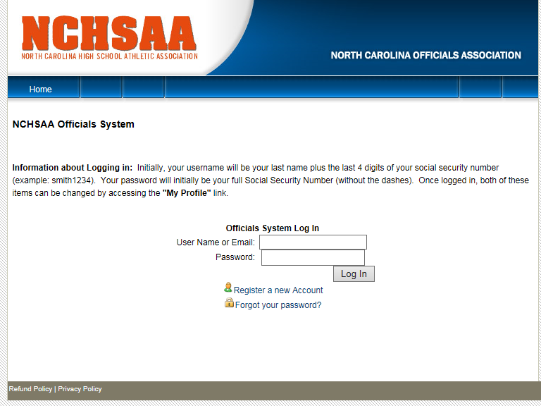
https://officiating.nchsaa.org/login.aspx

Slide 13
Announcements From NCHSAA
2015 SEASON FAST FACTS
First Day of Practice: Feb. 16, 2015
First Contest Date: March 2, 2015
*Reporting Deadline: May 4, 2015
1st Round of Playoffs: May 6, 2015
2nd Round of Playoffs: May 8, 2015
3rd Round of Playoffs: May 12, 2015
4th Round of Playoffs: May 15, 2015
Regional Round of Playoffs: May 19, 2015
State Championships: May 22-23, 2015

Slide 14
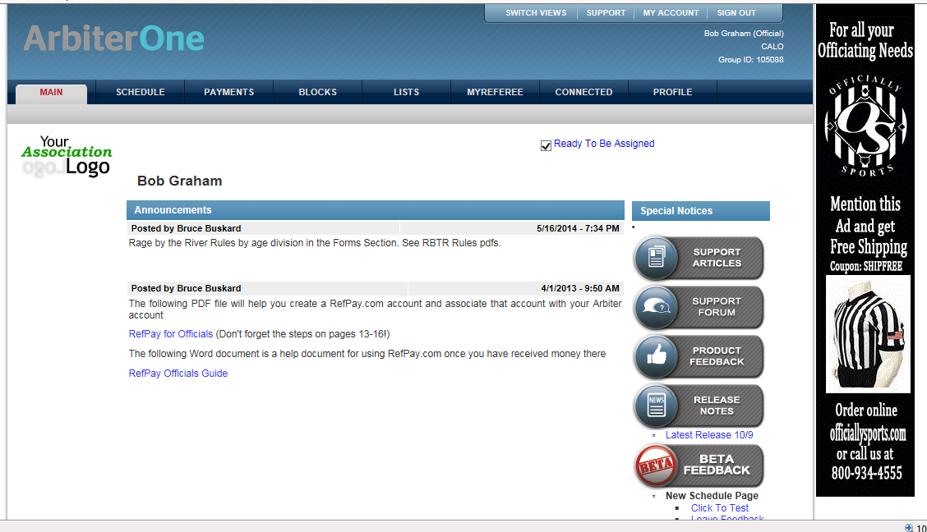
www.arbitersports.com

Slide 15
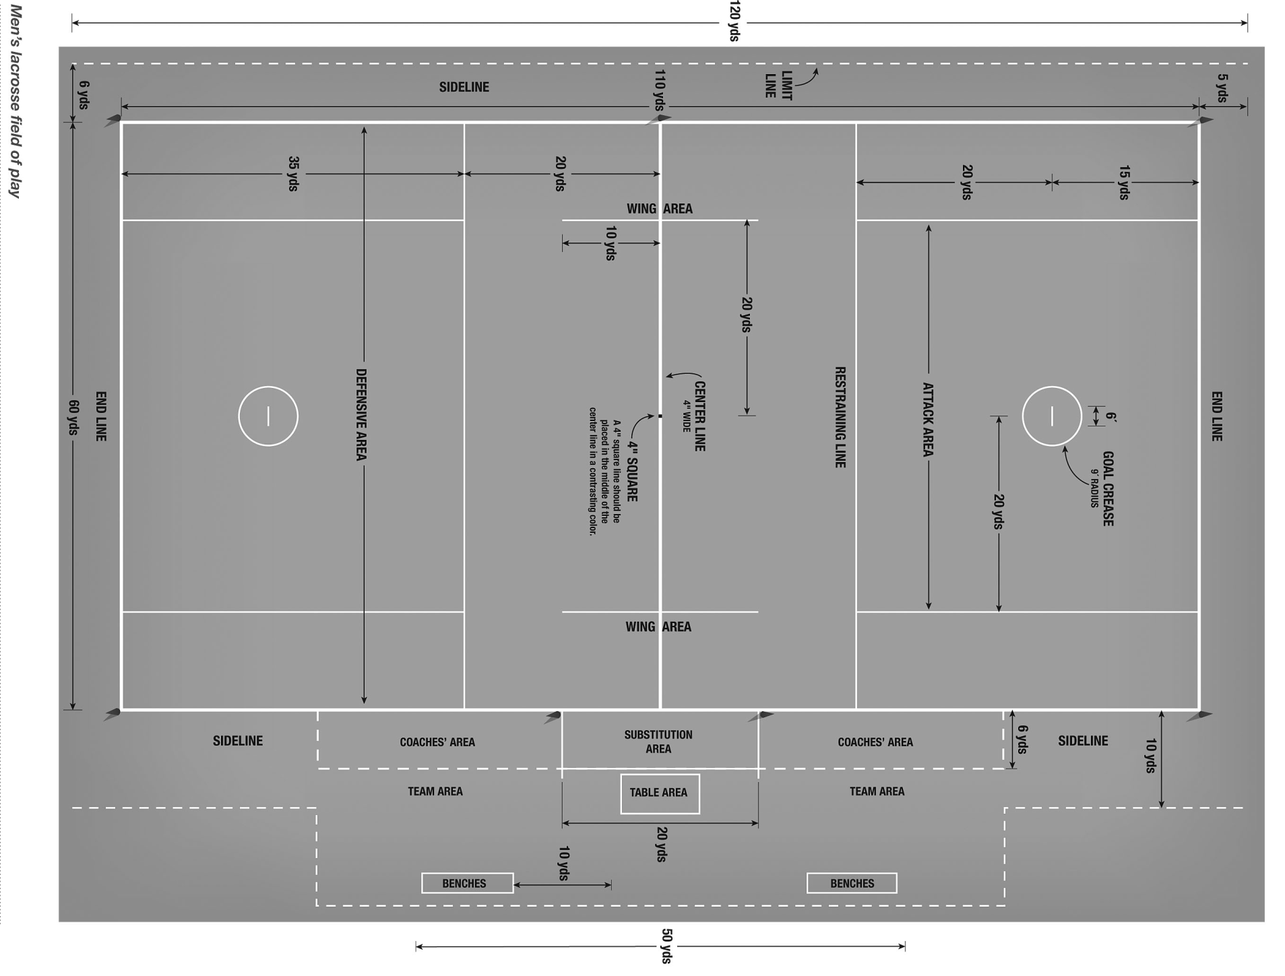

Slide 16
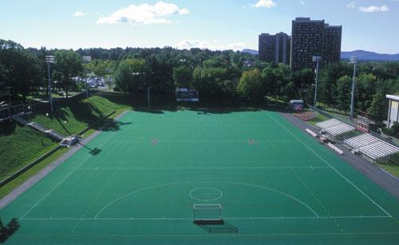
Garber Field - UMass

Slide 17
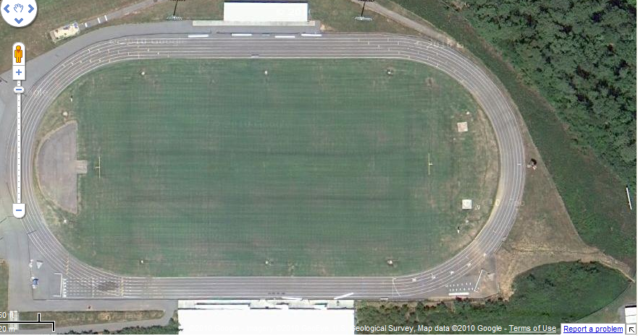
Your Local High School, Mecklenburg, NC

Slide 18
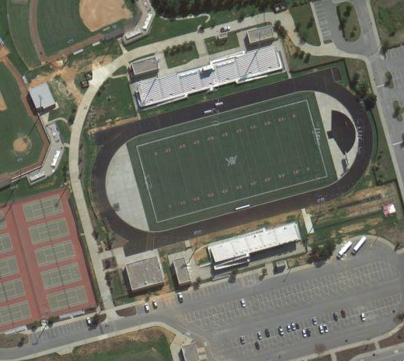
Your Local High School, Mecklenburg, NC
Audrey Kell HS

Slide 19
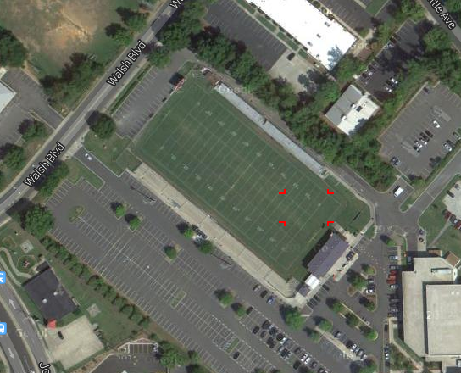
Charlotte Catholic

Slide 20
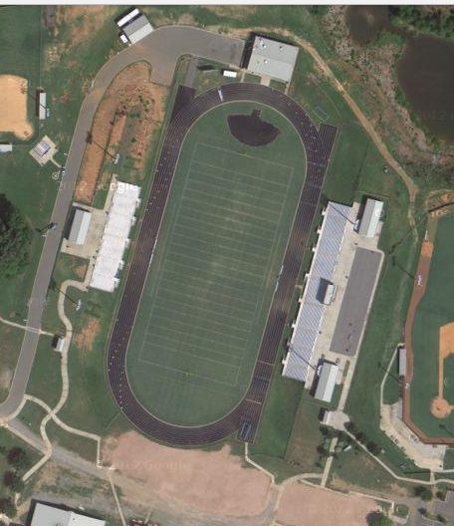
Your Local High School, Mecklenburg, NC
Audrey Kell HS

Slide 21
Week #2:
Basic Mechanics
Notes:
This presentation is intended as a three-hour introduction to three-man mechanics
It covers both NCAA and NFHS mechanics
Depending on your audience, you may wish to delete some slides (e.g., NFHS-only slides for an NCAA group, or more basic slides for an advanced group) or you may wish to skip some slides but keep them as backup material

Slide 22

Proper Officiating Mechanics Puts You in Position to See the Play.
Notes:
This presentation is intended as a three-hour introduction to three-man mechanics
It covers both NCAA and NFHS mechanics
Depending on your audience, you may wish to delete some slides (e.g., NFHS-only slides for an NCAA group, or more basic slides for an advanced group) or you may wish to skip some slides but keep them as backup material

Slide 23

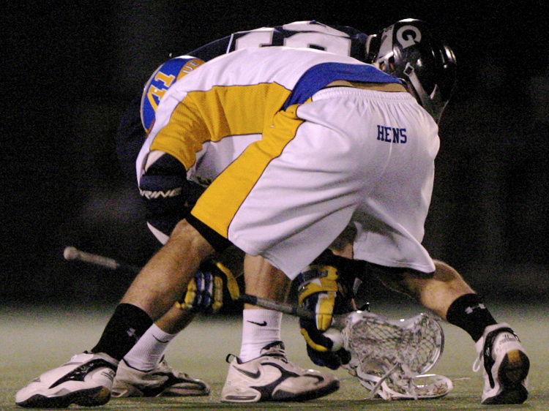
Where’s the Ball?

Slide 24
Proper Officiating Mechanics:
See the Beginning, The Middle and The End of the Play.
Notes:
This presentation is intended as a three-hour introduction to three-man mechanics
It covers both NCAA and NFHS mechanics
Depending on your audience, you may wish to delete some slides (e.g., NFHS-only slides for an NCAA group, or more basic slides for an advanced group) or you may wish to skip some slides but keep them as backup material

Slide 25
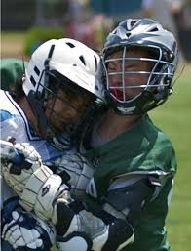

Slide 26
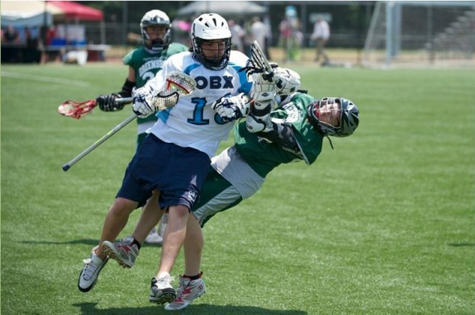

Slide 27
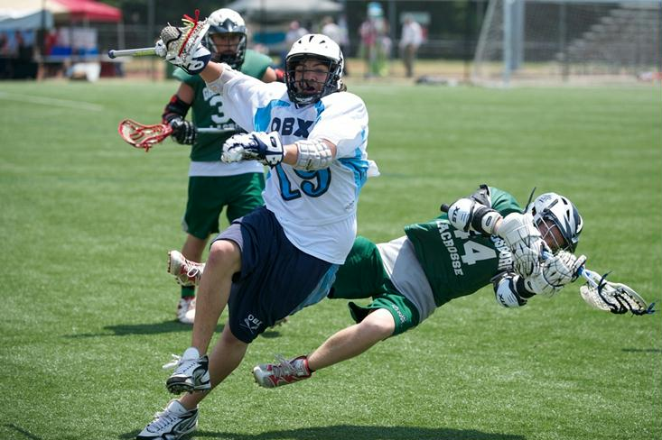

Slide 28
Pre-Game
Notes:
This presentation is intended as a three-hour introduction to three-man mechanics
It covers both NCAA and NFHS mechanics
Depending on your audience, you may wish to delete some slides (e.g., NFHS-only slides for an NCAA group, or more basic slides for an advanced group) or you may wish to skip some slides but keep them as backup material

Slide 29
Official’s Pre-Game Attitude
The crew that is thoroughly prepared for a game does a better job then the one that waits for problems to develop, then tries to sort them out.
Situations can be anticipated because the crew has discussed them.
There is less confusion on the field because the crew has discussed signals, responsibilities and mechanics. Bench personnel know their jobs, coaches are informed and the game flows better.

Slide 30
Official’s Pre-Game Attitude
Don't sweat the small stuff. This game is for the players, not the officials.
Our job is to make sure the game is played safely and fairly.
Let the game flow freely.
When you have to step in, step in.
At all other times, stay the heck out of the way.

Slide 31
Official’s Pre-Game Attitude
"You Only Have One Chance To Make A First Impression!“
Maintain good communication with partners
Concentrate, it’s a 4-quarter game
Anticipate the play, but if you don’t see the foul, don’t make the call; Let It Come To You
On The Field, You And Your Partner Make The Third Team.
Be Prompt With "Quick" Restarts, But Give The Goalie 5 Seconds If He Is Out Of The Crease.
Officiate Your Area - Don't Be A Ball Watcher.
  On The Ball - Watch The Ball, The Defender (Defensive Player Generally Commits The Foul) And The Crease.
  Off The Ball - Watch Cutters & Picks, Especially On The Crease.
Beat The Ball To The Lines! The Mid Line, The Attack Box, And The Goal Line.
Enjoy Yourself!

Slide 32
Official’s Pre-Game Coordination
EMAIL/PHONE/TEXT (as appropriate) partner(s) to confirm meeting time and uniform
Referee may email coaches (use selectively)
If you don’t hear from Referee, contact him!

Slide 33
PRE-GAME PROCEDURES
- When possible meet your partner in the parking lot a half-hour prior to game
- Walk on the field 20 minutes before game time
- Referee introduces crew to the head-coaches and asks for captains, in-home and certifies thee coaches: “Coach, are your players equipped by rule?"
- Remind the coaches of the points of emphasis for this year, that you will conduct a face-off clinic now and will then be available for equipment checks
- Give instructions to bench personnel and sign scorer’s books
- 5 minutes before the start of the game conduct coin toss

Slide 34
PRE-GAME CONFERENCE
CREW PREPARATION & GAME LOGISTICS
POSITION ASSIGNMENTS to start the game
TEAM ASSIGNMENTS – Which official gets which captains for faceoff, goals to inspect, pregame equip checks
MECHANICS
ALWAYS COUNT PLAYERS & CHECK THE CLOCK
COUNTS
HAND SIGNALS
CREASE COVERAGE (butt down, head up)
SUBSTITUTIONS (Trail official has timer & player counts, player on field has right of way)
RESTARTS (Communicate Ready Signal, Don’t go through “stop sign”, Wait Until Goalie is Ready)
FACEOFFS
STICK CHECKS

Slide 35
PRE-GAME CONFERENCE
SPECIAL SITUATIONS & POINTS OF EMPHASIS
HITS TO THE HEAD/NECK
FOULS (Simultaneous vs. Multiple, Live Ball or Dead Ball, Releasable)
PLAY-ON (Do Not Disadvantage Offended Team, Stop Play Quickly, No Subsequent Fouls)
STALLING - Early and often, R MUST Start it, Try for behind the goal (NO TRAPS)
FINAL TWO MINUTES (Shot or Deflection Out Of Box, Use Of Play-On Technique)
FIGHTING (Trail Freezes Both Benches, Lead Control Fight)
GOALIE LOSSES EQUIPMENT PLAY IS STOPPED IMMEADIATTLY

Slide 36
Two-Man
Lacrosse
Officiating
Mechanics

Slide 37
The Mission of our Mechanics
To put us in the best position to make the calls that allow us to keep the game safe and fair.
To use methods that are easily applied in a consistent manner by officials of various levels of ability in games of various levels of skill.

Slide 38
Field Position
Notes:
This presentation is intended as a three-hour introduction to three-man mechanics
It covers both NCAA and NFHS mechanics
Depending on your audience, you may wish to delete some slides (e.g., NFHS-only slides for an NCAA group, or more basic slides for an advanced group) or you may wish to skip some slides but keep them as backup material

Slide 39
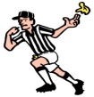
HOME
VISITOR
XXXX
OOOO

Slide 40

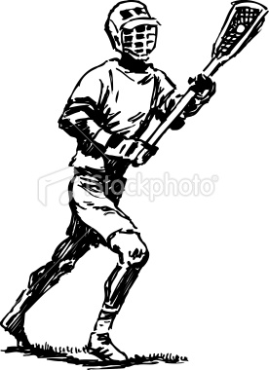


HOME
VISITOR
XXXX
OOOO
BALL

Slide 41
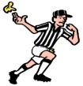
HOME
VISITOR
XXXX
OOOO

Slide 42
HOME
VISITOR
XXXX
OOOO
T
L
L
T
TRAIL:
Side-Line and fast break the other way
Watch late hits on shots, report goal scored by
Counts: wing & top
Technicals in area and Personals anywhere
LEAD:
Responsibility for entire offensive area until
trail is in position. Lead has first count.
Rubber band on Goal-Line Extended
End-Line and Side-Line behind
Focus on goal and crease on shots
Counts: first count, then wing
Technicals in area and Personals anywhere
ZLAX Publications

Slide 43
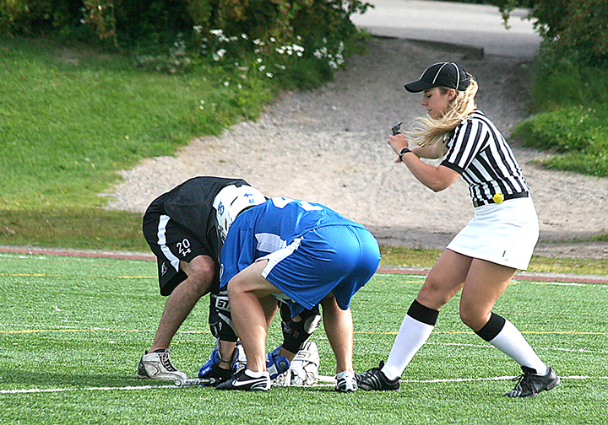
Face-Offs
Photo by Jim Manahan

Slide 44
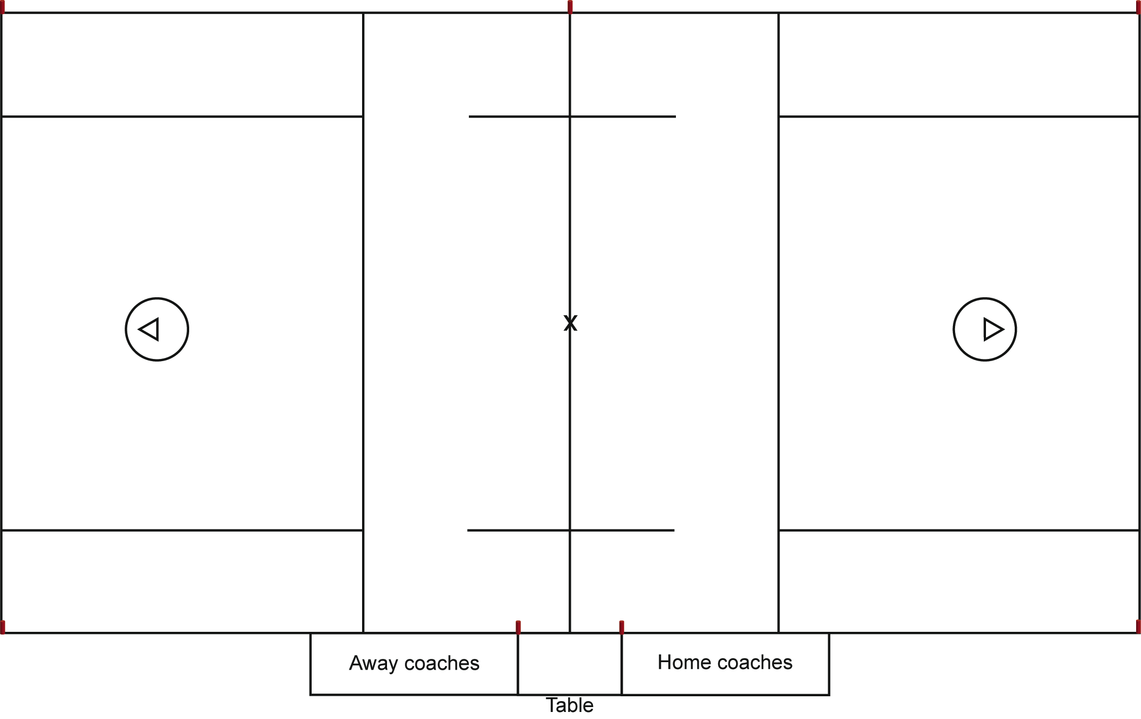
Face-off—X possession
W becomes L, has first 10-count, and gets to GLE
“Possession!”
W
X
O
X
O
X
O
X O
Team X gains possession here
L
X
O
X
O
X
O
Whistle
O
F
O
X
X
T
“Possession!”
F becomes T and has
20-timer
T
O X
Notes:
When play starts, F official backs out toward goal, then to correct sideline
F official has most possession calls: yell “Possession!” and wind arm
Other official echoes “Possession!”
Trail has 20-timer, if any; Lead has first 10-count

Slide 45
Face-off—O possession
“Possession!”
T
W
X
O
X
O
X
O
X O
W becomes T
Team O gains possession here
X
O
X
O
X
O
Whistle
O
F
O
X
X
L
L
“Possession!”
F becomes L and has
10-count
O X
Notes:
When play starts, F official backs out toward goal, then to correct sideline
F official has most possession calls: yell “Possession!” and wind arm
Other official echoes “Possession!”
Trail has 20-timer, if any; Lead has first 10-count

Slide 46
Transition
Check for
quick offside
T
X
O
X
O
X
O
O•
X
L
X
O
X
O
X
O
Goalie
makes
save
O
X
X O
O X
L
New T has 4-count and
20-timer
T
Check for
secondary offside

Slide 47
Settled situations I
T “yoyos” to midfield and back as ball becomes loose or goes back into possession
T
X
O
X
O
X
O
T’s main responsibility is the goal at the other end.
O•
X
X
O
X
O
X
O
O
X
X O
O X
L
L “yoyos” in and out along GLE, as close to crease as play allows
Notes:
L is on the GLE, as close to the crease as play allows
L “yoyos” in and out along the GLE to keep the ball in front and to keep outside of the “next pass” line.
Trail is near the corner of the attack area
Trail also “yoyos,” moving toward midfield when ball becomes loose and moving back to attack area when the offense regains possession
L and T call out of bounds on their own end line and sideline
Trail moves toward goal if L gets pushed behind goal

Slide 48
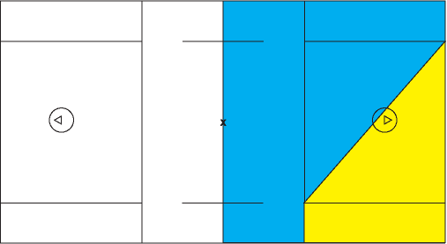
Settled situation: On/Off official
T is the “On” official when ball is in the blue area
T
L
L is the “On” official when ball is in the yellow area

Slide 49
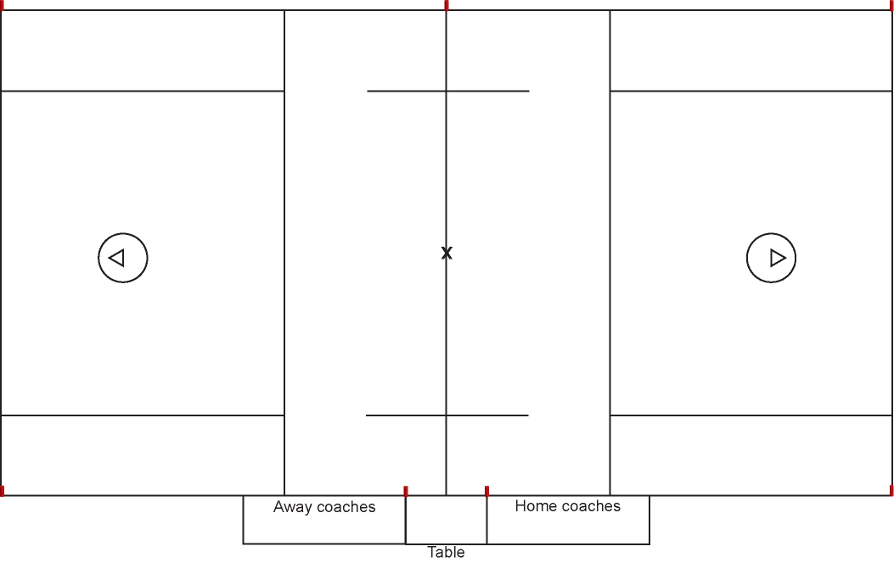
Settled situations II
L should never get trapped inside the play or pushed off the GLE if play is above GLE!
T
X
O
X
O
X
O
X
O
X
O
X
O
O•
X
O
X
X O
O X
L
L NO!
L NO!
O X
L YES!

Slide 50
Settled situations III
In that situation, the T moves into the box to help with goal coverage
T
X
O
X
O
X
O
O
X
X
O
X
O
X
O
O
X
X O•
On a contested end-line play, the L must move off the GLE
O X
L

Slide 51
Next pass
Team O has the ball ball
behind the goal. Where is
the next pass?
X
O
X
O
X
O
T
X
O
X
O
X
O
O X
O
X
X O•
L
O X
L needs to be outside passing lane, but not necessarily out as far as the wing players

Slide 52
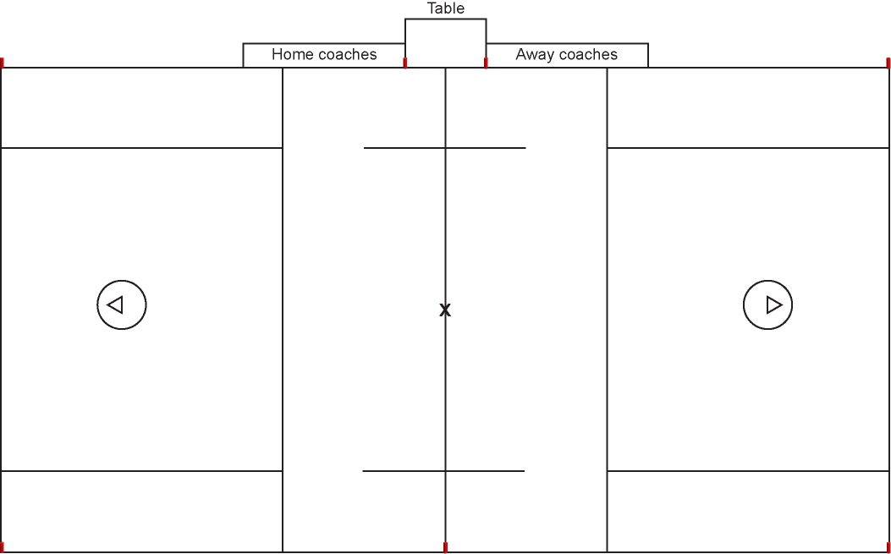
Key places to go
Ball loose—T goes to
the junction of the
sideline and midline
T
Ball in possession—T goes to the corner of the box
T
X
O
X
O
X
O
O•
X
X
O
X
O
X
O
O
X
X O
Ball loose or in offensive possession—L goes to the GLE
O X
L
L
On a shot, L goes to the end line

Slide 53
Goal scored—left side
W starts timer…
…then officials write goal on scorecard
W
X
O
X
O
X
O
L
X
O
X
O
X
O
L signals goal for 2–3 seconds
X O
Ball at
midfield
F
X O
O
X
Exchange
O X
T
If L is far from the goal when goal is scored, signal first, then run to the crease

Slide 54
Goal scored—right side
X
O
X
O
X
O
T
X
O
X
O
X
O
X O
F
Exchange
X O
O
X
L
O X
If far from the goal when goal is scored, signal first, then run to the crease
W

Slide 55
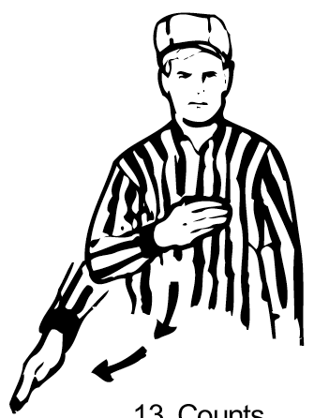
10-second count mechanics I
L always has first 10-count across midfield
The “on” official when count starts has all other counts
A hand count is used, from navel to 45 degrees past vertical
Switch arms if one count
ends and a new count begins
No verbal count: use visual
count only

Slide 56
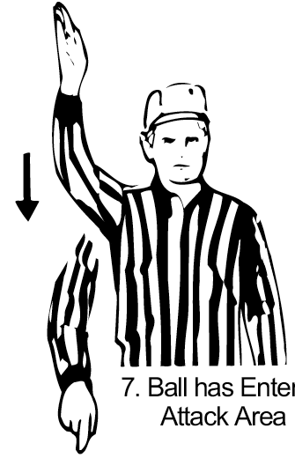
10-second count mechanics II
Use “reset” signal to indicate new count on changes of possession or after a play-on
If you have the count and it ends, simply stop counting
If you do not have the count
and the ball goes into the box
in your area, put your hand up
for 2–3 seconds, then point
into the attack area

Slide 57

Ball crosses the midline after the 10-second count ends.
The ball crosses the midline after the 10-second count ends, offense maintains possession.
T has the new 10-second count: “Get It In”

Slide 58
Most important responsibilities
L has the goal
T has the goal at the other end of the field
T is responsible for watching the shooter and flagging late hits

Slide 59
Restart Location
A timeserving penalty in the def. end results in a free clear
X
X
OOB on end line (shot, pass, step, or deflection) with no play-on or flag-down: ball restarts at the spot
A stoppage in the midfield area or alley restarts at the spot: do not move to the corner!
X
Simul. fouls with both teams serving time: no free clear, but ball moves out of the box
Any other stoppage in the attack area . . .
X
X
. . . the ball moves laterally outside the attack area
X
Move restart in 5 yards from near sub area
X
X
X

Slide 60
Flag down
Throw flag high into air, yell “Flag down!”
X
O
X
O
X
O
L
O X
X
O
X
O
X
O
X• O
O
X
Repeat “Flag down!”; give up the other goal and move to corner
O X
T
Stop play when appropriate

Slide 61
Signaling penalties (Lead)
While T reports, L gets field ready for restart
X
O
X
O
X
O
Must get eye contact with partner before restart!
L
O X
X
O
X
O
X
O
X O
O
X
Relay
signal
T starts timer when finished reporting penalty
O X
Relay
signal
T

Slide 62
Signaling penalties (Lead)
T
X
O
X
O
X
O
T
X
O
X
O
X
O
Relay
signal
O X
O
Relay
signal
X
X O
O X
L

Slide 63
Signaling penalties (Trail)
X
O
X
O
X
O
L
X
O
X
O
X
O
O X
X O
O
X
O X
First briefly signal partner
Then signal table
T

Slide 64
Signaling penalties (Trail)
T
X
O
X
O
X
O
First briefly signal partner
T
X
O
X
O
X
O
O X
O
Then
signal table
X
X O
O X
L

Slide 65
HOME
VISITOR
XXXX
OOOO

Slide 66
Coverage On Clear/ Offsides
Notes:
This presentation is intended as a three-hour introduction to three-man mechanics
It covers both NCAA and NFHS mechanics
Depending on your audience, you may wish to delete some slides (e.g., NFHS-only slides for an NCAA group, or more basic slides for an advanced group) or you may wish to skip some slides but keep them as backup material

Slide 67


HOME
VISITOR
XXXX
OOOO
Goalie makes save and passes to middie who runs with the ball to center of the field
L
G
G
T

Slide 68
HOME
VISITOR
XXXX
OOOO
T
G
G
Goalie makes save and passes to middie who runs with the ball to center of the field
L

Slide 69
HOME
VISITOR
XXXX
OOOO
Goalie makes save and passes to middie who runs with the ball to center of the field
T
G
G
L

Slide 70
HOME
VISITOR
XXXX
OOOO
T
G
G
Goalie makes save and passes to middie who runs with the ball to center of the field
L

Slide 71
HOME
VISITOR
XXXX
OOOO

Slide 72
HOME
VISITOR
XXXX
OOOO

Slide 73
HOME
VISITOR
XXXX
OOOO
T
L
L
T
TRAIL:
Side-Line and fast break the other way
Watch late hits on shots, report goal scored by
Counts: wing & top
Technicals in area and Personals anywhere
LEAD:
Responsibility for entire offensive area until
trail is in position. Lead has first count.
Rubber band on Goal-Line Extended
End-Line and Side-Line behind
Focus on goal and crease on shots
Counts: first count, then wing
Technicals in area and Personals anywhere
ZLAX Publications

Slide 74
End
?

Slide 75
2013 NFHS Boys Lacrosse Rules Revisions
Rules 4-3-6 New and 5-10-1d New
ART 6 . . . It is illegal for a player to deliberately use his hand or fingers to play the ball. This shall be enforced immediately as an unsportsmanlike conduct penalty.
It is illegal for a player to grab an opponent’s crosse with the open hand or fingers. This shall be enforced immediately as an unsportsmanlike conduct penalty.
Note: Inadvertent touching of the ball when the hand is grasping the stick should not be called as an unsportsmanlike conduct foul.
5-10-1d . . . d. Deliberately use his hand or fingers to play the ball or grab an opponent’s crosse with the open hand or fingers.
Note: Inadvertent touching of the ball when the hand is grasping the stick should not be called as an unsportsmanlike conduct foul.

Slide 76
Face Off Sportsmanship
The committee addressed sportsmanship issues with changes in Rules 4-3-6 and 5-10-1d. An unsportsmanlike conduct penalty will be assessed if a player deliberately uses his hands or fingers to play the ball, or if a player grabs an opponent’s crosse with the open hand or fingers.
“These revisions were made in response to situations where players attempt to deceive officials by using their hands or fingers to strip the ball from an opponent’s crosse on the faceoff,” Summers said.
Summers noted that inadvertent touching of the ball when the hand is grasping the stick should not be called as an unsportsmanlike conduct foul.

Slide 77
2013 NFHS Boys Lacrosse Rules Revisions
Rule 5-4
ART. 1 . . . A player shall not initiate contact to an opponent’s head or neck with a cross-check or with any part of his body (head, elbow, shoulder, etc.) or stick. Any follow-through that contacts the head or neck shall also be considered a violation of this rule.
ART. 2 . . . A player shall not initiate an excessive, violent or uncontrolled slash to the head/neck.
ART 3 . . . A player, including an offensive player in possession of the ball, shall not block an opponent with the head or initiate contact with the head (known as spearing).
PENALTY: One-, two- or three-minute non-releasable foul, at the official’s discretion, for violation of Article 1, 2 or 3. If the contact to the head/neck is considered deliberate or reckless, the penalty shall be a minimum two- or three-minute non-releasable foul. An excessively violent violation of this rule may result in an ejection.

Slide 78
Reducing Head Injuries
With the recent concentration on reducing head injuries in high school sports, the committee added new language to Rule 5-4 which states that “a player shall not initiate an excessive, violent or uncontrolled slash to the head/neck.” In addition, the rule now prohibits an offensive player in possession of the ball from blocking an opponent with the head or initiating contact with the head.
Kent Summers, NFHS director of performing arts and sports, said if the contact to the head/neck is considered deliberate or reckless, the penalty shall be a minimum two- or three-minute non-releasable foul.
“In light of the potentially devastating, long-term effects of head injuries, it remains a priority to eliminate or minimize the frequency and impact of violent checks and collisions,” Summers said.

