Slide 1
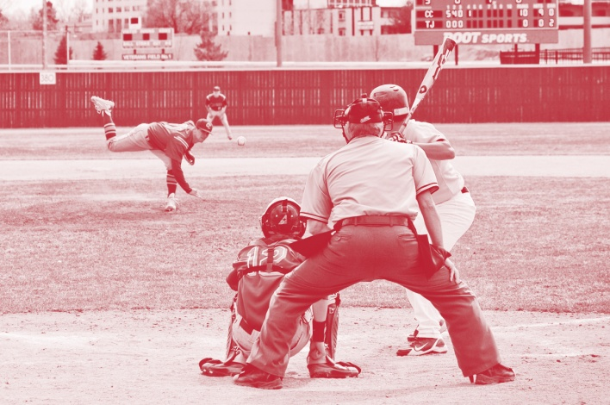
2015 NFHS Baseball Rule Changes
B. Elliot Hopkins, MLD, CAA
Director of Sports, Sanctioning and Student Services
Notes:
Thank you for participating in this annual interpretation meeting. While the game of baseball is in great shape, we continue to work toward improving the game and hopefully putting young people in safe conditions and in situations that they are able to find success in some aspect of the game. Ultimately, our goal is for them to be safe, have fun and gain some valuable life lessons from participation. New additions to our rules are indicated by underlining of the change. Deletions are noted by a strike-through of the deleted text.
Areas in this PowerPoint that are underlined designate that the text was newly added to the rules this year. Bold notations mean the language is either a title, heading or penalty. Deletions and modifications are aptly identified as well. Where appropriate, notes and comments will be found under some of the PowerPoint slides. Not every rule change or editorial change warrants an explanation over and above the stated rationale. Thank you again for your attendance, participation and dedication to interscholastic athletics. Have a fantastic baseball season!

Slide 2
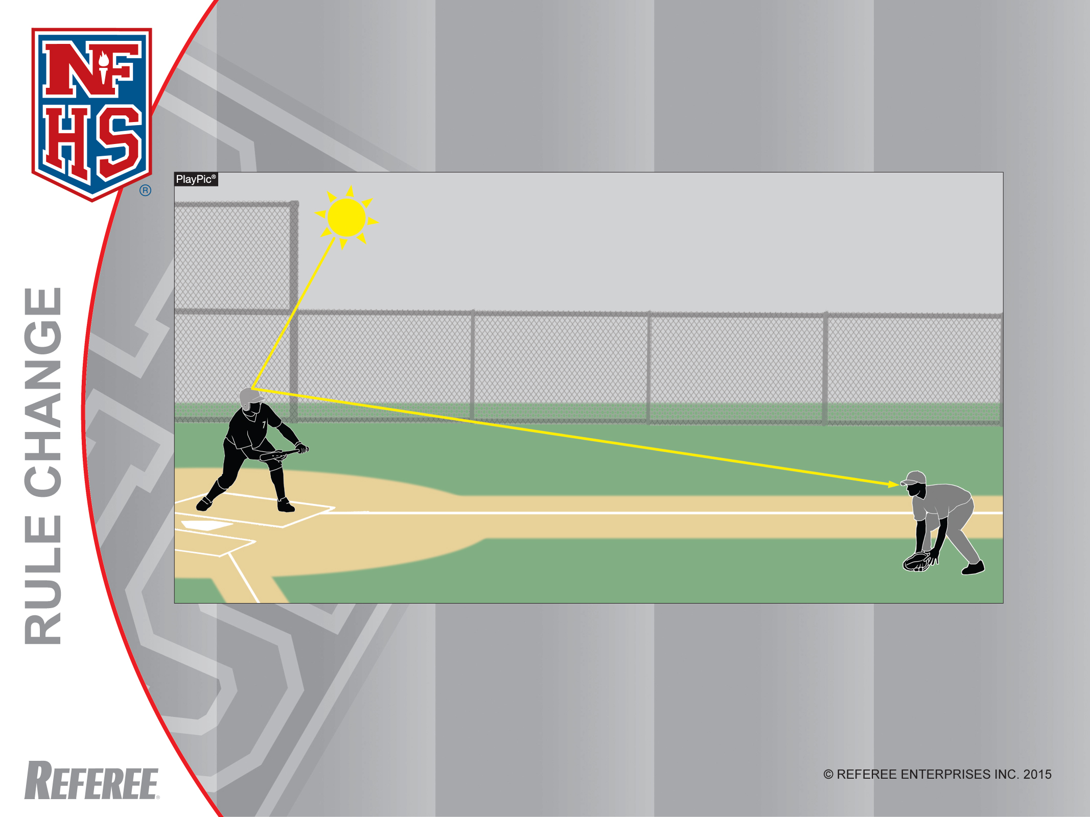
Legal Batting Helmets
Rule 1-5-1
Batting helmets shall have a non-glare, not mirror - like surface and shall meet the NOCSAE standard at the time of manufacture.

Slide 3
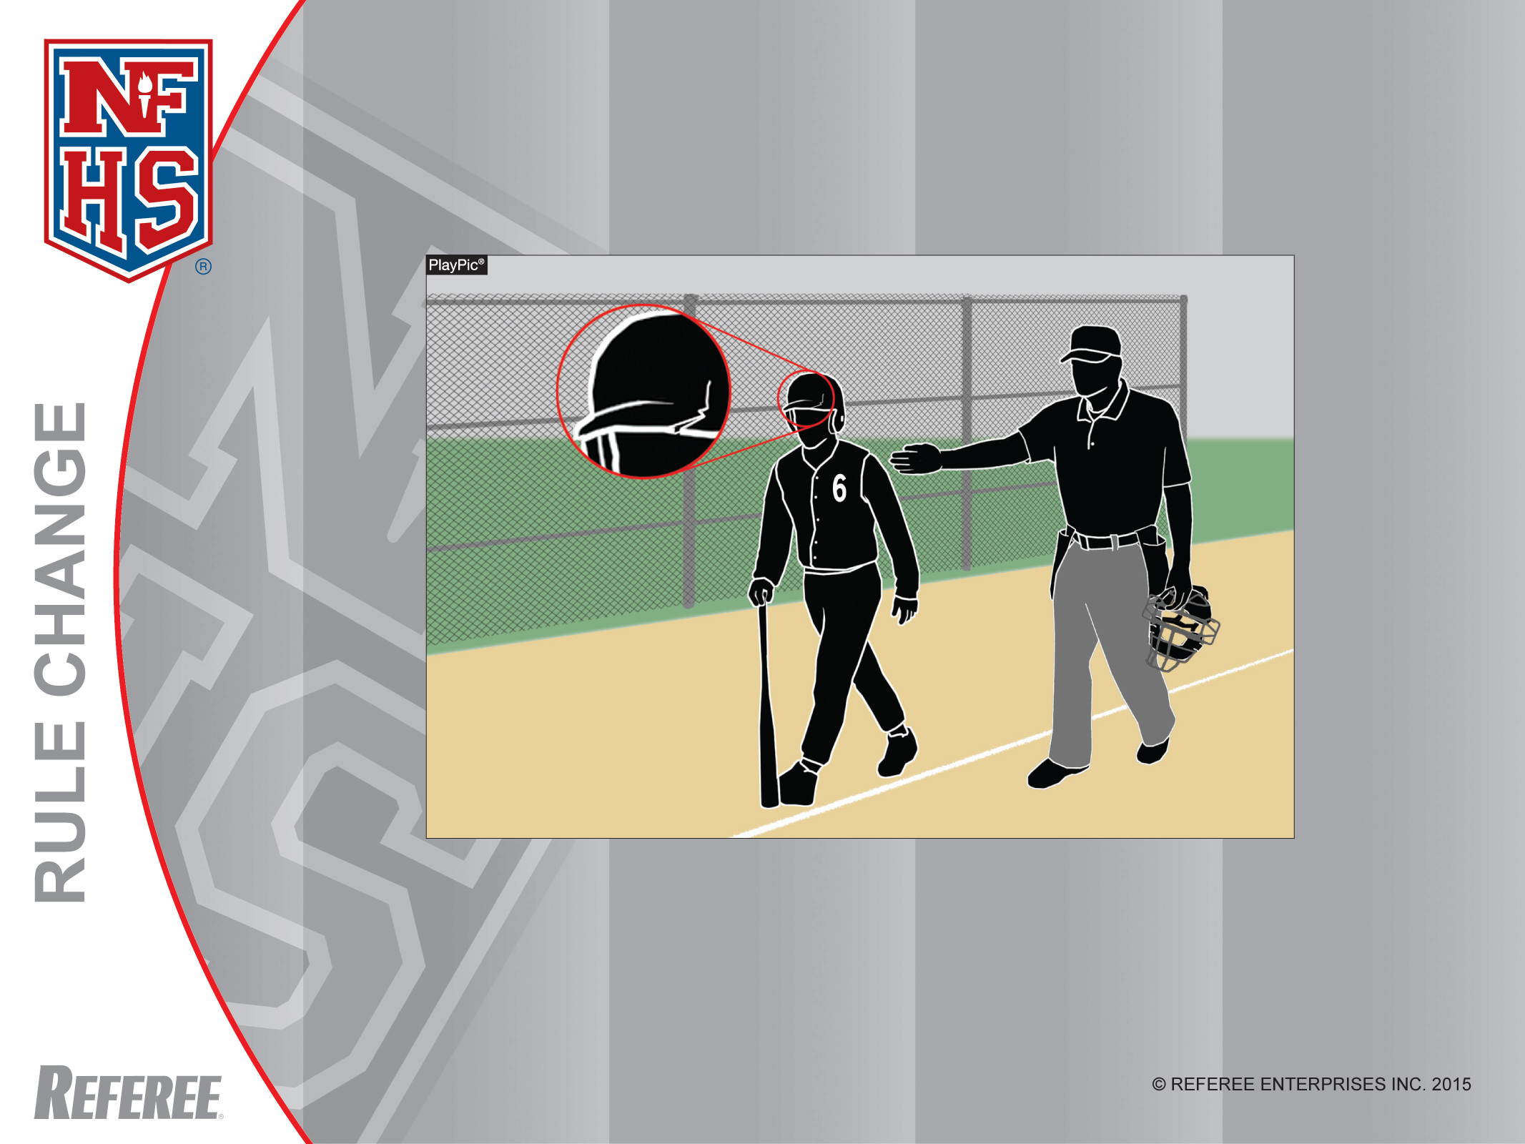
Defective Batting Helmet
Rule 1-5-1, 4-1-3b
Even though this helmet met the NOCSAE standard at the time of manufacture, the crack makes the helmet illegal. The batter must replace the helmet immediately.

Slide 4
Rule 1-5-1
ART.1 . . . It is mandatory for on-deck batters, batters, runners, retired runners, players/students in the coaches boxes as well as non-adult bat/ball shaggers to wear a batting helmet that has a non-glare (not mirror-like) surface and meets the NOCSAE standard at the time of manufacture.

Slide 5
Rule 1-5-1
(continued)
Rationale: Batting helmets are a key component for minimizing risk in high school baseball. It is critical that the surface of the helmet does not pose any risk for those who are wearing the helmet and for their opponents.
It is equally important that the batting helmet not only meet the prescribed NOCSAE standard at the time of manufacture, but that they are monitored regularly for excessive use and kept in good functioning order.

Slide 6
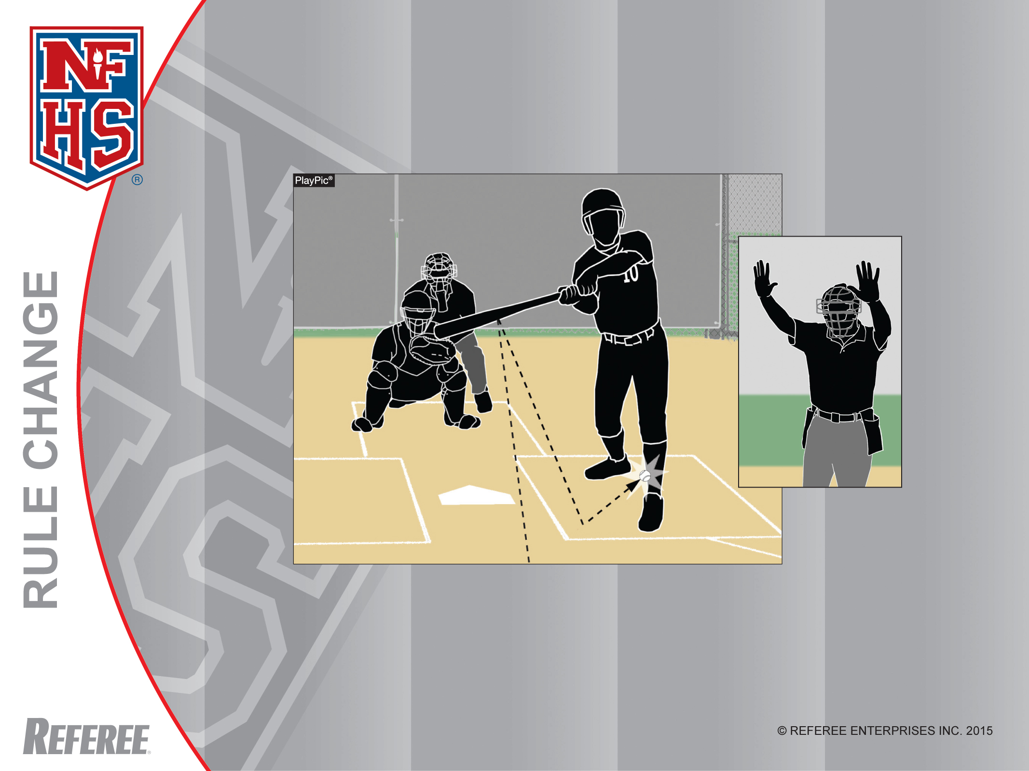
Foul Ball
Rule 2-16-1f
A batted ball that rebounds and hits the batter while he is still legally in the batter’s box shall be called a foul ball.

Slide 7
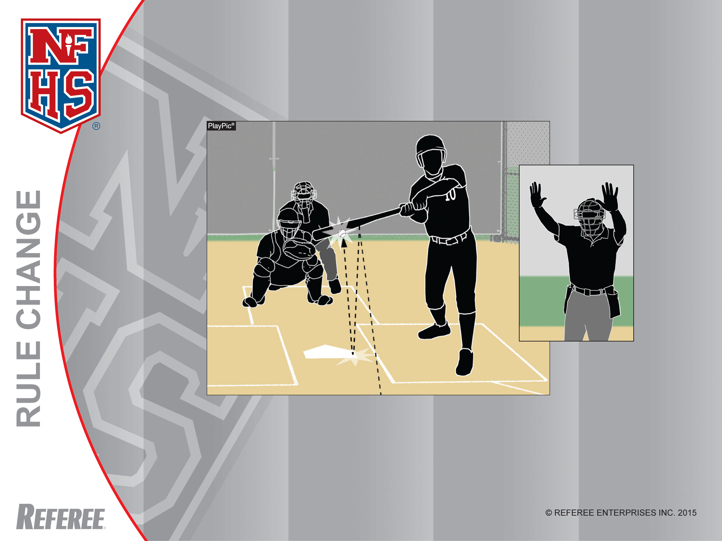
Foul Ball
Rule 2-16-1f
A batted ball that rebounds and hits the bat while the batter is still holding it while in the batter’s box shall be called a foul ball.

Slide 8
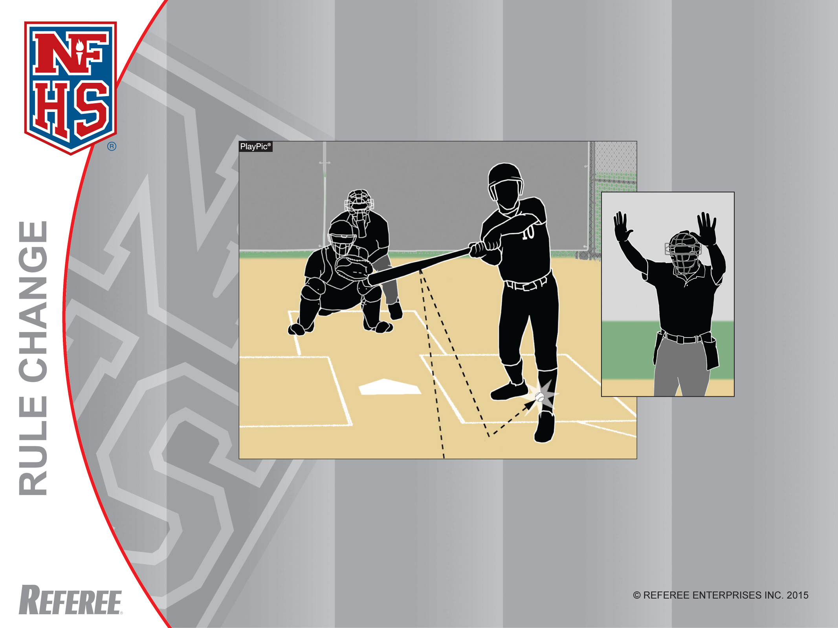
Foul Ball
Rule 2-16-1f
Even though this batter has one foot completely outside the batter’s box, he has one foot still in. Therefore, when the batted ball rebounds and hits him, it shall be called a foul ball.

Slide 9
Rule 2-16-1f and 1g
ART. 1 . . . A foul is a batted ball:
Sub-articles a-e unchanged.
f. that hits the batter in the batter’s box; or
g. that hits the ground or home plate and then his the batter or the bat which is held by the batter, while he is in the batter’s box.
Rationale: Foul balls are often topics that yield a tremendous amount of discussions. Given the opportunity to identify additional foul ball scenarios, it provides more education that is helpful to coaches and umpires.

Slide 10
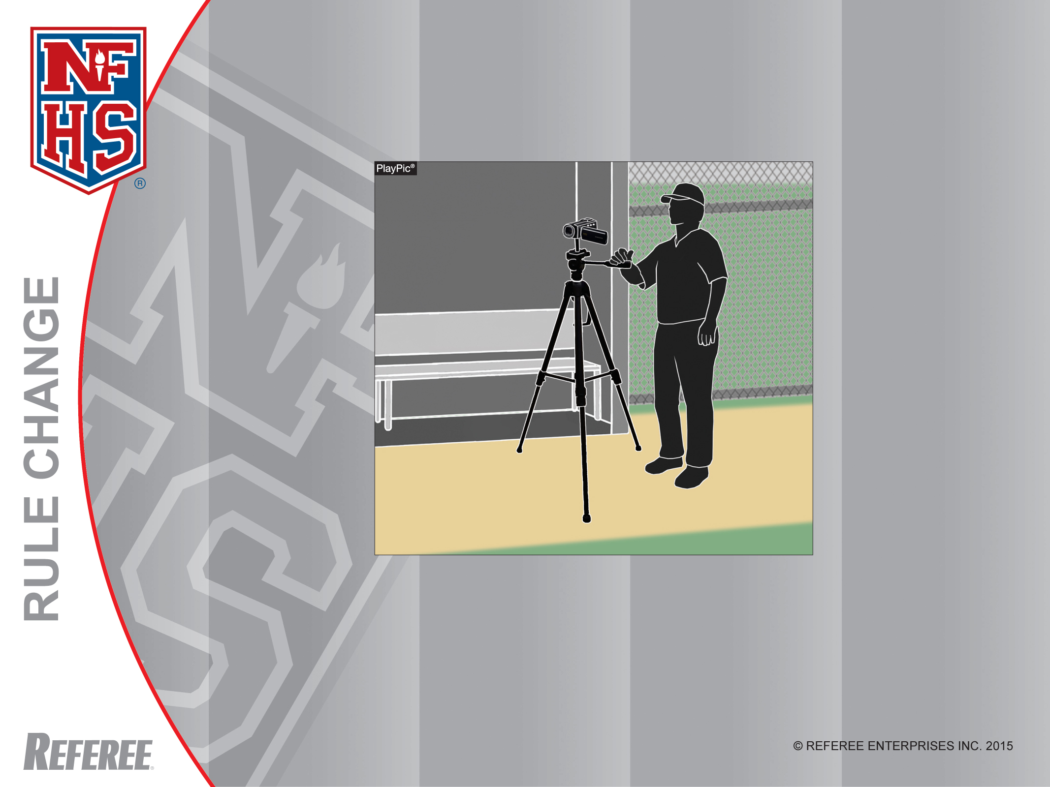
Video Permitted
Rule 3-3-1
The rule that prohibited using video for coaching purposes during a game has been removed. Therefore, it is legal for a coach or player to use a camera, tablet or phone to record video during a game from the dugout.

Slide 11
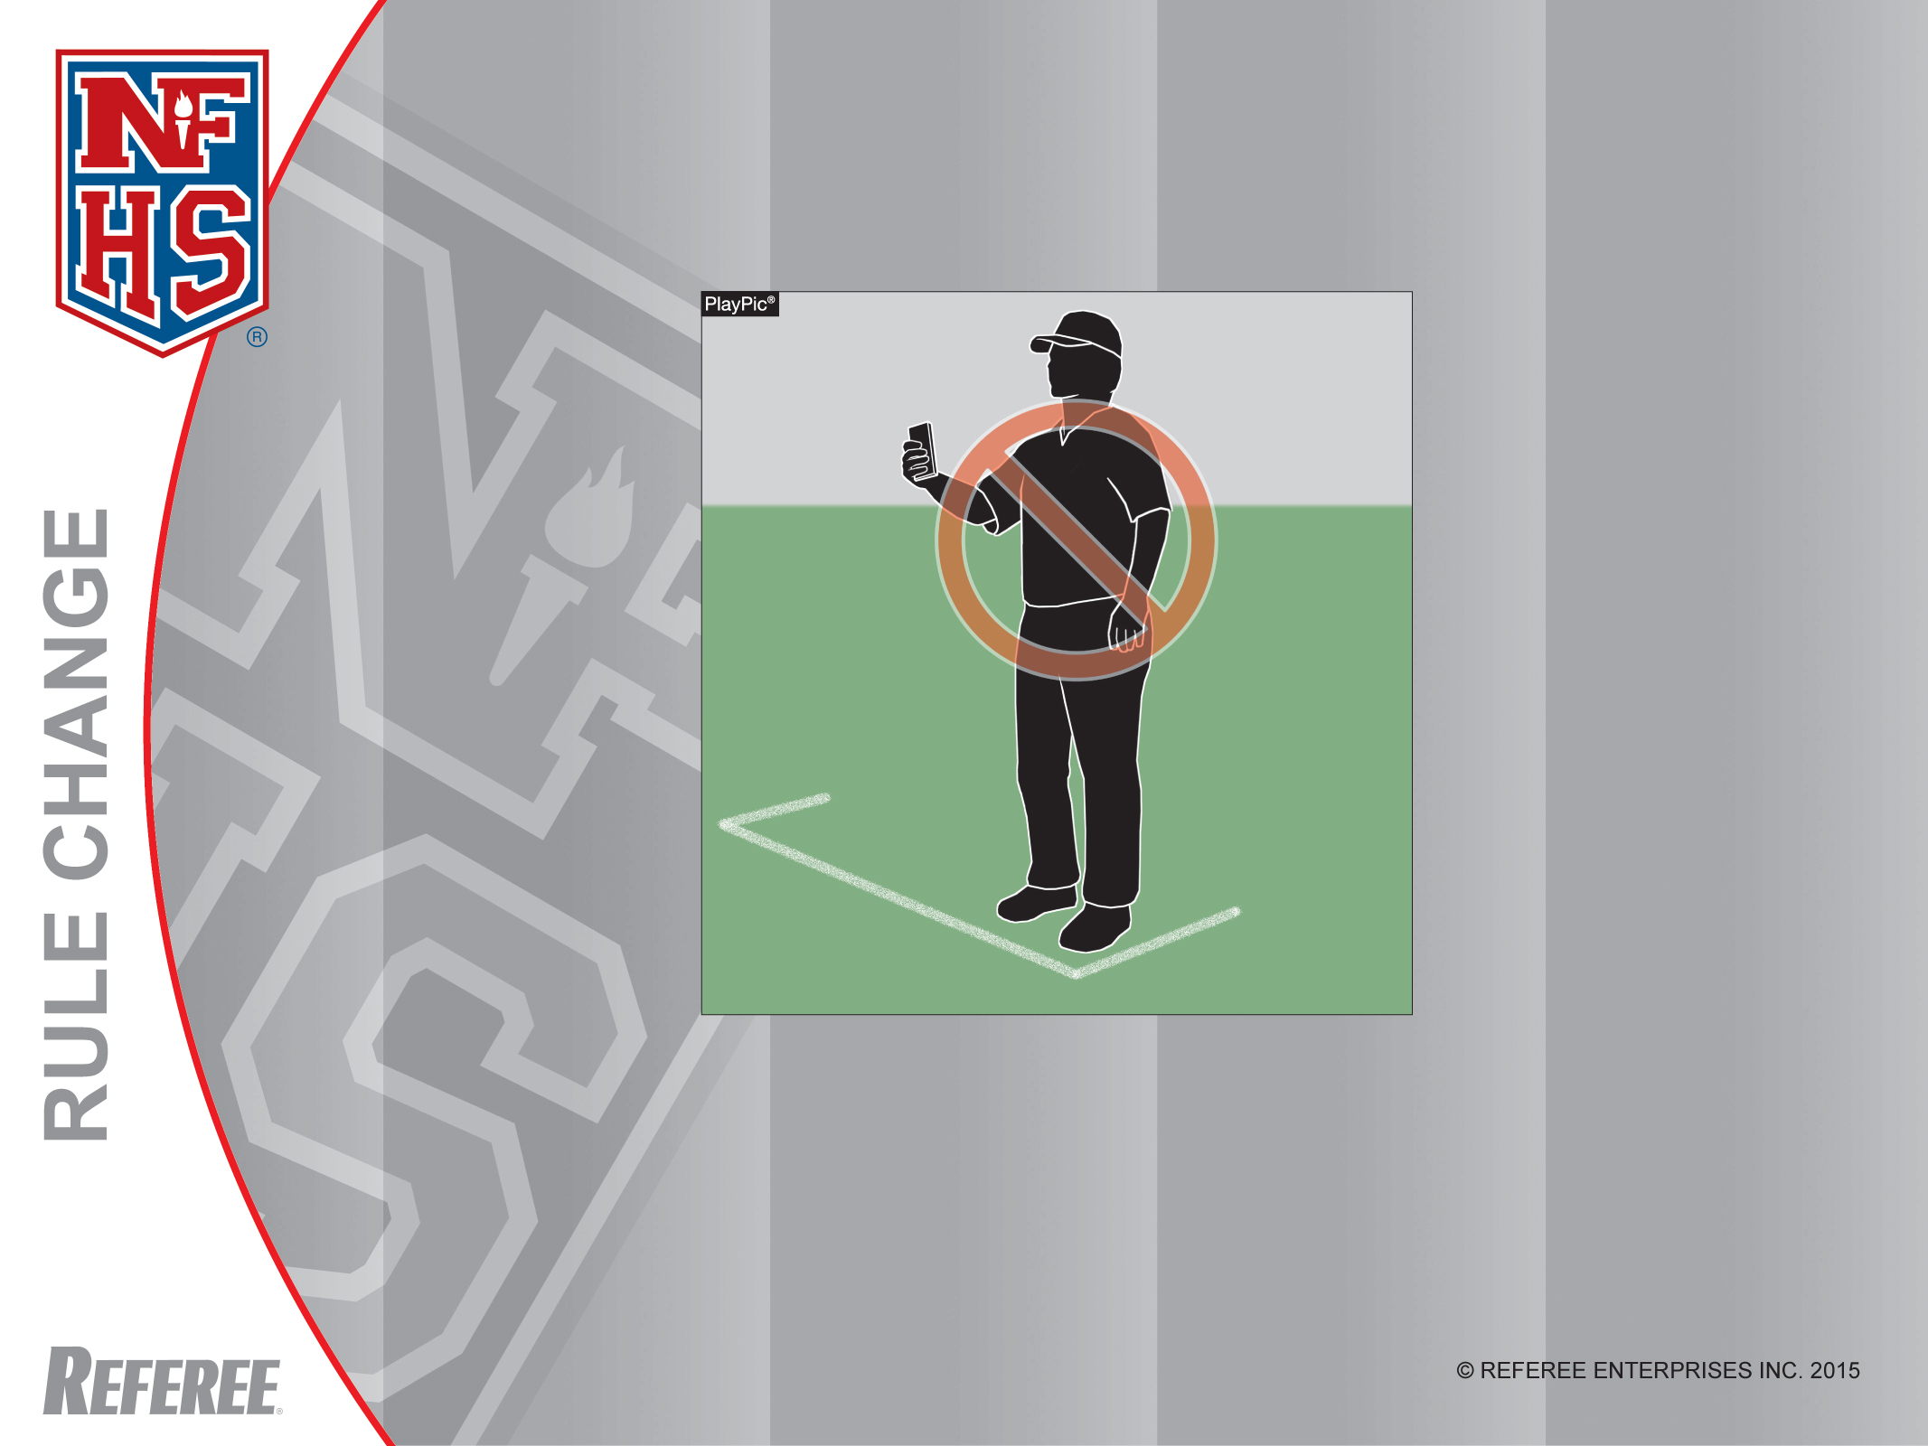
Video Equipment in Coaching Box
Rule 3-3-1h
Although it is now legal to use video for coaching purposes during a game, a coach is not permitted to record while in the coaching box. A coach may only have a stopwatch, rule book (hard copy) and scorebook while coaching in the box.

Slide 12
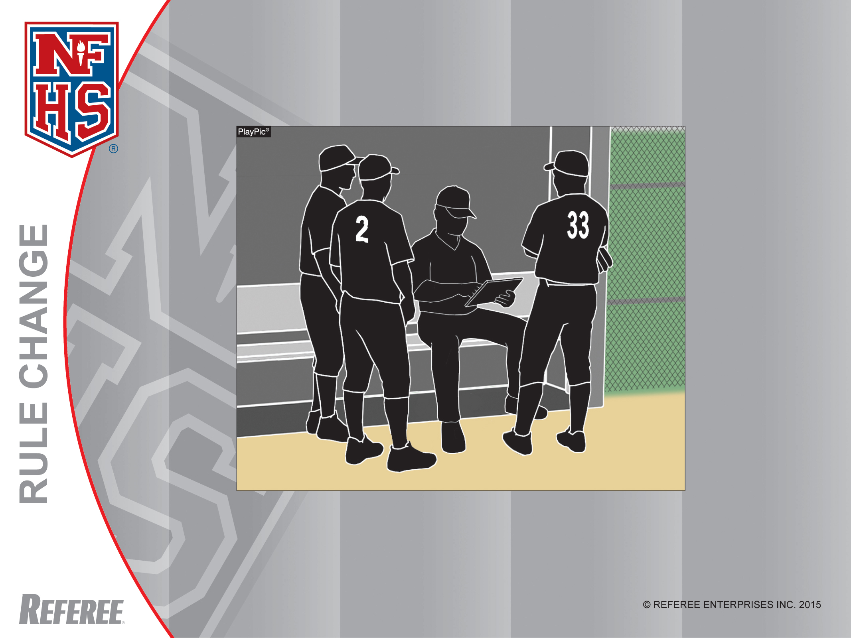
Video Equipment
Rule 3-3-1
Not only may teams record video during the game, but they may also watch it for coaching purposes.

Slide 13
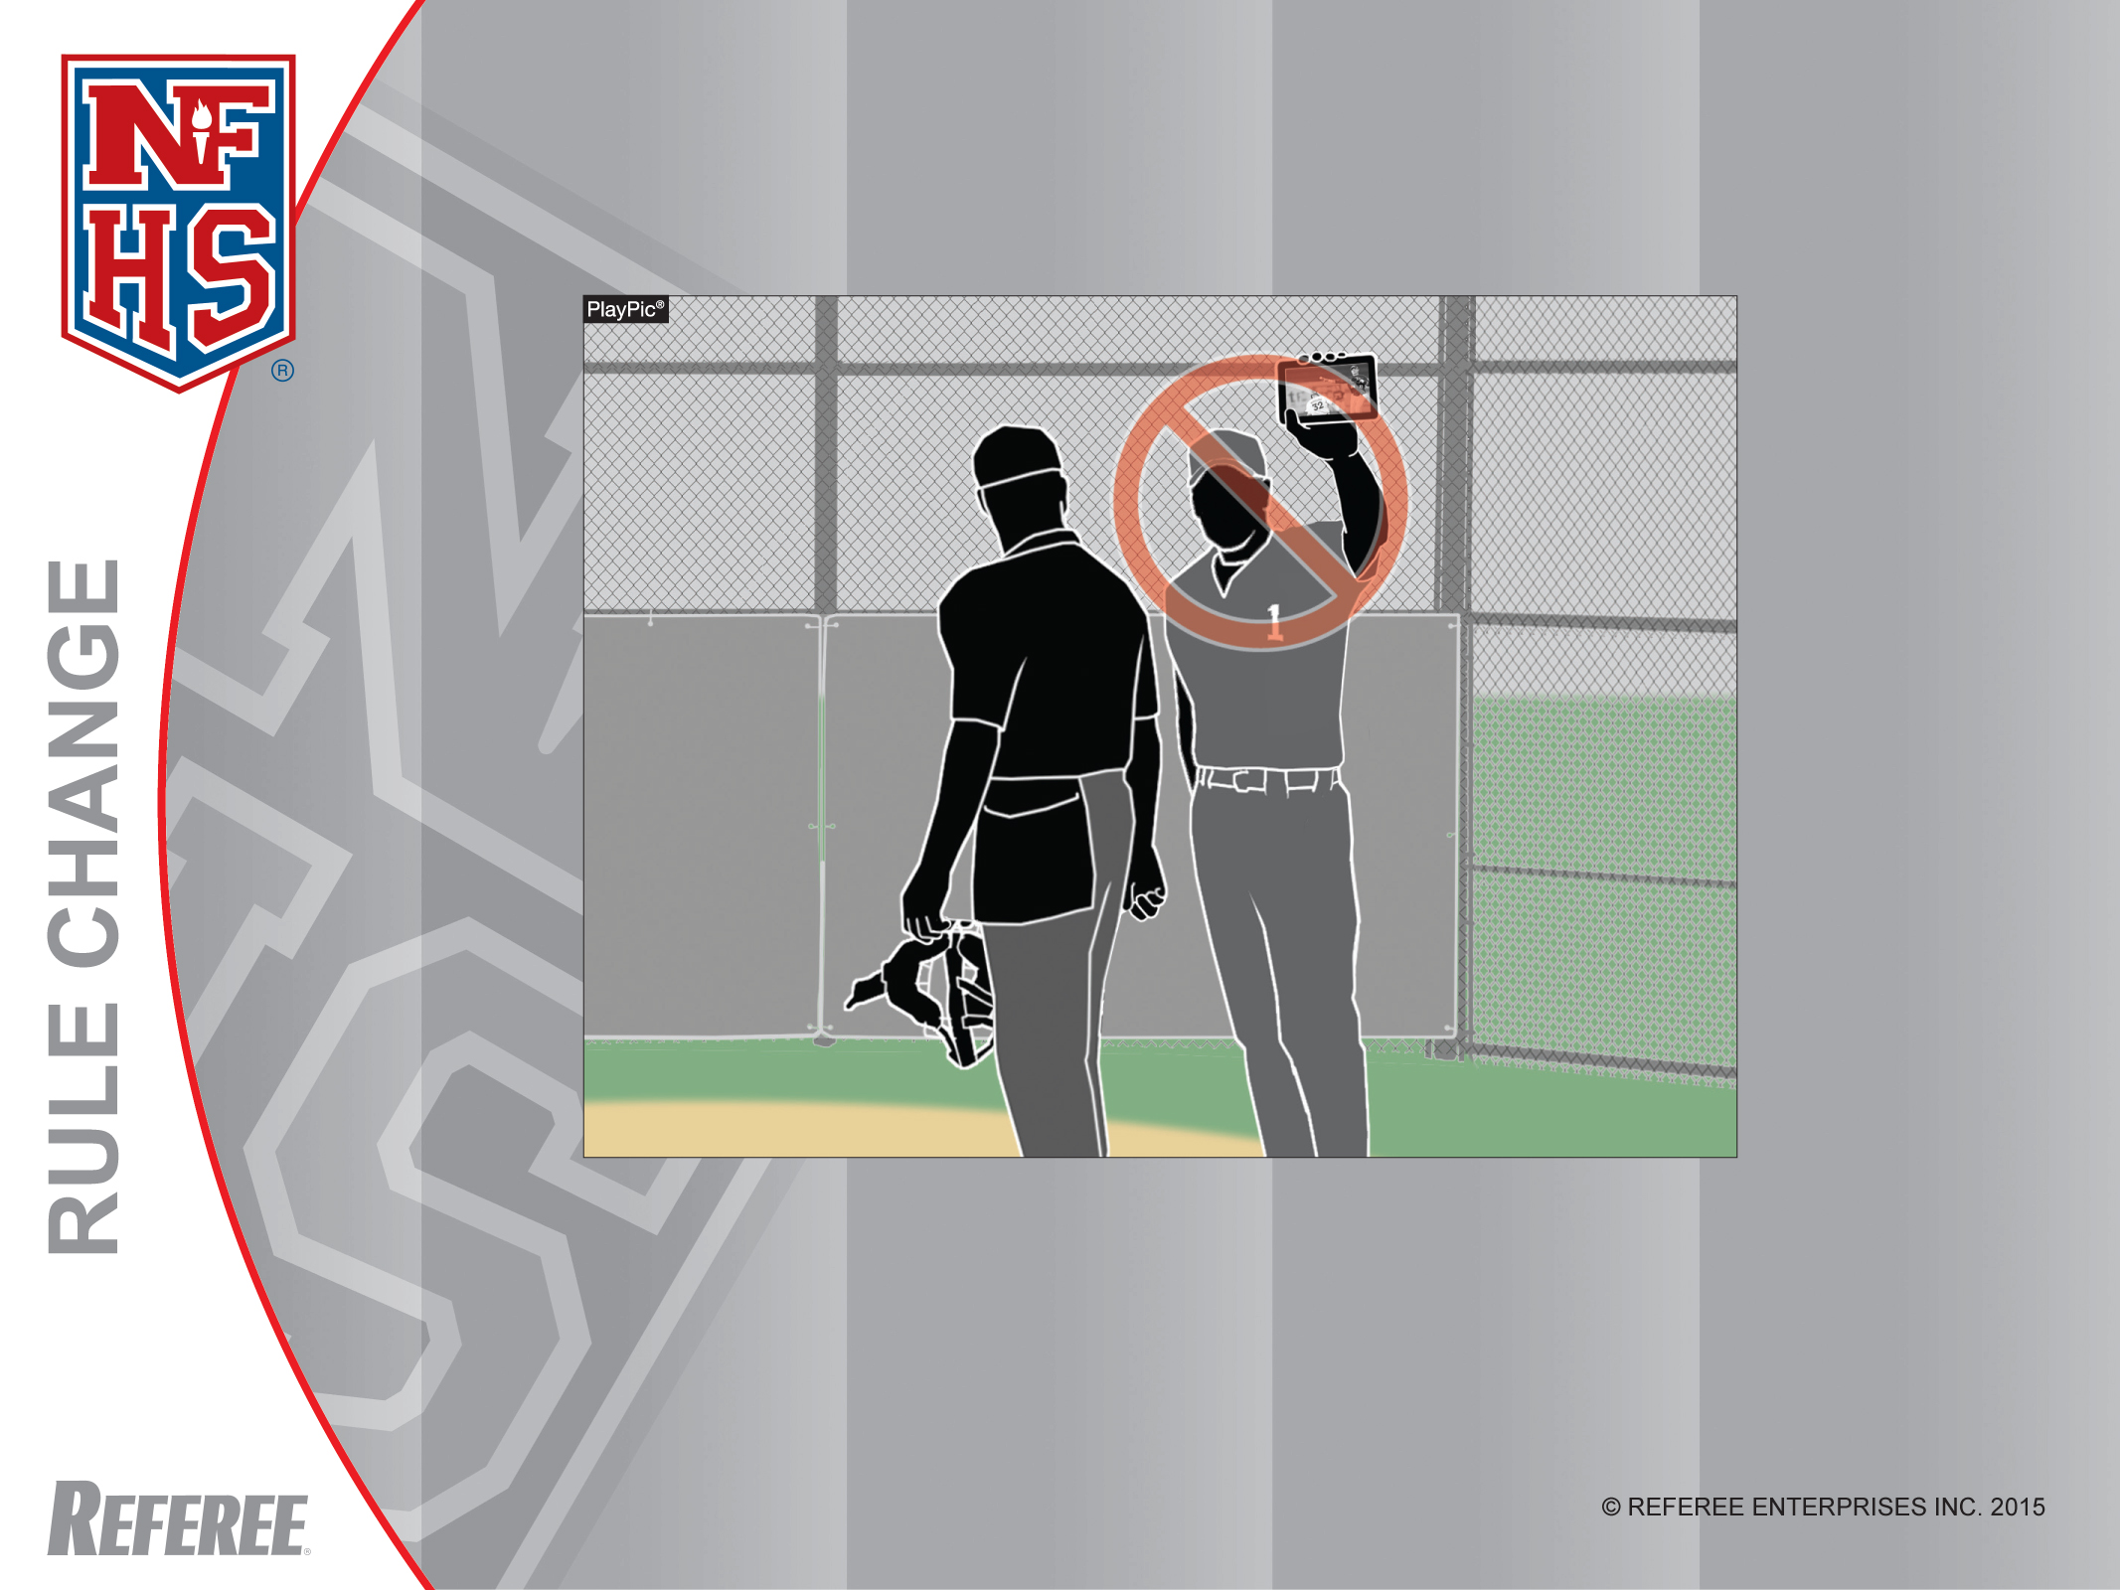
Video Equipment
Rule 3-3-1, 10-1-5
A coach is not permitted to show a play to umpires, as umpires are not allowed to use video equipment during a game. If a coach persists, he can be warned, restricted to the dugout or ejected.

Slide 14
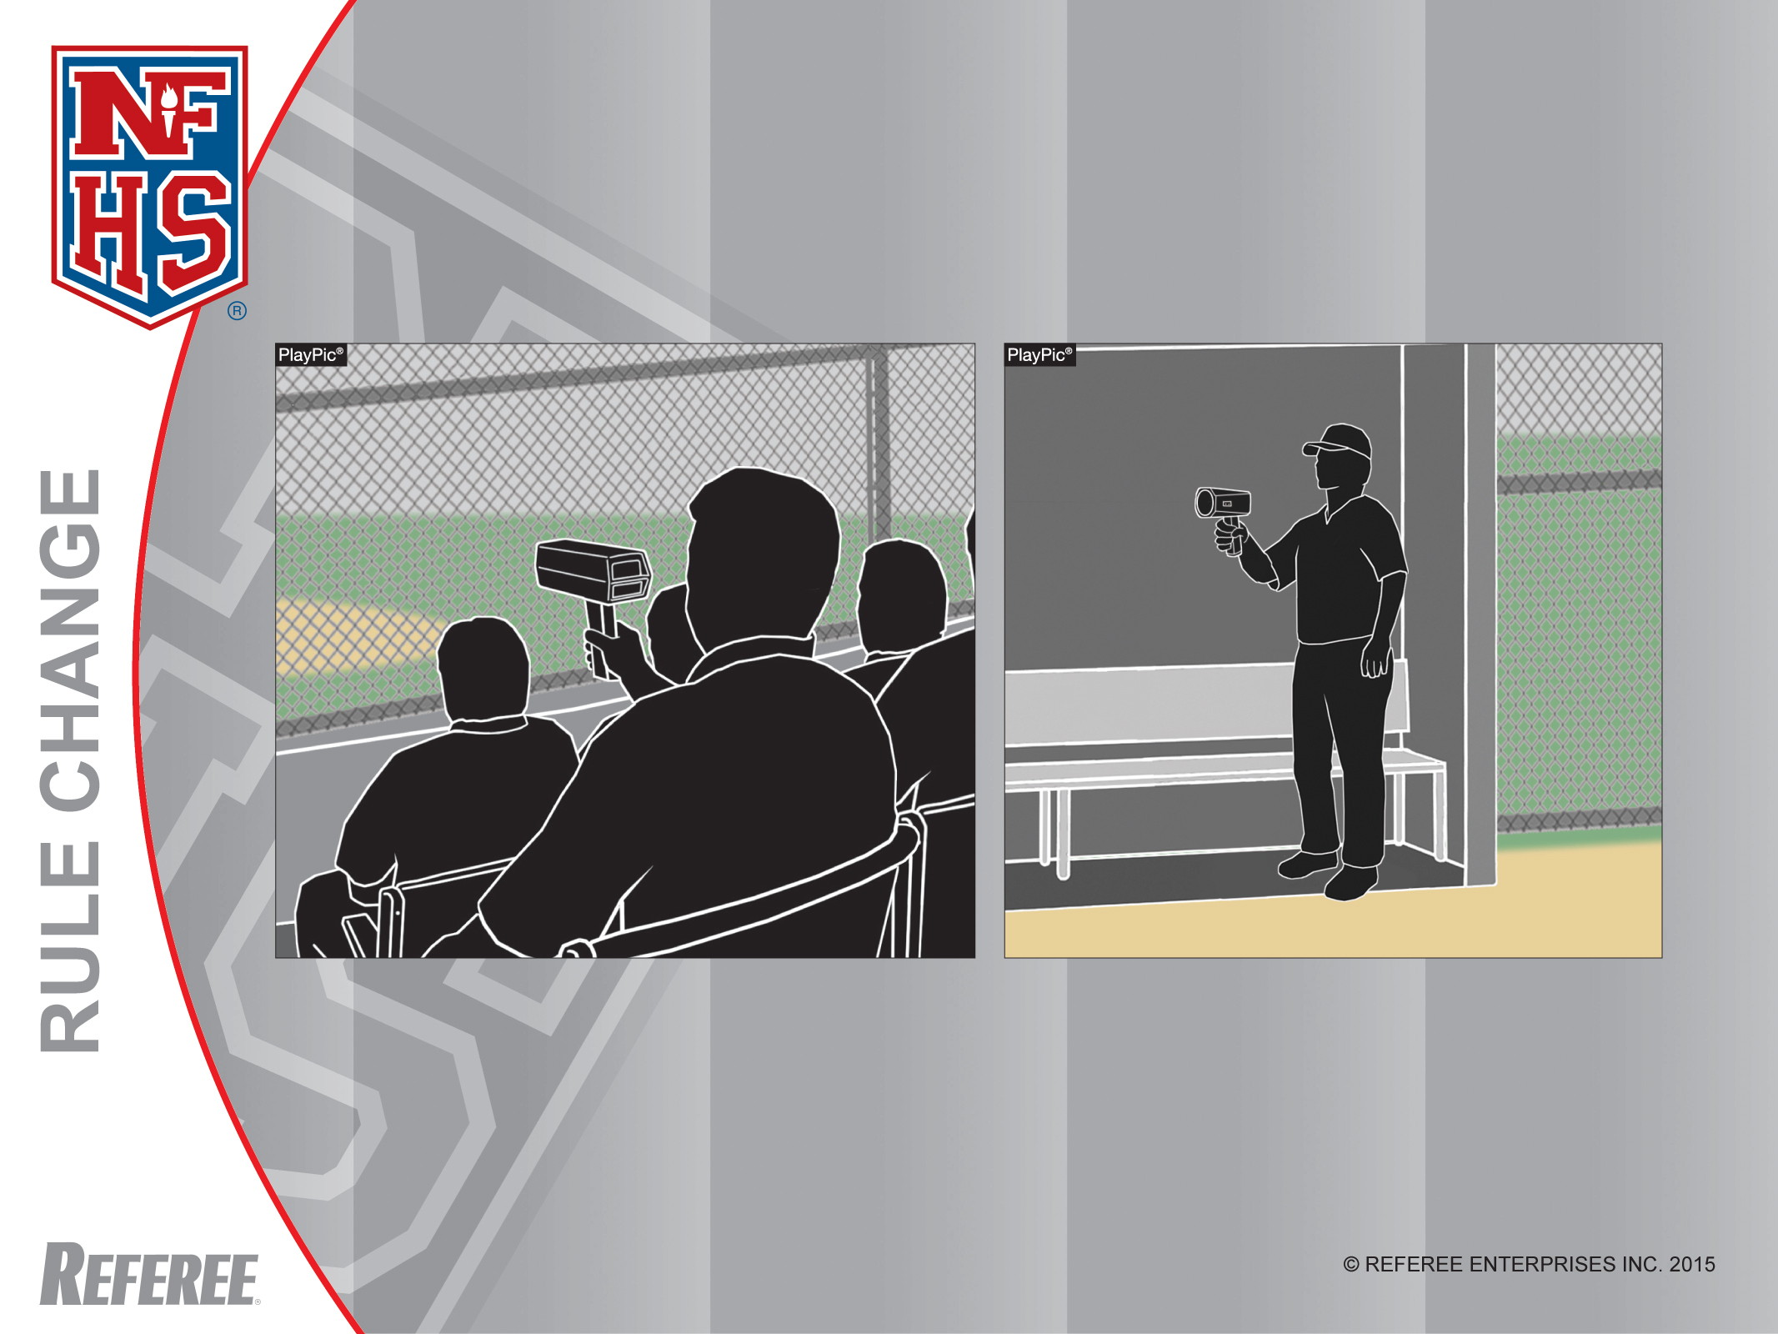
Radar Guns
Rule 3-3-1
The use of radar guns is permitted.

Slide 15
Rule 3-3-1f
ART. 1. . . Sub-articles a-e are unchanged.
f. Use of television monitoring or replay equipment for coaching purposes during the course of the game;
The rest of the sub-articles will be renumbered.
Rationale: The game of baseball has developed and technology is more affordable and available. Videotaping a game or players’ performances adds to the evolution of the game and enhances the educational ability for a coach to provide real-time instruction.

Slide 16
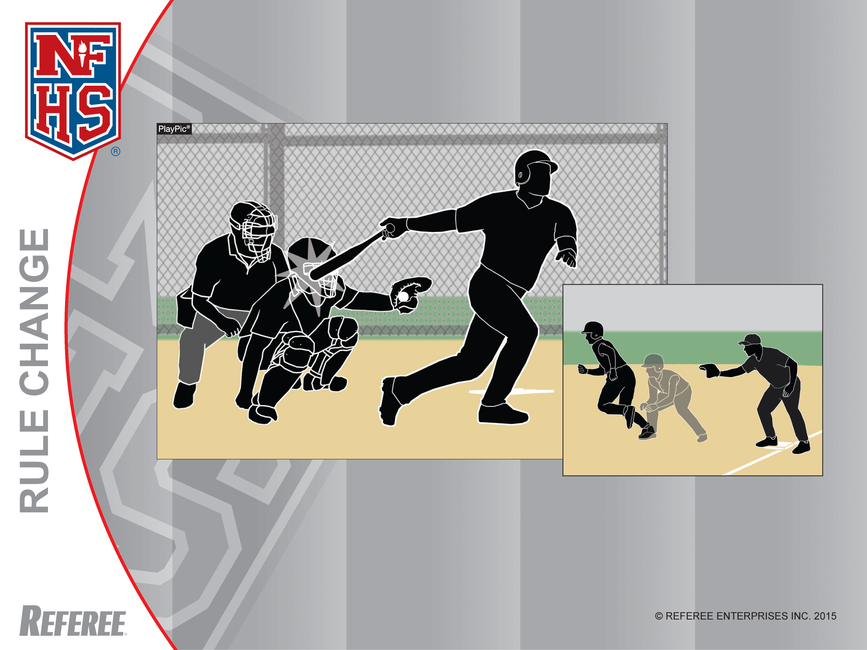
Follow-through Interference
Rule 2-21-4
On his natural follow-through, the batter has made contact with the catcher. The ball is delayed-dead on follow-through interference and if F2 isn’t able to throw out the runner attempting to steal, the runner must be returned to first base and the batter is out.

Slide 17
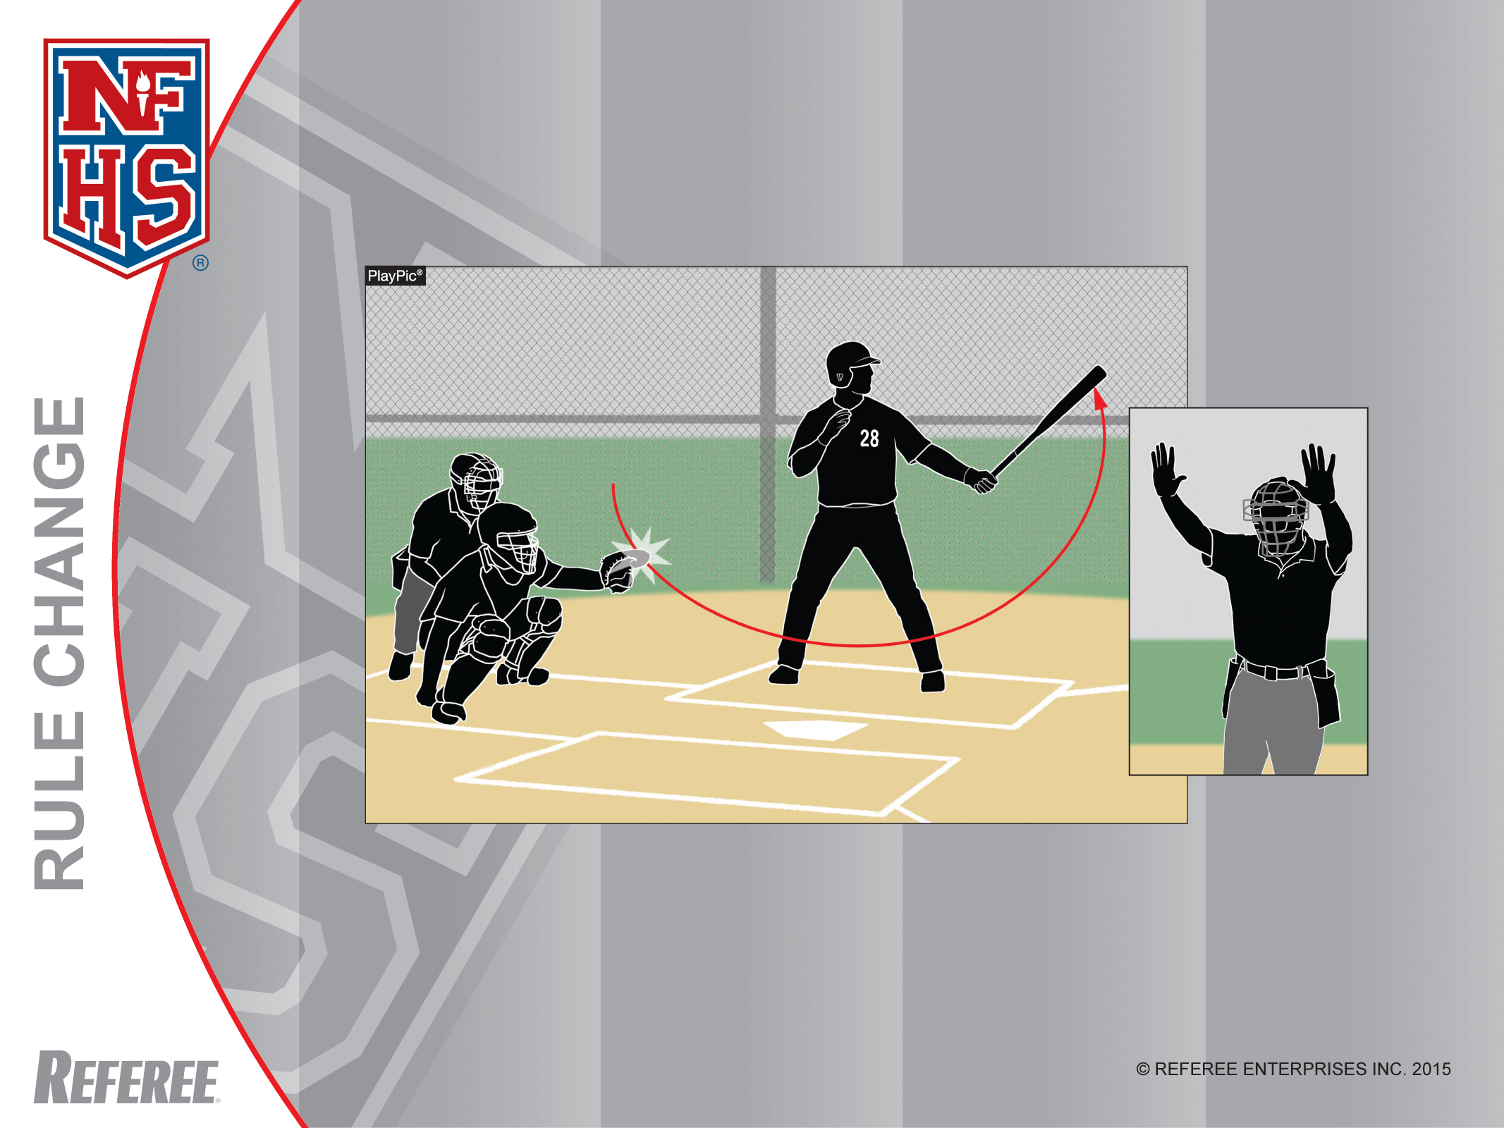
Backswing Interference
Rule 2-21-5
Before the time of the pitch, if the batter’s practice swing makes contact with the catcher or his equipment, the umpire shall call an immediate dead ball. There is no penalty.

Slide 18
Rule 2-21-4 and 5
ART. 4 . . . Follow-through interference is when the bat hits the catcher after the batter has swung at a pitch and hinders action at home plate or the catcher’s attempt to play on a runner.
ART. 5 . . . Backswing interference is when a batter contacts the catcher or his equipment prior to the time of the pitch.

Slide 19
Rule 2-21-4 and 5
(continued)
Rationale: Identifying the various types of offensive interference is pivotal when discussing the role of the batter in that manner. Follow-through and backswing interference are two separate and distinct acts and the penalties reflect their differences.

Slide 20
Rule 7-3-5c
c. making any other movement, including follow-through interference, which hinders actions at home plate or the catcher’s attempt to play on a runner or…
Rationale: After reviewing this rule change from last year, it became evident that the term “backswing” did not accurately capture the infraction, the term “follow-through” was more descriptive.

Slide 21
Rule 7-3-7 and Corresponding Penalty
ART. 7 . . . Commit backswing interference.
PENALTY: The ball is immediately dead.
Rationale: Clarification.

Slide 22
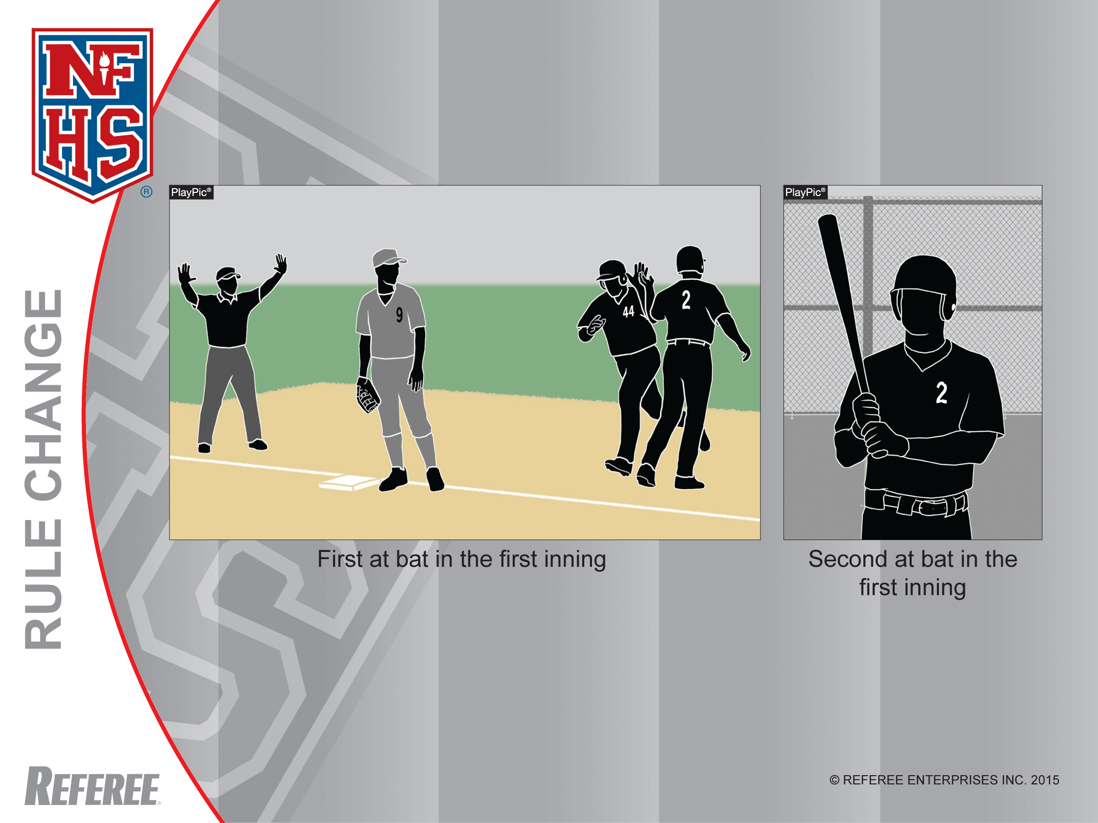
Optional Speed-Up Rules
Courtesy Runner
No. 44 is the courtesy runner for the catcher, No. 2. If his team bats around in an inning, No. 2 has not been substituted for and may bat when it is his turn.

Slide 23
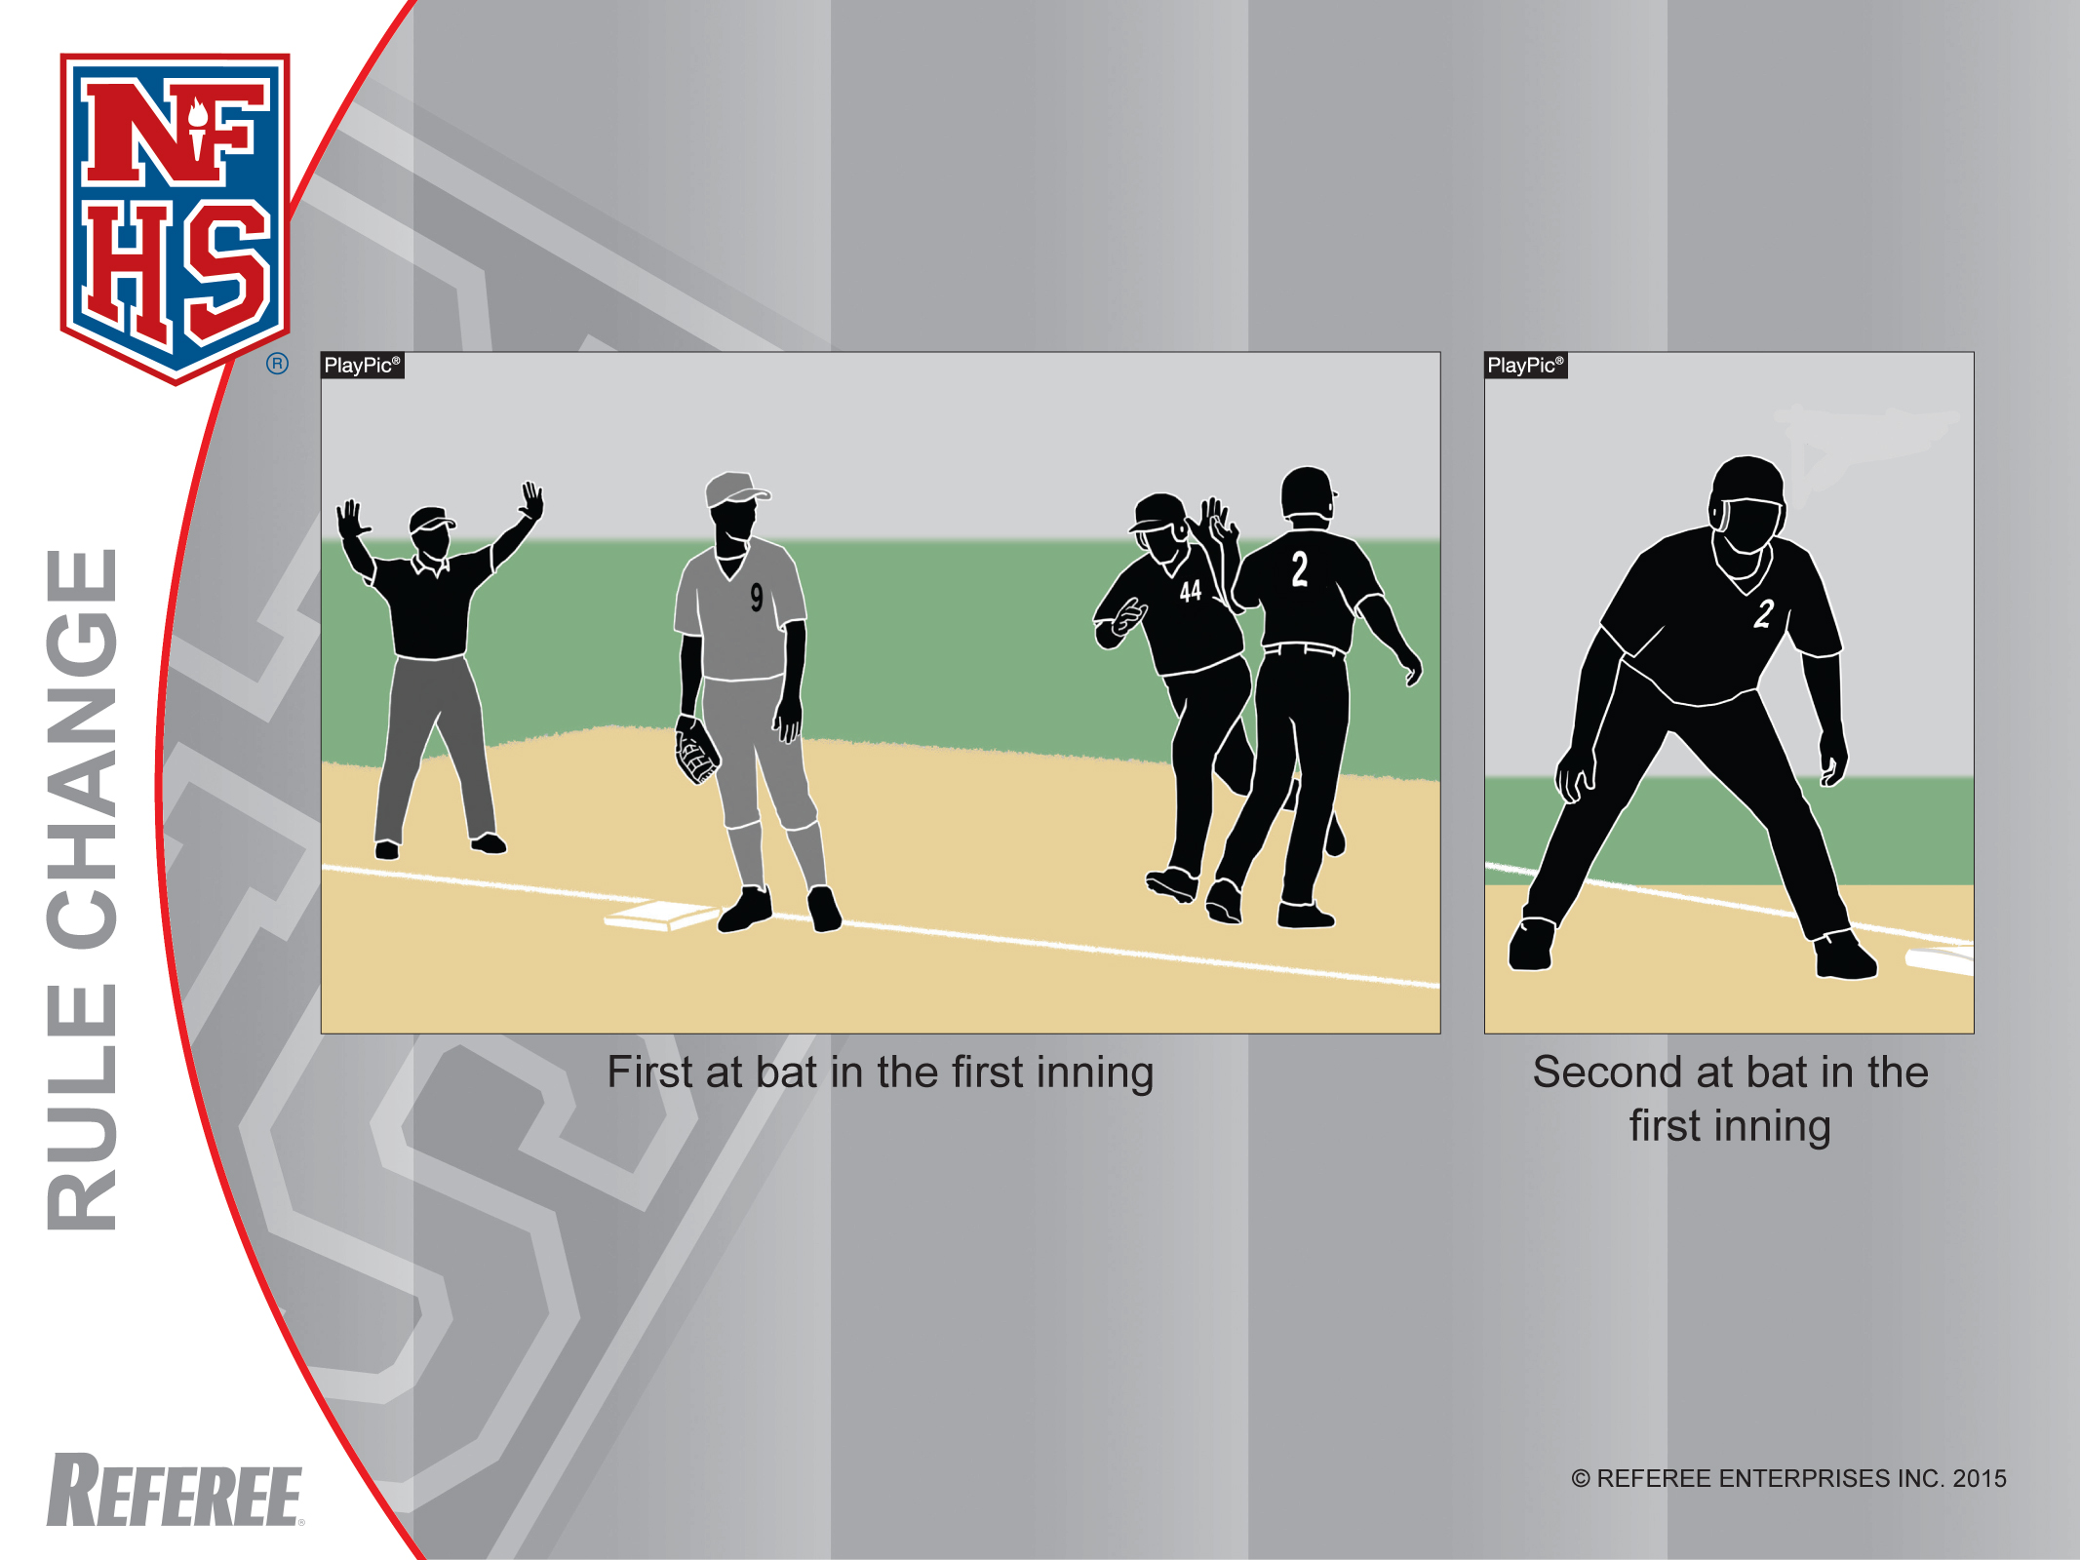
Optional Speed-Up Rules
Courtesy Runner
If the offense bats around and No. 2 reaches base a second time in the inning, he may run for himself and is not required to be replaced by a courtesy runner.

Slide 24
Courtesy Runner
1. At any time, the team at bat may use courtesy runners for the pitcher and/or the catcher. In the event that the offensive team bats around, the pitcher and/or catcher who had a courtesy runner inserted on their behalf may bat in their normal position in the batting order.
Rationale: Clarification when a particular scenario occurs and how that affects the role of courtesy runner for the pitcher and catcher.

Slide 25
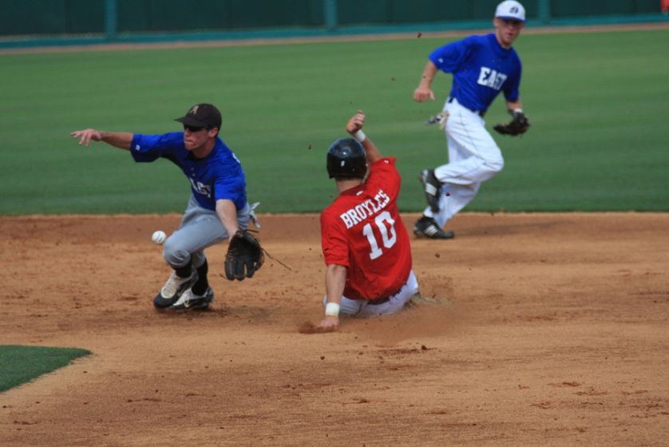
Points of Emphasis

Slide 26
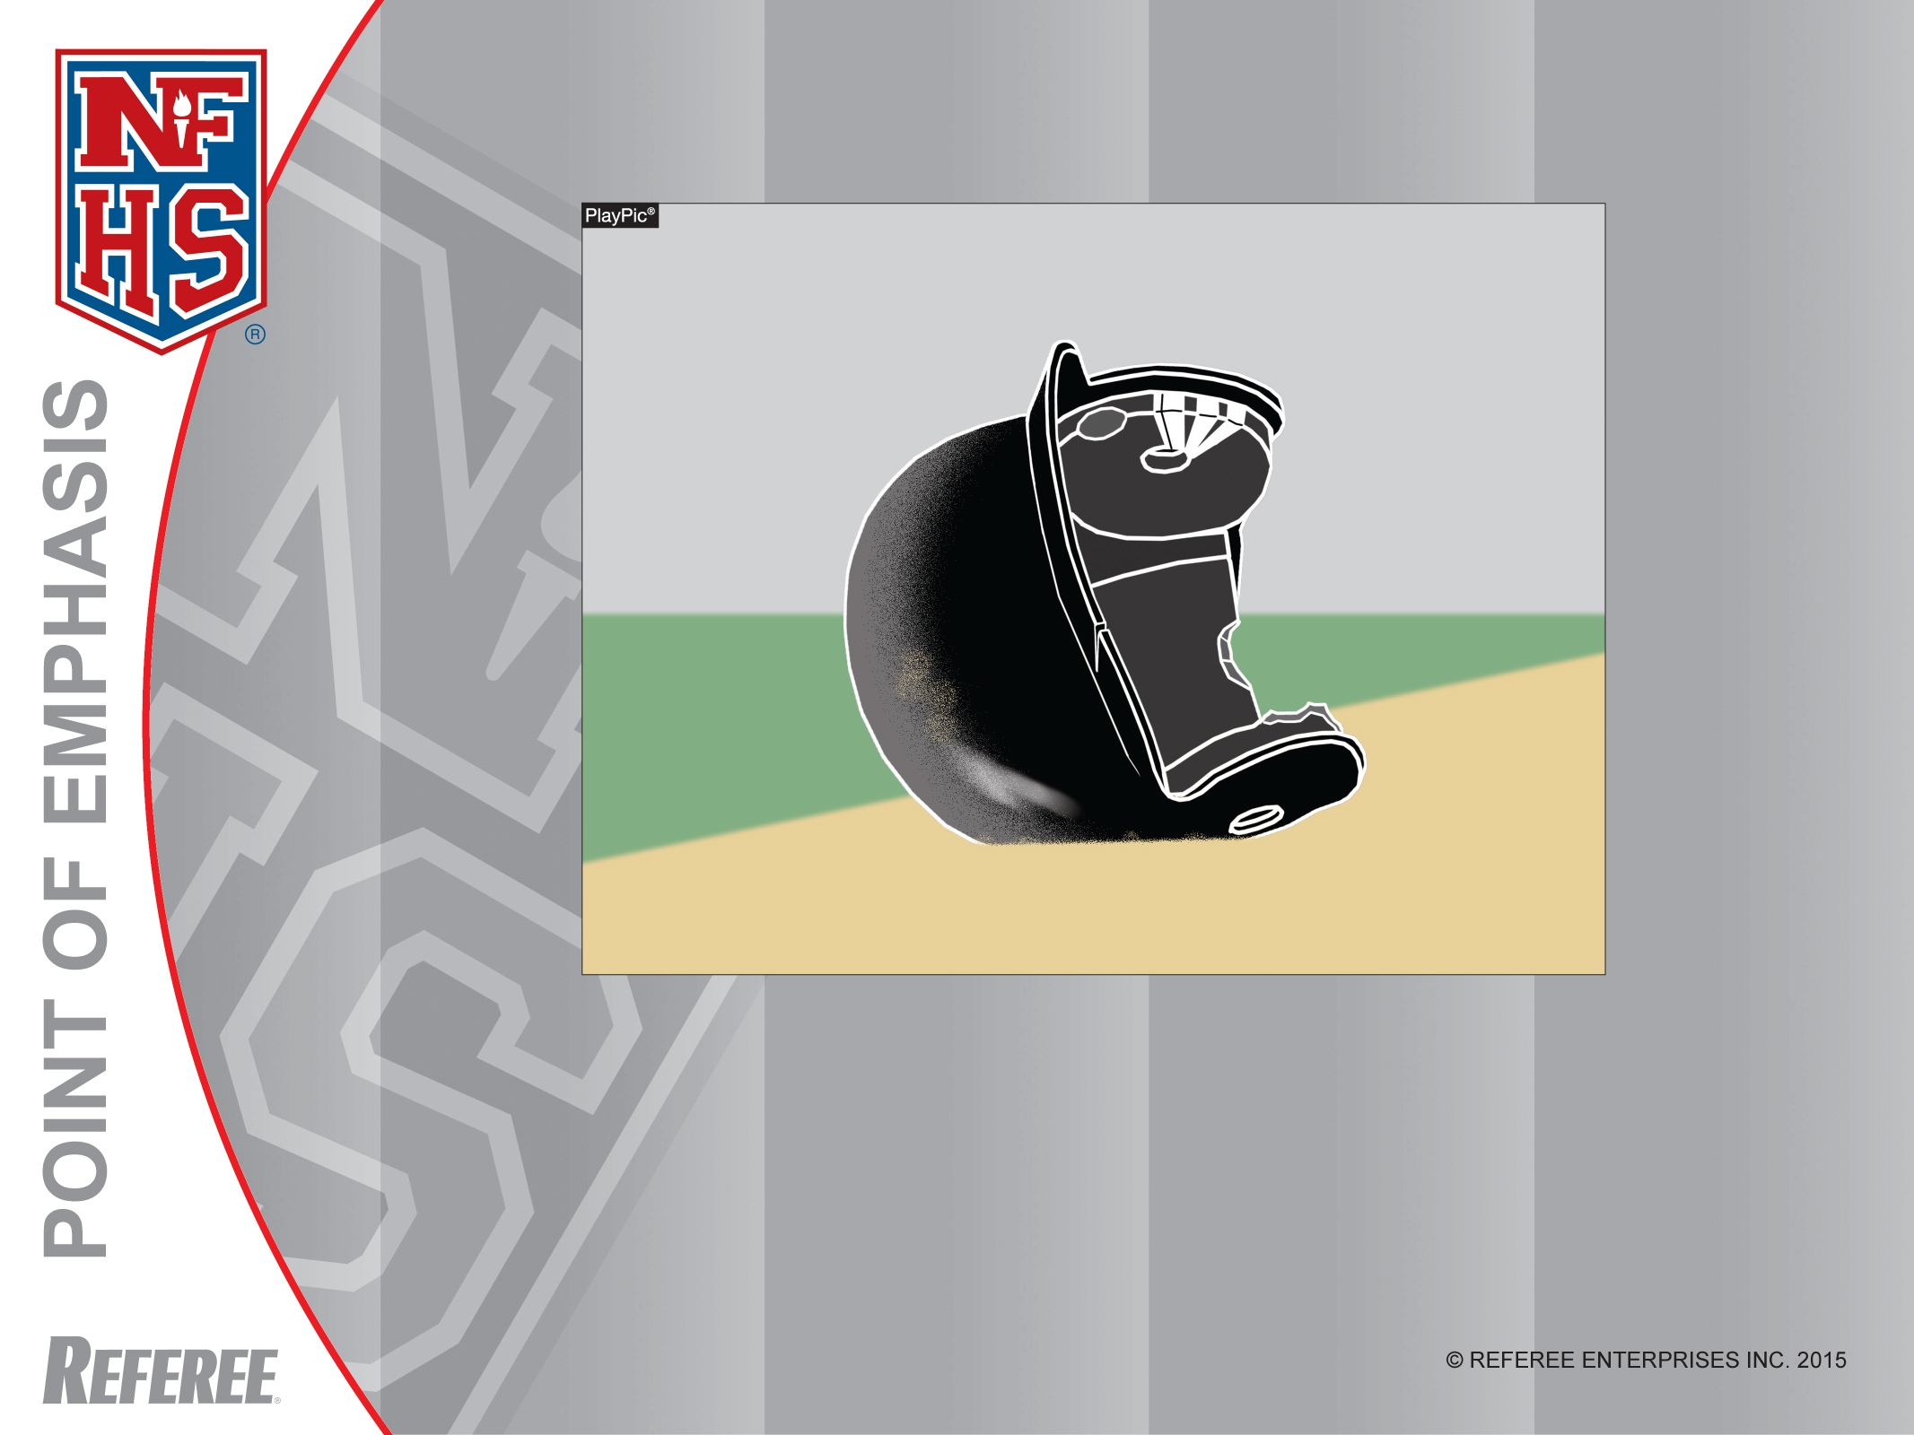
Helmet Care
Coaches need to ensure helmets (and all equipment) are in suitable condition for use, particularly when reviewing equipment prior to the start of a season. While this helmet met NOCSAE standards at the time of manufacture, it is no longer suitable for use.

Slide 27
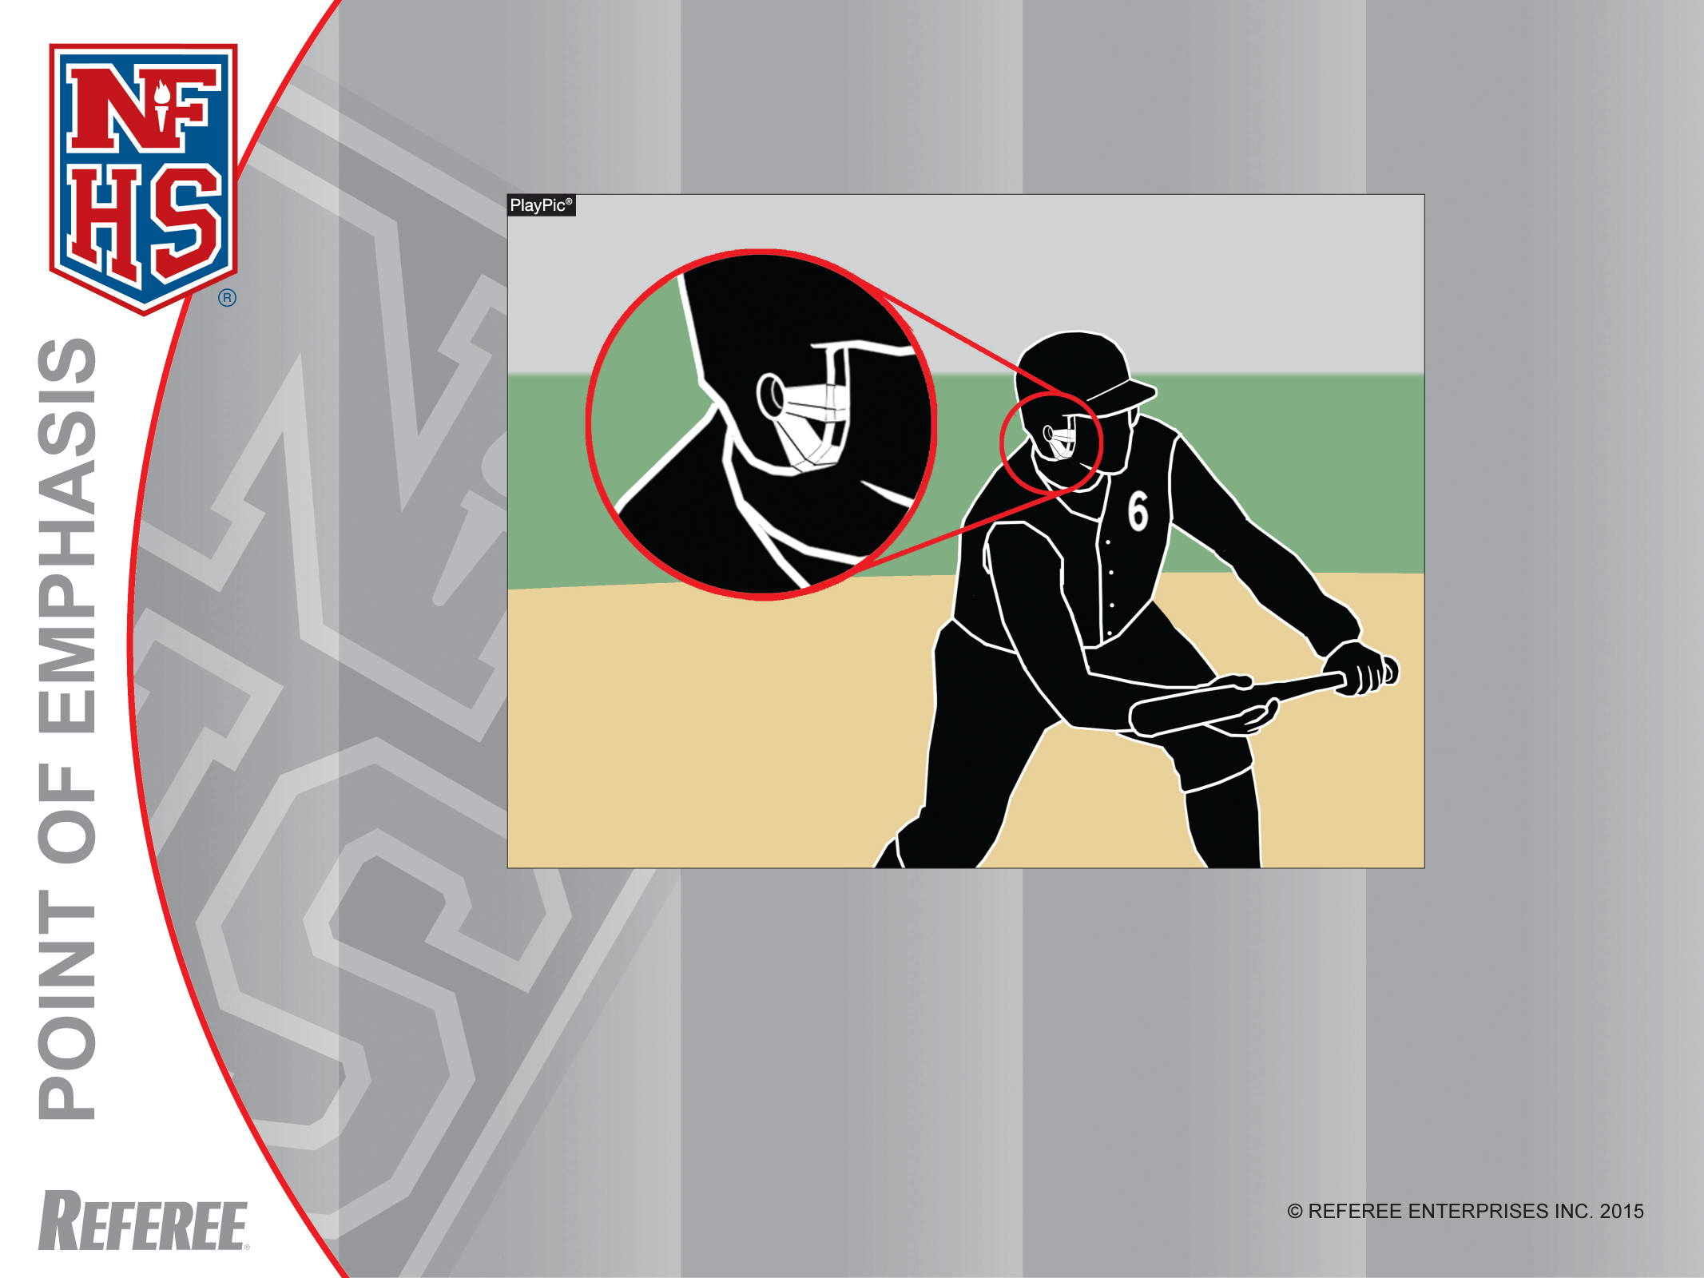
Helmet Care
Tape is not permitted on a batting helmet, since it could be covering up a crack or defect. Also, it could compromise the ability of the helmet to protect a player.

Slide 28
Helmet Maintenance and Usage
Reviewing the number of players (and some coaches) who are wearing batting helmets, it becomes clear that a lot of individuals are invested in protecting their head and brain by wearing a batting helmet that meets the NOCSAE performance standard.
There should be a routine scheduled review and assessment of the condition of the batting helmets established by coaches and school administrators.

Slide 29
Helmet Maintenance and Usage
(continued)
They should also be maintained in a manner that your team can enjoy several seasons of functional use.
Batting helmet manufacturers normally provide a routine maintenance schedule either with the product or on their company’s website.

Slide 30
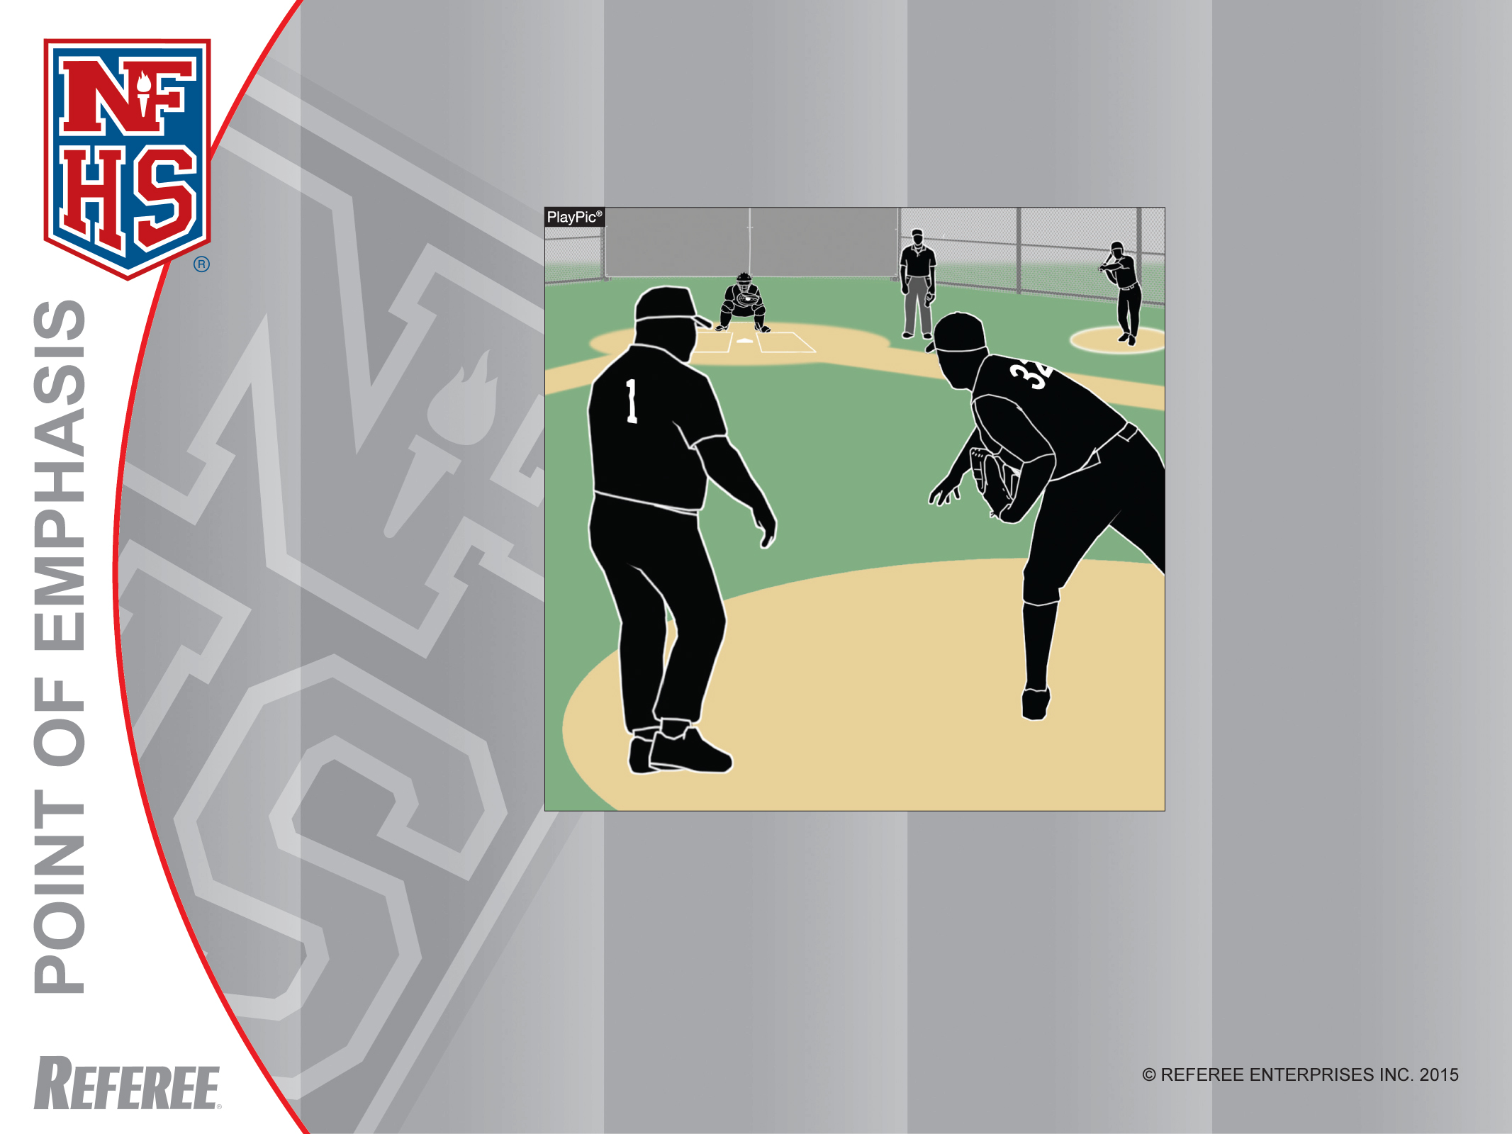
Pitching Substitution:
Coach Delaying the Game
A replacement pitcher gets eight warm-up throws. The defensive team shall be ready to resume play upon completion of the eighth throw. A coach is permitted to observe the throws, but must be off the field when they are completed.

Slide 31
Pitching Substitutions:
Coach Delaying the Game
Pitching is critical in our game and substituting the pitcher is a key personnel strategy.
By rule, there are some specific time guidelines provided for the execution of substituting the game pitcher.
It is becoming more noticeable that the defensive coach is extending his time around the mound while the substitute pitcher completes his warm-up pitches.

Slide 32
Pitching Substitutions:
Coach Delaying the Game
(continued)
This delay of the game by lingering around the mound has become problematic.
While it provides the coach an opportunity to speak to the rest of the defensive team, it is also lengthening and delaying the game.

Slide 33
Pitching Substitutions:
Coach Delaying the Game
(continued)
The coach should make his substitution known to the umpire-in-chief, scorekeeper, relieve the game pitcher, instruct his defensive players quickly and leave the diamond area heading back to the dugout/bench area.
For the sake of continuity, It is a better game when it is fluid and with minimal interruptions.

Slide 34
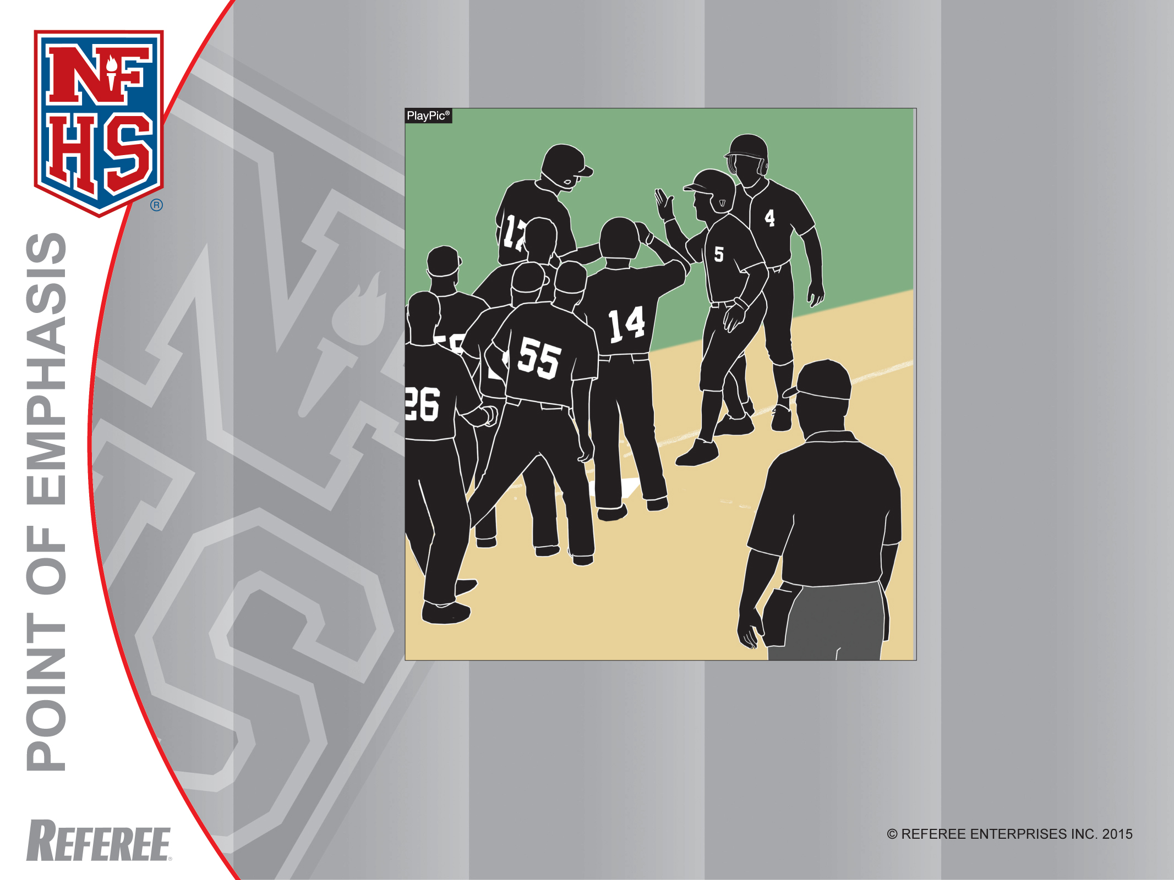
Celebrations
During a home-run celebration, team members must remain clear of the plate, allowing the umpire to ensure all runners legally touch.

Slide 35
Sportsmanship – Celebrations around or near Home Plate
Any walk-off game winning base hit or home run generates immediate excitement for the player who hit the ball, his teammates and fans.
Everyone on the winning team wants to congratulate the successful runner as he turns the corner at third base and heads to home plate.
The problem is that the umpire-in-chief has to be able to verify that the runner scores.

Slide 36
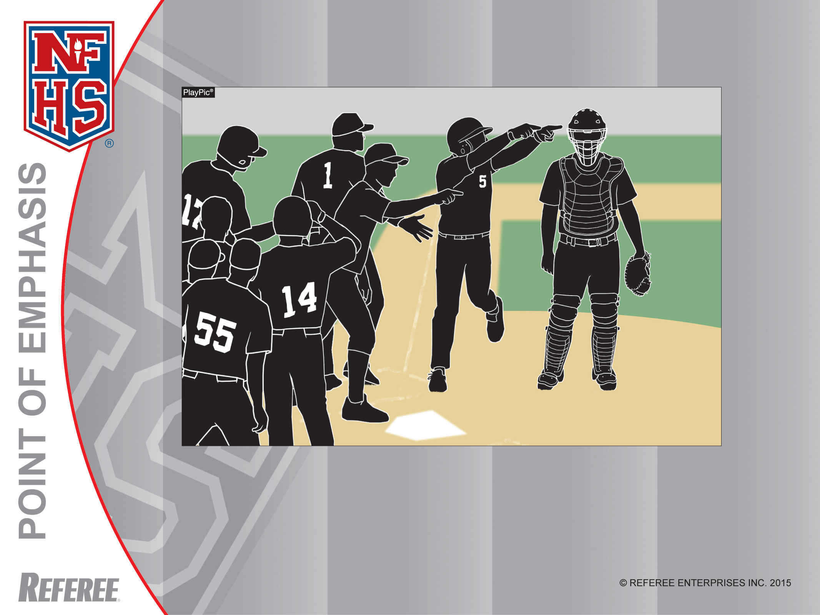
Celebrations
A team is permitted to be outside the dugout and celebrate during a dead-ball, such as after a home run. However, Rule 3-3-1f (4) does not permit unsporting behavior and can result in the ejection of players who taunt.

Slide 37
Sportsmanship – Celebrations around or near Home Plate
(continued)
It is important to keep that area around home plate clear of bodies (and equipment) so the umpire can do his job correctly.
In addition, hovering around the third base line and home plate is a perfect opportunity for bad sportsmanship actions with taunting and other boorish behavior.
Celebrations should be more diligently observed because of the number of poor sportsmanship incidents being reported throughout the country.

Slide 38
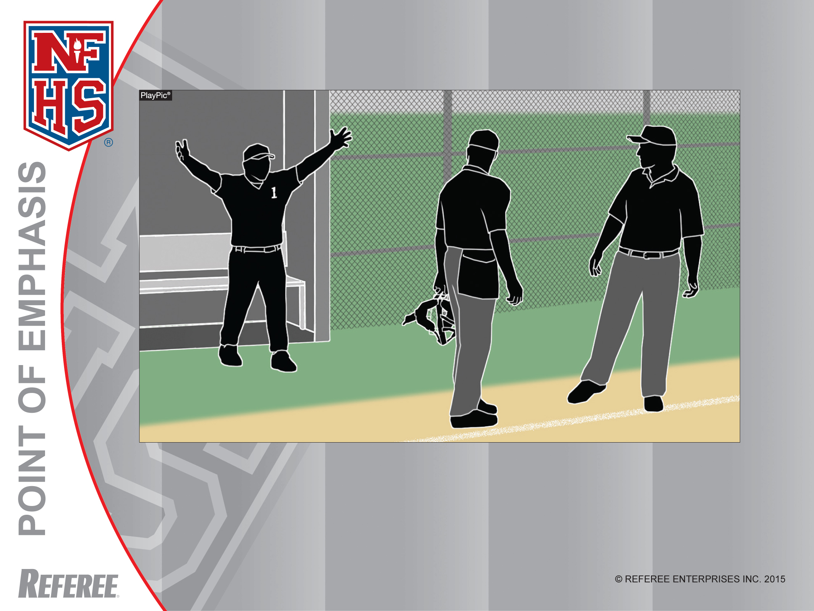
Postgame Conduct
Umpires retain jurisdiction and can eject players or coaches until all umpires have left the field. Even though the game is over, this coach is subject to being ejected.

Slide 39
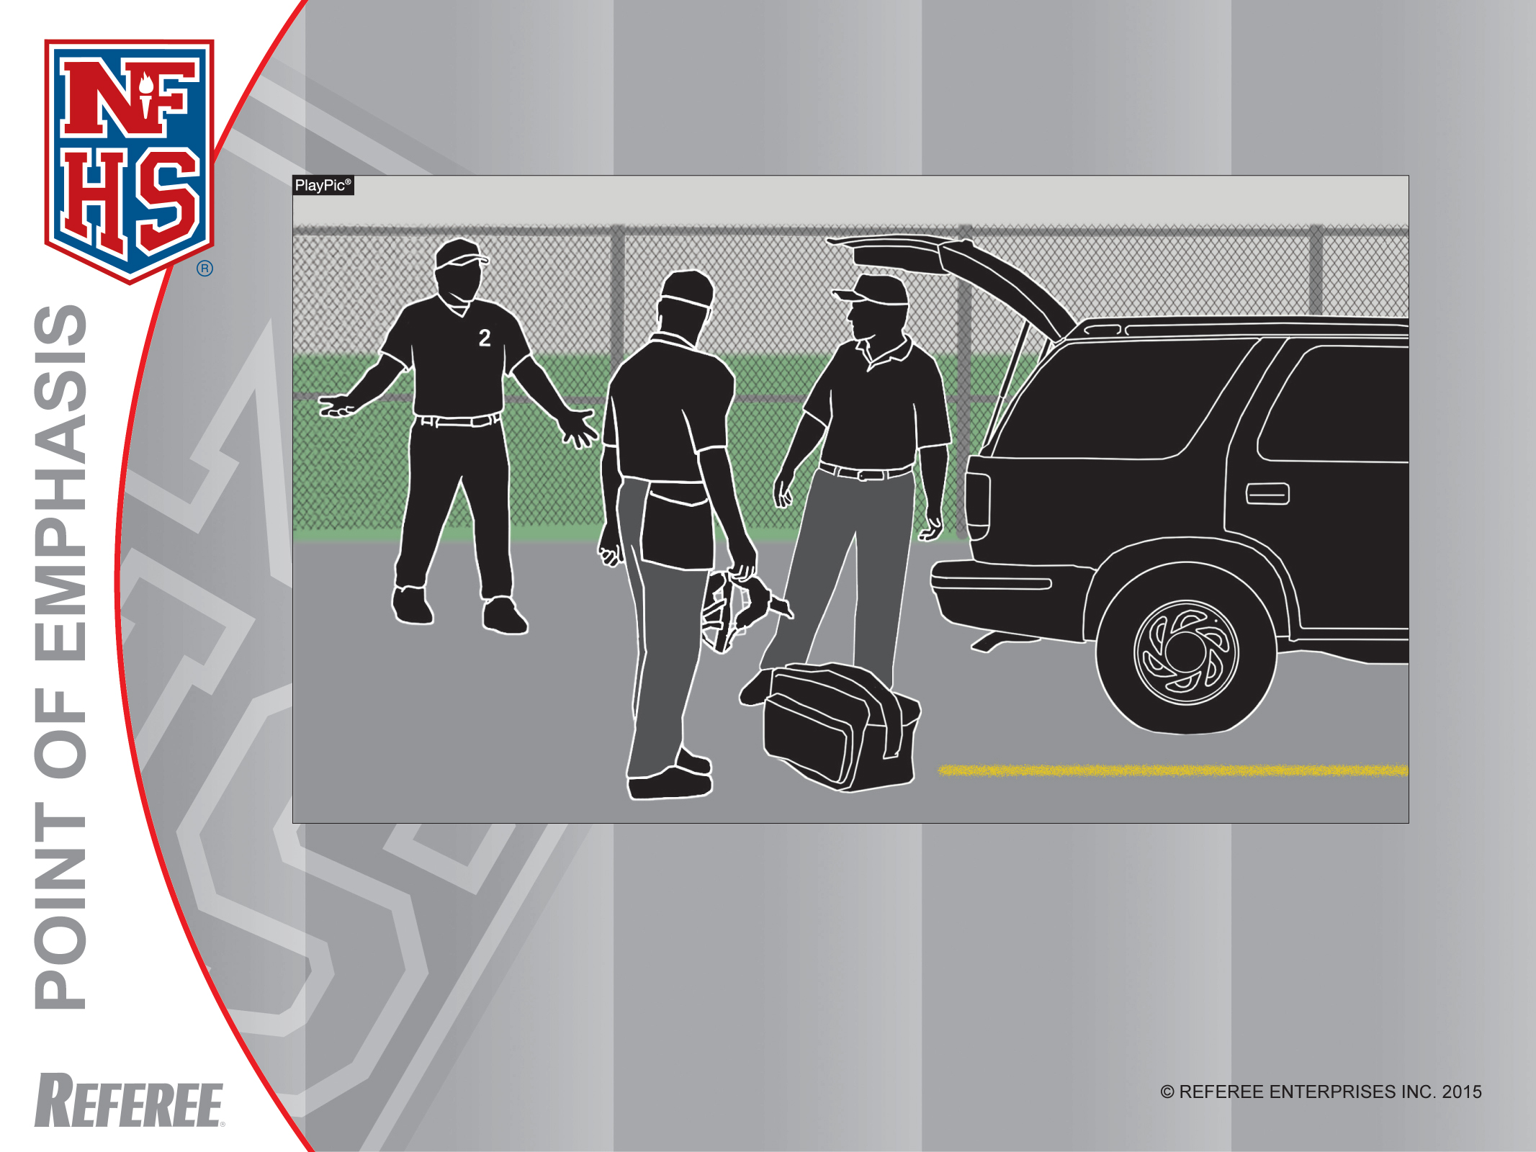
Postgame Conduct
Since the umpires have left the field, umpires cannot issue a post-game ejection. However, if confronted by a coach, player or fan, umpires are expected to report the conduct to their state association office.

Slide 40
Postgame Conduct
An occurrence that is becoming all too common is that the game has concluded and the losing team members, coaches or fans wait for the umpiring crew to leave the confines of the field and then verbally attack the umpires.

Slide 41
Postgame Conduct
(continued)
By rule, the umpires have the latitude through their local state association’s intervention to make a post-game report and forward it to the state association describing the type of bad behavior and based on the severity of the infraction, the umpires’ jurisdiction can be extended after the game has ended.
Please discuss this with your local state association for their guidance and procedure.

Slide 42
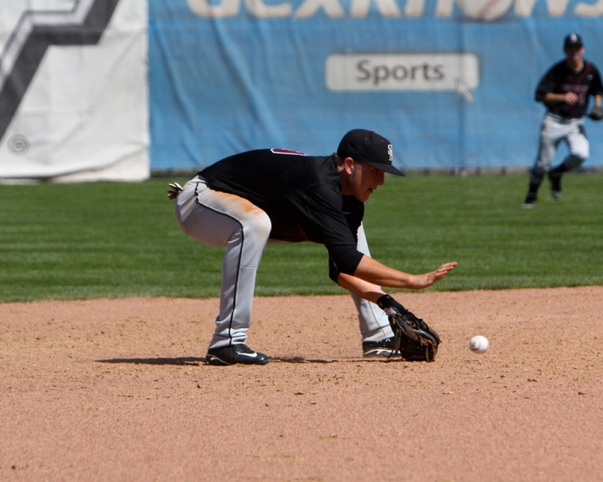
Editorial Changes

Slide 43
3-3-1PEN
Deleted the accompanying penalty for use of television monitoring or replay equipment.
Rationale: Clarification.

Slide 44
Rule 5-5-1n
Added n. Backswing interference occurs.
Rationale: Consistent with the aforementioned definitions of follow-through and backswing interference.

Slide 45
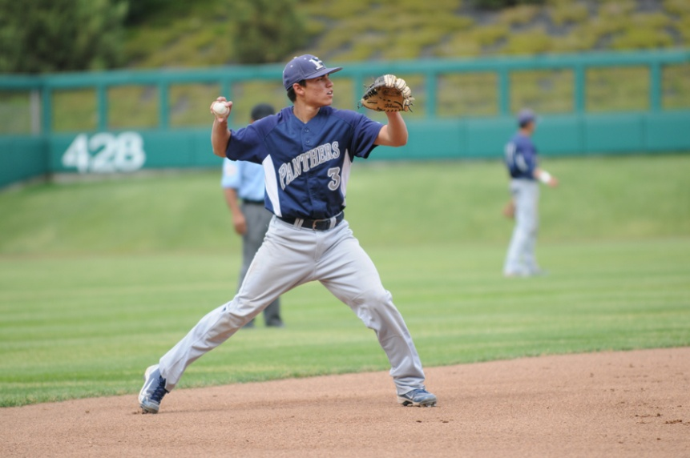
Pitcher’s Arm Care Suggestions
Notes:
The NFHS has again been asked by our member state associations to consult with experts in the medical area with suggestions of protecting high school pitchers’ arms. We have identified some of the best in the field of orthopedic and biomechanic medicine. Beginning with input from the NFHS Sports Medicine Advisory Committee and with world renown Dr. James Andrews of Andrews Sports Medicine Institute (ASMI). The following slides represent baseline recommendations for proper caring of a pitcher’s arm. We suggest that coaches and parents consult local orthopedic professionals for additional information and best practices.

Slide 46
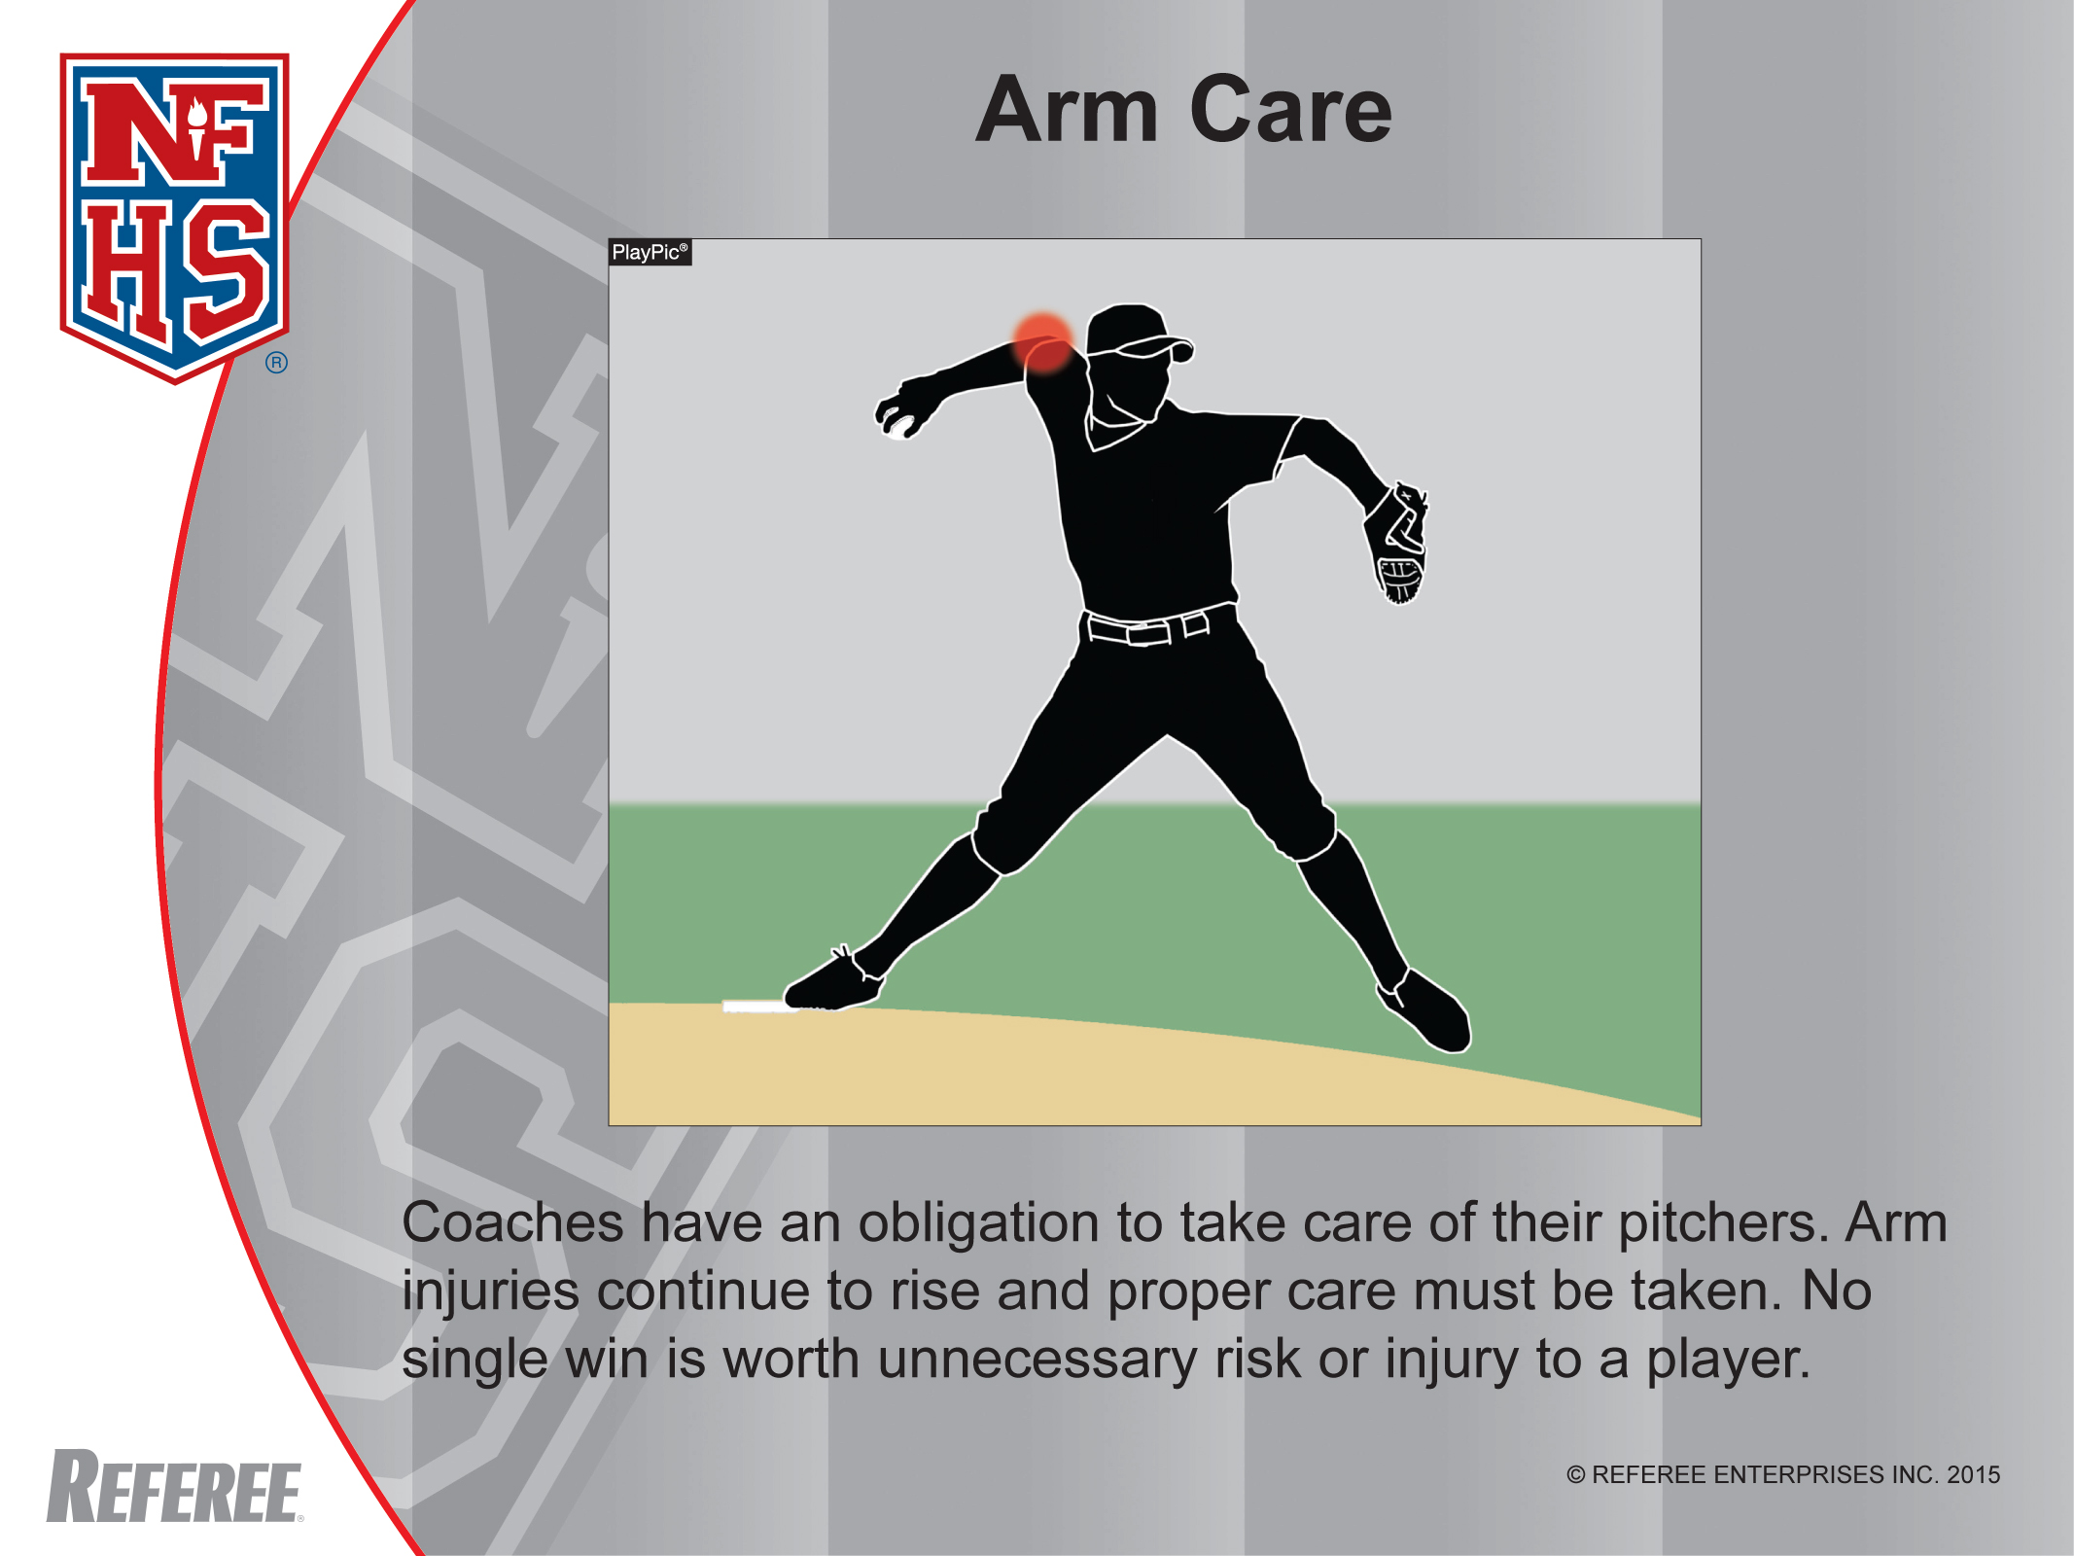

Slide 47
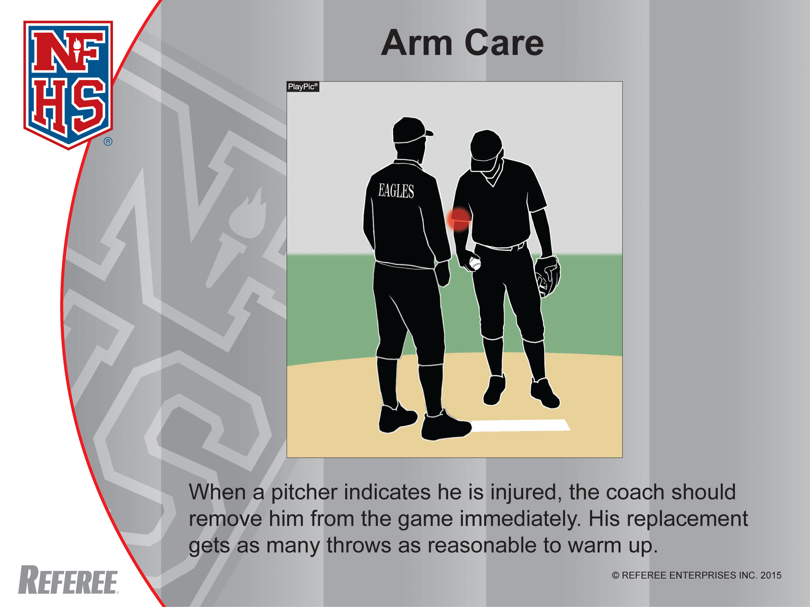

Slide 48
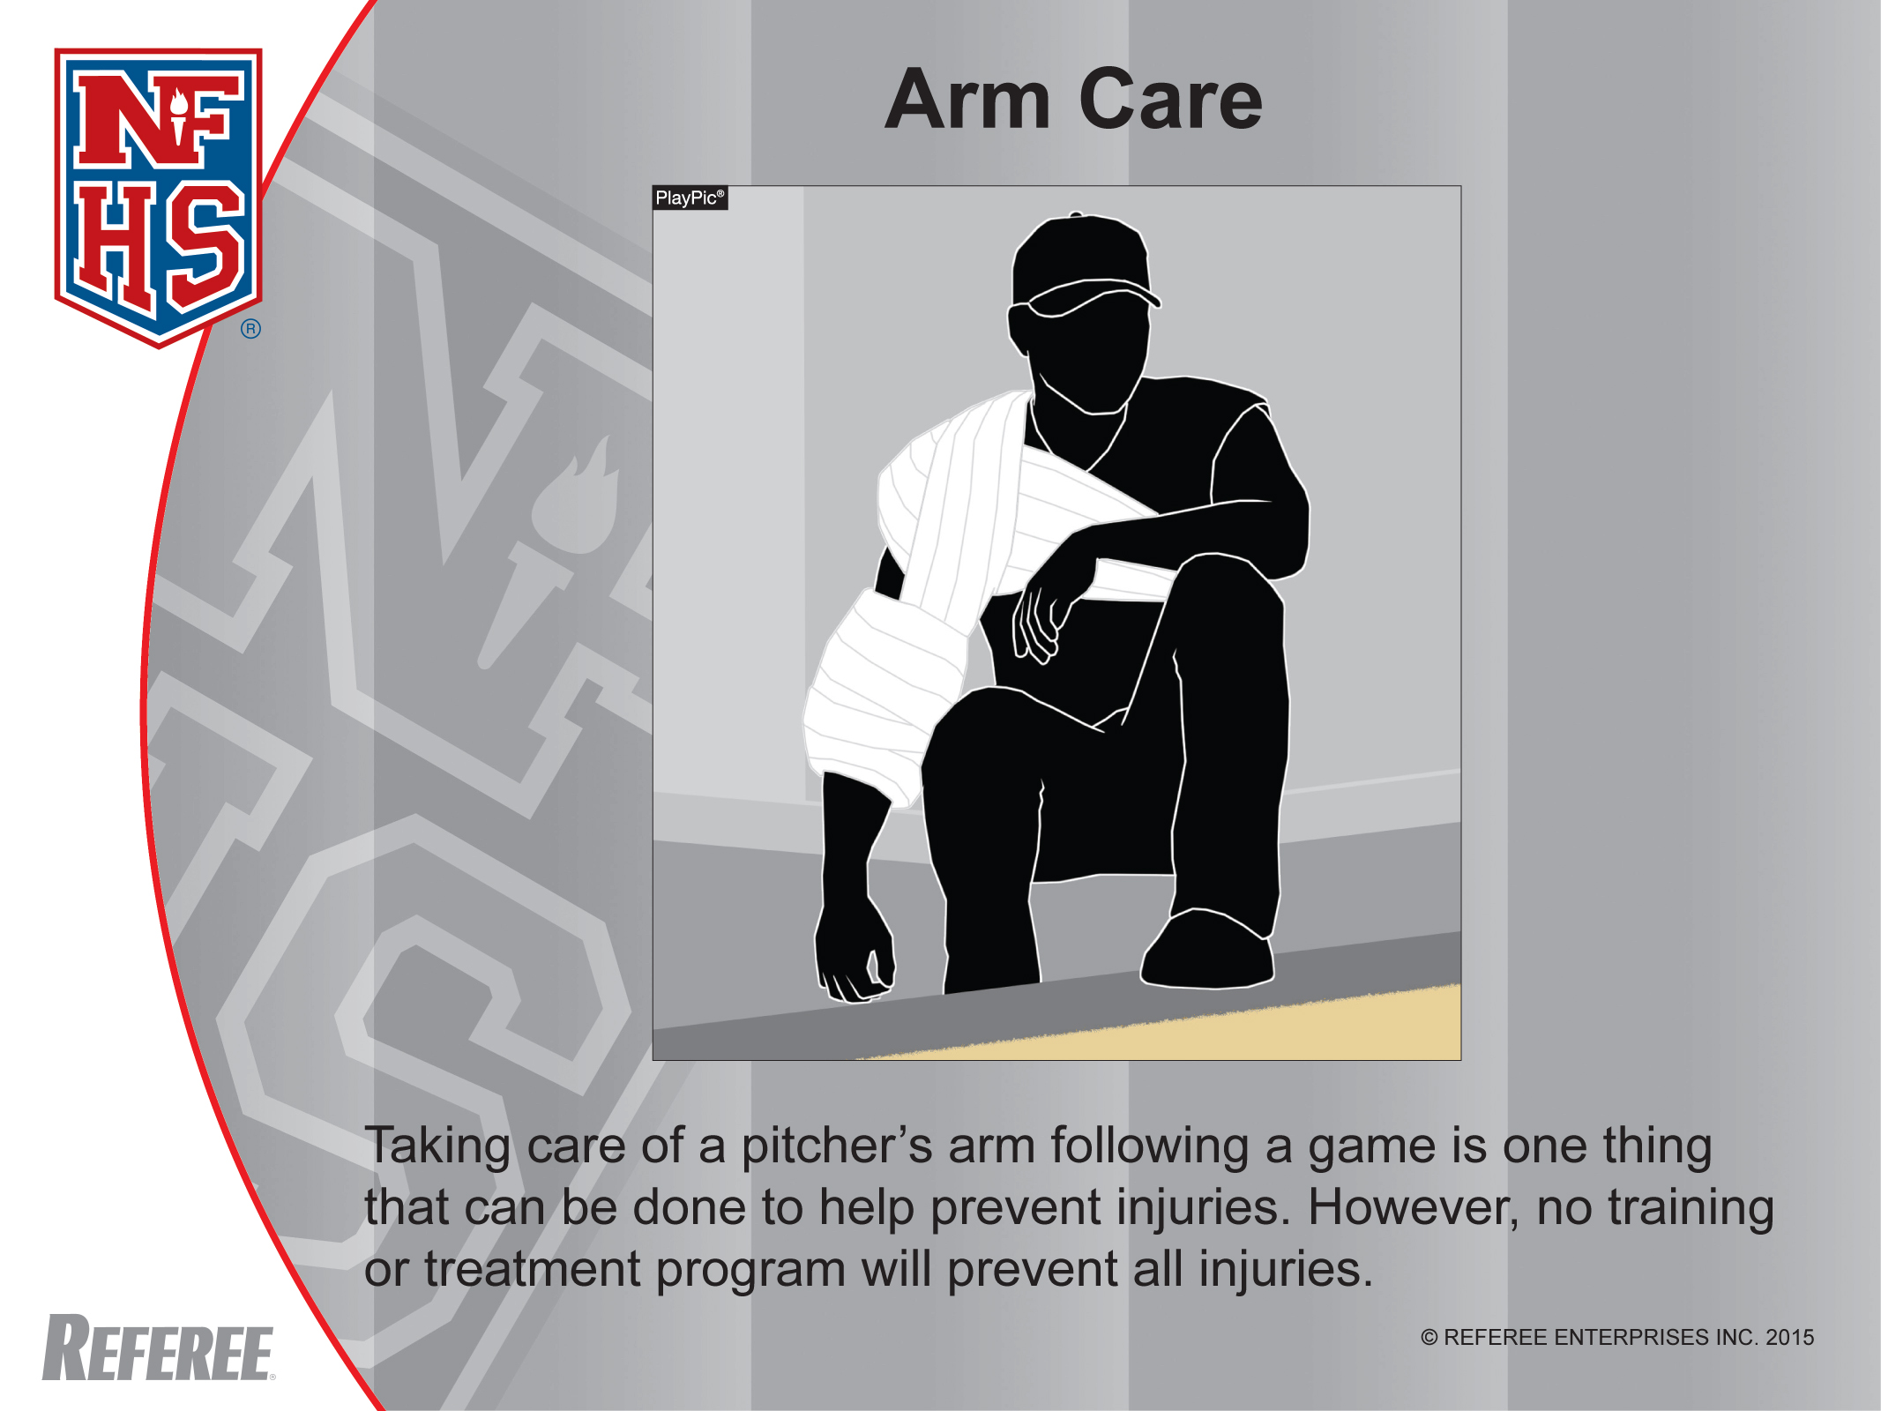

Slide 49
Arm Care Suggestions
Arm injuries are on the rise in high school age players.
Most of the arm injuries are at the pitcher position.
45% of pitchers under the age of 12 experience chronic elbow pain.
Ulnar collateral ligament reconstruction (Tommy John) surgeries have increased over 700% in the last decade for adolescent pitchers.

Slide 50
Arm Care Suggestions
4 Main Areas of Concern
Anterior Shoulder
Posterior Shoulder
Medial Elbow
Lateral Elbow

Slide 51
Arm Care Suggestions
Reasons
Overuse, undertrained, inadequate rest, insufficient recovery and repair time
Poor throwing/pitching delivery
Incomplete warm-up and cool down activity
Anatomical limitations or restrictions
Too many games and not enough practices
Poor physical conditioning
Parental and coaching ignorance or worse… indifference

Slide 52
Arm Care Suggestions
Red Flags
Decrease in velocity
Lack of command, breaking ball loses snap
Reluctant to throw off-speed pitches
Pitching delivery changes
Facial grimaces, frustration, rubbing or shaking arm
Normal routine altered, less or more time spent to get ready to pitch
Pain, sensitivity, burning sensation or swelling
Loss of range of motion and/or grip strength

Slide 53
Arm Care Suggestions
Corrective Actions
Proper technical, mental, nutritional and physical training before, during and after pitching with appropriate rest, recovery and repair time
Proper practices, workload management for pitches, pitchers and entire staff
Develop other pitchers to share the pitching load
Observe and understand pitchers’ tendencies, make pain assessments, review past performances, preparation and routine

Slide 54
Arm Care Suggestions
Corrective Actions
No overhead throwing of any kind for at least 2-3 months per year (4 months preferable).
No competitive baseball pitching for at least 4 months per year.
Do not pitch more than 100 innings in games in any calendar year.
Avoid pitching on multiple teams with overlapping seasons.
A pitcher should not also be team’s catcher due to overuse concerns.

Slide 55
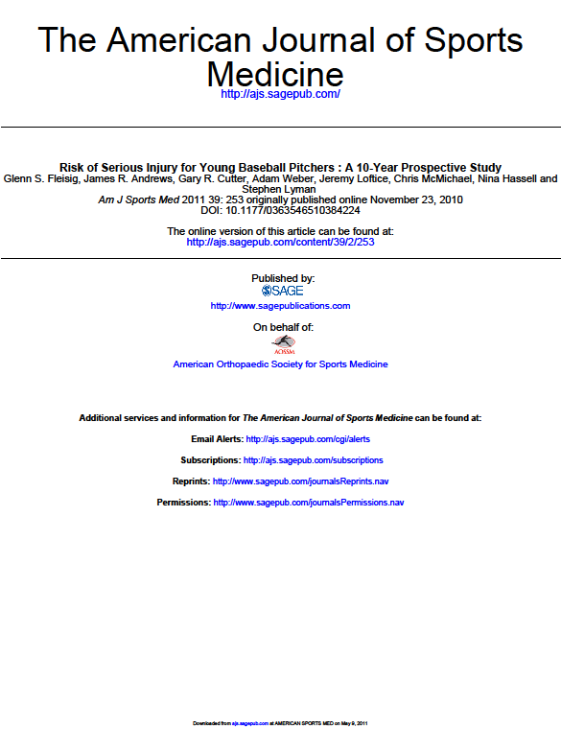
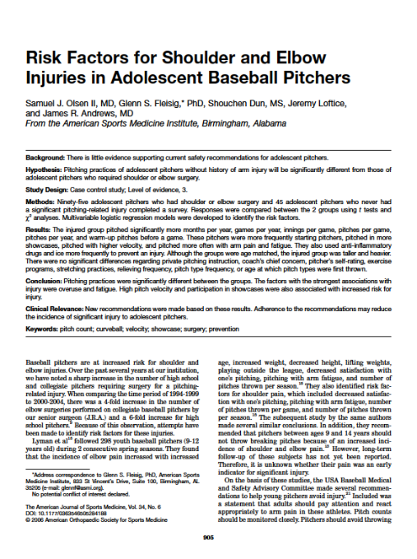
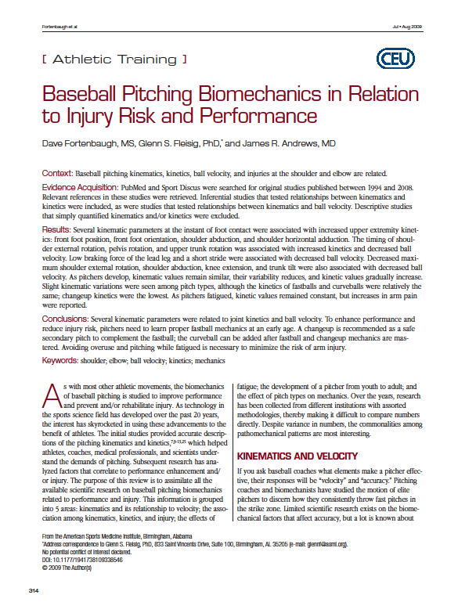
Arm Care Suggestions
PDF References
Notes:
In order to access the relevant medical recommendations for arm care procedures for high school pitchers, double click on any of the three articles saved as a PDF in the PowerPoint.

Slide 56
Arm Care Suggestions
References
The references for these suggestions are from:
Andrews Sports Medicine & Orthopaedic Center – www.andrewscenters.com
Paul Niggebrugge – www.Be Your Best Academy.com
American Sports Medicine Institute – www.asmi.org
  (http://www.asmi.org/research.php?page=research&section=positionStatement)

Slide 57
2015 NFHS Baseball Rules and Case Book as E-Books
Electronic Versions of the NFHS Baseball Rules and Case Book are now available for purchase as e-books.
Apple users can visit iTunes for available books.
Apple, Android and Kindle users can buy e-books from Amazon.com and view them through the Kindle app.
Price: $5.99 each
Visit www.nfhs.org/ebooks
for more information.

Slide 58
Important Dates
  Start Monday, February 16
1st Contest Monday, March 2
Reporting Saturday, May 9, 11:59 p.m.
1st Round Wednesday, May 13
2nd Round Saturday, May 16
3rd Round Tuesday, May 19
4th Round Friday, May 22
Regionals Tuesday-Saturday, May 26-30
States Friday, June 5
Saturday, June 6

Slide 59
Suspended Game Rule
Interruption at any point prior to the completion of 4 ½ innings = Pick up from the point of interruption if the game is to be completed
More than 4 ½ played (5 innings complete) AND winner can be determined = Final
After 5 innings
  Visitor scores tying or go-ahead run and Home does not have opportunity to bat or complete time at bat
    = Suspended Game

Slide 60
Suspended Game Rule
State Association Adoption
  Differs from NFHS
Game called for any reason AND a winner cannot be determined = Suspended Game
Suspended game does not count against weekly limitation in the week in which it is made up

Slide 61
Number of Contests
Pre-season
  2 varsity scrimmages
    Does not count toward season limitation
Regular Season
  23 game team limit
  4 per week
    4th game must be on a non-school day for both
  2 per day
Post Season
  Varsity conference tournament games are considered part of the state playoffs
    Does not count toward season limitation

Slide 62
MaxPreps
Official Statistics Provider
  Records and standings for post-season qualifications
    2014-15: MaxPreps Record = Official Record
    Incorrect record subject to DQ from playoffs
  All game results MUST be entered by Saturday, May 9th at 11:59 p.m.
    Triple check your record!
  Instructions can be found on the NCHSAA website

Slide 63
Qualifying for the Playoffs
All classifications will be a 64-team bracket
Qualifiers
  Automatic
    Must finish 1,2 or 3 in straight conference, 1 or 2 in a split
  At Large
    Based off highest 22-game winning percentage

Slide 64
Playoff Seeding
Once the 64 qualifiers have been determined
  Split East and West based on geography
Seed the East then the West based on the following:
  Seed all #1’s by 22-game record
  Seed all #2’s by 22-game record
  Seed all #3’s by 22-game record
  Seed all “at large” teams by 22-game record
  1 v 32, 2 v 31, 3 v 30, etc.

Slide 65
Sportsmanship
The quality of responsible behavior characterized by a spirit of generosity and a genuine concern for opponents, officials and teammates.
Wholesome athletic environment
Good Sportsmanship > Victory
Modest in victory, gracious in defeat
Respecting judgment and integrity of game officials
Role modeling good behavior

Slide 66
Inclement/Hot Weather Guidelines
The following should be considered when scheduling practice:
- Time of day
- Intensity level of practice
- Equipment worn
- Environmental conditions
*High Temperature and high humidity create a dangerous situation for athletes. High humidity and low temperature can also cause serious heat-related problems.*
*Water/fluid replacement breaks recommended each 20 or 30 minutes. (depending on practice conditions)
*Check with your AD on your LEA’s and school’s policy pertaining to practice on days of extreme heat.

Slide 67
Coaches’ Education
NFHS Fundamentals of Coaching Course
  Currently, all non-faculty and newly hired coaches must take the Fundamentals of Coaching Course; certificate of completion must be on file at the individual school
  Complete prior to first contest; subject to a $500 fine; continuing to coach without completion = another $500
  All coaches must have satisfied the requirement to take this course by August 1, 2015.

Slide 68
Coaches’ Education
Concussion Management Certification
  Effective August 1, 2014, the NFHS Concussion Course (free on-line course) or an equivalent course must be completed by all coaches
  Prior to the first date of practice for that sport; subsequently, the certificate of completion must be on file at the individual school; subject to $500 fine

Slide 69
Coaches’ Education
  Accredited Interscholastic Coach (AIC)
    Requires completion of 4 courses:
      Fundamentals of Coaching
      1st Aid, Health & Safety for Coaches
      Sport Specific Course or Teaching Sports Skills
      Concussion in Sports (Free)

Slide 70
Coaches’ Education
  Certified Interscholastic Coach (CIC)
    Completion of AIC requirements
    Plus:
      Teaching & Modeling Behavior
      Engaging Effectively with Parents
      Sportsmanship
      Creating a Safe and Respectful Environment
      Strength & Conditioning
      2 additional courses (User Choice0

Slide 71
Sportsmanship
Teaching & Modeling Behavior Course
  Required for any coach ejected during a contest
  Required for any coach who has player (s) ejected for fighting
NFHS Sportsmanship Course
  Replaces the Star Sportsmanship Course for any ejected/disqualified player
  Free, on-line course (nfhslearn.com)
  All certificates must be sent to NCHSAA

Slide 72
Gfeller-Waller Concussion Law
Requirements of the Law:
  Concussion signs and symptoms
    Given prior to participation
    Parents/athletes sign indicating “receipt of”
  Return to Play (RTP) form signed by a physician licensed to practice medicine
  When in doubt, sit them out”
  An up-to-date Emergency Action Plan (EAP)
    Must be on-file
    Must be posted
    Must be updated annually

Slide 73
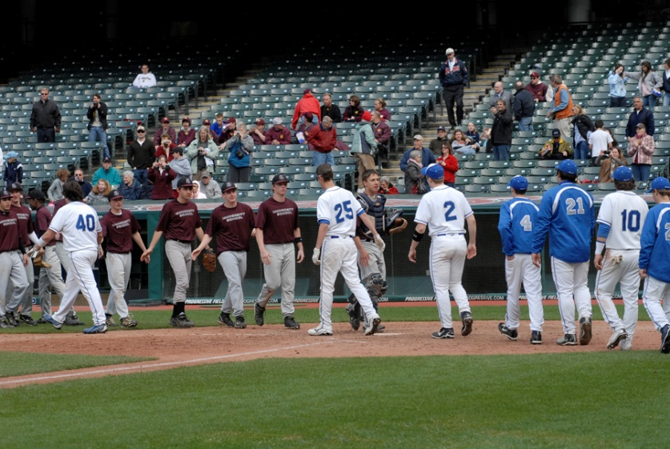
Thank you for your time and commitment to high school baseball.

