Slide 1
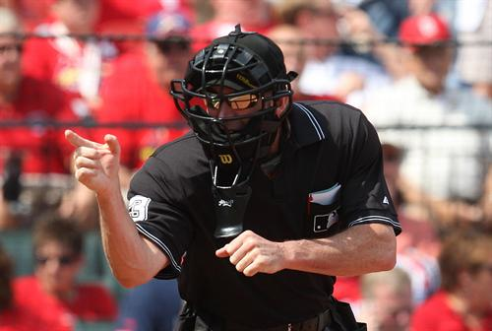
So You Think You’re
“GOOD ENOUGH”
MOUNTAIN WEST
OFFICIALS ASSN.
WHEN “GOOD ENOUGH” ISN’T GOOD ENOUGH

Slide 2
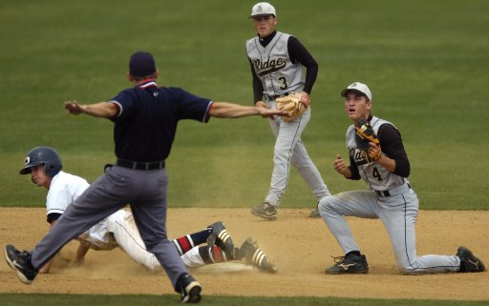
When “Good Enough”
Isn’t Good Enough
MOUNTAIN WEST
OFFICIALS ASSN.
SIX STEPS TO GO FROM “GOOD” TO BETTER
Notes:
You’re a “Veteran”
You’ve been doing this forever and have things down pretty good
You usually get the job done with only minor conflict or issues
Although you currently work high school, you feel you are as good as any umpire on TV!
“I only have to give as good as I get” so considering the games I get, I am “GOOD ENOUGH”
If this sounds like you, here are a few tips to help you GET BETTER because:
GOOD ENOUGH ISNT GOOD ENOUGH!

Slide 3
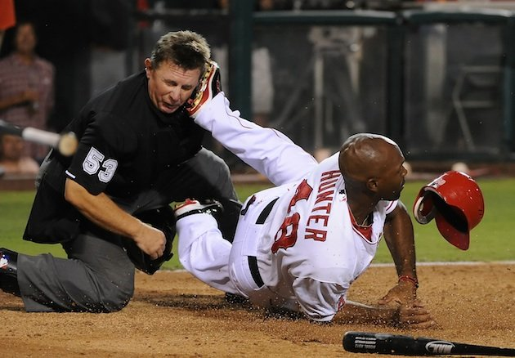
1. “Competence Breeds Confidence”
“Good Enough” says
  “I know what the umpire manual says about mechanics, but I have my own system that has worked for years”
“Get Better” says
  “I trust the collective knowledge of hundreds of umpires over dozens of years to develop the best mechanics”
Notes:
Trust me, many umpires better than you have worked to develop the best mechanics possible whether it is 2, 3, or 4 man crews.
When is the last time you really studied the Umpire’s Manual?
Do you know all your coverages or do “you take all tags and your partner take all touches”?
Study the Umpire’s Manual. “Good Enough” knows where to stand”. “Get Better” not only knows where to stand but what to be looking at!

Slide 4
1. “Competence Breeds Confidence”
“Good Enough” says
  “I read the Rulebook once a year. That’s one time more than most coaches. If something crazy happens, I can usually BS my way around it”
“Get Better” says
  “I need to STUDY the rulebook until I know how to properly apply the rules to ALL situations”
Notes:
If once through the rulebook is “Good Enough” for you, then you are asking for trouble.
Think back on your career and ask yourself “have I ever tanked a rule”?
If you said NO, not only are you barely “Good Enough”, but a liar as well.
Everyone makes an occasional mistake at some point, but if you have mis-applied
the same rule more than once, you should probably stick to T-ball.
If you STUDY enough and become COMPETENT and proficient in the rules and mechanics,
it will automatically translate to CONFIDENCE on the field.

Slide 5
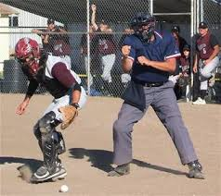
2. “Expect the Expected”
We are all familiar with the phrase “Expect the Unexpected”. While this is true, you must also learn to “Expect the Expected”.
What the heck does THAT mean?
Notes:
Expect the Expected. In other words anticipate what the current situation is dictating.

Slide 6
2. “Expect the Expected”
Understand the on-field situation:
With runners at first and third, EXPECT:
  the steal
  a balk
Late in a one-run or tied game, with a runner at third with less than two outs, EXPECT the squeeze.
When a batter squares, EXPECT
  hit by pitch
  a double hit,
  batter/runner touching a ball in play
On pickoff attempts at first, EXPECT the first baseman to obstruct the runner
Notes:
No one likes surprises. They often trick us into doing things we shouldn’t do.
Our first instinct is a rash decision because “what the heck just happened”?

Slide 7
2. “Expect the Expected”
Understand the on-field situation:
With two out and baserunner(s) in scoring position, EXPECT a third out by a non-force play (timing)
For a base hit with runners on, EXPECT a play behind the lead runner
On every pitch with runners on base, EXPECT a balk
If a batter is 4-for-4 with a couple of homers, EXPECT a hit-by-pitch
If you tank a rule, EXPECT a butt chewing from the coach! (just kidding)
Notes:
Obviously, these are not all possible situations, but the point is, you should know that certain situations often lead to particular actions
Don’t get surprised by what should have been EXPECTED or anticipated. There are enough un-expected things that can do that. Don’t add to the list!

Slide 8
3. “Think Inside the Box”
Everyone has an occasional bad day behind the dish. When that happens and strikes are hard to find, try one of the following:
Watch the catcher’s mitt when receiving the pitch. If it turns down, call it low. If it turns up, its at the knees (assuming it also has the plate).
Notes:
While this first trick is not technically correct, it will get you by 95% of the time, assuming it has the plate. This will get you through the game, but then you need to figure out why you weren't sharper with your ball/strike.
Understand that the MLB average for accuracy is 97%. If you call 200 pitches a game and miss 6, that’s pretty good (but can still be improved upon)

Slide 9
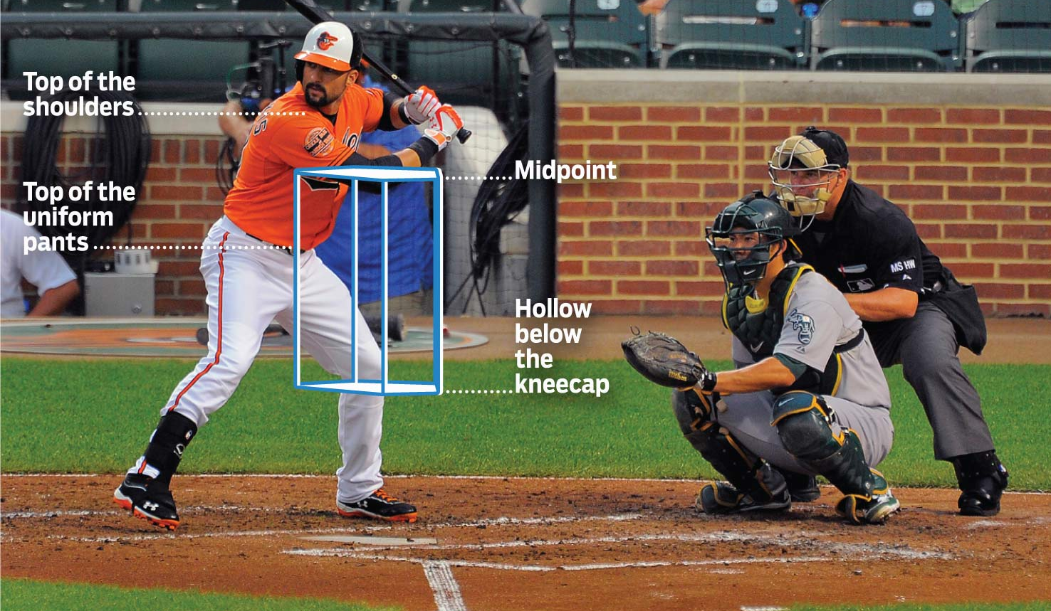
3. “Think Inside the Box”
Everyone has an occasional bad day behind the dish. When that happens and strikes are hard to find, try one of the following:
Some umpires try to envision and actually “see” the rectangular box (strike zone) for each batter
Notes:
Try to find visual markers to help you define your zone.
Are the batter’s hands at the top of the zone?
Is the batter’s front elbow at the top of the zone?
Is the catcher’s helmet at the top of the zone?
Is the catcher’s mitt at the bottom of the zone?
Are the catcher’s knees at the same level as the batter’s knees?

Slide 10
3. “Think Inside the Box”
Everyone has an occasional bad day behind the dish. When that happens and strikes are hard to find, try one of the following:
Focus on “high/low” and not “in/out”
Notes:
If you need to narrow your focus, make sure you get high and low right.
Everyone can tell if you miss that, but not necessarily if you are missing in and/or out.
Focus High and Low until your zone comes back to you after an inning or two.

Slide 11
3. “Think Inside the Box”
Everyone has an occasional bad day behind the dish. When that happens and strikes are hard to find, try one of the following:
Adjust the slot and/or raise your stance a bit
Notes:
The “low and away” pitch is missed more often than any other.
If you are missing them (and you will know it) you are probably doing one of two things:
You may have left the slot and are hiding behind the catcher. Self preservation is important, but not at the expense of not seeing the outside corner of the plate
You might be too low in your crouch. Raise up a bit until you can see the entire outer edge of the plate
Make sure you are properly located in the slot with just a “slight” angle toward the second baseman (towards shortstop for lefties).

Slide 12
3. “Think Inside the Box”
Everyone has an occasional bad day behind the dish. When that happens and strikes are hard to find, try one of the following:
Find the strikes wherever you can
Notes:
We have all had those games where both pitchers are struggling to find the zone.
Expand your zone as necessary (same for both pitchers) in order to “find the strikes”
A liberal zone will get you by most of the time. Coaches don’t complain too much about called strikes (as long as you don’t miss up or down) and 9 times out of 10 will tell their kids to adjust. However, If you are squeezing and nit-picking pitches, you will assuredly incur the wrath of the coach, dugout and fans.
Almost ALL new umpires tend to squeeze the strike zone. Some never change.
Understand that if the coach, players, fans, and moms and dads are all yelling at you, you might be missing a few.

Slide 13
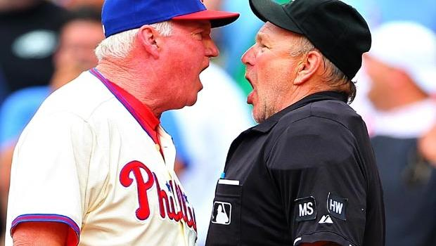
4. “You Only Get Three Chances to Make a First Impression”
And you thought you had only One!
  When you first arrive at the field
  Your first few calls
  Your first conflict
You may be “Good Enough” to get by with any one of the above, but to “Get Better”, you should master all three.
Notes:
Obviously your first chance to make an impression on a new coach is your arrival on the field.
Do you look professional?
Are you just on time or did you take the initiative to arrive early?
Do you do all your pregame tasks (equipment check, walk the field, etc)
Even after arriving at the field, you still have a chance to make an impression.
How are you carrying yourself on the field?
Are you making calls with confidence and authority?
Are you hustling and making calls from the correct position?
Do you check with you partner when appropriate or necessary?
And after all of this, you still have one last chance to make an impression by handling conflict
Are you threatening the coach often for questioning your calls?
Do you take a confrontational posture/stance when he comes out of the dugout?
Do you have a calm conversation or a heated one?
Do you feel you have to “win” the debate?

Slide 14
5. “Make the Last Your Best”
Get better every game
You’re only as good as your last game
Yes, after 300 games, you still have something to learn
Notes:
You have heard the term, “Save your best for last”.
In this case, “Make your Last Your Best”
Always take something away from every game and try to learn something every game. Find the “one thing” you were most disappointed in your performance and turn it around for the next 300. Experience is the best teacher.
It doesn’t matter if you were top-notch in the previous 10 games, the next one you tank is the one you are remembered for.
There is no magic number of games that gets you where you want to be. Some learn quicker than others. Some games have many “teaching moments” for the umpire while others may only have a few.

Slide 15
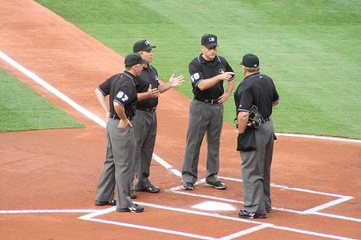
6. “You CAN Win Them All”
P-R-E-P-A-R-E
  Pre-Game
  Read/React
  Education
  Pride
  Ask
  Role
  Evaluate
Notes:
All of you have heard the truism “You cant win them all”. Well, you CAN win them all if you PREPARE.
P = You must PRE-GAME each and every game. Cover all issues and be sure you and your partner are on the same page.
R = READ the play, then react.
E = EDUCATE yourself. Discuss situations with your partners. Read all of the related literature you can. Attend all meetings. Work all the games you can at all levels
P = Take PRIDE in what you do. Be the best you can be. Make it your goal to be cast in the best light whenever your skills and abilities are discussed, whether it is coaches, players, fans or peers.
A = ASK for answers to all questions you have. No one knows everything and you should strive to learn something new every day.
R = Understand your ROLE. You are an arbiter of the game. Your job is to assure the game is played within the rules of the game. Its not your job to educate the coach or show the kids how or what to do. You are neither a coach nor a teammate.
E = Always self-evaluate your performance after every game. Don’t be afraid to ask your partner what he thinks and don’t be afraid to provide honest feedback when asked by your partner. Also, take any information provided by your Evaluator to heart… it is not criticism, it is instruction
If you PREPARE, you CAN win them all and leave every game with a smile on your face.

