Slide 1

North Carolina High School Athletic Association
NCHSAA Regional Meetings
September 15 – 25, 2014

Slide 2
NCHSAA Board of Directors 2014-2015
Region 4
  Paul Hoggard, AD/Football Coach
    Richmond County Senior High School
  Reggie Peace, AD/Basketball Coach
    Lee County High School

Slide 3
NCHSAA Staff
Davis Whitfield
  Commissioner
Que Tucker
  Deputy Commissioner
Rick Strunk
  Associate Commissioner
Carolyn Shannonhouse
  Assistant Commissioner, Retired
Karen DeHart
  Associate Commissioner
Brad Alford
  Director of Sports & Championships

Slide 4


Slide 5
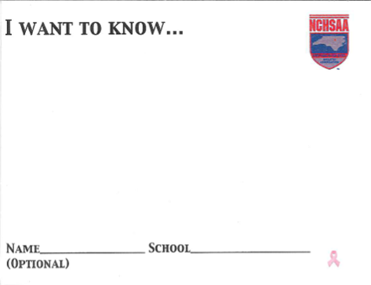
I Want to Know…

Slide 6
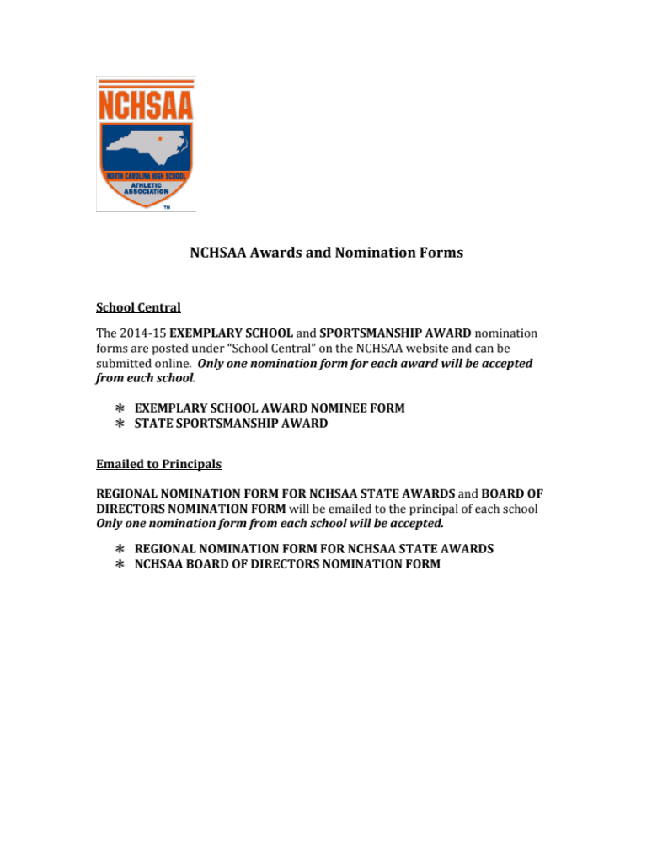
NCHSAA Awards and Nomination Forms

Slide 7
NCHSAA Board of Directors
Region 1
  Ron Butler – Pitt County Schools
  Allison Osmon – Currituck County Schools
  Dwayne Stallings – Perquimans County Schools
Region 2
  M.D. Guthrie – Wallace-Rose Hill High School
  Joe Poletti – Croatan High School
Region 3
  Angie Miller – Nash/Rocky Mount Schools
  Dennis Sawyer – Roanoke Rapids City Schools

Slide 8
NCHSAA Board of Directors
Region 4
  Paul Hoggard – Richmond Senior High School
  Reggie Peace – Lee County High School
Region 5
  Brad Craddock – Robert B. Glenn High School
  Mo Green – Guilford County Schools
  Rodney Shotwell – Rockingham County Schools
Region 6
  Carla Black – Concord High School
  Bill Rogers – Porter Ridge High School

Slide 9
NCHSAA Board of Directors
Region 7
  Sandy George – Mount Airy High School
  Teresa Hays – North Iredell High School
Region 8
  Tony Baldwin – Buncombe County Schools
  David Gentry – Murphy High school
  Bill Miller – Polk County Schools

Slide 10
NCHSAA Board of Directors
1A
  David Gentry
    Murphy HS
  Sandy George
    Mt. Airy HS
  M.D. Guthrie
    Wallace-Rose Hill HS
  Dwayne Stallings
    Perquimans County Schools
2A
  Ron Butler
    Pitt County Schools
  Rodney Shotwell
    Rockingham County Schools
  Joe Poletti
    Croatan HS
  Dennis Sawyer
    Roanoke Rapids City Schools

Slide 11
NCHSAA Board of Directors
3A
  Carla Black
    Concord HS
  Angie Miller
    Nash/Rocky Mount Schools
  Reggie Peace
    Lee County HS
  Teresa Hays
    North Iredell HS
4A
  Tony Baldwin
    Buncombe County Schools
  Brad Craddock
    Glenn HS
  Paul Hoggard
    Richmond Senior HS
  Bill Rogers
    Porter Ridge HS

Slide 12
NCHSAA Board of Directors
Affiliate Members
  Wendell Hall – NC State School Boards Association
  Mac Morris – NC Coaches Association
  Roger Morton – Piedmont Officials Association
  Burt Jenkins – NCDPI
  Rex Wells – NC Athletic Directors Association

Slide 13
NCHSAA Board of Directors
Policy Committee
  Carla Black – Chairman, Region 6
  M.D. Guthrie – Vice Chair, Region 2
  Paul Hoggard – Region 4
  Brad Craddock – Region 5
  Rex Wells – NCADA
  Burt Jenkins – DPI

Slide 14
NCHSAA Board of Directors
Sports Committee
  Dwayne Stallings – Chairman, Region 1
  Joe Poletti – Vice Chair, Region 2
  Bill Rogers – Region 6
  David Gentry – Region 8
  Teresa Hays – Region 7
  Mac Morris - NCCA

Slide 15
NCHSAA Board of Directors
Review/Officiating Committee
  Ron Butler – Chairman, Region 1
  Sandy George – Vice Chair, Region 7
  Dennis Sawyer – Region 3
  Reggie Peace – Region 4
  Roger Morton – Piedmont Officials Association
  Wendell Hall – NC State School Boards Assoc.

Slide 16
NCHSAA Board of Directors
Finance/Personnel Committee
  Mo Green – Chairman, Region 5
  Bill Miller – Vice Chair, Region 8
  Angie Miller – Region 3
  Rodney Shotwell – Region 5
  Tony Baldwin – Region 8
  Allison Osmon – Region 1

Slide 17
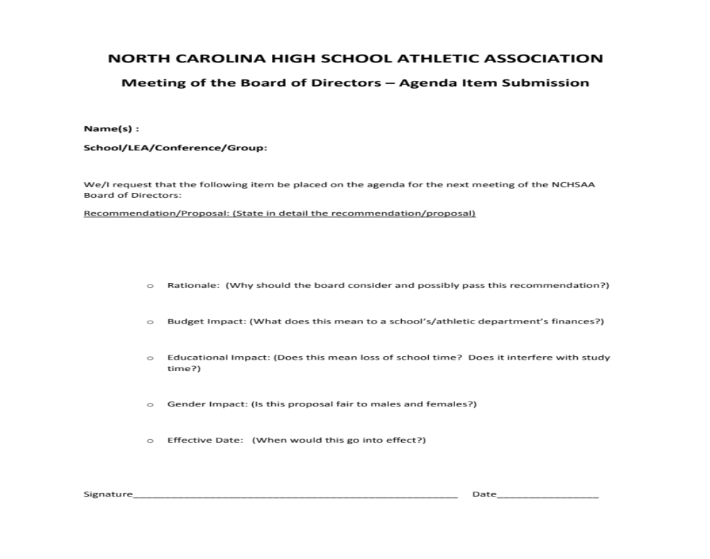
Agenda Item Submission Form

Slide 18
Continuing Education/Certification
Certified Athletic Administrator (CAA)
Certified Master Athletic Administrator (CMAA)
Fundamentals of Coaching
Accredited Interscholastic Coach (AIC)
Certified Interscholastic Coach (CIC)

Slide 19

North Carolina Coaches Association
Joe Franks – Director, NCCA

Slide 20




The NCCA exists to promote and improve athletics in NC’s public schools and to foster high standards of ethics and sportsmanship.

Slide 21

Board of Directors 2014-2015
2014-2015 Directors
District 1 | Mark Harnly (Camden County) | District 5 | Darlene Joyner (Northwest Guilford)
District 1 | Freddie (Sport) Sawyer (Washington) | District 5 | Pete Gilchrist (North Forsyth)
District 2 | Doug Kidd (Swansboro) | District 6 | Joe Pinyan (Carson)
District 2 | Brett Queen (Hoggard) | District 6 | Donnie Kiefer (Central Cabarrus)
District 3 | Randy Pinkowski (Clayton) | District 7 | Mike Absher (Davie County)
District 3 | Brent Walston (Corinth Holders) | District 7 | Nick Bazzle (Alexander Central)
District 4 | Richard Bailey (Scotland County) | District 8 | Mike Sexton (C.A. Erwin)
District 4 | Michael Baker (Fairmont) | District 8 | Jimmy Cleaveland (Smoky Mountain)

Slide 22
NCCA Officers
2014 - 2015 Officers
President | Reggie Peace (Lee County)
Vice-President | Tom Harper (Fred T. Foard)
Past President | Marc Payne (Ashe County)
Executive Director | Phil Weaver
Executive Director | Mac Morris
Executive Secretary | Marion Kirby

Slide 23
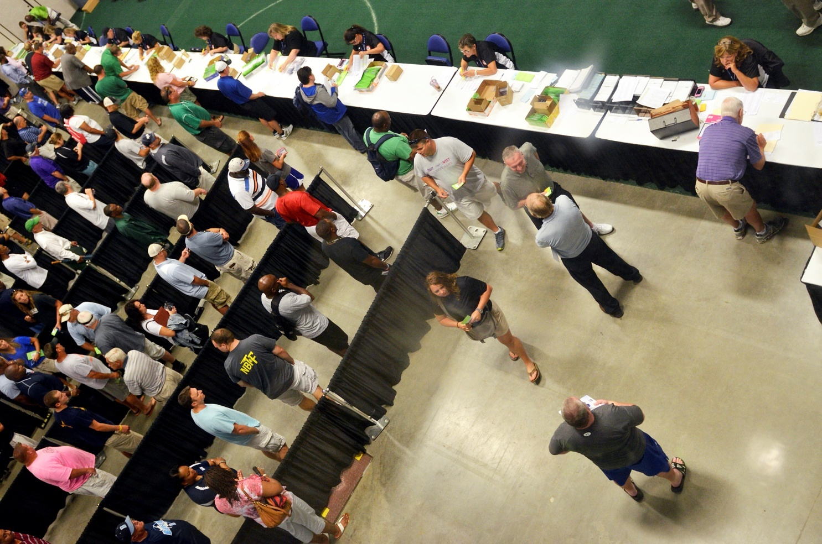
Superintendents!
Thank you for supporting the mission and goals of the NCCA, and for verifying NCCA Membership!

Slide 24
Principals!
Thank you for supporting continuing education by encouraging your coaches to join the NCCA!

Slide 25
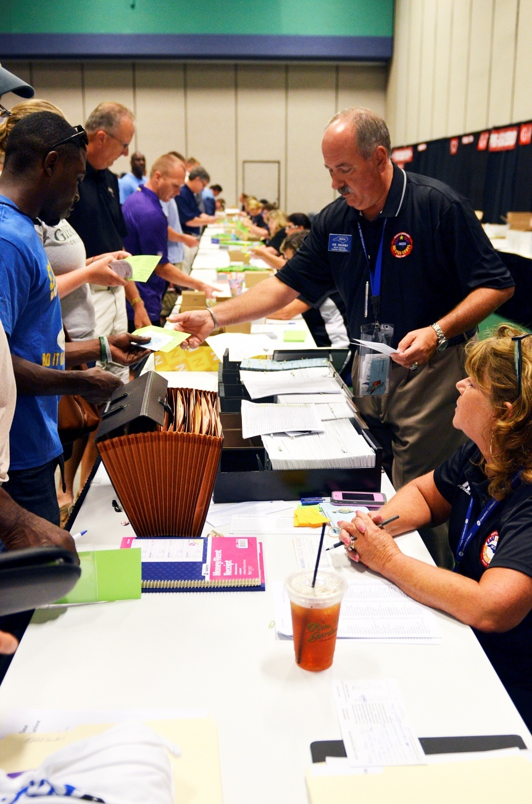
Athletic Directors!
Thank you for assisting your coaches to register for the NCCA Clinic, and for verifying Associate status!

Slide 26

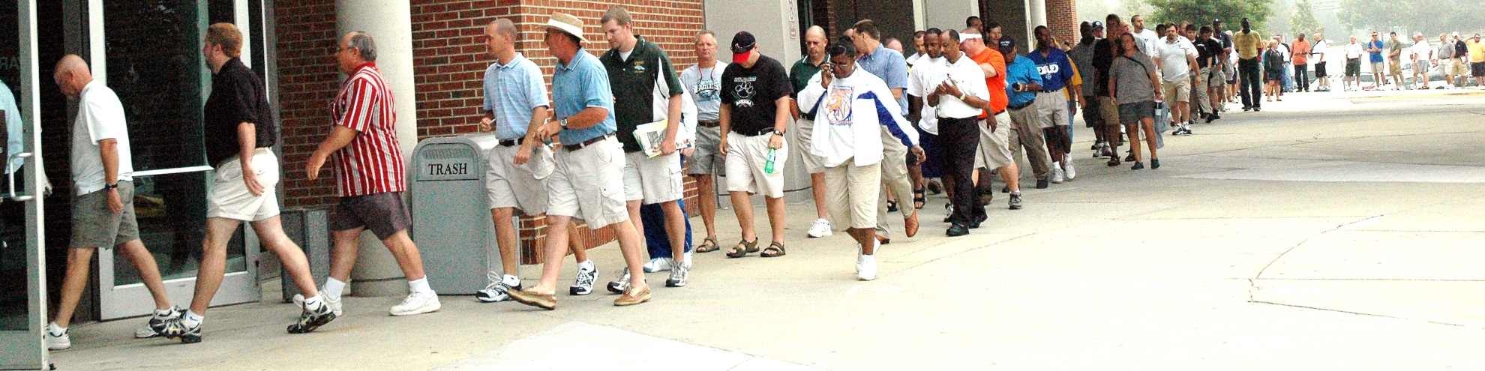
2015 NCCA Coaching Clinic Dates
Monday, July 20-Thursday, July 23, 2015

Slide 27

NCCA Clinic Preregistration
Preregistration is open only to current members.
If a school preregisters its entire staff, Associates
and new members can be registered at the $55.00 rate. Schools saved over $17,000 last year!
Registration is $75.00 after July 1 deadline.

Slide 28
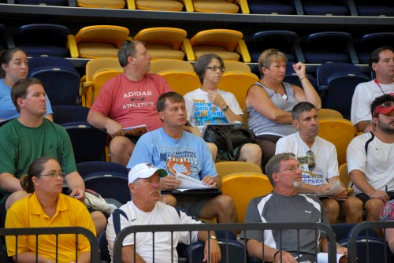
NCCA Categories of Membership
Regular Member
Full-time, certified employee OR teacher’s assistant AND a coach, athletic director or licensed athletic trainer paid by system-wide supplement.

Slide 29
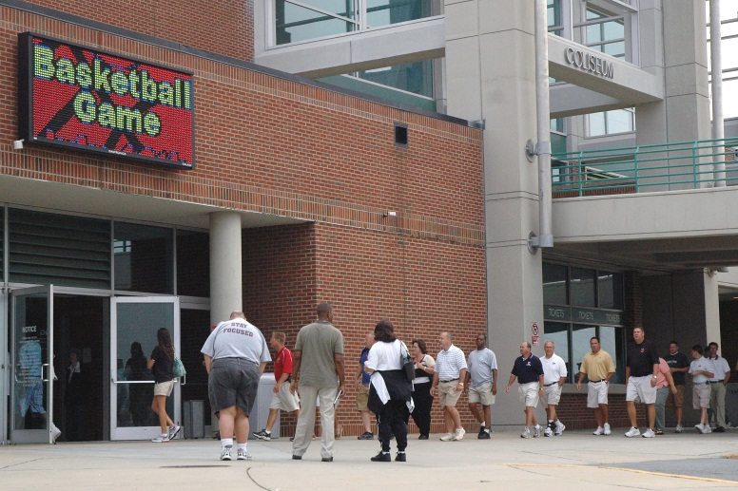
NCCA Categories of Membership
Associate
Non-Faculty OR Volunteer Coach
First Responder (who does not coach)
Classified personnel who are volunteers and receive a stipend rather than a supplement.)

Slide 30

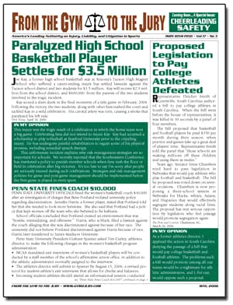
Each issue will be emailed to every school’s Athletic Director.
AD’s! Please forward to your coaches and administrators, and central office staff.

Slide 31
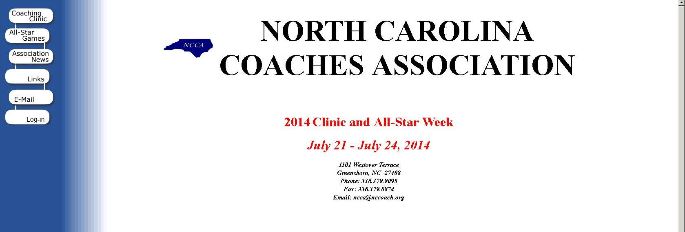
www.nccoach.org

Slide 32

www.twitter.com/nccoachesassn

Slide 33
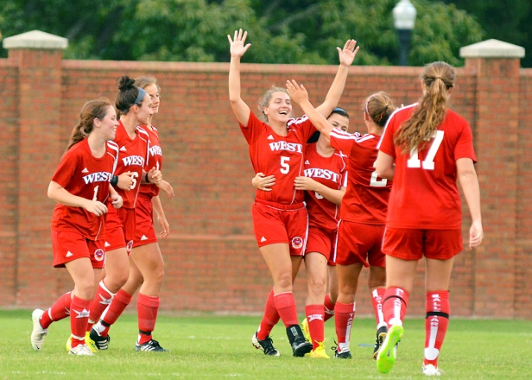
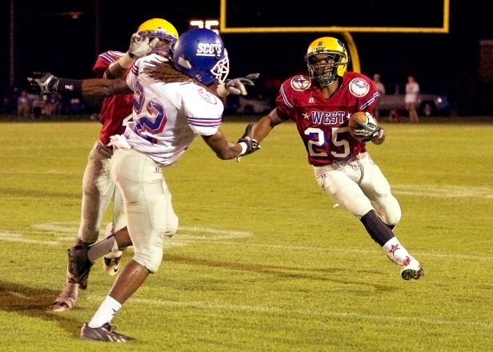
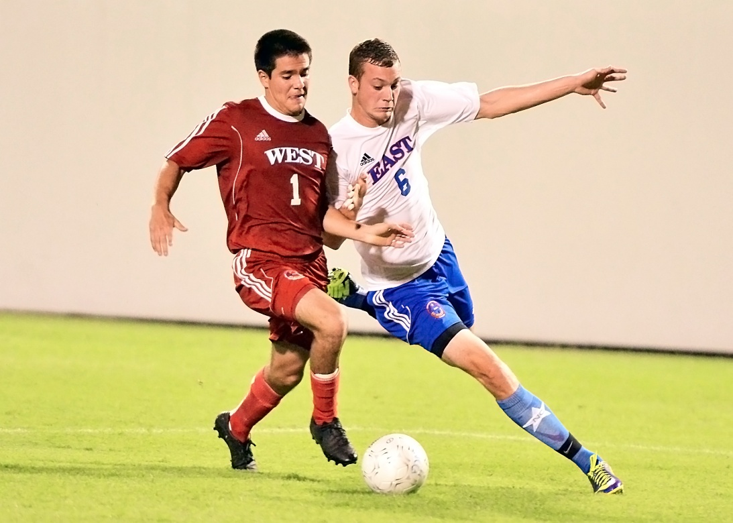
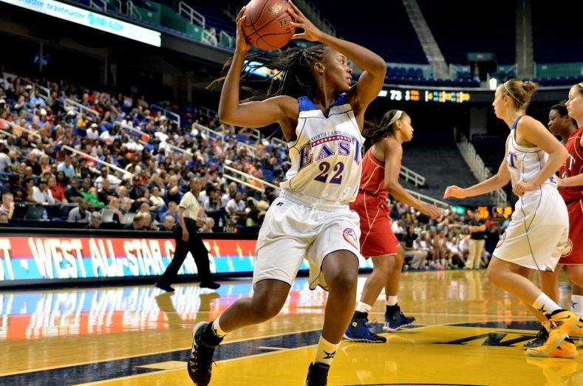
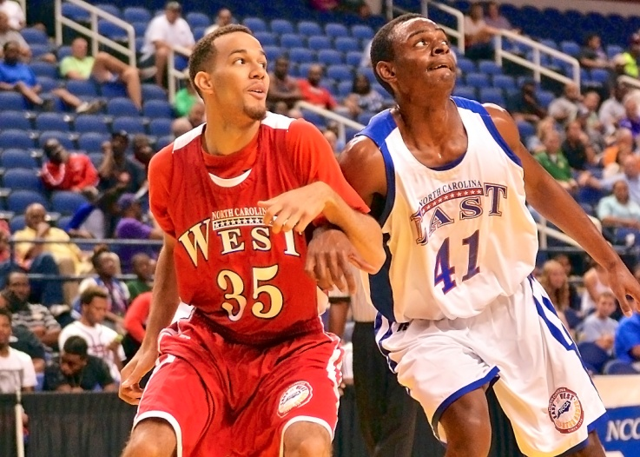
East-West All-Star Games
Congratulations to 2015 Coaches!

Slide 34
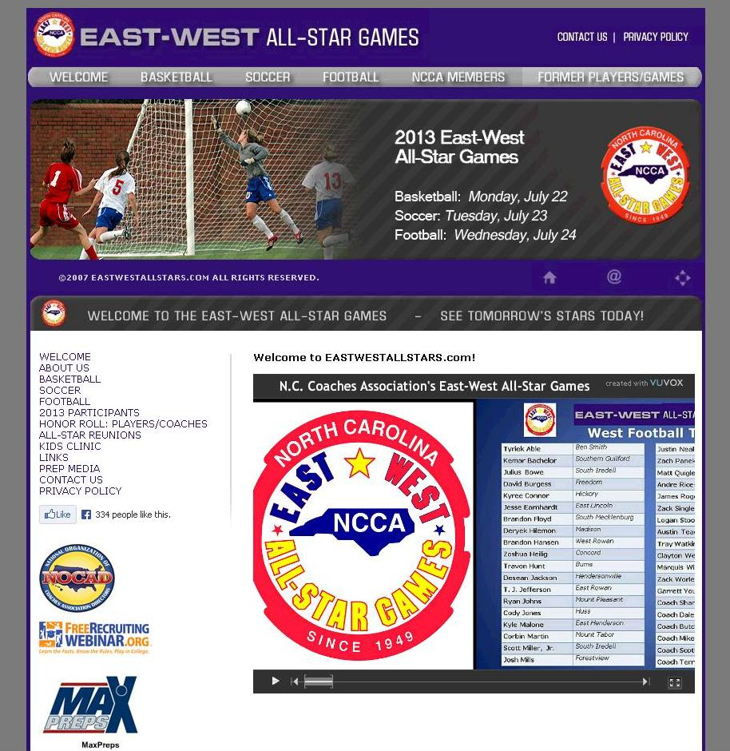
www.eastwestallstars.com

Slide 35


www.facebook.com/eastwestallstars

Slide 36

2015 East-West All-Star Games
T-Shirt Design Contest!
Open to any NCHSAA student!
Must include the East-West All-Star logo and colors!
$200 Grand Prize, plus tickets to the Games!
Submission deadline is January 1, 2015.

Slide 37

North Carolina/South Carolina Basketball
March 28, 2015

Slide 38

North Carolina Coaches Association
336-379-9095
ncca@nccoach.org
www.nccoach.org

Slide 39

North Carolina Athletic Director’s Association

Slide 40
North Carolina Athletic Director’s Association
Troy Lindsey
Athletic Director
Douglas Byrd High School

Slide 41
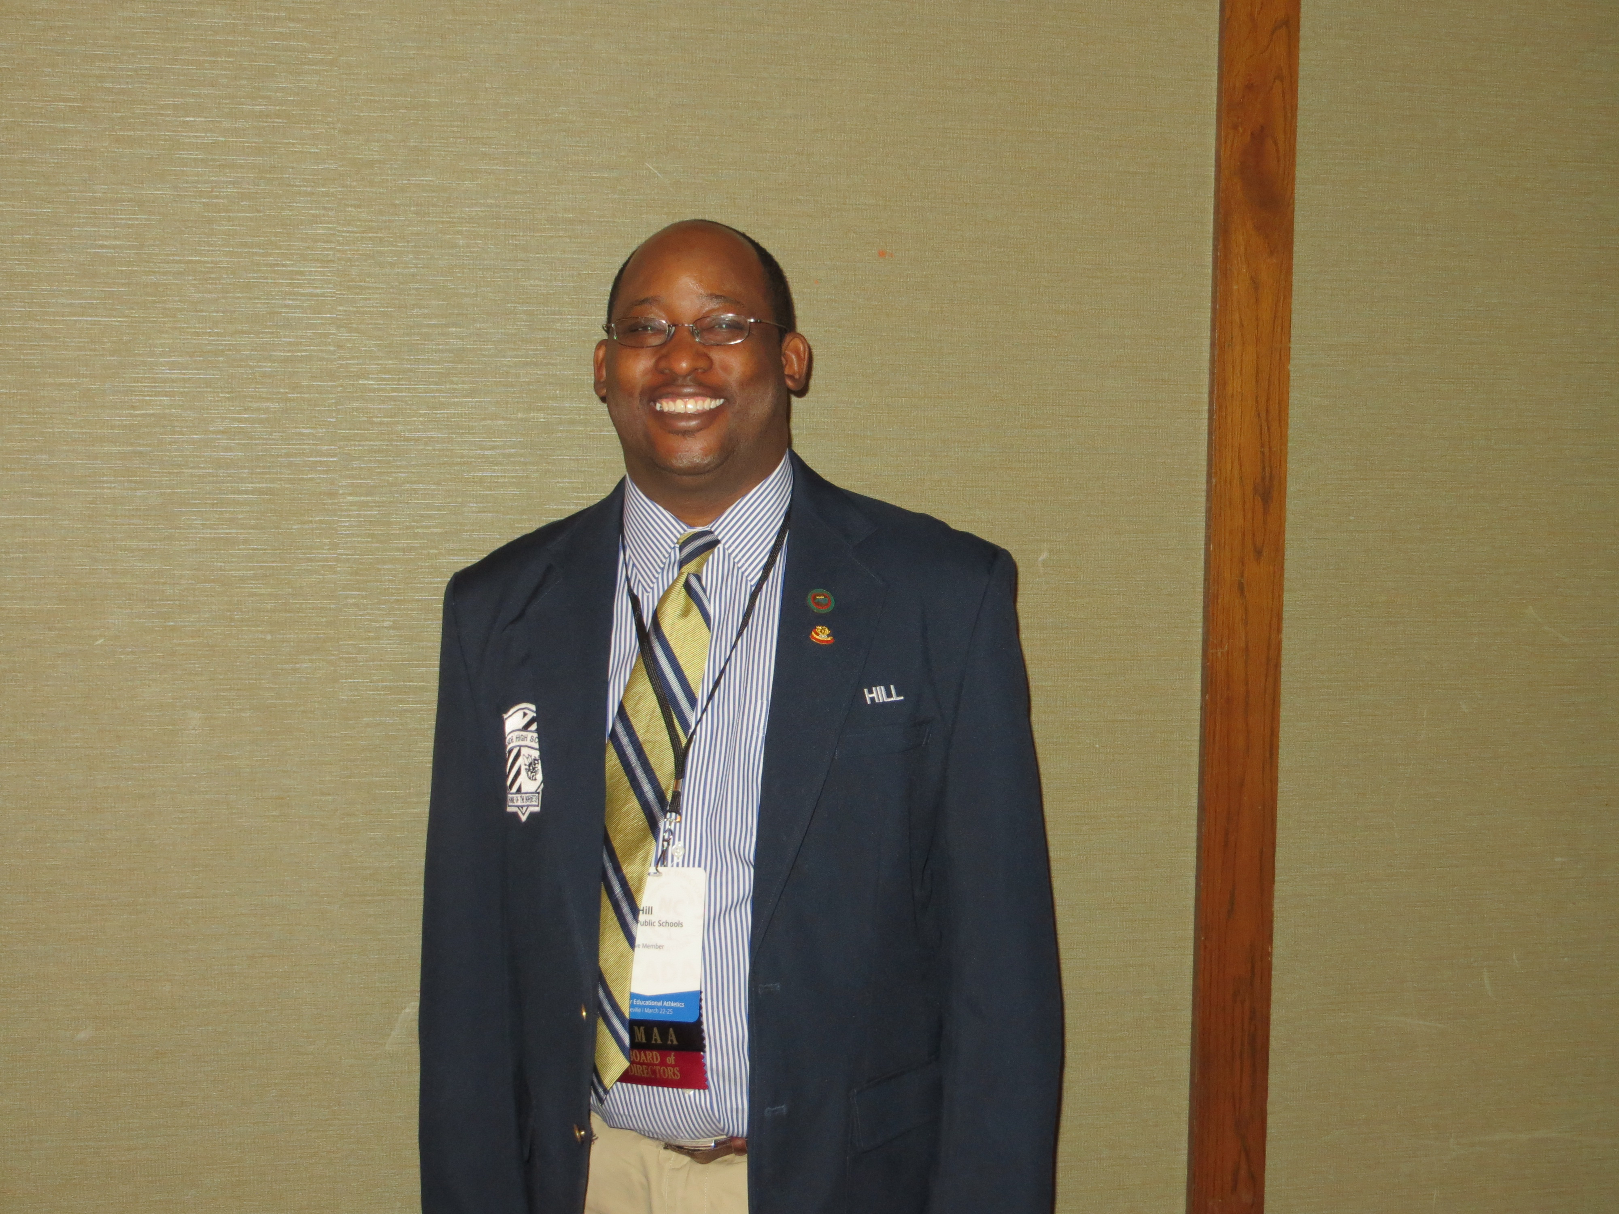
NCADA Leadership
Executive Director
  Jerry McGee
President
  Bobby Hill, Hillside High School
Vice President
  Chris Roehner, South Brunswick
Secretary
  Jeff Morris, Gray Stone Day
Past President
  Rex Wells, Asheville High School
President Bobby Hill

Slide 42
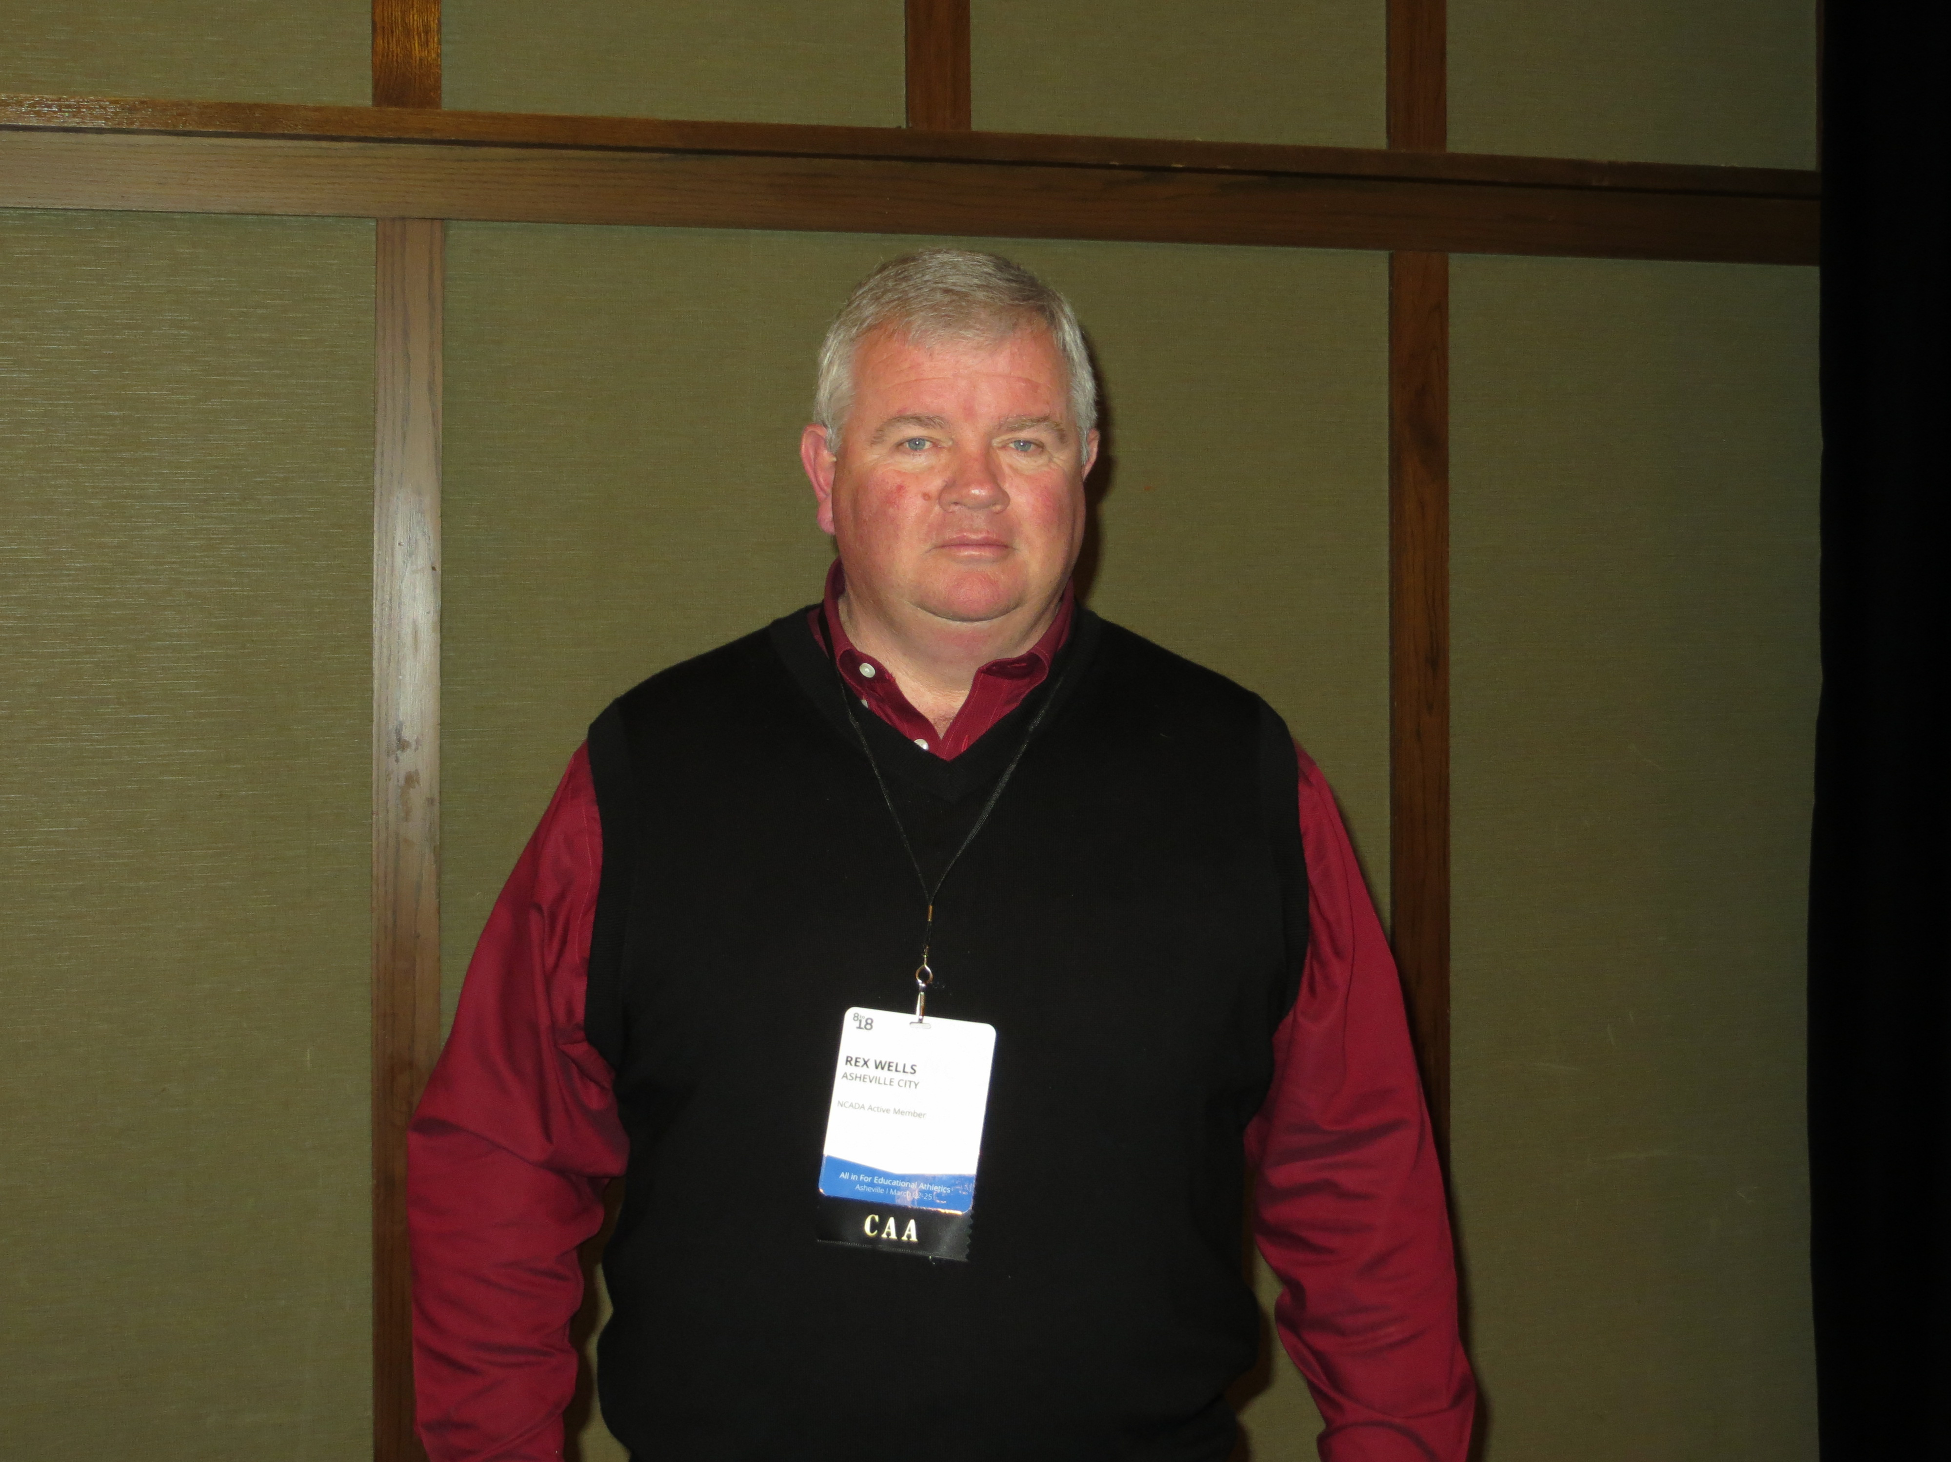
NCADA Leadership
NCADA Representative on NCHSAA Board of Directors
  Rex Wells, Asheville High School
NIAAA Credentials and NFHS Coach’s
Education Committee
  Angie Miller, Nash/Rocky Mount Schools
NIAAA Publications Committee and Blue Ribbon Panel
  Rusty Lee, Page High School
National Coach’s Education Committee Chairman
  Bobby Guthrie, Retired
NCADA Awards Committee Chairperson
  Roger Dixon, Retired
Rex Wells

Slide 43
Certified Athletic Administrator Requirements
(Athletic Director Certification - Part of NCHSAA Strategic Plan)
Bachelor’s Degree or Higher
Personal Data Form
2 or More Years Experience as AD
Currently Employed as AD
Take LTI 501, 502, 504 & 506
Successful Completion of CAA Examination
Read NIAAA Code of Ethics

Slide 44


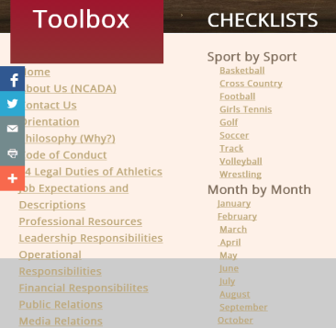
NCADA Toolbox www.ncadatoolbox.com
NCADA Toolbox Contents:
Legal Issues
Job Expectations
Organizations
Leadership
Operations
Finances
Media/Public Relations
Forms
Checklists
Admin. Apps/Technology

Slide 45
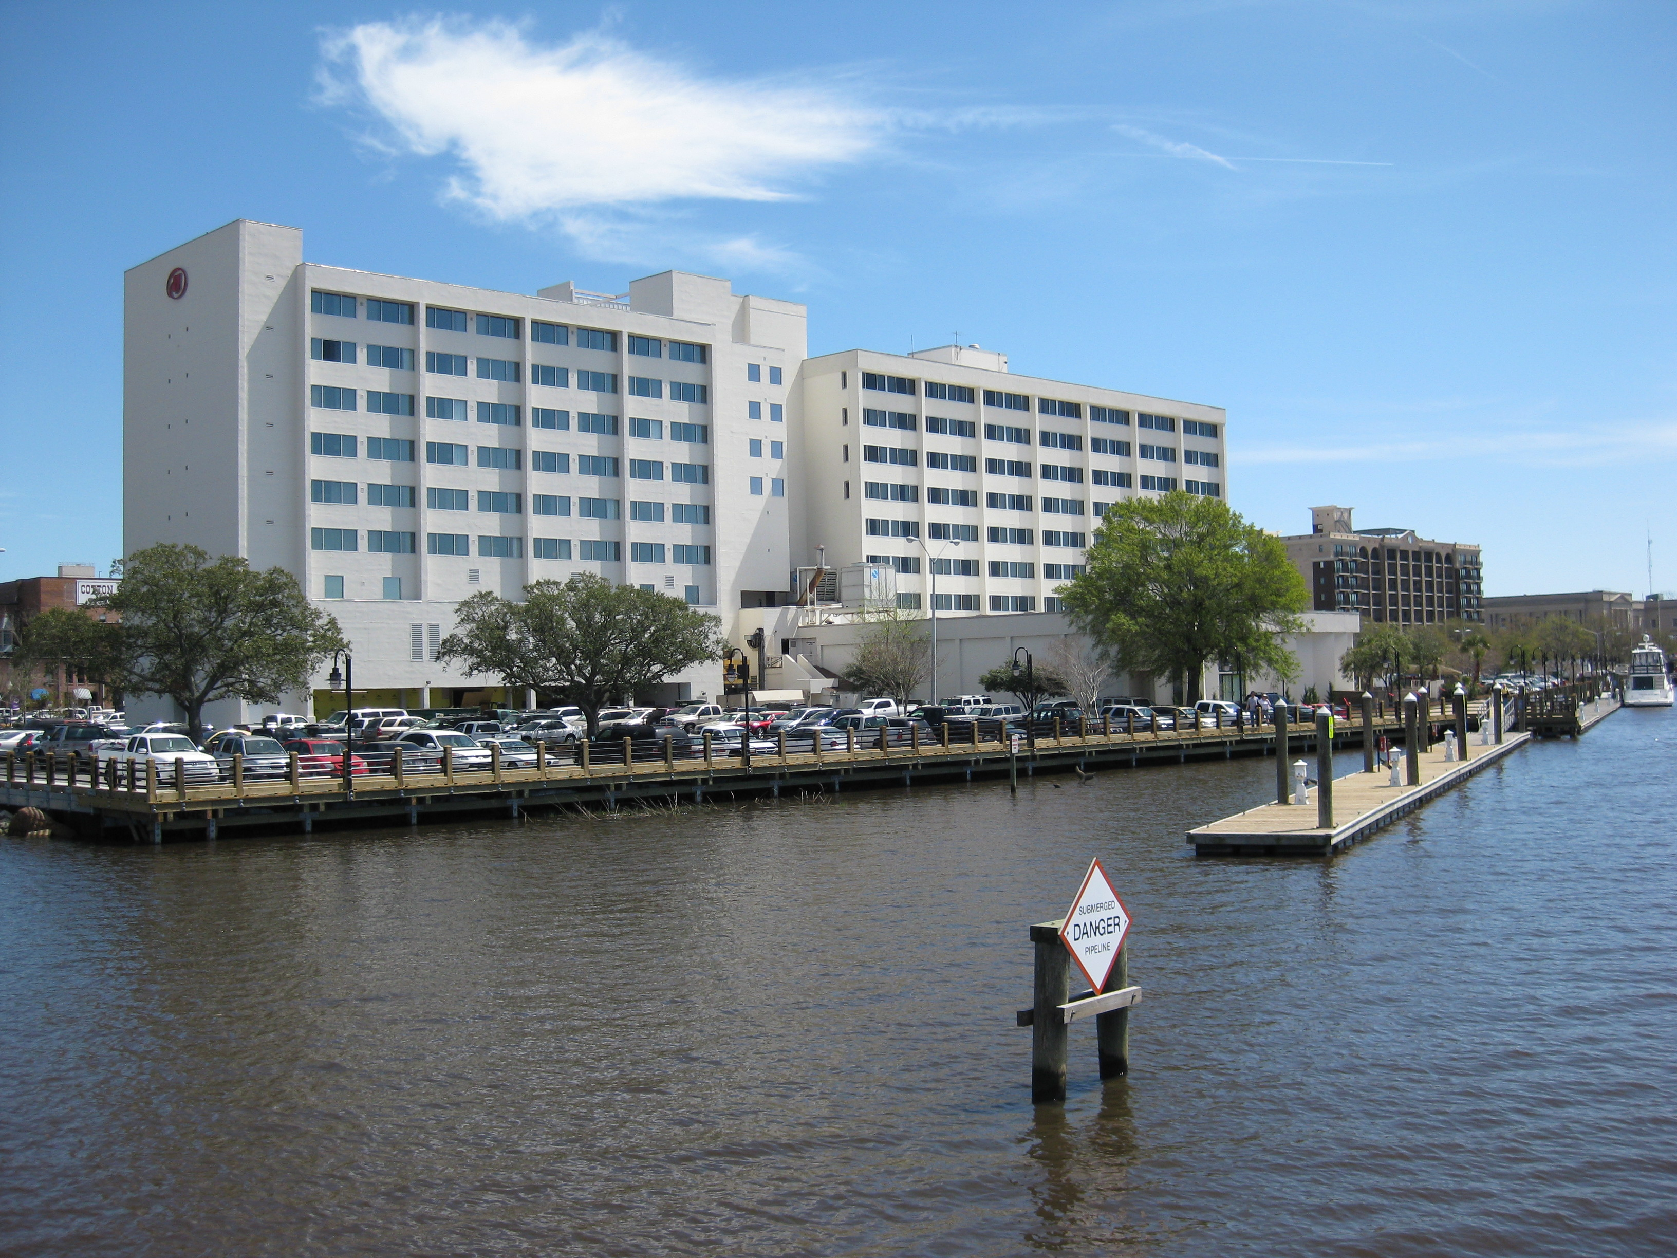

NCADA Key Dates to Remember
City/County Athletic Director’s Meeting
  October 8th, 2014
  Durham, NC
45th Annual National Athletic Director’s Conference
  December 13-16, 2014
  National Harbor, Maryland
44th Annual NCADA State
Conference – Wilmington
  March 29-April 1, 2015
  Awards Banquet, HOF,
  LTI Classes

Slide 46

WE Are the NCHSAA

Slide 47

Student-Athlete Advisory Council (SAAC) Report
Caleb Edkins
Junior
South View High School
Soccer
saac4@nchsaa.org
Emily Yarborough
Junior
Terry Sanford High School
Cross Country, Swimming
saac4@nchsaa.org

Slide 48
What is the NCHSAA Student-Athlete Advisory Council?
A group of student-athletes (16) representing each NCHSAA region will serve as ambassadors for other student-athletes and for the NCHSAA when necessary
Members will exemplify leadership and sportsmanlike conduct while carrying out the overall mission of the NCHSAA
Some of the SAAC responsibilities
  Required to lead and complete at least one service project within their respective regions
  Attend and present at their Regional Meeting
  Report to the Board of Directors at the winter and spring meetings
  Volunteer at an NCHSAA state championship event
  Collaborate on a project that will be the foundation for future councils

Slide 49
Realignment
Davis Whitfield – Commissioner

Slide 50
Overview
2013-2017 Realignment
  Process
    SAS
    Staff Model
    Decision
  2-Year Appeals
    December Board of Director’s Meeting
    Appeals in writing by November 1st
Notes:
HARD TO BELIEVE……TALKING ABOUT 17-21 ALIGNMENT
START WITH REVIEW….BROUGHT US WHERE WE ARE TODAY….
DECISION WTH COMMITTEE …… BOARD …… DETERMINED BEST….
APPEALS….SEND THEM, EVEN IF SENT BEFORE…..

Slide 51
New Process?
Changes to process?
Suggestions
  Regional Model
  SAS Model
  Combination Model
  Staff Model
  Additional Committee Meetings?
Committee Nominations
  Ballot
Notes:
DO WE NEED A NEW PROCESS?
FOLLOWING LATEST REALIGNMENT, DISCUSSED SEVERAL SUGGESTIONS…..
MOST PRIOR TO PROCESS
ONE DURING THE PROCESS
NEED YOUR NOMINATIONS….ONE PER SCHOOL

Slide 52
Other Considerations - Classifications
3 Classifications
  0 - 797 – 1A
  799 - 1215 – 2A
  1221 - 2833 – 3A
Divergence Increase
64 Fewer Playoff Opportunities
4 Classifications
  0 - 686 – 1A
  687 - 989 – 2A
  996 - 1408 – 3A
  1415 - 2833 – 4A
5 Classifications
  Maps
  Travel Increase
Notes:
OTHER ITEMS FOR CONSIDERATION…
LOOKED AT FOR THIS 13 – 17 ALIGNMENT
NUMBER OF CLASSIFICATIONS…..
LOOKED AT ANOTHER ONE THAT I WILL SHARE LATER…..

Slide 53
Future Considerations
  Football Only Conferences
    Every 2 Years
  Non-Football vs Football
    1A – 115
    2A – 95
    3A – 94
    4A – 94
  Models – Website
Notes:
FOOTBALL IS CLEARLY A TREMENDOUS OBSTACLE IN REALIGNMENT
SOLUTION TO SOLVE THAT OBSTACLE
DIFFERENT – YES
MULTIPLE CONFERENCES – YES
SOLVE ISSUE? MANY THAT I HAVE TALKED TO SAY YES……
MODELS BY OCT. 1…..NUMBERS ARE OLD!!!!!!

Slide 54
Future Considerations
20-30-30-20
  0 - 586 – 1A (78 schools)
  587 - 999 – 2A (117 schools)
  999 - 1520 – 3A (117 schools)
  1522 - 2833 – 4A (78 schools)
Models?

Slide 55
Realignment Feedback
Straw Polls
  Football Only
    2-Years
  Non-Football Schools Out – Set – Add
  20-30-30-20
  3, 4, or 5 Classes
  Travel vs Small School in Split

Slide 56
Compliance & Sports
Que Tucker – Deputy Commissioner

Slide 57
Eligibility
Power Point
  Required Viewing for All Coaches
  Led by Athletic Director
  Miscellaneous Discussion Opportunities: concussions/sudden cardiac arrests/Sickle Cell Trait, etc.

Slide 58
Eligibility
Preseason Meeting
  Required attendance by all parents
  Time to get all required signatures--pledges, Gfeller-Waller information, etc.
Eligibility Checklist
  Helps ensure due diligence by school
Hardships
  Will transition to Whitney Frye – General Counsel/Associate Commissioner

Slide 59
Compliance
Catastrophic Insurance Payment
  Due Date: October 1
Membership Dues Payment
  Due Date: November 1
Late Payments & Penalties
  $100 fine
  Teams ineligible for playoffs—either fall or winter

Slide 60
Attendance Policy
  85% rule—No longer exists at state level
  Attendance now regulated by the LEA
    Must meet local policy
      Period vs Daily

Slide 61
Gfeller-Waller Concussion Act
It’s the Law!
  Concussion signs and symptoms
    Annual review prior to participation
    Parents, athletes, coaches, nurses, athletic trainers must sign indicating “receipt of”
  Return to Play (RTP) form signed by a physician licensed to practice medicine
  When in doubt, sit them out”
  Emergency Action Plan (EAP)
    Must be on-file
    Must be posted
    Must be updated annually

Slide 62
Gfeller-Waller Audits
  DPI
  Found multiple instances of non-compliance
  NCHSAA is developing sanctions

Slide 63
Clinic Attendance
Head coaches in football, soccer, volleyball, basketball, wrestling, swimming, baseball, softball, and track & field and lacrosse must attend an NCHSAA approved State Rules Clinic.
  Athletic directors cannot satisfy this requirement by attending a rules’ session in place of the head coach
  Can satisfy at NCCA clinics in July OR
  Can satisfy at local game officials’ clinics
  Check NCHSAA website for dates/sites
  Must satisfy prior to coaching in the first contest
    Subject to $400 fine; additional $500 fine if he/she actually coaches in the contest

Slide 64
Coaches’ Education
NFHS Fundamentals of Coaching Course
  Currently:
    All non-faculty and newly hired coaches must take the Fundamentals of Coaching Course; certificate of completion filed
    Must be completed prior to first contest; subject to a $500 fine; continuing to coach without completion = another $500
  By August 1, 2015:
    All coaches must have satisfied the requirement to take this course

Slide 65
Coaches’ Education
Concussion Management Certification
  Effective August 1, 2014:
    All athletic personnel required to take the NFHS Concussion Course (free and on-line);
    An equivalent course could be substituted
  Must be completed prior to the first date of practice for that sport
    Certificate of completion must filed; subject to $500 fine

Slide 66
Coaches’ Education
Accredited Interscholastic Coach (AIC)
  Requires completion of 4 courses:
    Fundamentals of Coaching
    1st Aid, Health & Safety for Coaches
    Sport Specific Course or Teaching Sports Skills
    Concussion in Sports (Free)

Slide 67
Coaches’ Education
Certified Interscholastic Coach (CIC)
  Completion of AIC requirements
  Plus:
    Teaching & Modeling Behavior
    Engaging Effectively with Parents
    Sportsmanship
    Creating a Safe and Respectful Environment
    Strength & Conditioning
    2 additional courses (User Choice)

Slide 68
Athletic Directors’ Education Program
Certification through NIAAA (NIAAA.ORG)
  RAA
    LTC 501, LTC 502 + Additional Administrative Steps
  CAA
    LTC 501, LTC 502, LTC 504, LTC 506 + CAA Exam + Additional Administrative Steps
  CMAA
    Must be CAA
    LTC 501, LTC 502, LTC 504, LTC 506, LTC 508 + 6 LTC Electives + Additional Administrative Steps

Slide 69
Sportsmanship
Teaching & Modeling Behavior Course
  Required for any coach ejected during a contest
  Required for any coach who has player (s) ejected for fighting
NFHS Sportsmanship Course
  Replaces the Star Sportsmanship Course for any ejected/disqualified player
  Free, on-line course (nfhslearn.com)
  All certificates must be sent to NCHSAA

Slide 70
Sportsmanship
2013-2014 Ejection Breakdown (489 Total)
  Fighting - 145
  Profanity – 100
  Flagrant Contact – 98
  Disrespectfully Addressing Official - 88
  Taunting/Baiting - 35
New for 2014-2015
  Official submits the ejection/disqualification notice
  NCHSAA sends ejection notification to principal and athletic director
  Once received, school sends confirmation--on-line—receipt to NCHSAA

Slide 71
2014-2015 Playoffs
NCHSAA will use MaxPreps Records for seeding
Seeding all 64-team bracketed sports
  Volleyball*
  Soccer
  Football
  Basketball
  Softball
  Baseball
Eliminated POD system for 1A

Slide 72
Sports Information
Football
  Proposal: 10 Days – Unlimited Skill Development
  Clarified 8-Quarter Rule language
  Approved Mercy Rule
    42 point differential at half or anytime thereafter
    Running clock will be mandatory
  State Championships
    December 12 & 13
    NC State University - 1A/1AA/3A/3AA
    Wake Forest University - 2A/2AA/4A/4AA

Slide 73
Sports Information
Volleyball
  Approval of 23-match seasonal limitation
    Applies to team and individuals
    Daily, weekly limits still in effect for individuals
  State Championship
    Reynolds Coliseum in 2014
    2015 – TBD
Cheerleading – November 15th
  Registration Fees & Deadline

Slide 74


Slide 75
Sports Information
Wrestling
  Added additional weekly match opportunity
  1st Responder/Athletic Trainer now required at all wrestling matches
  Dual Team Wrestling Championships
    Neutral sites?

Slide 76
Sports Information
Basketball
  Approved Mercy Rule –
    40-point differential by halftime
  Eastern & Western Regionals
    Fayetteville and Winston-Salem for 2015
    Format moving forward
Baseball/Softball
  College sites being considered to address potential equity issues

Slide 77
General
Legal Custodian
  “A person or agency awarded legal, court-ordered custody of a child”
  NCHSAA does not recognize guardianship in most cases
Middle School Students
  Not allowed to practice and/or play against high school students during open facility or skill development sessions during the school year
  Education regarding NCAA structure—grades, expectations, etc.
Challenges:
  1st Responder/Licensed Athletic Trainer Issues
  Health and Safety – national perspective
  Social Media—texting, tweeting, Instagrams, etc.

Slide 78
Case Studies
ACADEMICS:
  James failed 2 of 4 courses on the block in the spring semester last school year--2013-2014. Student took a course in summer school that was failed spring semester in 2012-2013 school year--he passed the course. Is James eligible academically?
8-SEMESTER:
  Kenan is in the 8th grade after 2 years in the 7th grade. Because of the middle school rule, he is allowed to "play up" in 8th grade. Kenan is now in 3rd year of 9-12 high school; was ineligible last semester; does not have enough credits to be promoted for this semester. Any eligibility remaining for Kenan? If so, how much?

Slide 79
Case Studies
AGE RULE:
  Student played up as over-aged 8th grader in the 2010-2011 school year. Is that student eligible this school year?
RESIDENCE RULE:
  Sally--now 9th grader--and Susie--10 grader--are sisters, and were students in LEA where mom lived during fall semester of 2013-2014. In January, both moved in with dad in another LEA. What is the eligibility status for Sally? For Susie? What goes in residence column of master eligibility sheet?

Slide 80
NCHSAA Commissioner’s Report
Davis Whitfield – Commissioner, NCHSAA

Slide 81
Mission & Vision
The Mission of the NCHSAA is to provide governance and leadership for interscholastic athletic programs that support and enrich the educational experience of students
The Vision of the NCHSAA is to be the national model for developing and inspiring greatness through interscholastic athletic experiences
Notes:
MAINTAIN MISSION
WORK ALONGSIDE YOU AS SUPERS, PRINC, AD’S TO DEVELOP WELL-ROUNDED YOUNG PEOPLE
NATIONAL MODEL……I WANT US TO BE THE BEST IN OUR STATE AT EVERYTHING WE DO….
CHAMPIONSHIPS
GOVERNANCE
MEDIA RELATIONS
OFFICIATING
MARKETING, BRANDING, SPONSORSHIPS
DO THAT, WILL BE THE NATIONAL MODEL….

Slide 82
2012-17 Strategic Plan - New Tag Line
Inspiring Individuals, Encouraging Excellence Through Education-Based Athletics
Notes:
WANTED OUR TAG-LINE TO APPLY SPECIFICALLY TO NC HIGH SCHOOL ATHLETICS

Slide 83
2012-2017 Strategic Plan - Core Values
Sportsmanship
Integrity
Fair Play
Honesty
Respect
Equity
Fair Competition
Development of Student-Athletes

Slide 84
2012-2017 Strategic Plan - Priorities
Education & Development
Policy and Procedures
Communication and Public Relations
Safety and Well-Being of Student-Athletes
Budget, Funding, and Revenue

Slide 85
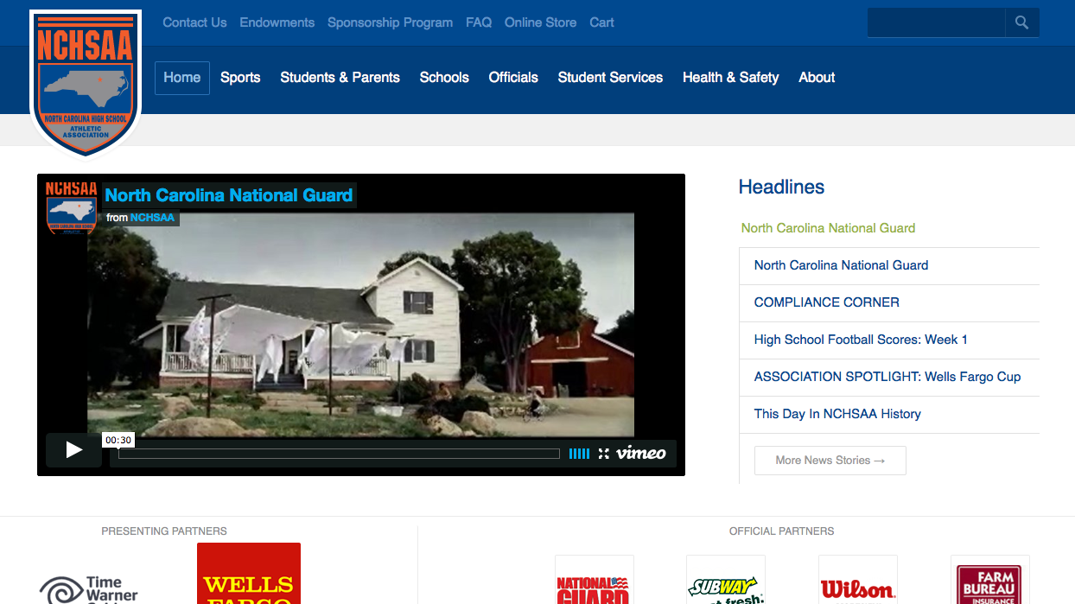
NCHSAA.ORG

Slide 86
NCHSAA Building Renovation
222 Finley Golf Course Road
  Currently undergoing renovations
  Anticipated completion date – March, 2015
216 Finley Golf Course Road
  Current Location
  Mailing Address Remains the same
    PO Box 3216
    Chapel Hill, NC 27515
Support
  Our officials donated over $6,000 towards the building renovation

Slide 87
NCHSAA Handbook
New Format for the 2014-2015 Season
4 Sections
  Section 1 – Student (Requirements for Interscholastic Athletic Participation)
  Section 2 – School (Administration of Interscholastic Athletic Programs)
  Section 3 – State (NCHSAA Administrative Responsibilities to Member Schools)
  Section 4 – Interscholastic Athletic Activities

Slide 88
NCHSAA Directory
Most important conduit for information
Ensure information is up-to-date and complete
CAA, CMAA, AIC, CIC
  Designate on School Information Sheet

Slide 89
NCHSAA Staff Changes
Carolyn Shannonhouse
  Retired after 28 years
Brad Alford
  Director of Sports & Championships
    Golf, Soccer, Swimming, Baseball
Chiquana Dancy
  Director of Sports, Championships & Student Services
    Cross-Country, Indoor Track, Softball, Track, Volleyball, W. Basketball
Tra Waters
  Director of Sports & Championships
    Football, Lacrosse, M. Basketball, Tennis, Wrestling

Slide 90
Transfer Requests
Transfer Waiver Requests – 62
Approved – 37
Denied – 25

Slide 91
Transfer Criteria
Default Rule: A Student is ineligible for 365 days after transferring
Waiver Request
  LEA to LEA
  Within LEA
Waiver Requirements (NCHSAA)
  Can be Found on Website
  Release and Acceptance
  Transfer Criteria
  Statement of Information
Caution
  Attend a school outside of LEA and return to home school, would be ineligible for 365 days.
Notes:
WITHIN LEA……..365 OR CRITERIA
ONE LEA TO ANOTHER…..365 OR WAIVER FROM NCHSAA OFFICE
TALK WAIVERS IN A MOMENT
CAUTION =

Slide 92
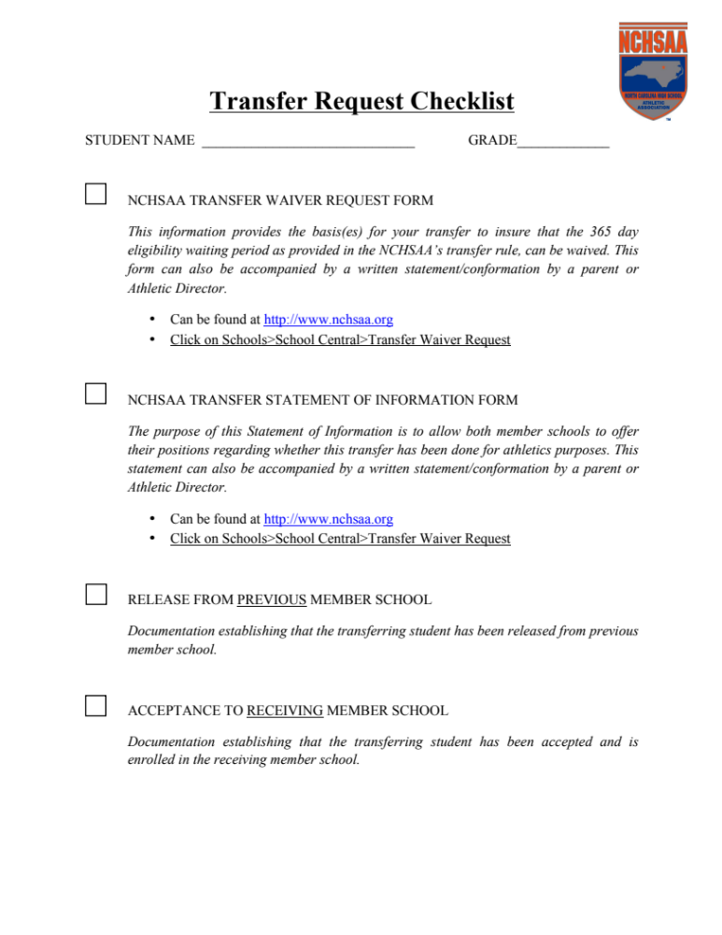
Transfer Rule
Notes:
SOI IS NOT THE RELEASE……DO WE NEED A FORM TO GO WITH THIS….??????

Slide 93
Transfer – Waiver Criteria
Basis(es) for Request
  Special Curricular Needs – Course of Study
  Documented Medical Needs
  Student’s parent/legal custodian is a permanently assigned employee of another school system
  Family/student child care needs
  Documented Safety Concerns
  Federal or State Mandated Transfers
  Other Serious or Continuing Hardship

Slide 94
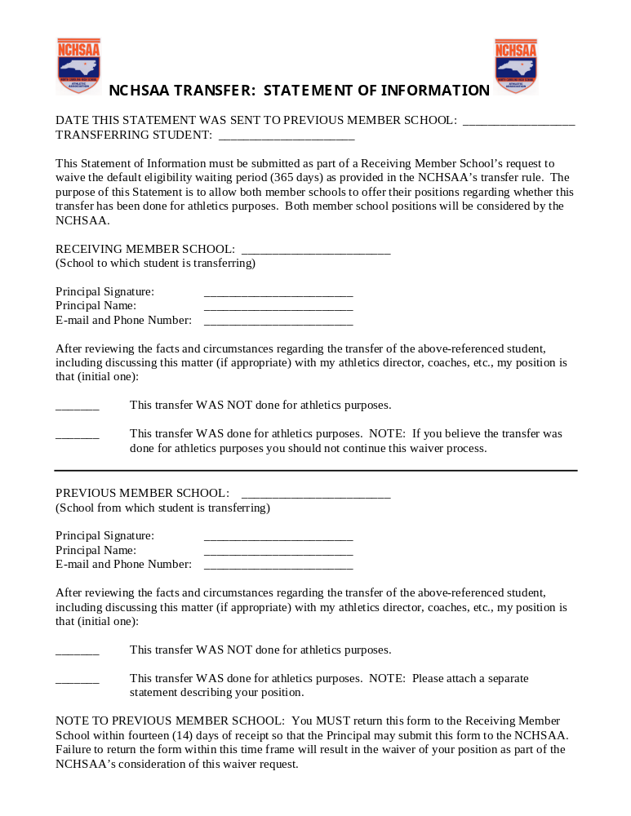
Transfer Rule
Notes:
THIS IS NOT THE RELEASE AND ACCEPTANCE…….

Slide 95
Transfer Case Scenarios
John Doe lives in LEA 1 but attends Tucker Parochial –a member school. John’s family moves to a new home in LEA 1 and John then transfers to Whitfield High, his home school in LEA 1. Does WHS have to submit a transfer waiver on John Doe’s behalf?
Jane Doe lives in LEA 1, but attends non-member Tucker High School. Jane transfers from Tucker High School to Waters High School which is a member school in LEA 2 without a bona fide move. Is Jane eligible at Waters High School?
Notes:
BONA FIDE MOVE AND WHS IS SCHOOL OF RESIDENCE
NO, NOT WITHOUT A TRANSFER WAIVER…..WOULD NOT SATISFY RESIDENCE RULE SINCE LIVES IN LEA 1 AND TRANSFERS TO ATTENS SCHOOL IN LEA 2 W/O BONAFIDE MOVE

Slide 96
Transfer Case Scenarios
James Smith lives in LEA 1, but enters the 9th grade at Frye high School, a member school in LEA 2. Following his freshman year at Frye High School, John enrolls at his home school—Richards High—in LEA 1.
  Is James eligible at Frye High School in LEA 1?
  Is James eligible at Richards High when he transfers after his freshman year at Frye?
Sally Smith attended her home school Shannon High School, in LEA 1 for her freshman year. She transfers to a non-member school to start her sophomore year; however, after Christmas, Sally transfers to House High, a member school in LEA 2.
  Is Sally eligible at House High School in LEA 2?
  If Sally transferred back to Shannon High from the non-member, would she be eligible?
Notes:
YES, INITIAL ENTRY IN TO 9TH GRADE
NOT ELIGIBLE….WITHOUT A WAIVER
NOT ELIGIBLE …. WITHOUT A WAIVER
YES….FROM NON-MEMBER TO MEMBER……

Slide 97
Transfer Case Scenarios
John Doe attends Pepper High School in LEA 1, a member school, but lives in Michael High School, LEA 2 district. Transfers following Freshman year to Cindy High School in LEA 2 without a bona fide move. Is John Eligible?
Jane Doe attends an early college and lives in LEA 1 (no athletics offered). Jane Doe moves in with Dad still in LEA 1 and transfers to a member non-traditional school in LEA 2. Is Jane Doe Eligible?
Notes:
NOT ELIGIBLE WITHOUT A TRANSFER WAIVER
SOT FROM MICHAEL HS……
YES BECAUSE OF MOVE AND TRANSFER AND RESIDENCE WITHIN 25 MILES

Slide 98
NCHSAA Finances
Resources Returned to Our Membership
Past:
  $1,500 Returned in 2011-12
    Total: $563,000
  Almost $1,700 in 2012-13
    Total: $667,000
Present:
  Almost $1,700 in 2013-14
  Total: $641,812

Slide 99
NCHSAA Finances – How it Works…
25% of $1 Surcharge of Playoff and Championship Tickets
50% of Interest and Dividends
50% of Excess Operating Budget
  1 Share for Travel in Bracketed Sports
  ½ Share for Home Game in Bracketed Sports
2013-14
  $641,812
Since 1993-94
  Over $8M
  Endowment Games

Slide 100
$8,420,533.42
$3,860,459.50

Slide 101
Fund Usage | Summarized Amount
Olympic Championship Event Expenses | $261,910
Reimbursements to schools based on cat Insurance premiums | $670,000
Offset Financial hardship | $2000
Toby Webb Coach Awards | $34,000
Clary Medal Student Awards | $34,000
Pat Gainey Student Awards | $26,000
Pat Gainey Coach Awards | $10,000
AED Placement Project | $190,616
Charlie Adams Endowed Scholarships | $15,000
Jerry McGee Endowed Scholarships | $4000
Tony Cullen Memorial Scholarships | $2000
25% of $1 ticket surcharge | $507,906
50% of Endowment Fund interest earned | $650,618
Grand Total: | $2,408,050
Notes:
Fund Usage since 1993/94 through 2013-14 (20 year period)

Slide 102
Catastrophic Insurance
$0 - $25,000
  Need to have own coverage (School or Student)
$25,000 +
  Categorized as Catastrophic Injury
  New $5,000,000 coverage for such injuries

Slide 103
Budget Review
Expenses
  Salaries and Benefits $ 1,133,167
  Office Supplies/Expenses $ 206,500
  Utilities and Grounds $ 84,500
  Meeting Expenses $ 121,500
  Awards/Scholarships $ 161,000
  Championships/Gate Receipts $ 1,160,000
  Professional Services $ 192,000
  Travel and Printing $ 173,000
  Insurance $ 526,521
  Miscellaneous $ 262,000
Total Expenses $4,020,188
Notes:
TOTAL EXPENSES ARE UP $9K FROM LAST YEAR….

Slide 104
Budget Review
Revenue
  Playoffs $ 1,309,000
  Corporate Sponsors $ 1,103,358
  Other Revenue $ 1,608,500
    Endowment Games
    Officials Registration
    Membership Dues
    Fines & Publications
    Special Events
    Insurance
Total Revenue $ 4,020,858

Slide 105
Sponsorship/Marketing/Scholarships
Time Warner Cable
  New Agreement
Scholarships
  Toby Webb Award
    Nominations…

Slide 106



• 10% discount off catering orders.
• Kits will be sent to each head
coach via NCHSAA office.
• Healthy alternative for Sports
Banquets, Awards events, away
travel, other school functions.

Slide 107


Slide 108


• NCHSAA EVENTS ARE INTENDED TO BE HELD AT FACILITIES
AND SITES MEETING THE RECOMMENDED MINIMUM LIGHTING STANDARDS AS OUTLINED IN THE NCHSAA LIGHTING STANDARDS MANUAL, AVAILABLE ON NCHSAA WEBSITE.
- INCLUDES CHECKLIST (PAGE 11).
• PROPER LIGHTING IS IMPORTANT TO THE SAFETY
AND WELL-BEING OF THE STUDENT ATHLETES, PARENTS,
FANS AND COACHES.
• DID YOU KNOW: OF 120 HIGH SCHOOLS TESTED –
- 28% MET IES FOOTCANDLE LEVELS
- 22% MET IES UNIFORMITY OR SMOOTHNESS STANDARD
• MUSCO, AN EVENT SPONSOR OF THE NCHSAA REGIONAL
MEETINGS, CAN PROVIDE FREE LIGHTING ANALYSES
LOCAL CONTACT: DINA NEELEY- dina.neeley@musco.com
866/748-8739 x6428 toll free
336/414-1030 cell
Notes:
FOOTCANDLE: a common unit of measurement used to calculate adequate lighting levels of workspaces in buildings or outdoor spaces
IES: ILLUMINATING ENGINBEERING SOCIETY

Slide 109








North Carolina Army National Guard your partners in education
The YOU CAN school Program is an award winning program that is delivered by certified presenters on a range of 35 separate topics.
Career Direction 2 is a comprehensive program designed to help students make appropriate educational and career choices.
The HEAR Program is a anti-bullying presentation that was developed by Harvard Graduate School and the University of Nebraska-Lincoln.
The HSPD Program is a football camp that is designed to teach leadership along with traditional football skills.
The SASVAB is a battery of test that when combined with the interpretation is an excellent tool to determine aptitudes and road map the students future.
The Scholar Athlete program is a Guard sponsored NCHSAA program that strives to recognize students for their performance on and off the field.
NORTH CAROLINA
NationalGuard.com/NC
Ask us for more information on any of these FREE programs at 855-NC-GUARD
Notes:
Please visit with the NC National Guard representative on site at todays meeting to learn more about these wonderful and beneficial programs.

Slide 110


Slide 111
Student Services
Opportunities for leadership development of students as well as adults.
  Conferences, seminars, retreats, etc.
  2015 Student Leadership Conference
    Spring of 2015
  Student Athlete Advisory Council (SAAC)
    Need to Increase # of Nominations!!!
Unified Program

Slide 112
Athletic Director’s Information
Athletic Director Checklist on website
Athletic Director in Multiple Roles
  AD/Coach
  AD/Teacher
  AD/Coach/Teacher
Coach Mentor Program

Slide 113
High School Athletics
Importance of High Schools
  Limitation on out of season work
Co-Curricular
  Weight Lifting or Power Lifting
  All students can participate
    Increase Self-Esteem
    Increase Grades
    Improve Attendance

Slide 114
Miscellaneous
Television
  Regular Season
  Cable/ESPN
Annual Meeting
  Pros/Cons?

Slide 115
Questions/Comments/Concerns?

Slide 116
Realignment Feedback
Straw Polls
  Football Only
    2-Years
  Non-Football Schools Out – Set – Add
  20-30-30-20
  3, 4, or 5 Classes
  Travel vs Small School in Split

Slide 117
NCHSAA Awards
Student Services Awards
  2013-2014 Ejection-Free Schools
NCHSAA Special Awards

Slide 118
THANK YOU!!!!
VOLUNTEERS
  MARK PEPPER, REGGIE FIELDS, CHRIS QUALLY, TRIPP SATTERWHITE
TINA BRATCHER, CUMBERLAND COUNTY SCHOOLS
PAUL HOGGARD, AD/FOOTBALL COACH, RICHMOND COUNTY SENIOR HIGH SCHOOL
CORPORATE SPONSORS

Slide 120
Best Wishes for a Great 2014-2015 School Year

