Slide 1
2014-15 NFHS Spirit Rule Revisions
Major Rules Changes
Situations and Rulings
Points of Emphasis

Slide 2
2014-15 NFHS Spirit Rule Revisions
Major Rules Changes

Slide 3
Major Spirit Rules Revisions
Rule 1
Lift Defined Identical to Stunt/Partner Stunt –
Added to the Definitions Section:
Lift – See Stunt
Stunt/Partner Stunt/Lift –
Notes:
To clarify that the dance term “lift” is defined the same as a stunt/partner stunt which is the terminology typically used in cheerleading. This will stipulate that all restrictions which apply to stunts/partner stunts also apply to lifts.

Slide 4
Major Spirit Rules Revisions
Rule 1
New Definition
Foldover Stunt – An inverted stunt in which the top person bends at the waist and is caught on his/her back by multiple catchers while one or both of the top person’s ankles/feet remain in the grip of the base(s) (e.g. yo-yo, pancake, etc.).
Notes:
A new definition of a foldover stunt was added for clarification.

Slide 5
Major Spirit Rules Revisions
Rule 1
Revised Definition
Forward/Backward Roll – A foot hip-over-head rotation that is executed either on the performing surface or in a partner stunt in which the top person is in contact with a person on the ground.
Notes:
This revision more accurately describes a roll and specifies that it can be performed both on the performing surface and in a partner stunt.

Slide 6
Major Spirit Rules Revisions
Rule 1
Revised Definition
Suspended Roll/Flip – A stunt in which a person is assisted by upright base(s) or post(s) hold a top person’s hand(s)/arm(s) while the top person performs continuous foot hip-over-head rotation.
Notes:
This revised definition more accurately describes the elements of a suspended roll.

Slide 7
Major Spirit Rules Revisions
Rule 1
Revised Definition
Tumbling – Gymnastic skills that begin and end on the performing surface, including forward/backward rolls, inverted extended skills (cartwheels, handstands, walkovers, aerials, handsprings, etc.), aerials, twists and flips. NOTE: Jumps, leaps and log side rolls on the performing surface are not considered to be tumbling.
Notes:
This revision now stipulates that, in order to be considered tumbling skills, they must begin and end on the performing surface.

Slide 8
Major Spirit Rules Revisions
Rule 2-3-8
ART. 8 . . . Supports, braces, soft casts, etc., which that are hard and unyielding or have rough edges or surfaces must be padded with a closed-cell, slow-recovery foam padding no less than one-half inch thick. Padded knee, ankle and wrist braces unaltered from the manufacturer’s original design/production do not require any additional padding. Supports/braces that have been altered from the manufacturer’s original design/production must be padded with a closed-cell, slow-recovery foam padding no less than one-half inch thick if the participant is involved in partner stunts, pyramids or tosses. A participant wearing a plaster cast (excluding a properly covered air cast) or a walking boot must not be involved in partner stunts, pyramids or tosses or tumbling.
Notes:
This revision clarifies the use of supports, braces and soft casts and when padding is required for participation in stunts, pyramids and tosses. This rule is intended to minimize risk for all participants.

Slide 9
Major Spirit Rules Revisions
Rule 2-3-8
Actual Revised Wording
ART. 8 . . . Supports, braces, soft casts, etc. that are unaltered from the manufacturer’s original design/production do not require any additional padding. Supports/braces that have been altered from the manufacturer’s original design/production must be padded with a closed-cell, slow-recovery foam padding no less than one-half inch thick if the participant is involved in partner stunts, pyramids or tosses. A participant wearing a plaster cast or a walking boot must not be involved in partner stunts, pyramids or tosses.

Slide 10
Major Spirit Rules Revisions
Rule 2-5-2a
ART. 2 . . .In specific situations, a top person may be inverted in partner stunts/pyramids.
a. In all inverted partner stunts:
1. At least one base or spotter must be in a position to protect the head/neck of the top person.
2. The base or spotter maintains contact with the top person’s upper body (waist and above, including arms/hands) until the top person is no longer inverted or his/her hands are on the performing surface. The contact must be sufficient to stabilize/control the top person’s position.
Exception: A top person in an inverted position on the performing surface can be released to a loading position below shoulder height.
Notes:
Additional changes were made this year to reduce confusion, to address concern that correct technique for executing specific inversions are illegal and to allow greater creativity without adding undue risk to participants. The rule revision adds the requirement that upper body contact be sufficient to control/stabilize the position of inverted top person. The rule revision allows an inverted participant on the performing surface to be released to a loading position. Additionally, inversions that pass through but do not stop in an extended position are allowed. In a foldover stunt, such as a pancake, the top person may initiate the inversion without upper body contact. Inversions can dismount to a cradle or an upright position on the performing surface. An additional revision clarifies the use of new catchers during suspended rolls. Article 3 was deleted, incorporating Suspended Rolls into Article 2. This allows Suspended rolls to follow the same rules as other inverted partner stunts. An addition to restrict an inverted top person from holding objects was added.

Slide 11
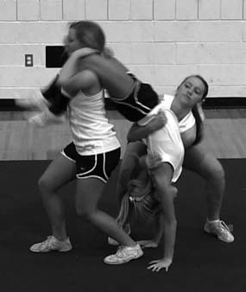
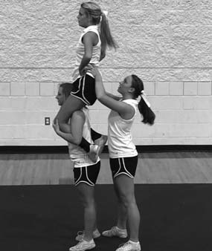
Major Spirit Rules Revisions
Rule 2-5-2a
1 2
Legal

Slide 12
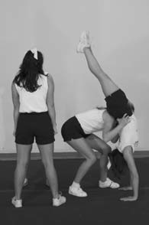
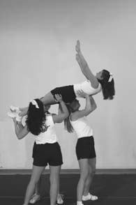
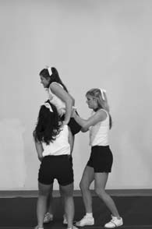
Major Spirit Rules Revisions
Rule 2-5-2a
1 2 3
              Legal

Slide 13
Major Spirit Rules Revisions
Rule 2-5-2b & c
b. Inverted partner stunts must begin and end below an extended position. An inverted top person is allowed to pass through an extended position, but must not pause or stop while extended.
c. A spotter is required if the base of support is at or above shoulder level. Exception: Double base suspended rolls do not require a spotter.

Slide 14
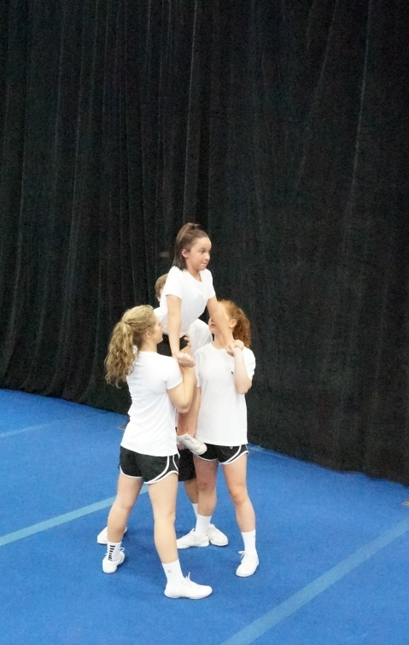
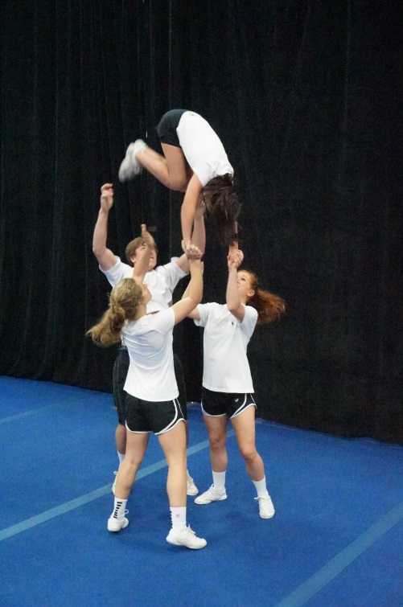
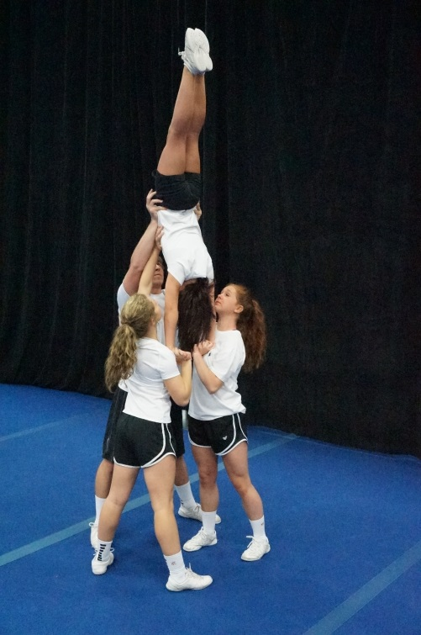
Major Spirit Rules Revisions
Rule 2-5-2b
1 2 3
Legal

Slide 15
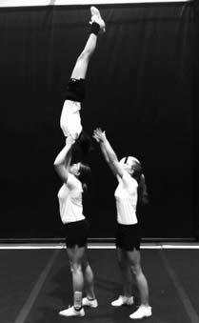
Major Spirit Rules Revisions
Rule 2-5-2c
Legal

Slide 16
Major Spirit Rules Revisions
Rule 2-5-2d
d. If the inverted top person is moving downward (downward inversion):
1. At least two people on the performing surface must be in a position to protect the head/neck of the top person.
2. The bases/spotters maintain contact with the top person’s upper body (waist and above, including arms/hands) until the top person is no longer inverted or his/her hands are on the performing surface. The contact must be sufficient to stabilize/control the top person’s position.
Exception: In a foldover stunt, the top person may initiate the inversion without upper body contact.
3. The top person must not go directly to an inverted position on the performance surface from a prep position or higher.

Slide 17
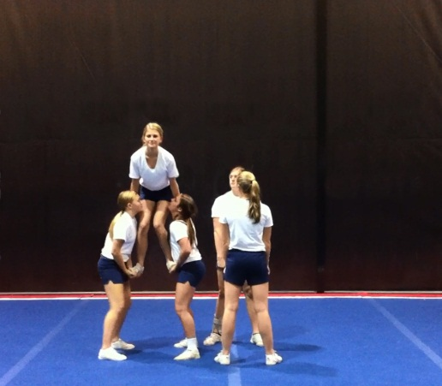
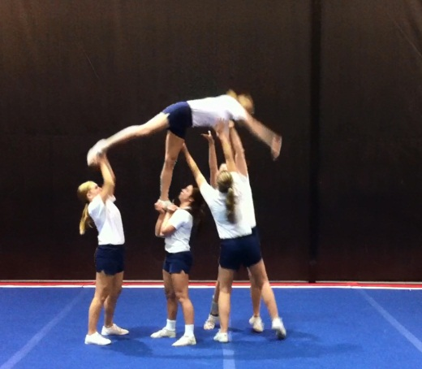
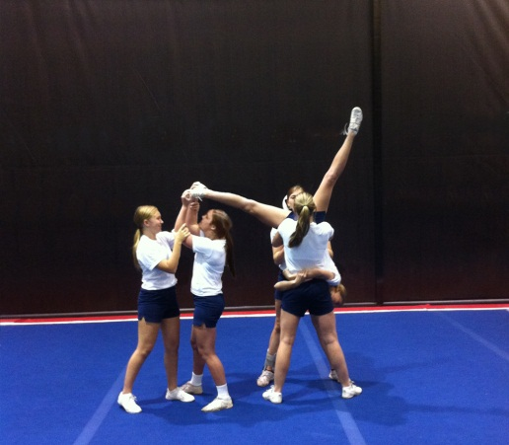
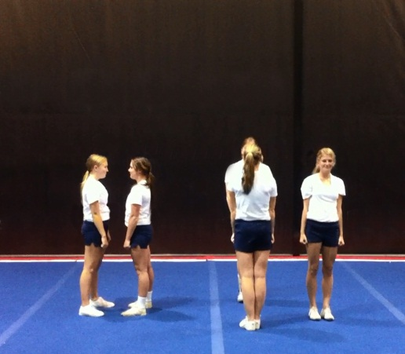
Major Spirit Rules Revisions
1 Rule 2-5-2d 2
3 4
Legal

Slide 18
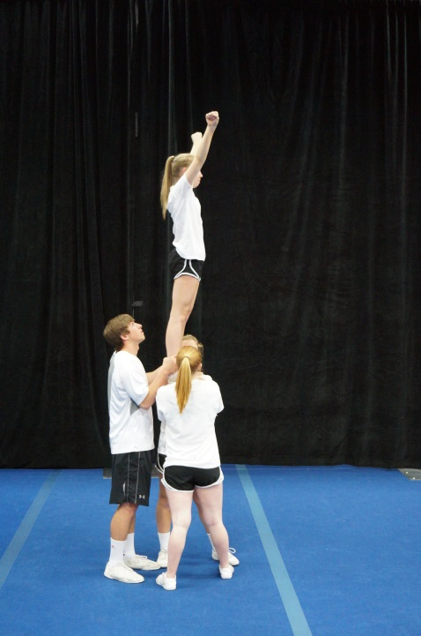
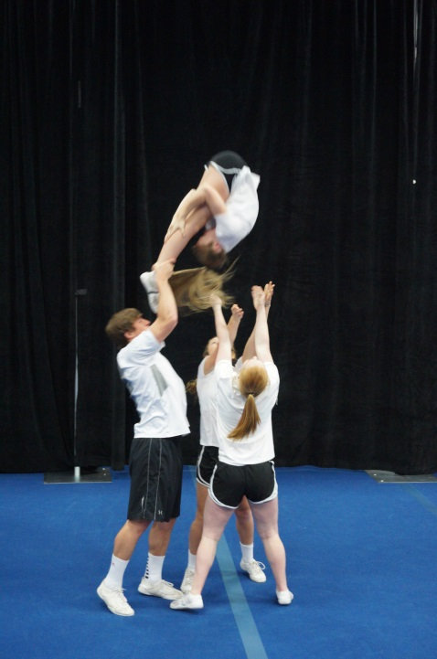
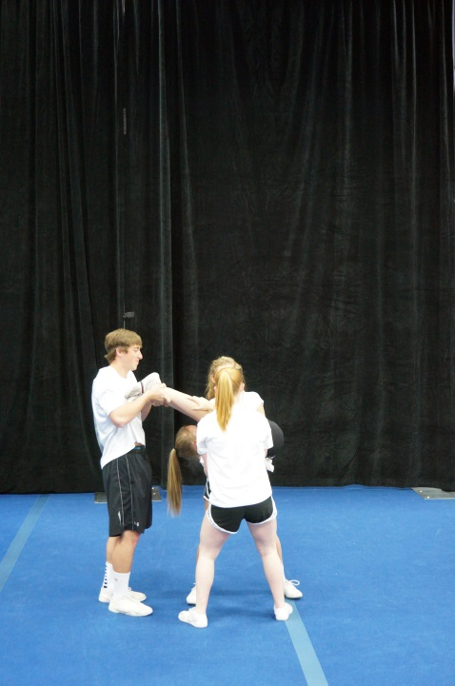
Major Spirit Rules Revisions
Rule 2-5-2d
1 2 3
Legal

Slide 19
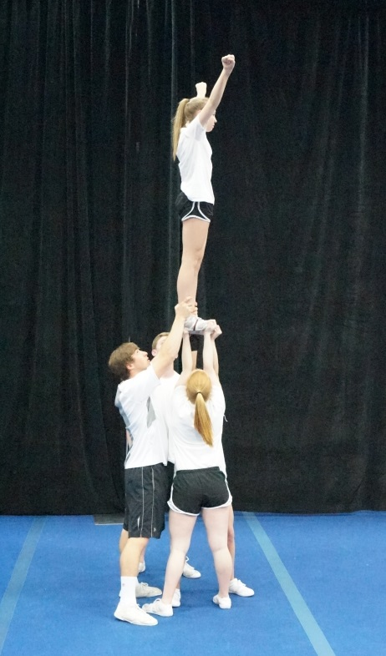
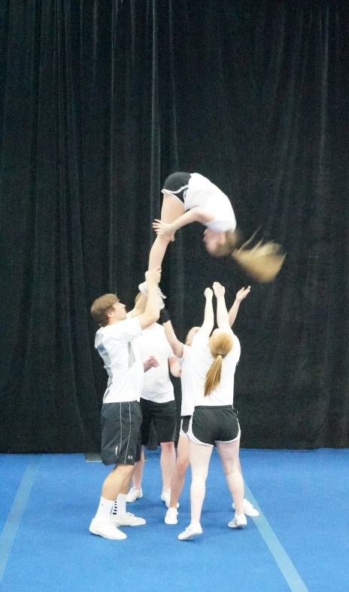
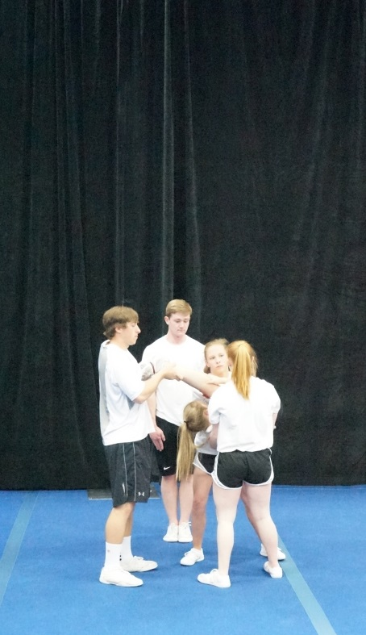
Major Spirit Rules Revisions
Rule 2-5-2d
1 2 3
Legal

Slide 20
Major Spirit Rules Revisions
Rule 2-5-2e
e. Suspended rolls are permitted provided:
1. Two people on the performing surface control the top person with continuous hand-to-hand/arm contact to a stunt, two-person cradle, loading position or the performing surface.
2. A single base or post controls the top person with continuous hands-to-hands contact to a stunt, two-person cradle, loading position or the performing surface.
NOTE: A single base/post suspended roll that ends on the performing surface requires a spotter per rule 2-5-2(c).
3. If caught in a cradle, load or stunt, the new catchers are in place and are not involved with any other skill when the suspended roll is initiated.
4. The feet/ankles of the top person are released.

Slide 21
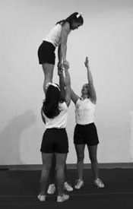
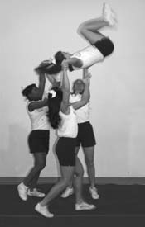
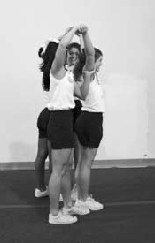
Major Spirit Rules Revisions
Rule 2-5-2e
1 2 3
Legal

Slide 22
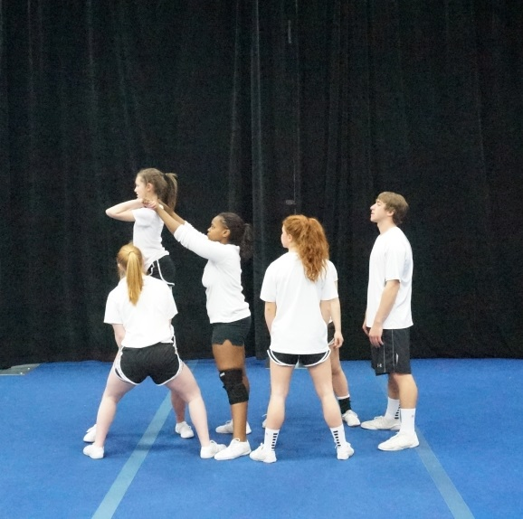
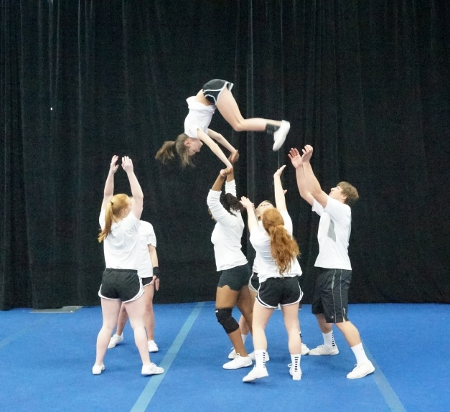
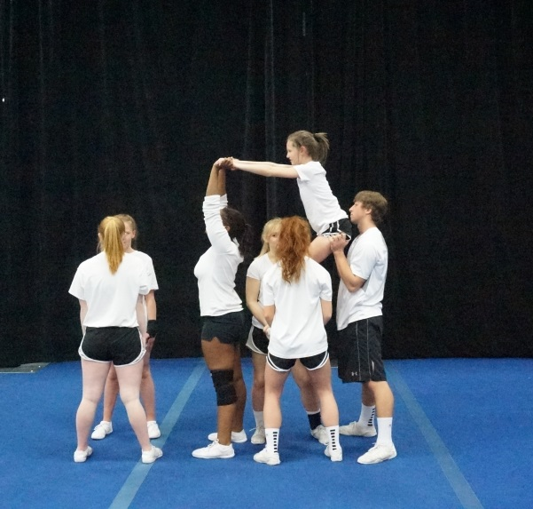
Major Spirit Rules Revisions
Rule 2-5-2e
1 2 3
Legal

Slide 23
Major Spirit Rules Revisions
Rule 2-5-2f
f. Dismounts from inverted stunts to a cradle or an upright position on the performing surface are allowed provided the top person begins in a static or “pump and go” position (e.g., handstand) and does not perform any skill (e.g. toe touches, twists, etc.). Dismounts to the performing surface from shoulder height or above must follow Rule 2-9-2.

Slide 24
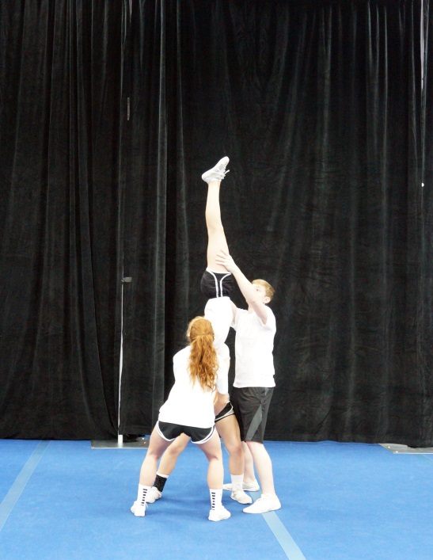
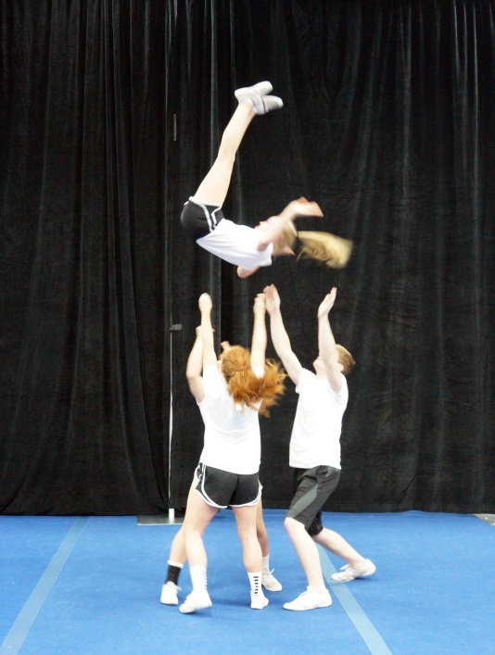
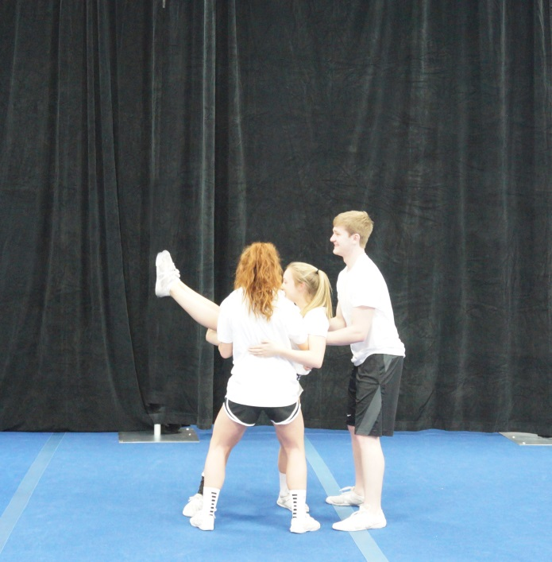
Major Spirit Rules Revisions
Rule 2-5-2f
1 2 3
Legal

Slide 25
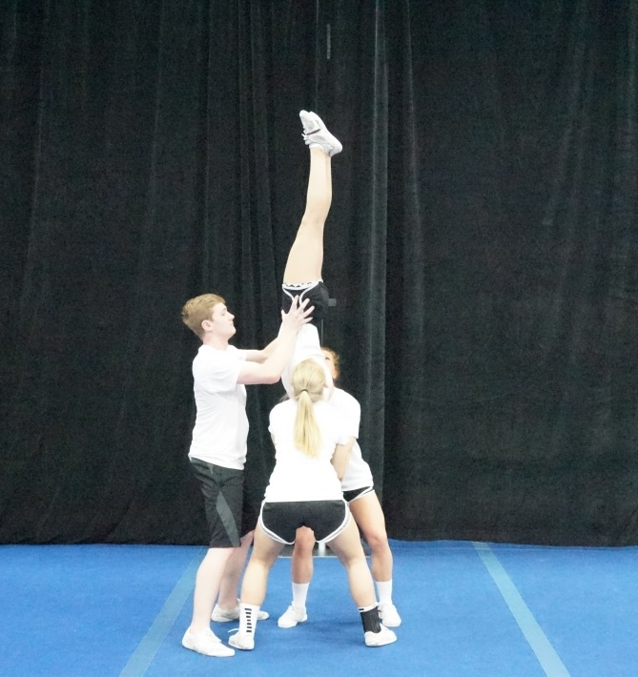
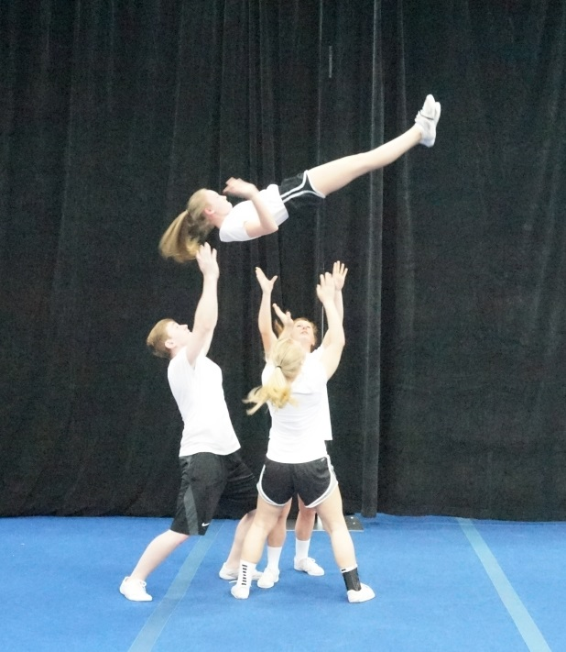
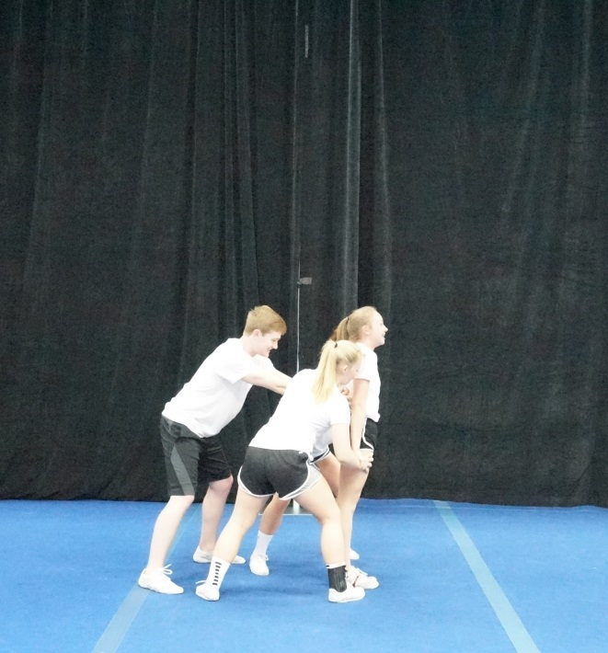
Major Spirit Rules Revisions
Rule 2-5-2f
1 2 3
Legal

Slide 26
Major Spirit Rules Revisions
Rule 2-5-3
ART 3. . Art 3 Deleted
ART 3 . . (Old ART 4) Braced forward or backward flips or rolls in a pyramid are allowed. (No other changes).

Slide 27
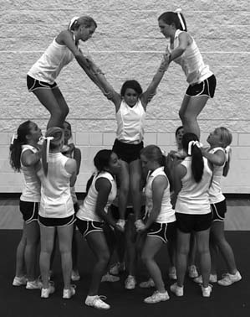
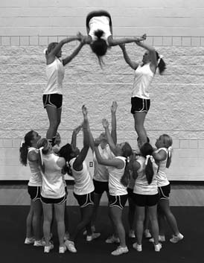
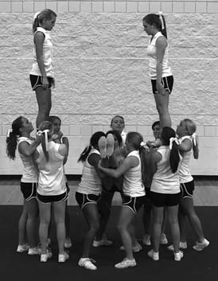
Major Spirit Rules Revisions
Rule 2-5-3
1 2 3
Legal

Slide 28
Major Spirit Rules Revisions
Rule 2-5-4 New
2-5-4: “An inverted top person must not hold objects (poms, signs, etc.) in his/her hands”.

Slide 29
Major Spirit Rules Revisions
Rule 2-6-13
2-6-13: A flip from the performing surface that lands in a partner stunt or cradle is illegal.
Please note that this rule is not new. It was in the 2013-14 Spirit Rules Book as Rule 2-10-4. It was moved to Rule 2-6-13 as the committee believed that was a more logical place for it.

Slide 30
Major Spirit Rules Revisions
Rule 2-7-5 Note
Delete NOTE.
NOTE: A helicopter is an exception to the release transition rule, 2-7-7.
Notes:
This revision deletes the note for a helicopter as an exception to the release transitions rule as this stipulation is now covered elsewhere.

Slide 31
Major Spirit Rules Revisions
Rule 2-7-6 Note
Delete NOTE.
NOTE: A log roll is an exception to the release transition rule, 2-7-7.
Notes:
This deletes the log roll note because this information is now covered elsewhere.

Slide 32
Major Spirit Rules Revisions
Rule 2-7-6
A log roll is legal provided it does not involve more than one complete rotation and the top person is not in contact with another released top person.
Notes:
Revises and clarifies the intent of the note for log rolls as an exception to the release transition rule. The top persons in two log rolls cannot brace one another.

Slide 33
Major Spirit Rules Revisions
Rule 2-9-1
EXCEPTION: The bases may make a ¼ turn to catch a cradle.
Notes:
This exception allows bases to make a ¼ turn to catch the cradle.

Slide 34
Major Spirit Rules Revisions
Rule 2-9-8
A twist to a cradle or to the performing surface must not involve more than 1 ¼ complete rotations. except when dismounting from a side facing stunt or toss, 1 ¼ rotations are permitted. The bases may make a ¼ turn to catch the cradle.
Notes:
This revision allows 1¼ rotation in a cradle regardless of the direction the stunt is facing.

Slide 35
Major Spirit Rules Revisions
Rule 2-9-9
In all dismounts to catchers who are not the original bases, the following conditions must be met:
a. The top person must be cradled by two bases/catchers and a head-and-shoulders spotter/catcher.
b. The new catchers must remain close to the original bases.
c. The new catchers must be in place and must not be involved in any other skill when the release is initiated.
d. The top person must not execute any skill (twist, toe touch, etc.) following the release.
Notes:
This revision clarifies the use of new catchers during dismounts.

Slide 36
Major Spirit Rules Revisions
Rule 2-10-1
Tumbling or rebounding over or under a stunt, person or prop is illegal with the exception of a forward roll non-aerial tumbling over a person or prop on the performing surface.
Notes:
This revision allows non-aerial tumbling over a person or prop on the performing surface. Allowing additional non-aerial tumbling provides opportunities for creativity without adding undue risk to participants.

Slide 37
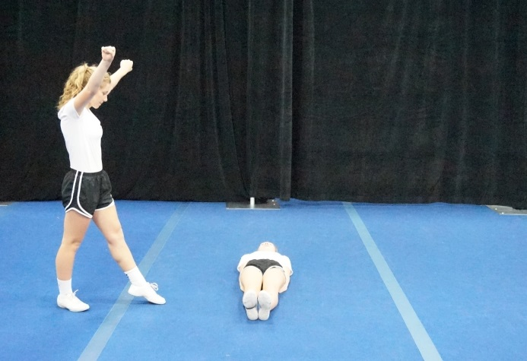
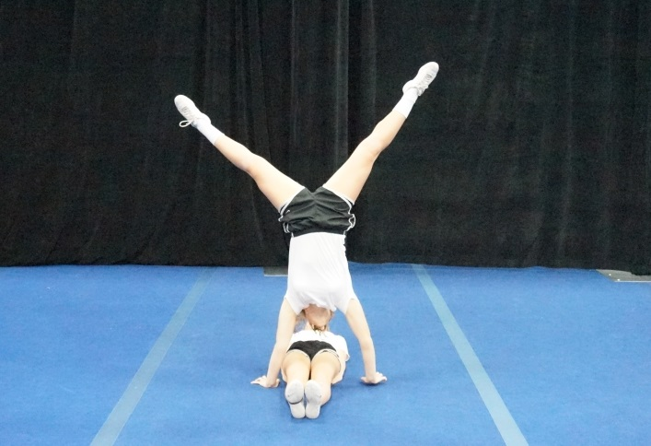
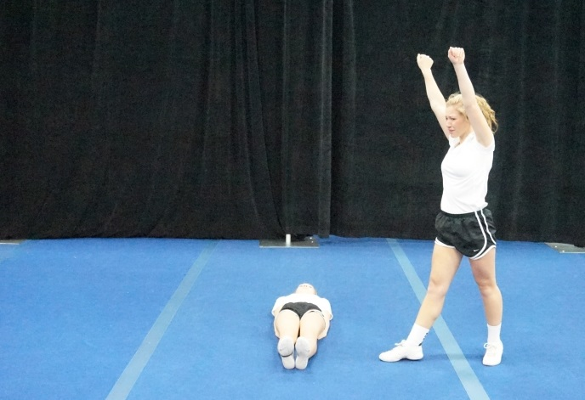
Major Spirit Rules Revisions
Rule 2-10-1
1 2 3
Legal

Slide 38
Major Spirit Rules Revisions
Rule 2-11
ART. 1 . . . A twist performed to a cradle or to the performing surface must not involve more than one complete rotation except, when dismounting from a side-facing stunt or toss, 1¼ rotations are permitted. The bases may make a ¼ turn to catch the cradle.
ART. 2 . . . A twist performed during a tumbling pass must not involve more than one complete rotation.
ART. 3 . . . A twist on the performing surface (jump-twist-land) must not involve more than two complete rotations.
Notes:
This revision deletes articles one and two that are now addressed in section 9 and article three is also deleted as twisting on the performance surface presents minimal risk to participants.

Slide 39
2014-15 NFHS Spirit Rule Revisions
New and Revised Situations and Rulings

Slide 40
New and Revised
Situations and Rulings
*2.1.1 SITUATION: A coach allows a team member to participate with jewelry in a new piercing because the parent insists. RULING: illegal.
*2.1.5 SITUATION D: A spirit team in shoulder stands is holding a sign for football players to run through. RULING: illegal. COMMENT: The close proximity of other participants makes stunting in this situation unsafe.

Slide 41
New and Revised
Situations and Rulings
*2.3.1 SITUATION A: A participant is wearing: (a) a watch; (b) post earrings covered by tape; (c) a religious medal on a chain; (d) a navel ring; (e) fish line or spacer through a piercing; (g) a dermal piercing without the jewelry adornment removed; (h) a gauge in a stretched ear piercing. RULING: All are illegal. COMMENTS: (g) If the jewelry adornment of a dermal piercing is removed, it is legal. (h) Participants may choose to cover the opening with tape after removing the gauge or jewelry.

Slide 42
New and Revised
Situations and Rulings
*2.3.1 SITUATION B: Cheerleaders are wearing: (a) uniforms with rhinestones sewn, punched or glued on; (b) rhinestones woven into their hair; (c) rhinestones glued on their faces. RULING: (a) legal; (b) and (c) illegal.
*2.3.6 SITUATION: Cheerleaders are wearing uniforms that have sheer, “see through” material around the midriff. RULING: illegal.

Slide 43
New and Revised
Situations and Rulings
*2.3.8 SITUATION A: A participant wearing a brace that has been modified from the manufacturer’s original design/production: (a) acts as a post during a suspended roll; (b) participates in a sideline chant. RULING: (a) illegal; (b) legal. COMMENT: (b) Participating in individual skills while wearing braces that have been altered from the manufacturer’s design do not present risk to other participants.
*2.3.8 SITUATION B: A participant in a walking boot (a) bases a stunt; (b) spots a stunt; (c) executes a cartwheel. RULING: (a) and (b) illegal; (c) legal. COMMENT: (c) Participating in individual skills while wearing a walking boot does not present risk to other participants. A medical professional is the appropriate person to determine whether such activities are safe for the injured participant.

Slide 44
New and Revised
Situations and Rulings
*2.4.1 SITUATION B: A base is holding poms in one hand while: (a) supporting a top person in a prep; (b) holding a top person’s hitched foot with his/her other hand. RULING: (a) illegal; (b) legal.
*2.4.5 SITUATION A: A spotter is standing slightly behind an extension and: (a) stays visually focused on the head and shoulders of the top person; (b) glances away for a moment to check other stunts; (c) hands a sign to the top person. RULING: (a) and (b) legal; (c) illegal.

Slide 45
New and Revised
Situations and Rulings
*2.4.5 SITUATION B: A team executes a double base prep. A spotter holds the ankles of the top person while looking at the crowd. RULING: legal COMMENT: Spotting rules do not apply to stunts that don’t require a spotter.

Slide 46
New and Revised
Situations and Rulings
* 2.5.1 SITUATION: A top person: (a) in a basket toss drops her head back to the point her shoulders are below her waist; (b) is a bracer for a flip that starts on the floor. Her shoulders inadvertently go below her waist as she reaches down to assist the top person. RULING: Both are illegal.
*2.5.2 SITUATION A: Two participants are standing back to back with their arms hooked together. The base leans forward as the top person does a backward roll over the base’s back and lands upright on the performing surface. RULING: illegal. COMMENT: By facing away from the inverted top person, the base is not is not considered to be in a position to protect the head/neck.

Slide 47
New and Revised
Situations and Rulings
*2.5.2 SITUATION B: A participant in a handstand on the performing surface: (a) is lifted, released and flipped by two bases, landing in a load; (b) is lifted into a prep by two bases who hold her arms and thighs; (b) hooks her legs over the shoulders of a base and transitions to a shoulder sit without assistance. RULING: (a) and (b) legal; (c) illegal.
*2.5.2 SITUATION C: Participants execute chorus line flips in which: (b) two performers lean against the outstretched interlocked arms of three bases/posts, and roll backwards over their arms; (b) three performers lean against the outstretched interlocked arms of four bases/posts and roll as in (a). RULING: (a) legal; (b) illegal. COMMENT: (b) At least one base/post for each top person must have a free hand.

Slide 48
New and Revised
Situations and Rulings
*2.5.2 SITUATION D: A top person in a prep is pushed above the bases’ heads by the spotter/post. The top person immediately folds, rotates forward and is caught on her back in a pike position by the original bases. The bases/catchers do not have contact with her upper body as she initiates the inversion. RULING: legal. COMMENT: Foldover stunts are the exception to the requirement for continuous upper body contact during an inversion. However, the catchers must still reach upward to acquire upper body contact prior to the catch.
*2.5.2 SITUATION E: A top person in a prep is supported on her upper body by two bases. She executes (a) a back arch to a handstand on the floor; (b) a cartwheel to her feet on the floor. RULING: (a) illegal; (b) legal.

Slide 49
New and Revised
Situations and Rulings
*2.5.2 SITUATION F: A top person is in a straddle sit with two bases and a spotter. She executes a suspended forward roll by: (a) grasping a hand of each base who assist her to the performing surface; (b) grasping a hand of each base who assist her to a handstand position where she pauses before continuing to the performing surface; (c) grasps both hands of the spotter and, as the bases hold her feet, executes the roll by swinging down and back up to a prep. RULING: (a) legal; (b) and (c) illegal. COMMENT: (c) The feet of the top person must be released during a suspended roll.
*2.5.2 SITUATION G: A top person in a flatback grasps the hands of a post standing at her head and executes a suspended backward roll. There are no spotters present. She (a) lands in a prep supported by two new bases; (b) lands on the performing surface; (c) releases one hand of the post and lands in a two-person cradle. RULING: (a) legal; (b) and (c) illegal.

Slide 50
New and Revised
Situations and Rulings
*2.5.2 SITUATION H: A top person is supported by two bases in a shoulder height handstand. The bases pop her and: (a) catch her in a cradle, assisted by a spotter; (b) assist her to an upright position on the performing surface; (c) assist her to a handstand on the performing surface; (d) catch her in a loading position. RULING: (a) and (b) legal; (c) and (d) illegal.
*2.5.2 SITUATION I: An inverted top person is supported by two bases who are holding her above their heads. The bases pop her and assist her to the performing surface. RULING: illegal. COMMENT: Inverted partner stunts must not begin (or end) in an extended position.

Slide 51
New and Revised
Situations and Rulings
*2.5.3 SITUATION A: A top person executes a forward flip in a layout position, assisted by two bracers, one on each side. (a) The bracers are facing away from the top person; (b) The bases and spotter intentionally toss the top person forward and step in front of the pyramid to catch her in a cradle. RULING: Both are illegal.
*2.5.3 SITUATION B: The top person in a multi-base extension executes a braced forward flip: (a) with a twist to a cradle; (b) to separate bases and spotter who are behind the top person; (c) to a prep with the original bases and spotter who then assist the top person to the performing surface. RULING: (a) and (b) illegal; (c) legal.

Slide 52
New and Revised
Situations and Rulings
*2.5.3 SITUATION C: There are three original bases/spotters underneath a top person during a braced flip. (a) Two catch the top person in a prep while the third person spots the landing; (b) All three catch the top person in a cradle. RULING: Both are legal. COMMENT: All three bases/spotters are not required to actually catch the top person in a braced flip. One or two can actively assist/spot the landing.
*2.5.3 SITUATION D: There are three original bases/spotters underneath a top person during a braced flip. One base catches the top person in a liberty while the other two assist/spot, (a) standing with one spotter directly behind the other; (b) standing in a manner where both spotters have a direct path to the stunt. RULING: (a) illegal, (b) legal.

Slide 53
New and Revised
Situations and Rulings
*2.5.4 SITUATION: A top person holding a sign is transitioned to a prone position. (a) She holds the sign as she executes a forward roll dismount; (b) she drops the sign to the side before beginning a forward roll dismount. RULING: (a) illegal; (b) legal.

Slide 54
New and Revised
Situations and Rulings
*2.6.4 SITUATION A: The top person in a double-base prep falls forward while a spotter/post grasps her ankles. She is caught on her upper body by the two original bases. RULING: legal.
*2.6.4 SITUATION B: The top person in an extension falls forward and: (a) is caught in a prone position by two new bases and a spotter who were in place prior to beginning the drop. (b) is caught in a horizontal position by two new catchers and spotter who were behind the original bases and moved into position during the drop. RULING: (a) legal; (b) illegal.

Slide 55
New and Revised
Situations and Rulings
*2.7.5 SITUATION B: A top person in a layout position is popped by bases and executes a log roll. The top person is braced by top persons in preps. RULING: legal. COMMENT: Because the top persons in the preps are not released, they can brace the log roll.
*2.7.7 SITUATION: A top person in a cradle is popped to a: (a) double base prep; (b) prep level straddle sit. RULING: Both are legal.

Slide 56
New and Revised
Situations and Rulings
*2.9.3 SITUATION: A top person in a single-base prep executes: (a) a twist to the floor without assistance; (b) a twist to the floor with the assistance of the base and a spotter; (c) a toe-touch during the dismount with the assistance of the base and a spotter. RULING: (a) illegal; (b) and (c) legal. COMMENT: The dismount must be no more than a pop that does not significantly increase the height of the top person.
*2.9.5 SITUATION: Two double-base extensions share a common middle base and: (a) one of the top persons dismounts to a double-base cradle with a separate head-and-shoulders spotter and the other to a single-base cradle with a separate head-and-shoulders spotter; (b) each of the top persons dismounts to double-base cradles with separate head-and-shoulders spotters. RULING: (a) illegal; (b) legal.

Slide 57
New and Revised
Situations and Rulings
* 2.9.8 SITUATION A: A top person in an extension on the gymnasium floor executes: (a) a single-twist to cradle; (b) a 1¼ twist to cradle (c) a double twist to cradle. RULING: (a) and (b) legal; (c) illegal COMMENT: The maximum number of rotations allowed is 1¼ . A gym floor is considered to be an appropriate surface for twisting cradles.
*2.9.8 SITUATION B: A top person in a front facing stunt makes a 1¼ rotation to land facing to the side. The bases make a ¼ turn to cradle the top person. RULING: legal. COMMENT: The safety of a twisting cradle does not depend on the direction a top person is facing when the stunt begins.

Slide 58
New and Revised
Situations and Rulings
*2.9.9 SITUATION: A top person executes a forward suspended roll over a post to new catchers who: (a) have just released another top person to new catchers; (b) move to catch the top person after the suspended roll is initiated; (c) are in place and not involved with any other stunt. Ruling: (a) and (b) illegal; (c) legal.
*2.10.1 SITUATION B: A participant executes: (a) a forward roll over a person on the floor; (b) a forward roll over a sign on the floor; (c) a cartwheel over a pom on the floor; (d) back handspring over a pom on the floor. RULING: (a), (b), and (c) legal; (d) illegal.

Slide 59
New and Revised
Situations and Rulings
*2.11.1 SITUATION B: As a team executes knee drops: (a) their fingers brush the floor at the same time as their knees; (b) their hands take the weight of their bodies before their knees land on the floor; (c) they roll forward onto their knees; (d) they spiral downward before landing on the floor. RULING: (a) illegal; (b), (c) and (d) legal.

Slide 60
New and Revised
Situations and Rulings
*3.1.3 SITUATION B: A dancer’s hair is long and unsecured. She: (a) executes a round-off, back handspring; (b) is the top person in a triple base flatback; (c) executes a cartwheel. (d) is the top person in a thigh stand. RULING: (a) and (b) illegal; (c) and (d) legal. COMMENT: Long, unsecured hair is not appropriate for extended partner stunts/lifts and airborne tumbling.

Slide 61
New and Revised
Situations and Rulings
*3.2.4 SITUATION: A participant executes the following over a small prop that is lying on the floor: (a) back handspring; (b) forward roll (c) cartwheel. RULING: (a) illegal; (b) and (c) legal. COMMENT: In this situation, the prop is not being used as a base. However, only non-aerial tumbling is allowed over a prop on the floor.

Slide 62
New and Revised
Situations and Rulings
*3.3.1 SITUATION: A top person is moving her feet on a painter’s scaffold on wheels that has bars across the back side. The spotter is standing (a) at the open front of the scaffold; (b) at the back of the scaffold behind the bars. RULING: (a) legal; (b) illegal.
* 3.4.2 SITUATION: A top person executes a forward suspended roll to the floor from a prop. She is assisted by: (a) one post who is holding both hands of the top person. No spotter is present. (b) one post who is holding both hands of the top person. A spotter is present, (b) two posts each holding one hand of the top person. RULING: (a) illegal; (b) legal.

Slide 63
New and Revised
Situations and Rulings
*3.5.1 SITUATION B: As a team executes knee drops: (a) their fingers brush the floor at the same time as their knees; (b) their hands take the weight of their bodies before their knees land on the floor; (c) they roll forward onto their knees; (d) they spiral downward before landing on the floor. RULING: (a) illegal; (b), (c) and (d) legal.

Slide 64
2014-15 NFHS Spirit Rule Revisions
Points of Emphasis

Slide 65
2014-15 Points of Emphasis
Points of Emphasis highlight the major rules changes and emphasize other rules for which additional clarification may be needed.

Slide 66
2014-15 Points of Emphasis
Coaches’ Responsibility: Education – Coaches have a professional responsibility to read and fully comprehend the entire NFHS Spirit Rules Book. It is vital that coaches fully understand all rules in order to correctly teach the appropriate skills to their athletes. It is also the coaches’ responsibility to educate their student-athletes so they are aware of the rule changes. In addition, coaches are expected to be advocates for and models of good sportsmanship and follow all rules as written.

Slide 67
2014-15 Points of Emphasis
Coaches’ Responsibility: Minimizing Risk – Risk minimization for participants must be the primary objective for all spirit coaches. Protecting the head, neck and shoulders of participants during stunting must be a top priority. Cheerleaders should be placed under the direction of a qualified and knowledgeable coach who can recognize a squad’s particular ability level and limit their activities accordingly. “Ability level” refers to the squad’s talents as a whole. Programs should qualify cheerleaders according to generally accepted teaching progressions. The NFHS skills and techniques of stunts appropriate for the abilities of the cheerleaders must be perfected before advancing to the next level. Only those skills mastered in practice and consistently executed correctly should be performed in public. Additionally, coaches should ensure that cheerleaders are thoroughly trained in proper spotting techniques and receive appropriate training before attempting any form of cheerleading stunting and tumbling. Coaches should also provide a comprehensive conditioning and strength-building program to ensure optimum fitness for their athletes.

Slide 68
2014-15 Points of Emphasis
Concussions – The understanding of sports related concussions has evolved dramatically in recent years. We have learned that young athletes are particularly vulnerable to the effects of concussion. An athlete who exhibits signs, symptoms or behaviors consistent with a concussion (such as loss of consciousness, headache, dizziness or balance problems) shall be immediately removed from participation and shall not resume participation until cleared by an appropriate health-care professional. Look to your state high school association and the NFHS for education regarding prevention and treatment of concussions.

Slide 69
2014-15 Points of Emphasis
Application of NFHS Spirit Rules Book – The spirit rules book provides rules and safety limitations that should be followed by all cheerleading/dance/drill/pom and other spirit teams that stunt, tumble or use props as a base. Dance/drill/pom and other spirit teams that stunt, tumble, or use props as a base must follow the appropriate safety limitations in Rule 2 and Rule 3. Cheerleading or other spirit teams that use props as a base must follow the appropriate safety limitations in Rule 3. It is important to note that cheerleaders must follow rule 2-3 and dancers must follow rule 3-1 regarding apparel/accessories.

Slide 70
2014-15 Points of Emphasis
Overuse Injuries – Overuse injuries are a common problem characterized by irritation to a body part. Cutting back on the intensity, duration and frequency of specific activities/skills will help to minimize the potential for overuse injuries to athletes. Headstands, headspring flips, back handsprings, or jumps are examples of skills that have the potential for injury due to overuse.

Slide 71
2014-15 Points of Emphasis
Performance surfaces and areas – The rules specify that “Performance surfaces and areas must be suitable for spirit activities and reasonably free from objects and/or impediments.” Further, the rules state that “When discarding props that are made of hard material or have corners or sharp edges, team members must gently toss or place the props.” In some situations, discarded props and signs could increase the risk of injury should team members step on them. This is true for both competitive and non-competitive spirit activities. In competitive spirit activities, state associations or local competition administrators can provide information on deductions that may be taken for stepping on objects on the performance surface.

Slide 72
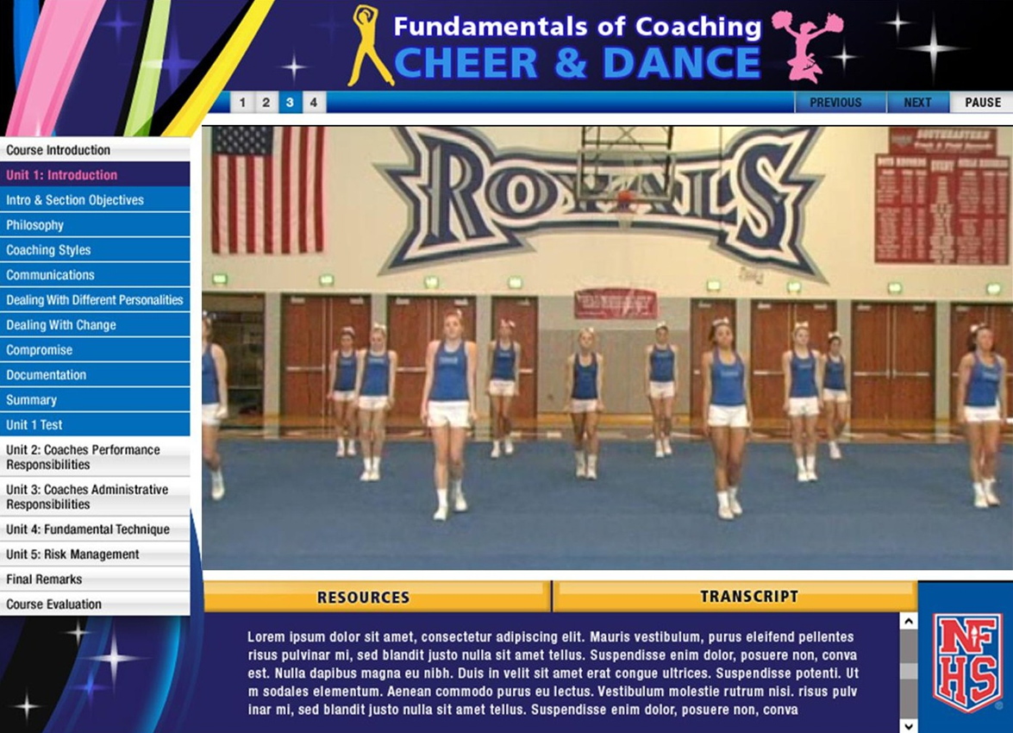
Notes:
Please refer to the NFHS website for additional information regarding the NFHS Learn Programs
Additional safety courses can also be found online at http://www.aacca.org/safetycourse

Slide 73

2014-15 NFHS Spirit Rules E-Books
The NFHS Spirit Rules Book is now available for purchase as an e-book.
Apple users can visit iTunes for available books.
Apple, Android and Kindle users can buy e-books from Amazon.com and view them through the Kindle app.
Price: $5.99 each
Visit www.nfhs.org/ebooks
for more information.

Slide 74

Notes:
Concussion awareness and education continue to be a major Point of Emphasis. Please be familiar with the Return to Play Policy (RTP) and the NFHS suggested Guidelines for Management of Concussions.

Slide 75

Notes:
NFHSlearn.com also offers an excellent online video free of charge that covers the role of the Parent in Sports.

Slide 76
NFHS Online Meeting Evaluation
Important
At the end of this session, do not close your browser. After the Webinar is concluded, a meeting evaluation form will appear.
Please complete and submit the evaluation form and then close your browser.
Thank you for your participation in the meeting and for completing the evaluation!

Slide 77
2014-15 NFHS Spirit Rule Revisions
Thank you for your participation.

