Slide 1
Understanding and Enforcing Hybrid Pitching Rules
February 2019

Slide 2
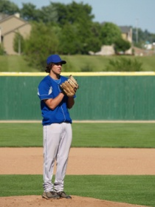
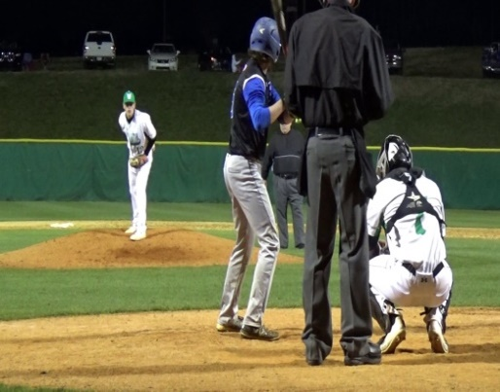
Pitching Positions
There are only two recognized pitching positions, the windup and the set position. Each has its own requirements.
The restrictions start in either position when the pitcher intentionally takes his signs from the pitcher’s plate. He must take the catcher's signal from the plate.
Rationale. To eliminate any confusion or circumvention of the NFHS pitching rules by a player or coach. The location of the pitcher’s feet shows if he is going to use the windup or set restrictions AND what his next required actions most be.
Windup
position
Set position

Slide 3
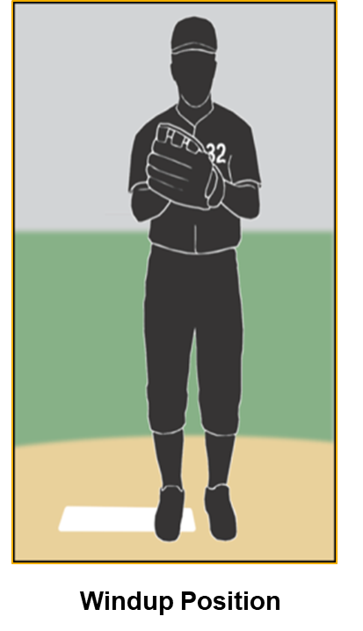
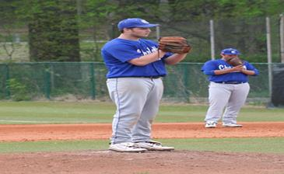
The Windup
The pitcher is not restricted how he shall hold the ball.
Three accepted locations of the pitcher’s hands:
Both hands at his side
Hands together in front of his body
Either hand at side and the other hand in front of his body
He is allowed from all three locations to bring his hands together momentarily, come to a stop to adjust the ball, to disengage the plate or to continue with his pitching motion. If he steps onto the pitcher’s plate with both hands apart, when he begins to move both hands simultaneously, that is the start of a pitch.
Prior to movements of the arms and legs not associated with his habitual pitching motion, he can remove his cap, shake-off a sign with his glove, or even roll his shoulders. These are considered arm movements not associated with the pitch and not engaging the batter.
Head movement is never restricted. The rule states any arm, hip, or leg movement toward the plate that is naturally associated with his pitching motion has committed him to complete the pitch in one continuous uninterrupted motion.

Slide 4
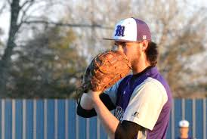
The Windup continued
To exit the windup position once the restrictions are in place, F1 needs to disengage the rubber with his pivot foot prior to separation of his hands and prior to any arm, hip, or leg motion to the plate (CS 6.1.1.d).
NOTE: NFHS rule interpretation does allow for a pitcher to correct a hybrid stance prior to any arm, hip, leg movement. Thereafter, it’s too late…balk or illegal pitch.
NFHS does not allow a pitcher to make any move to a base as long as the pitcher is in the windup position, even if he has not engaged the batter. With his feet in the windup position, the pitcher may only deliver a pitch or step backward off the pitcher's plate (R 6.1).

Slide 5
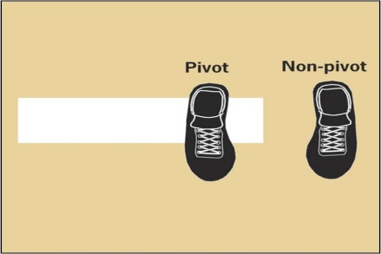
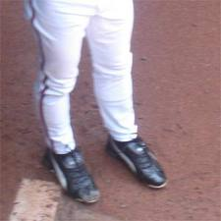
Pivot Foot in the Windup
NFHS regulations in the windup allows the pitcher’s pivot foot to be anywhere on the plate, even partially off the end just so it is in contact with the plate.
It is acceptable for just both heels only to be touching the plate.
Rationale. Disallowing the windup hybrid prevents the pitcher from gaining an advantage over a runner.
Legal
Only pivot can touch
Illegal
Free foot in front of the plate
Notes:
I made two slides for the one here.

Slide 6
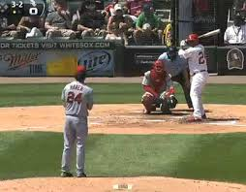
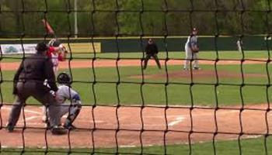
Non Pivot Foot in the Windup
Legal
Non pivot can be on or behind the front edge of a line
The non pivot foot must be on or behind the front edge of the line…extended indefinitely through the pitcher’s plate.
Allowing the pitcher to take a signal with the free foot entirely in front of the pitching plate is an illegal hybrid stance.
His free foot can start outside the 24” plate as long as it is not in front of the plate. He is not required to have it directly behind the plate.
Illegal
Non pivot foot is in front of the rubber’s front line

Slide 7
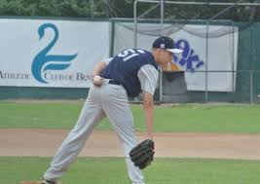
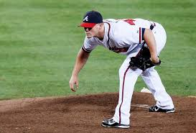
Set Position
Unlike the windup, F1 is restricted in the set position as to how he can hold the baseball. It must be either in his pitching hand or his glove. The pitching hand must be down at his side or behind his back when he takes the sign.
When starting to take the signs and he has not engaged the batter, F1 should be allowed to bend at the waist, some fidgeting, or take a deep breath. He is not attempting to conceal the ball. If F1 allows his glove arm to rest on his thigh and his pitching hand to get concealed in his abdominal area, this is too close. It's a balk.
Rationale. NFHS wants any runner to be able to see the hand separation when the pitcher contacts the rubber and engages the batter.

Slide 8
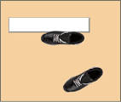
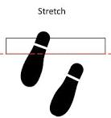
Pivot Foot in the Set Position
Any part of the foot touching the plate or entire foot parallel to and in front of the plate and not at a 45 degree angle is now LEGAL.
The change for the 2019 season from prior years is that the entire pivot is not required to be in contact with the pitcher’s plate.
Rationale. Many pitching mounds are constructed such that it is problematic for a pitcher’s foot to have full contact with the plate.
Legal
Entire foot is on or parallel the plate.
Illegal
Pivot foot is not parallel to the plate.

Slide 9
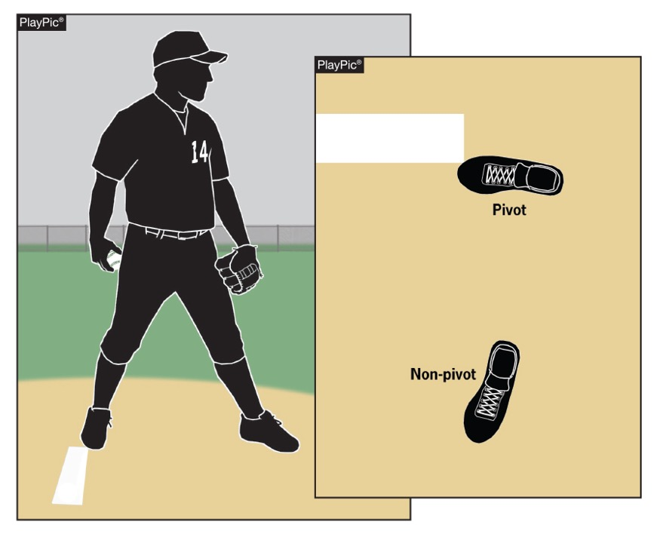
Pivot Foot and Pitching Plate Rule 6-1-3 Rule Change for 2019
Legal
THIS IS THE ONLY RULE CHANGE FOR 2019

Slide 10
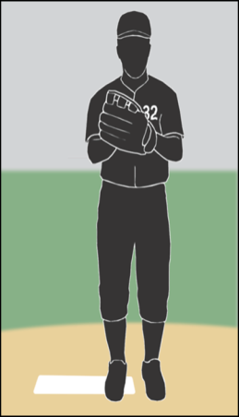
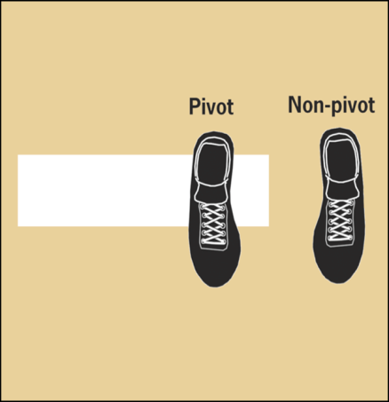
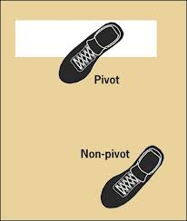
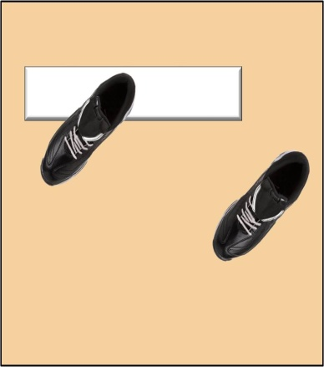
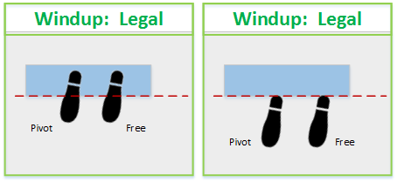
Windup. Legal or Illegal?
Legal
Legal
Illegal
HEELS ARE TOUCHING THE FRONT LINE
Windup Position
The pitcher’s non-pivot foot shall be in any position on or behind a line extending through the front edge of the pitcher’s plate.

Slide 11
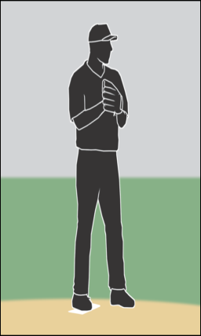
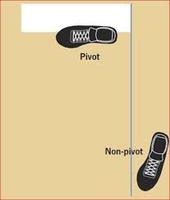
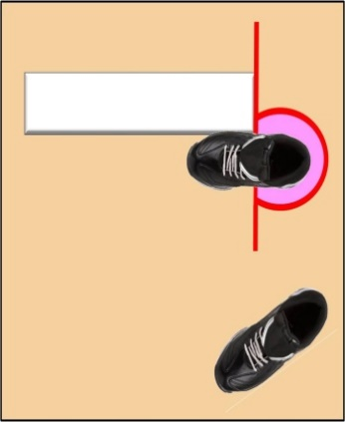
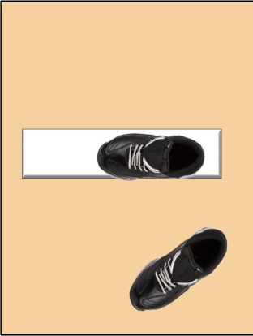
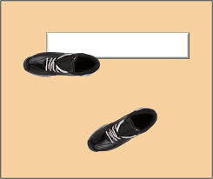
Set Position. Legal or Illegal?
Illegal
Illegal
Legal
Set Position

Slide 12
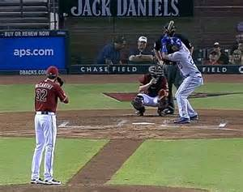
Most Common Illegal
Example: Photo below shows both illegal NFHS set positions.
WINDUP - free foot is in front of the plate’s line
SET- pivot foot is not parallel to the plate. Pitcher’s feet are facing more toward the baseline than the batter’s box.

Slide 13
Intellectual content the property of Carolina Umpire Association.
All rights reserved. No part of this publication may be reproduced, distributed, or transmitted in any form or by any means, including photocopying, recording, or other electronic or mechanical methods, without the prior written permission of the publisher, except in the case of brief quotations embodied in critical reviews and certain other noncommercial uses permitted by copyright law. For permission requests, write to the publisher, addressed “Attention: Supervisor,” at gary_swanson@hotmail.com.

